Slide 1
CKD: Chapter 6 Acute kidney injury
United States Renal Data System
2012 Annual Data Report

Slide 2
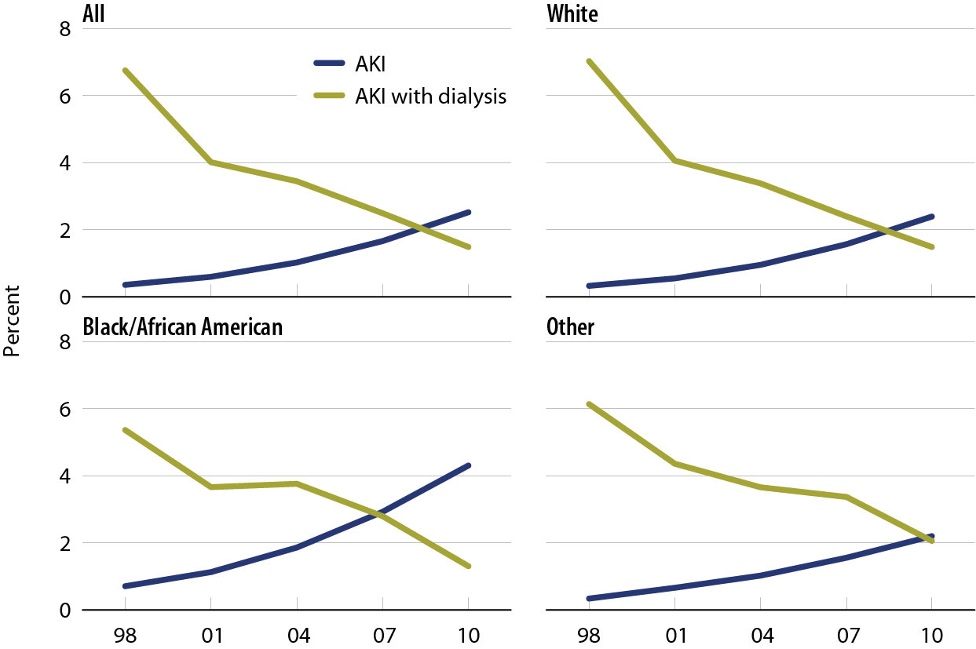
Hospitalizations for acute kidney injury, with or without dialysis, by race Figure 6.1 (volume 1)
Medicare patients age 66 & older.

Slide 3
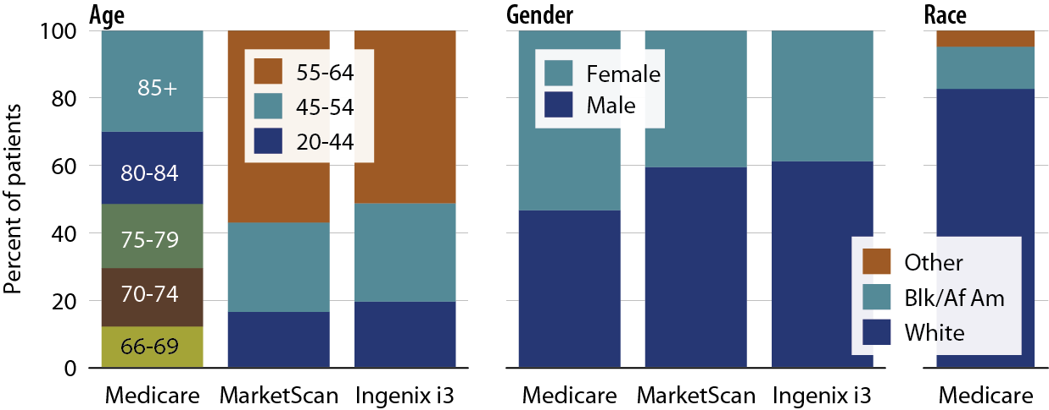
Characteristics of patients with acute kidney injury, by age, gender, & race, 2010 Figure 6.2 (volume 1)
Medicare AKI patients age 66 & older, & MarketScan & Ingenix i3 patients AKI age 20–64.

Slide 4
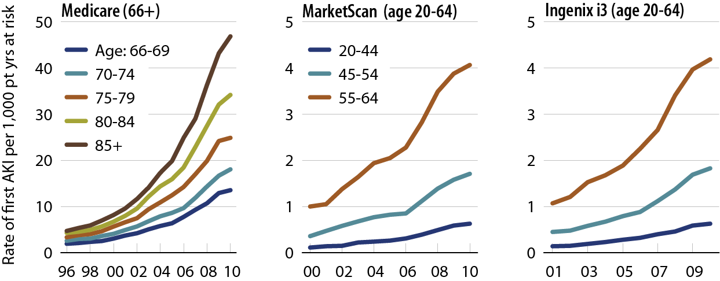
Rates of AKI, by age & dataset Figure 6.3 (volume 1)
Medicare AKI patients age 66 & older, & MarketScan & Ingenix i3 patients AKI age 20–64.

Slide 5
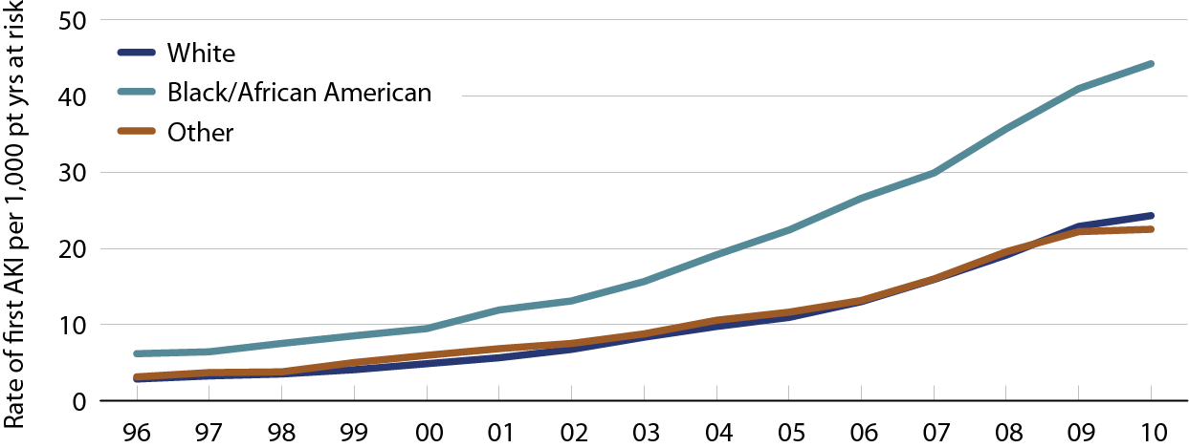
Rates of AKI in Medicare patients, by race Figure 6.4 (volume 1)
Medicare AKI patients age 66 & older.

Slide 6
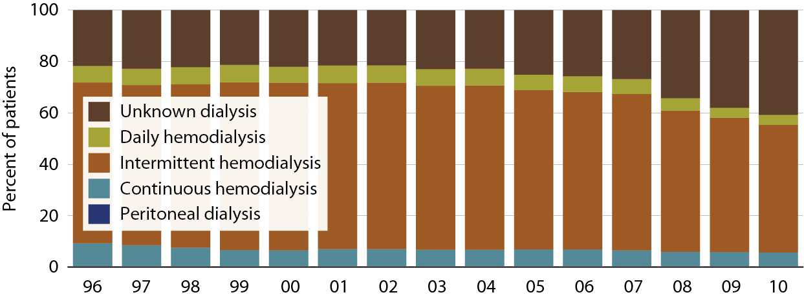
Type of dialysis in hospitalized Medicare AKI patients age 66 & older who require dialysis Figure 6.5 (volume 1)
Medicare AKI patients age 66 & older.

Slide 7
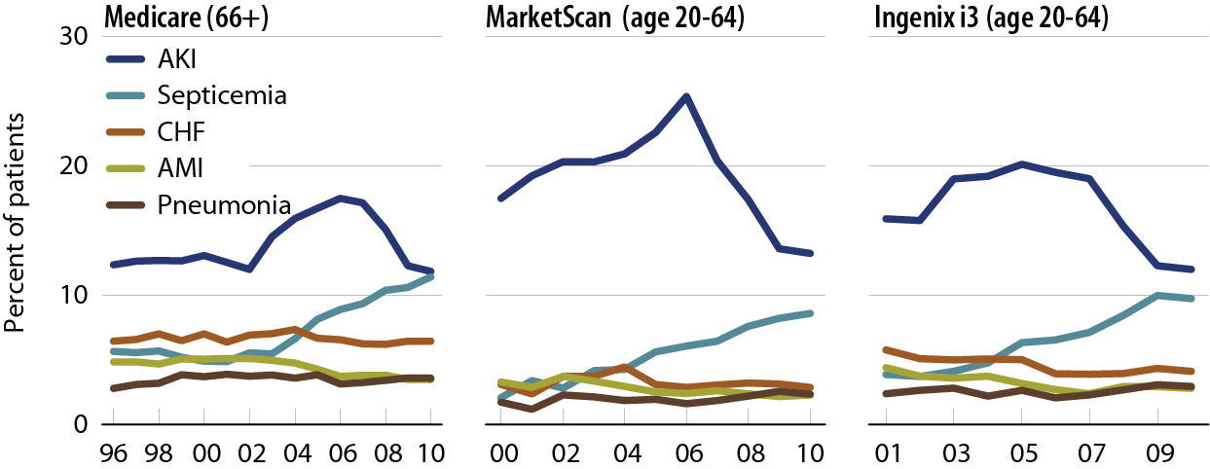
Primary diagnosis code for patients with AKI, by dataset Figure 6.6 (volume 1)
Medicare AKI patients age 66 & older, & MarketScan & Ingenix i3 patients age 20–64.

Slide 8
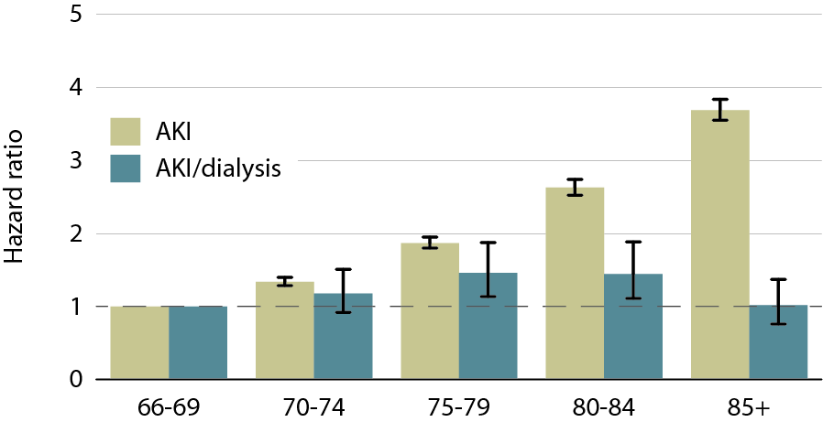
Adjusted hazard of an AKI hospitalization in Medicare patients, by age, 2010 Figure 6.7 (volume 1)
Medicare patients age 66 & older; adj: gender/race; ref: patients age 66–69, 2010

Slide 9
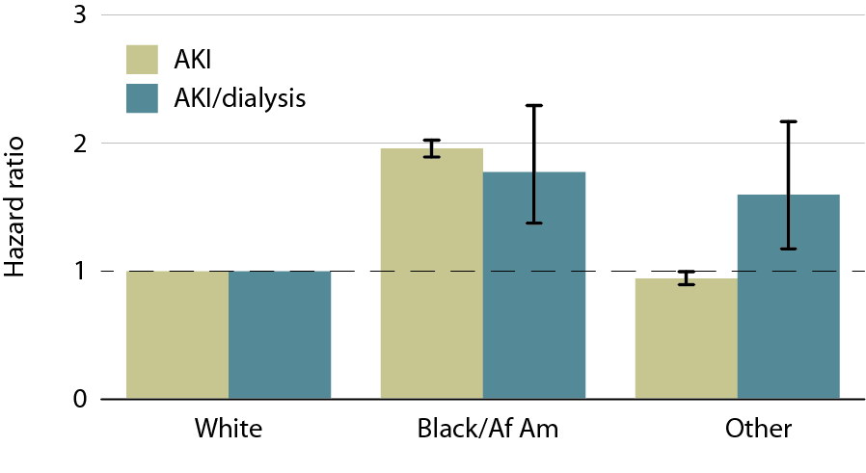
Adjusted hazard of an AKI hospitalization in Medicare patients, by race, 2010 Figure 6.8 (volume 1)
Medicare patients age 66 & older; adj: age, & gender; ref: whites, 2010.

Slide 10
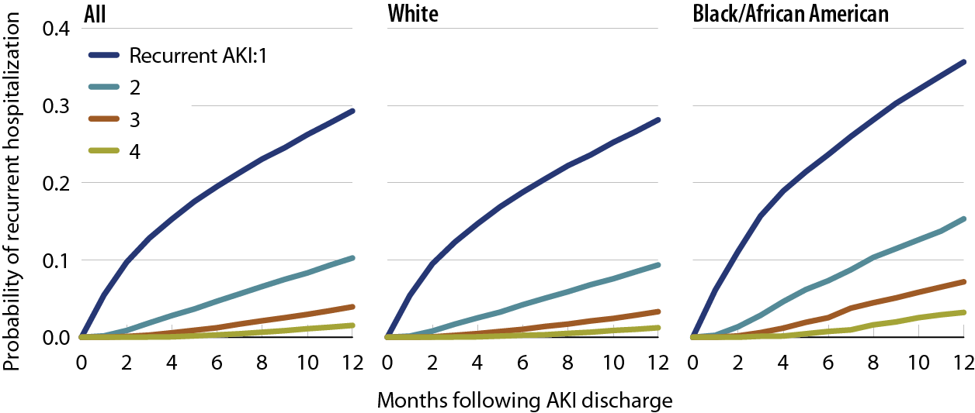
Probability of a recurrent AKI hospitalization in Medicare patients, by number of events & race, 2009–2010 Figure 6.9 (volume 1)
Medicare AKI patients age 66 & older, 2009–2010.

Slide 11
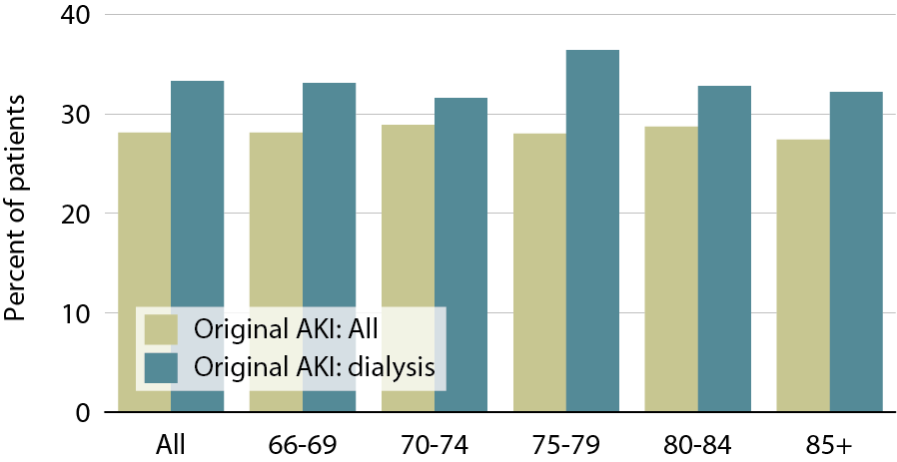
Patients with a recurrent AKI, by age, 2009–2010 Figure 6.10 (volume 1)
Medicare patients age 66 & older; original AKI in 2009, recurrent AKI within one year.

Slide 12
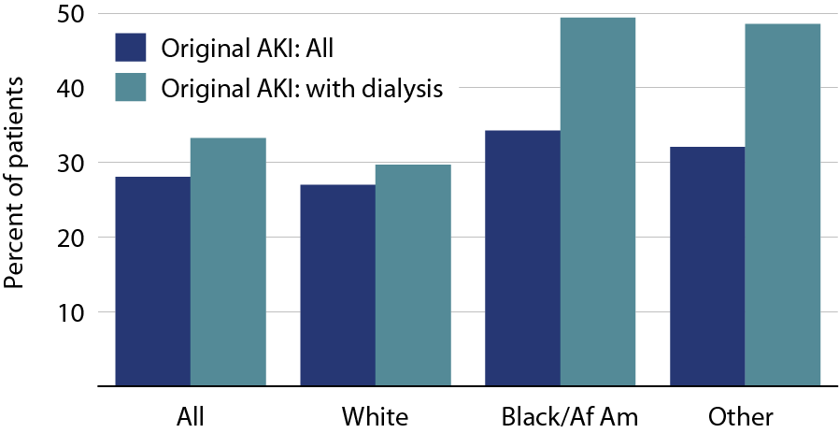
Patients with a recurrent AKI, by race, 2009–2010 Figure 6.11 (volume 1)
Medicare patients age 66 & older; original AKI in 2009, recurrent AKI within one year.

Slide 13
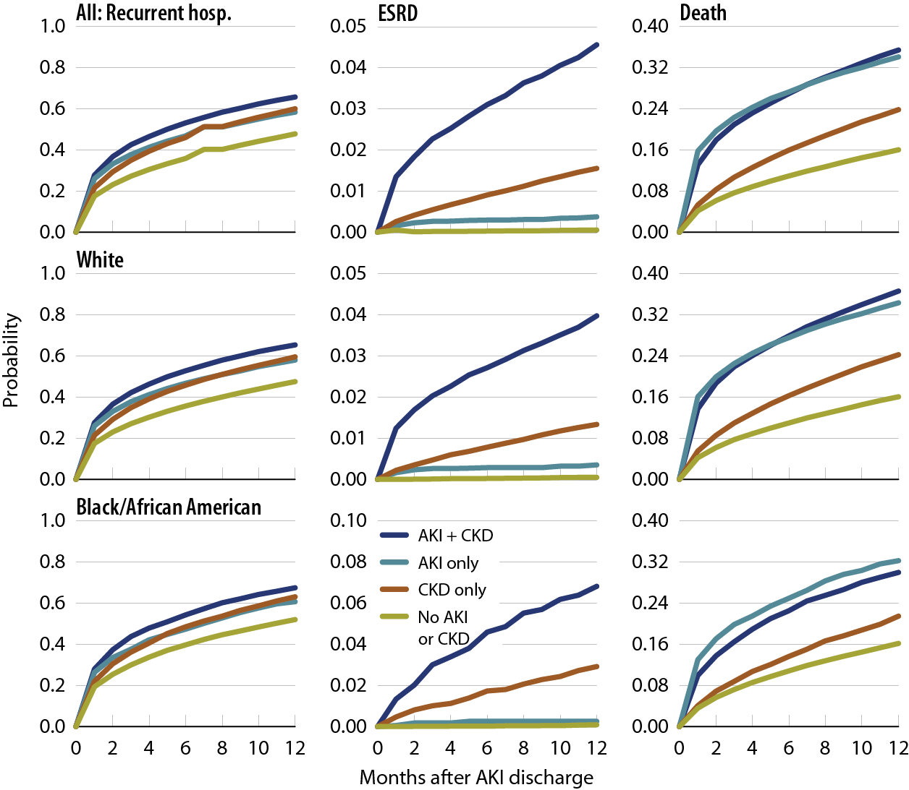
Probability of a recurrent hospitalization, ESRD, or death following hospitalization for AKI, by race, 2010 Figure 6.12 (volume 1)
Medicare patients age 66 & older, 2009–2010.

Slide 14
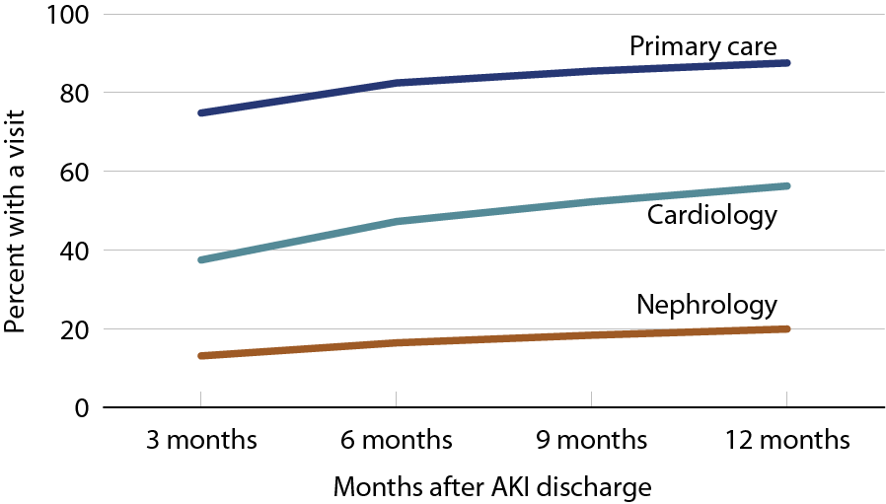
Outpatient physician visits following initial AKI discharge Figure 6.13 (volume 1)
Medicare AKI patients age 66 & older, 2009–2010.

Slide 15
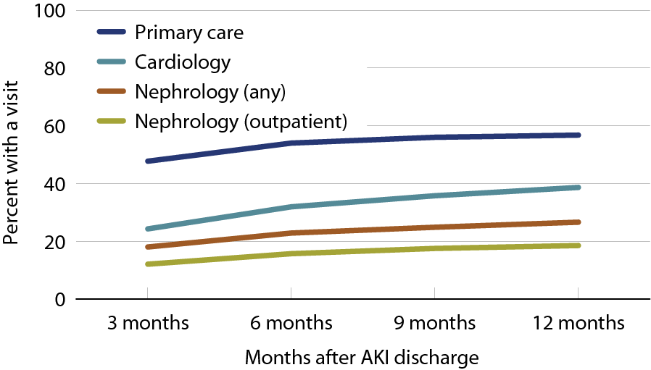
Physician visits in the year following a recurrent AKI discharge Figure 6.14 (volume 1)
Medicare AKI patients age 66 & older, 2009–2010.

Slide 16
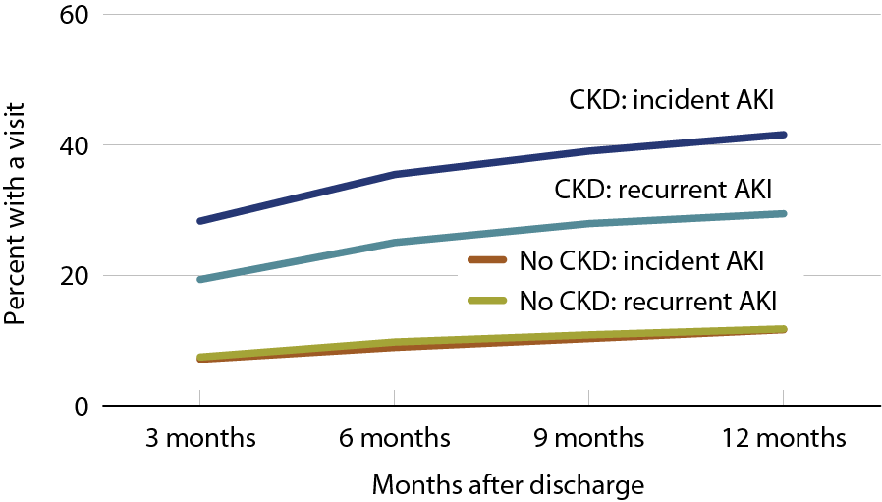
Outpatient nephrology visits in the year following a recurrent AKI discharge 2009-2010 Figure 6.15 (volume 1)
Medicare AKI patients age 66 & older, 2009–2010.

Slide 17
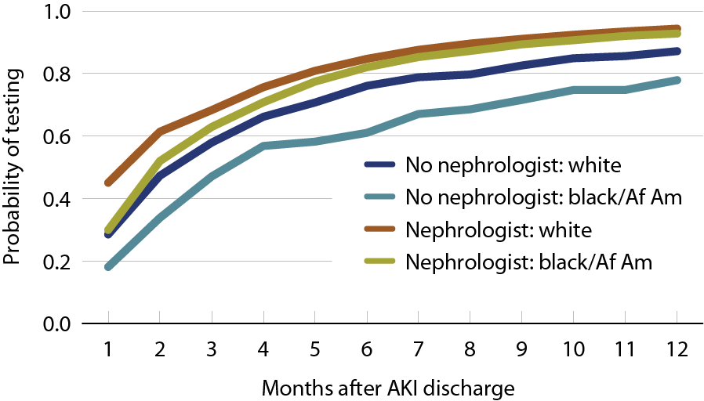
Probability of serum creatinine testing after hospitalization for acute kidney injury, 2010 Figure 6.16 (volume 1)
Medicare AKI patients, age 66 & older, 2009.

Slide 18
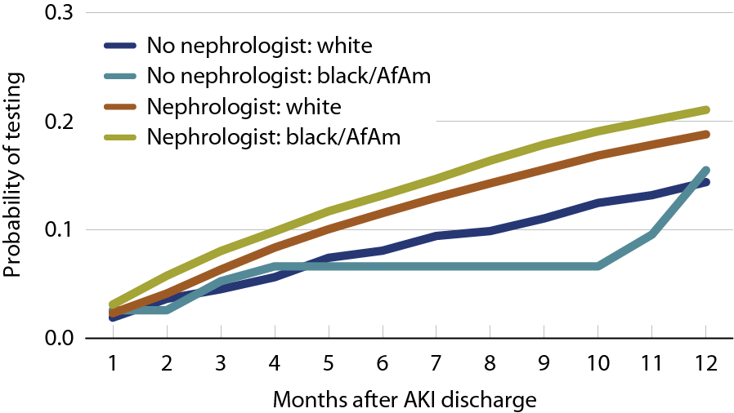
Probability of urine albumin testing after hospitalization for acute kidney injury, 2010 Figure 6.17 (volume 1)
Medicare AKI patients, age 66 & older, 2009.

Slide 19
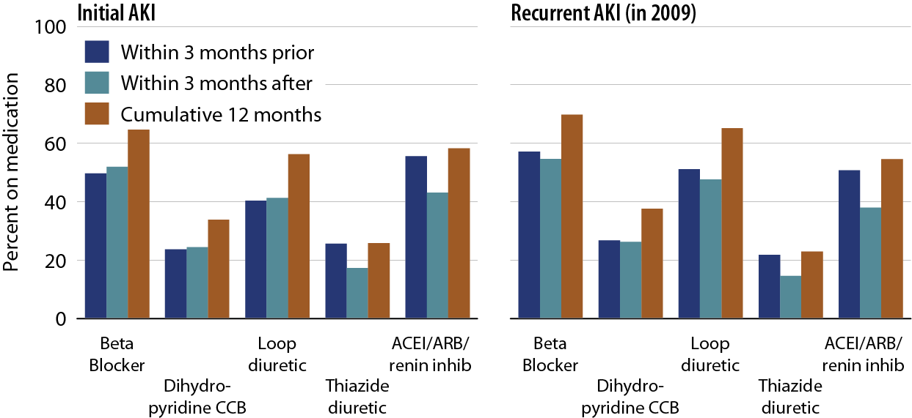
Drug therapy prior to & after hospitalization for AKI in patients with Medicare Part D coverage, for initial & recurrent AKI Figure 6.18 (volume 1)
AKI patients with Part D coverage, 2009.

Slide 20
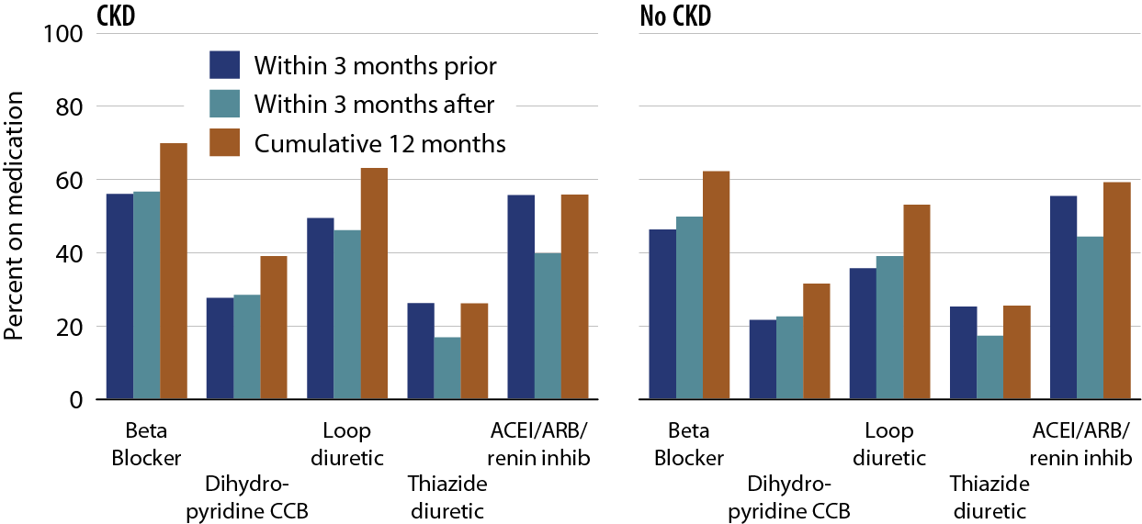
Drug therapy prior to & after hospitalization for AKI in patients with Medicare Part D coverage, by CKD status Figure 6.19 (volume 1)
AKI patients with Part D coverage, 2009; CKD identified as any CKD claim during the three months prior to AKI.

Slide 21
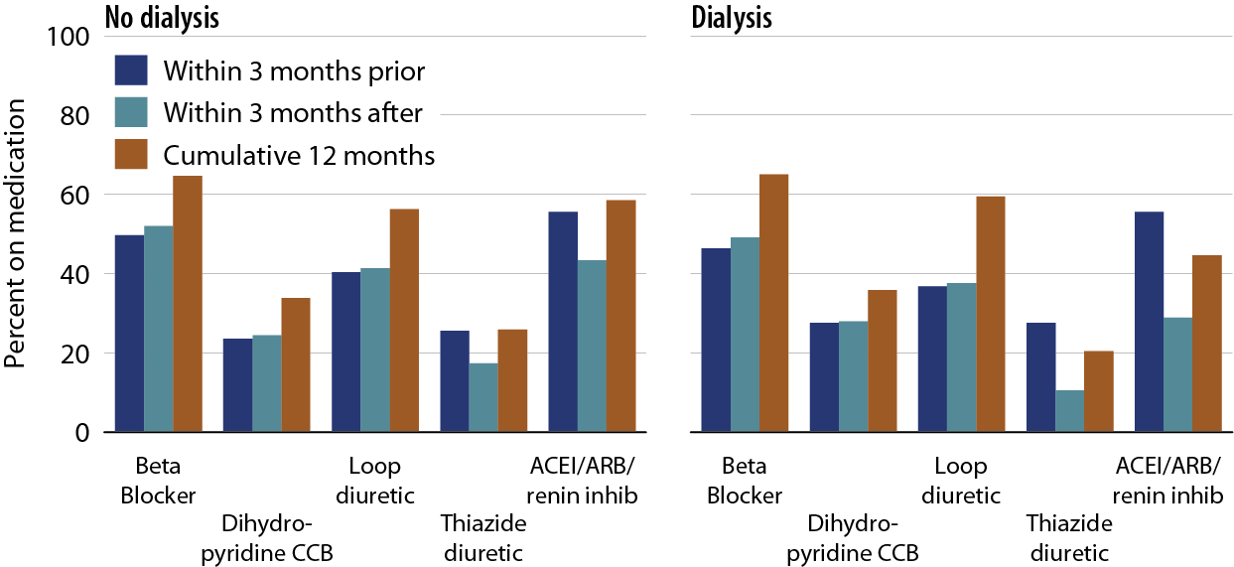
Drug therapy prior to & after AKI hospitalization in patients with Medicare Part D coverage, with or without dialysis Figure 6.20 (volume 1)
AKI patients with Part D coverage, 2009

Slide 22
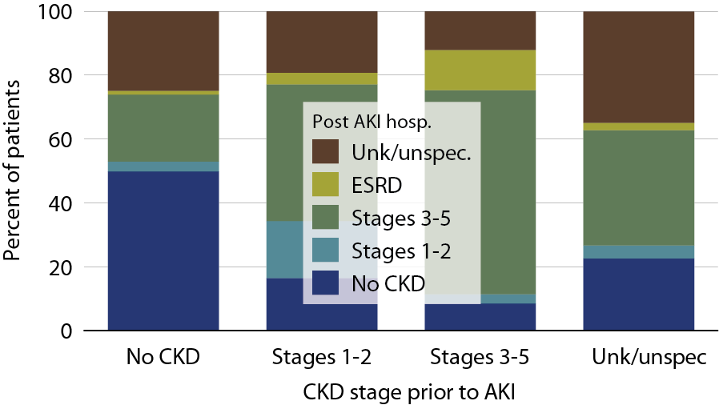
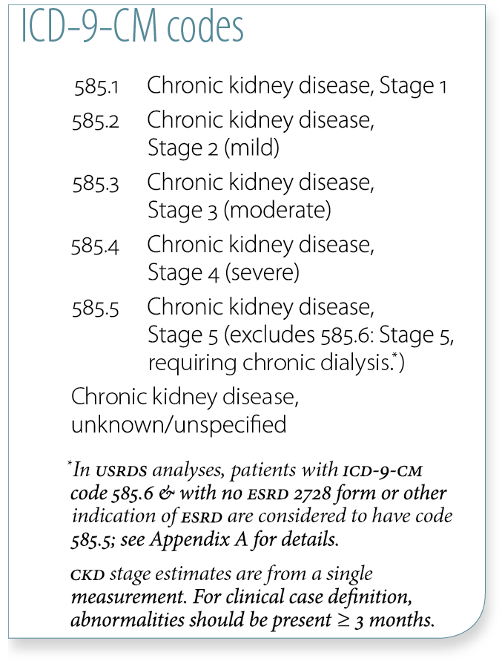
Changes to CKD status following hospitalization for AKI in Medicare patients, 2010 Figure 6.21 (volume 1)
Medicare AKI patients age 66 & older, 2010

Slide 23
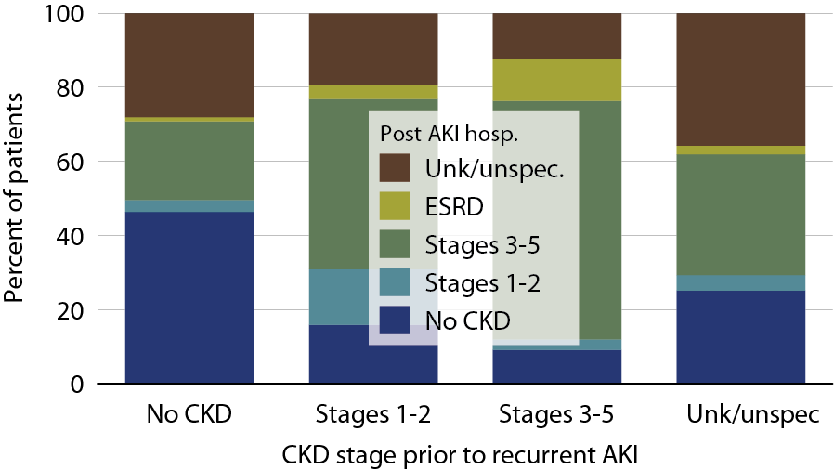
Changes to CKD status following a recurrent rehospitalization for AKI in Medicare patients, 2010 Figure 6.22 (volume 1)
Medicare AKI patients age 66 & older, 2010; recurrent hospitalization occurred in 2009

Slide 24
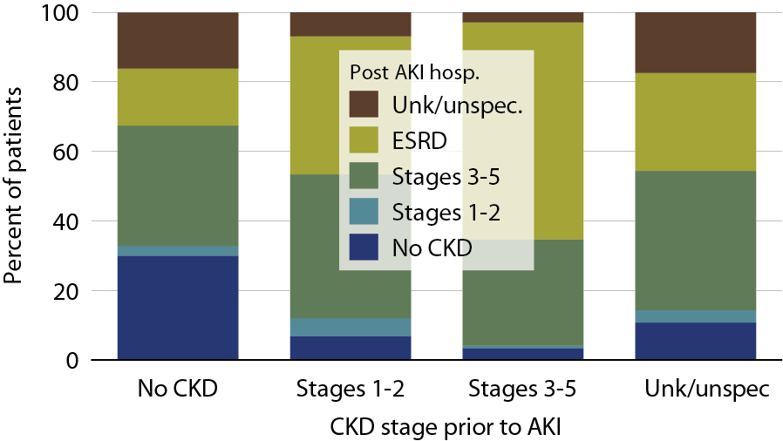
Changes to CKD status following a hospitalization for AKI with dialysis in Medicare patients, 2010 Figure 6.23 (volume 1)
Medicare AKI patients age 66 & older, 2010; data limited to AKI events with dialysis.

Slide 25
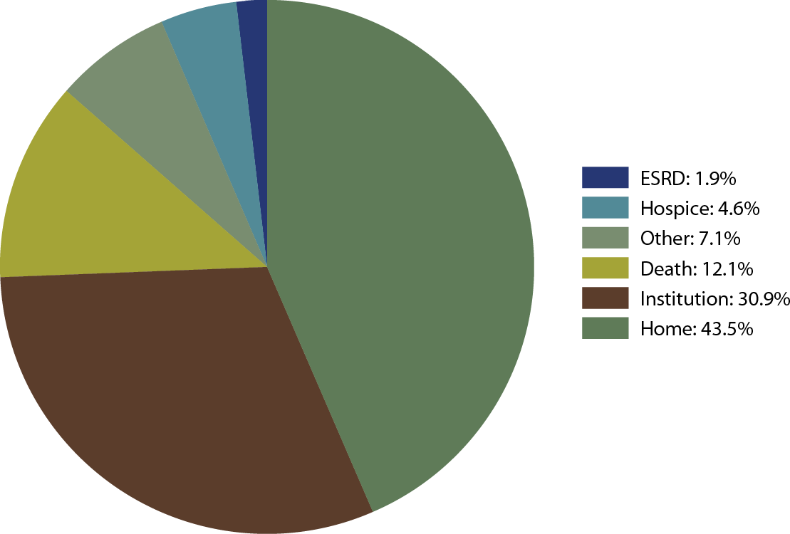
Outcomes following an AKI hospitalization, 2010 Figure 6.24 (volume 1)
Medicare AKI patients age 66 & older, 2010.

