Slide 1
ESRD: Chapter Three
Hospitalization
United States Renal Data System
2013 Annual Data Report

Slide 2
Change in adjusted all-cause & cause- specific hospitalization rates, by modality Figure 3.1 (Volume 2)
Period prevalent ESRD patients. Adj: age/gender/race/primary diagnosis; ref: ESRD patients, 2010.

Slide 3
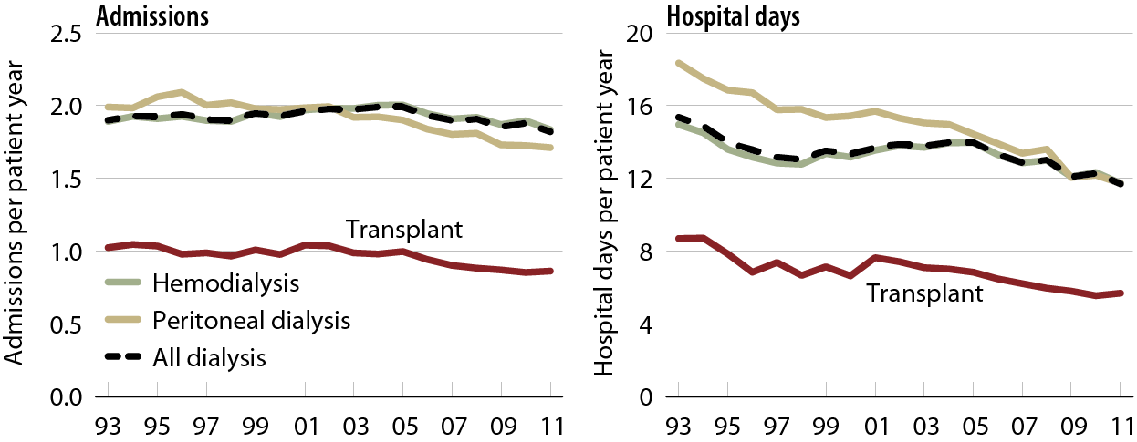
Adjusted all-cause hospital admission rates & days, by modality Figure 3.2 (Volume 2)
Period prevalent ESRD patients. Adj: age/gender/race/primary diagnosis; ref: ESRD patients, 2010.

Slide 4
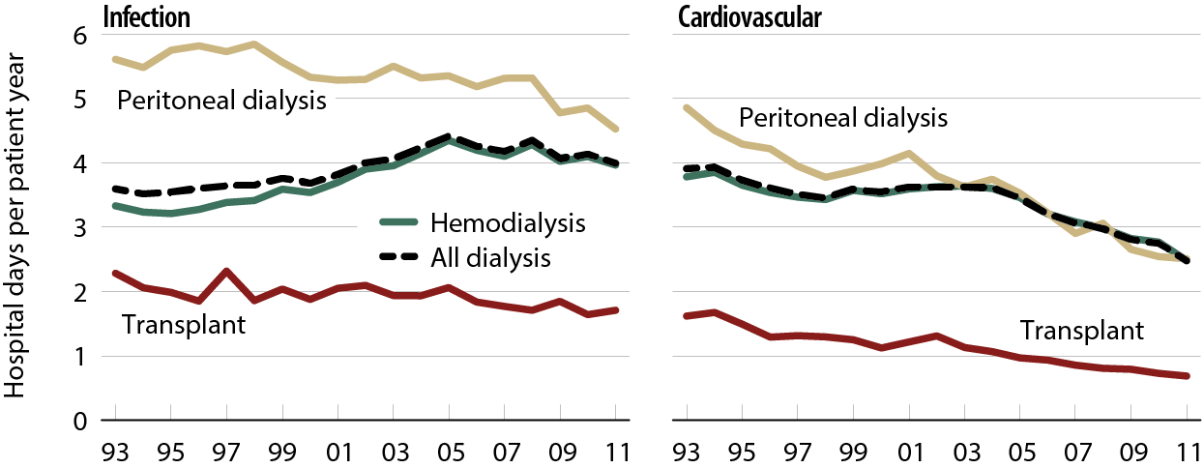
Adjusted infection & cardiovascular hospital days, by modality Figure 3.3 (Volume 2)
Period prevalent ESRD patients. Adj: age/gender/race/primary diagnosis; ref: ESRD patients, 2010.

Slide 5
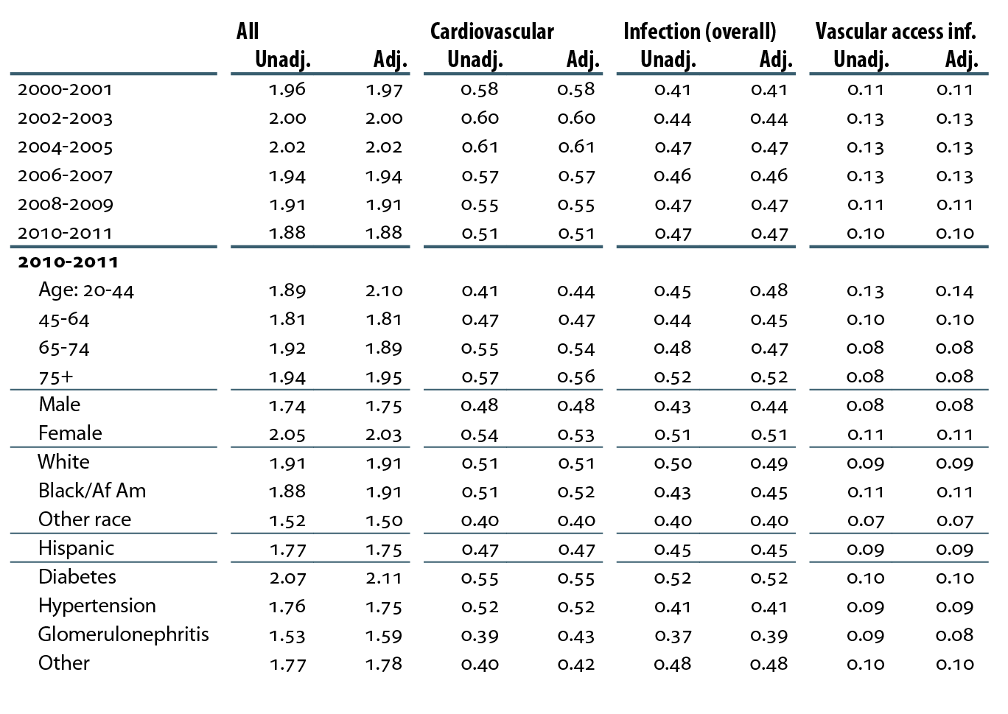
Unadjusted & adjusted all-cause & cause-specific hospitalization rates (per patient year) in hemodialysis patients Table 3.a (Volume 2)
Period prevalent hemodialysis patients age 20 & older. Adj: age/gender/ race/primary diagnosis; rates by one factor adjusted for the other three; ref: hemodialysis patients, 2010.

Slide 6
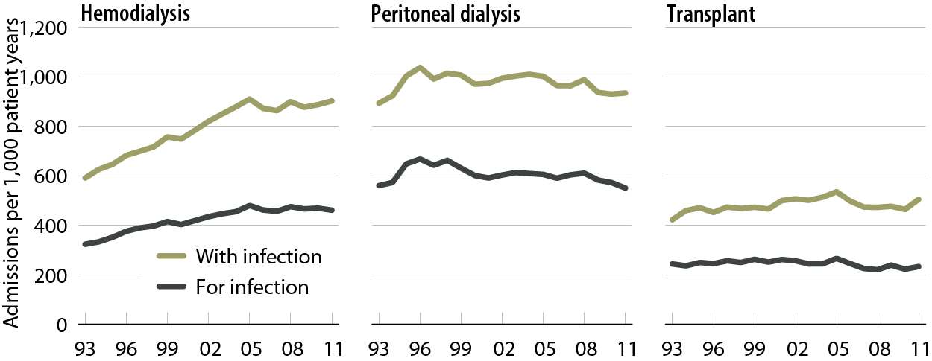
Adjusted rates of hospital admissions, by modality & diagnosis code type: infection Figure 3.4 (Volume 2)
Period prevalent ESRD patients. Adj: age/gender/race/primary diagnosis; ref: ESRD patients, 2010.

Slide 7
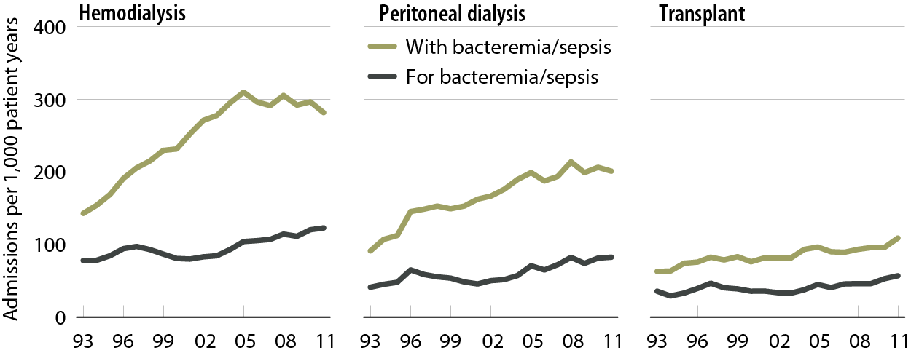
Adjusted rates of hospital admissions, by modality & diagnosis code type: bacteremia/sepsis Figure 3.5 (Volume 2)
Period prevalent ESRD patients. Adj: age/gender/race/primary diagnosis; ref: ESRD patients, 2010.

Slide 8
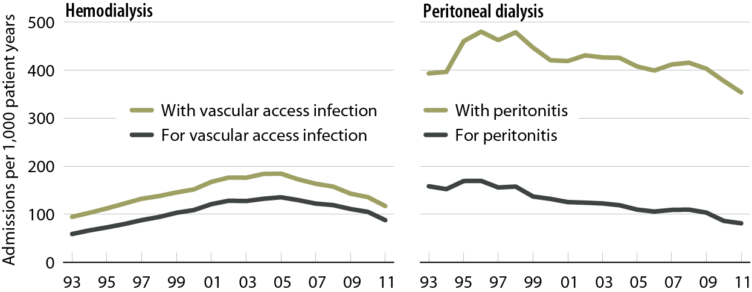
Adjusted rates of hospital admissions, by modality & diagnosis code type: dialysis-related infection Figure 3.6 (Volume 2)
Period prevalent dialysis patients. Adj: age/gender/race/primary diagnosis; ref: ESRD patients, 2010.

Slide 9
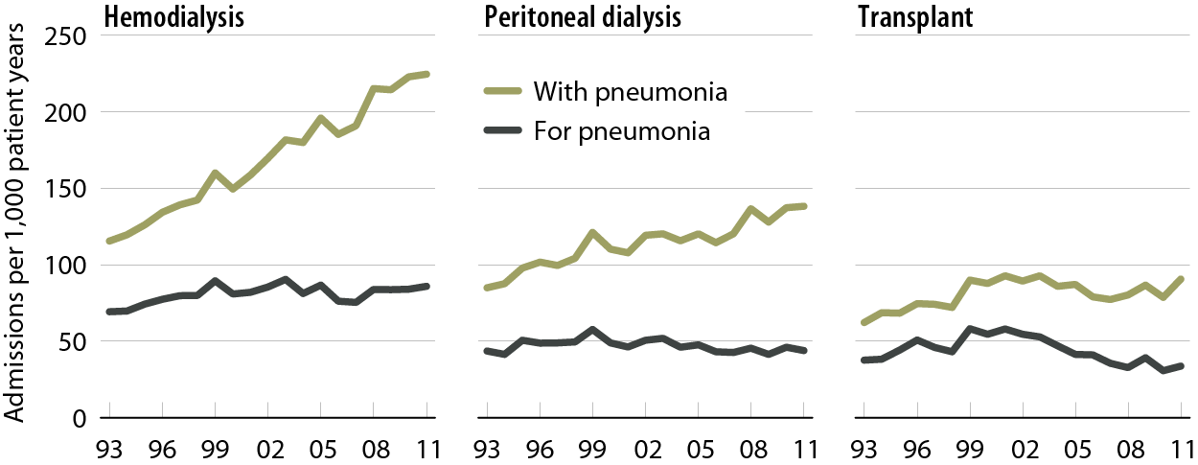
Adjusted rates of hospital admissions, by modality & diagnosis code type: pneumonia Figure 3.7 (Volume 2)
Period prevalent ESRD patients. Adj: age/gender/race/primary diagnosis; ref: ESRD patients, 2010.

Slide 10
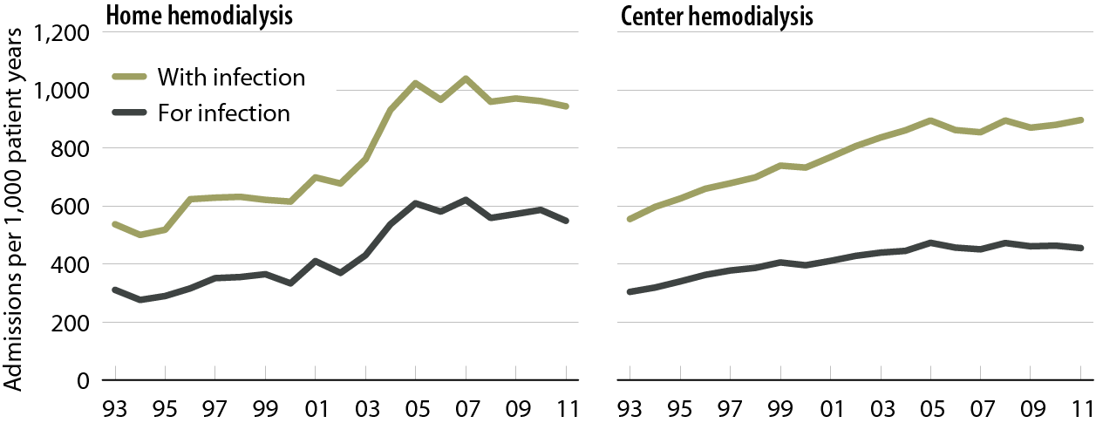
Unadjusted rates of infection hospital admissions among home hemodialysis & center hemodialysis patients, by diagnosis code type Figure 3.8 (Volume 2)
Period prevalent hemodialysis patients; unadjusted.

Slide 11
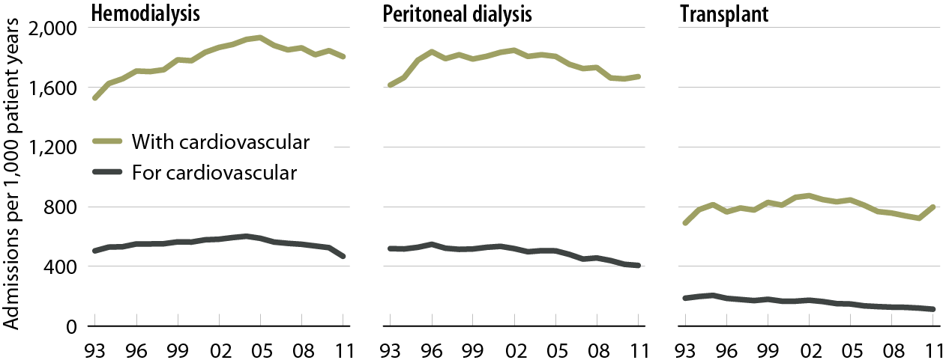
Adjusted rates of hospital admissions, by modality & diagnosis code type: cardiovascular Figure 3.9 (Volume 2)
Period prevalent ESRD patients. Adj: age/gender/race/primary diagnosis; ref: ESRD patients, 2010.

Slide 12
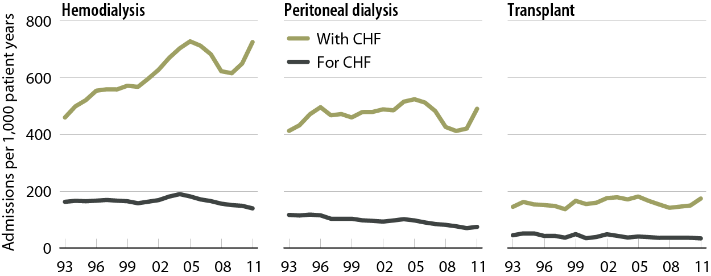
Adjusted rates of hospital admissions, by modality & diagnosis code type: CHF Figure 3.10 (Volume 2)
Period prevalent ESRD patients. Adj: age/gender/race/primary diagnosis; ref: ESRD patients, 2010.

Slide 13
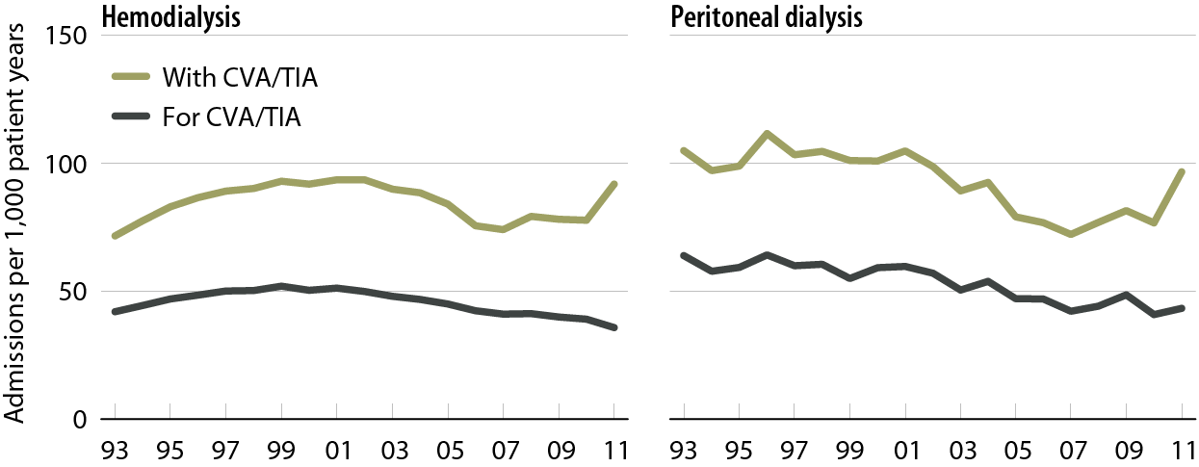
Adjusted rates of hospital admissions, by modality & diagnosis code type: CVA/TIA Figure 3.11 (Volume 2)
Period prevalent ESRD patients. Adj: age/gender/race/primary diagnosis; ref: ESRD patients, 2010.

Slide 14
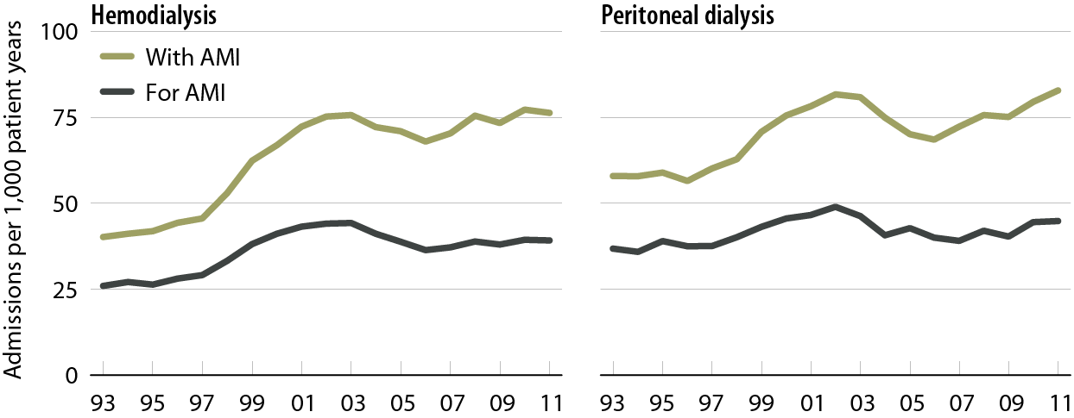
Adjusted rates of hospital admissions, by modality & diagnosis code type: AMI Figure 3.12 (Volume 2)
Period prevalent dialysis patients. Adj: age/gender/race/primary diagnosis; ref: ESRD patients, 2010.

Slide 15
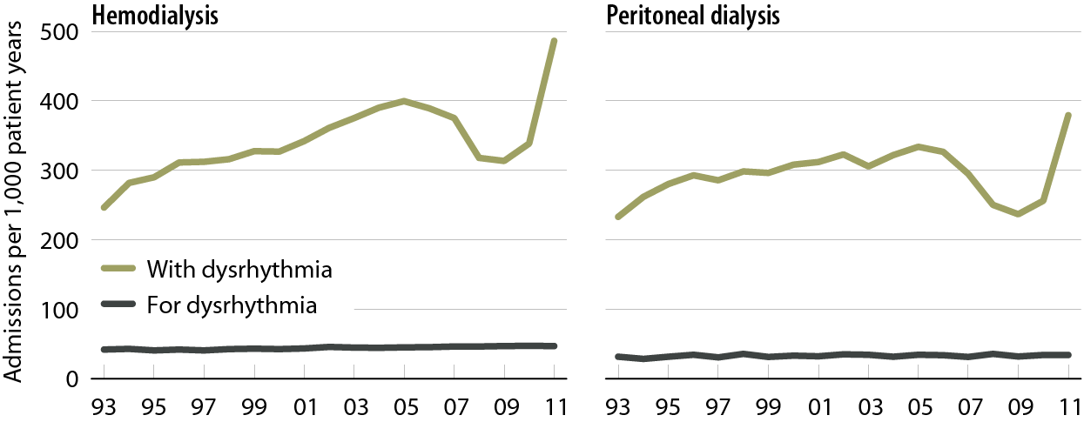
Adjusted rates of hospital admissions, by modality & diagnosis code type: dysrhythmia Figure 3.13 (Volume 2)
Period prevalent dialysis patients. Adj: age/gender/race/primary diagnosis; ref: ESRD patients, 2010.

Slide 16
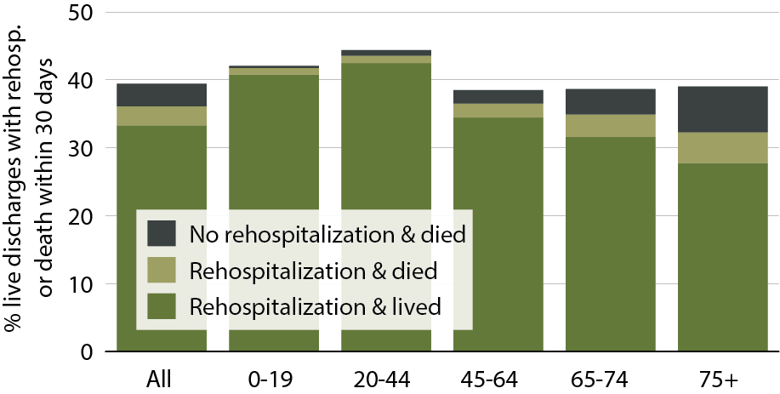
All-cause rehospitalization or death 30 days after live hospital discharge, by age, 2011 Figure 3.14 (Volume 2)
Period prevalent hemodialysis patients, all ages, 2011; unadjusted. Includes live hospital discharges from January 1 to December 1, 2011.

Slide 17
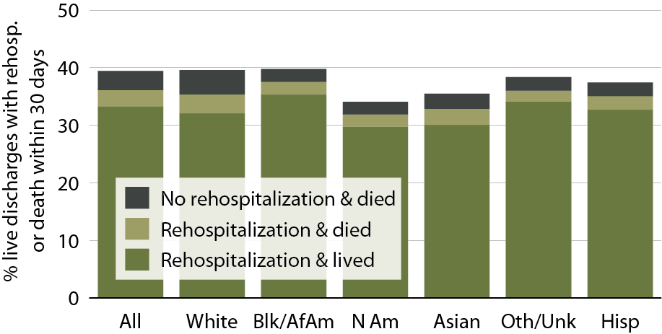
All-cause rehospitalization or death 30 days after live hospital discharge, by race/ethnicity, 2011 Figure 3.15 (Volume 2)
Period prevalent hemodialysis patients, all ages, 2011; unadjusted. Includes live hospital discharges from January 1 to December 1, 2011.

Slide 18
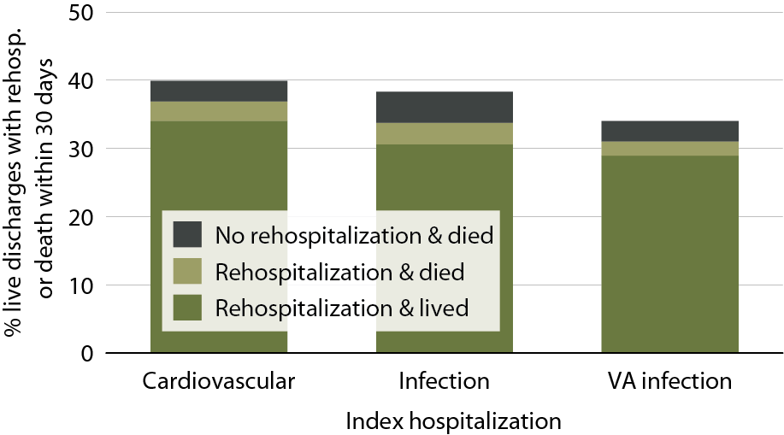
All-cause rehospitalization or death 30 days after live hospital discharge, by cause-specific index hospitalization, 2011 Figure 3.16 (Volume 2)
Period prevalent hemodialysis patients, all ages, 2011; unadjusted. Includes live hospital discharges from January 1 to December 1, 2011.

Slide 19
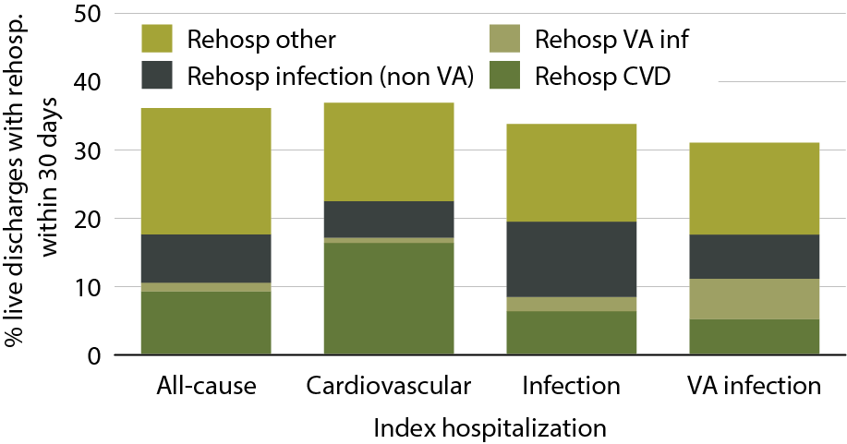
Cause-specific rehospitalization 30 days after live hospital discharge, by cause-specific index hospitalization, 2011 Figure 3.17 (Volume 2)
Period prevalent hemodialysis patients, all ages, 2011, unadjusted; includes live hospital discharges from January 1 to December 1, 2011.

Slide 20
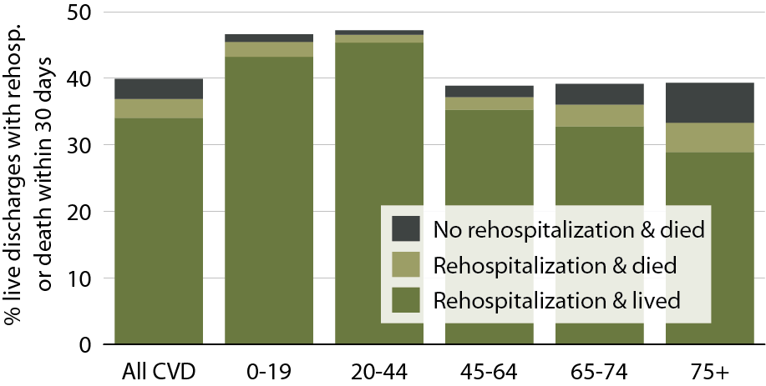
All-cause rehospitalization or death 30 days after live hospital discharge from cardiovascular index hospitalization, by age, 2011 Figure 3.18 (Volume 2)
Period prevalent hemodialysis patients, all ages, 2011, unadjusted; includes live hospital discharges from January 1 to December 1, 2011.

Slide 21
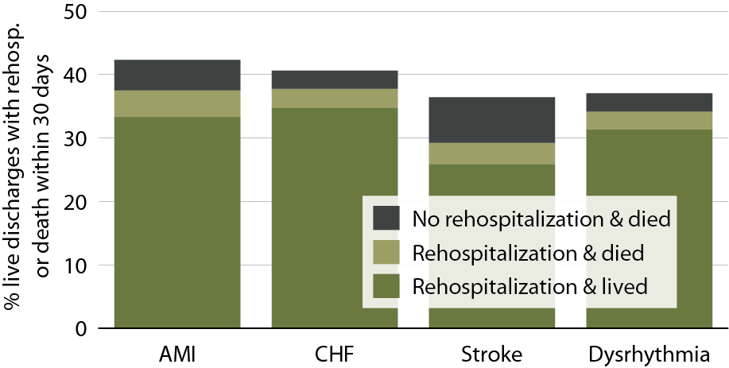
All-cause rehospitalization or death 30 days after live hospital discharge, by cause-specific cardiovascular index hospitalization, 2011 Figure 3.19 (Volume 2)
Period prevalent hemodialysis patients, all ages, 2011, unadjusted; includes live hospital discharges from January 1 to December 1, 2011.

Slide 22
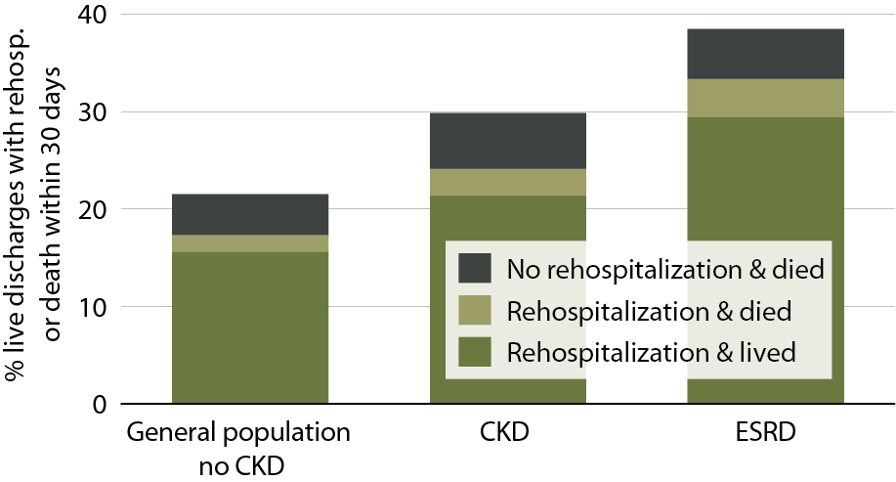
All-cause rehospitalization or death within 30 days after live hospital discharge in patients age 66 & older, by population, 2011 Figure 3.20 (Volume 2)
January 1, 2011 point prevalent Medicare patients age 66 & older on December 31, 2010; for the CKD & no CKD cohorts during 2010, CKD is defined & patients are continuously enrolled in Medicare Parts A & b with no HMO coverage & without ESRD.

