Slide 2
^{Table A. ICD-9-CM Codes}
Table A. ICD-9-CM Codes
585.1 | Chronic kidney disease, Stage 1
585.2 | Chronic kidney disease, Stage 2 (mild)
585.3 | Chronic kidney disease, Stage 3 (moderate)
585.4 | Chronic kidney disease, Stage 4 (severe)
585.5 | Chronic kidney disease, Stage 5 (excludes 585.6: Stage 5, requiring chronic dialysisª)
CKD unspecified identified by multiple codes including 585.9, 250.4x, 403.9xm & others. CKD stage estimates are from a single measurement. For clinical case definition, abnormalities should be present ≥ 3 months.
ª In USRDS analyses, patients with ICD-9-CM code 585.6 & with no ESRD 2728 form or other indication of end-stage renal disease (ESRD) are considered to have code 585.5. See the CKD Analytical Methods chapter for details.

Slide 3
vol 1 Table 2.1 Prevalence of coded DM, CKD, CHF & CVA among Medicare patients age 65+, 2012
 | Medicare 5% Sample | Distribution
All | 1,230,285 | 100%
Total CHF | 112,316 | 9.1
Total DM | 299,052 | 24.3
Total CKD | 127,941 | 10.4
Total CVA | 107,026 | 8.7
DM & CHF | 21,429 | 1.7
DM & CKD | 33,392 | 2.7
DM & CVA | 20,143 | 1.6
CHF & CKD | 12,829 | 1.0
CHF & CVA | 8,471 | 0.7
CKD & CVA | 7,312 | 0.6
CHF & DM & CVA | 5,818 | 0.5
CKD & DM & CVA | 6,626 | 0.5
CKD & CHF & CVA | 4,329 | 0.4
DM & CHF & CKD | 15,273 | 1.2
DM & CHF & CKD & CVA | 6,148 | 0.5
No DM, CKD, CHF & CVA | 770,062 | 62.6
Data Source: Medicare 5 percent sample. Period prevalent patients, 2012, without ESRD, age 65 or older (Medicare). Abbreviations: CHF, congestive heart failure; CKD, chronic kidney disease; CVA, cerebrovascular accident; DM, diabetes mellitus.

Slide 4
vol 1 Table 2.2 Characteristics of all patients, characteristics of CKD patients among Medicare patients age 65+, 2012
 | Overall |  | Patients with CKD
 | N | Distribution of Characteristics (%) | N | Distribution of Characteristics (%)
All | 1,230,285 | 100 | 127,941 | 100
65-74 | 654,860 | 53.2 | 47,139 | 36.8
75-84 | 403,494 | 32.8 | 51,577 | 40.3
85+ | 171,931 | 13.9 | 29,225 | 22.8
Male | 522,684 | 42.5 | 60,194 | 47.0
Female | 707,601 | 57.5 | 67,747 | 52.9
White | 1,064,647 | 86.5 | 106,359 | 83.1
Black/African Am | 93,195 | 7.6 | 14,091 | 11.1
Native Am | 4,916 | 0.4 | 536 | 0.4
Asian | 22,961 | 1.9 | 2,568 | 2.1
Other | 40,193 | 3.3 | 4,114 | 3.2
Unknown | 4,373 | 0.4 | 273 | 0.2
DM | 299,050 | 24.3 | 61,439 | 48.1
HTN | 751,550 | 61.1 | 118,129 | 92.3
CHF | 112,316 | 9.1 | 38,579 | 30.1
Cancer | 127,979 | 10.4 | 22,712 | 17.7
Data Source: Medicare 5 percent sample. Period prevalent patients, 2012, without ESRD, age 65 or older (Medicare). Abbreviations: CHF, congestive heart failure; DM, diabetes mellitus; HTN, hypertension.

Slide 5
vol 1 Table 2.3 Prevalence of CKD, and adjusted odds ratios of CKD among Medicare patients age 65+, 2012
 | Prevalence of CKD (% of overall) | Adjusted Odds Ratios of CKD
Overall | 10.4 | -ª
65-74 | 7.2 | Ref.
75-84 | 12.8 | 1.4
85+ | 17.0 | 1.8
Male | 11.5 | Ref.
Female | 9.6 | 0.8
White | 9.9 | Ref.
Black/African Am | 15.1 | 1.4
Native Am | 10.9 | 1.1
Asian | 11.2 | 1.1
Other/Unknown | 10.2 | 0.9
DM | 20.5 | 2.1
HTN | 15.7 | 3.7
CVD | 18.4 | 2.3
Data Source: Medicare 5 percent sample. Period prevalent patients, 2012, without ESRD, age 65 or older (Medicare). Adjustments included are age, gender, race, and comorbidities. Abbreviations: DM, diabetes mellitus; HTN, hypertension; CVD, cardiovascular disease. CVD is defined as either one of the following comorbidities being true: cerebrovascular accident, peripheral vascular disease, atherosclerotic heart disease, congestive heart failure, dysrhythmia or other cardiac comorbidities. a Not applicable.

Slide 6
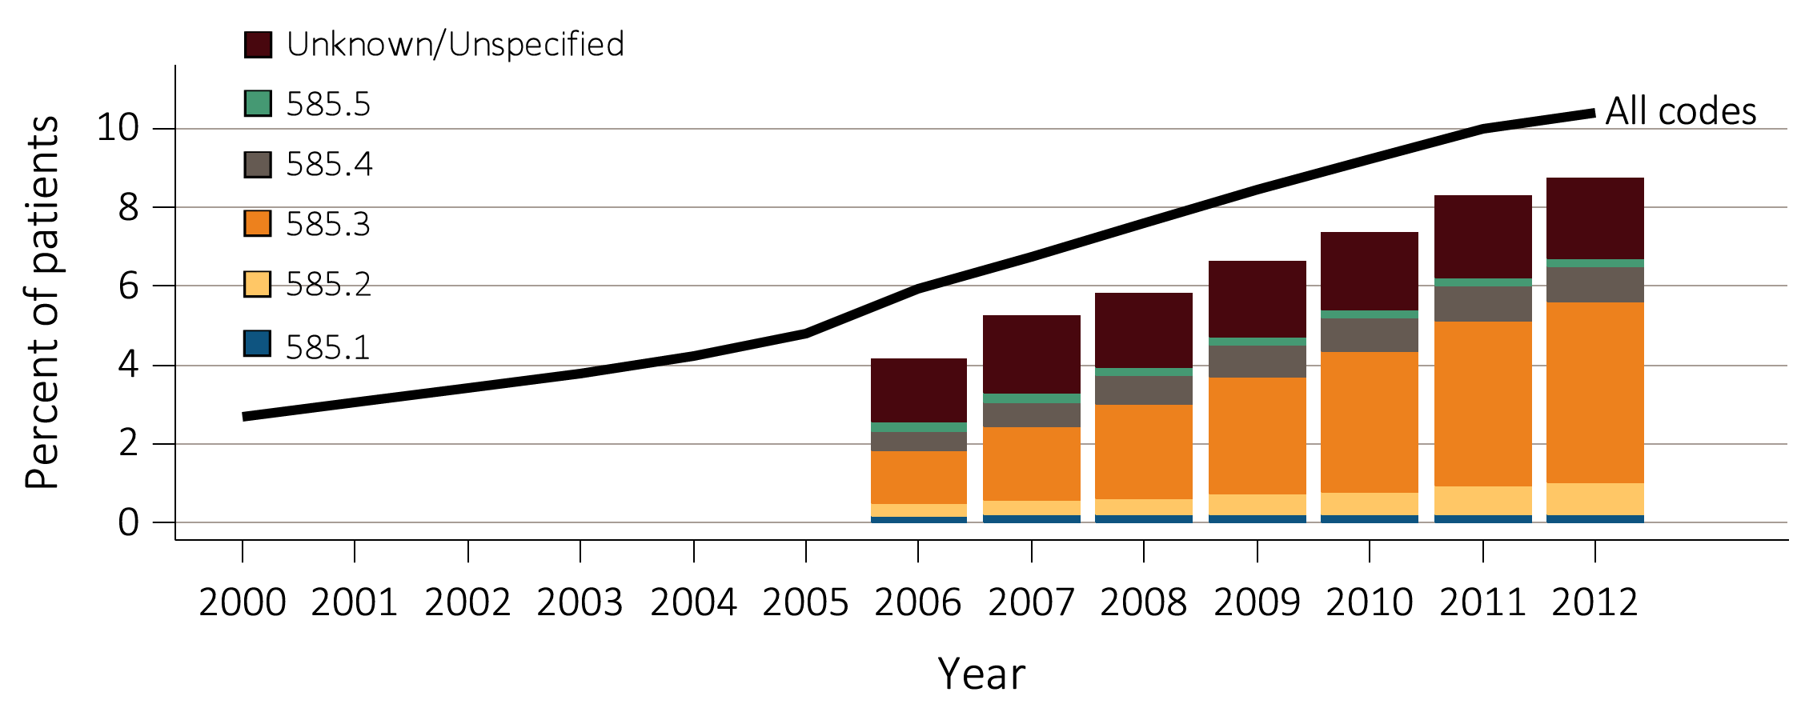
vol 1 Figure 2.1 Temporal trends in CKD prevalence, overall and by CKD stage, among Medicare patients age 65+, 2000-2012
Data Source: Medicare 5 percent sample. See Table A at the beginning of this chapter for a description of ICD-9-CM codes and CKD stages.

Slide 7
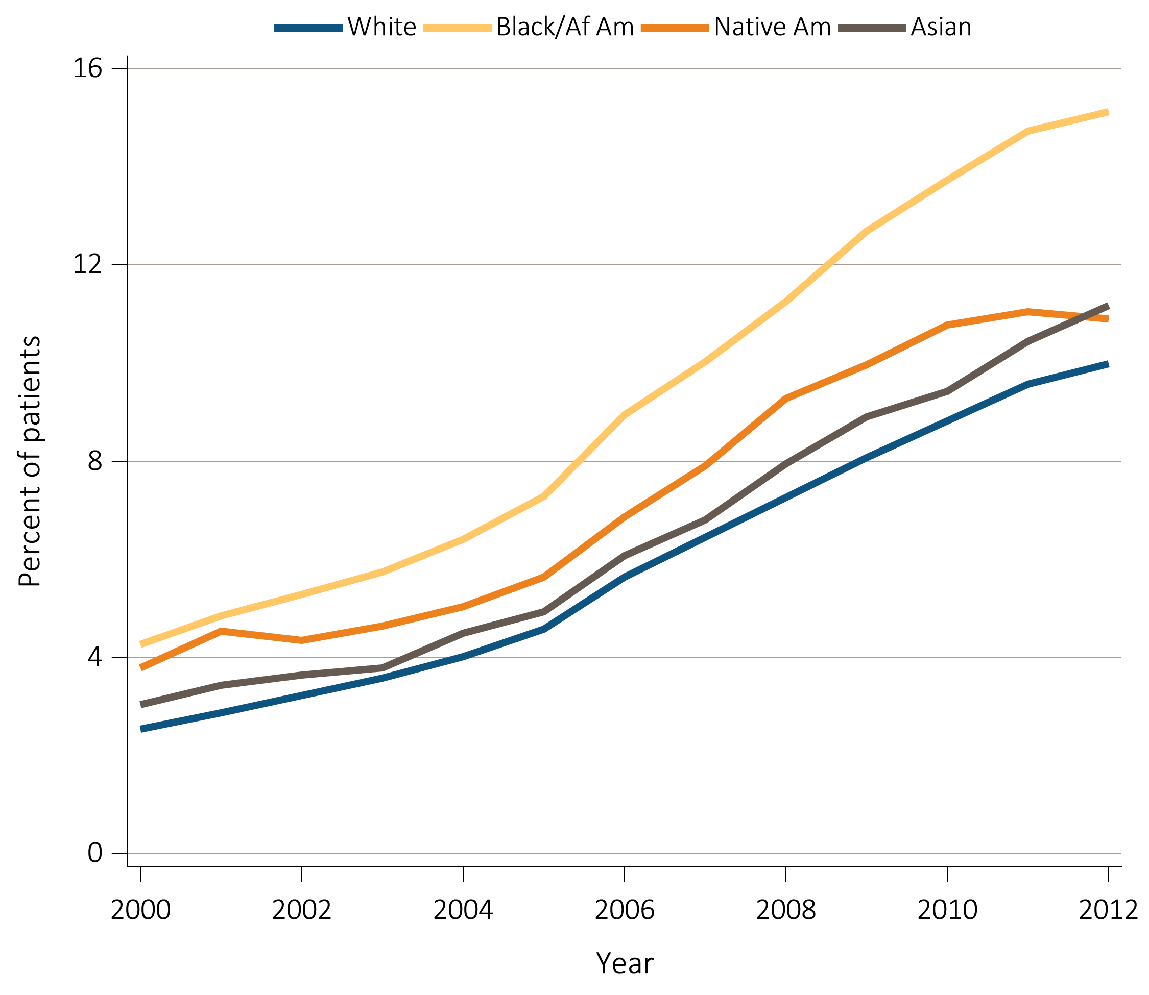
vol 1 Figure 2.2 Temporal trends in CKD prevalence by race among Medicare patients age 65+, 2000-2012
Data Source: Medicare 5 percent sample.

Slide 8
vol 1 Table 2.4 Percent of patients with CKD by demographic characteristics, among patients overall and with DM, HTN, or CVD, in NHANES (2011-2012) and Medicare (2012) datasets
 | Overall |  | DM (No HTN) |  | HTN (No DM) |  | Any CVD
 | NHANES | Medicare | NHANES | Medicare | NHANES | Medicare | NHANESª | Medicare^{b}
65-74 | 26.4 | 7.2 | 7.5 | 9.3 | 31.4 | 12.4 | 40.9 | 21.1
75-79 | 50.4 | 12.8 | * | 12.6 | 45.4 | 17.7 | 66.7 | 25.8
80+ | 65.2 | 17 | * | 15.3 | 67.2 | 24.0 | 80.5 | 29.8
White | 38.3 | 9.9 | 24.9 | 11.3 | 44.5 | 17.3 | 55.6 | 24.5
Black/ African Am | 49.9 | 15.1 | * | 11.9 | 46.6 | 21.4 | 68.3 | 35.2
Native Am | - | 10.9 | - | 9.9 | - | 16.3 | - | 27.5
Asian | - | 11.2 | - | 12.7 | - | 16.9 | - | 29.4
Other/Unk | 42.4 | 10.2 | 18.3 | 11.5 | 47.0 | 15.5 | 70.1 | 27.2
Male | 37.9 | 11.5 | 29.5 | 12.4 | 41.7 | 19.8 | 44.3 | 26.8
Female | 41.3 | 9.6 | 20.7 | 10.2 | 47.2 | 15.9 | 75.9 | 24.3
All | 39.7 | 10.4 | 26.6 | 11.3 | 44.9 | 17.5 | 58.5 | 25.4
Data Source: Medicare patients from the 5 percent sample, age 65 or older alive & eligible for all of 2012 and NHANES 2011-2012 participants, age 65 or older. CKD claims as well as other diseases identified in 2012. Abbreviations: CVD, cardiovascular disease; DM, diabetes mellitus; HTN, hypertension. * Values for cells with 10 or fewer patients are suppressed. ª CVD defined as any of the self-report diseases: angina, myocardial infarction, stroke, coronary heart disease, or congestive heart failure. ^{b} CVD defined as either one of the following comorbidities: cerebrovascular accident, peripheral vascular disease, atherosclerotic heart disease, congestive heart failure, dysrhythmia or other cardiac comorbidities. - No available data.

Slide 9
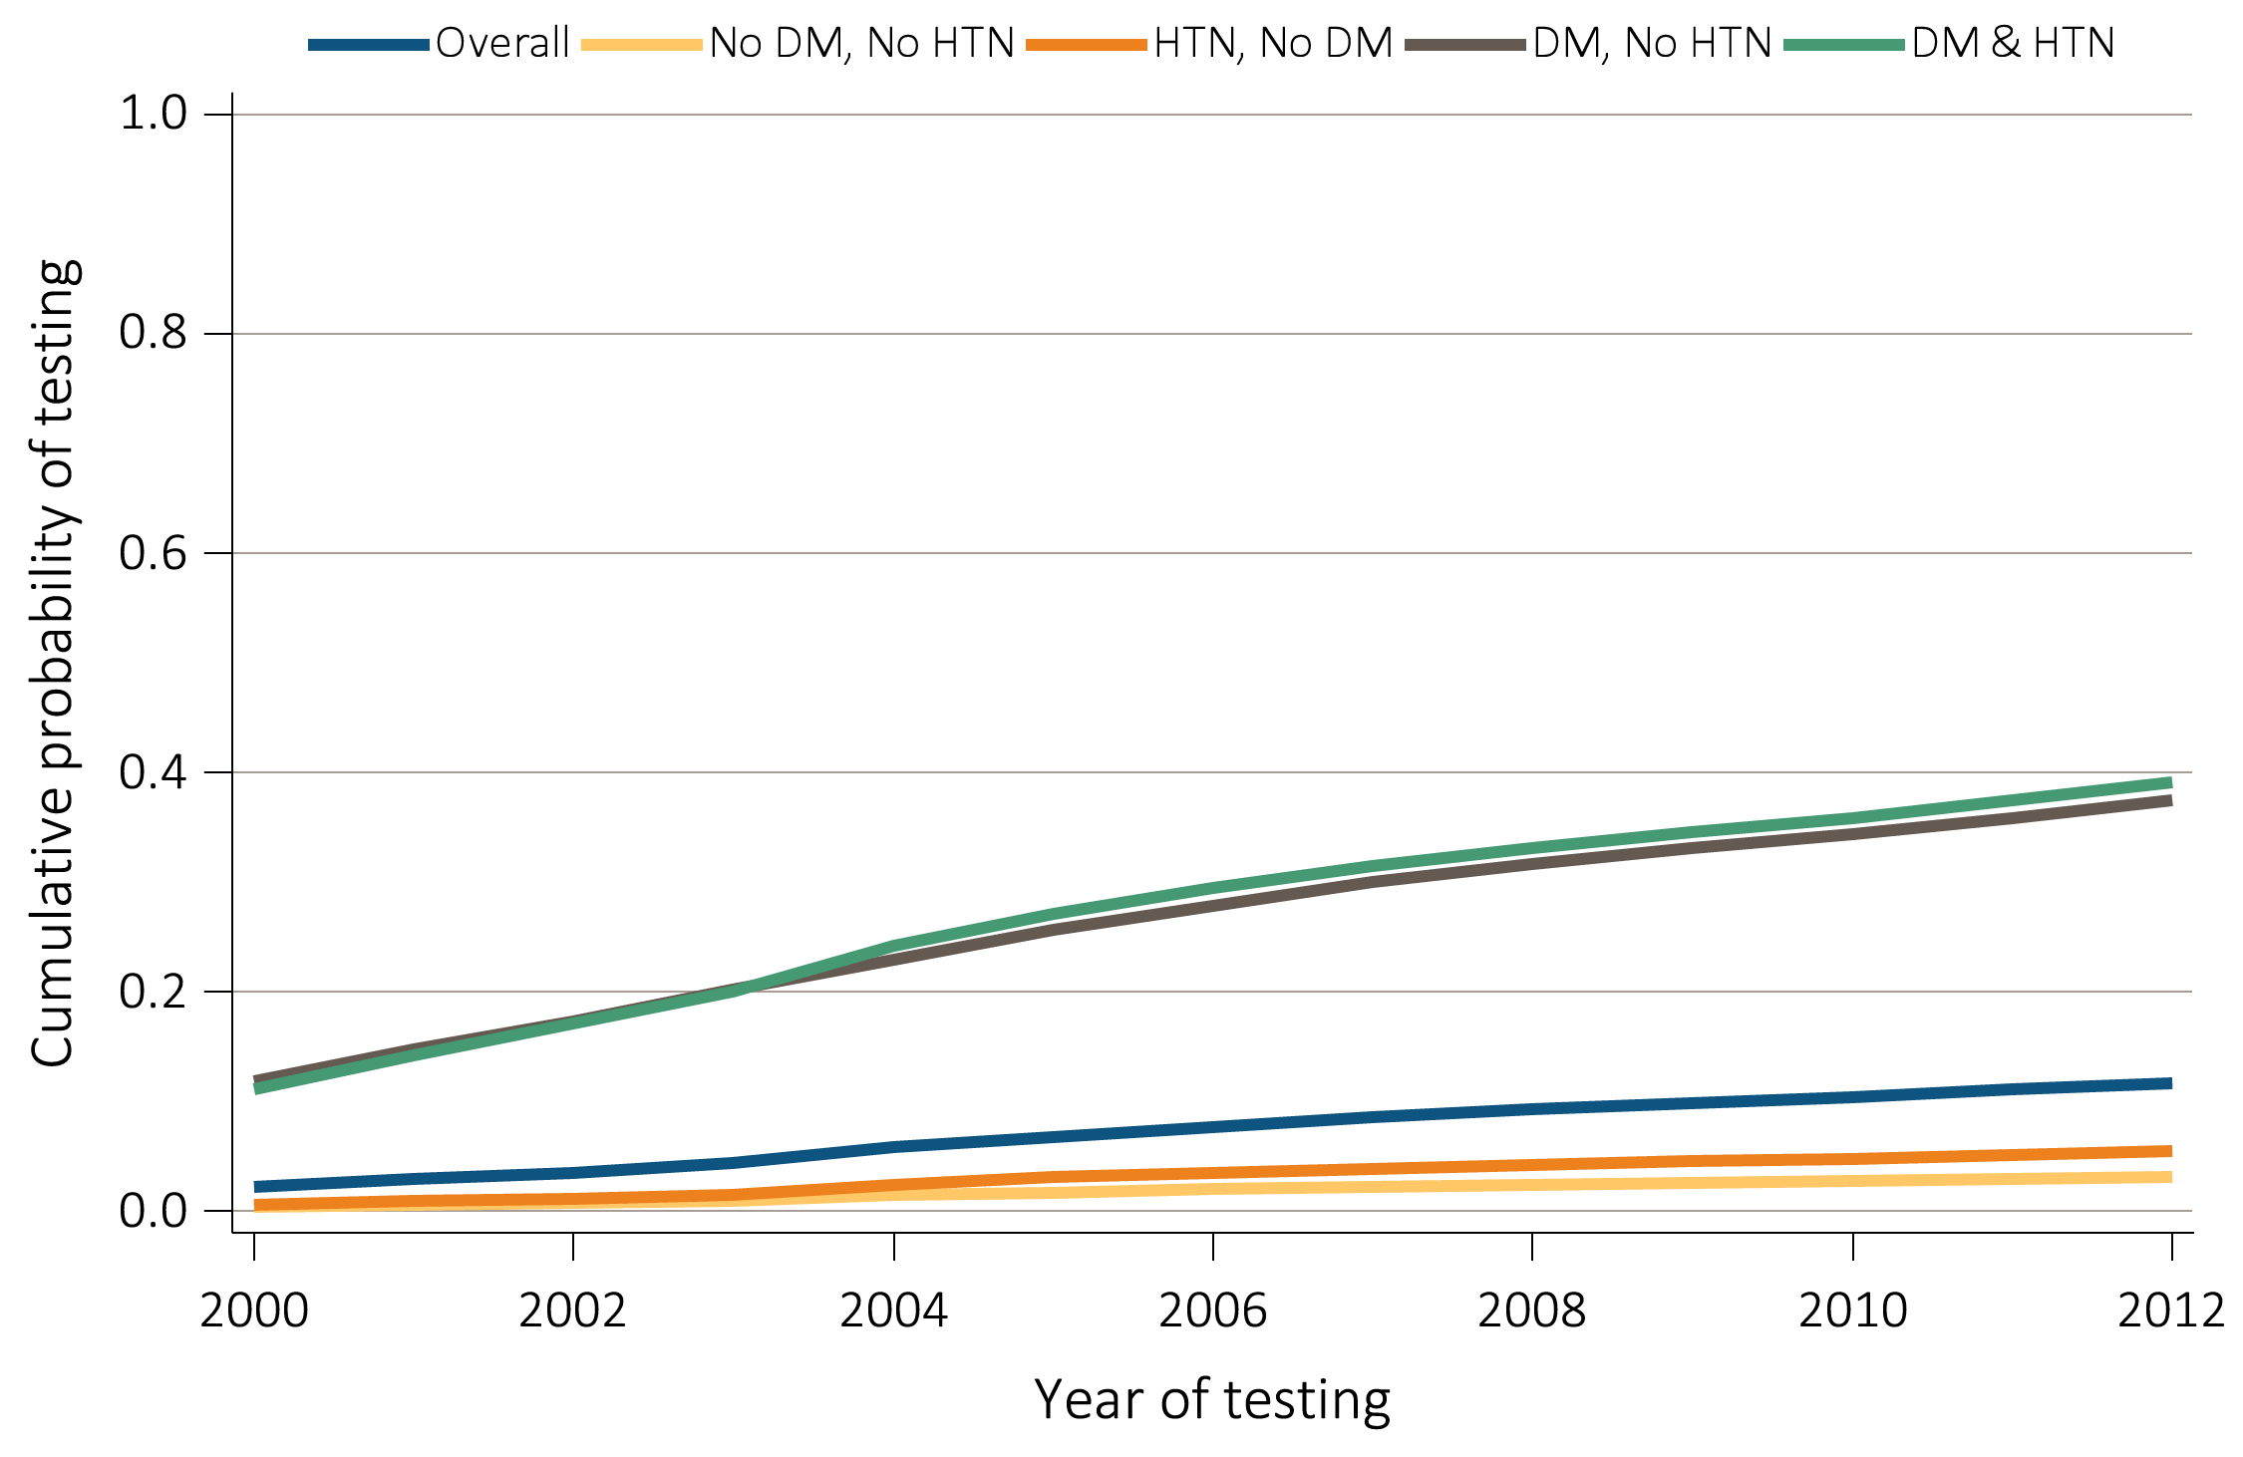
vol 1 Figure 2.3 Unadjusted cumulative probability for urine albumin & serum creatinine testing, among Medicare patients age 65+ WITHOUT a diagnosis of CKD, 2000-2012
(A) Urine albumin
Data Source: Medicare patients from the 5 percent sample, age 65 or older with Part A & B coverage in the prior year. Tests tracked during each year. Abbreviations: DM, diabetes mellitus; HTN, hypertension.

Slide 10
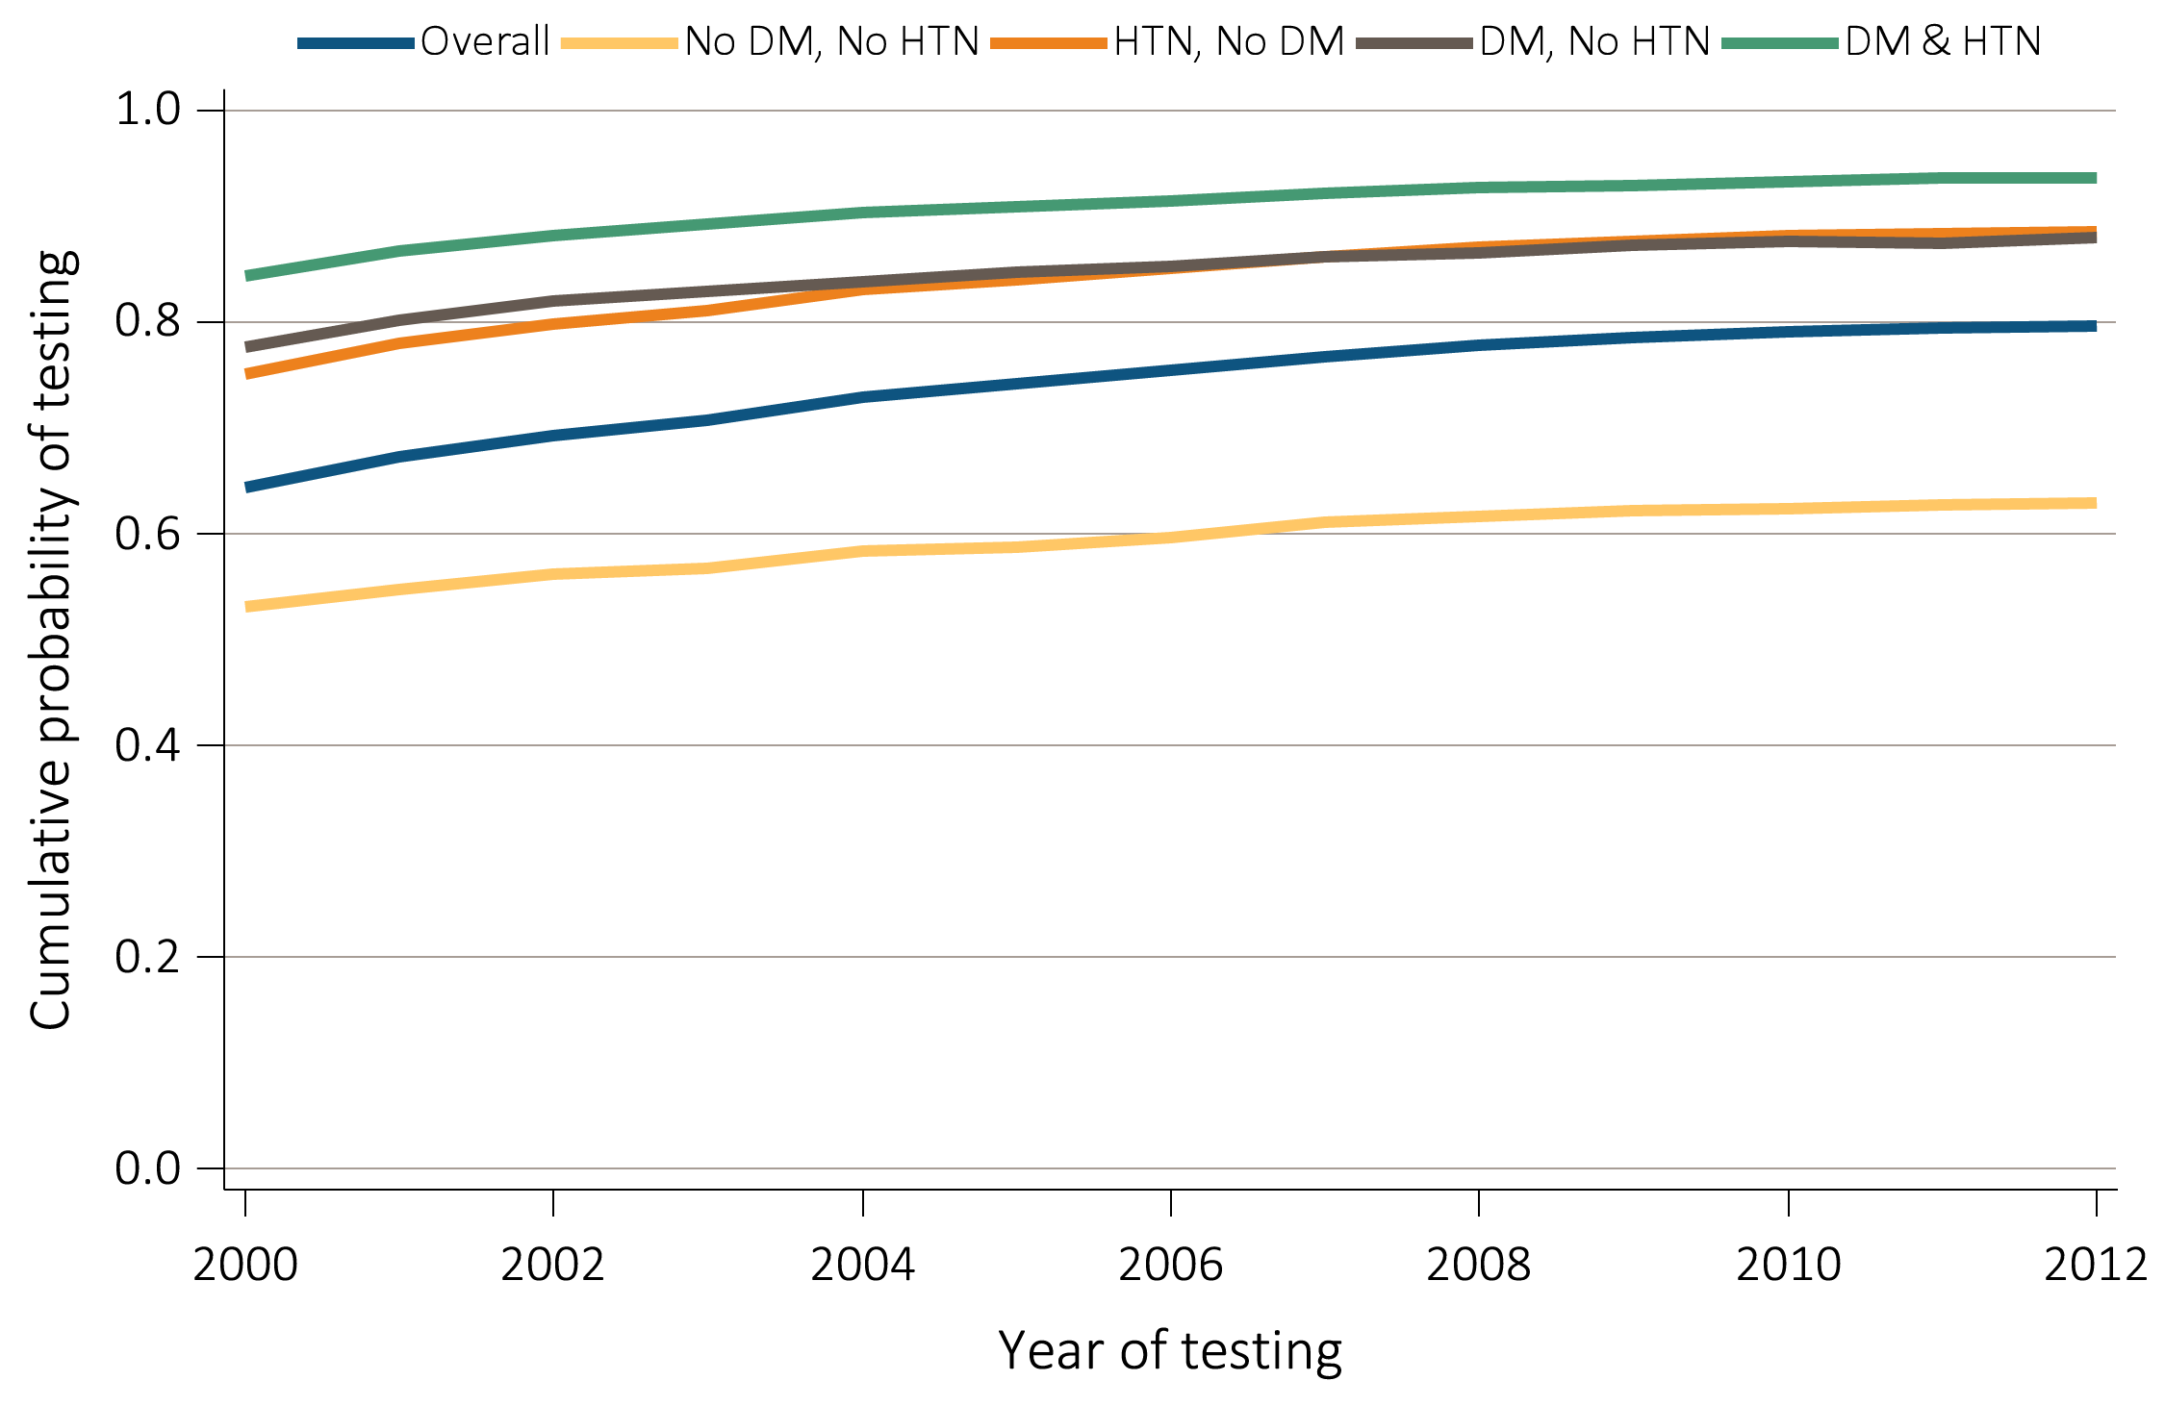
vol 1 Figure 2.3 Unadjusted cumulative probability for urine albumin & serum creatinine testing, among Medicare patients age 65+ WITHOUT a diagnosis of CKD, 2000-2012
(B) Serum creatinine
Data Source: Medicare patients from the 5 percent sample, age 65 or older with Part A & B coverage in the prior year. Tests tracked during each year. Abbreviations: DM, diabetes mellitus; HTN, hypertension.

Slide 11
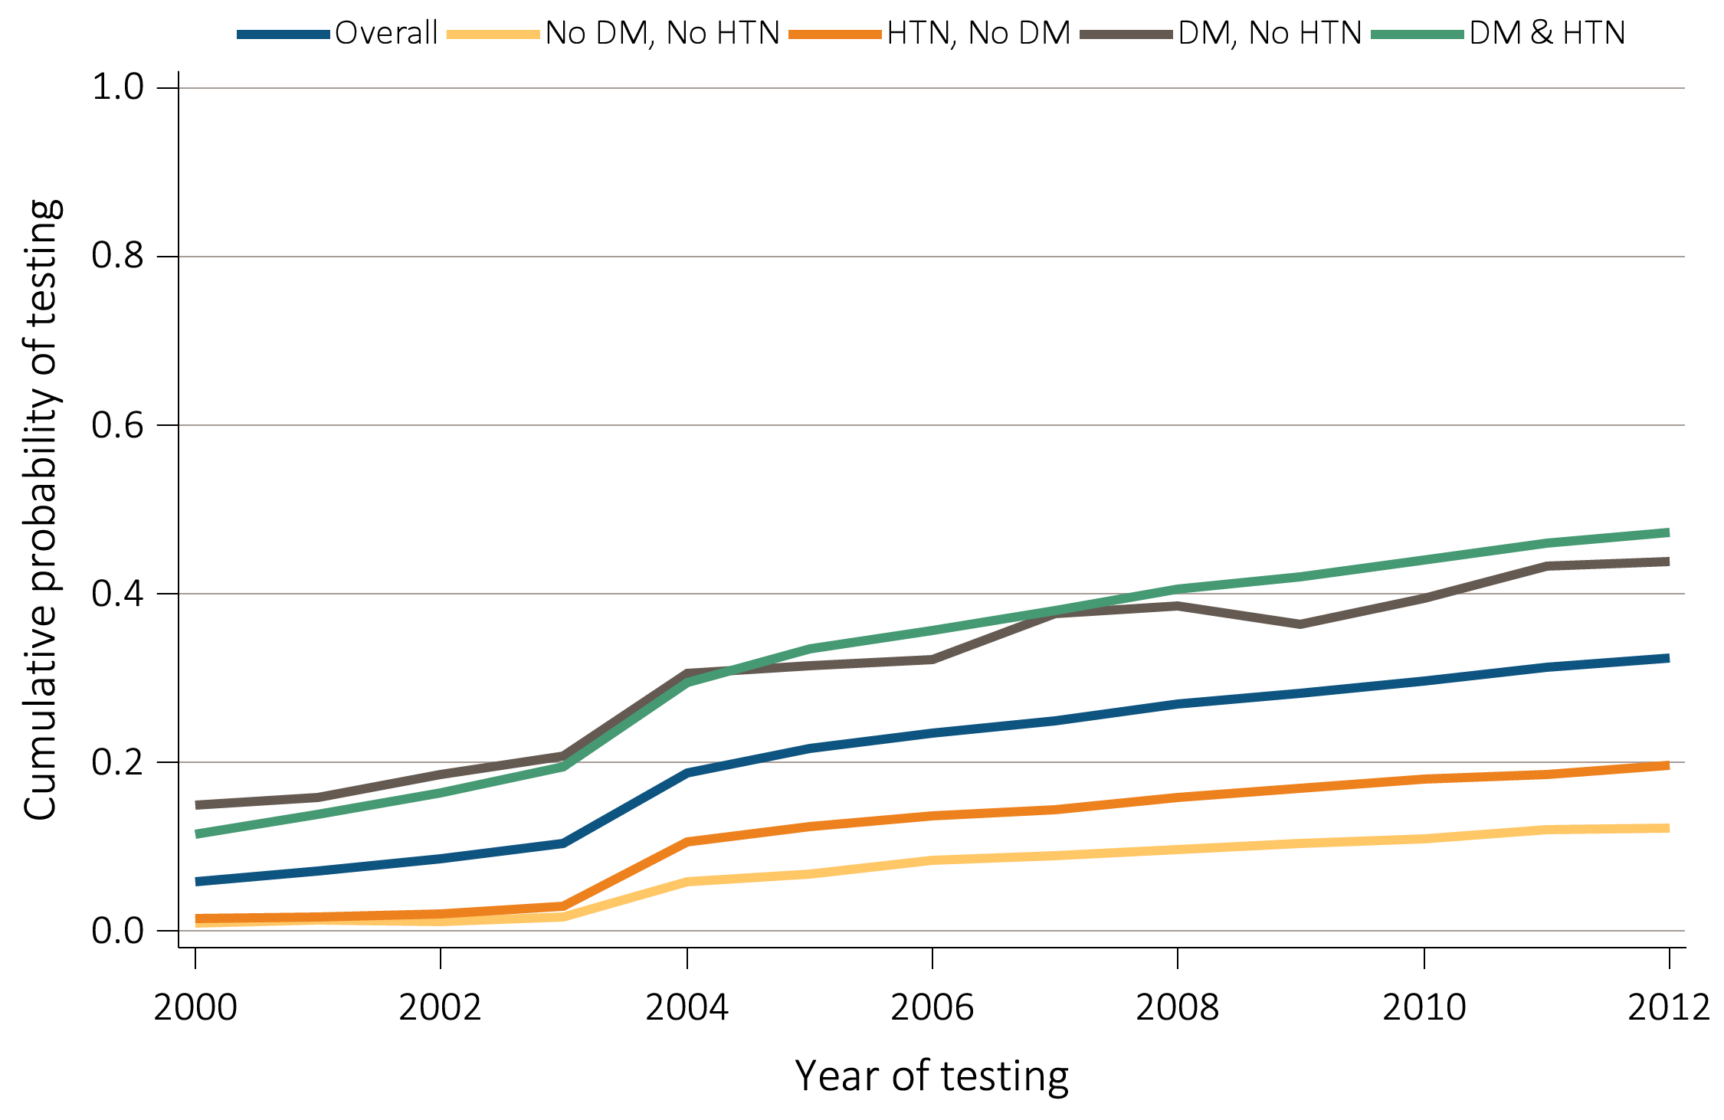
vol 1 Figure 2.4 Unadjusted cumulative probability for urine albumin & serum creatinine testing, among Medicare patients age 65+ WITH a diagnosis of CKD, 2000-2012
(A) Urine albumin
Data Source: Medicare patients from the 5 percent sample, age 65 or older with Part A & B coverage in the prior year. Tests tracked during each year. Abbreviations: DM, diabetes mellitus; HTN, hypertension.

Slide 12
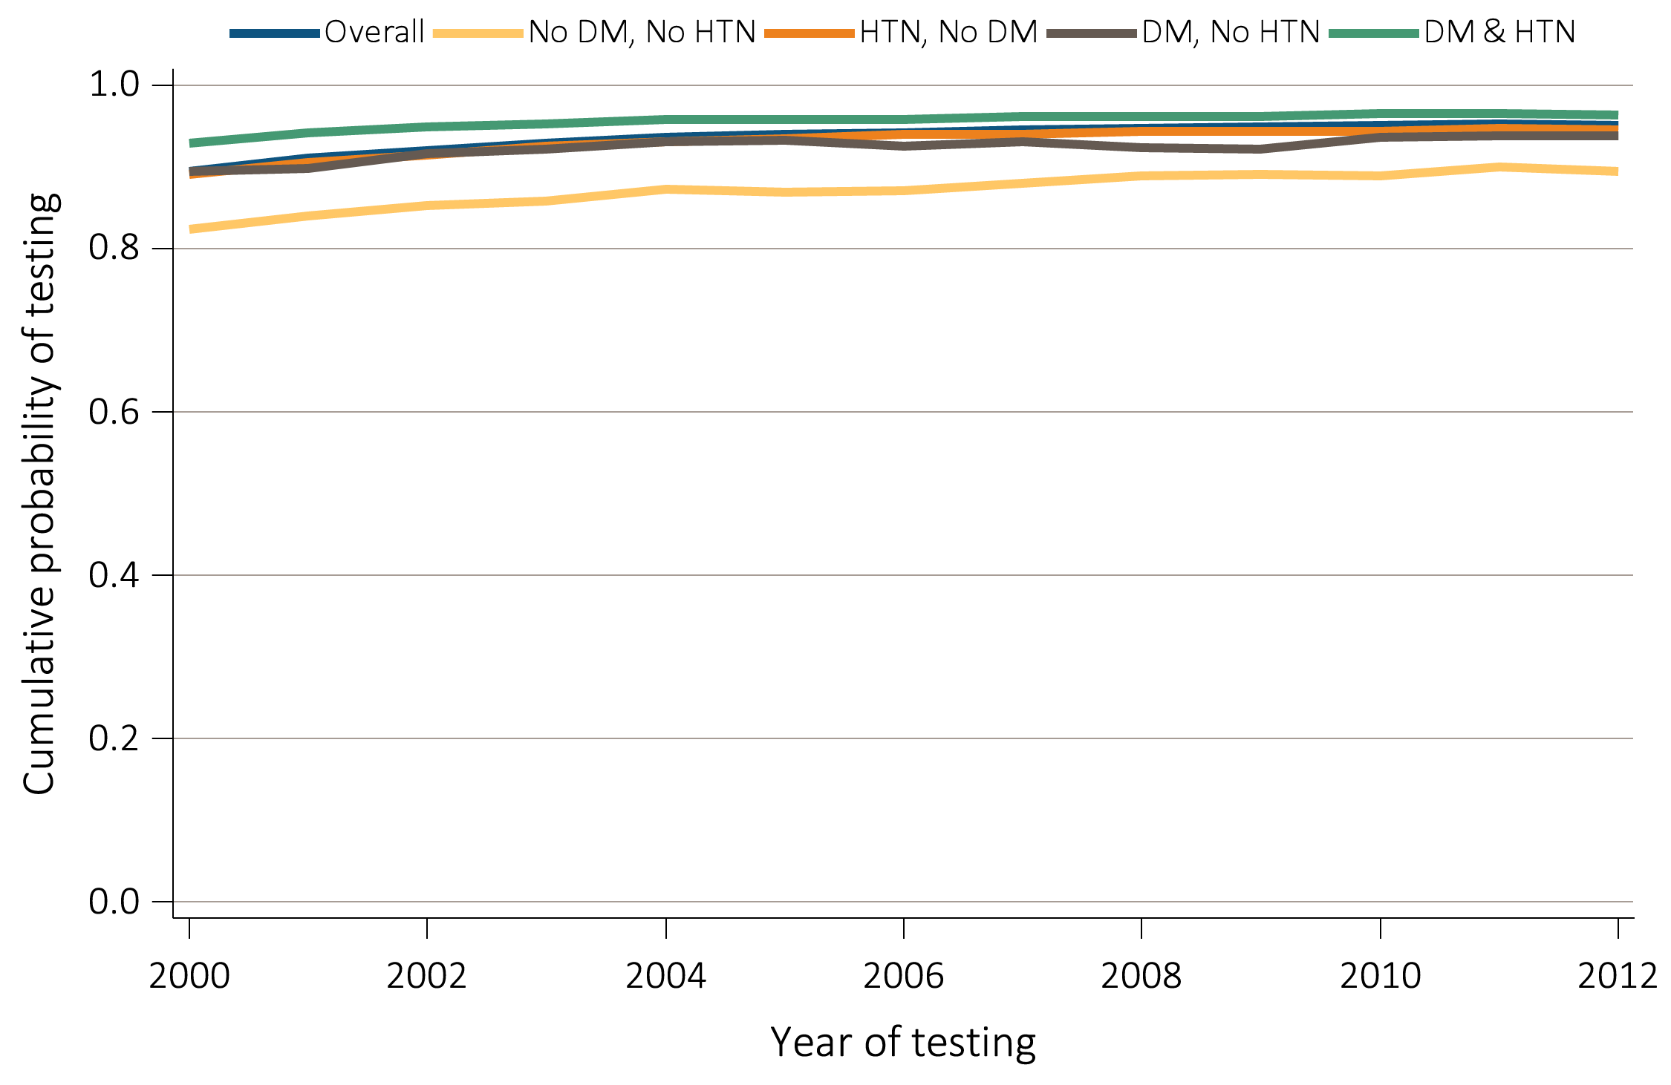
vol 1 Figure 2.4 Unadjusted cumulative probability for urine albumin & serum creatinine testing, among Medicare patients age 65+ WITH a diagnosis of CKD, 2000-2012
(B) Serum creatinine
Data Source: Medicare patients from the 5 percent sample, age 65 or older with Part A & B coverage in the prior year. Tests tracked during each year. Abbreviations: DM, diabetes mellitus; HTN, hypertension.

Slide 13
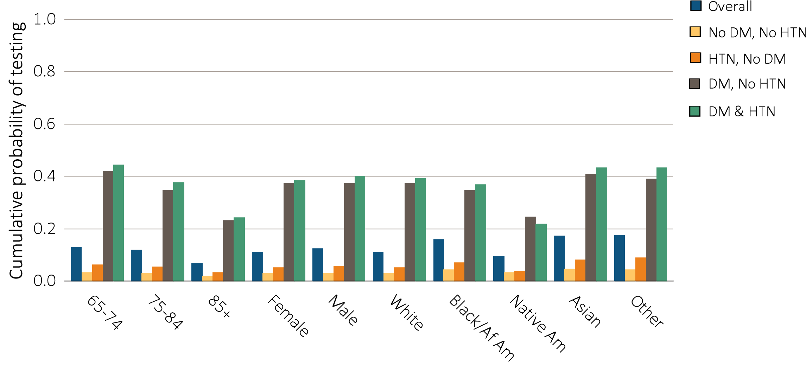
vol 1 Figure 2.5 Adjusted cumulative probability of urine albumin (a) & serum creatinine (b) testing by demographic characteristics, among Medicare patients age 65+ WITHOUT a diagnosis of CKD, 2012
(A) Urine albumin
Data Source: Medicare 5 percent sample. Models are adjusted for age, race, and gender. Abbreviations: DM, diabetes mellitus; HTN, hypertension.

Slide 14
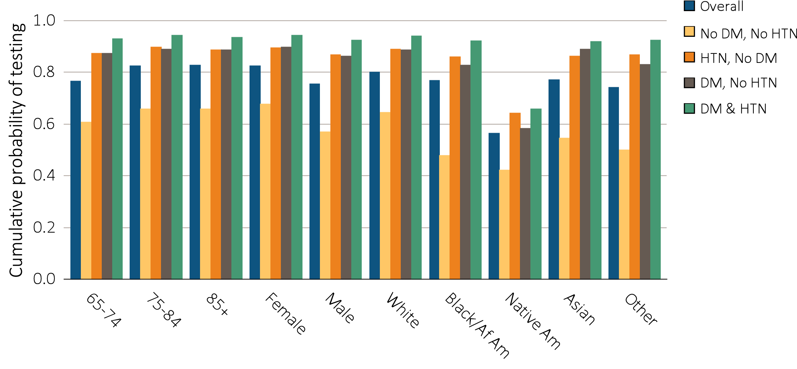
vol 1 Figure 2.5 Adjusted cumulative probability of urine albumin (a) & serum creatinine (b) testing by demographic characteristics, among Medicare patients age 65+ WITHOUT a diagnosis of CKD, 2012
(B) Serum creatinine
Data Source: Medicare 5 percent sample. Models are adjusted for age, race, and gender. Abbreviations: DM, diabetes mellitus; HTN, hypertension.

Slide 15
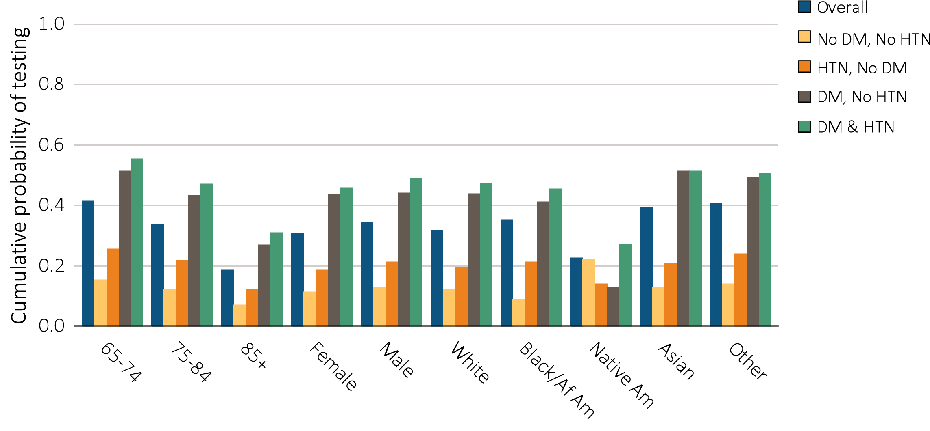
vol 1 Figure 2.6 Adjusted cumulative probability of urine albumin (a) & serum creatinine (b) testing by demographic characteristics, among Medicare patients age 65+ WITH a diagnosis of CKD, 2012
(A) Urine albumin
Data Source: Medicare 5 percent sample. Models are adjusted for age, race and gender. Abbreviations: DM, diabetes mellitus; HTN, hypertension.

Slide 16
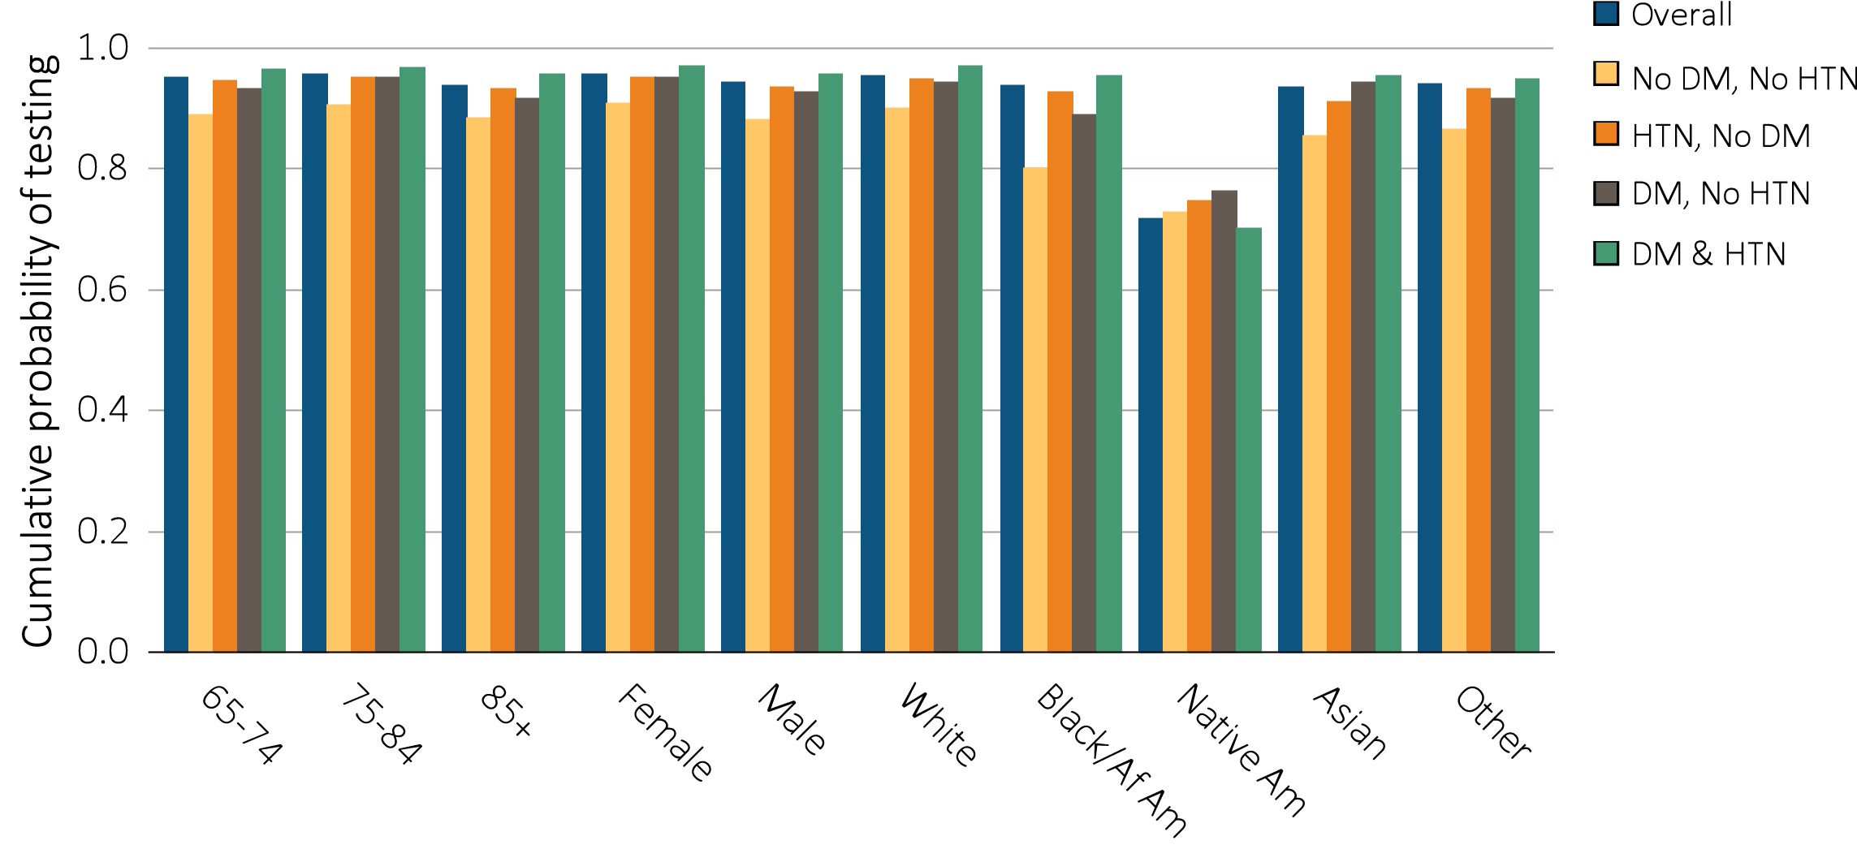
vol 1 Figure 2.6 Adjusted cumulative probability of urine albumin (a) & serum creatinine (b) testing by demographic characteristics, among Medicare patients age 65+ WITH a diagnosis of CKD, 2012
(B) Serum creatinine
Data Source: Medicare 5 percent sample. Models are adjusted for age, race and gender. Abbreviations: DM, diabetes mellitus; HTN, hypertension.

Slide 17
vol 1 Table 2.5 Cumulative probability of a physician visit at month 12 after CKD diagnosis in 2011 among Medicare patients age 65+
 | Any CKD Diagnosis |  |  | CKD Diagnosis Code of 585.3 or Higher
 | Primary Care | Cardiologist | Nephrologist | Primary Care | Cardiologist | Nephrologist
65-74 | 0.88 | 0.54 | 0.31 | 0.89 | 0.55 | 0.56
75-84 | 0.90 | 0.61 | 0.29 | 0.90 | 0.62 | 0.51
85+ | 0.90 | 0.6 | 0.22 | 0.91 | 0.61 | 0.39
Male | 0.90 | 0.55 | 0.27 | 0.91 | 0.56 | 0.48
Female | 0.88 | 0.62 | 0.29 | 0.89 | 0.64 | 0.52
White | 0.89 | 0.59 | 0.28 | 0.90 | 0.60 | 0.49
Black/African Am | 0.89 | 0.56 | 0.33 | 0.89 | 0.57 | 0.55
Other | 0.88 | 0.54 | 0.29 | 0.88 | 0.55 | 0.49
Overall | 0.91 | 0.62 | 0.31 | 0.92 | 0.64 | 0.55
Data Source: Medicare 5 percent sample. Patients alive & eligible all of 2011. CKD diagnosis is at date of first CKD claim in 2011; claims for physician visits were searched during the 12 months following that date. CKD diagnosis code of 585.3 or higher represents CKD Stages 3-5.

