Slide 2
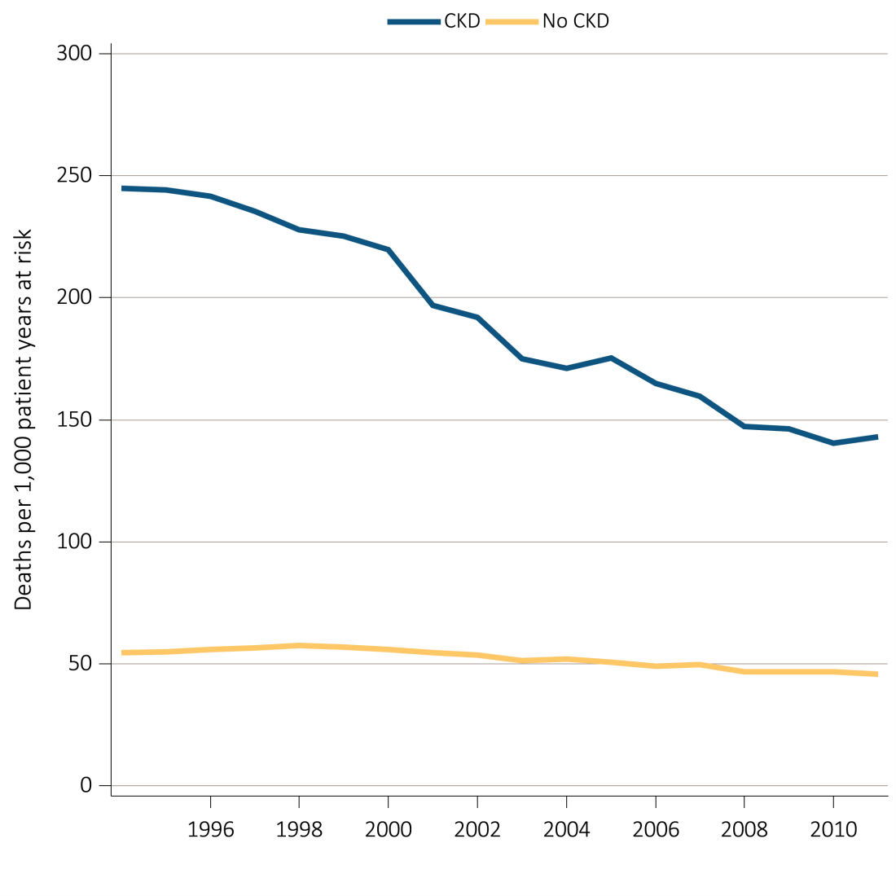
vol 1 Figure 3.1 Unadjusted and adjusted all-cause mortality rates (per 1,000 patient years at risk) for Medicare patients aged 66 and older, by CKD status and year, 1995-2012
(a) Unadjusted
Data source: Medicare 5 percent sample. January 1, 2012 point prevalent Medicare patients age 66 and older. Adj: age/sex/race/prior year hospitalization/comorbidities. Ref: 2012 patients. Abbreviations: CKD, chronic kidney disease.

Slide 3
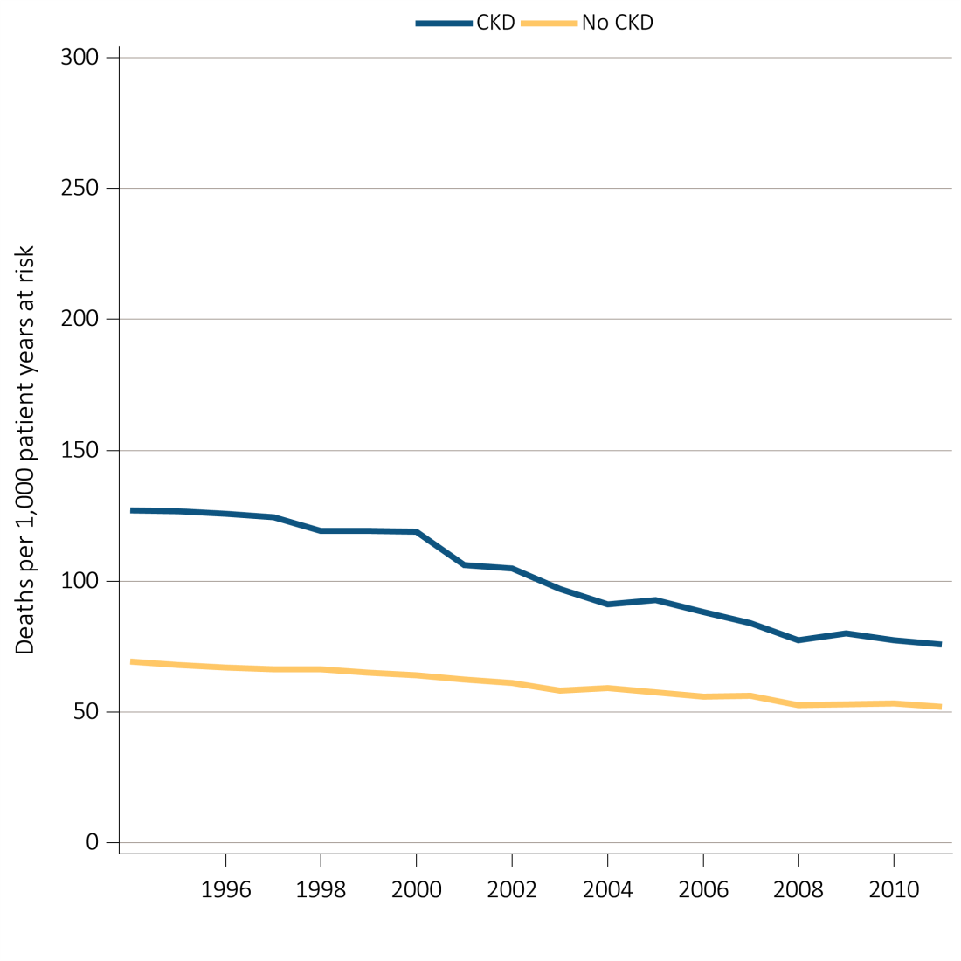
vol 1 Figure 3.1 Unadjusted and adjusted all-cause mortality rates (per 1,000 patient years at risk) for Medicare patients aged 66 and older, by CKD status and year, 1995-2012
(b) Adjusted
Data source: Medicare 5 percent sample. January 1, 2012 point prevalent Medicare patients age 66 and older. Adj: age/sex/race/prior year hospitalization/comorbidities. Ref: 2012 patients. Abbreviations: CKD, chronic kidney disease.

Slide 4
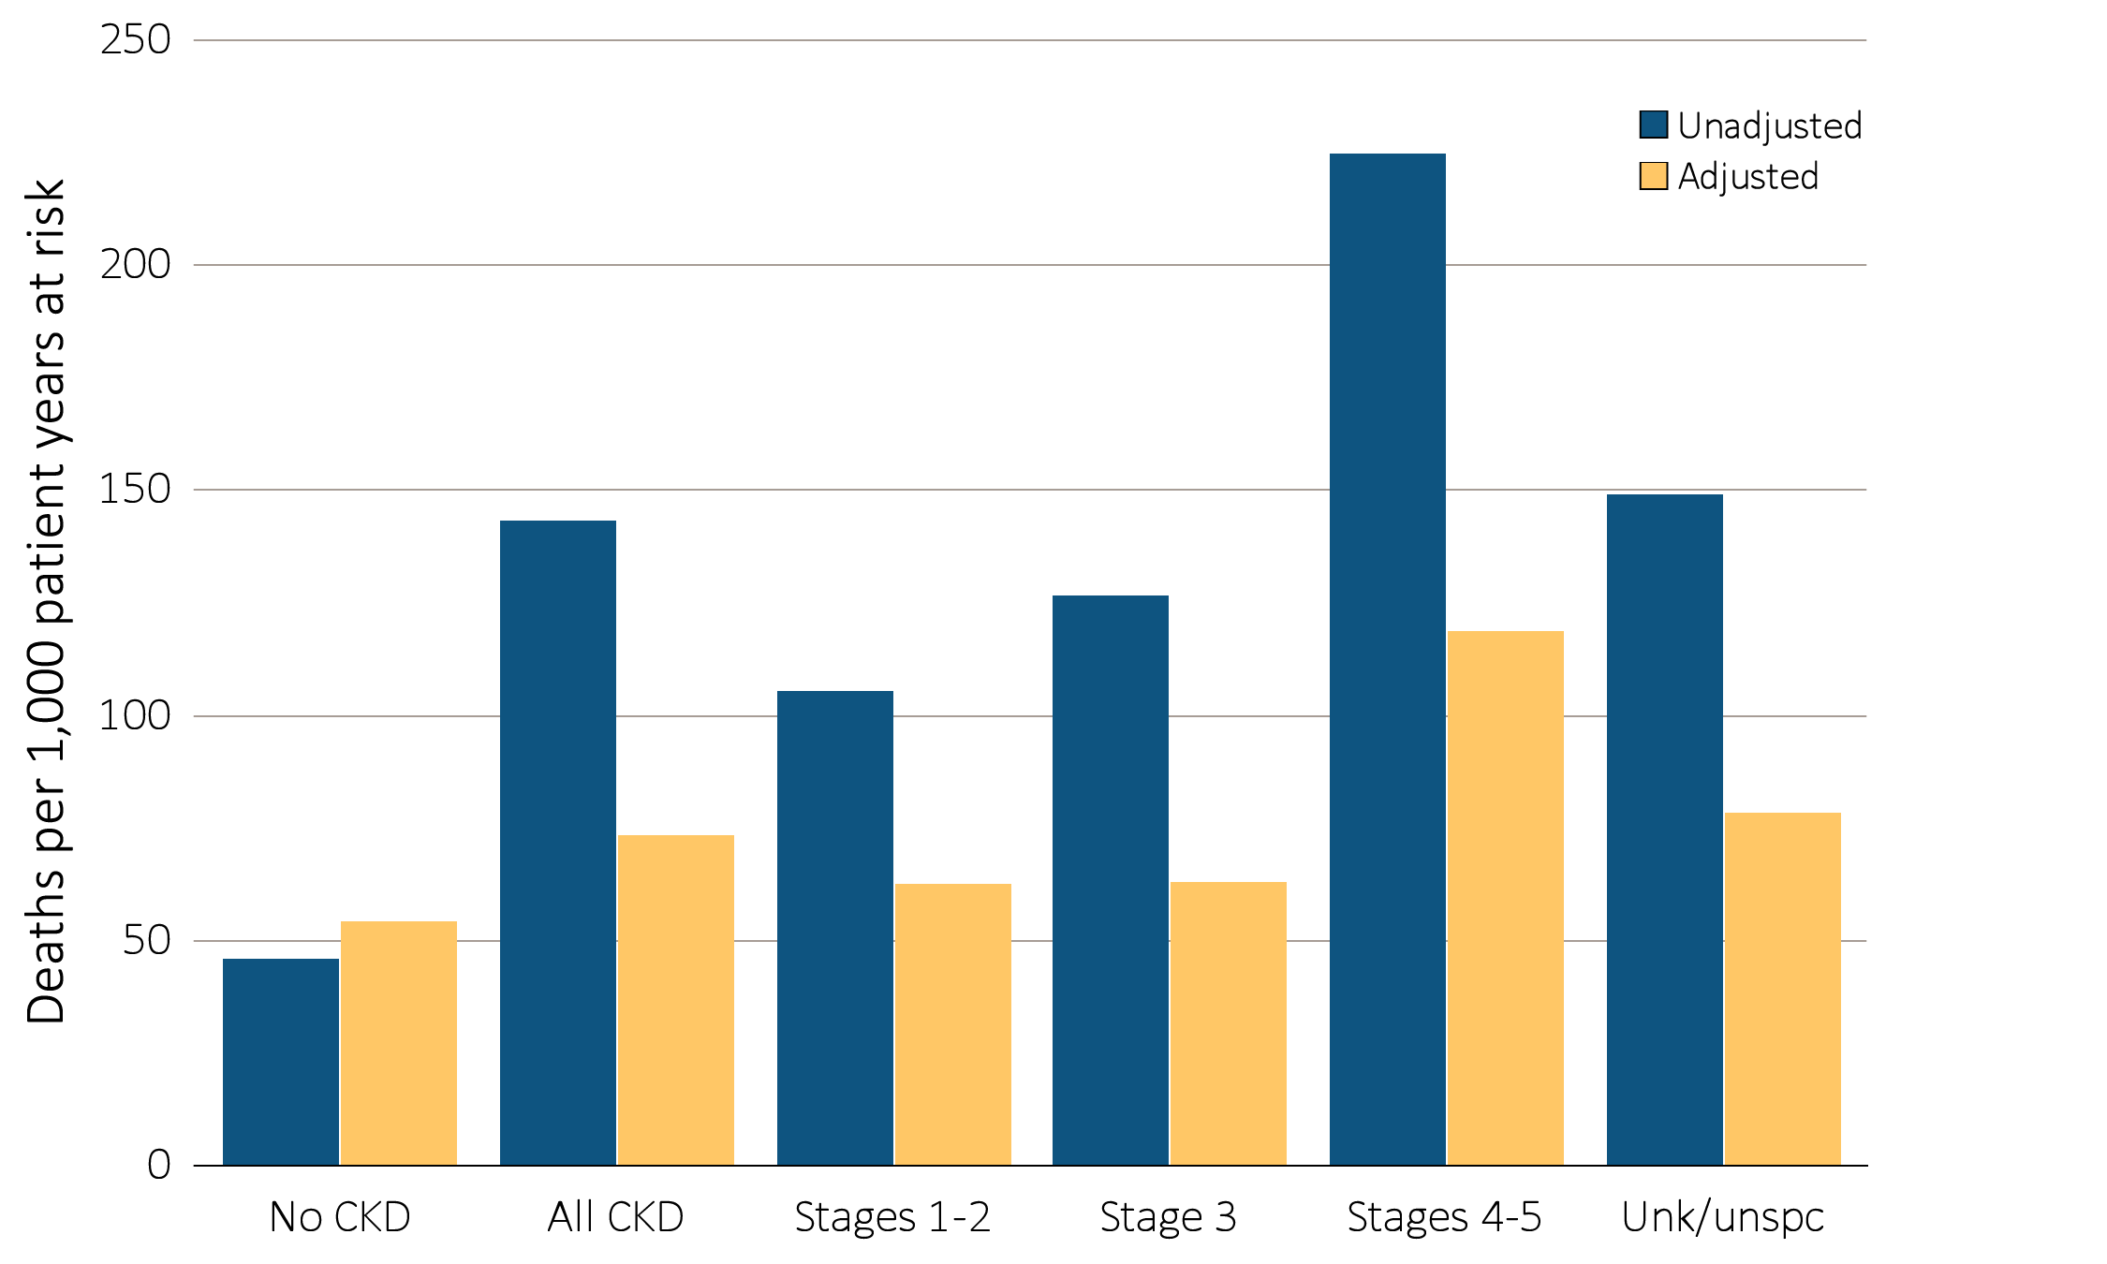
vol 1 Figure 3.2 Unadjusted and adjusted all-cause mortality rates (per 1,000 patient years at risk) for Medicare patients aged 66 and older by CKD status and stage, 2012
Data source: Medicare 5 percent sample. January 1, 2012 point prevalent Medicare patients age 66 and older. Adj: age/sex/race/prior year hospitalization/comorbidities. Ref: all patients, 2012. See Table A for CKD stage definitions. Abbreviations: CKD, chronic kidney disease; Unk/unspc, CKD stage unidentified.

Slide 5
^{Table A. ICD-9-CM Codes}
Table A. ICD-9-CM Codes
585.1 | Chronic kidney disease, Stage 1
585.2 | Chronic kidney disease, Stage 2 (mild)
585.3 | Chronic kidney disease, Stage 3 (moderate)
585.4 | Chronic kidney disease, Stage 4 (severe)
585.5 | Chronic kidney disease, Stage 5 (excludes 585.6: Stage 5, requiring chronic dialysisª)
CKD unspecified identified by multiple codes including 585.9, 250.4x, 403.9xm & others. CKD stage estimates are from a single measurement. For clinical case definition, abnormalities should be present ≥ 3 months.
ª In USRDS analyses, patients with ICD-9-CM code 585.6 & with no ESRD 2728 form or other indication of end-stage renal disease (ESRD) are considered to have code 585.5. See the CKD Analytical Methods chapter for details.

Slide 6
vol 1 Table 3.1 Unadjusted and adjusted mortality rates (per 1,000 patient years at risk) in Medicare patients, by age, sex, race, and CKD status, 2012
 | Unadjusted |  | Adjusted
 | No CKD | All CKD | No CKD | All CKD
All | 45.7 | 143.0 | 54.0 | 73.2
66–69 | 15.3 | 69.1 | 22.8 | 35.8
70–74 | 21.4 | 78.2 | 27.8 | 40.1
75–84 | 44.6 | 125.5 | 47.5 | 66.4
85+ | 138.3 | 261.7 | 129.9 | 161.9
Male | 46.4 | 149.4 | 58.5 | 77.4
Female | 45.2 | 137.3 | 49.4 | 71.0
White | 46.3 | 146.5 | 53.0 | 73.8
Black/Af Am | 45.9 | 130.6 | 56.9 | 71.9
Other | 35.5 | 113.4 | 46.3 | 62.4
Data source: Medicare 5 percent sample. January 1, 2012 point prevalent patients age 66 and older. Adj: age/sex/race/prior year hospitalization/comorbidities. Ref: all patients, 2012. Abbreviations: Af Am, African American; CKD, chronic kidney disease.

Slide 7
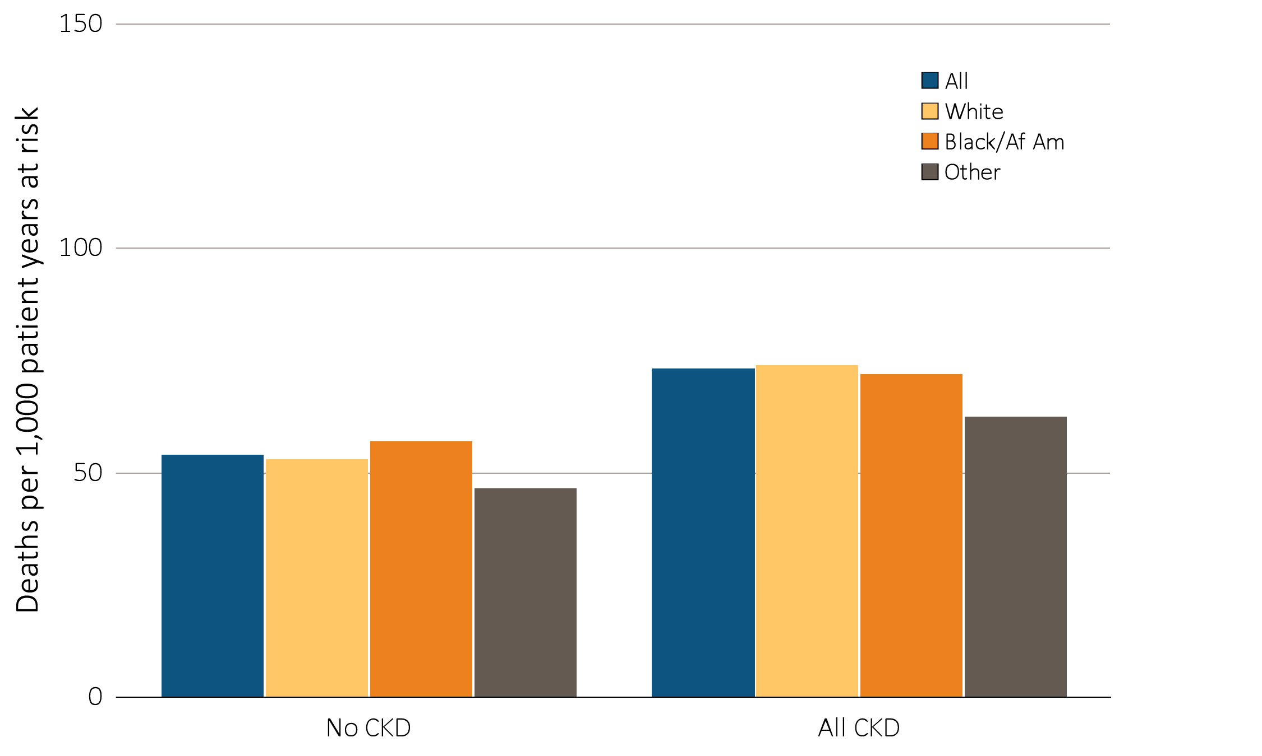
vol 1 Figure 3.3 Adjusted mortality rates (per 1,000 patient years at risk) in Medicare patients aged 66 and older, by race and CKD status, 2012
Data source: Medicare 5 percent sample. January 1, 2012 point prevalent patients age 66 and older. Adj: age/sex/race/prior year hospitalization/comorbidities. Ref: all patients, 2012. Abbreviations: Af Am, African American; CKD, chronic kidney disease.

Slide 8
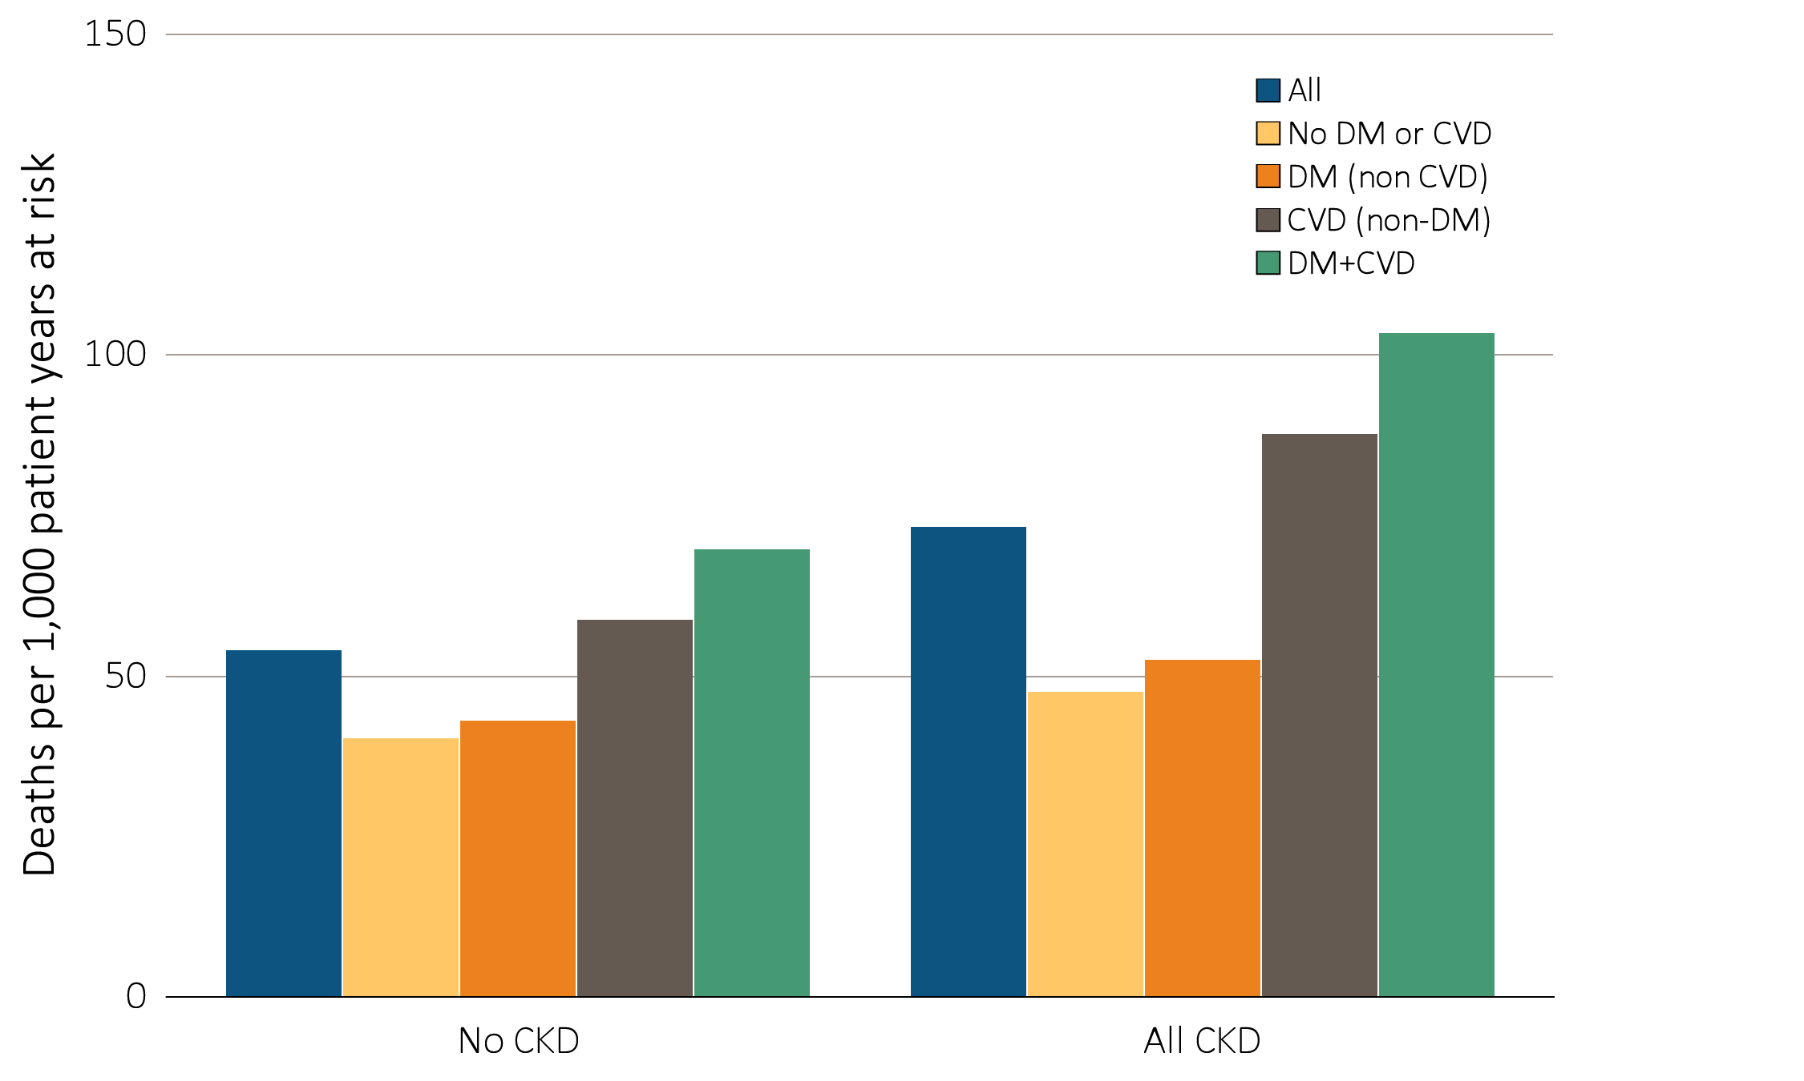
vol 1 Figure 3.4 Adjusted mortality rates (per 1,000 patient years at risk) in Medicare patients aged 66 and older, by cardiovascular disease, diabetes mellitus, and CKD status, 2012
Data source: Medicare 5 percent sample. January 1, 2012 point prevalent patients age 66 and older. Adj: age/sex/race/prior year hospitalization/comorbidities. Ref: all patients, 2012. Abbreviations: CKD, chronic kidney disease; CVD, cardiovascular disease; DM, diabetes mellitus.

Slide 9
vol 1 Table 3.2 Unadjusted and adjusted all-cause hospitalization rates (per 1,000 patient years at risk) for Medicare patients aged 66 and older, by CKD status, 2012
 | Unadjusted |  | Adjusted
 | No CKD | All CKD | No CKD | All CKD
All | 282 | 749 | 294 | 404
66–69 | 183 | 639 | 232 | 345
70–74 | 221 | 665 | 245 | 351
75–84 | 315 | 754 | 305 | 412
85+ | 467 | 868 | 425 | 505
Male | 276 | 744 | 297 | 396
Female | 287 | 753 | 292 | 410
White | 283 | 738 | 293 | 405
Black/Af Am | 313 | 855 | 329 | 433
Other | 227 | 695 | 255 | 367
Data source: Medicare 5 percent sample. January 1, 2012 point prevalent Medicare patients, age 66 and older. Adj: age/sex/race/prior hospitalization/comorbidity; rates by one factor are adjusted for the others. Ref: all patients, 2012. Abbreviations: Af Am, African American; CKD, chronic kidney disease.

Slide 10
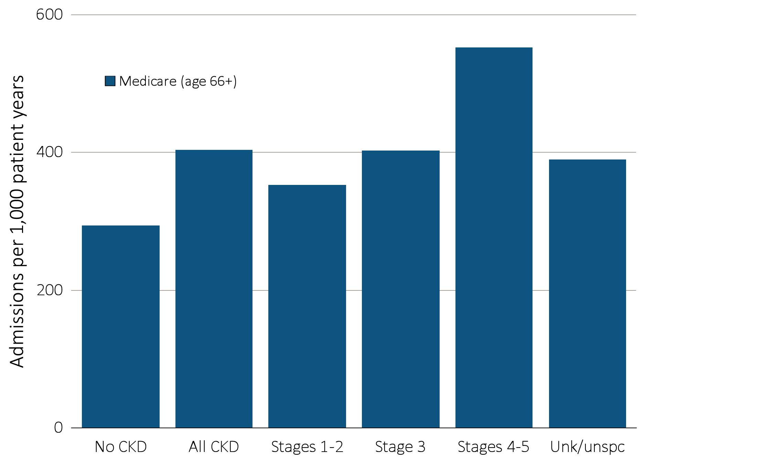
vol 1 Figure 3.5 Adjusted all-cause hospitalization rates (per 1,000 patient years at risk) for Medicare patients aged 66 and older by CKD status and stage, 2012
Data source: Medicare 5 percent sample. January 1, 2012 point prevalent Medicare patients, age 66 and older. Adj: age/sex/race/prior year hospitalization/comorbidity. Ref: all patients, 2012. See Table A for CKD stage definitions. Abbreviations: CKD, chronic kidney disease; Unk/unspc, CKD stage unidentified.

Slide 11
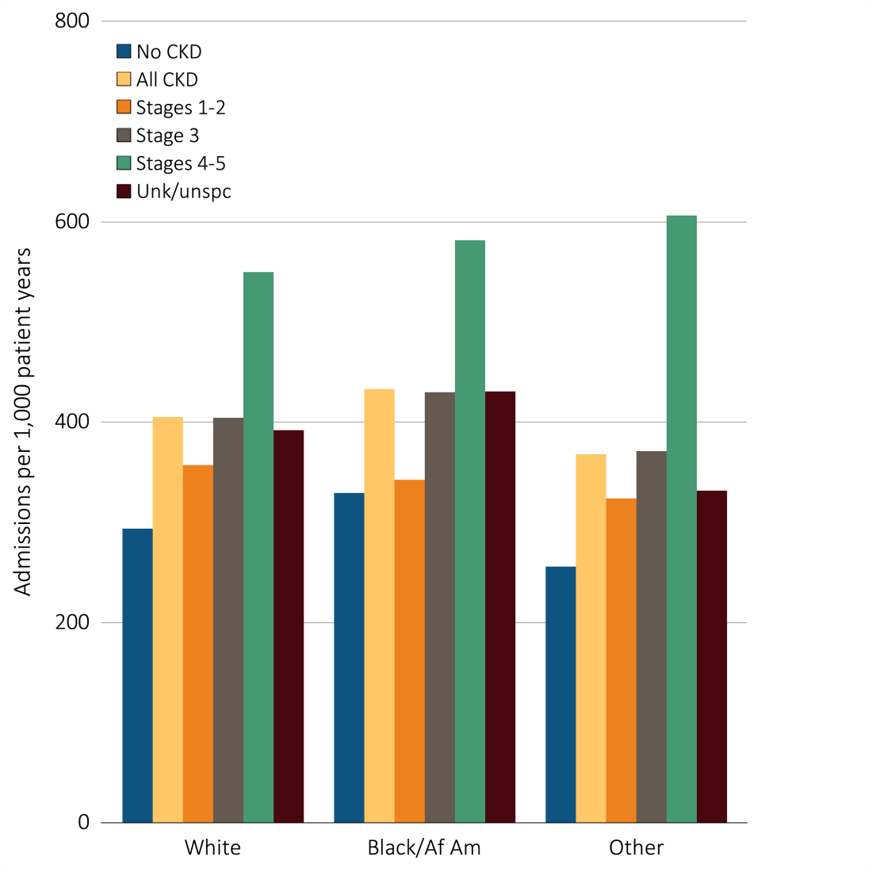
vol 1 Figure 3.6 Adjusted all-cause hospitalization rates (per 1,000 patient years at risk) in Medicare patients aged 66 and older, by race, CKD status, and stage, 2012
Data source: Medicare 5 percent sample. January 1, 2012 point prevalent Medicare patients, age 66 and older. Adj: age/sex/race/prior year hospitalization/comorbidity; rates by one factor are adjusted for the others. Ref: all patients, 2012. See Table A for CKD stage definitions. Abbreviations: Af Am, African American; CKD, chronic kidney disease; Unk/unspc, CKD stage unidentified.

Slide 12
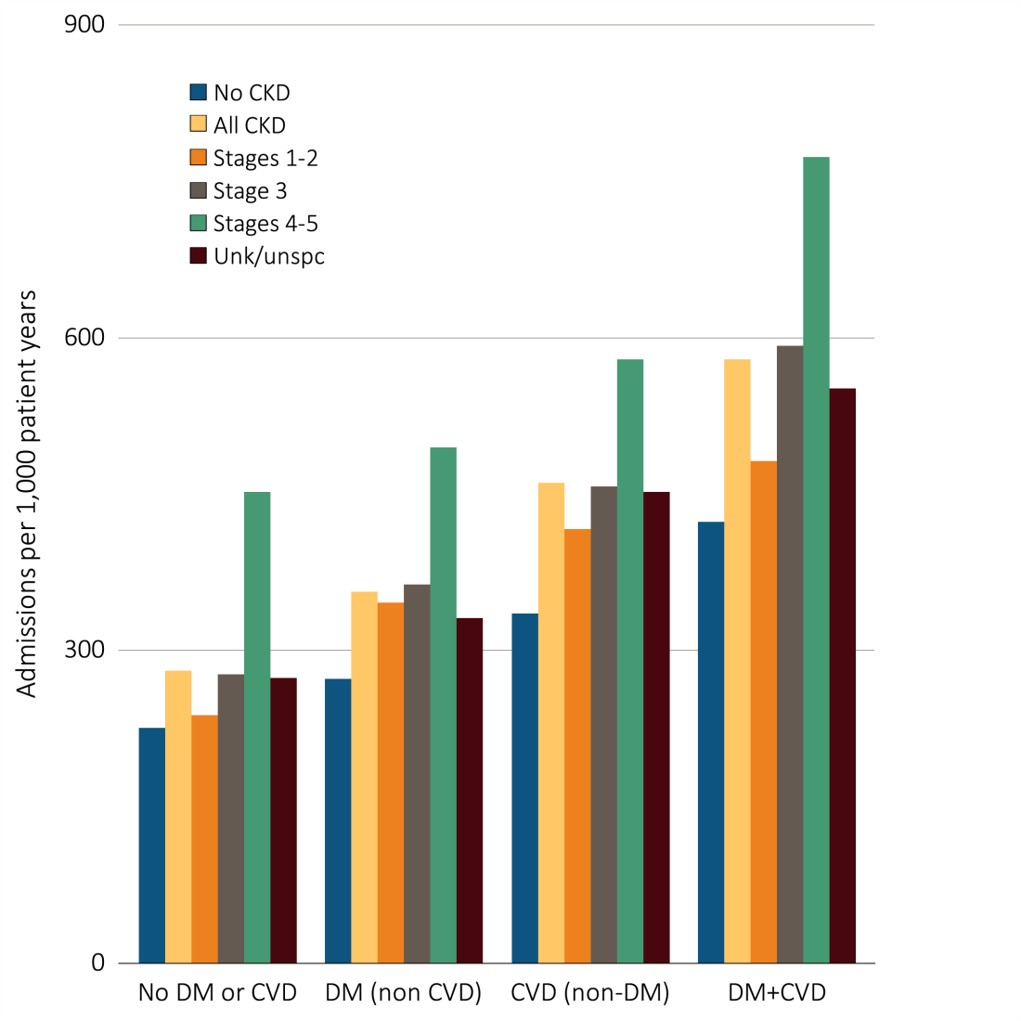
vol 1 Figure 3.7 Adjusted all-cause hospitalization rates (per 1,000 patient years at risk) in Medicare patients aged 66 and older, by cardiovascular disease, diabetes mellitus, CKD status, and stage, 2012
Data source: Medicare 5 percent sample. January 1, 2012 point prevalent Medicare patients, age 66 and older. Adj: age/sex/race/prior year hospitalization/comorbidity; rates by one factor are adjusted for the others. Ref: all patients, 2012. See Table A for CKD stage definitions. Abbreviations: CKD, chronic kidney disease; CVD, cardiovascular disease; DM, diabetes mellitus; Unk/unspc, CKD stage unidentified.

Slide 13
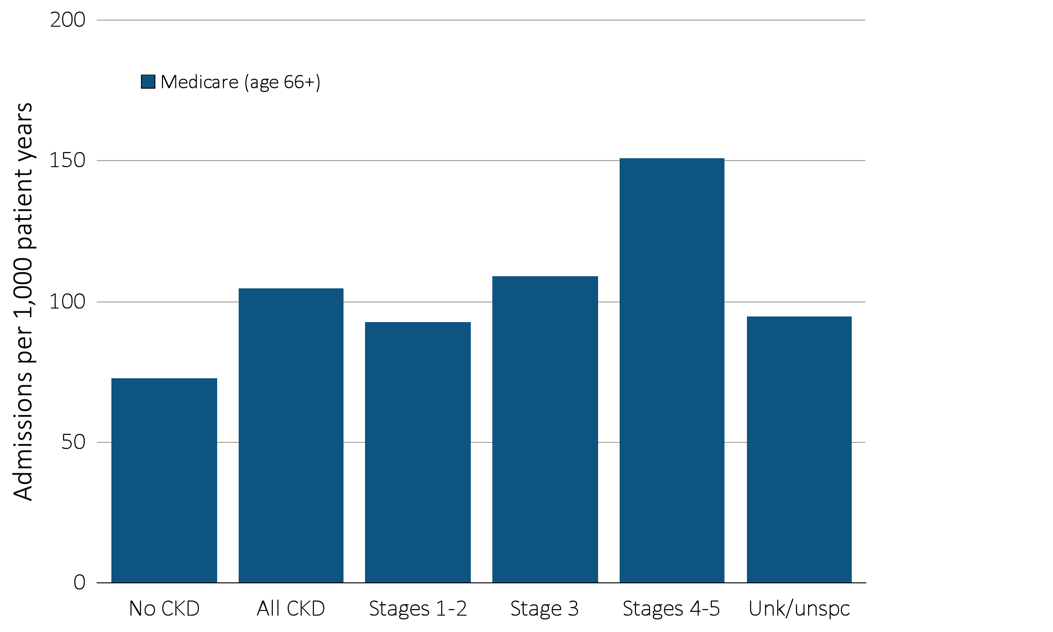
vol 1 Figure 3.8 Adjusted rates of hospitalization for cardiovascular disease (per 1,000 patient years at risk) in Medicare patients aged 66 and older, by CKD status and stage, 2012
Data source: Medicare 5 percent sample. January 1, 2012 point prevalent Medicare patients, age 66 and older. Adj: age/sex/race/prior year hospitalization/comorbidity; rates by one factor are adjusted for the others. Ref: all patients, 2012. See Table A for CKD stage definitions. Abbreviations: CKD, chronic kidney disease; Unk/unspc, CKD stage unidentified.

Slide 14
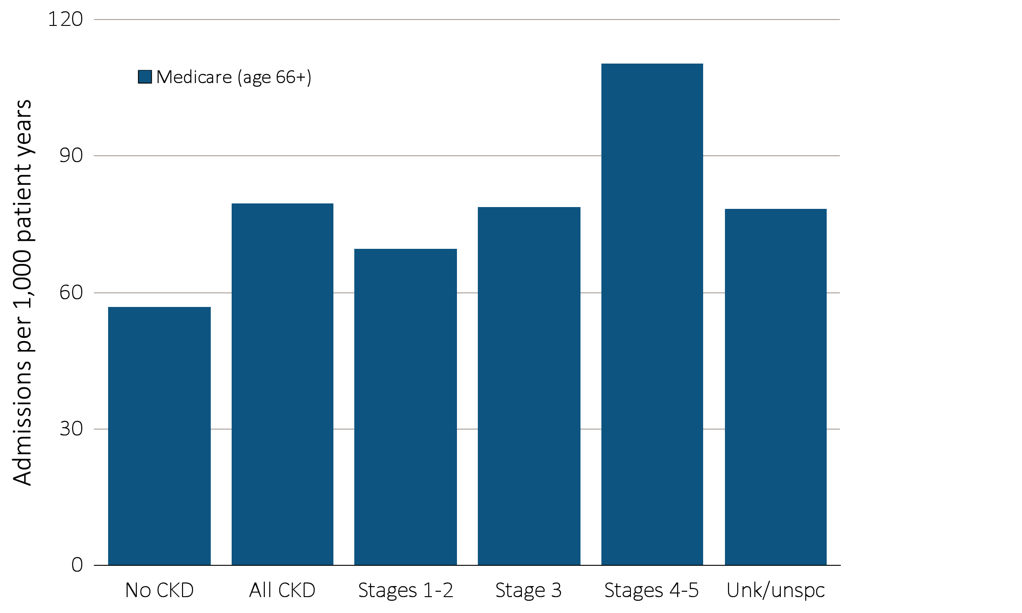
vol 1 Figure 3.9 Adjusted rates of hospitalization for infection (per 1,000 patient years at risk) in Medicare patients aged 66 and older, by CKD status and stage, 2012
Data source: Medicare 5 percent sample. January 1, 2012 point prevalent Medicare patients, age 66 and older. Adj: age/sex/race/prior year hospitalization/comorbidity; rates by one factor are adjusted for the others. Ref: all patients, 2012. See Table A for CKD stage definitions. Abbreviations: CKD, chronic kidney disease; Unk/unspc, CKD stage unidentified.

Slide 15
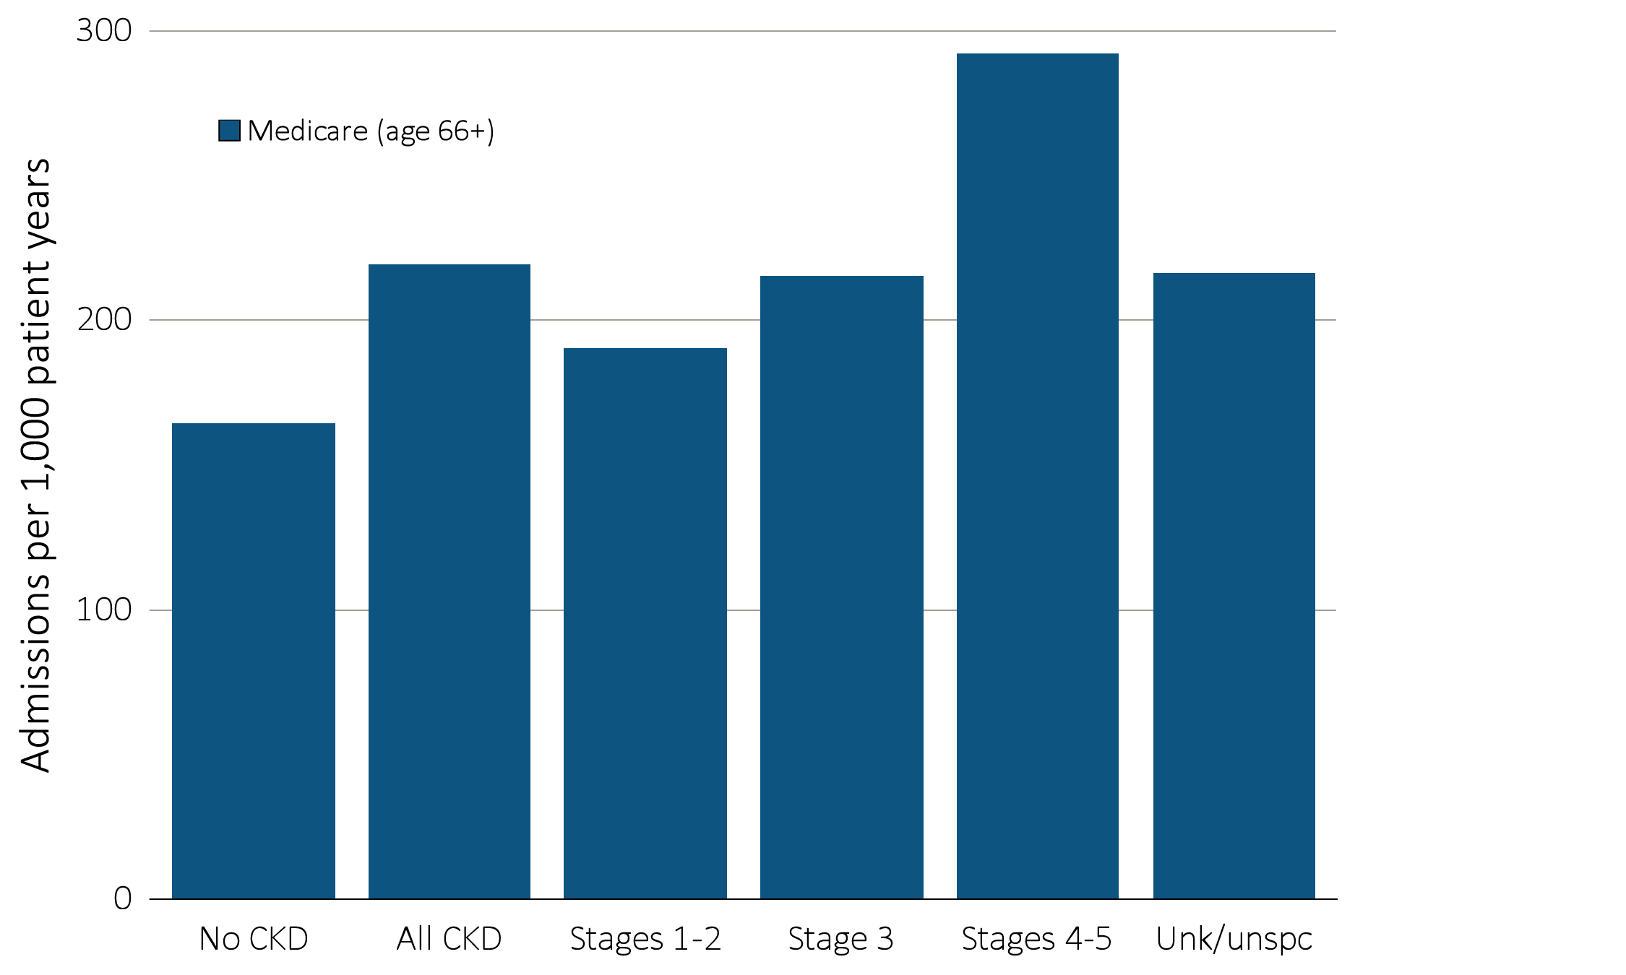
vol 1 Figure 3.10 Adjusted rates of hospitalization for causes other than cardiovascular disease or infection (per 1,000 patient years at risk) in Medicare patients aged 66 and older, by CKD status and stage, 2012
Data source: Medicare 5 percent sample. January 1, 2012 point prevalent Medicare patients, age 66 and older. Adj: age/sex/race/prior year hospitalization/comorbidity; rates by one factor are adjusted for the others. Ref: all patients, 2012. See Table A for CKD stage definitions. Abbreviations: CKD, chronic kidney disease; Unk/unspc, CKD stage unidentified.

Slide 16
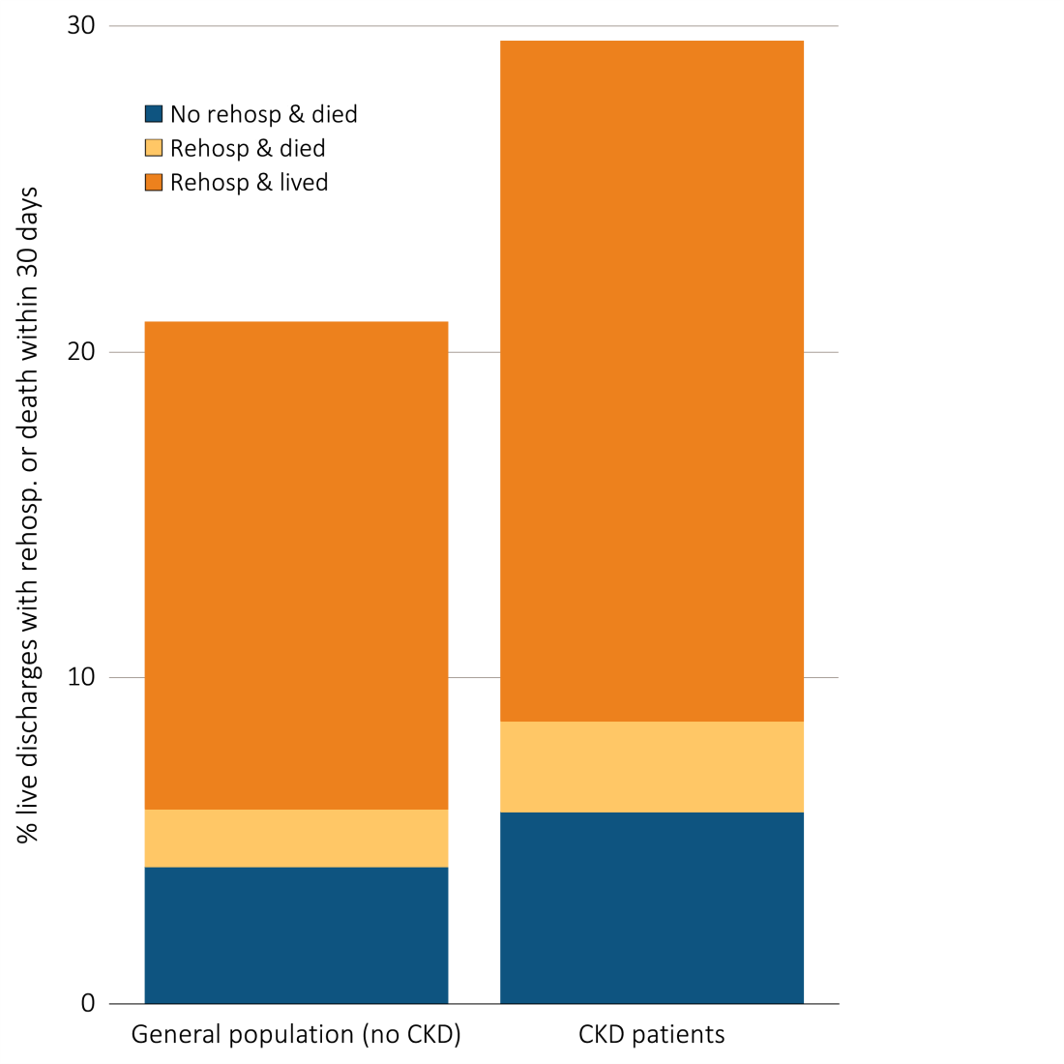
vol 1 Figure 3.11 Unadjusted percentage readmitted to the hospital within 30 days of discharge, among Medicare patients aged 66 and older, discharged alive from an all-cause index hospitalization between January 1 and December 1, by CKD status, 2012
Data source: Medicare 5 percent sample. January 1, 2012 point prevalent, Medicare patients age 66 and older, discharged alive from an all-cause index hospitalization between January 1, 2012, and December 1, 2012, unadjusted. Abbreviations: CKD, chronic kidney disease; Rehosp, rehospitalized.

Slide 17
vol 1 Table 3.3 Unadjusted percentage readmitted to the hospital within 30 days of discharge, among Medicare patients aged 66 and older, discharged alive from an all-cause index hospitalization between January 1 and December 1, by CKD status and stage, 2012
 | No CKD | All CKD | Stages 1-2 | Stage 3 | Stages 4-5 | Unk/unspc
All | 16.7 | 23.7 | 23.2 | 23.8 | 25.3 | 23.0
66-69 | 16.0 | 25.9 | 23.9 | 25.4 | 28.5 | 26.2
70-74 | 16.4 | 24.1 | 23.6 | 23.7 | 24.4 | 24.5
75-84 | 17.0 | 24.1 | 23.8 | 24.3 | 26.1 | 23.3
85+ | 17.0 | 21.8 | 21.5 | 22.7 | 23.4 | 20.2
Male | 17.6 | 24.3 | 23.6 | 24.5 | 26.1 | 23.5
Female | 16.1 | 23.1 | 22.8 | 23.3 | 24.6 | 22.5
White | 16.5 | 23.2 | 22.8 | 23.3 | 24.6 | 22.7
Black/Af Am | 18.7 | 26.2 | 26.4 | 26.4 | 26.8 | 25.7
Other | 17.2 | 24.8 | 21.4 | 26.6 | 30.0 | 21.1
No rehospitalization & died | 4.2 | 5.9 | 5.1 | 5.4 | 7.2 | 6.1
Rehospitalization & died | 1.8 | 2.8 | 2.5 | 2.7 | 3.4 | 2.7
Rehospitalization & lived | 15.0 | 20.9 | 20.7 | 21.1 | 21.9 | 20.3
Data source: Medicare 5 percent sample. January 1, 2012 point prevalent, Medicare patients age 66 and older, discharged alive from an all-cause index hospitalization between January 1, 2012, and December 1, 2012; unadjusted. See Table A for CKD stage definitions. Abbreviations: Af Am, African American; CKD, chronic kidney disease; Unk/unspc, CKD stage unidentified.

Slide 18
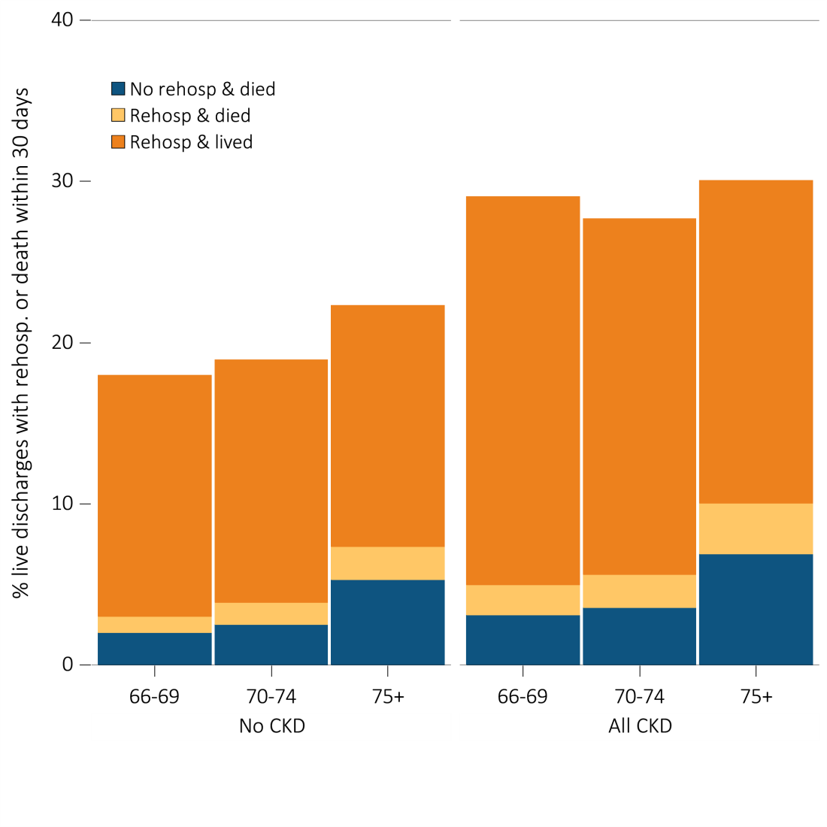
vol 1 Figure 3.12 Unadjusted percentage readmitted to the hospital within 30 days of discharge, among Medicare patients aged 66 and older, discharged alive from an all-cause index hospitalization between January 1 and December 1, by age and CKD status, 2012
Data source: Medicare 5 percent sample. January 1, 2012 point prevalent, Medicare patients age 66 and older, discharged alive from an all-cause index hospitalization between January 1, 2012, and December 1, 2012; unadjusted. Abbreviations: CKD, chronic kidney disease; Rehosp, rehospitalized.

Slide 19
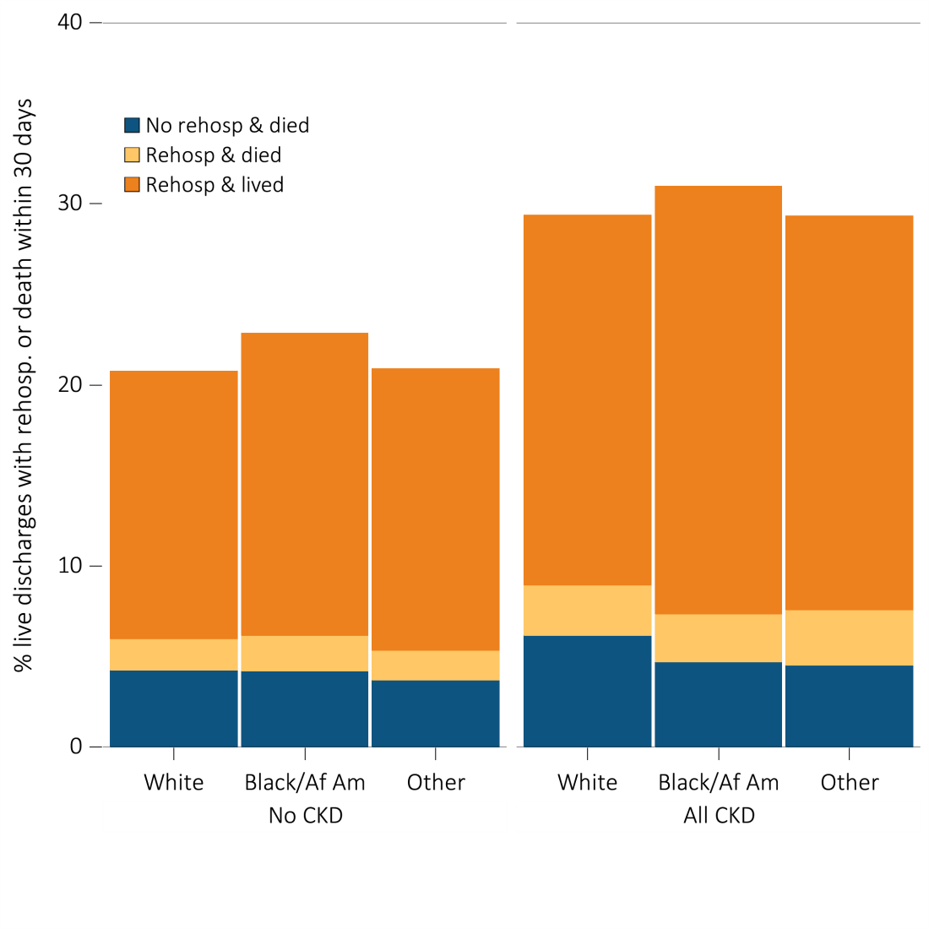
vol 1 Figure 3.13 Unadjusted percentage readmitted to the hospital within 30 days of discharge, among Medicare patients aged 66 and older, discharged alive from an all-cause index hospitalization between January 1 and December 1, by race and CKD status, 2012
Data Source: Medicare 5 percent sample. January 1, 2012 point prevalent, Medicare patients age 66 and older, discharged alive from an all-cause index hospitalization between January 1, 2012, and December 1, 2012; unadjusted. Abbreviations: Af Am, African American; CKD, chronic kidney disease; Rehosp, rehospitalized.

Slide 20
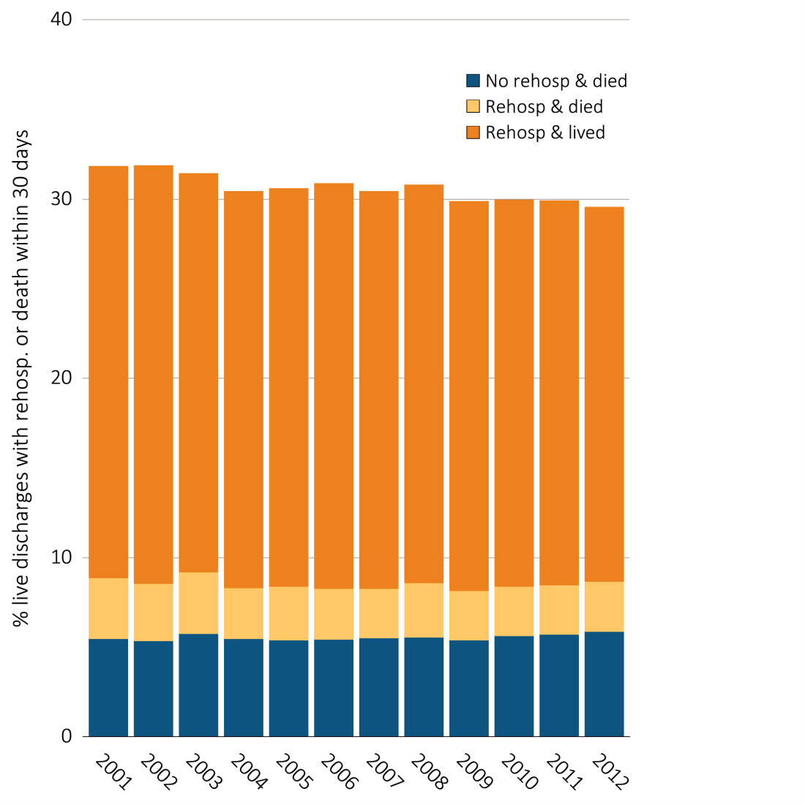
vol 1 Figure 3.14 Adjusted percentage readmitted to the hospital within 30 days of discharge, among Medicare CKD patients aged 66 and older, discharged alive from an all-cause index hospitalization between January 1 and December 1, by year, 2001-2012
Data source: Medicare 5 percent sample. January 1, 2012 of each reported year point prevalent, Medicare patients age 66 and older with CKD (defined during the prior year) discharged alive from an all-cause index hospitalization between January 1 and December 1 of the reported year. Adj: age/sex/race. Ref: 2012. Abbreviations: CKD, chronic kidney disease; Rehosp, rehospitalized.

Slide 21
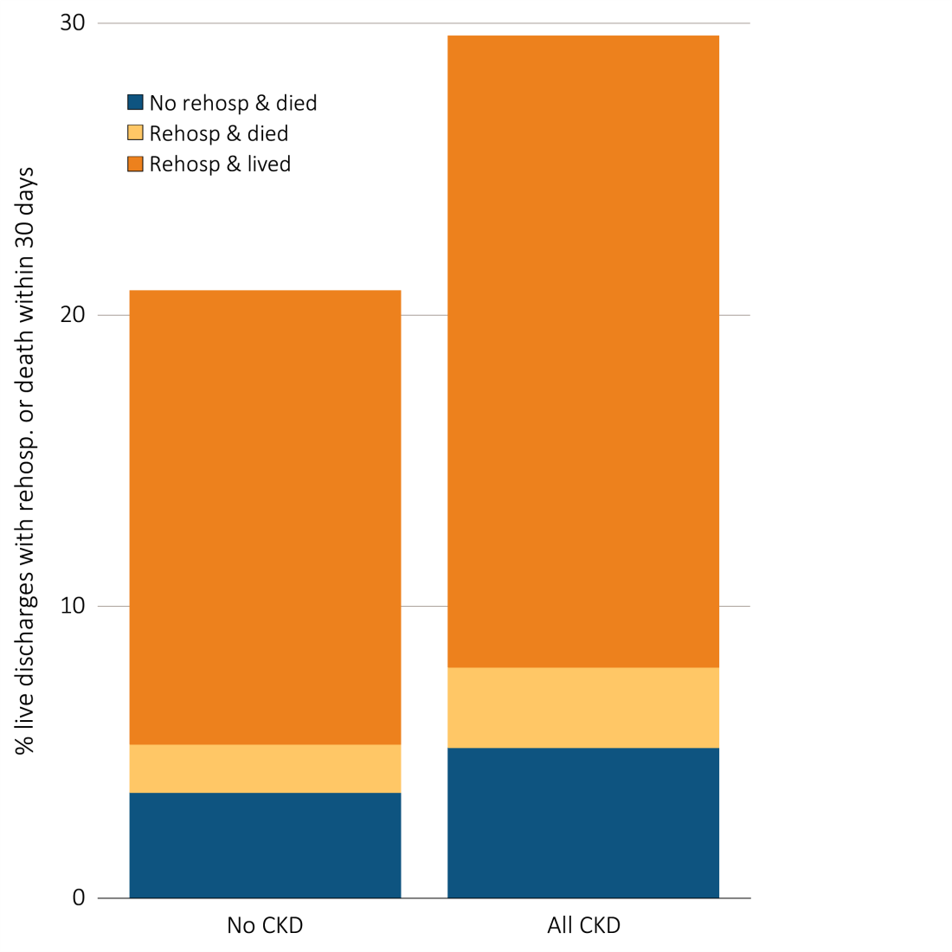
vol 1 Figure 3.15 Unadjusted percentage readmitted to the hospital within 30 days of discharge, among Medicare patients aged 66 and older, discharged alive from a cardiovascular-related index hospitalization between January 1 and December 1, by CKD status, 2012
Data Source: Medicare 5 percent sample. January 1, 2012 point prevalent, Medicare patients age 66 and older discharged alive from a cardiovascular-related index hospitalization between January 1, 2012, and December 1, 2012; unadjusted. Abbreviations: CKD, chronic kidney disease; Rehosp, rehospitalized.

