Slide 2
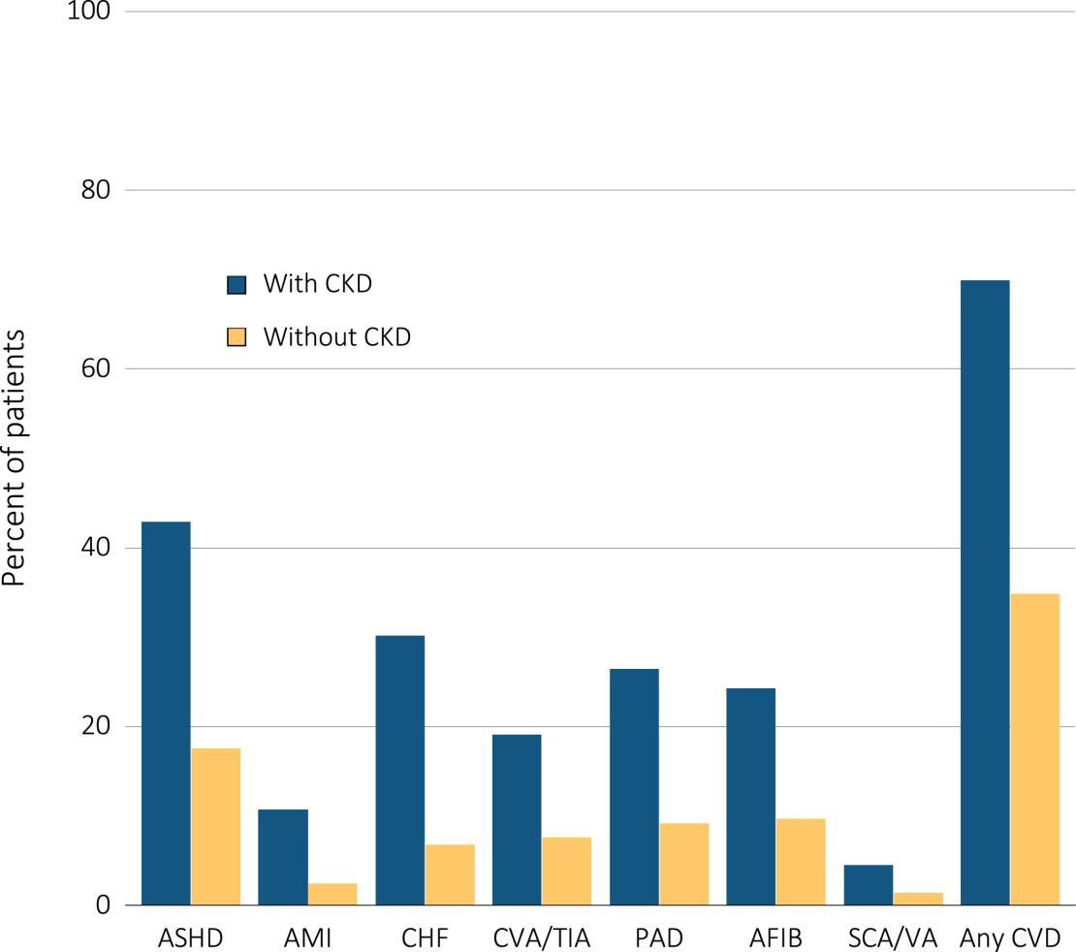
vol1 Figure 4.1 Cardiovascular disease in patients with or without CKD, 2012
Data Source: Medicare 5 percent sample. Patients age 66 and older, alive, without end-stage renal disease, and residing in the U.S. on 12/31/2012 with fee-for-service coverage for the entire calendar year. Abbreviations: AFIB, atrial fibrillation; AMI, acute myocardial infarction; ASHD, atherosclerotic heart disease; CHF, congestive heart failure; CKD, chronic kidney disease; CVA/TIA, cerebrovascular accident/transient ischemic attack; CVD, cardiovascular disease; PAD, peripheral arterial disease; SCA/VA, sudden cardiac arrest and ventricular arrhythmias.

Slide 3
vol1 Table 4.1 Prevalence of cardiovascular comorbidities & procedures (percent), by CKD status, age, race & sex, 2012
Cardiovascular Comorbiditiesª
 | Overall | 66-69 | 70-74 | 75-84 | 85+ | White | Black / Af Am | Other | Male | Female
Atherosclerotic heart disease (ASHD)
Without CKD | 17.4 | 11.6 | 15.4 | 20.6 | 23.1 | 17.9 | 14.2 | 14.7 | 23.2 | 13.3
Any CKD | 42.9 | 35.2 | 39.5 | 44.8 | 46.1 | 43.9 | 36.4 | 40.1 | 50.2 | 36.3
Acute myocardial infarction (AMI)
Without CKD | 2.4 | 1.7 | 2.1 | 2.7 | 3.3 | 2.5 | 1.9 | 1.6 | 3.1 | 1.9
Any CKD | 10.6 | 9.7 | 9.7 | 10.6 | 11.8 | 11.0 | 8.9 | 8.1 | 12.6 | 8.9
Congestive heart failure (CHF)
Without CKD | 6.7 | 3.3 | 4.5 | 7.6 | 14.0 | 6.7 | 8.1 | 5.4 | 6.9 | 6.6
Any CKD | 30.1 | 22.2 | 24.3 | 29.4 | 39.5 | 30.1 | 32.3 | 26.4 | 30.2 | 30.1
Cerebrovascular accident/transient ischemic attack (CVA-TIA)
Without CKD | 7.5 | 4.3 | 5.9 | 9.1 | 12.1 | 7.5 | 8.5 | 6.4 | 7.5 | 7.6
Any CKD | 19.1 | 14.7 | 16.2 | 20.0 | 21.9 | 18.9 | 21.4 | 17.8 | 19.0 | 19.2
Peripheral artery disease (PAD)
Without CKD | 9.1 | 4.6 | 6.4 | 10.5 | 17.9 | 9.2 | 10.1 | 7.1 | 9.2 | 9.1
Any CKD | 26.4 | 19.5 | 22.4 | 26.8 | 32.0 | 26.6 | 26.2 | 22.9 | 27.3 | 25.6
Atrial fibrillation (AFIB)
Without CKD | 9.6 | 4.3 | 6.6 | 11.9 | 18.0 | 10.3 | 4.8 | 5.3 | 10.8 | 8.7
Any CKD | 24.2 | 14.1 | 18.2 | 25.0 | 32.3 | 26.0 | 14.6 | 16.1 | 26.5 | 22.1
Cardiac arrest and ventricular arrhythmias (SCA/VA)
Without CKD | 1.3 | 0.9 | 1.2 | 1.6 | 1.6 | 1.4 | 1.1 | 0.8 | 1.9 | 0.9
Any CKD | 4.5 | 4.0 | 4.5 | 4.8 | 4.3 | 4.6 | 4.5 | 2.9 | 6.2 | 3.0
Data Source: Medicare 5 percent sample. Patients age 66 and older, alive, without end-stage renal disease, and residing in the U.S. on 12/31/2012 with fee-for-service coverage for the entire calendar year. ª The denominators for all cardiovascular comorbidities are Medicare enrollees age 66+. Abbreviations: AFIB, atrial fibrillation; AMI, acute myocardial infarction; ASHD, atherosclerotic heart disease; CHF, congestive heart failure; CKD, chronic kidney disease; CVA/TIA, cerebrovascular accident/transient ischemic attack; PAD, peripheral arterial disease; SCA/VA, sudden cardiac arrest and ventricular arrhythmias; CVD, cardiovascular disease; Af Am, African American.

Slide 4
vol1 Table 4.1 Prevalence of cardiovascular comorbidities & procedures (percent), by CKD status, age, race & sex, 2012 (cont.)
Cardiovascular Procedures^{b}
 | Overall | 66-69 | 70-74 | 75-84 | 85+ | White | Black / Af Am | Other | Male | Female
Revascularization - percutaneous coronary interventions (PCI)
Without CKD | 4.2 | 6.2 | 5.1 | 3.9 | 2.1 | 4.3 | 3.5 | 3.8 | 4.7 | 3.6
Any CKD | 5.3 | 7.8 | 6.7 | 5.5 | 3.3 | 5.4 | 4.7 | 4.8 | 5.9 | 4.6
Revascularization - coronary artery bypass graft (CABG)
Without CKD | 1.1 | 1.7 | 1.4 | 1.1 | 0.3 | 1.2 | 0.8 | 0.9 | 1.4 | 0.8
Any CKD | 1.8 | 2.9 | 2.8 | 1.9 | 0.6 | 1.9 | 1.3 | 1.3 | 2.2 | 1.2
Implantable cardioverter defibrillators & cardiac resynchronization therapy with defibrillator (ICD/CRT-D)
Without CKD | 0.8 | 1.4 | 1.1 | 0.9 | 0.3 | 0.8 | 0.5 | 0.8 | 1.3 | 0.4
Any CKD | 1.2 | 2.0 | 1.8 | 1.5 | 0.5 | 1.3 | 0.9 | 1.2 | 1.9 | 0.6
Data Source: Medicare 5 percent sample. Patients age 66 and older, alive, without end-stage renal disease, and residing in the U.S. on 12/31/2012 with fee-for-service coverage for the entire calendar year. ^{b} The denominators for PCI and CABG are Medicare enrollees age 66+ with ASHD. The denominator for ICD/CRT-D is Medicare enrollees age 66+ with CHF. Abbreviations: Af Am, African American; CKD, chronic kidney disease; CVD, cardiovascular disease; CABG, coronary artery bypass grafting; ICD/CRT-D, implantable cardioverter defibrillators/cardiac resynchronization therapy with defibrillator devices; PCI, percutaneous coronary interventions.

Slide 5
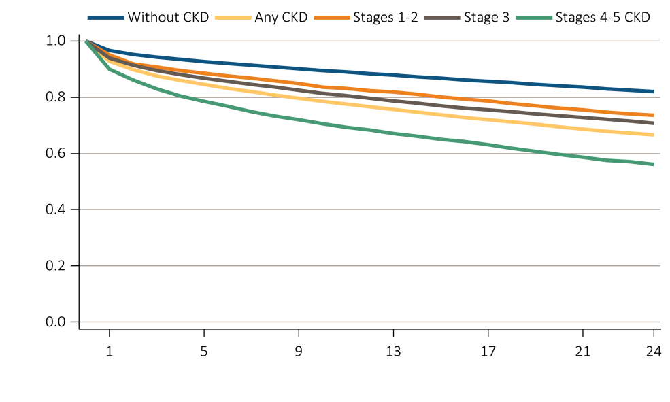
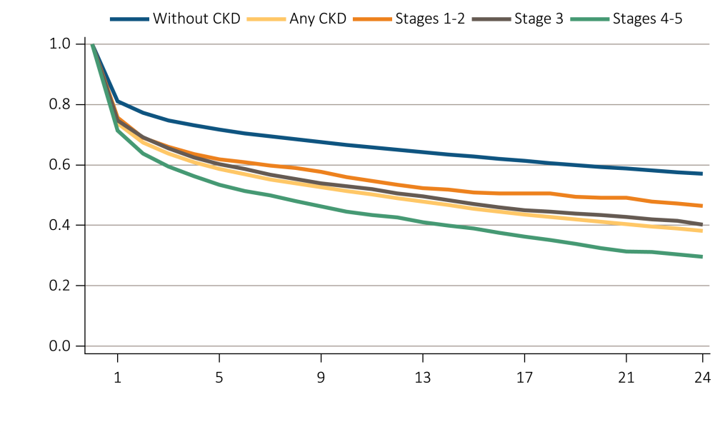
vol1 Figure 4.2 Survival of patients with a cardiovascular diagnosis or procedure, by CKD status, 2010-2012
ASHD
AMI
Data Source: Medicare 5 percent sample. Patients age 66 and older, alive, without end-stage renal disease, and residing in the U.S. on 12/31/2012 with fee-for-service coverage for the entire calendar year. Abbreviations: AMI, acute myocardial infarction; ASHD, atherosclerotic heart disease; CKD, chronic kidney disease.

Slide 6
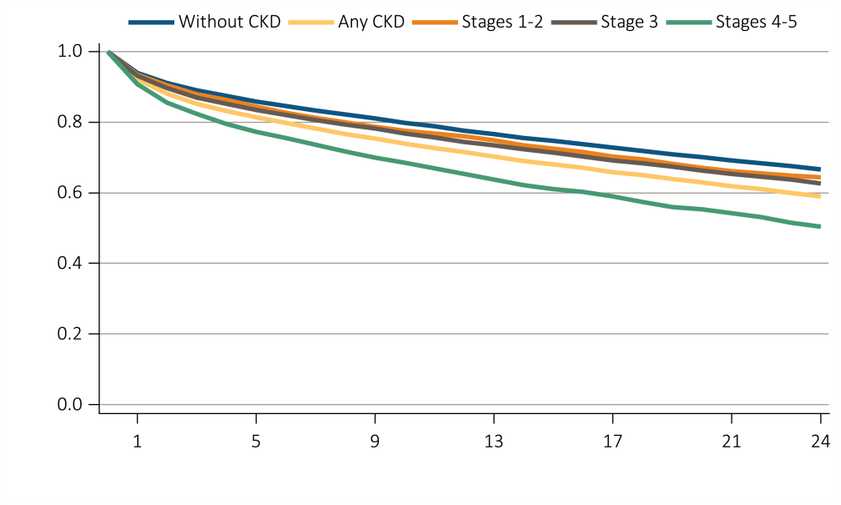
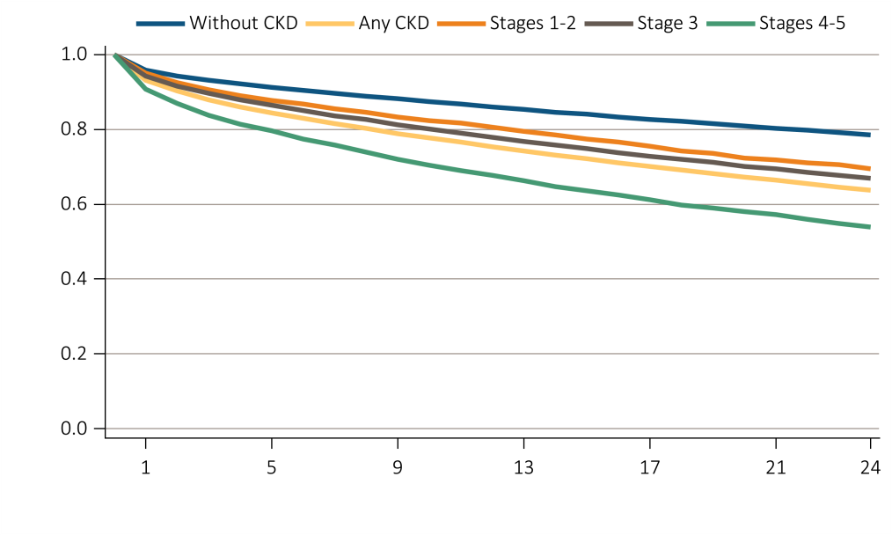
vol1 Figure 4.2 Survival of patients with a cardiovascular diagnosis or procedure, by CKD status, 2010-2012 (cont.)
CHF
CVA / TIA
Data Source: Medicare 5 percent sample. Patients age 66 and older, alive, without end-stage renal disease, and residing in the U.S. on 12/31/2012 with fee-for-service coverage for the entire calendar year. Abbreviations: CHF, congestive heart failure; CKD, chronic kidney disease; CVA/TIA, cerebrovascular accident/transient ischemic attack.

Slide 7
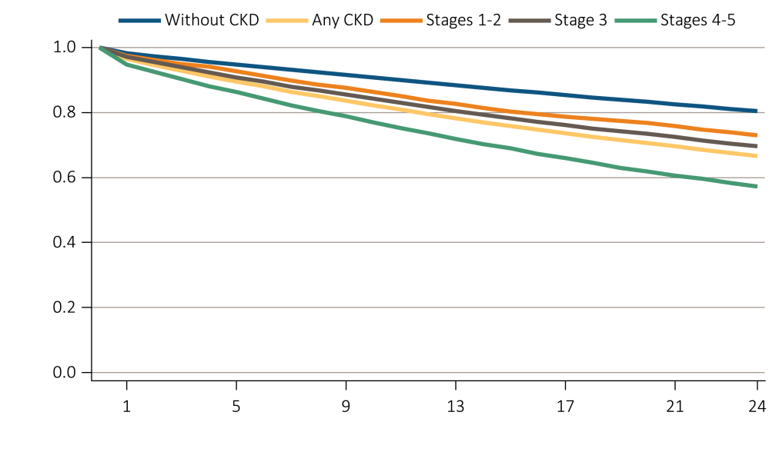
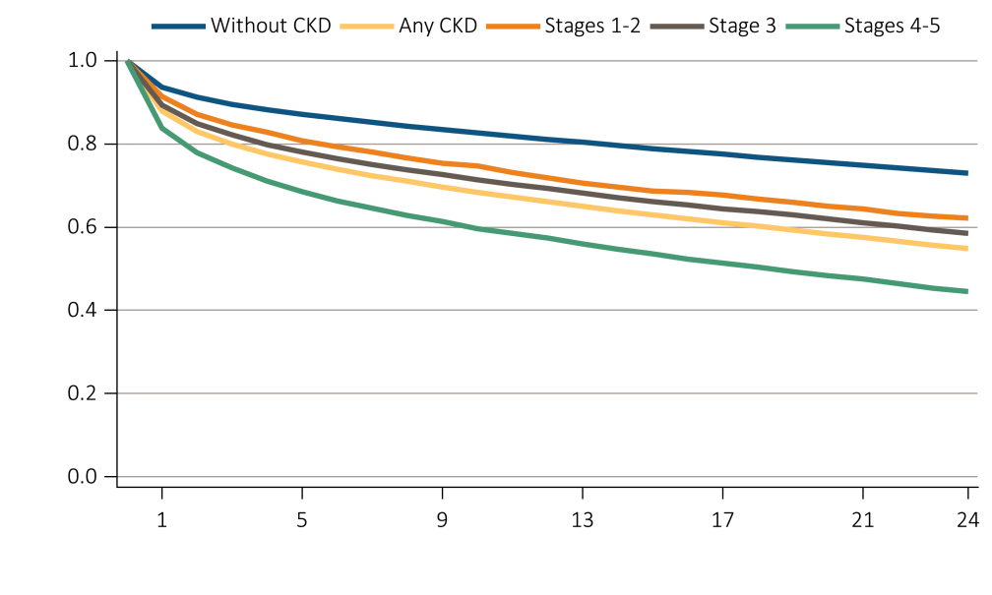
vol1 Figure 4.2 Survival of patients with a cardiovascular diagnosis or procedure, by CKD status, 2010-2012 (cont.)
PAD
AFIB
Data Source: Medicare 5 percent sample. Patients age 66 and older, alive, without end-stage renal disease, and residing in the U.S. on 12/31/2012 with fee-for-service coverage for the entire calendar year. Abbreviations: AFIB, atrial fibrillation; CKD, chronic kidney disease; PAD, peripheral arterial disease.

Slide 8
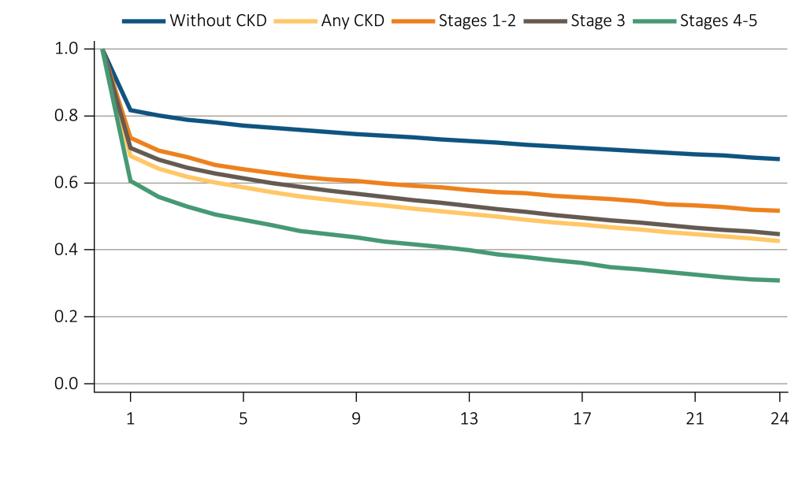
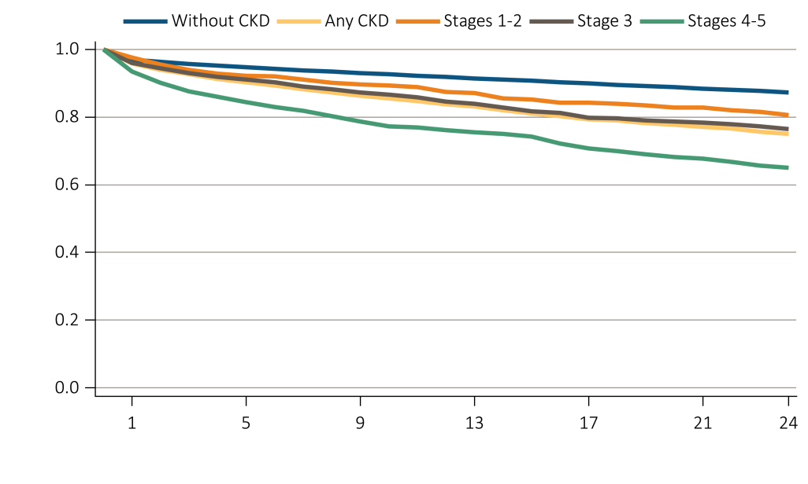
vol1 Figure 4.2 Survival of patients with a cardiovascular diagnosis or procedure, by CKD status, 2010-2012 (cont.)
SCA/VA
PCI
Data Source: Medicare 5 percent sample. Patients age 66 and older, alive, without end-stage renal disease, and residing in the U.S. on 12/31/2012 with fee-for-service coverage for the entire calendar year. Abbreviations: CKD, chronic kidney disease; PCI, percutaneous coronary interventions; SCA/VA, sudden cardiac arrest and ventricular arrhythmias.

Slide 9
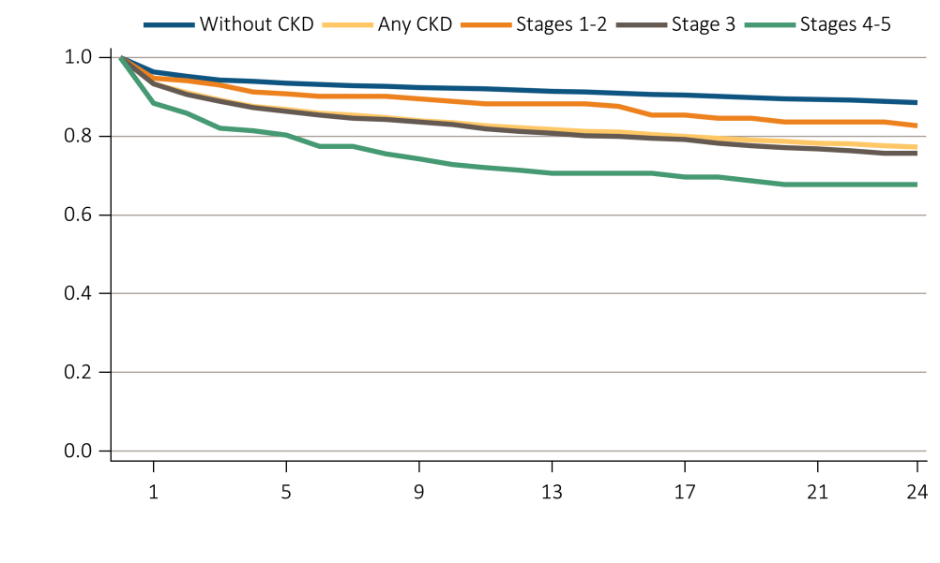
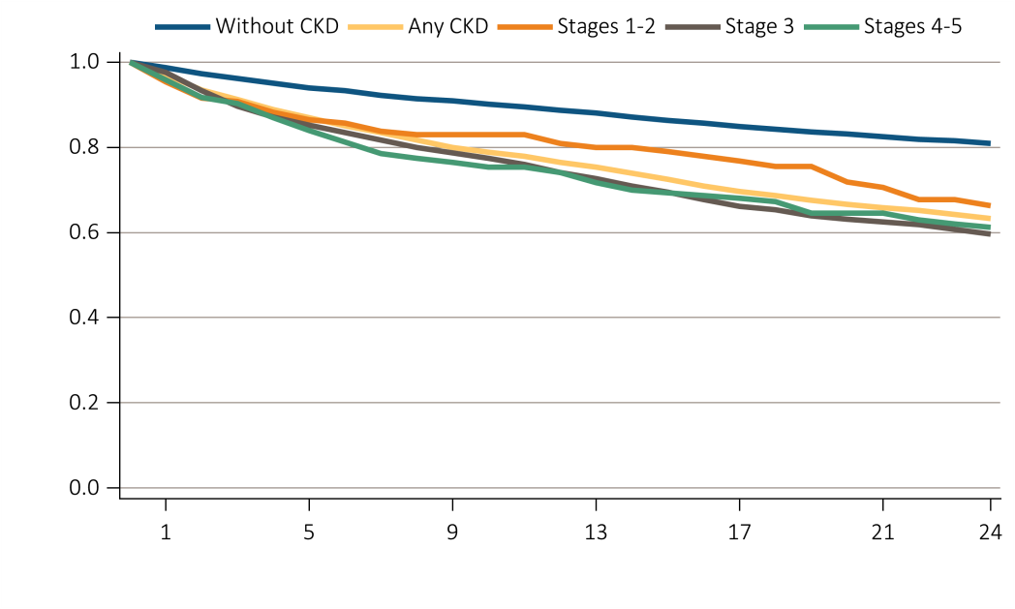
vol1 Figure 4.2 Survival of patients with a cardiovascular diagnosis or procedure, by CKD status, 2010-2012 (cont.)
CABG
ICD / CRT / D
Data Source: Medicare 5 percent sample. Patients age 66 and older, alive, without end-stage renal disease, and residing in the U.S. on 12/31/2012 with fee-for-service coverage for the entire calendar year. Abbreviations: CABG, coronary artery bypass grafting; CKD, chronic kidney disease; ICD/CRT-D, implantable cardioverter defibrillators/cardiac resynchronization therapy with defibrillator devices.

Slide 10
vol1 Table 4.2 Characteristics of patients with heart failure, by CKD status, 2012
 |  | Systolic +/- Diastolic heart failure |  | Diastolic only heart failure |  | Heart failure, unspecified
 |  | Without CKD | Any CKD | Without CKD | Any CKD | Without CKD | Any CKD
Age:
66-69 |  | 13.9 | 10.2 | 10.2 | 9.4 | 10.5 | 9.0
70-74 |  | 18.2 | 16.9 | 15.2 | 14.0 | 15.7 | 14.9
75-84 |  | 39.6 | 40.5 | 39.0 | 39.1 | 37.2 | 38.8
85+ |  | 28.3 | 32.4 | 35.7 | 37.4 | 36.6 | 37.3
Male |  | 52.7 | 56.3 | 31.1 | 35.3 | 39.0 | 45.4
Female |  | 47.3 | 43.7 | 68.9 | 64.7 | 61.0 | 54.6
White |  | 88.0 | 84.1 | 87.7 | 84.1 | 86.0 | 82.4
Black/African American |  | 7.7 | 11.2 | 8.3 | 11.4 | 9.2 | 12.1
Other race |  | 4.3 | 4.7 | 4.1 | 4.5 | 4.8 | 5.5
Non-diabetes |  | 61.4 | 43.6 | 61.7 | 42.9 | 62.0 | 45.3
Diabetes |  | 38.6 | 56.4 | 38.3 | 57.1 | 38.0 | 54.7
Data Source: Medicare 5 percent sample. Patients age 66 and older, alive, without end-stage renal disease, and residing in the U.S. on 12/31/2012 with fee-for-service coverage for the entire calendar year. Abbreviation: CKD, chronic kidney disease.

Slide 11
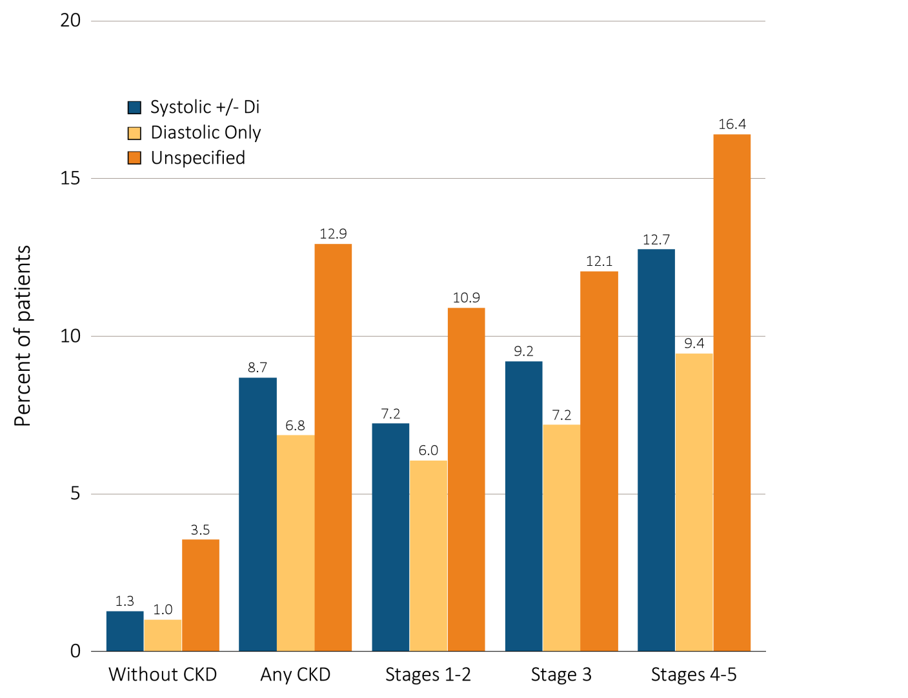
vol1 Figure 4.3 Heart failure in patients with or without CKD, 2012
Data Source: Medicare 5 percent sample. Patients age 66 and older, alive, without end-stage renal disease, and residing in the U.S. on 12/31/2012 with fee-for-service coverage for the entire calendar year. Abbreviation: CKD, chronic kidney disease.

Slide 12
vol1 Table 4.3 Adjusted hazard ratio of all-cause death (a) associated with the presence of CHF in patients with CKD, and (b) associated with the presence of CKD in patients with CHF, 2011-2012
(a)
 |  | Hazard ratio | Confidence Interval | p-value
Age: | 66-69 | reference
 | 70-74 | 1.25 | 1.18 - 1.33 | <.0001
 | 75-84 | 1.83 | 1.74 - 1.93 | <.0001
 | 85+ | 3.63 | 3.44 - 3.82 | <.0001
Male |  | reference
Female |  | 0.83 | 0.81 - 0.85 | <.0001
White |  | reference
Black/African American |  | 0.95 | 0.92 - 0.99 | 0.0223
Other race |  | 0.82 | 0.77 - 0.87 | <.0001
CHF | Yes vs. No | 2.57 | 2.50 - 2.63 | <.0001
Diabetes | Yes vs. No | 1.08 | 1.06 - 1.11 | <.0001
Hypertension | Yes vs. No | 0.88 | 0.83 - 0.92 | <.0001
Data Source: Medicare 5 percent sample. Patients age 66 and older, alive, without end-stage renal disease, and residing in the U.S. on 12/31/2012 with fee-for-service coverage for the entire calendar year. Abbreviations: CKD, chronic kidney disease; CHF, congestive heart failure.

Slide 13
vol1 Table 4.3 Adjusted hazard ratio of all-cause death (a) associated with the presence of CHF in patients with CKD, and (b) associated with the presence of CKD in patients with CHF, 2011-2012 (cont.)
(b)
 |  | Hazard ratio | Confidence Interval | p-value
Age: | 66-69 | reference
 | 70-74 | 1.18 | 1.11 - 1.25 | <.0001
 | 75-84 | 1.74 | 1.66 - 1.83 | <.0001
 | 85+ | 3.30 | 3.14 - 3.47 | <.0001
Male |  | reference
Female |  | 0.87 | 0.85 - 0.89 | <.0001
White |  | reference
Black/African American |  | 0.89 | 0.85 - 0.92 | <.0001
Other race |  | 0.76 | 0.72 - 0.81 | <.0001
CKD | Yes vs. No | 1.52 | 1.49 - 1.56 | <.0001
Diabetes | Yes vs. No | 1.09 | 1.07 - 1.12 | <.0001
Hypertension | Yes vs. No | 0.91 | 0.88 - 0.94 | <.0001
Data Source: Medicare 5 percent sample. Patients age 66 and older, alive, without end-stage renal disease, and residing in the U.S. on 12/31/2012 with fee-for-service coverage for the entire calendar year. Abbreviations: CKD, chronic kidney disease; CHF, congestive heart failure.

