Slide 2
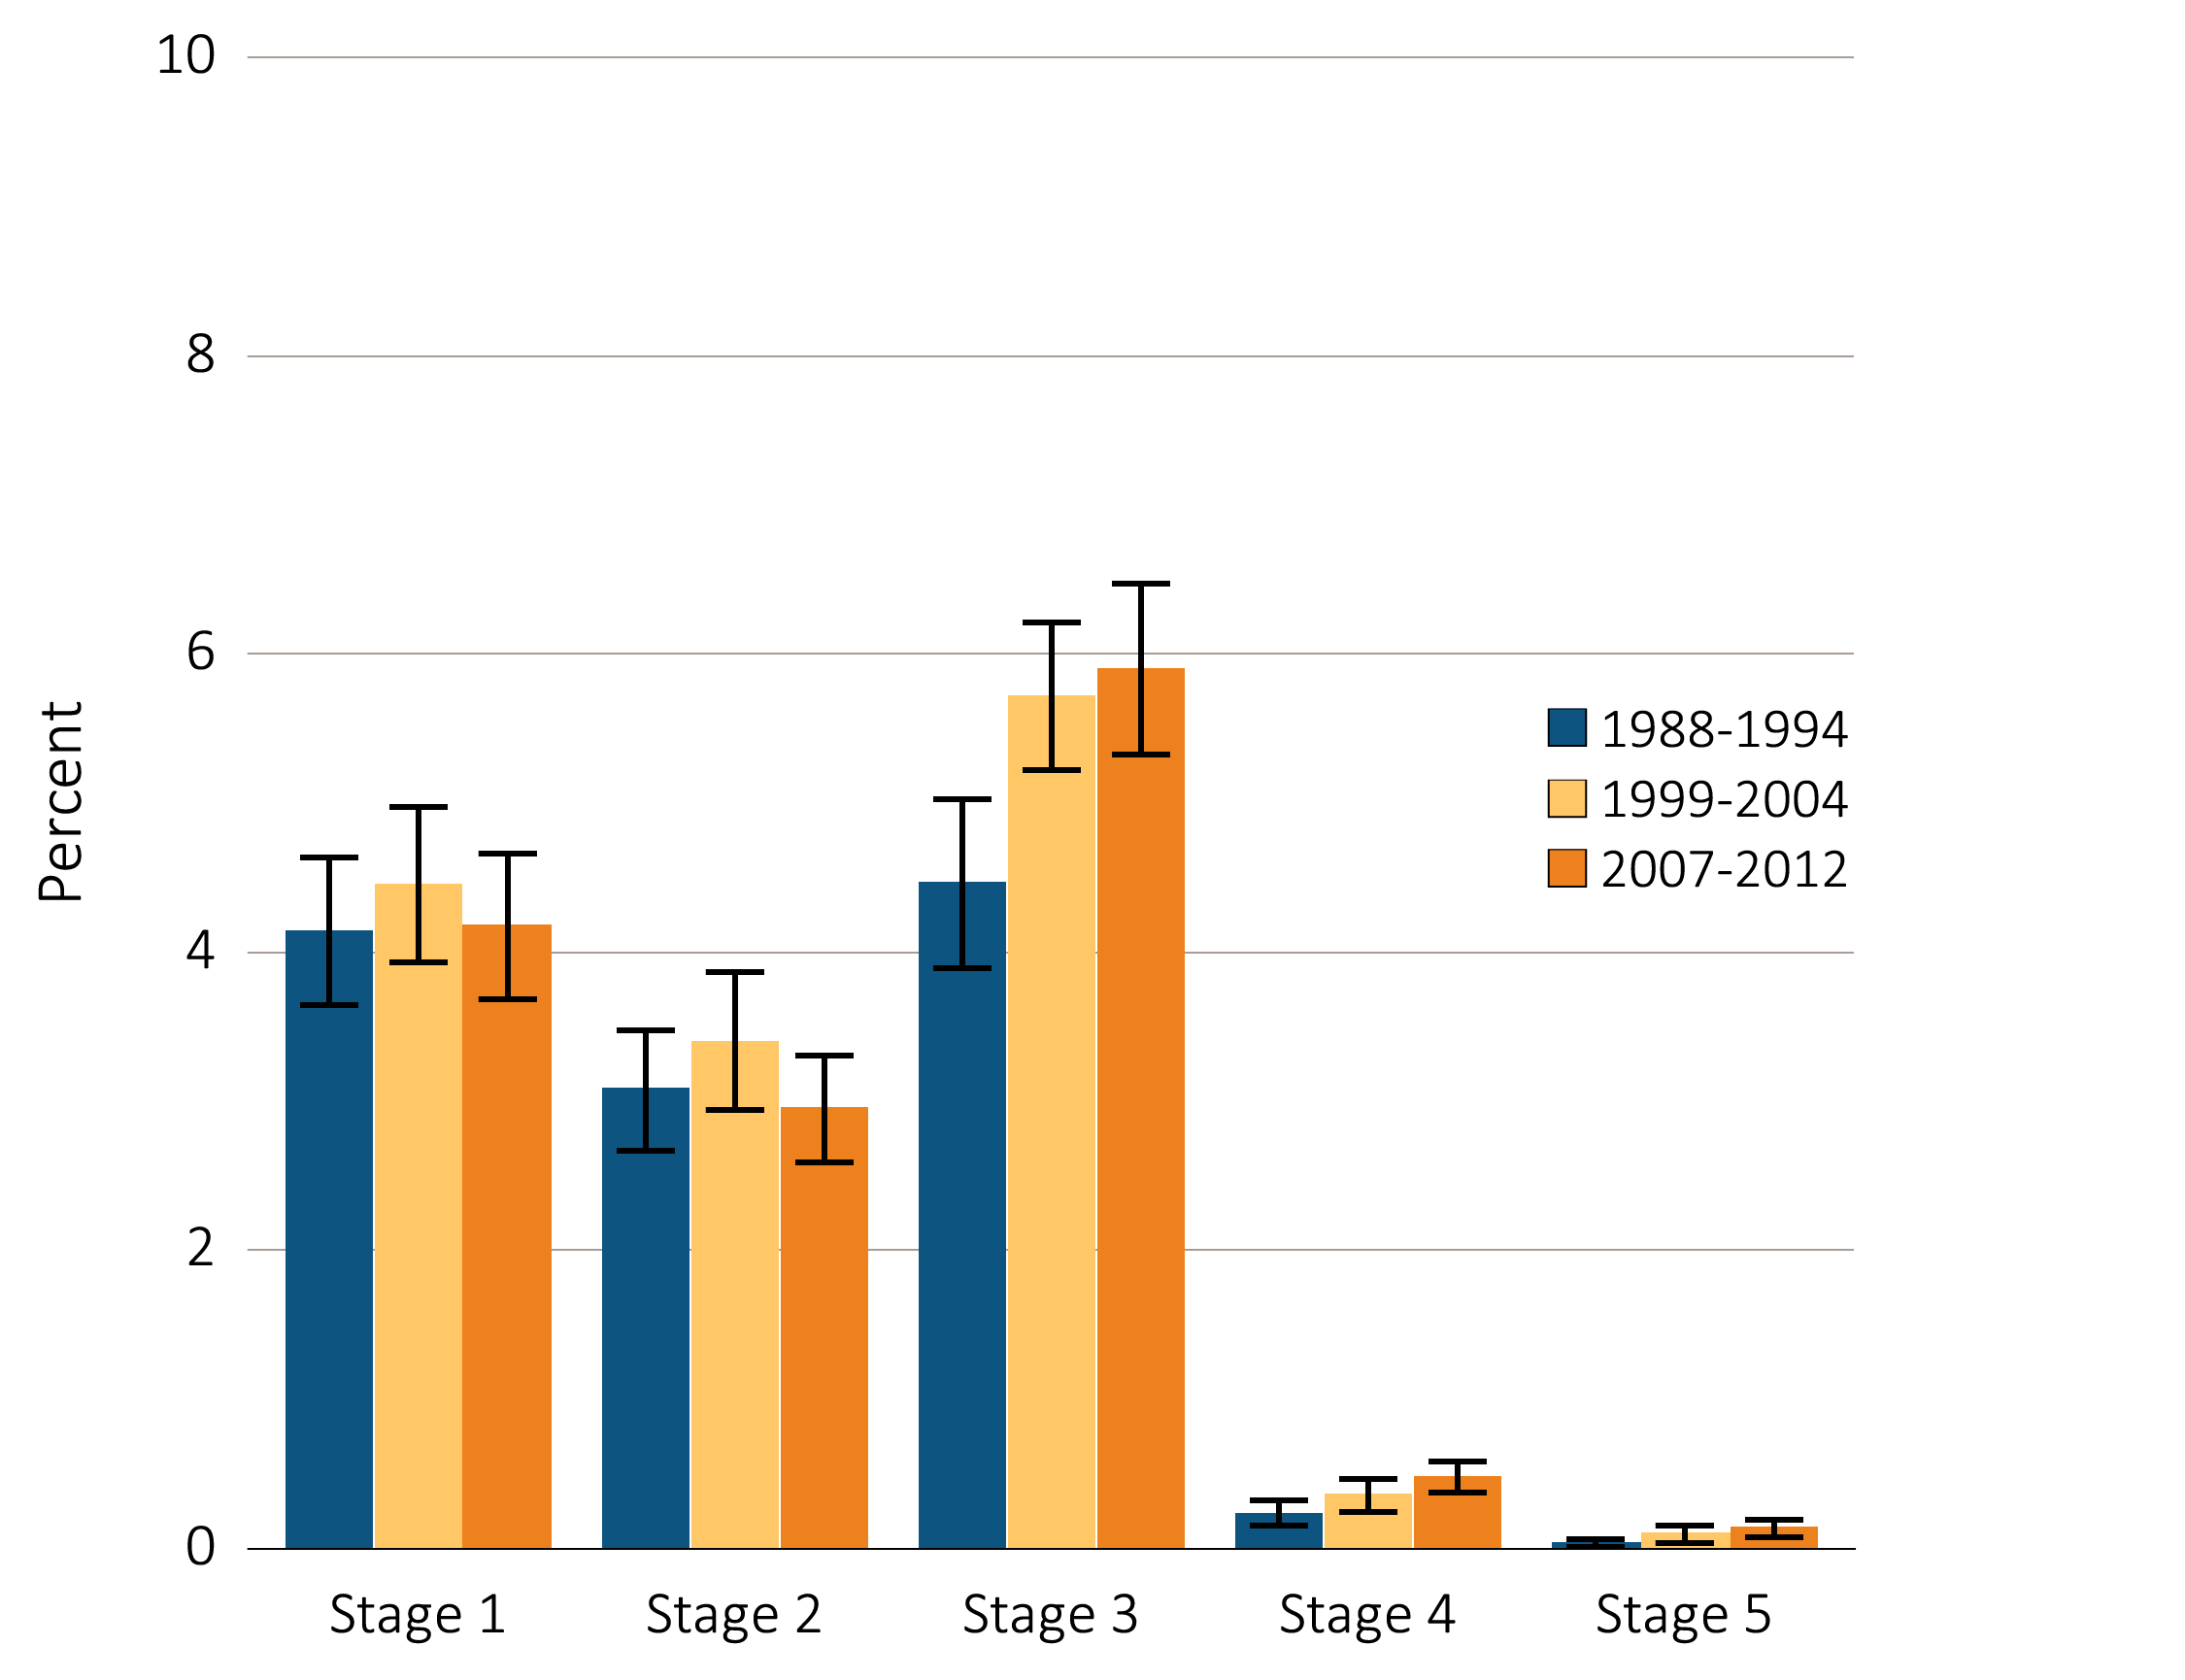
Figure i.1 Prevalence of CKD by stage among NHANES participants, 1988-2012
Stages of CKD – KDOQI 2002 Definitions
Stage 1: eGFR ≥ 90 ml/min/1.73m² and ACR ≥ 30 mg/g
Stage 2: eGFR 60-89 ml/min/1.73m² and ACR ≥ 30 mg/g
Stage 3: eGFR 30-59 ml/min/1.73m²
Stage 4: eGFR 15-29 ml/min/1.73m²
Stage 5: eGFR < 15 ml/min/1.73m²
Data Source: National Health and Nutrition Examination Survey (NHANES), 1988–1994, 1999-2004 & 2005–2012 participants age 20 & older. Whisker lines indicate 95% confidence intervals. Abbreviations: CKD, chronic kidney disease. This graphic also appears as Figure 1.1.

Slide 3
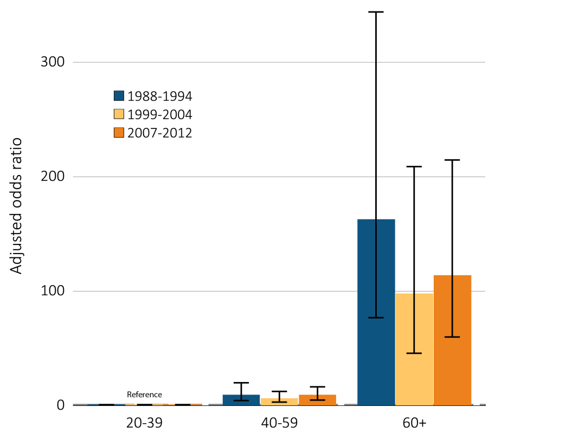
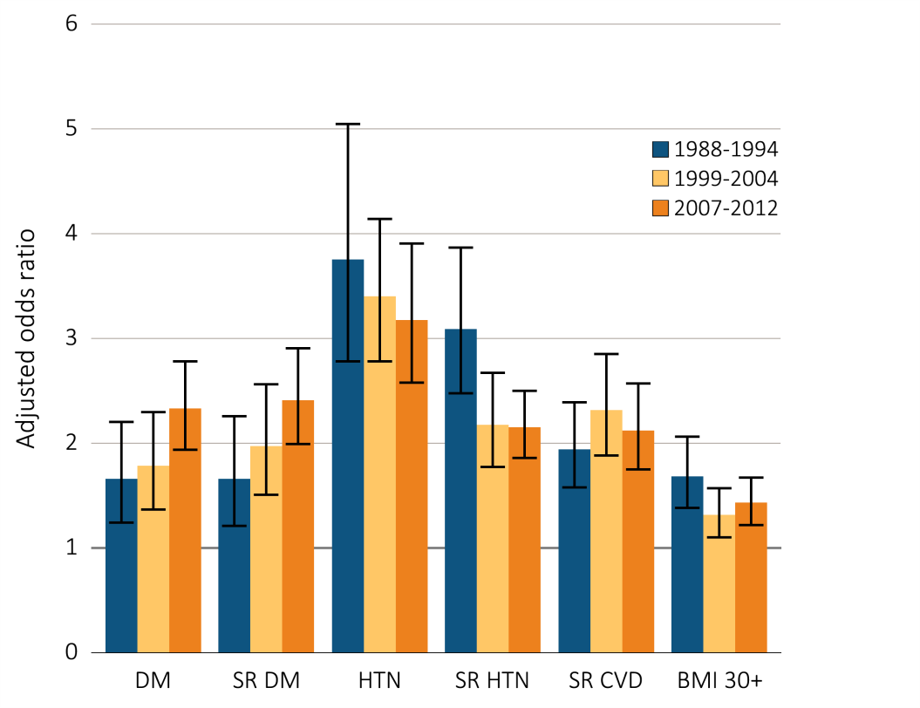
Figure i.2 Adjusted odds ratios of eGFR <60 ml/min/1.73m² in NHANES participants by age & other risk factors, 1998-2012
(A) Age category
(B) CKD risk factor
Data Source: National Health and Nutrition Examination Survey (NHANES), 1988–1994, 1999-2004 & 2007–2012 participants age 20 & older; single-sample estimates of eGFR & ACR. Adj: age, sex, & race; eGFR calculated using the CKD-EPI equation. Whisker lines indicate 95% confidence intervals. Abbreviations: BMI, body mass index; CKD, chronic kidney disease; CVD, cardiovascular disease; DM, diabetes mellitus; HTN, hypertension; SR, self-report. This graphic also appears as Figure 1.9.

Slide 4
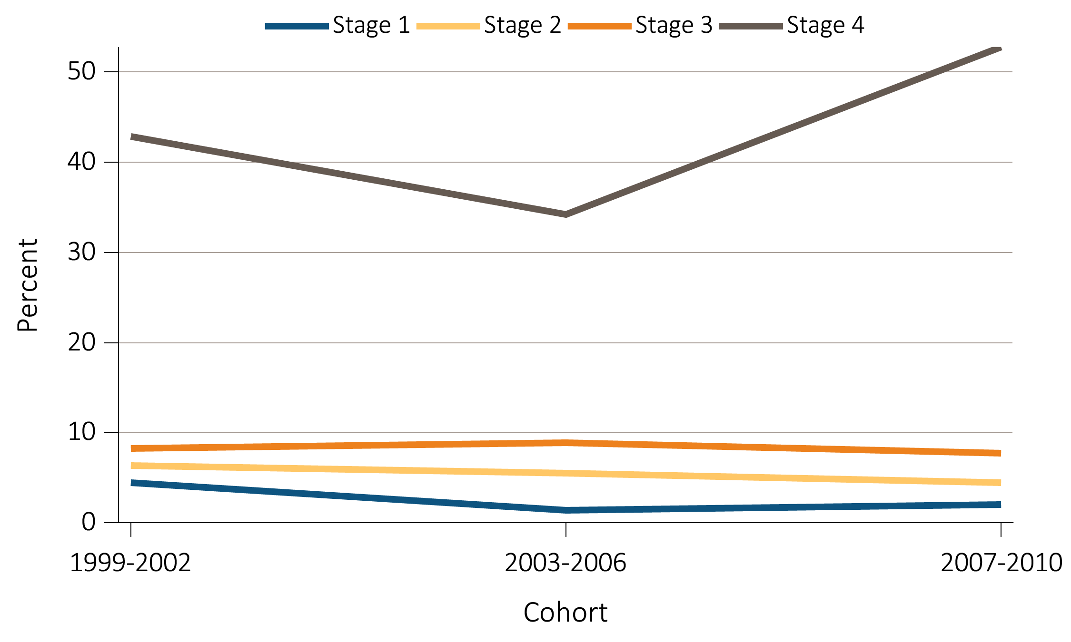
Figure i.3 NHANES participants with CKD aware of their kidney disease, 1999-2010
Data Source: National Health and Nutrition Examination Survey (NHANES), 1988–1994, 1999-2004 & 2007–2012 participants age 20 & older. Abbreviations: CKD, chronic kidney disease. This graphic also appears as Figure 1.11.

Slide 5
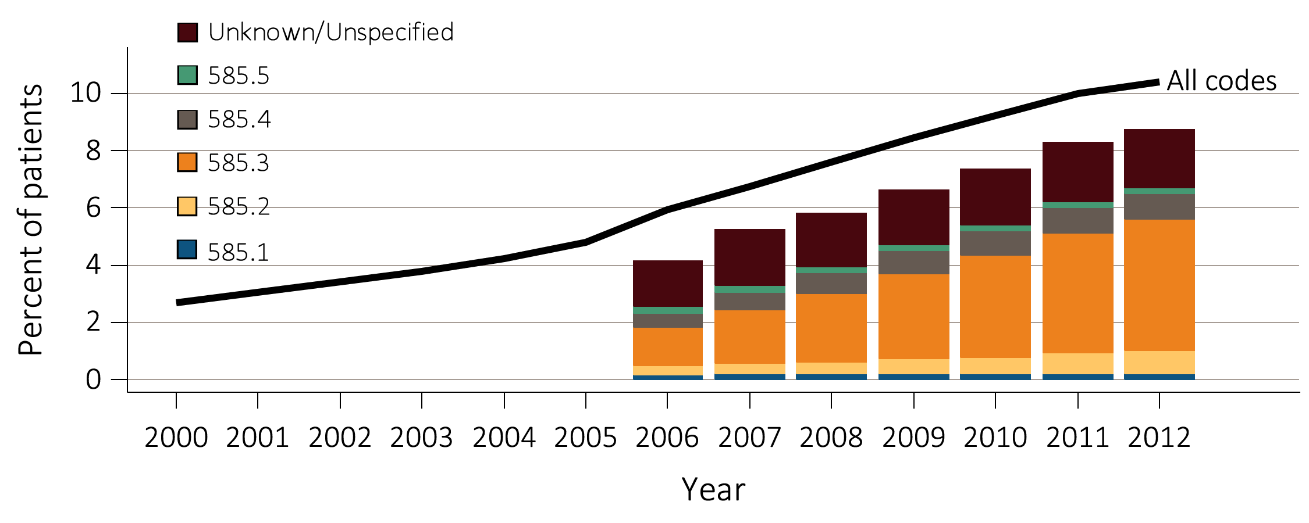
Figure i.4 Temporal trends in CKD prevalence, overall and by CKD stage, among Medicare patients age 65+, 2000-2012
Data Source: Medicare 5 percent sample. This graphic also appears as Figure 2.1.

Slide 6
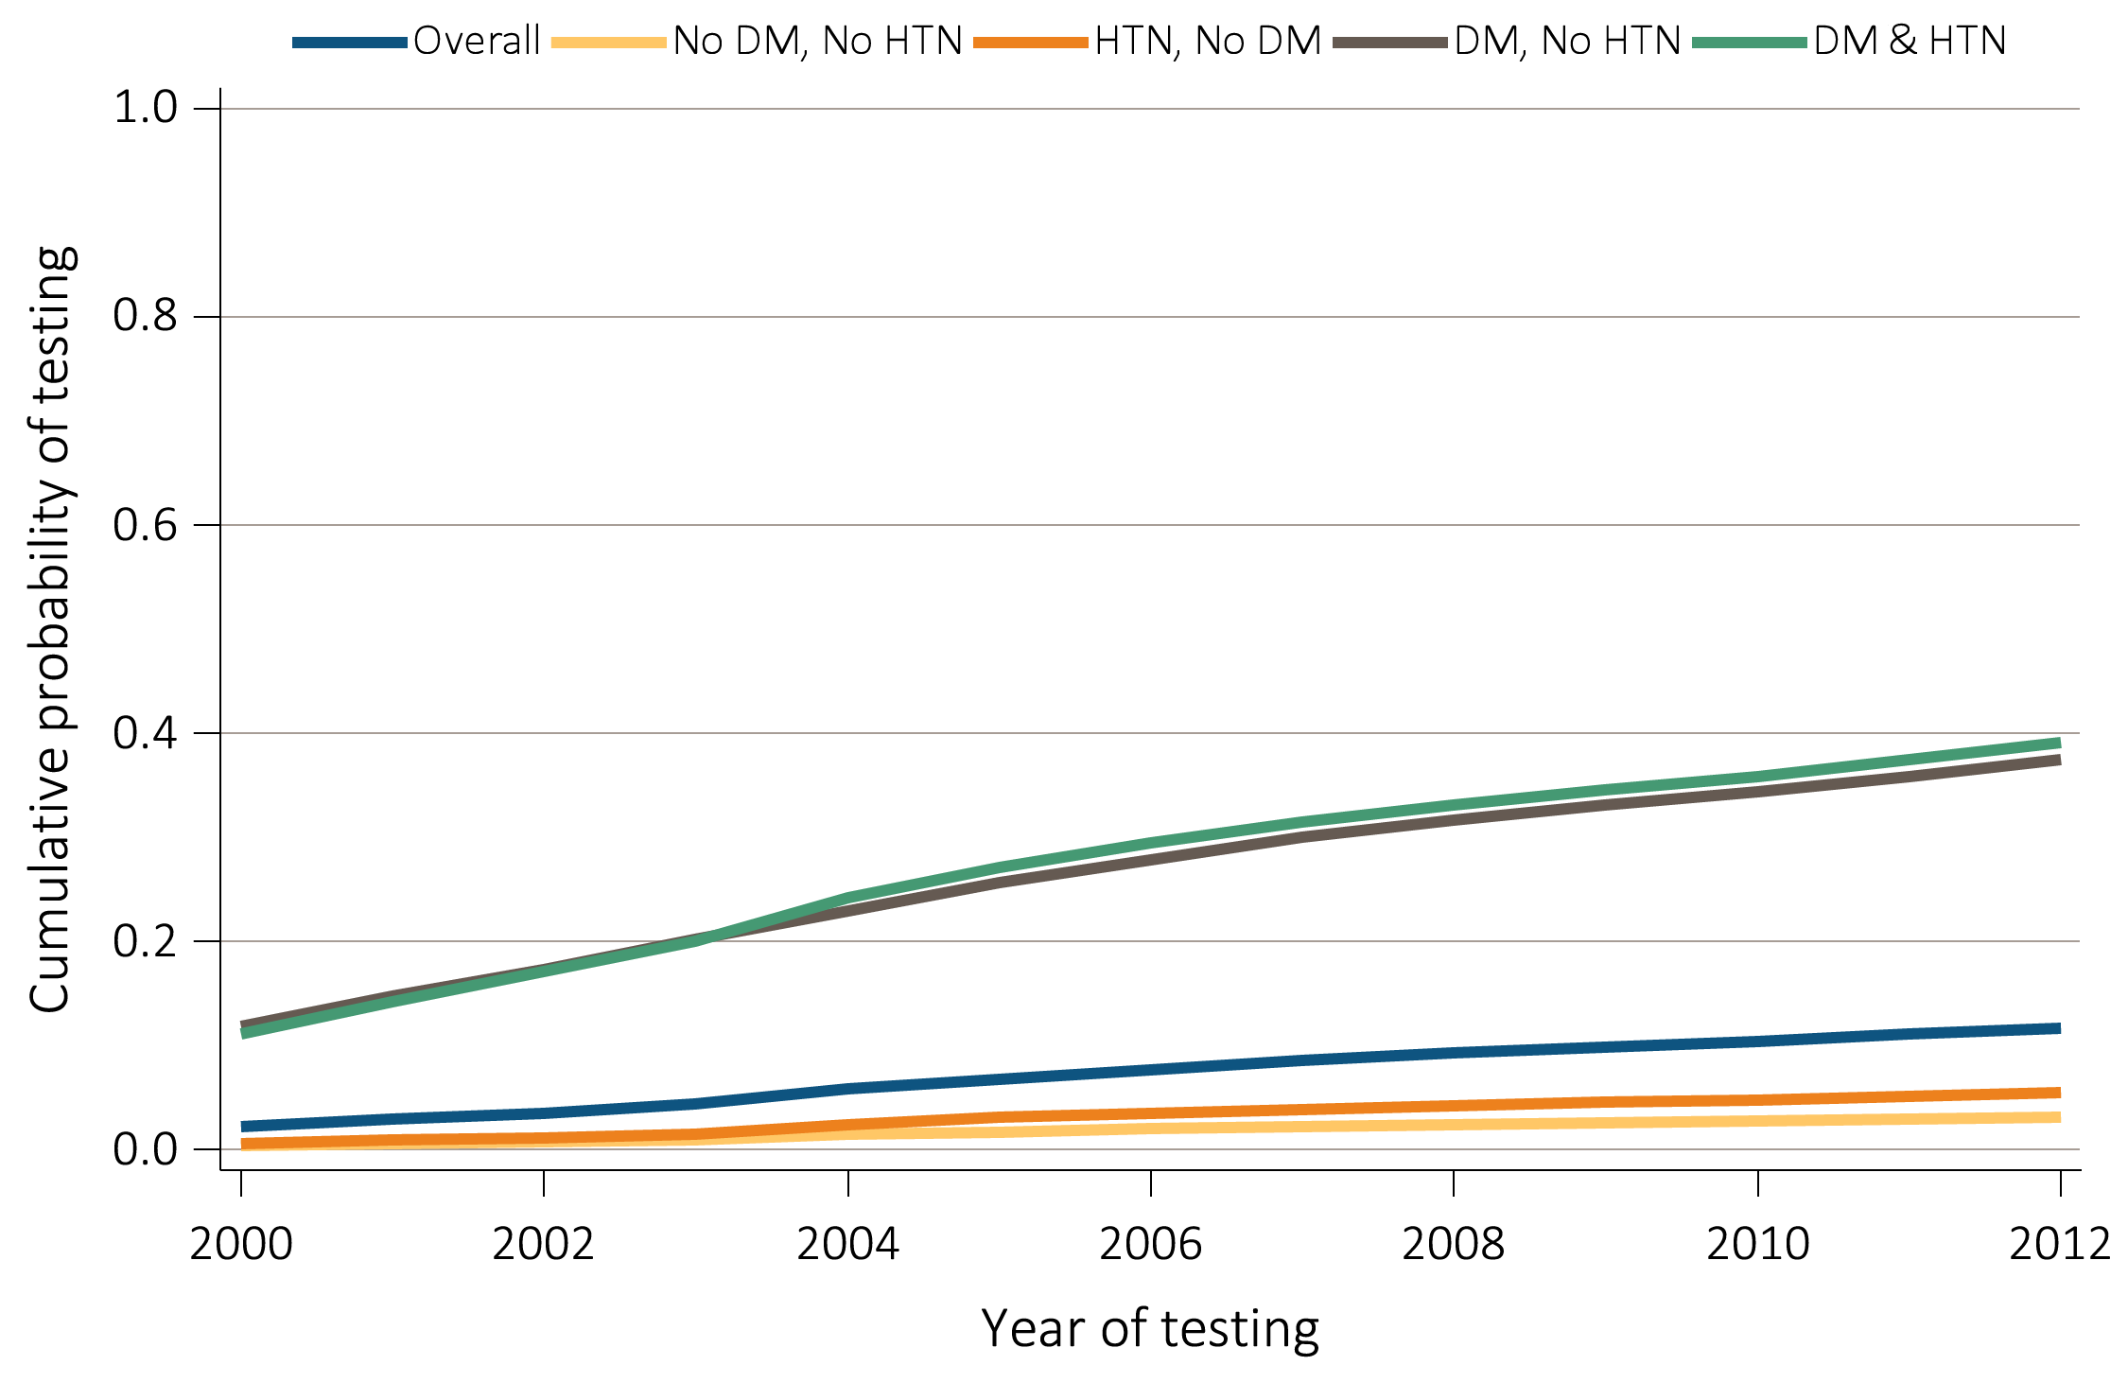
Figure i.5 Unadjusted cumulative probability for urine albumin testing, among Medicare patients age 65+ without a diagnosis of CKD, 2000-2012
Data Source: Medicare patients from the 5 percent sample, age 65 or older with Part A & B coverage in the prior year. Tests tracked during each year. Abbreviations: CKD, chronic kidney disease; DM, diabetes mellitus; HTN, hypertension. This graphic is adapted from Figure 2.3A.

Slide 7
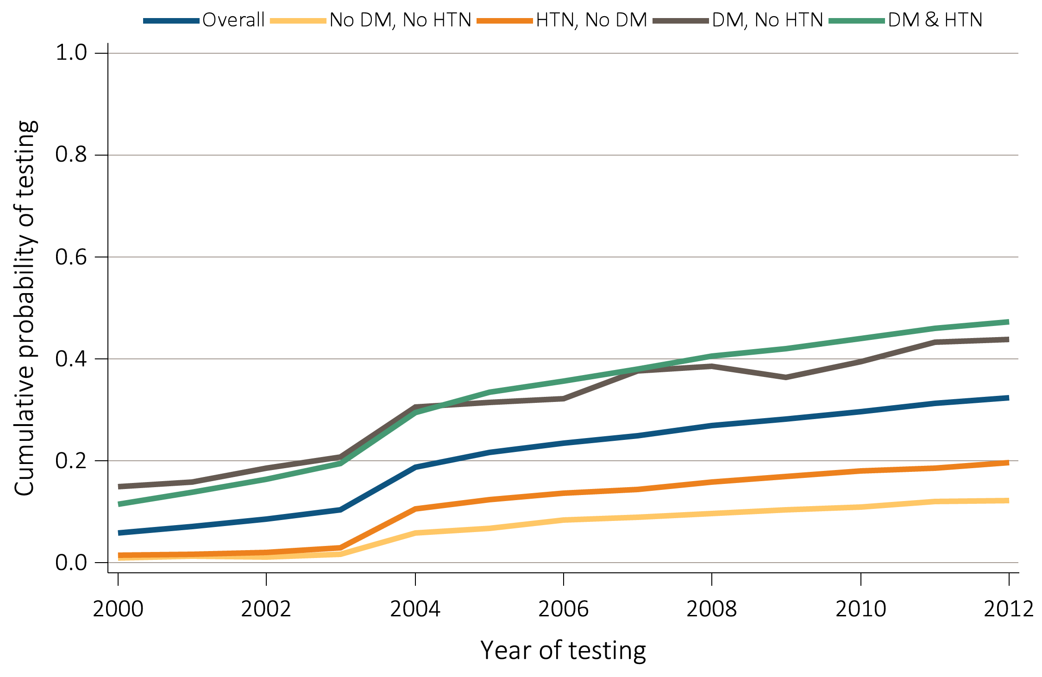
Figure i.6 Unadjusted cumulative probability of urine albumin testing, among Medicare patients age 65+ with a diagnosis of CKD, 2000-2012
Data Source: Medicare patients from the 5 percent sample, age 65 or older with Part A & B coverage in the prior year. Tests tracked during each year. Abbreviations: CKD, chronic kidney disease; DM, diabetes mellitus; HTN, hypertension. This graphic is adapted from Figure 2.4A.

Slide 8
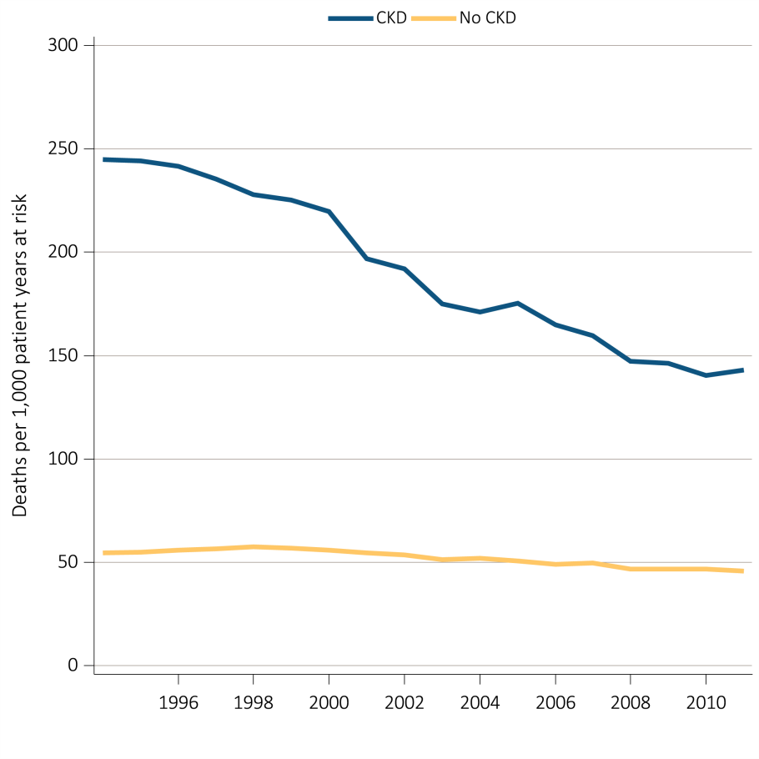
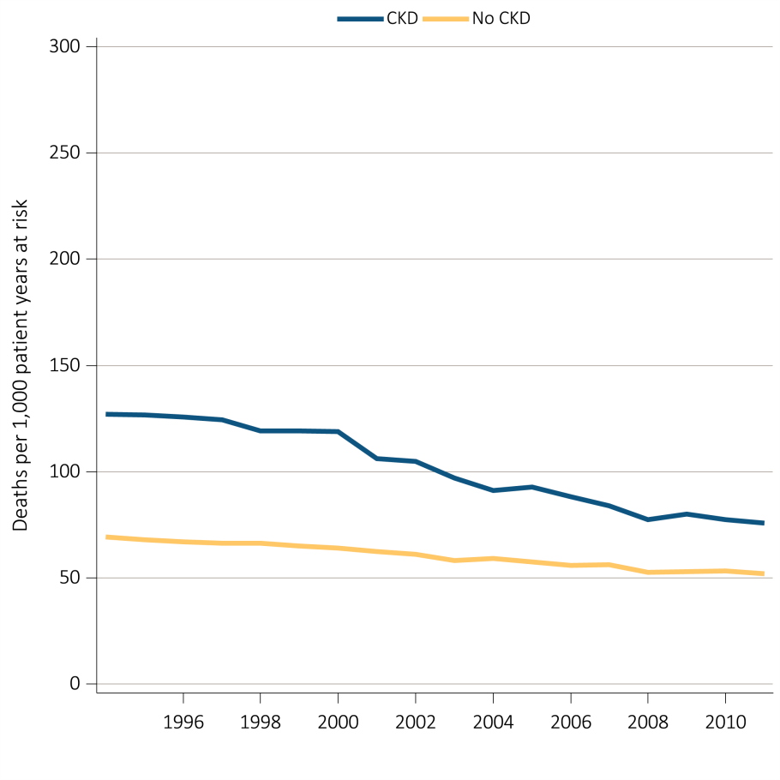
Figure i.7 Unadjusted and adjusted all-cause mortality rates (per 1,000 patient years at risk) for Medicare patients aged 66 and older, by CKD status and year, 1995-2012
(A) Unadjusted
(B) Adjusted
Data source: Medicare 5 percent sample. January 1 point prevalent Medicare patients age 66 and older. Adj: age/sex/race/prior year hospitalization/comorbidities. Ref: 2012 patients. Abbreviations: CKD, chronic kidney disease. This graphic also appears as Figure 3.1.

Slide 9
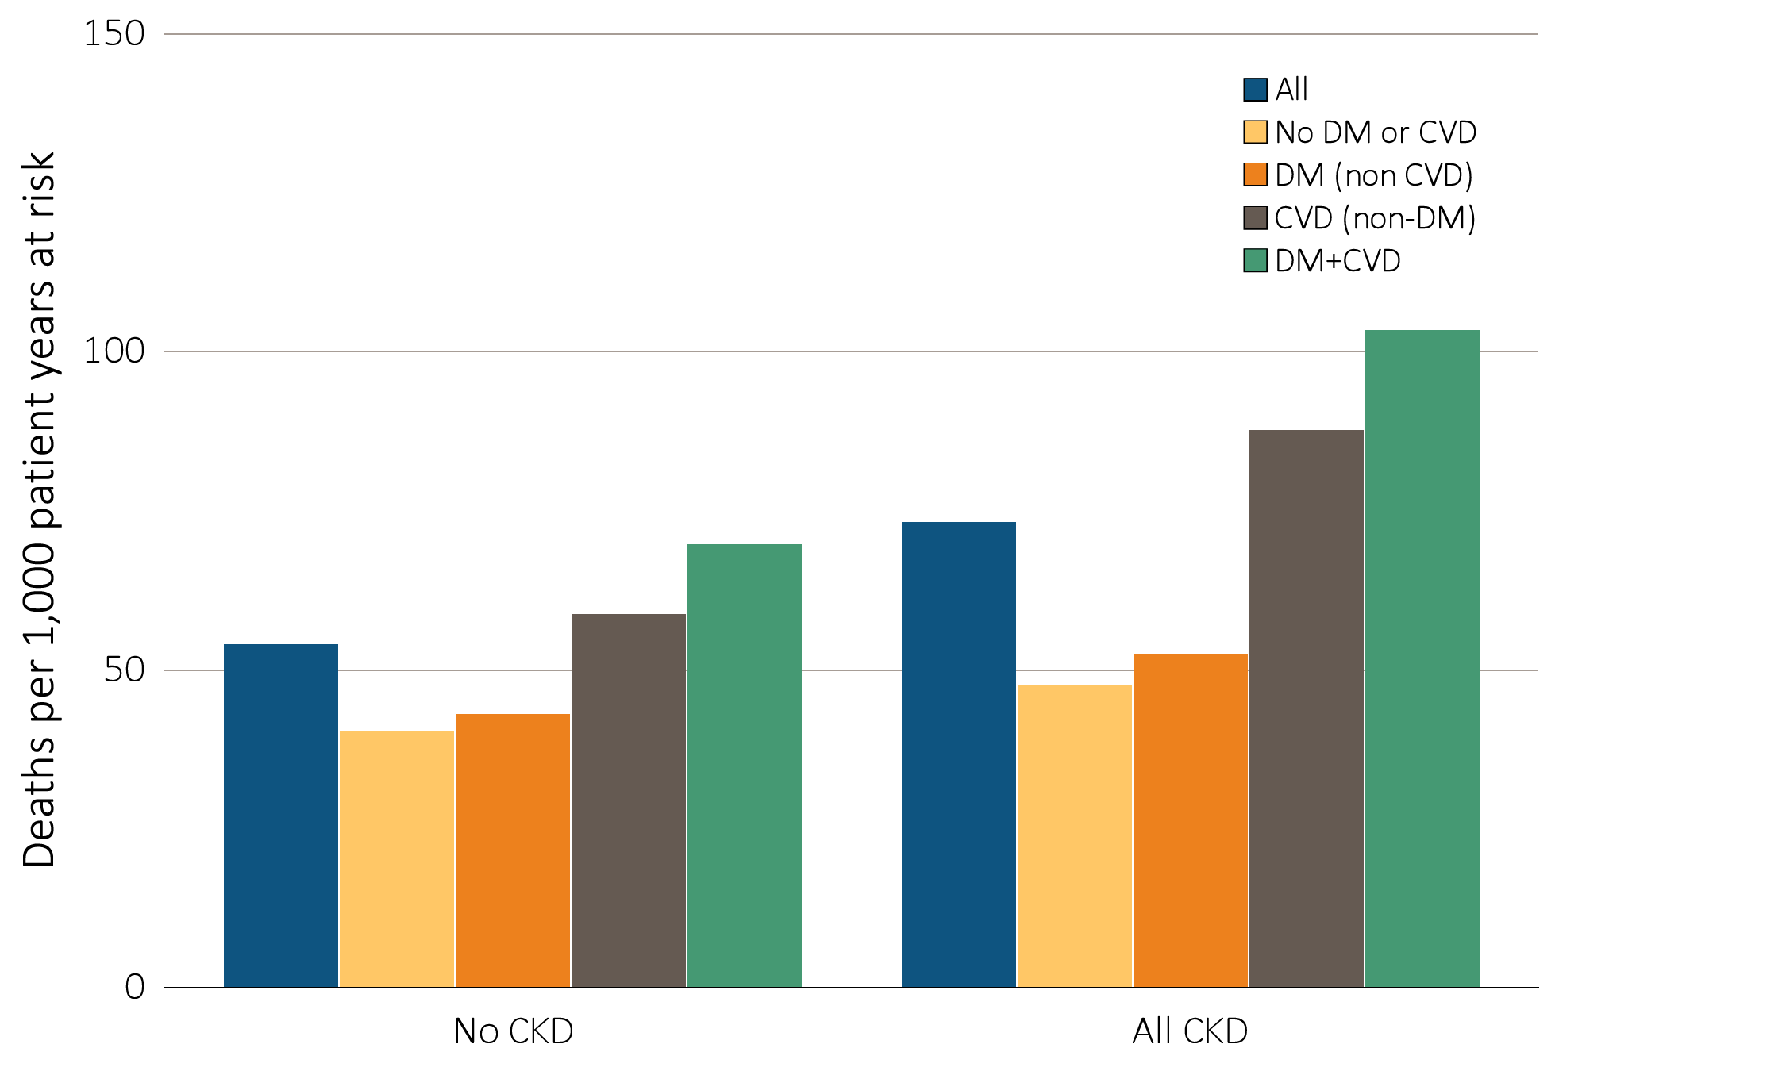
Figure i.8 Adjusted mortality rates (per 1,000 patient years at risk) in Medicare patients aged 66 and older, by cardiovascular disease, diabetes mellitus, and CKD status, 2012
Data source: Medicare 5 percent sample. January 1, 2012 point prevalent patients age 66 and older. Adj: age/sex/race/prior year hospitalization/comorbidities. Ref: all patients, 2012. Abbreviations: CKD, chronic kidney disease; CVD, cardiovascular disease; DM, diabetes mellitus. This graphic also appears as Figure 3.4.

Slide 10
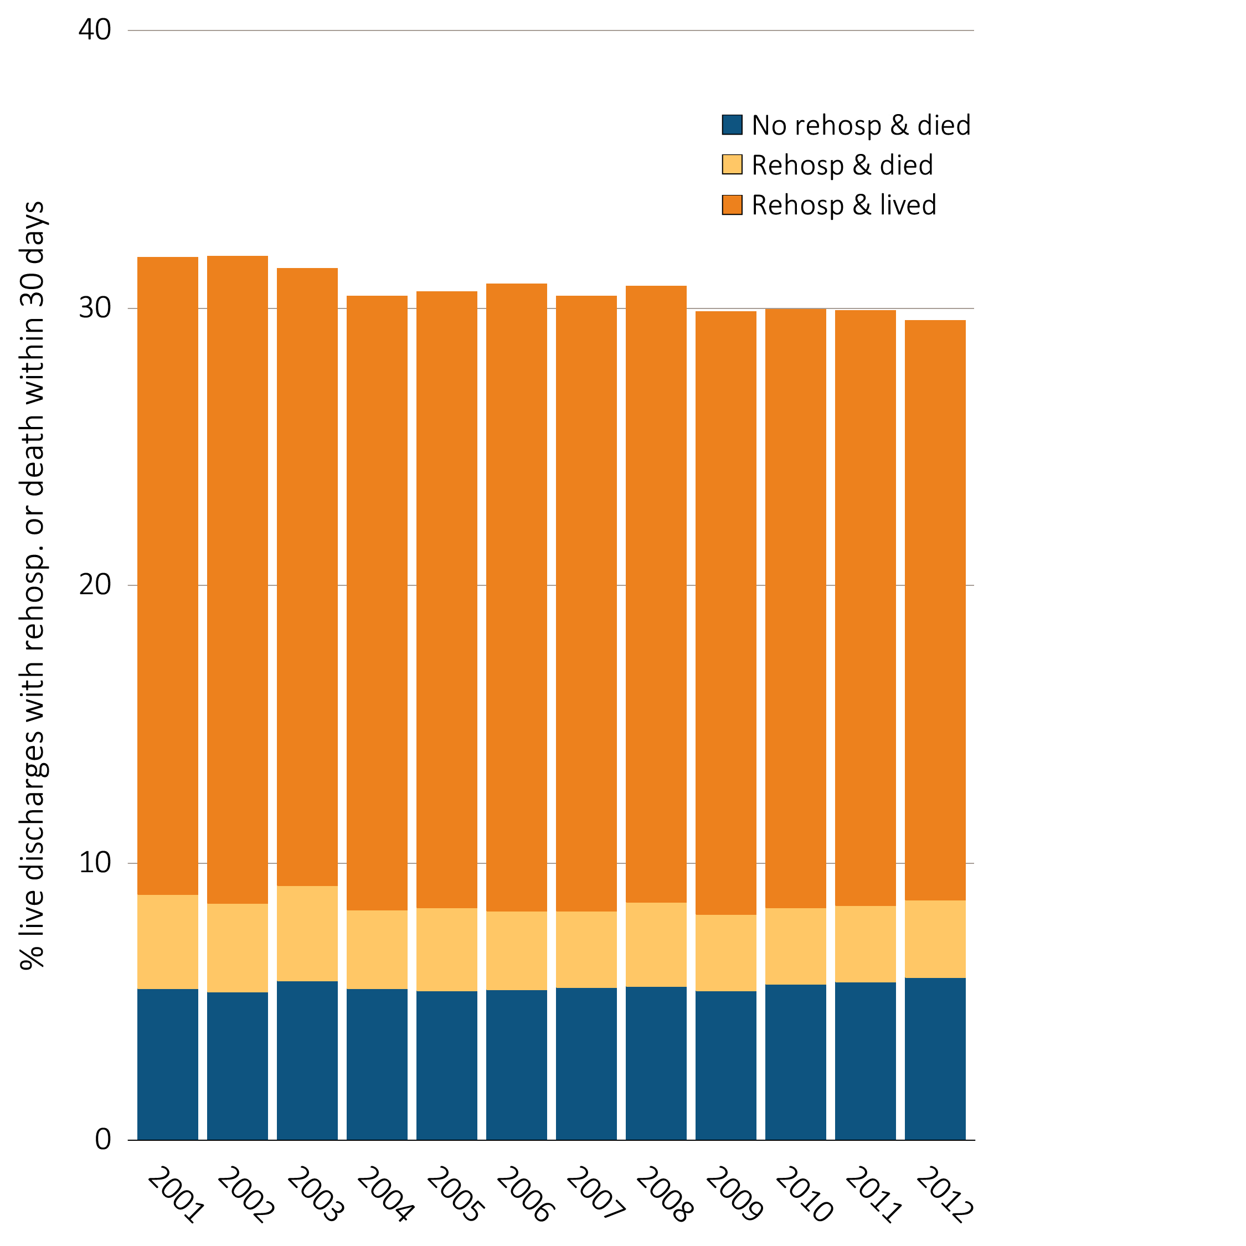
Figure i.9 Adjusted percentage readmitted to the hospital within 30 days of discharge, among Medicare CKD patients aged 66 and older, discharged alive from an all-cause index hospitalization between January 1 and December 1, by year, 2001-2012
Data source: Medicare 5 percent sample. January 1 of each reported year point prevalent, Medicare patients age 66 and older with CKD (defined during the prior year) discharged alive from an all-cause index hospitalization between January 1 and December 1 of the reported year. Adj: age/sex/race. Ref: 2012. Abbreviations: CKD, chronic kidney disease; Rehosp, rehospitalized. This graphic also appears as Figure 3.14.

Slide 11
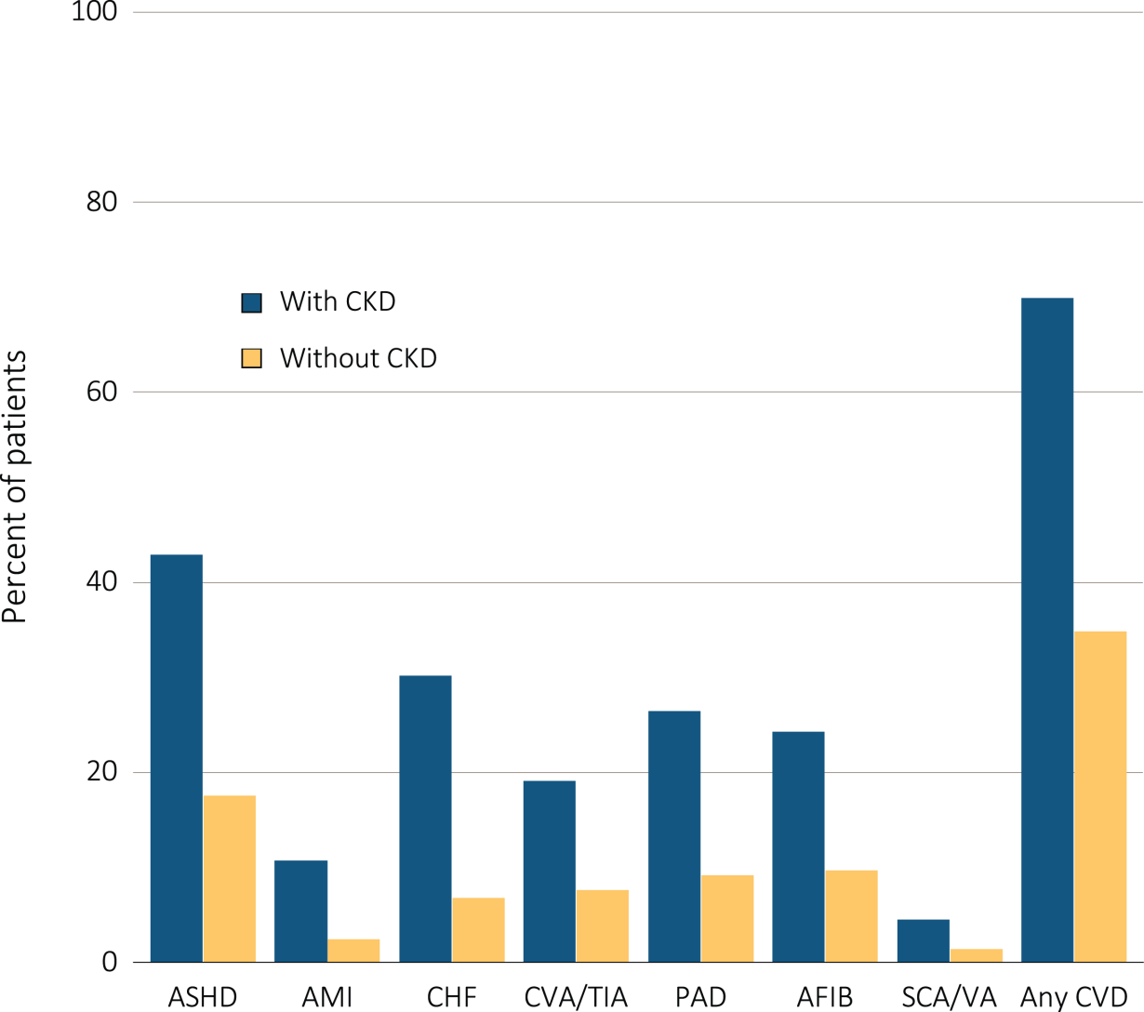
Figure i.10 Cardiovascular disease in patients with or without CKD, 2012
Data Source: Medicare 5 percent sample. Patients age 66 and older, alive, without end-stage renal disease, and residing in the U.S. on 12/31/2012 with fee-for-service coverage for the entire calendar year. Abbreviations: AFIB, atrial fibrillation; AMI, acute myocardial infarction; ASHD, atherosclerotic heart disease; CHF, congestive heart failure; CKD, chronic kidney disease; CVA/TIA, cerebrovascular accident/transient ischemic attack; CVD, cardiovascular disease; PAD, peripheral arterial disease; SCA/VA, sudden cardiac arrest and ventricular arrhythmias. This graphic also appears as Figure 4.1.

Slide 12
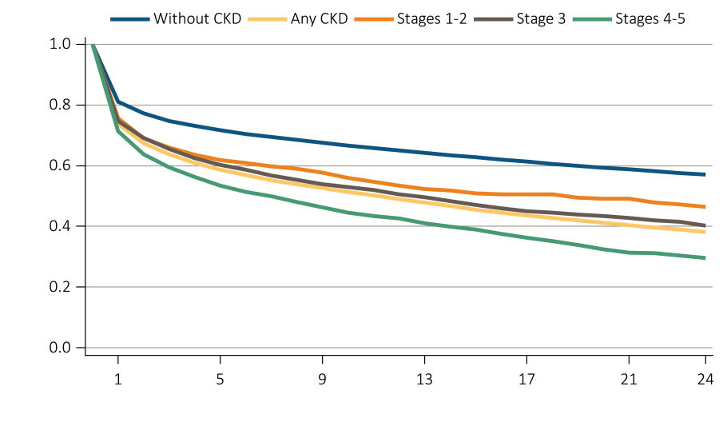
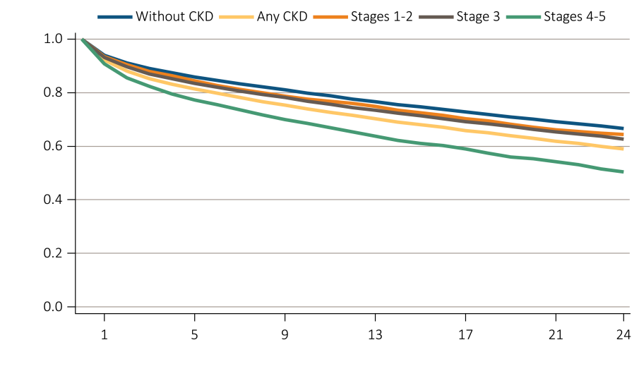
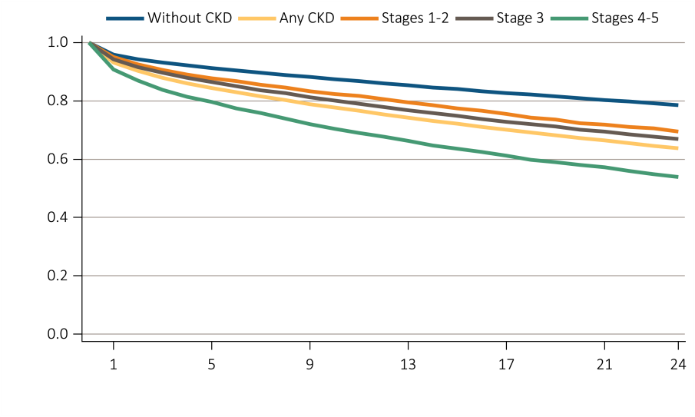
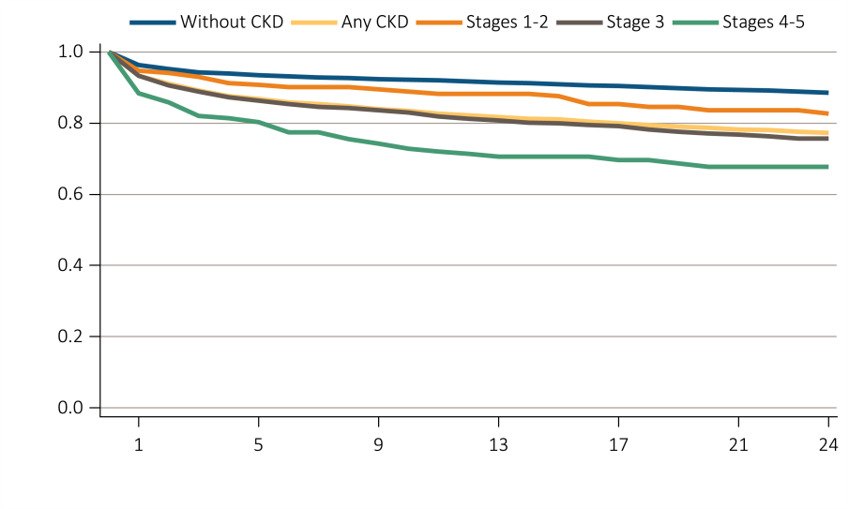
Figure i.11 Survival of patients with a cardiovascular diagnosis or procedure, by CKD status, 2010-2012
(A) AMI
(B) CHF
(C) CVA/TIA
(D) CABG
Data Source: Medicare 5 percent sample. Patients age 66 and older, alive, without end-stage renal disease, and residing in the U.S. on 12/31/2012 with fee-for-service coverage for the entire calendar year. Abbreviations: AMI, acute myocardial infarction; CABG, coronary artery bypass grafting; CHF, congestive heart failure; CKD, chronic kidney disease; CVA/TIA, cerebrovascular accident/transient ischemic attack. This graphic is adapted from Figure 4.2.

Slide 13
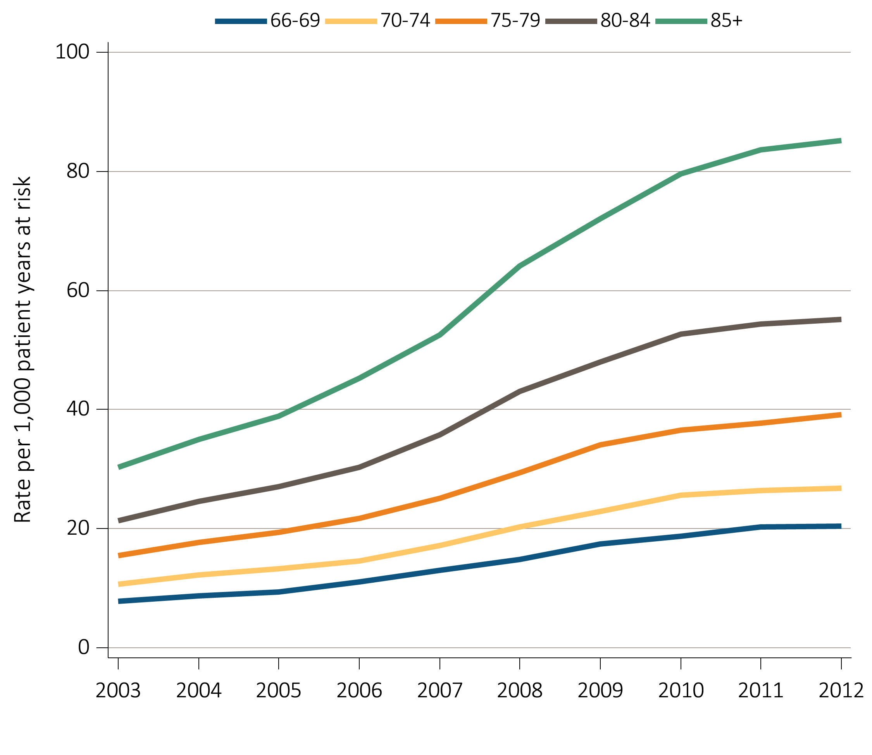
Figure i.12 Unadjusted rates of first hospitalization with AKI for Medicare patients aged 66+ by age and year, 2003-2012
Data Source: Medicare 5 percent sample. Age as of January 1 of specified year. All patient-years at risk for Medicare patients aged 66 or older who had both Medicare Parts A & B, no Medicare Advantage plan (Part C/HMO), no ESRD by first service date from Medical Evidence form, and were alive on January 1 of year shown. Censored at death, ESRD, end of Medicare Parts A & B participation, or switch to Medicare Advantage program. Abbreviations: AKI, acute kidney injury. This graphic also appears as Figure 5.2.

Slide 14
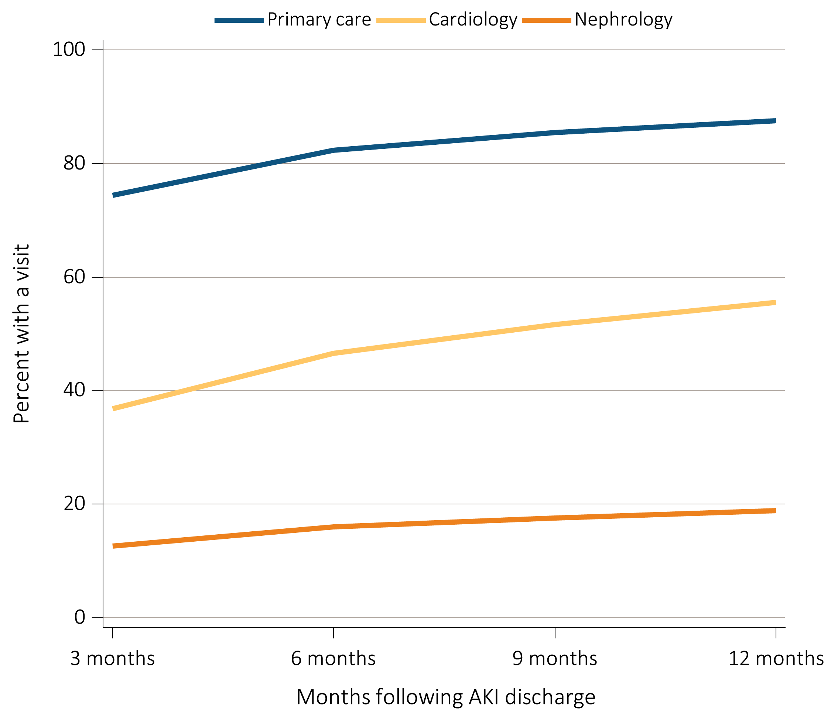
Figure i.13 Outpatient physician visits within one year of live discharge from first AKI hospitalization in 2011 for Medicare patients aged 66+ by physician specialty and time
Data Source: Medicare 5 percent sample. Medicare patients aged 66 and older who had both Medicare Parts A & B, no Medicare Advantage plan (Part C/HMO), no ESRD by first service date from Medical Evidence form on 1/1/2011, and were discharged alive from a first AKI hospitalization in 2011. For each time point, the denominator is all patients alive, without ESRD, not in a Medicare Advantage plan and with Medicare Parts A & B. Physician visits are from physician/supplier claims with provider specialty codes for primary care (01, 08-family practice, 11-internal medicine), cardiology (06), and nephrology (39) and claim source indicating an outpatient setting. Abbreviations: AKI, acute kidney injury. This graphic also appears as Figure 5.9.

Slide 15
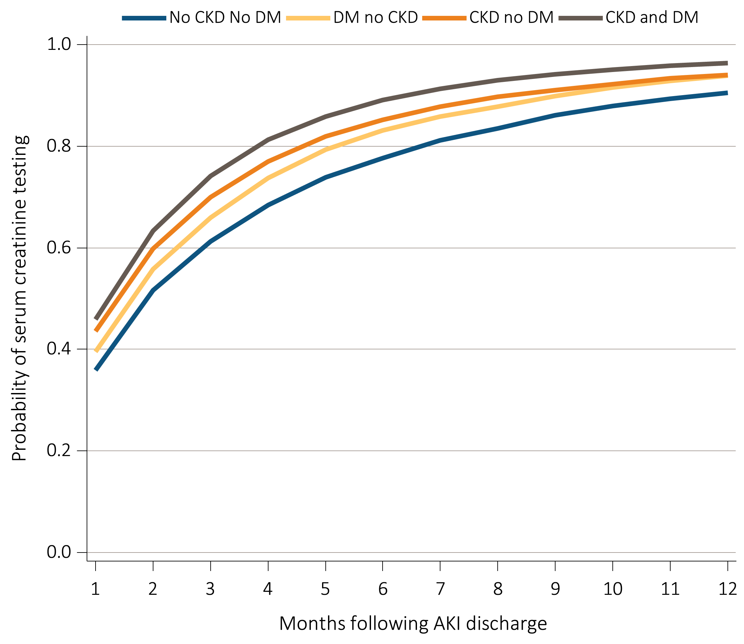
Figure i.14 Cumulative probability of a claim for a serum creatinine test within one year of live discharge from first AKI hospitalization in 2011 for Medicare patients aged 66+, by CKD, DM and time
Data Source: Medicare 5 percent sample. Medicare patients aged 66 and older who had both Medicare Parts A & B, no Medicare Advantage plan (Part C/HMO), no ESRD by first service date from Medical Evidence form on 1/1/2011, and were discharged alive from a first AKI hospitalization in 2011. Date of first serum creatinine test following AKI discharge is from inpatient and outpatient claims with healthcare common procedure coding system (HCPCS) codes of 80048, 80050, 80053, 80069, or 82565. Censored at death, ESRD, end of Medicare Parts A & B participation, or switch to Medicare Advantage program. Abbreviations: AKI, acute kidney injury; CKD, chronic kidney disease; DM, diabetes mellitus; This graphic also appears as Figure 5.11.

Slide 16
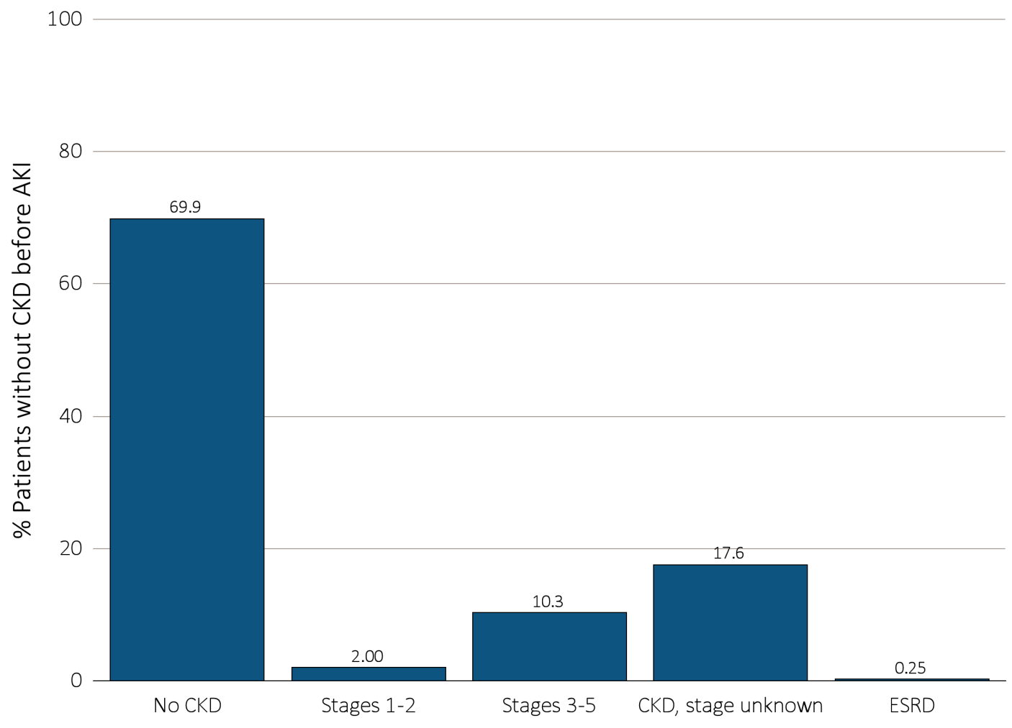
Figure i.15 Renal status one year following discharge from AKI hospitalization in 2010-2011, among surviving Medicare patients aged 66+ without kidney disease prior to AKI hospitalization, by CKD stage and ESRD status
Data Source: Medicare 5 percent sample. Medicare patients aged 66 and older who had both Medicare Parts A & B, no Medicare Advantage plan (Part C/HMO), did not have ESRD, were discharged alive from a first AKI hospitalization in 2010 or 2011, and did not have any claims with a diagnosis of CKD in the 365 days prior to the AKI. Renal status after AKI determined from claims between discharge from AKI hospitalization and 365 days after discharge. Stage determined by 585.x claim closest to 365 days after discharge; ESRD by first service date on Medical Evidence form. Abbreviations: AKI, acute kidney injury; CKD, chronic kidney disease I. This graphic also appears as Figure 5.13.

Slide 17
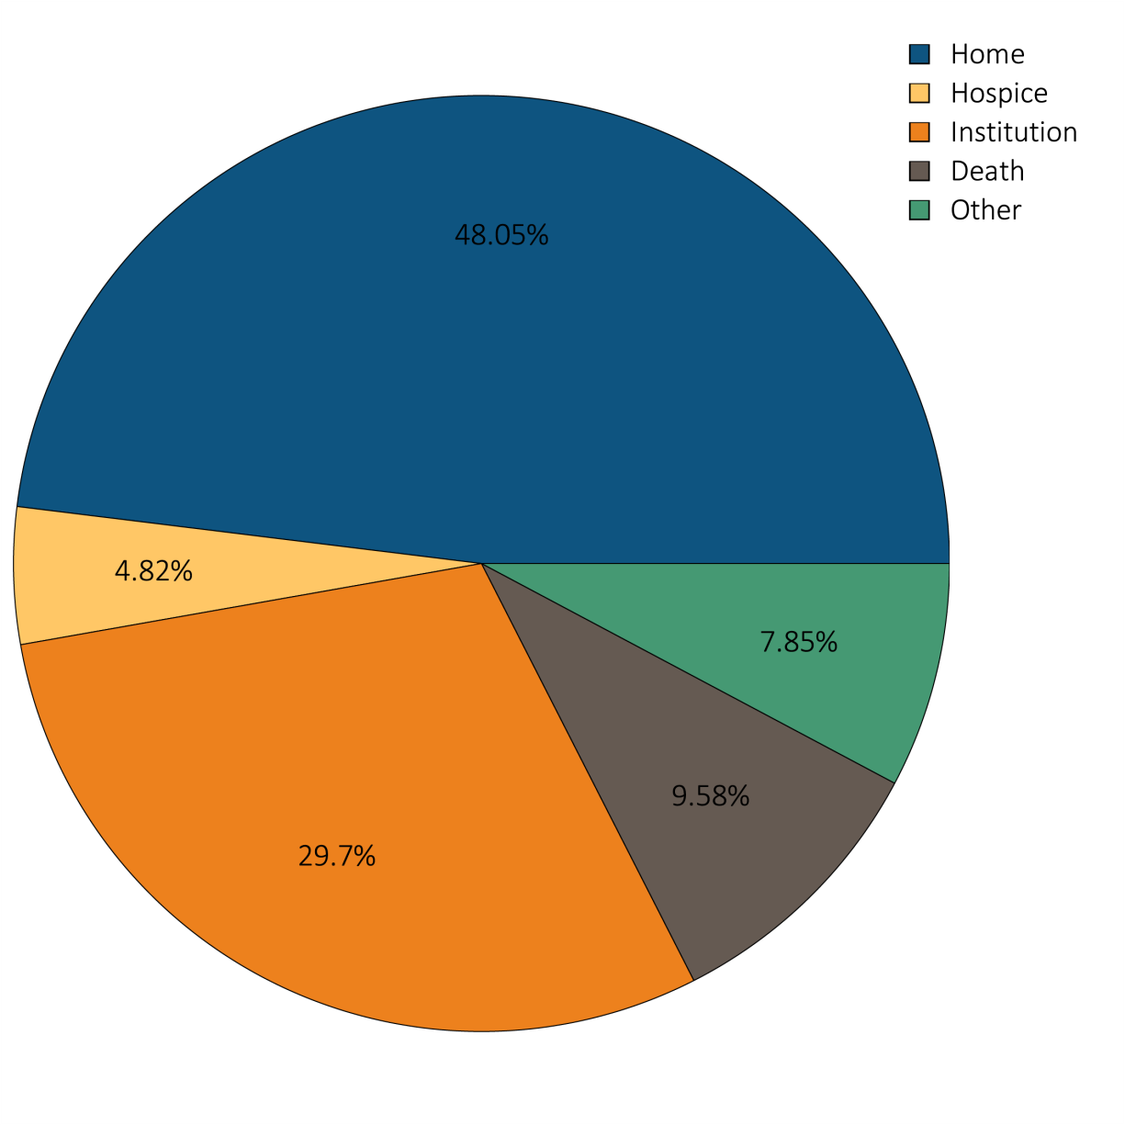
Figure i.16 Hospital discharge status of first AKI hospitalization for Medicare patients aged 66+, 2012
Data Source: Medicare 5 percent sample. Medicare patients aged 66 or older who had both Medicare Parts A & B, no Medicare Advantage plan (Part C/HMO), did not have ESRD on 1/1/2012 and had a first AKI hospitalization in 2012. Institution includes short-term skilled nursing facilities, rehabilitation hospitals, and long-term care facilities. Home also includes patients receiving home health care services. Excludes patients admitted to the acute care hospital from a skilled nursing facility. Abbreviation: AKI, acute kidney injury. This graphic also appears as Figure 5.14.

Slide 18
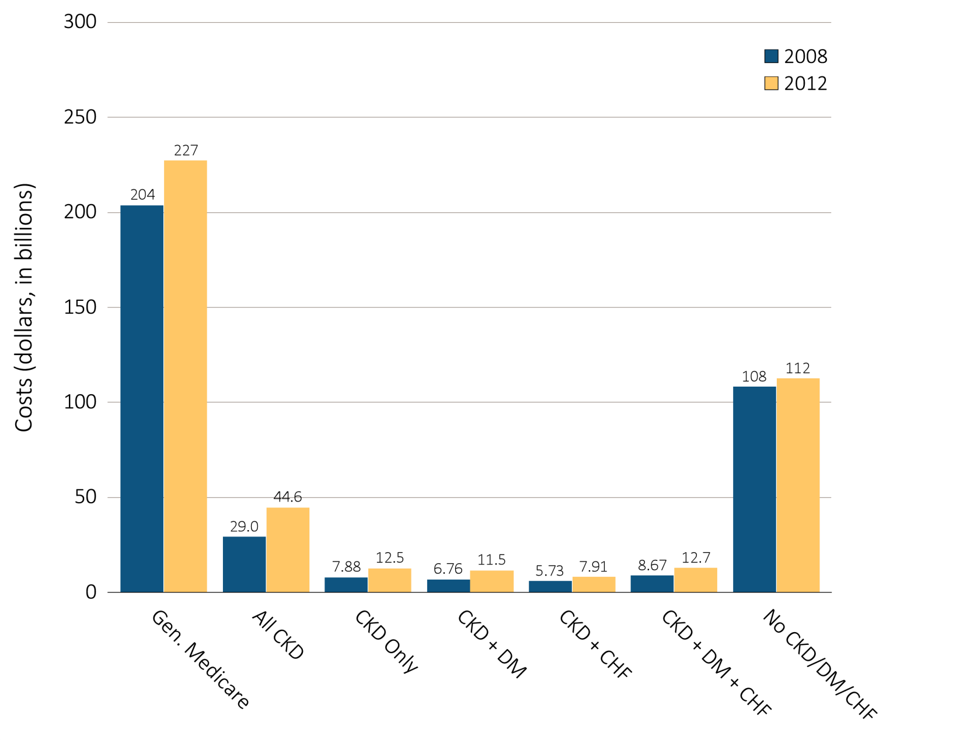
Figure i.17 Overall Medicare Parts A and B costs for fee-for-service patients aged 65 and older, by CKD, DM, CHF, and year, 2008 and 2012
Data source: Medicare 5 percent sample. Abbreviations: CKD, chronic kidney disease; CHF, congestive heart failure, DM, diabetes mellitus. This graphic also appears as Figure 6.1.

