Slide 2
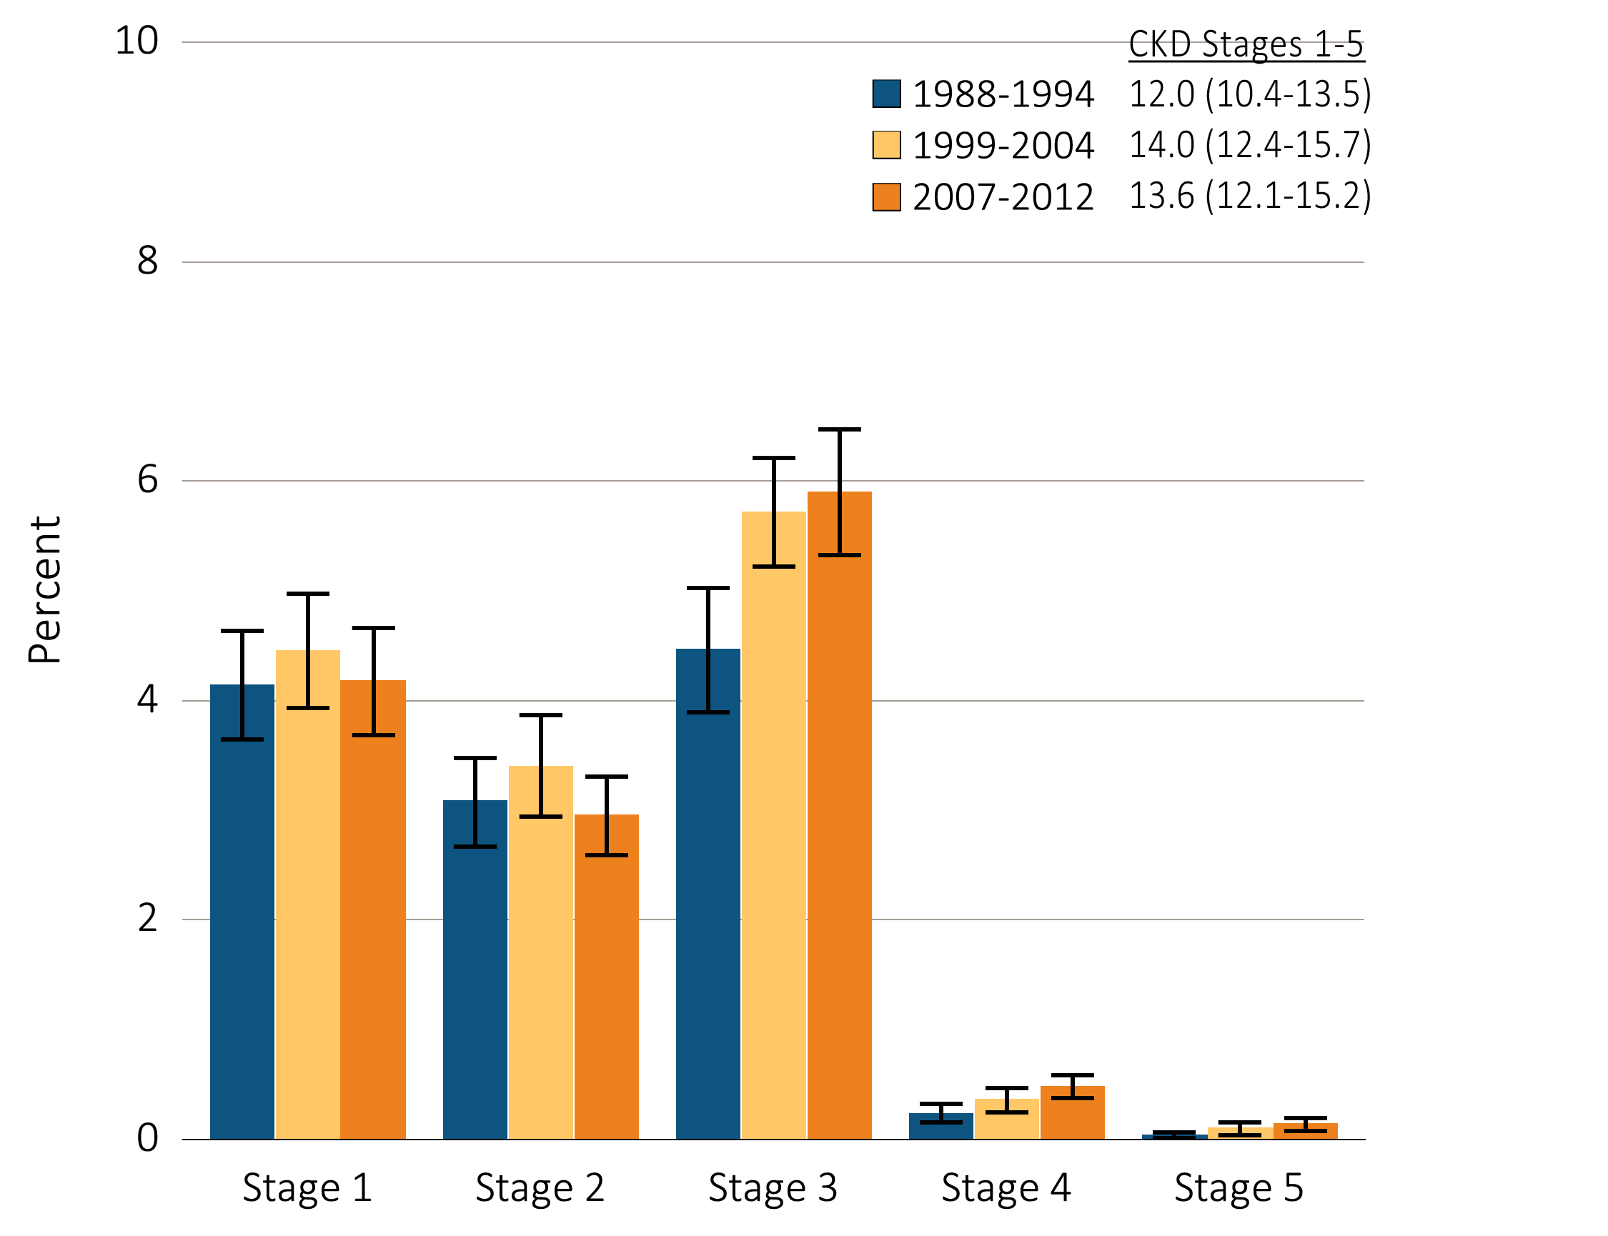
Figure i.1 Prevalence of CKD by stage among NHANES participants, 1988-2012
Data Source: National Health and Nutrition Examination Survey (NHANES), 1988–1994, 1999-2004 & 2007–2012 participants aged 20 & older. Whisker lines indicate 95% confidence intervals. Abbreviations: CKD, chronic kidney disease. This graphic also appears as Figure 1.2.

Slide 3
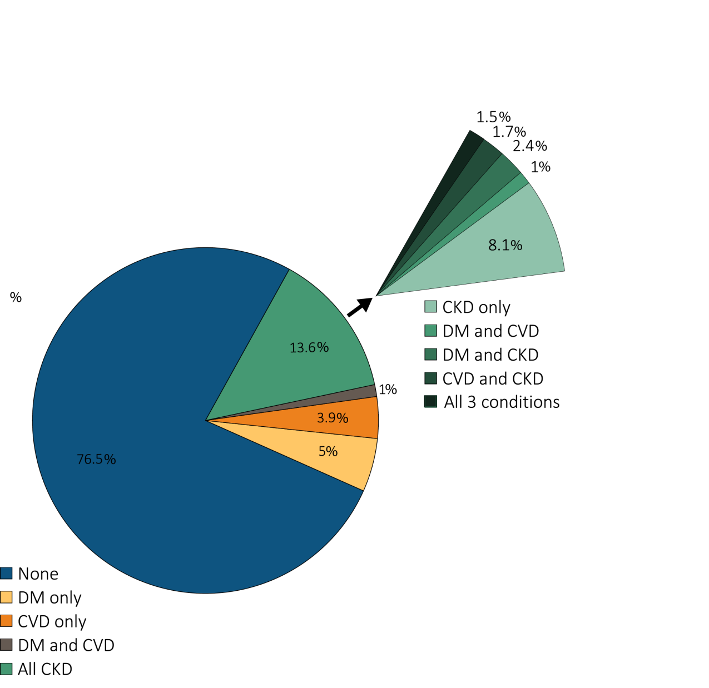
Figure i.2 Distribution of NHANES participants with diabetes, self-reported cardiovascular disease, & single-sample markers of CKD, 2007-2012
Data Source: National Health and Nutrition Examination Survey (NHANES), 1988–1994, 1999-2004 & 2007–2012 participants aged 20 & older. Note: Cardiovascular disease designation is based on self-report of any CVD condition (see CKD Analytical Methods chapter for detail); CKD is defined as eGFR <60 or ACR ≥30. Abbreviations: ACR, urine albumin/creatinine ratio; CKD, chronic kidney disease; DM, diabetes mellitus; eGFR, estimated glomerular filtration rate; SR CVD, self-reported cardiovascular disease. This graphic also appears as Figure 1.1.

Slide 4
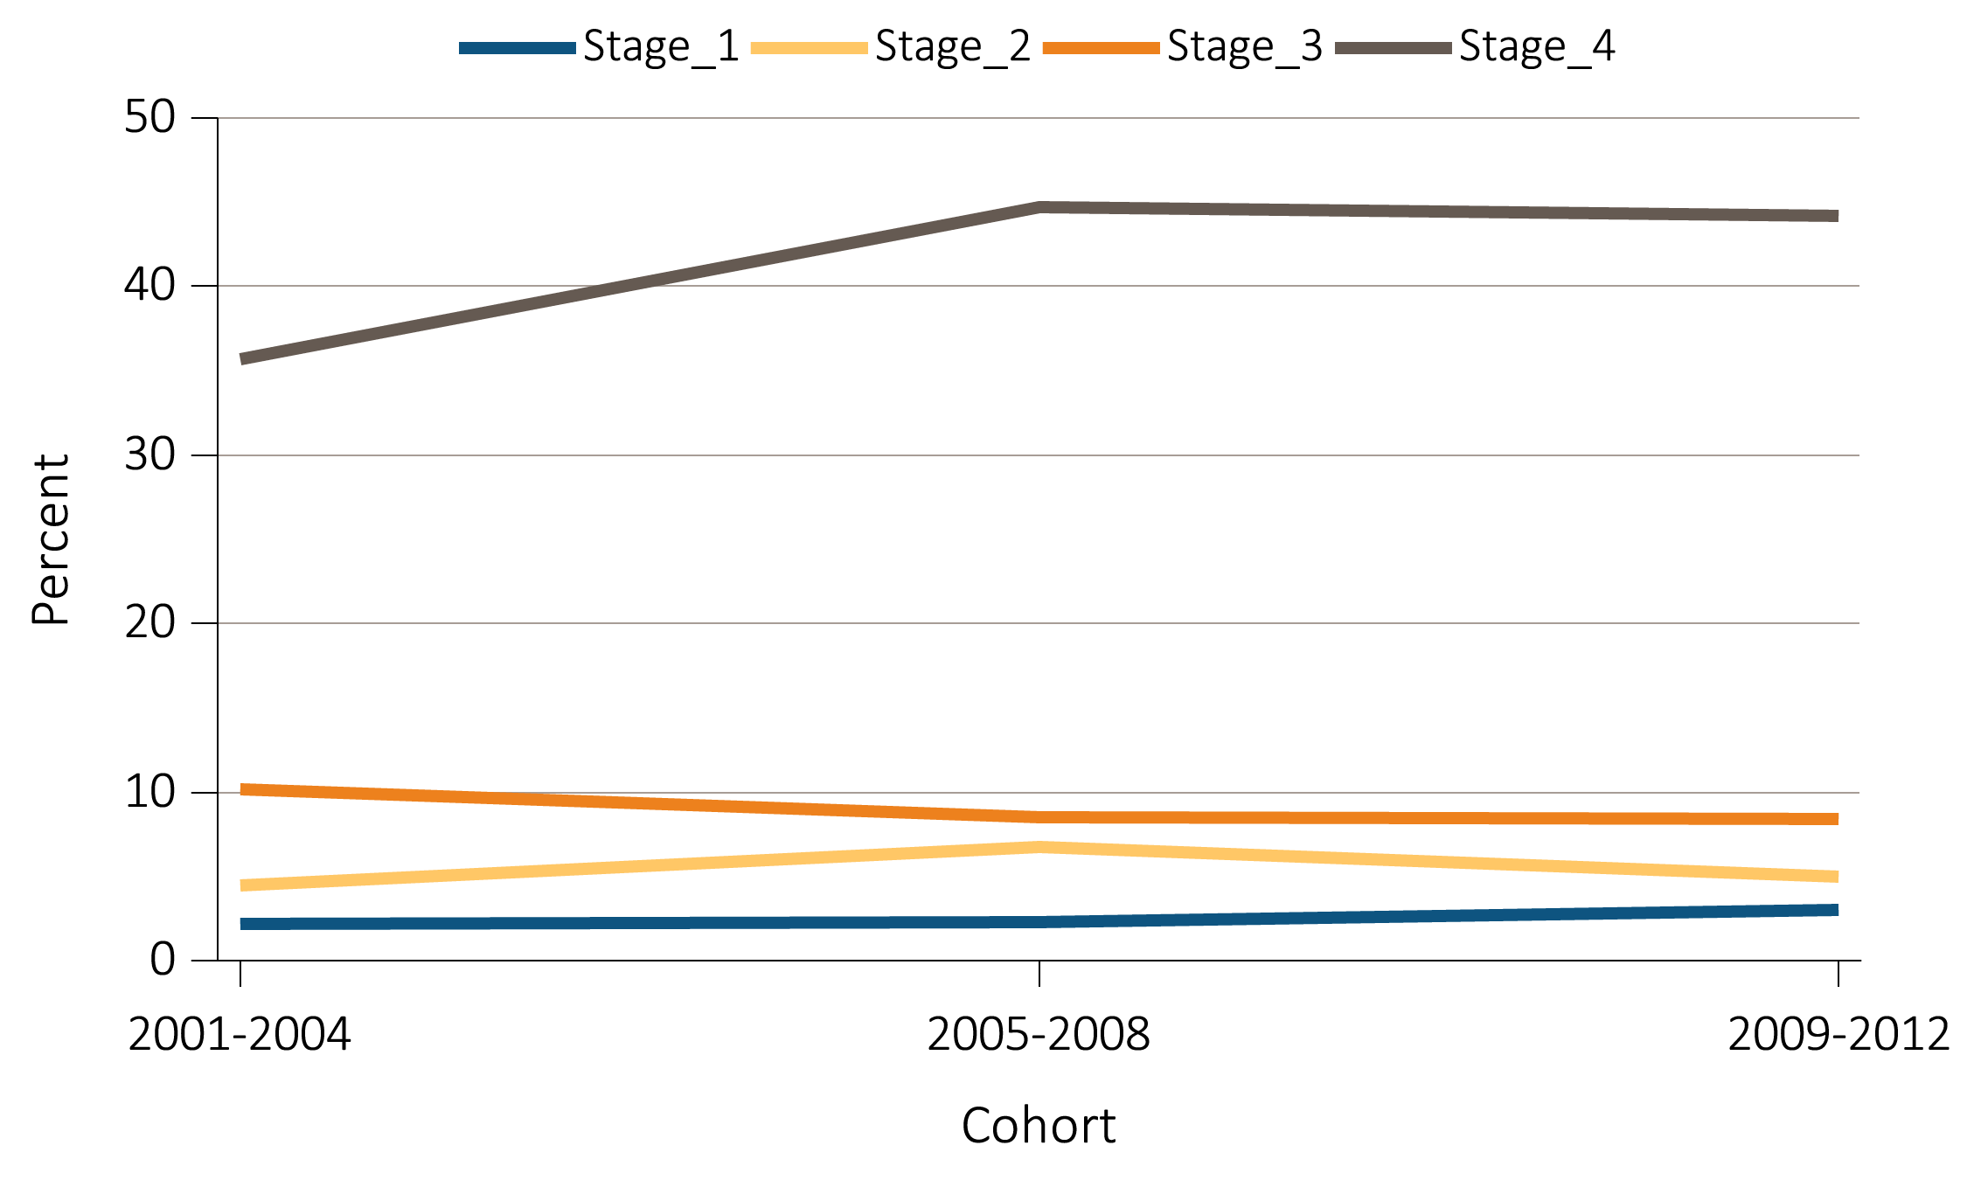
Figure i.3 NHANES participants with CKD aware of their kidney disease, 2001-2012
Data Source: National Health and Nutrition Examination Survey (NHANES), 2001-2012 participants aged 20 & older. Abbreviations: CKD, chronic kidney disease. This graphic also appears as Figure 1.16.

Slide 5
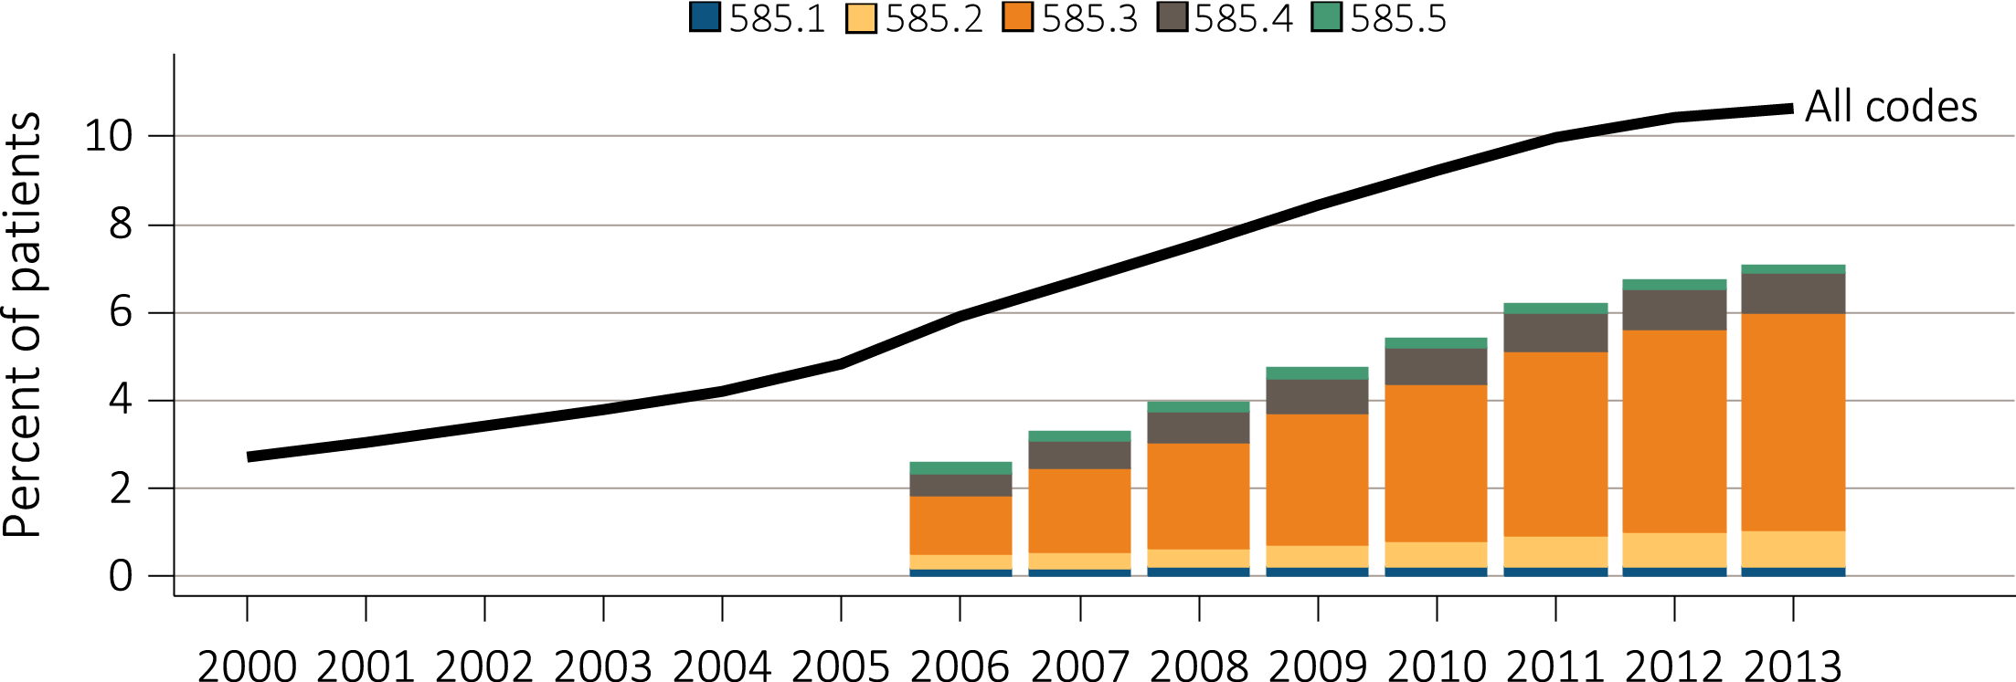
Figure i.4 Trends in prevalence of recognized CKD, overall and by CKD stage,
among Medicare patients aged 65+, 2000-2013
Data Source: Special analyses, Medicare 5 percent sample. Known CKD stages presented as bars; curve showing “All codes” includes known CKD stages (codes 585.1-585.5) and the CKD-stage unspecified codes (585.9, and remaining non-585 CKD codes). Note: In previous years, this graph reported 585.9 codes as a component of the stacked bars. Abbreviation: CKD, chronic kidney disease. This graphic also appears as Figure 2.1.

Slide 6
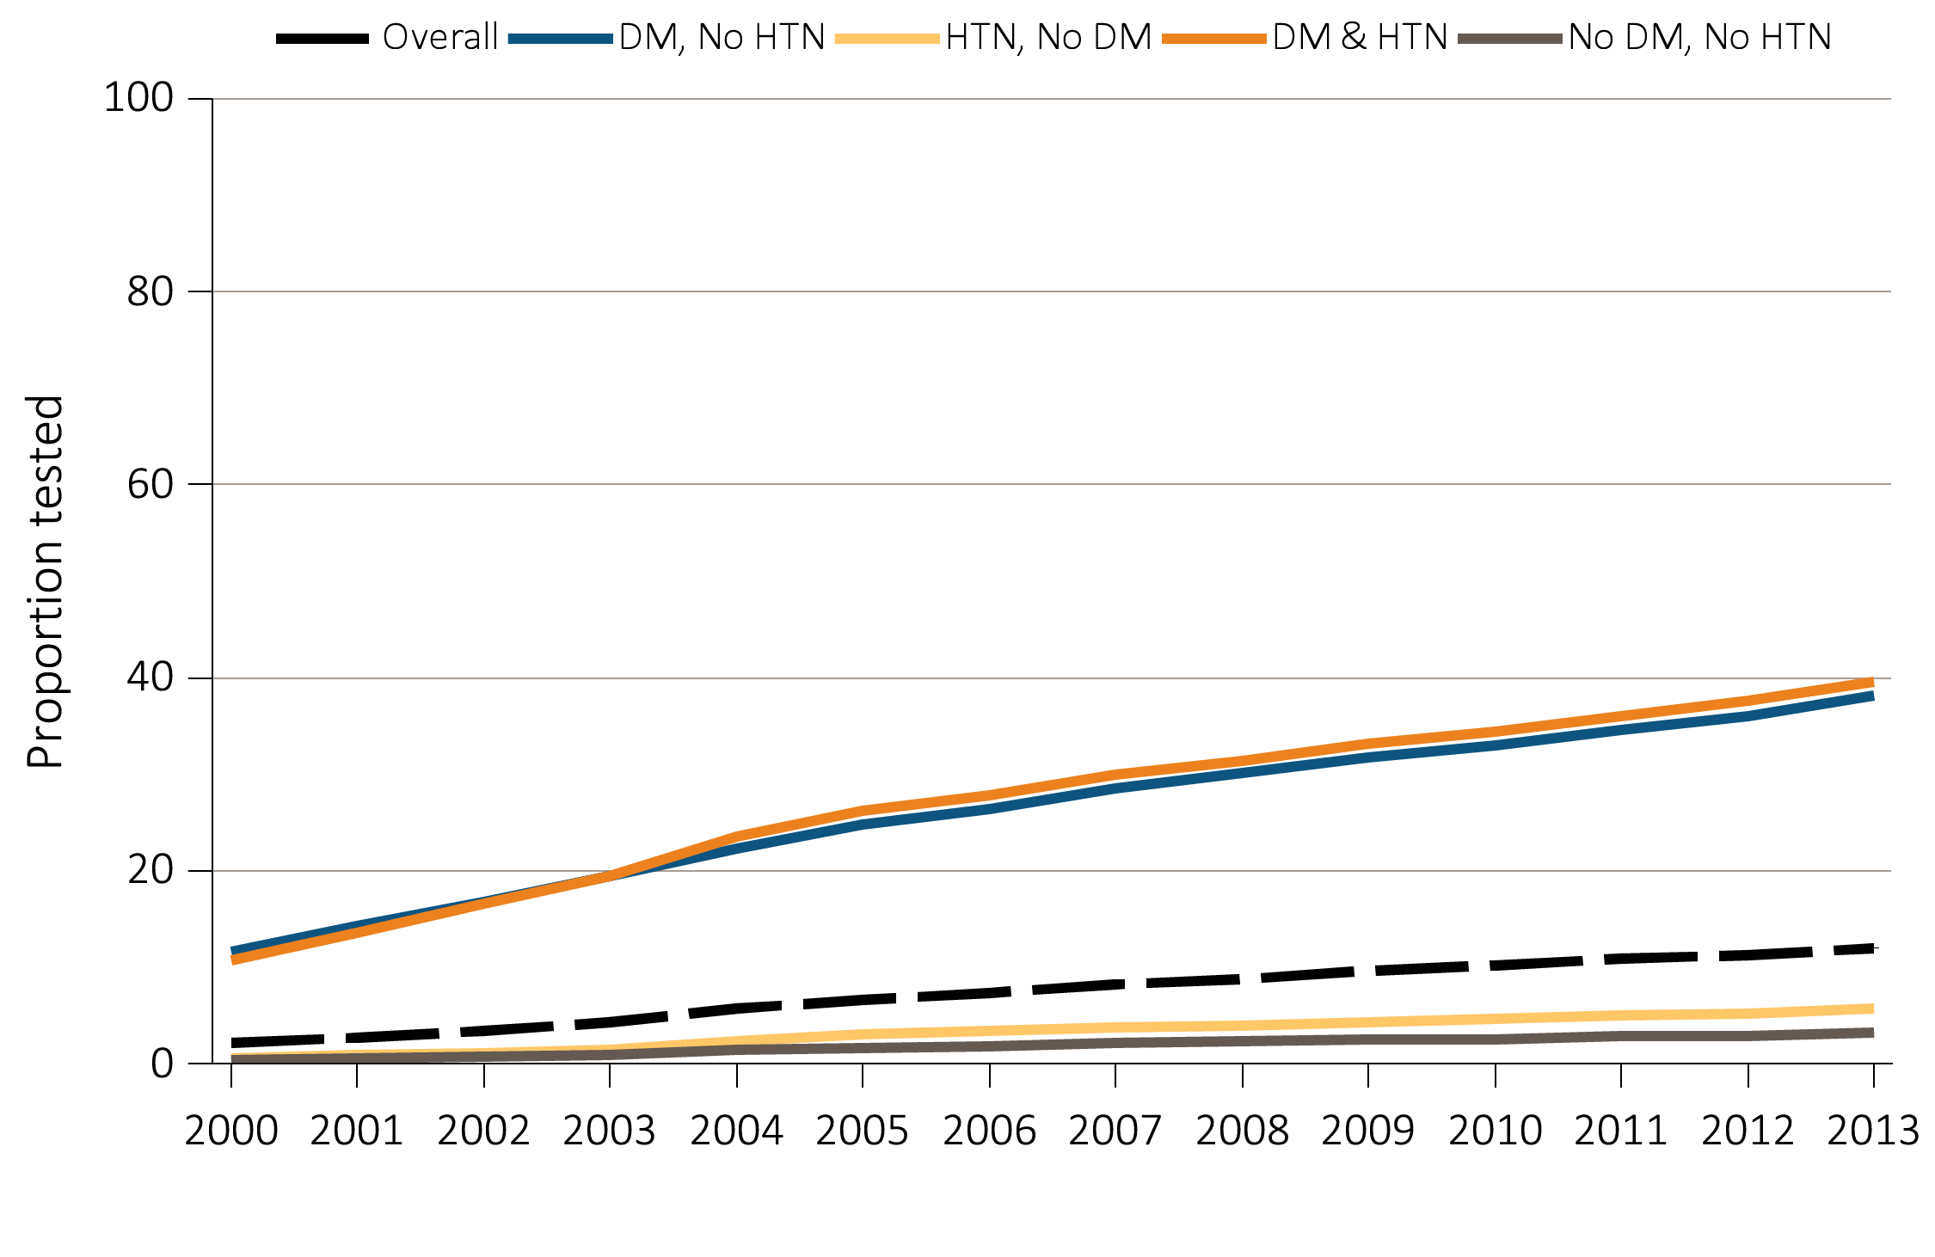
Figure i.5 Trends in proportion of patients with urine albumin testing, by year,
among Medicare patients aged 65+ WITHOUT a diagnosis of CKD, 2000-2013
Data Source: Special analyses, Medicare 5 percent sample. Patients aged 65 and older with Part A & B coverage in the prior year. Tests tracked during each year. Abbreviations: CKD, chronic kidney disease; DM, diabetes mellitus; HTN, hypertension. This graphic is adapted from Figure 2.3.a.

Slide 7
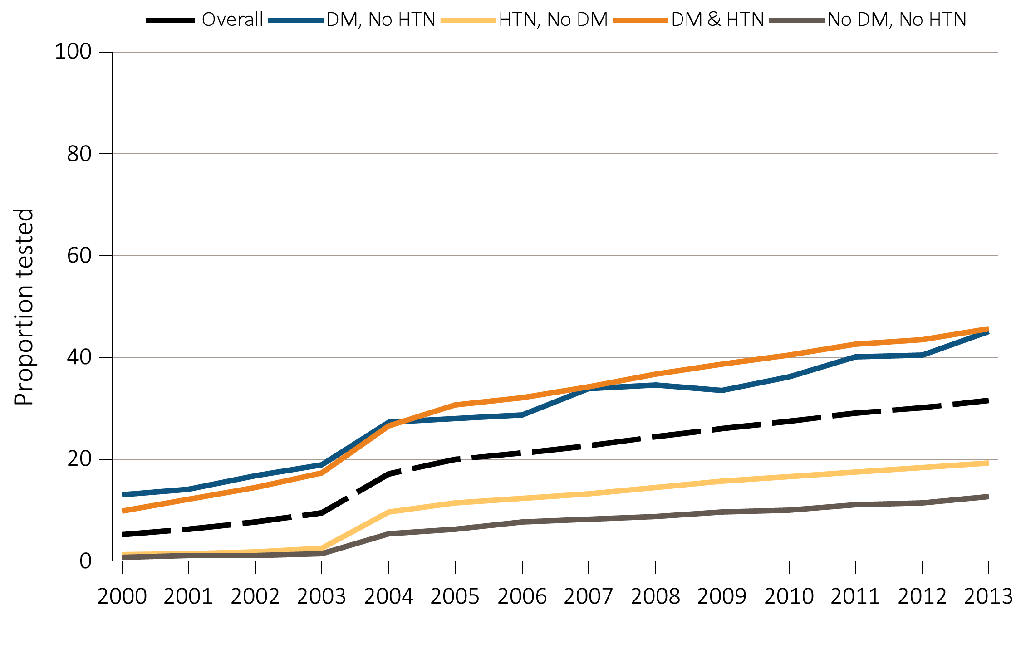
Figure i.6 Trends in proportion of patients with urine albumin testing, by year,
among Medicare patients aged 65+ WITH a diagnosis of CKD, 2000-2013
Data Source: Special analyses, Medicare 5 percent sample. Patients aged 65 and older with Part A & B coverage in the prior year. Tests tracked during each year. Abbreviations: CKD, chronic kidney disease; DM, diabetes mellitus; HTN, hypertension. This graphic is adapted from Figure 2.4.a.

Slide 8
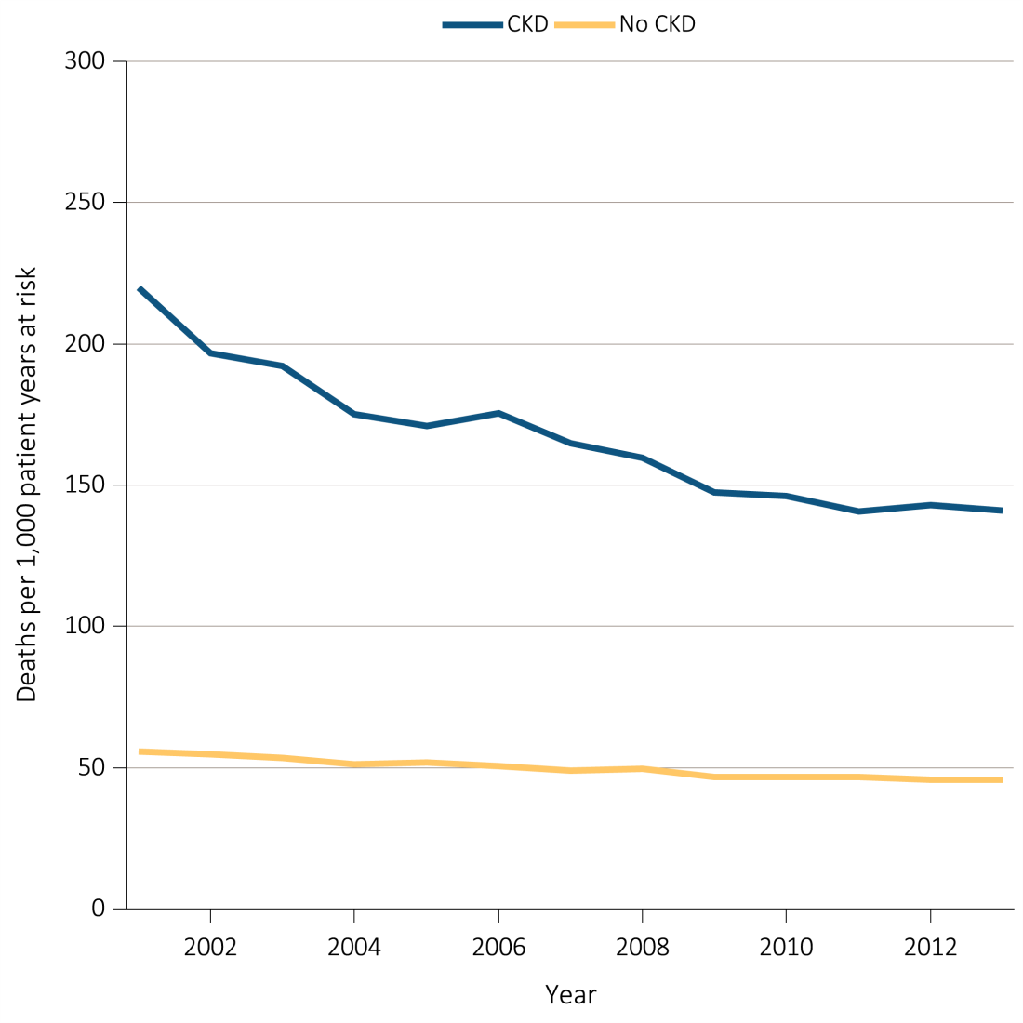
Figure i.7 All-cause mortality rates (per 1,000 patient years at risk)
for Medicare patients aged 66+, by CKD status and year, 2001-2013
^{(a) Unadjusted}
Data source: Special analyses, Medicare 5 percent sample. January 1 of each reported year, point prevalent Medicare patients age 66 and older. Ref: 2012 patients. Abbreviation: CKD, chronic kidney disease. This graphic also appears as Figure 3.1.

Slide 9
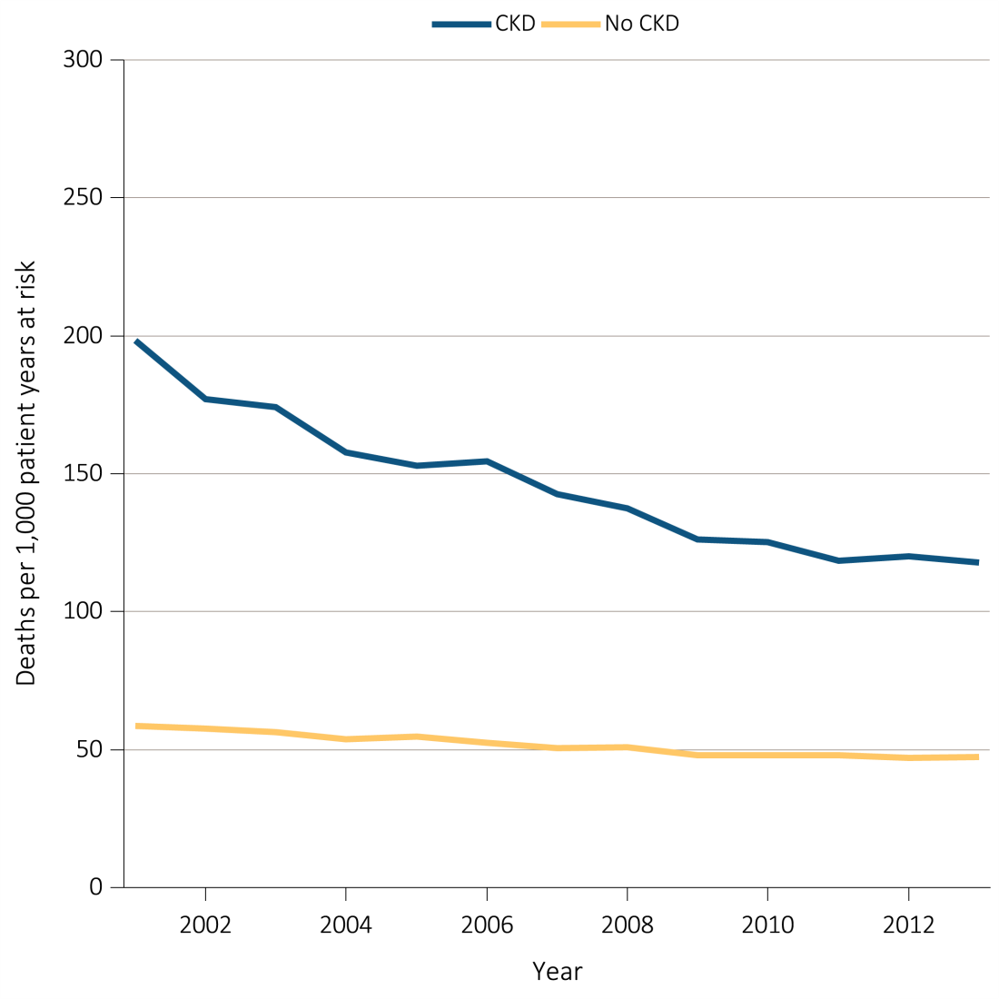
Figure i.7 All-cause mortality rates (per 1,000 patient years at risk)
for Medicare patients aged 66+, by CKD status and year, 2001-2013
^{(b) Adjusted}
Data source: Special analyses, Medicare 5 percent sample. January 1 of each reported year, point prevalent Medicare patients age 66 and older. Adj: age/sex/race. Ref: 2012 patients. Abbreviation: CKD, chronic kidney disease. This graphic also appears as Figure 3.1.

Slide 10
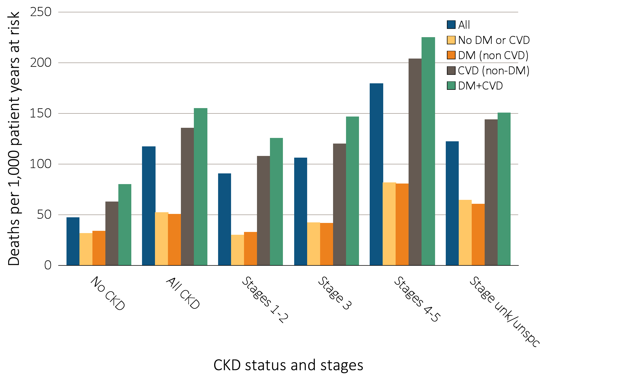
Figure i.8 Adjusted all-cause mortality rates (per 1,000 patient years at risk) for
Medicare patients aged 66+, by cardiovascular disease and diabetes mellitus,
^{CKD status and stage, 2013}
Data source: Special analyses, Medicare 5 percent sample. January 1, 2013 point prevalent patients aged 66 and older. Adj: age/sex/race. Ref: all patients, 2013. Abbreviations: CKD, chronic kidney disease; CVD, cardiovascular disease; DM, diabetes mellitus. This graphic also appears as Figure 3.6.

Slide 11
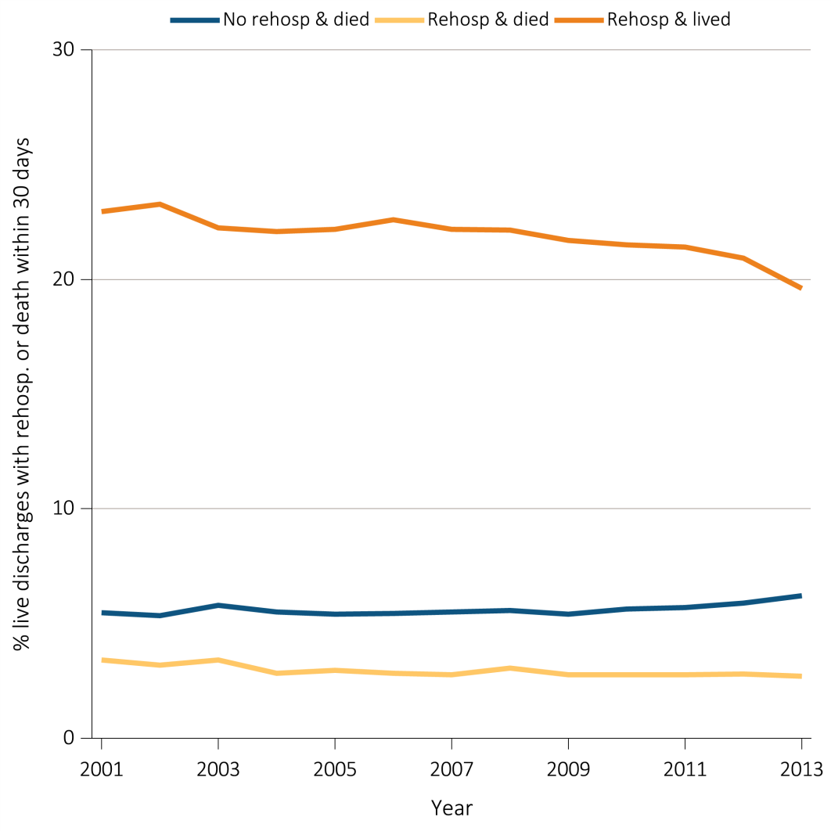
Figure i.9 Adjusted percentage of patients readmitted to the hospital within 30 days of discharge, among Medicare CKD patients aged 66+, discharged alive from an all-cause index hospitalization between January 1 and December 1, by year, 2001-2013
Data Source: Special analyses, Medicare 5 percent sample. Point prevalent Medicare patients aged 66 and older with CKD (defined during the prior year), discharged alive from an all-cause index hospitalization between January 1 and December 1 of the reported year. Adj: age/sex/race. Ref: 2013. Abbreviations: CKD, chronic kidney disease; Rehosp, rehospitalized. This graphic also appears as Figure 3.16.

Slide 12
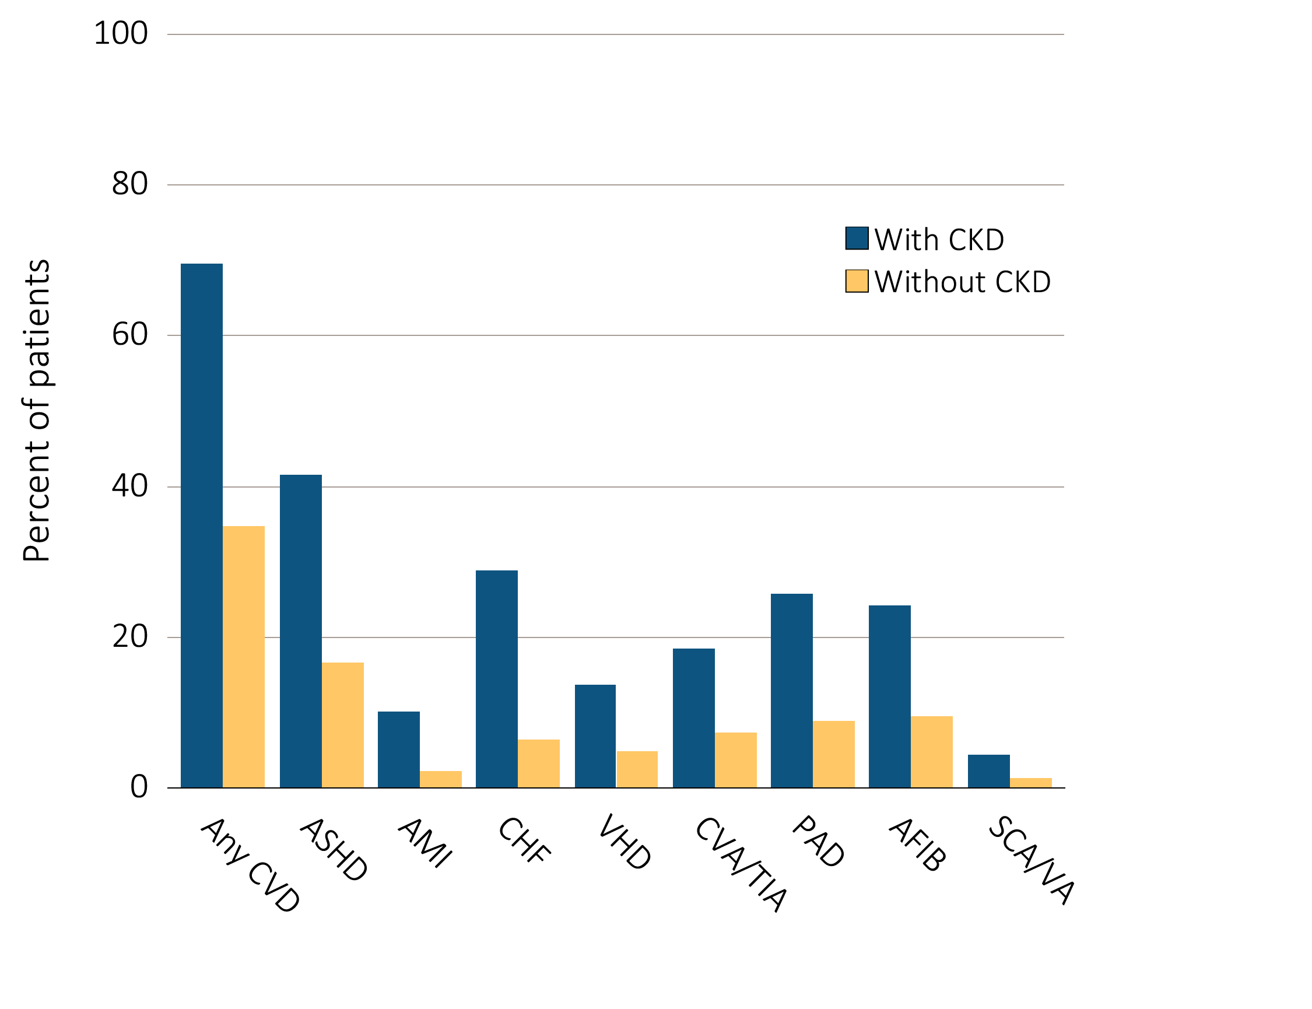
Figure i.10 Cardiovascular disease in patients with or without CKD, 2013
Data Source: Special analyses, Medicare 5 percent sample. Patients aged 66 and older, alive, without end-stage renal disease, and residing in the U.S. on 12/31/2013 with fee-for-service coverage for the entire calendar year. Totals of patients for the study cohort: N=1,238,888; With CKD=132,840; Without CKD=1,106,048. Abbreviations: AFIB, atrial fibrillation; AMI, acute myocardial infarction; ASHD, atherosclerotic heart disease; CHF, congestive heart failure; CKD, chronic kidney disease; CVA/TIA, cerebrovascular accident/transient ischemic attack; CVD, cardiovascular disease; PAD, peripheral arterial disease; SCA/VA, sudden cardiac arrest and ventricular arrhythmias; VHD, valvular heart disease. This graphic also appears as Figure 4.1.

Slide 13
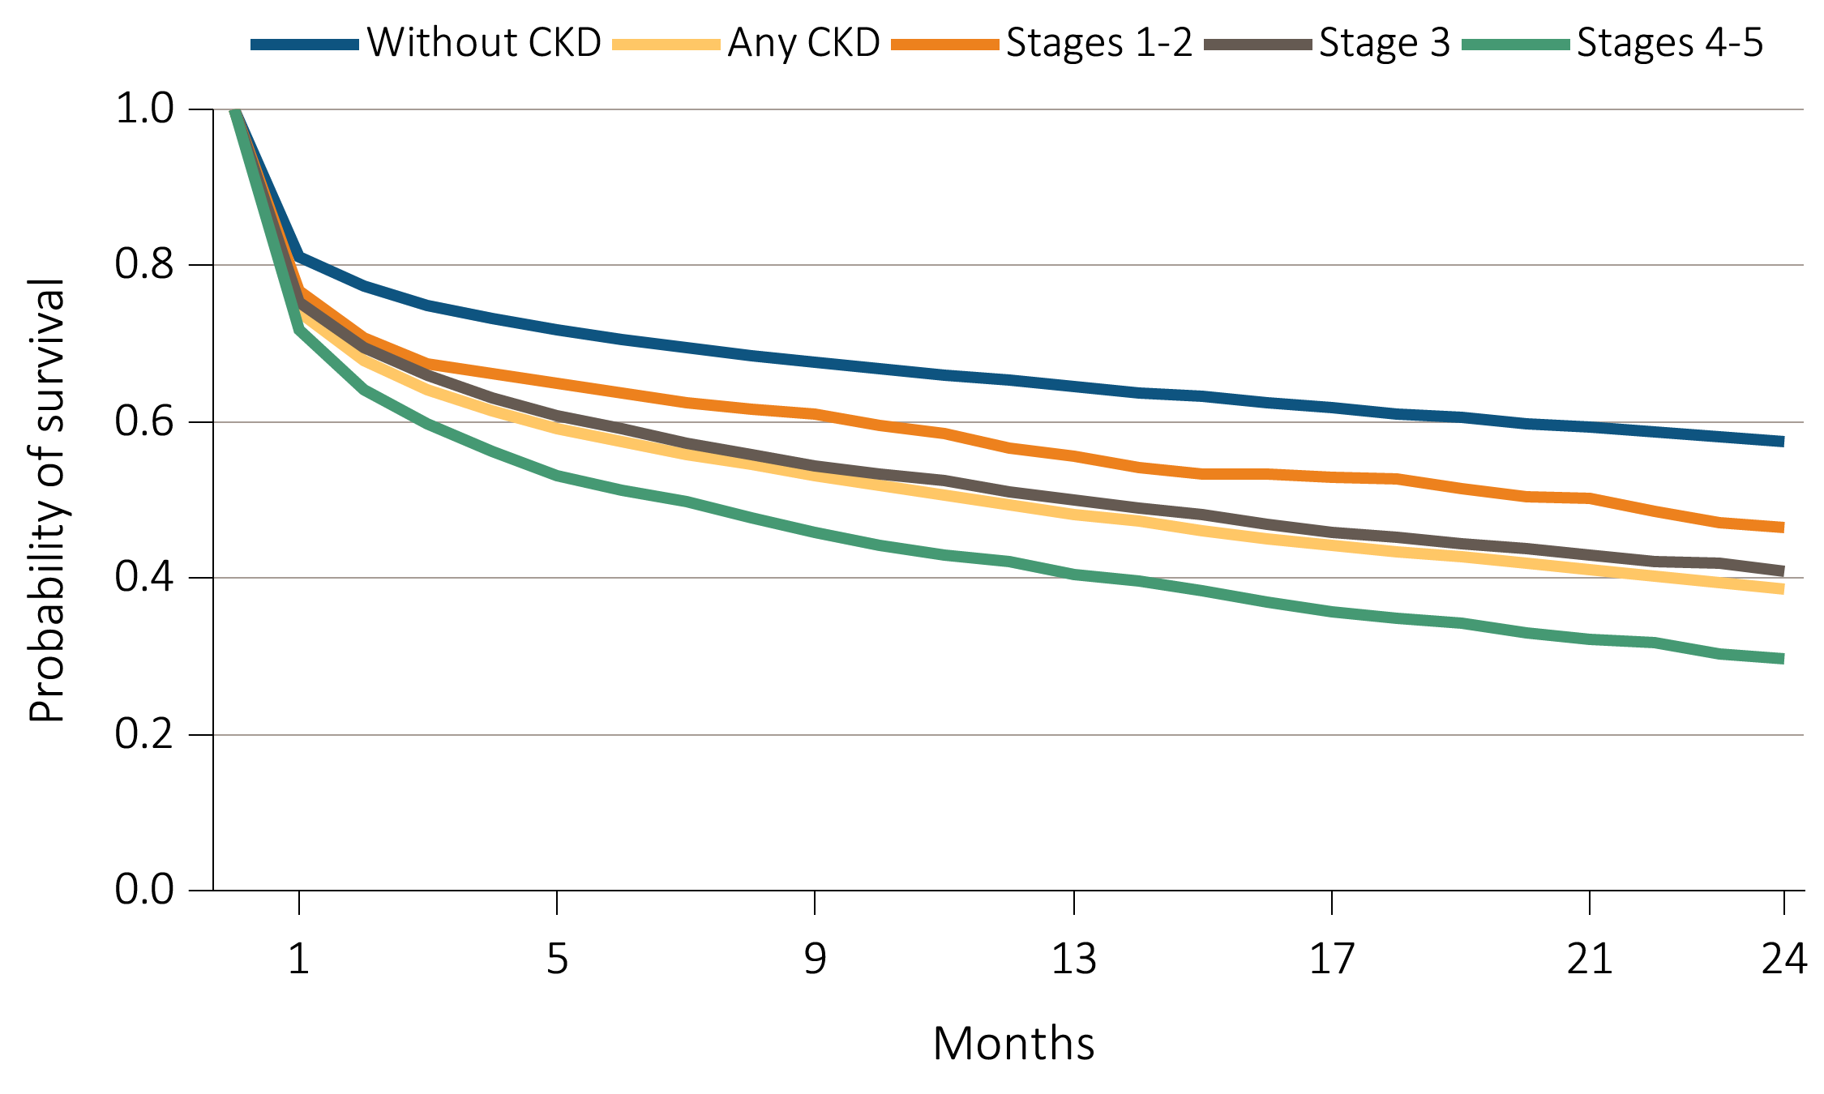
Figure i.11 Survival of patients with a cardiovascular diagnosis or procedure,
^{by CKD status, 2011-2013}
^{(a) AMI}
Data Source: Special analyses, Medicare 5 percent sample. Patients aged 66 and older, alive, without end-stage renal disease, and residing in the U.S. on the index date, which is the date of the first condition/procedure claim, with fee-for-service coverage for the entire year prior to this date. Abbreviations: AMI, acute myocardial infarction; CKD, chronic kidney disease. This graphic is adapted from Figure 4.2.

Slide 14
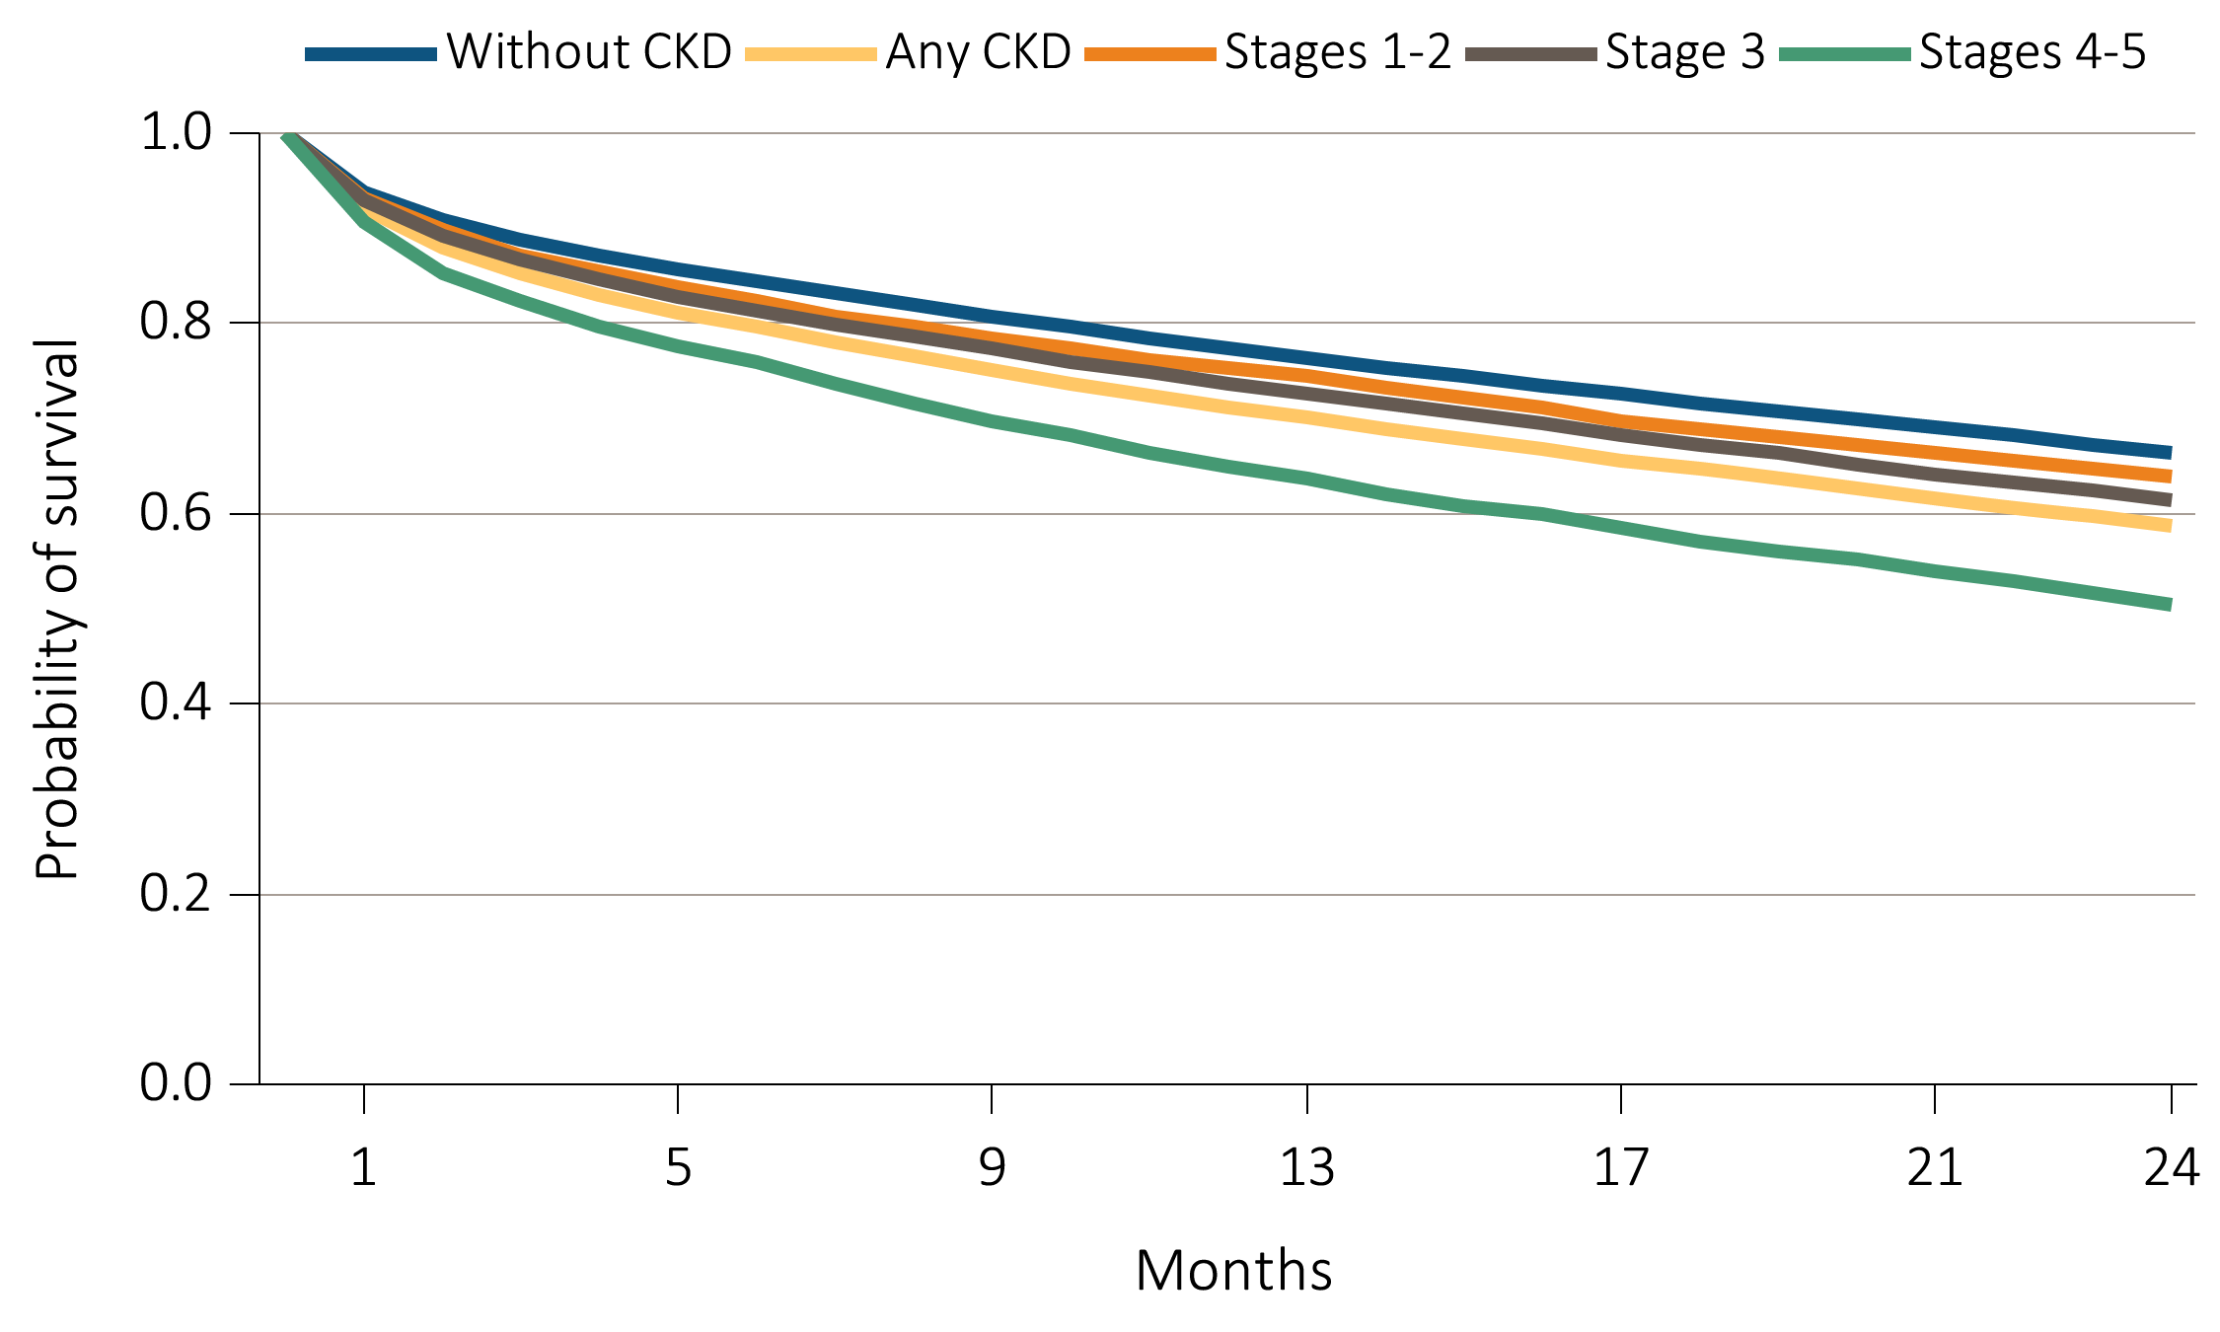
Figure i.11 Survival of patients with a cardiovascular diagnosis or procedure,
^{by CKD status, 2011-2013}
^{(b) CHF}
Data Source: Special analyses, Medicare 5 percent sample. Patients aged 66 and older, alive, without end-stage renal disease, and residing in the U.S. on the index date, which is the date of the first condition/procedure claim, with fee-for-service coverage for the entire year prior to this date. Abbreviations: CHF, congestive heart failure; CKD, chronic kidney disease. This graphic is adapted from Figure 4.2.

Slide 15
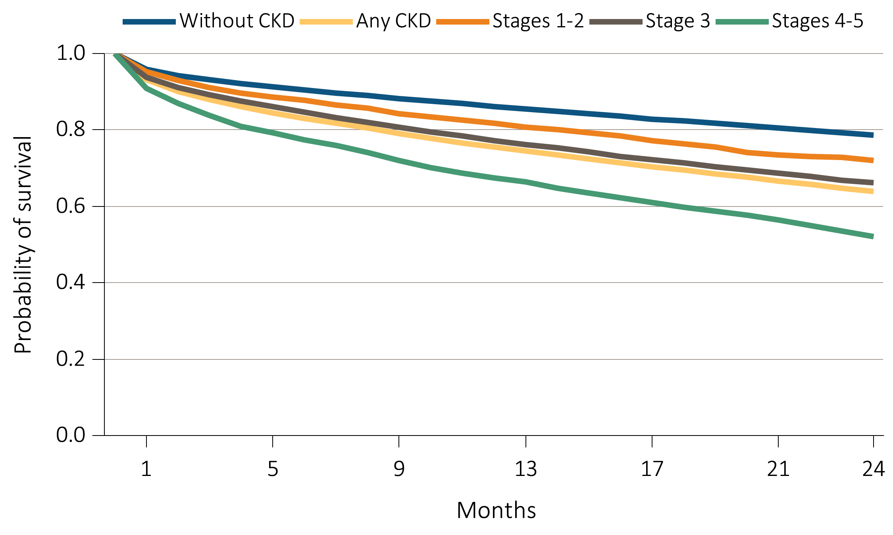
Figure i.11 Survival of patients with a cardiovascular diagnosis or procedure,
^{by CKD status, 2011-2013}
^{(c) CVA/TIA}
Data Source: Special analyses, Medicare 5 percent sample. Patients aged 66 and older, alive, without end-stage renal disease, and residing in the U.S. on the index date, which is the date of the first condition/procedure claim, with fee-for-service coverage for the entire year prior to this date. Abbreviations: CVA/TIA, cerebrovascular accident/transient ischemic attack; CKD, chronic kidney disease. This graphic is adapted from Figure 4.2.

Slide 16
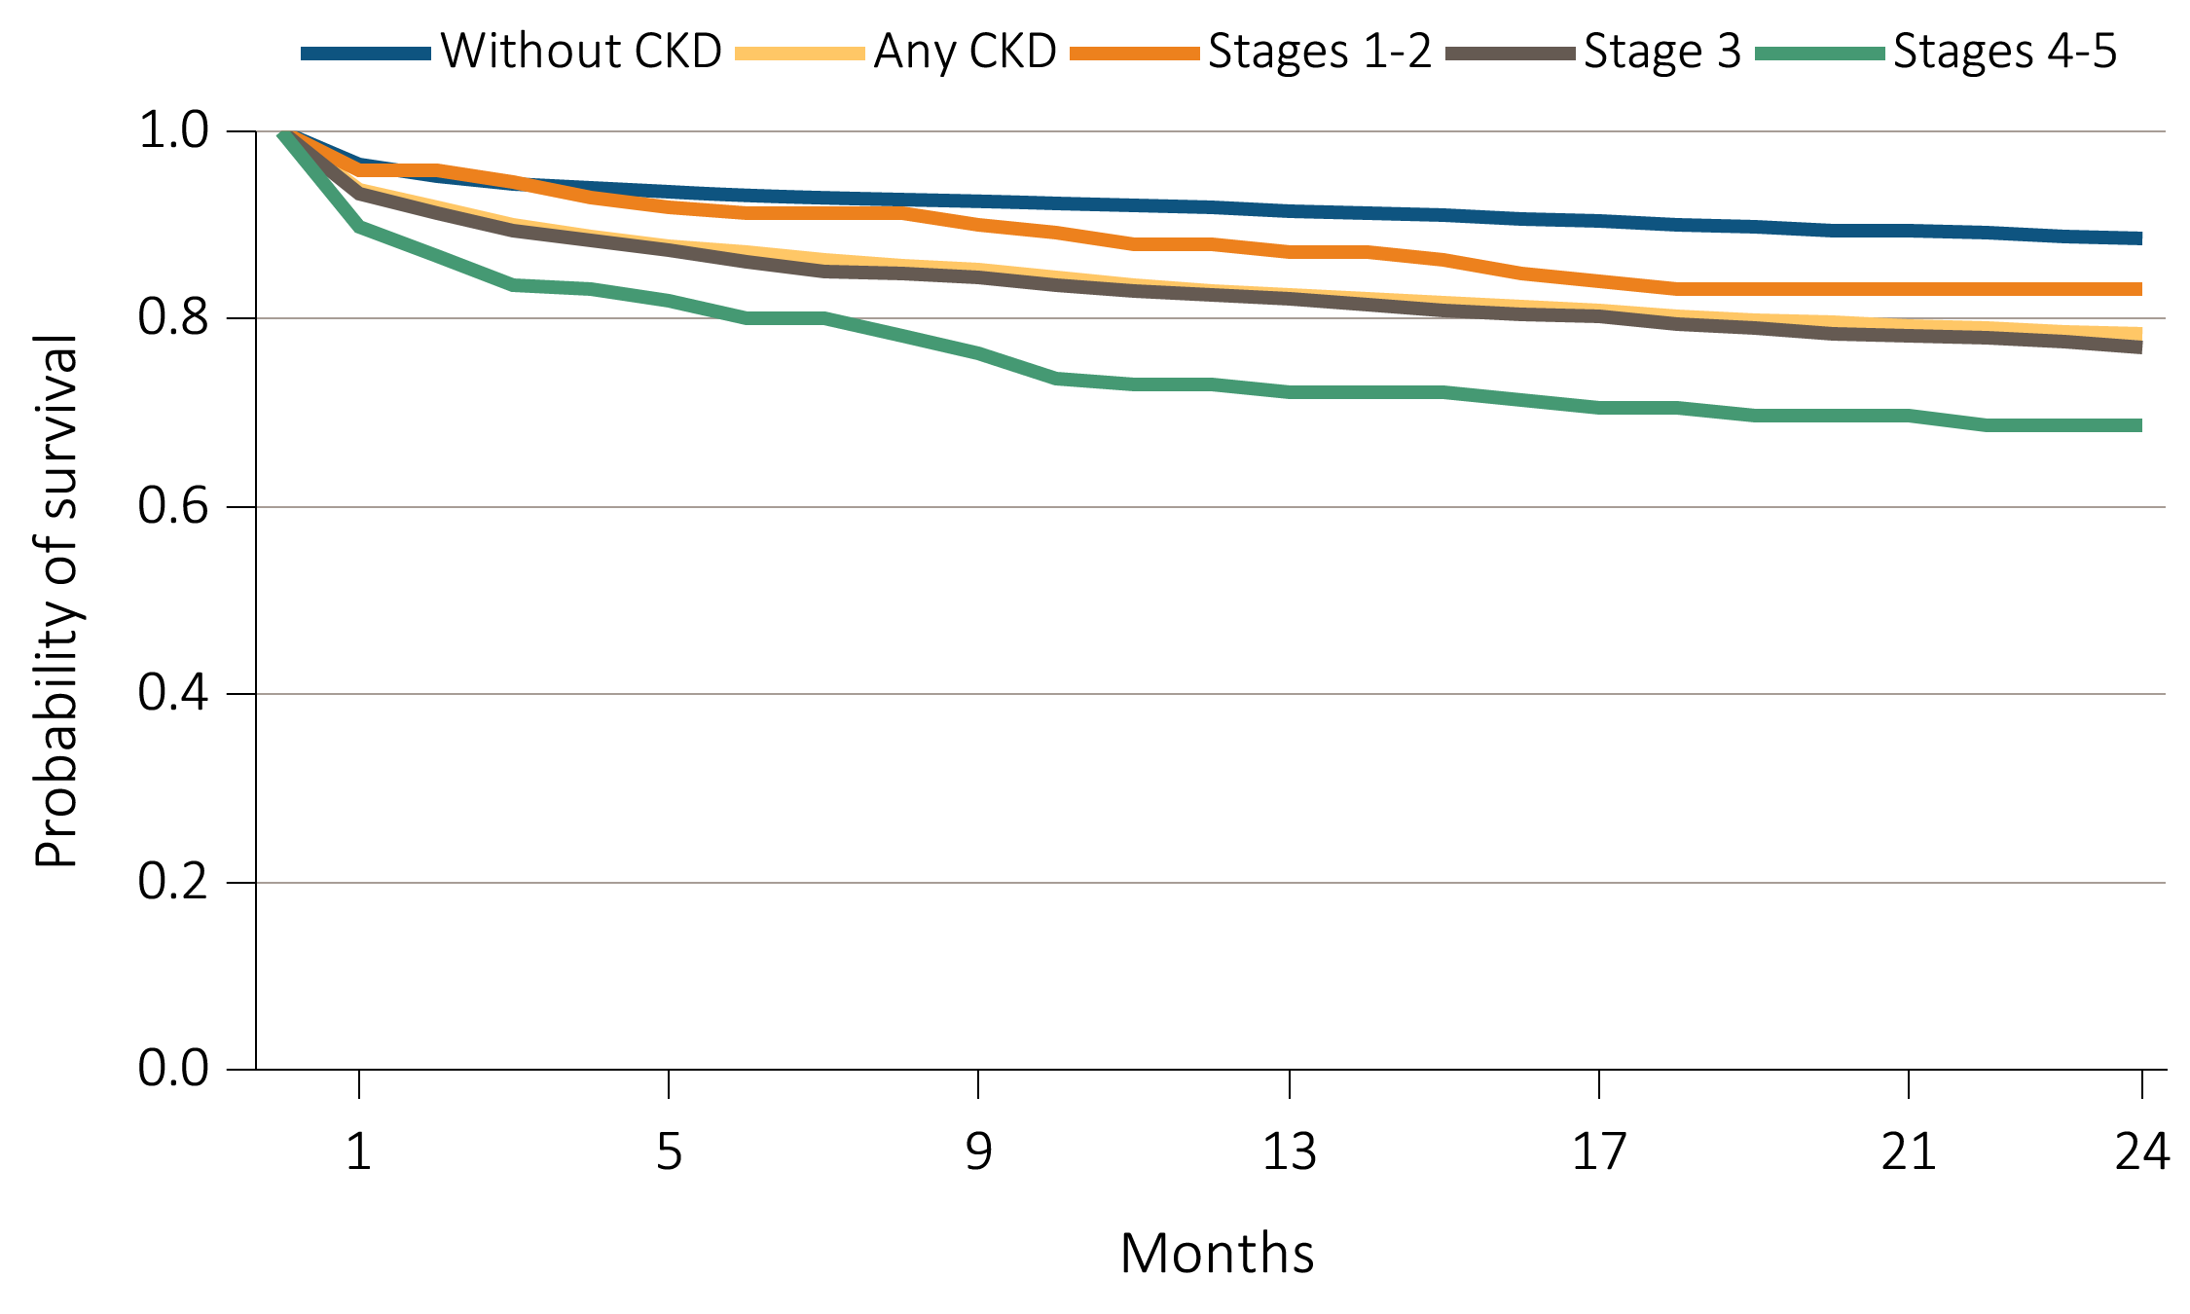
Figure i.11 Survival of patients with a cardiovascular diagnosis or procedure,
^{by CKD status, 2011-2013}
^{(d) CABG}
Data Source: Special analyses, Medicare 5 percent sample. Patients aged 66 and older, alive, without end-stage renal disease, and residing in the U.S. on the index date, which is the date of the first condition/procedure claim, with fee-for-service coverage for the entire year prior to this date. Abbreviations: CABG, coronary artery bypass grafting; CKD, chronic kidney disease. This graphic is adapted from Figure 4.2.

Slide 17
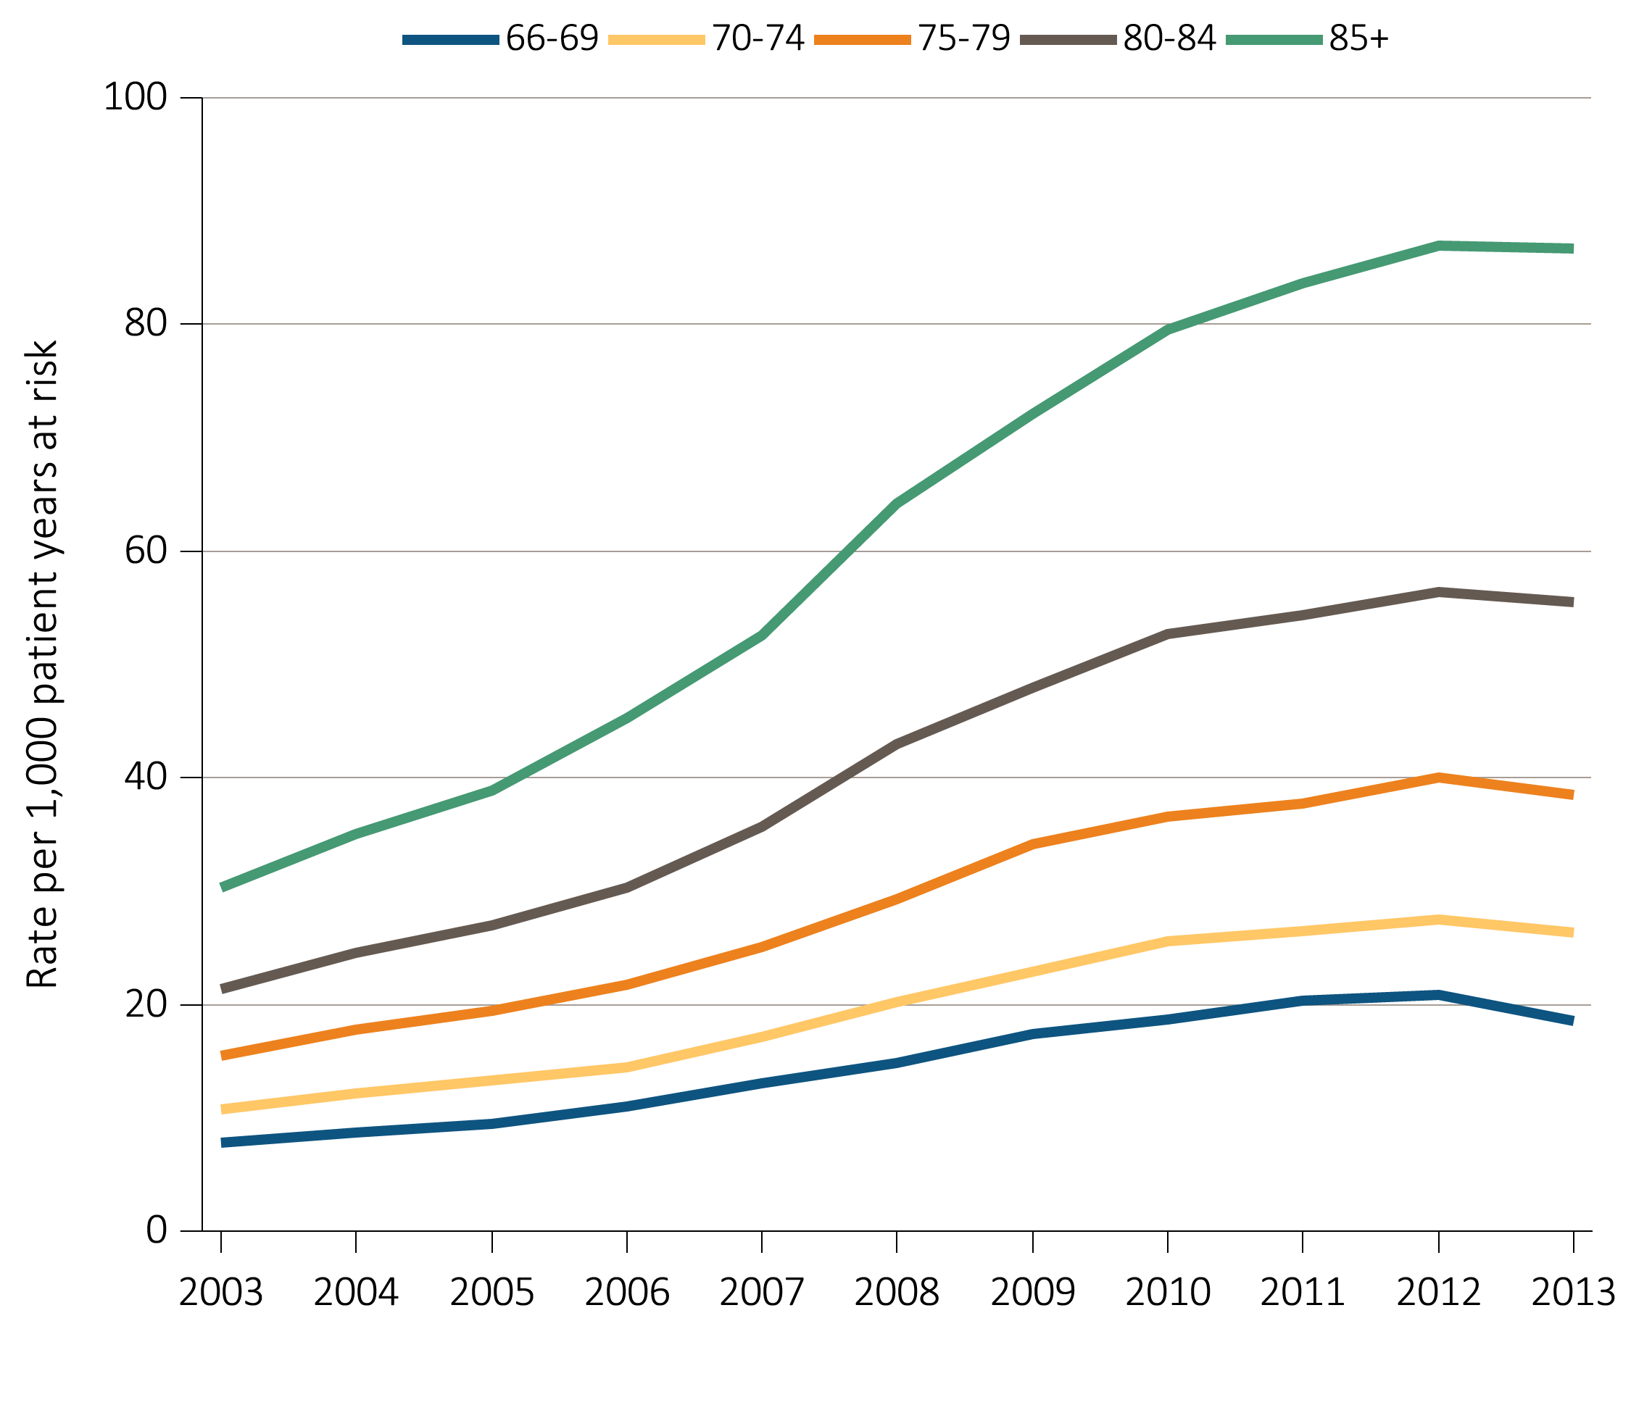
Figure i.12 Unadjusted rates of first hospitalization with AKI
for Medicare patients aged 66+, by age and year, 2003-2013
Data Source: Special analyses, Medicare 5 percent sample. Age as of January 1 of specified year. All patient-years at risk for Medicare patients aged 66 and older who had both Medicare Parts A & B, no Medicare Advantage plan, no ESRD by first service date from Medical Evidence form, and were alive on January 1 of year shown. Censored at death, ESRD, end of Medicare Parts A & B participation, or switch to Medicare Advantage program. Abbreviations: AKI, acute kidney injury; ESRD, end-stage renal disease. This graphic also appears as Figure 5.2.

Slide 18
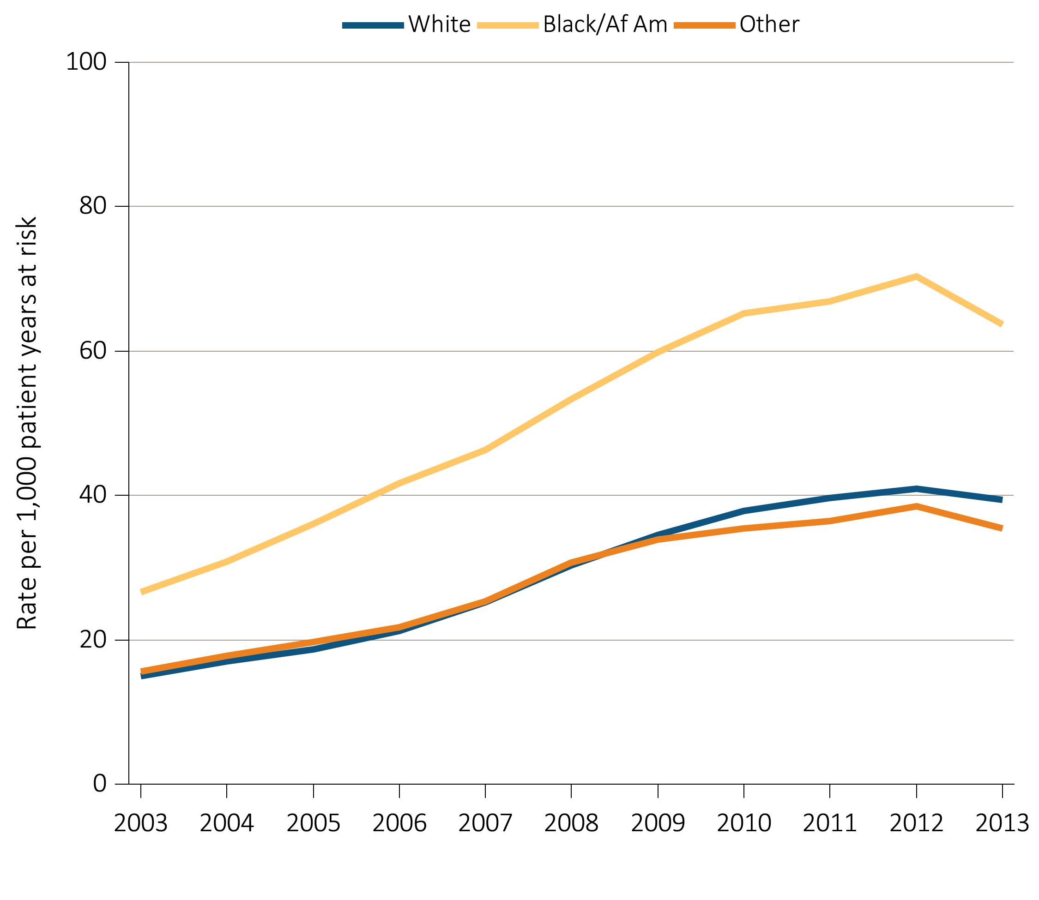
Figure i.13 Unadjusted rates of first hospitalization with AKI
for Medicare patients aged 66+, by race and year, 2003-2013
Data Source: Special analyses, Medicare 5 percent sample. All patient-years at risk for Medicare patients aged 66 and older who had both Medicare Parts A & B, no Medicare Advantage plan, no ESRD by first service date from Medical Evidence form, and were alive on January 1 of year shown. Censored at death, ESRD, end of Medicare Parts A & B participation, or switch to Medicare Advantage program. Abbreviations: Af Am, African American; AKI, acute kidney injury; ESRD, end-stage renal disease. This graphic also appears as Figure 5.3.

Slide 19
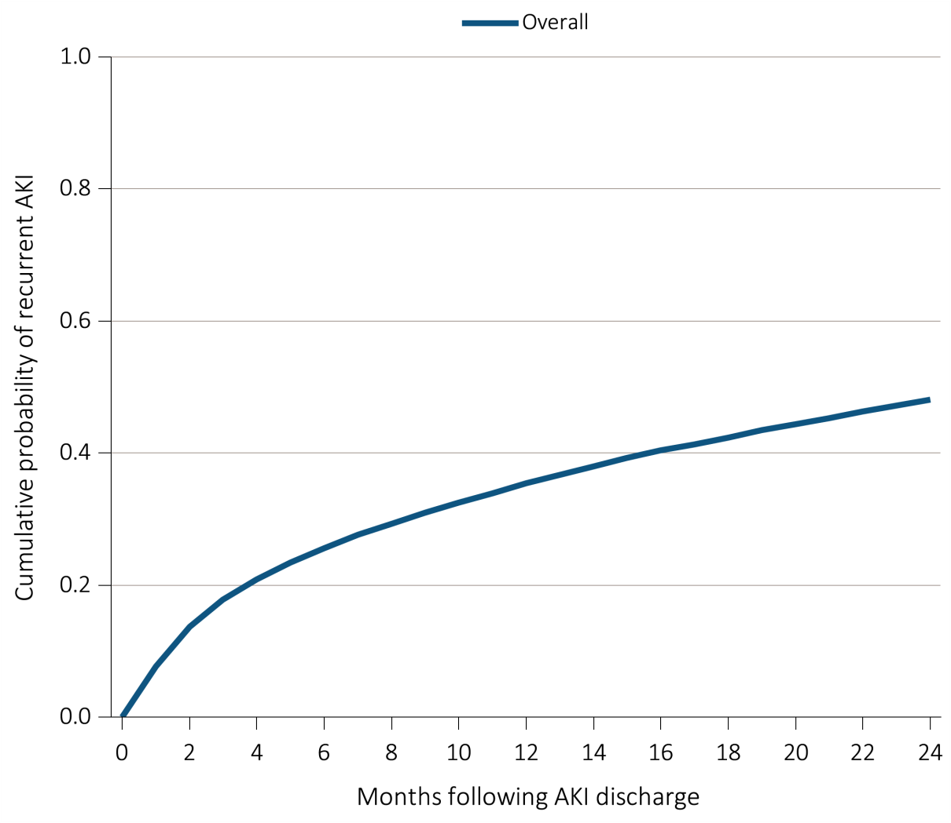
Figure i.14 Cumulative probability of a recurrent AKI hospitalization within two years of live discharge from first AKI hospitalization in 2011 for Medicare patients aged 66+
^{(a) Overall}
Data Source: Special analyses, Medicare 5 percent sample. Age on January 1, 2011. Medicare patients aged 66 and older who had both Medicare Parts A & B, no Medicare Advantage plan, no ESRD by first service date from Medical Evidence form on 1/1/2011 and were discharged alive from an AKI hospitalization in 2011. Censored at death, ESRD, end of Medicare Parts A & B participation, or switch to Medicare Advantage program. Abbreviations: AKI, acute kidney injury; ESRD, end-stage renal disease. This graphic also appears as Figure 5.7.

Slide 20
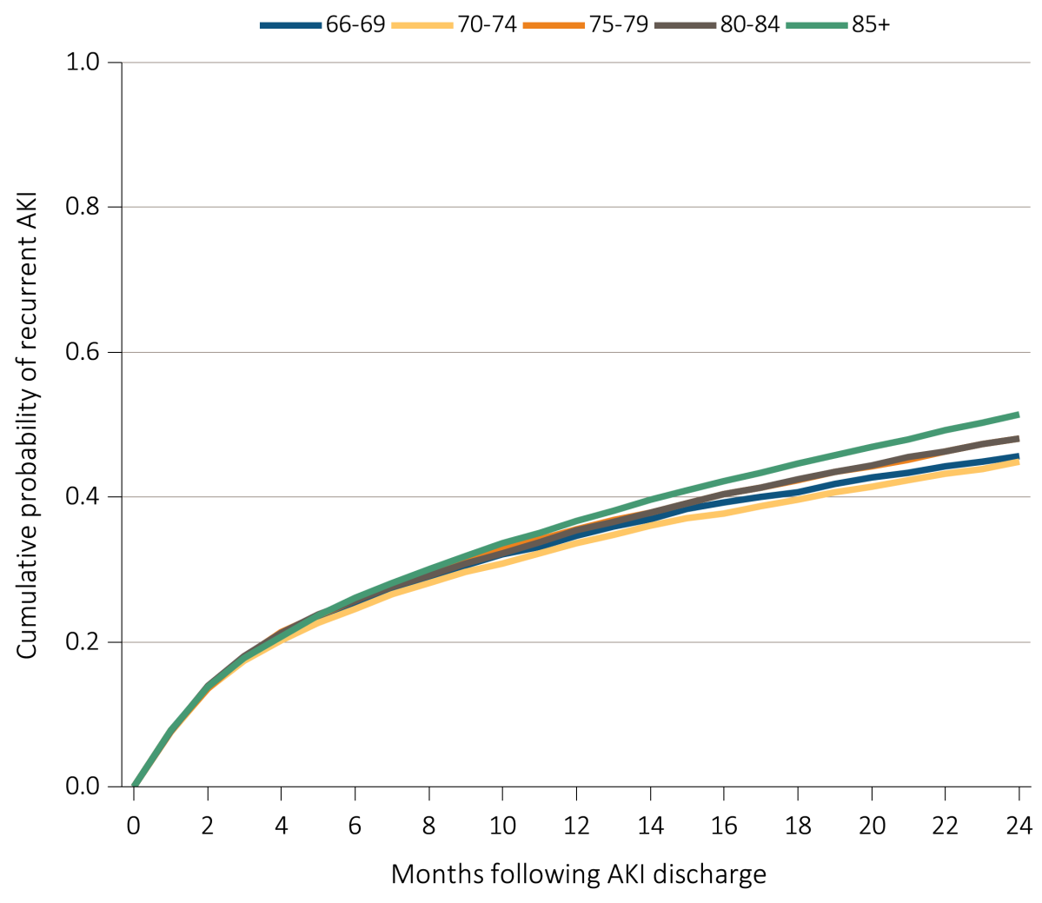
Figure i.14 Cumulative probability of a recurrent AKI hospitalization within two years of live discharge from first AKI hospitalization in 2011 for Medicare patients aged 66+
^{(b) Age}
Data Source: Special analyses, Medicare 5 percent sample. Age on January 1, 2011. Medicare patients aged 66 and older who had both Medicare Parts A & B, no Medicare Advantage plan, no ESRD by first service date from Medical Evidence form on 1/1/2011 and were discharged alive from an AKI hospitalization in 2011. Censored at death, ESRD, end of Medicare Parts A & B participation, or switch to Medicare Advantage program. Abbreviations: AKI, acute kidney injury; ESRD, end-stage renal disease. This graphic also appears as Figure 5.7.

Slide 21
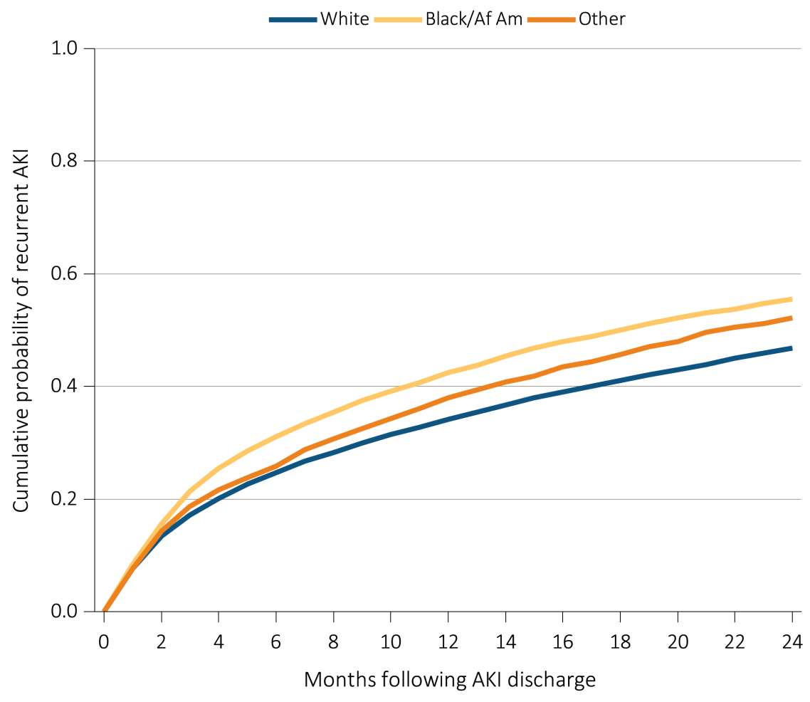
Figure i.14 Cumulative probability of a recurrent AKI hospitalization within two years of live discharge from first AKI hospitalization in 2011 for Medicare patients aged 66+
^{(c) Race}
Data Source: Special analyses, Medicare 5 percent sample. Age on January 1, 2011. Medicare patients aged 66 and older who had both Medicare Parts A & B, no Medicare Advantage plan, no ESRD by first service date from Medical Evidence form on 1/1/2011 and were discharged alive from an AKI hospitalization in 2011. Censored at death, ESRD, end of Medicare Parts A & B participation, or switch to Medicare Advantage program. Abbreviations: AKI, acute kidney injury; Af Am, African American; ESRD, end-stage renal disease. This graphic also appears as Figure 5.7.

Slide 22
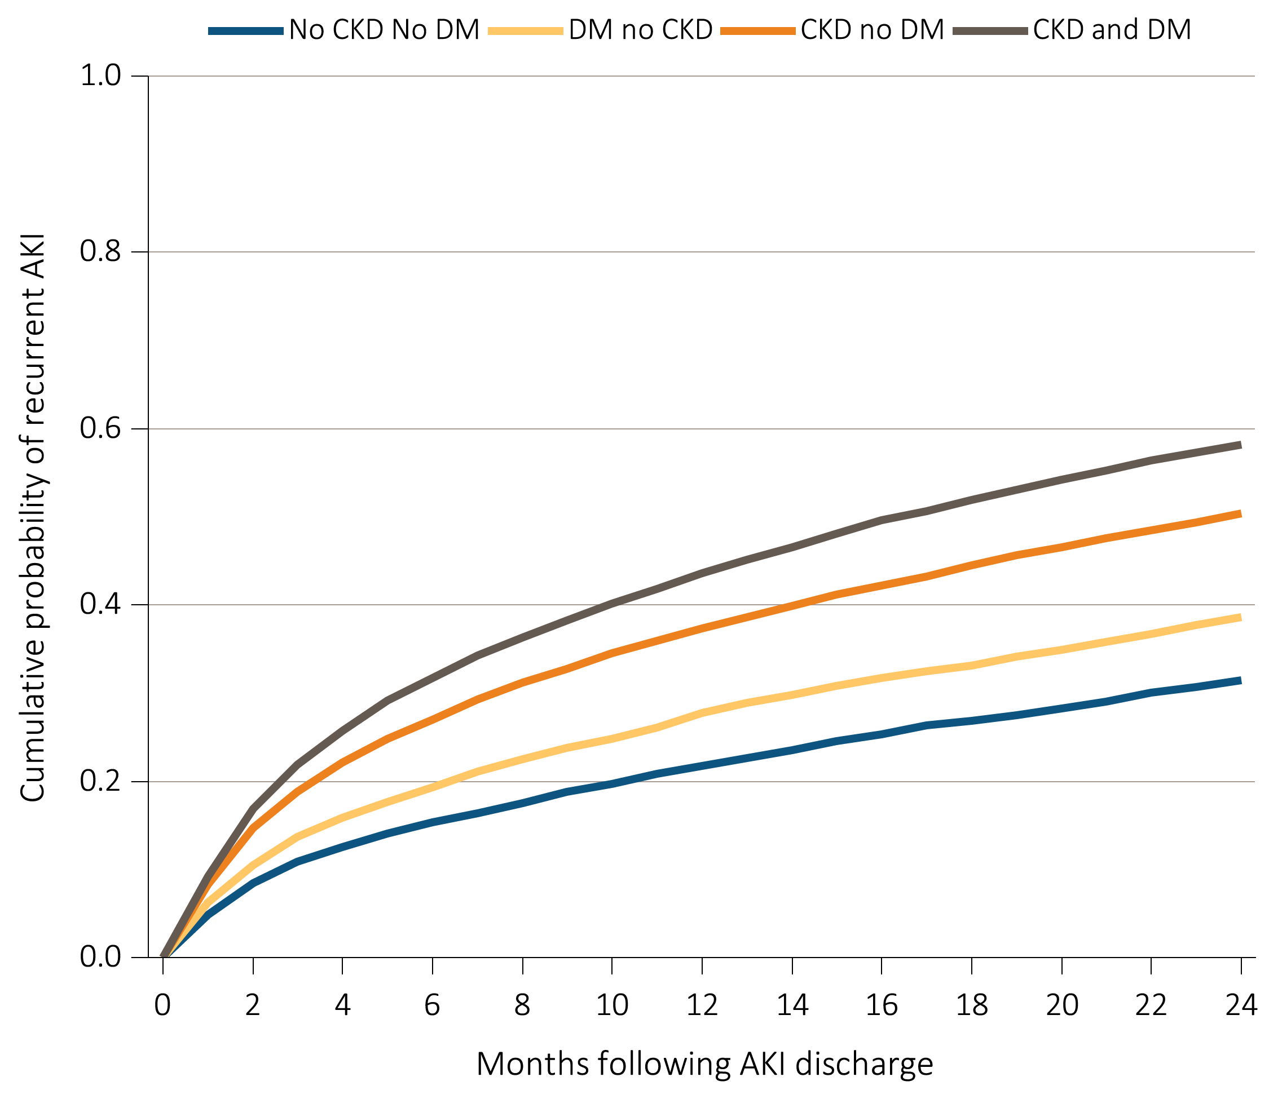
Figure i.14 Cumulative probability of a recurrent AKI hospitalization within two years of live discharge from first AKI hospitalization in 2011 for Medicare patients aged 66+
^{(d) CKD and DM}
Data Source: Special analyses, Medicare 5 percent sample. Age on January 1, 2011. Medicare patients aged 66 and older who had both Medicare Parts A & B, no Medicare Advantage plan, no ESRD by first service date from Medical Evidence form on 1/1/2011 and were discharged alive from an AKI hospitalization in 2011. Censored at death, ESRD, end of Medicare Parts A & B participation, or switch to Medicare Advantage program. Abbreviations: AKI, acute kidney injury; CKD, chronic kidney disease; DM, diabetes mellitus; ESRD, end-stage renal disease. This graphic also appears as Figure 5.7.

Slide 23
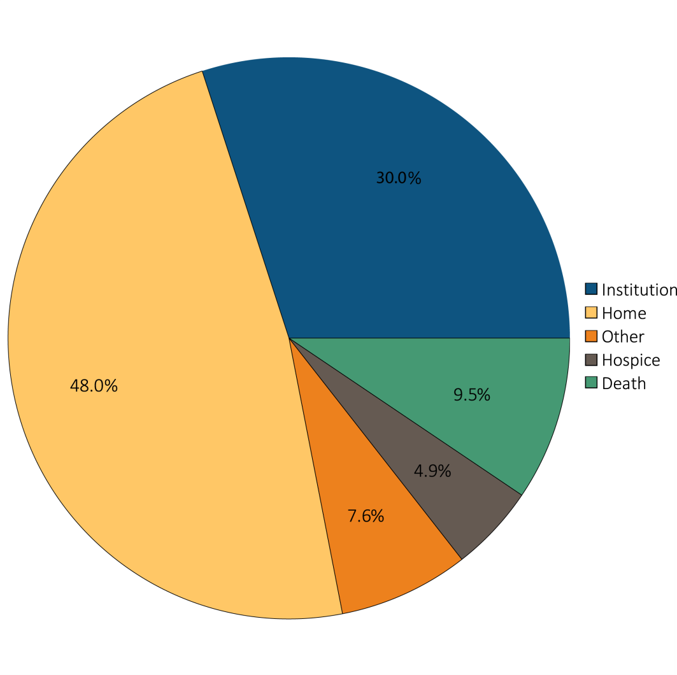
Figure i.15 Hospital discharge status of first AKI hospitalization
for Medicare patients aged 66+, 2013
Data Source: Special analyses, Medicare 5 percent sample. Medicare patients aged 66 and older who had both Medicare Parts A & B, no Medicare Advantage plan, did not have ESRD on 1/1/2013, and had a first AKI hospitalization in 2013. Institution includes short-term skilled nursing facilities, rehabilitation hospitals, and long-term care facilities. Home also includes patients receiving home health care services. Excludes patients admitted to the acute care hospital from a skilled nursing facility. Abbreviations: AKI, acute kidney injury; ESRD, end-stage renal disease. This graphic also appears as Figure 5.14.

Slide 24
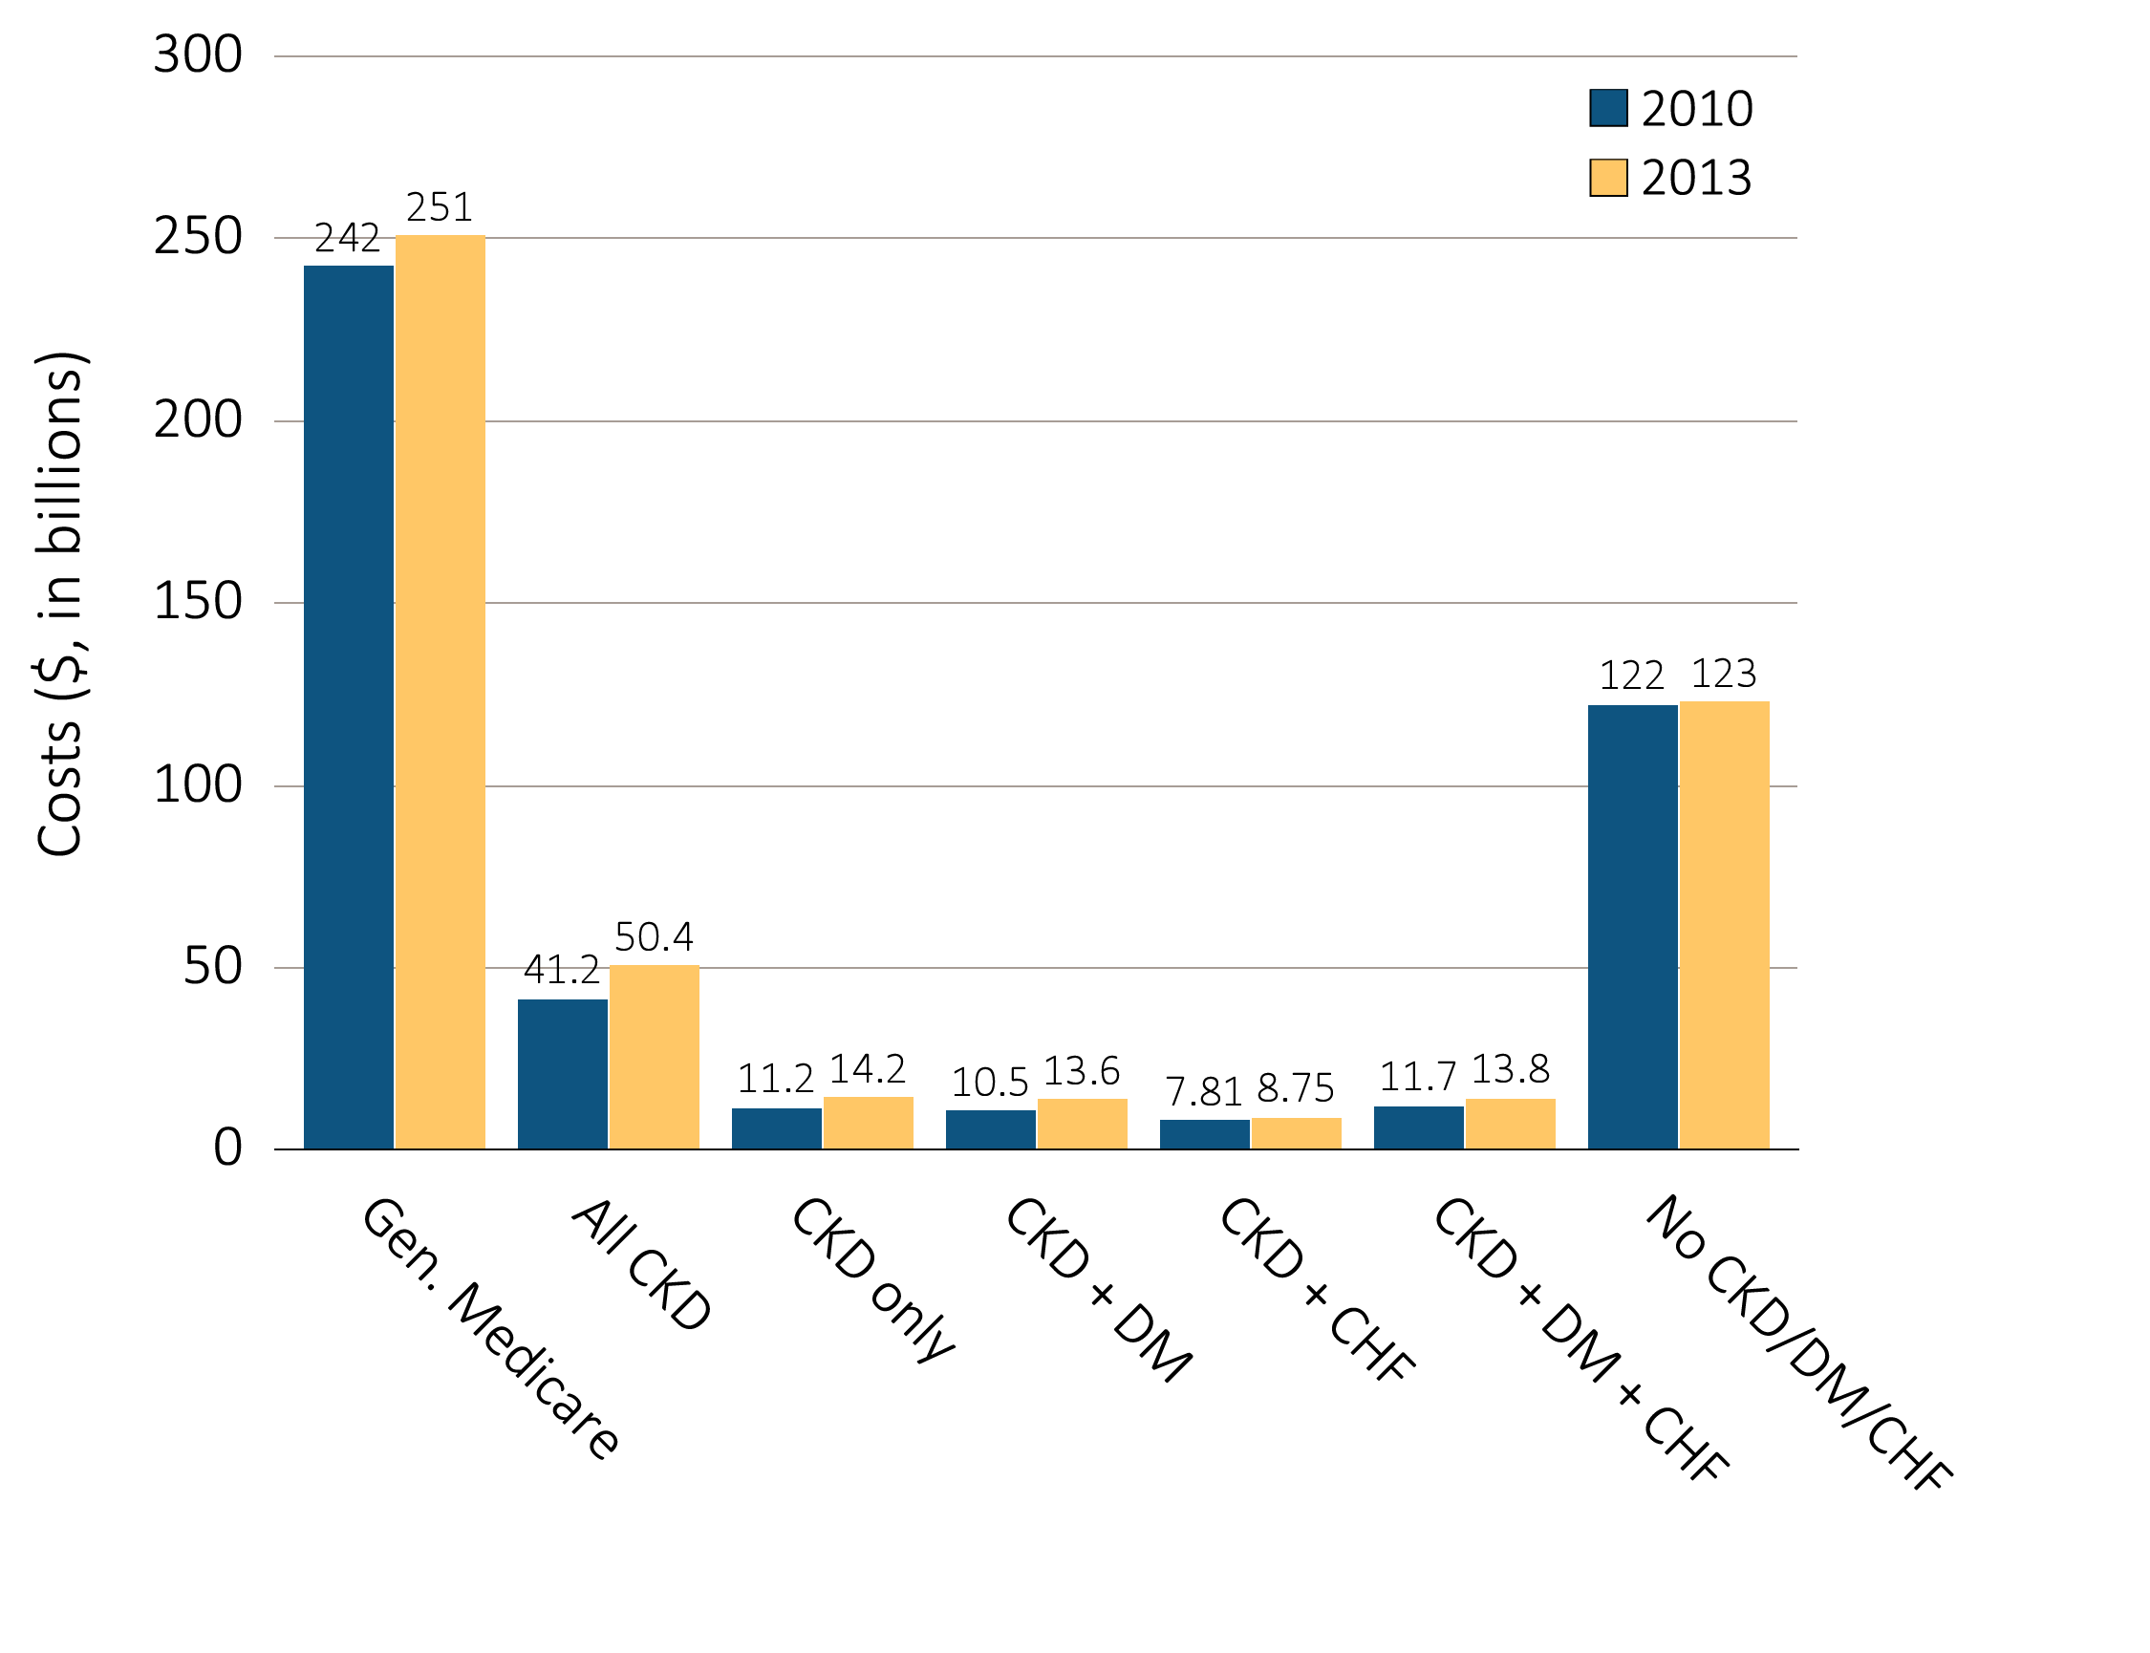
Figure i.16 Overall Medicare Parts A, B, and D costs for fee-for-service patients aged 65+, by CKD, DM, CHF, and year, 2010 & 2013
Data source: Special analyses, Medicare 5 percent sample. Abbreviations: CKD, chronic kidney disease; CHF, congestive heart failure, DM, diabetes mellitus. This graphic also appears as Figure 6.1.

Slide 25
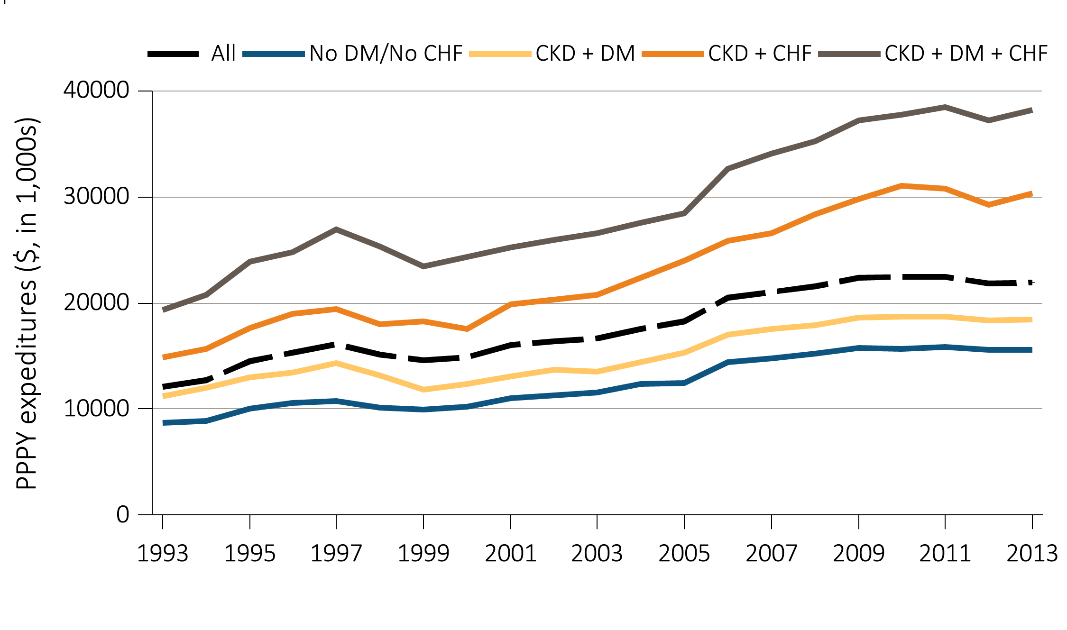
Figure i.17 Per person per year expenditures on Parts A, B, and D services for the CKD Medicare population aged 65+, by DM, CHF, and year, 1993-2013
Data Source: Special analyses, Medicare 5 percent sample. Abbreviations: CKD, chronic kidney disease; CHF, congestive heart failure, DM, diabetes mellitus; PPPY, per person per year. This graphic also appears as Figure 6.5.

Slide 26
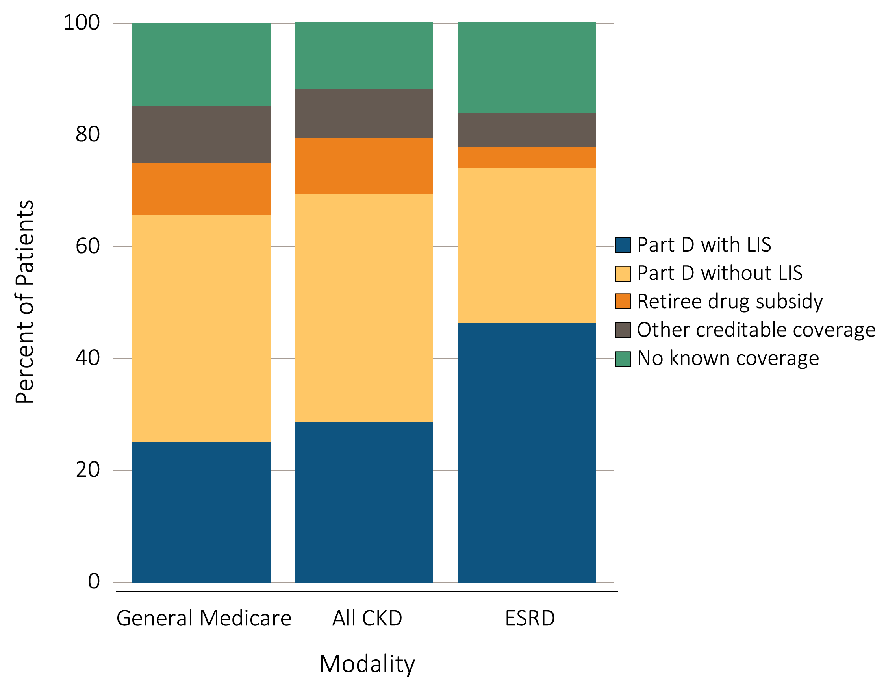
Figure i.18 Sources of prescription drug coverage in Medicare enrollees,
^{by population, 2013}
Data source: Special analyses, Medicare 5 percent sample. Point prevalent Medicare enrollees alive on January 1, 2013. Abbreviations: CKD, chronic kidney disease; ESRD, end-stage renal disease; LIS, Medicare Low-income Subsidy; Part D, Medicare prescription drug coverage benefit. This graphic also appears as Figure 7.1.

Slide 27
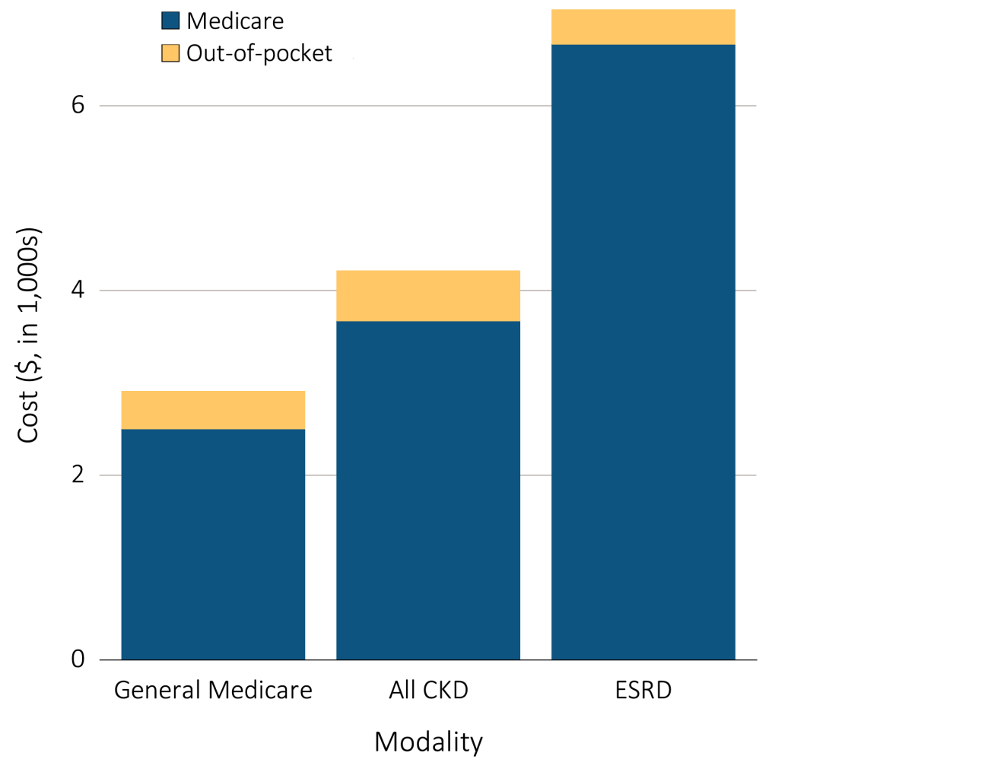
Figure i.19 Per person per year Medicare & out-of-pocket Part D costs for enrollees, 2013
^{(a) All part D enrollees}
Data source: Special analyses, Medicare 5 percent sample. Medicare totals include Part D claims for Part D enrollees with traditional Medicare (Parts A & B). CKD totals include Medicare CKD patients as determined from claims. ESRD totals include all Part D claims for Medicare ESRD patients with Medicare Part D stand-alone prescription drug plans. Costs are per person per year for calendar year 2013. Medicare total is the sum of Medicare net payment plus Low-income Supplement amount. Abbreviations: CKD, chronic kidney disease; ESRD, end-stage renal disease; Part D, Medicare prescription drug coverage benefit. This graphic also appears as Figure 7.5.a .

Slide 28
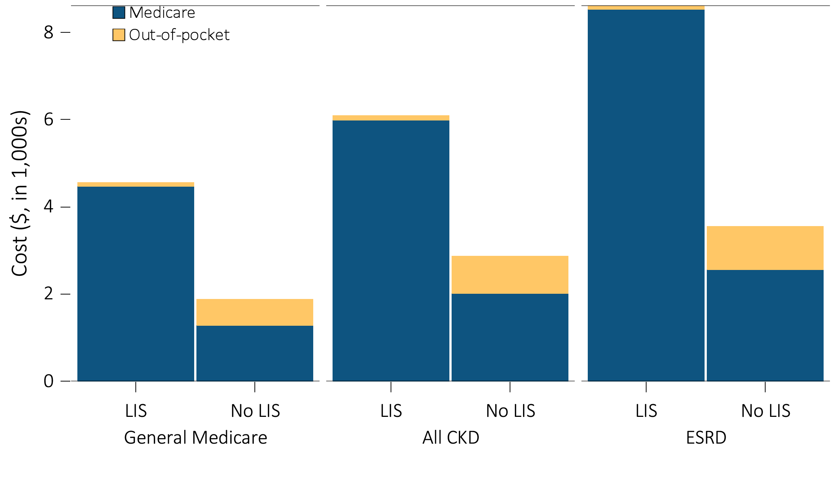
Figure i.19 Per person per year Medicare & out-of-pocket Part D costs for enrollees, 2013
(b) Part D enrollees by low income subsidy status
Data source: Special analyses, Medicare 5 percent sample. Medicare totals include Part D claims for Part D enrollees with traditional Medicare (Parts A & B). CKD totals include Medicare CKD patients as determined from claims. ESRD totals include all Part D claims for Medicare ESRD patients with Medicare Part D stand-alone prescription drug plans. Costs are per person per year for calendar year 2013. Medicare total is the sum of Medicare net payment plus Low-income Supplement amount. Abbreviations: CKD, chronic kidney disease; ESRD, end-stage renal disease; Part D, Medicare prescription drug coverage benefit. This graphic also appears as Figure 7.5.b.

Slide 29
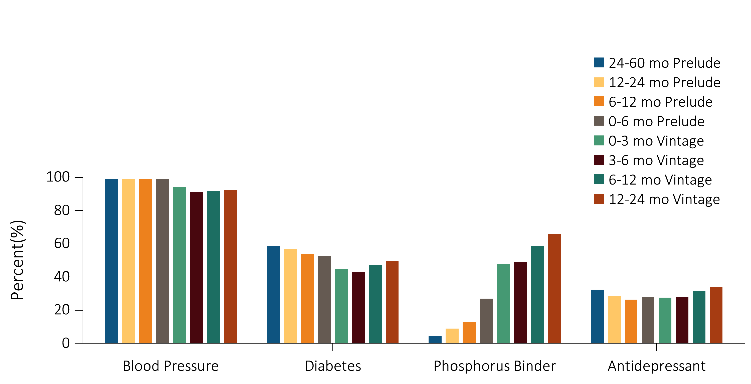
Figure i.20 Medications prescribed to 52,172 incident ESRD veterans who transitioned to ESRD from 10/1/2007-9/30/2011
Data source: Special analyses, VHA Administrative data and CMS Medicare Inpatient and Outpatient data. An individual's data includes the period from 60 months prior to transition (prelude) to 24 months following transition (vintage). Abbreviations: CMS, Centers for Medicare & Medicaid; ESRD, end-stage renal disease; mo, month; VHA, Veterans Health Administration. This graphic also appears as Figure 8.3.

Slide 30
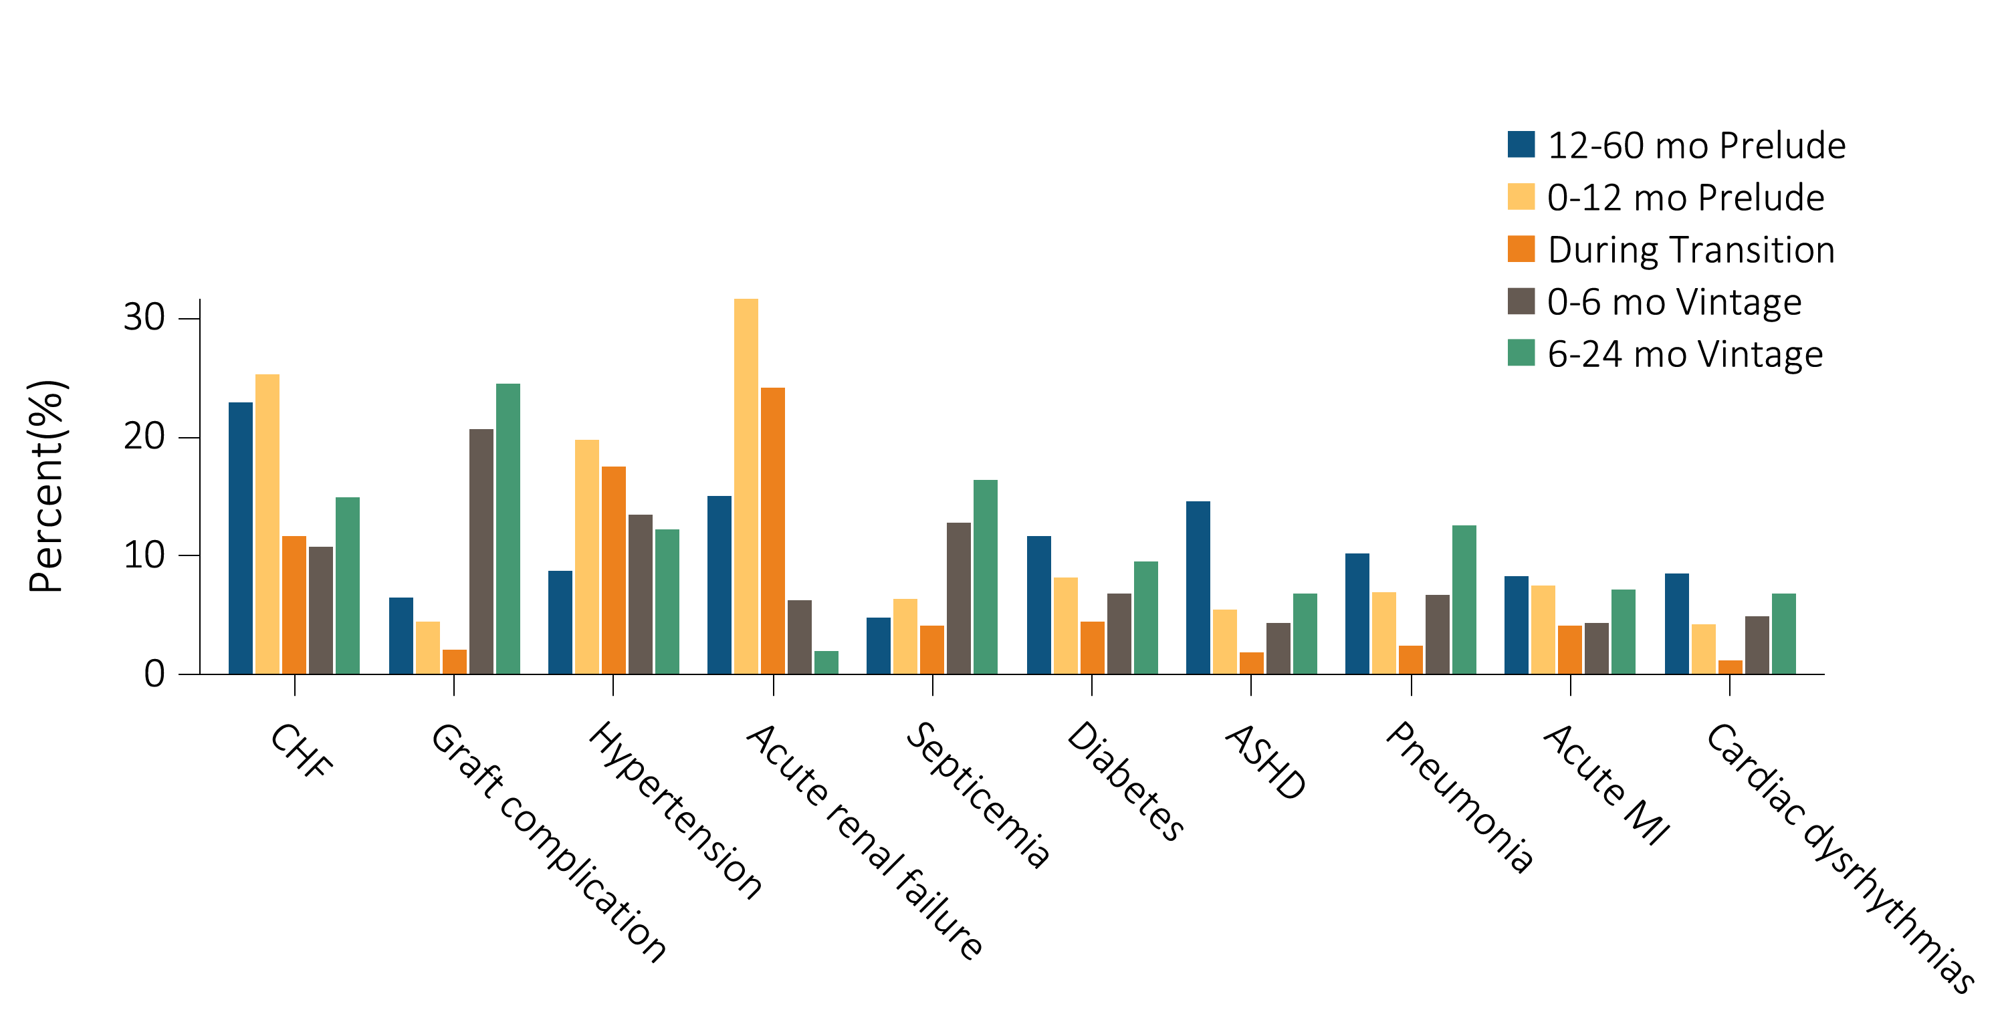
Figure i.21 Top 20 causes of hospitalizations in 46,625 incident ESRD veterans who were hospitalized at least once during the -60 months prior to ESRD transition (prelude) up to +24 months after ESRD transition (vintage)
(a) 10 of the top 20 causes of hospitalizations
Data source: Special analyses, VHA Administrative data, USRDS ESRD Database, CMS Medicare Inpatient and Outpatient data. Abbreviations: ASHD, atherosclerotic heart disease; CHF, congestive heart failure; CMS, Centers for Medicare & Medicaid; MI, myocardial infarction; mo, month; VHA, Veterans Health Administration. This graphic also appears as Figure 8.6.a.

Slide 31
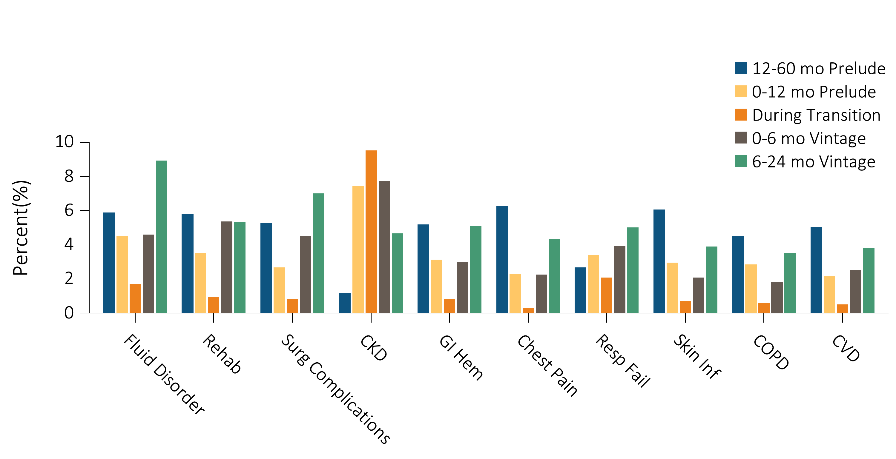
Figure i.21 Top 20 causes of hospitalizations in 46,625 incident ESRD veterans who were hospitalized at least once during the -60 months prior to ESRD transition (prelude) up to +24 months after ESRD transition (vintage)
(b) 10 of the top 20 causes of hospitalizations
Data source: Special analyses, VHA Administrative data, USRDS ESRD Database, CMS Medicare Inpatient and Outpatient data. Abbreviations: CKD, chronic kidney disease; CMS, Centers for Medicare & Medicaid; COPD, chronic obstructive pulmonary disease; CVD, acute cerebrovascular disease; GI Hem, gastrointestinal hemorrhage; mo, month; Resp Fail, respiratory failure; Skin Inf, skin infection; surg, surgical; VHA, Veterans Health Administration. This graphic also appears as Figure 8.6.b.

Slide 32
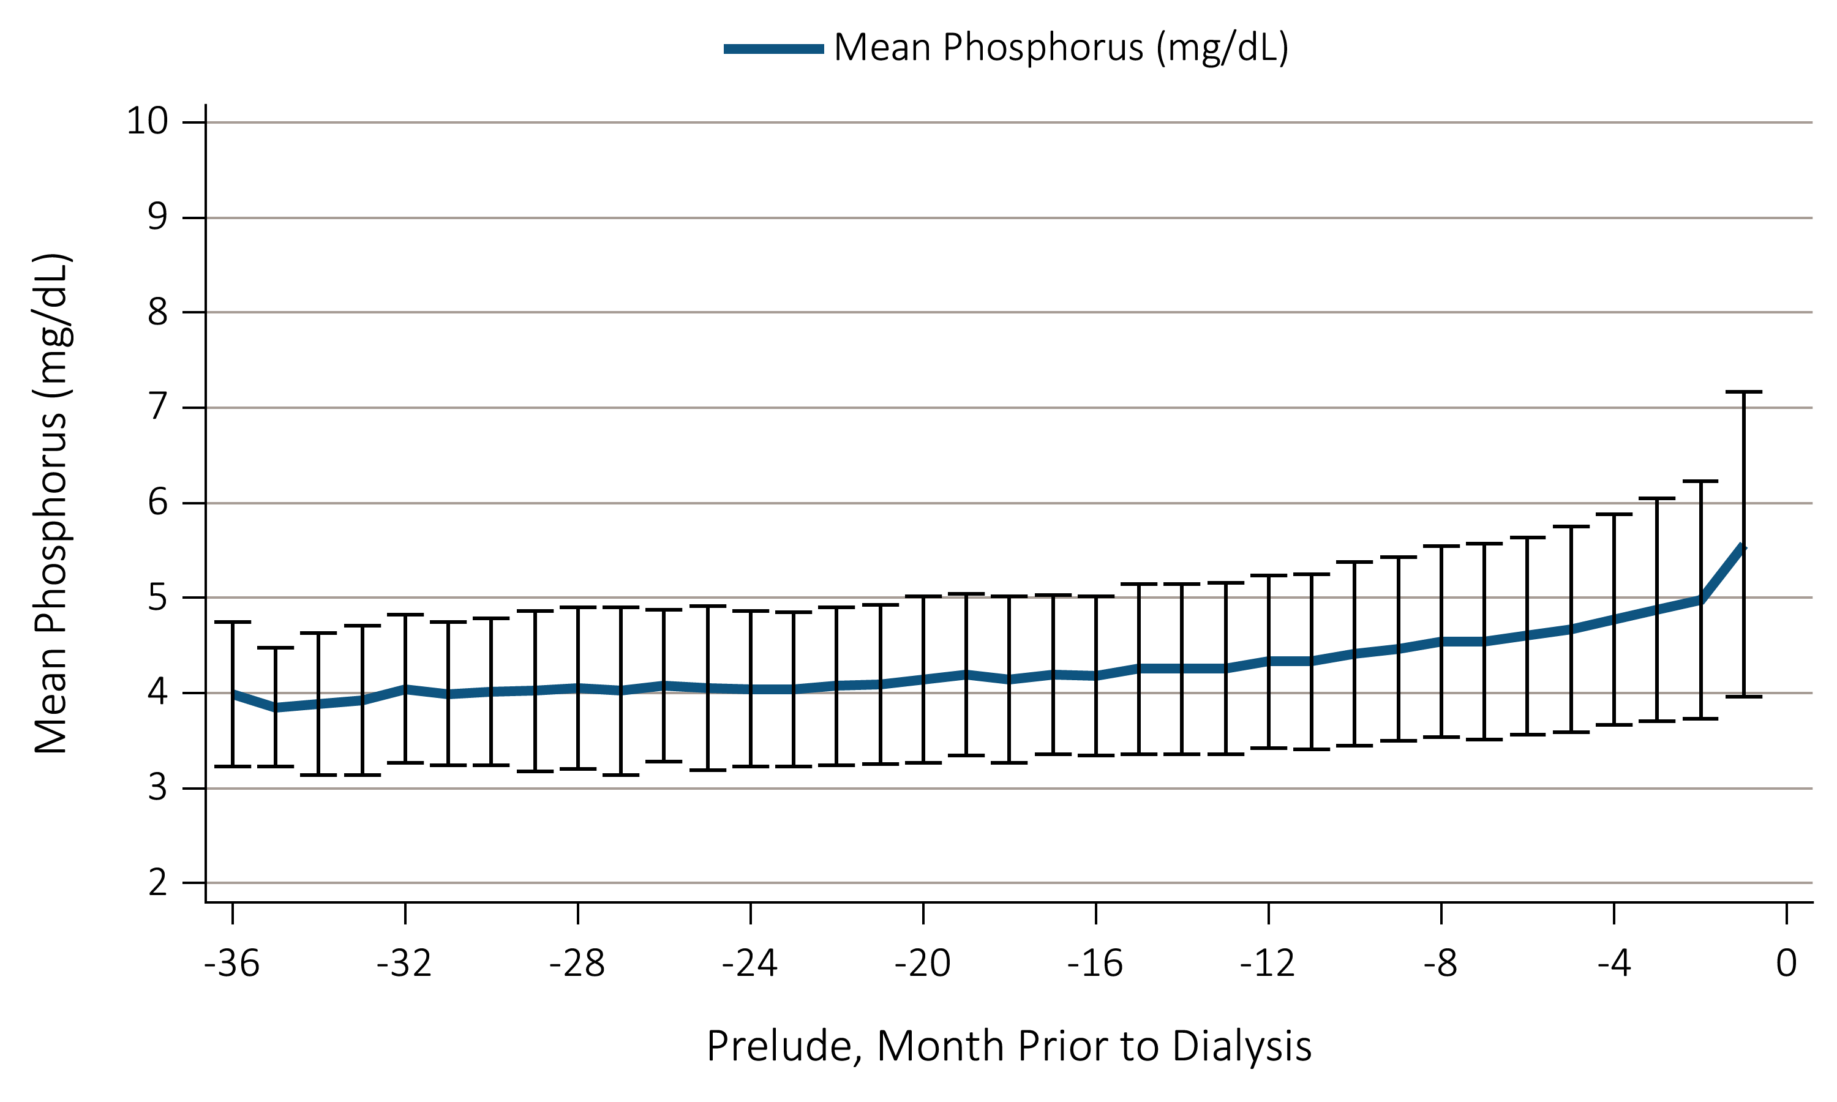
Figure i.22 Trend in serum phosphorus level during the prelude (pre-ESRD) time over 36 months in 11,896 veterans who later transitioned to ESRD during 10/1/2007-9/31/2011
Data source: Special analyses, VHA Administrative data, USRDS ESRD Database. Abbreviations: ESRD, end-stage renal disease; g/dL, grams per deciliter; VHA, Veterans Health Administration. This graphic also appears as Figure 8.9.

