Slide 2
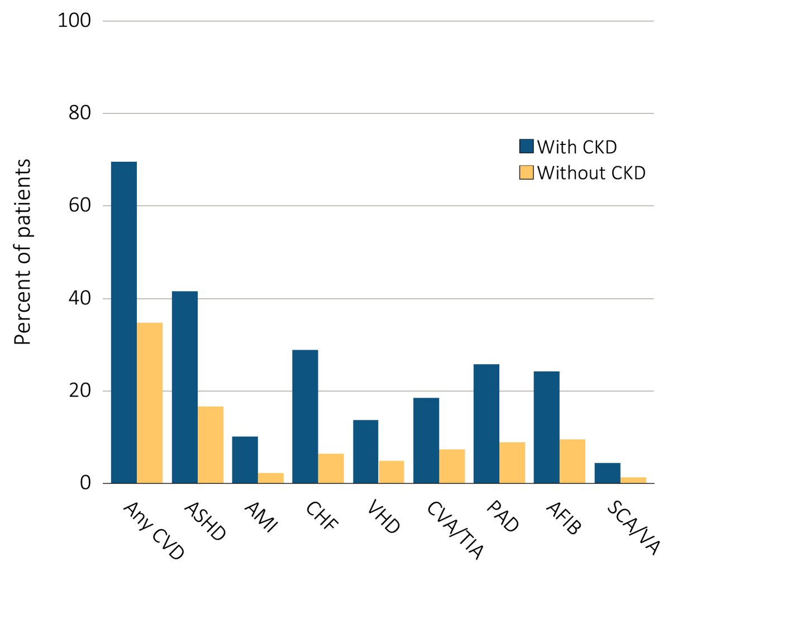
Figure 4.1 Cardiovascular disease in patients with or without CKD, 2013
Data Source: Special analyses, Medicare 5 percent sample. Patients aged 66 and older, alive, without end-stage renal disease, and residing in the U.S. on 12/31/2013 with fee-for-service coverage for the entire calendar year. Totals of patients for the study cohort: N=1,238,888; With CKD=132,840; Without CKD=1,106,048. Abbreviations: AFIB, atrial fibrillation; AMI, acute myocardial infarction; ASHD, atherosclerotic heart disease; CHF, congestive heart failure; CKD, chronic kidney disease; CVA/TIA, cerebrovascular accident/transient ischemic attack; CVD, cardiovascular disease; PAD, peripheral arterial disease; SCA/VA, sudden cardiac arrest and ventricular arrhythmias; VHD, valvular heart disease.

Slide 3
Table 4.1 Prevalence of cardiovascular comorbidities & procedures (%),
by CKD status, age, race & sex, 2013
 | Overall | 66-69 |  | 70-74 |  |  | 75-84 | 85+ | White | Black/ Af Am | Other | Male | Female
Cardiovascular Comorbidities¹
Atherosclerotic heart disease (ASHD)
Without CKD | 16.5 | 10.5 |  | 14.6 |  |  | 20.1 | 22.9 | 17.0 | 13.3 | 13.3 | 22.0 | 12.5
Any CKD | 41.5 | 33.1 |  | 38.3 |  |  | 43.5 | 45.0 | 42.5 | 35.6 | 38.2 | 49.0 | 34.7
Acute myocardial infarction (AMI)
Without CKD | 2.3 | 1.5 |  | 2.0 |  |  | 2.6 | 3.3 | 2.3 | 1.8 | 1.5 | 2.9 | 1.8
Any CKD | 10.1 | 8.7 |  | 9.5 |  |  | 10.1 | 11.1 | 10.4 | 8.8 | 7.7 | 11.9 | 8.4
Congestive heart failure (CHF)
Without CKD | 6.4 | 3.0 |  | 4.3 |  |  | 7.4 | 13.8 | 6.4 | 7.6 | 5.0 | 6.6 | 6.3
Any CKD | 28.8 | 21.3 |  | 22.7 |  |  | 27.9 | 38.3 | 28.9 | 30.4 | 24.5 | 28.9 | 28.7
Valvular heart disease (VHD)
Without CKD | 4.9 | 2.4 |  | 3.7 |  |  | 6.2 | 8.5 | 5.1 | 3.2 | 3.6 | 4.7 | 5.0
Any CKD | 13.6 | 8.4 |  | 10.1 |  |  | 14.0 | 18.2 | 14.2 | 10.2 | 11.1 | 13.5 | 13.7
Cerebrovascular accident/transient ischemic attack (CVA-TIA)
Without CKD | 7.3 | 3.9 |  | 5.7 |  |  | 9.1 | 12.0 | 7.3 | 8.2 | 5.8 | 7.2 | 7.3
Any CKD | 18.4 | 13.7 |  | 16.1 |  |  | 19.5 | 20.9 | 18.3 | 20.2 | 16.3 | 18.6 | 18.2
Peripheral artery disease (PAD)
Without CKD | 8.9 | 4.2 |  | 6.3 |  |  | 10.5 | 18.3 | 9.0 | 9.9 | 6.9 | 9.0 | 8.9
Any CKD | 25.8 | 19.2 |  | 21.8 |  |  | 26.2 | 31.5 | 26.1 | 25.5 | 22.1 | 26.9 | 24.8
Atrial fibrillation (AFIB)
Without CKD | 9.5 | 4.0 |  | 6.6 |  |  | 12.1 | 18.5 | 10.1 | 4.8 | 5.1 | 10.7 | 8.6
Any CKD | 24.1 | 14.1 |  | 17.5 |  |  | 25.0 | 32.7 | 25.9 | 14.6 | 16.0 | 26.4 | 22.1
Cardiac arrest and ventricular arrhythmias (SCA/VA)
Without CKD | 1.3 | 0.8 |  | 1.2 |  |  | 1.6 | 1.6 | 1.4 | 1.1 | 0.8 | 1.8 | 0.9
Any CKD | 4.3 | 3.9 |  | 4.1 |  |  | 4.7 | 4.3 | 4.4 | 4.5 | 2.8 | 5.9 | 2.9
(Continued on next slide)

Slide 4
Table 4.1 Prevalence of cardiovascular comorbidities & procedures (%),
by CKD status, age, race & sex, 2013 (continued)
 | Overall | 66-69 | 70-74 | 75-84 | 85+ | White | Black/ Af Am | Other | Male | Female
Cardiovascular Procedures²
Revascularization - percutaneous coronary interventions (PCI)
Without CKD | 2.3 | 3.5 | 2.7 | 2.1 | 1.3 | 2.4 | 1.9 | 2.0 | 2.4 | 2.2
Any CKD | 3.6 | 5.2 | 4.3 | 3.6 | 2.5 | 3.6 | 3.2 | 3.2 | 3.7 | 3.3
Revascularization - coronary artery bypass graft (CABG)
Without CKD | 1.1 | 1.7 | 1.4 | 1.1 | 0.3 | 1.1 | 0.8 | 0.9 | 1.4 | 0.7
Any CKD | 1.8 | 3.0 | 2.7 | 1.9 | 0.6 | 1.9 | 1.0 | 1.4 | 2.2 | 1.2
Implantable cardioverter defibrillators & cardiac resynchronization therapy with defibrillator (ICD/CRT-D)
Without CKD | 0.6 | 1.0 | 1.0 | 0.6 | 0.2 | 0.6 | 0.4 | 0.5 | 0.9 | 0.3
Any CKD | 1.0 | 1.6 | 1.5 | 1.2 | 0.4 | 1.0 | 1.0 | 0.9 | 1.6 | 0.5
Data Source: Special analyses, Medicare 5 percent sample. Patients aged 66 and older, alive, without end-stage renal disease, and residing in the U.S. on 12/31/2013 with fee-for-service coverage for the entire calendar year. Total patients for the study cohort: N=1,238,888. Abbreviations: AFIB, atrial fibrillation; AMI, acute myocardial infarction; ASHD, atherosclerotic heart disease; Af Am, African American; CABG, coronary artery bypass grafting; CHF, congestive heart failure; CKD, chronic kidney disease; CVA/TIA, cerebrovascular accident/transient ischemic attack; CVD, cardiovascular disease; ICD/CRT-D, implantable cardioverter defibrillators/cardiac resynchronization therapy with defibrillator devices; PAD, peripheral arterial disease; PCI, percutaneous coronary interventions; SCA/VA, sudden cardiac arrest and ventricular arrhythmias; VHD, valvular heart disease.
1 The denominators for overall prevalence of all cardiovascular comorbidities are 1,106,048 Medicare enrollees age 66+ without CKD and 132,840 Medicare enrollees age 66+ with any CKD.
2 The denominators for overall prevalence of PCI and CABG are 182,891 Medicare enrollees age 66+ with ASHD and without CKD and 55,108 Medicare enrollees age 66+ with ASHD and with any CKD. The denominators for overall prevalence of ICD/CRT-D is 70,766 Medicare enrollees age 66+ with CHF and without CKD and 38,256 Medicare enrollees age 66+ with CHF and with any CKD.

Slide 5
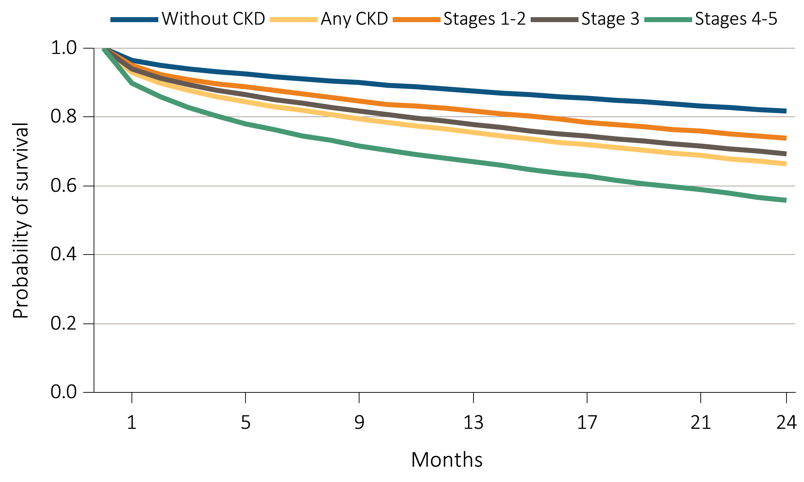
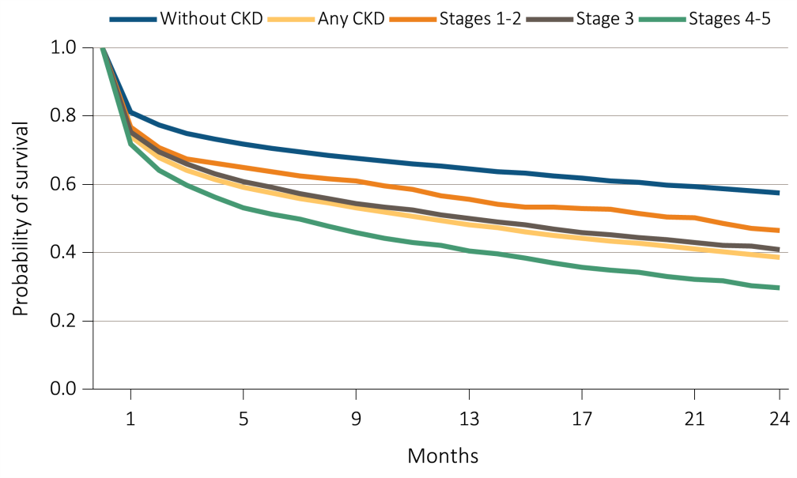
Figure 4.2 Survival of patients with a cardiovascular diagnosis or procedure,
by CKD status, 2011-2013
(a) ASHD
(b) AMI
Data Source: Special analyses, Medicare 5 percent sample. Patients aged 66 and older, alive, without end-stage renal disease, and residing in the U.S. on the index date, which is the date of the first condition/procedure claim, with fee-for-service coverage for the entire year prior to this date. Abbreviations: AMI, acute myocardial infarction; ASHD, atherosclerotic heart disease; CKD, chronic kidney disease.

Slide 6
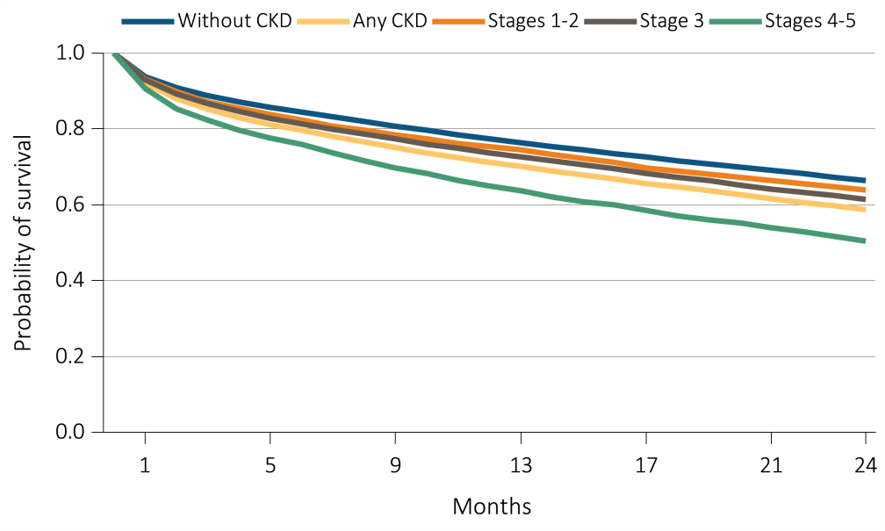
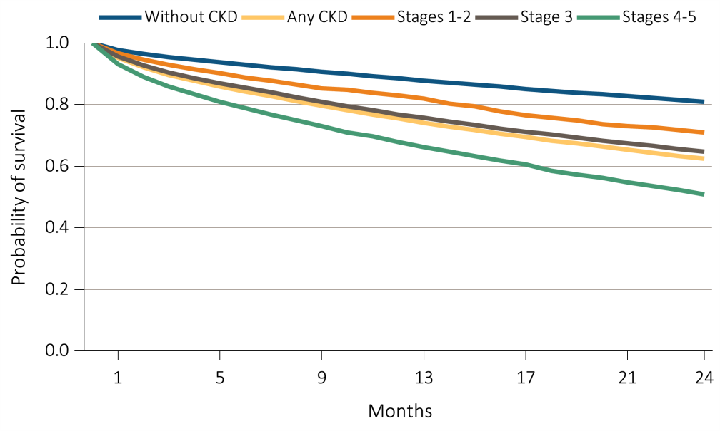
Figure 4.2 Survival of patients with a cardiovascular diagnosis or procedure,
by CKD status, 2011-2013
(c) CHF
(d) VHD
Data Source: Special analyses, Medicare 5 percent sample. Patients aged 66 and older, alive, without end-stage renal disease, and residing in the U.S. on the index date, which is the date of the first condition/procedure claim, with fee-for-service coverage for the entire year prior to this date. Abbreviations: CHF, congestive heart failure; CKD, chronic kidney disease; VHD, valvular heart disease.

Slide 7
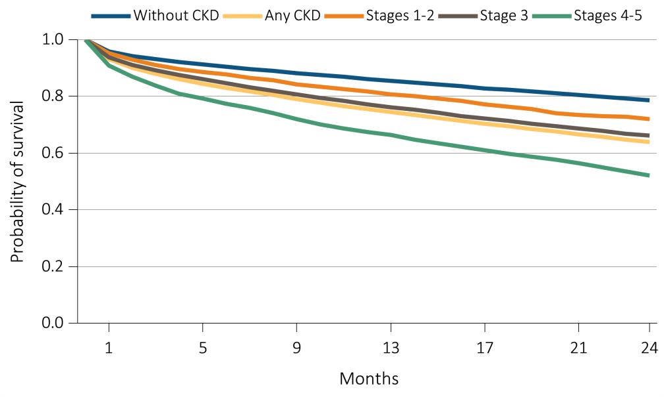
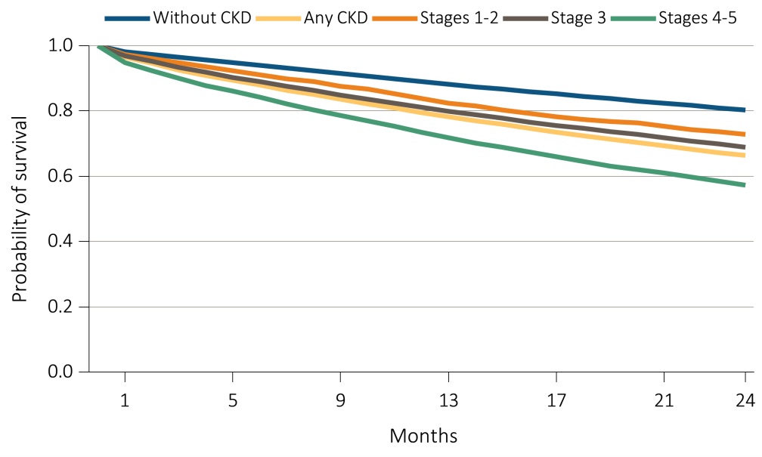
Figure 4.2 Survival of patients with a cardiovascular diagnosis or procedure,
by CKD status, 2011-2013
(e) CVA/TIA
(f) PAD
Data Source: Special analyses, Medicare 5 percent sample. Patients aged 66 and older, alive, without end-stage renal disease, and residing in the U.S. on the index date, which is the date of the first condition/procedure claim, with fee-for-service coverage for the entire year prior to this date. Abbreviations: CKD, chronic kidney disease; CVA/TIA, cerebrovascular accident/transient ischemic attack; PAD, peripheral arterial disease.

Slide 8
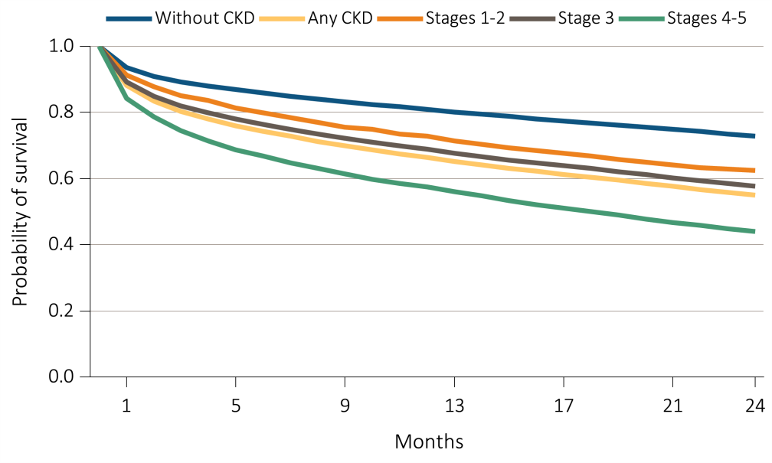
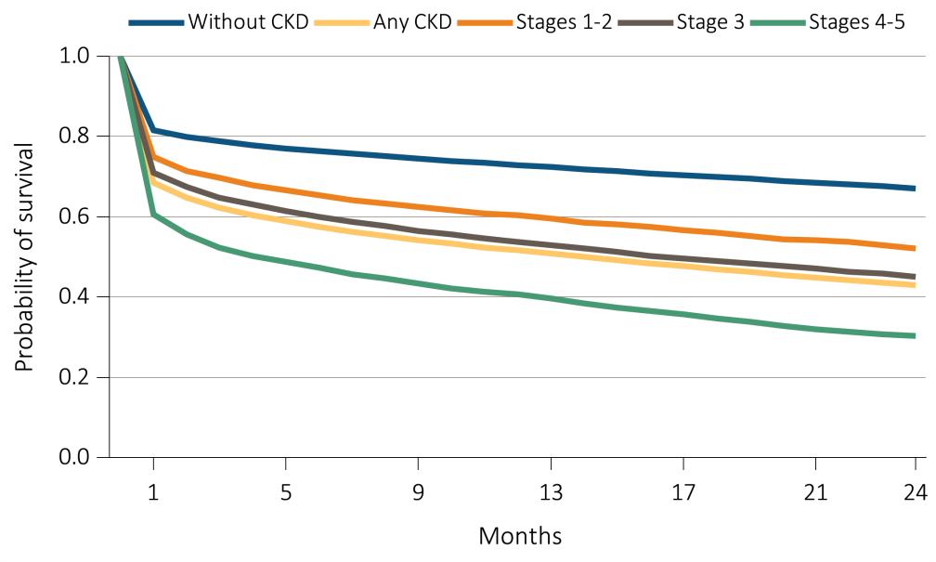
Figure 4.2 Survival of patients with a cardiovascular diagnosis or procedure,
by CKD status, 2011-2013
(g) AFIB
(h) SCA / VA
Data Source: Special analyses, Medicare 5 percent sample. Patients aged 66 and older, alive, without end-stage renal disease, and residing in the U.S. on the index date, which is the date of the first condition/procedure claim, with fee-for-service coverage for the entire year prior to this date. Abbreviations: AFIB, atrial fibrillation; CKD, chronic kidney disease; SCA/VA, sudden cardiac arrest and ventricular arrhythmias.

Slide 9
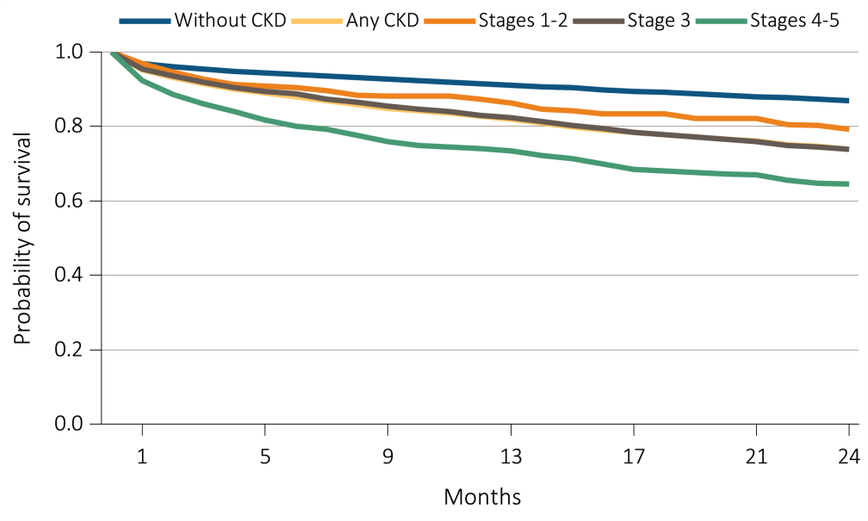
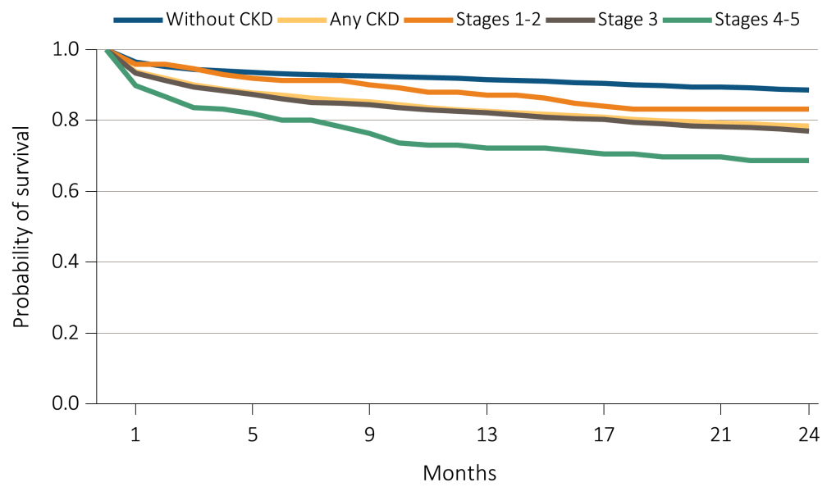
Figure 4.2 Survival of patients with a cardiovascular diagnosis or procedure,
by CKD status, 2011-2013
(i) PCI
(j) CABG
Data Source: Special analyses, Medicare 5 percent sample. Patients aged 66 and older, alive, without end-stage renal disease, and residing in the U.S. on the index date, which is the date of the first condition/procedure claim, with fee-for-service coverage for the entire year prior to this date. Abbreviations: CABG, coronary artery bypass grafting; CKD, chronic kidney disease; PCI, percutaneous coronary interventions.

Slide 10
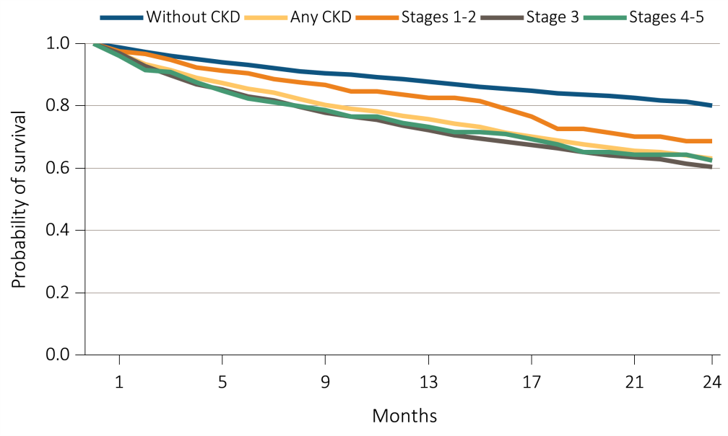
Figure 4.2 Survival of patients with a cardiovascular diagnosis or procedure,
by CKD status, 2011-2013
(k) ICD / CRT / D
Data Source: Special analyses, Medicare 5 percent sample. Patients aged 66 and older, alive, without end-stage renal disease, and residing in the U.S. on the index date, which is the date of the first condition/procedure claim, with fee-for-service coverage for the entire year prior to this date. Abbreviations: CKD, chronic kidney disease; ICD/CRT-D, implantable cardioverter defibrillators/cardiac resynchronization therapy with defibrillator devices.

Slide 11
Table 4.2 Characteristics of patients with heart failure, by CKD status, 2013
 | Systolic +/- Diastolic heart failure |  | Diastolic only heart failure |  | Heart failure, unspecified
 | Without CKD | Any CKD | Without CKD | Any CKD | Without CKD | Any CKD
N | 13,419 | 11,339 | 11,584 | 9,315 | 35,899 | 15,470
Age (% of N):
66-69 | 13.7 | 11.0 | 10.6 | 9.2 | 11.1 | 9.3
70-74 | 19.5 | 16.5 | 14.9 | 14.5 | 15.7 | 14.6
75-84 | 38.8 | 39.2 | 38.1 | 38.3 | 36.9 | 38.3
85+ | 28.0 | 33.2 | 36.3 | 38.0 | 36.3 | 37.9
Sex (% of N)
Male | 54.1 | 57.7 | 31.8 | 36.3 | 39.8 | 45.2
Female | 45.9 | 42.3 | 68.2 | 63.7 | 60.2 | 54.8
Race (% of N)
White | 87.7 | 83.8 | 88.2 | 84.8 | 85.9 | 83.0
Black/African American | 8.0 | 11.6 | 7.7 | 10.7 | 9.1 | 11.4
Other race | 4.3 | 4.6 | 4.1 | 4.5 | 5.1 | 5.7
Comorbidity (% of N)
Non-diabetes | 61.6 | 43.0 | 62.7 | 44.0 | 62.3 | 44.8
Diabetes | 38.4 | 57.0 | 37.3 | 56.0 | 37.7 | 55.2
Data Source: Special analyses, Medicare 5 percent sample. Patients aged 66 and older, alive, without end-stage renal disease, and residing in the U.S. on 12/31/2013 with fee-for-service coverage for the entire calendar year. Total patients for the study cohort: N=97,026. Abbreviation: CKD, chronic kidney disease.

Slide 12
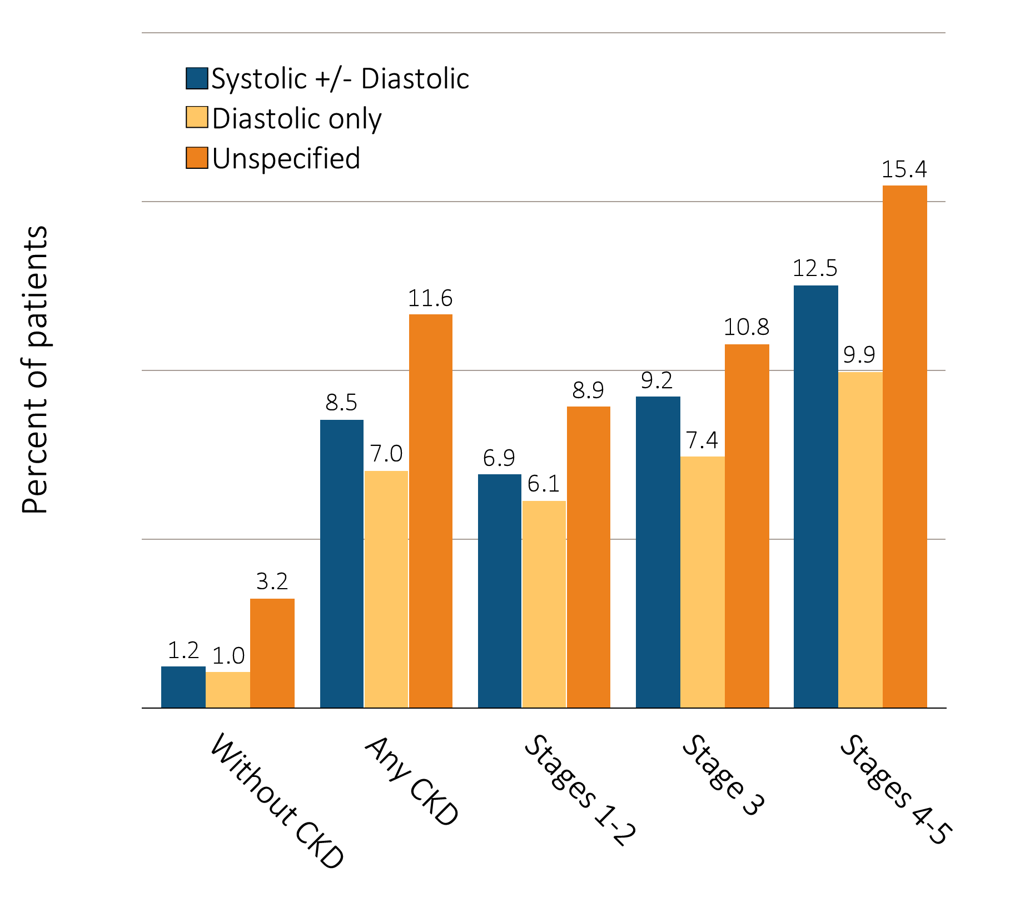
Figure 4.3 Heart failure in patients with or without CKD, 2013
Data Source: Special analyses, Medicare 5 percent sample. Patients aged 66 and older, alive, without end-stage renal disease, and residing in the U.S. on 12/31/2013 with fee-for-service coverage for the entire calendar year. Totals of patients for the study cohort: N=1,238,88; Without CKD=1,106,048; Any CKD=132,840; Stages 1-2=13,271; Stage 3=61,466; Stages 4-5=13,504. Abbreviations: CKD, chronic kidney disease.

Slide 13
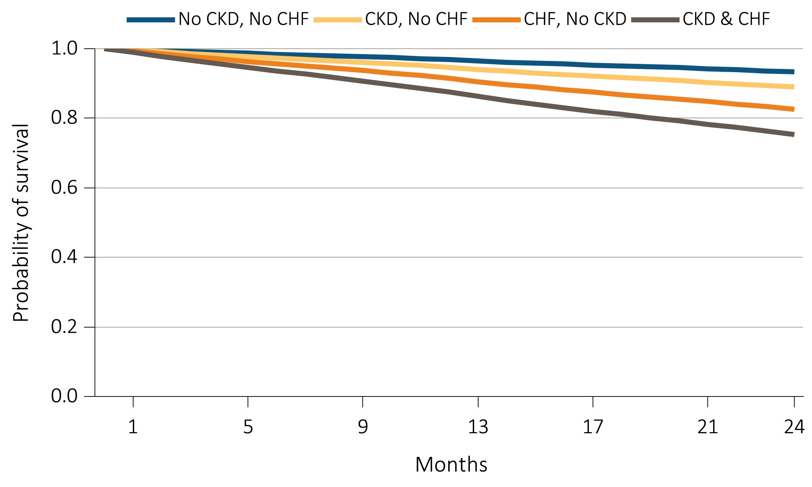
Figure 4.4 Adjusted survival of patients by CKD and CHF status, 2012-2013
Data Source: Special analyses, Medicare 5 percent sample. Patients aged 66 and older, alive, without end-stage renal disease, and residing in the U.S. on 12/31/2011 with fee-for-service coverage for the entire calendar year. Survival is adjusted for age, sex, race, diabetic status, and hypertension status. Abbreviations: CKD, chronic kidney disease; CHF, congestive heart failure.

Slide 14
Table 4.3 Prevalence of AFIB by stage of CKD, age, race, sex, diabetic status,
hypertension status, and CHF status, 2013
 | Stage of CKD
 | Stages 1-2 | Stage 3 | Stages 4-5
AFIB (Overall) | 20.8 | 24.5 | 26.6
Age:
66-69 | 11.3 | 14.7 | 16.8
70-74 | 14.9 | 18.0 | 20.8
75-84 | 22.6 | 25.1 | 26.6
85+ | 31.3 | 32.9 | 32.9
Sex
Male | 23.0 | 27.3 | 29.3
Female | 18.8 | 22.0 | 24.4
Race
White | 22.9 | 26.3 | 29.3
Black/African American | 12.9 | 15.4 | 14.2
Other race | 11.7 | 16.1 | 18.6
Comorbidity
Non-diabetes | 20.5 | 24.0 | 25.9
Diabetes | 21.1 | 25.1 | 27.3
Non-hypertension | 10.3 | 15.0 | 17.1
Hypertension | 21.7 | 25.2 | 27.0
No Heart Failure (CHF) | 12.5 | 14.2 | 13.5
Heart Failure (CHF) | 47.8 | 49.8 | 46.7
Data Source: Special analyses, Medicare 5 percent sample. Patients aged 66 and older, alive, without end-stage renal disease, and residing in the U.S. on 12/31/2013 with fee-for-service coverage for the entire calendar year. Totals of patients for the study cohort: N=88,241; Stages 1-2=13,271; Stage 3=61,466; Stages 4-5=13,504. Abbreviations: AFIB, atrial fibrillation; CHF, congestive heart failure; CKD, chronic kidney disease.

