Slide 2
Table 6.1 Point prevalent distribution of Medicare fee-for-service patients aged 65+, and total annual costs of Medicare Parts A, B, and D services, by DM, CHF, and/or CKD, 2013
 | U.S. Medicare Population | Costs (millions, U.S. $) | PPPY (U.S. $) | Population (%) | Costs (%)
All | 23,897,280 | $250,503 | $10,854 | 100.00 | 100.00
With CHF or CKD or DM | 8,041,400 | $127,725 | $16,810 | 33.65 | 50.99
CKD only (- DM & CHF) | 964,240 | $14,223 | $15,614 | 4.04 | 5.68
DM only (- CHF & CKD) | 4,088,260 | $47,039 | $11,842 | 17.11 | 18.78
CHF only (- DM & CKD) | 911,260 | $17,321 | $20,716 | 3.81 | 6.91
CKD and DM only (- CHF) | 780,520 | $13,605 | $18,404 | 3.27 | 5.43
CKD and CHF only (- DM) | 339,040 | $8,748 | $30,312 | 1.42 | 3.49
DM and CHF only (- CKD) | 535,020 | $12,968 | $26,477 | 2.24 | 5.18
CKD and CHF and DM | 423,060 | $13,822 | $38,230 | 1.77 | 5.52
No CKD or DM or CHF | 15,855,880 | $122,778 | $7,931 | 66.35 | 49.01
All CKD (+/- DM & CHF) | 2,506,860 | $50,398 | $21,909 | 10.49 | 20.12
All DM (+/- CKD & CHF) | 5,826,860 | $87,433 | $15,718 | 24.38 | 34.90
All CHF (+/- DM & CKD) | 2,208,380 | $52,858 | $26,750 | 9.24 | 21.10
CKD and DM (+/- CHF) | 1,203,580 | $27,427 | $24,916 | 5.04 | 10.95
CKD and CHF (+/- DM) | 762,100 | $22,570 | $34,715 | 3.19 | 9.01
DM and CHF (+/- CKD) | 958,080 | $26,789 | $31,469 | 4.01 | 10.69
Data Source: Medicare 5 percent sample. Abbreviations: CKD, chronic kidney disease; CHF, congestive heart failure; DM, diabetes mellitus; PPPY, per patient per year costs.

Slide 3
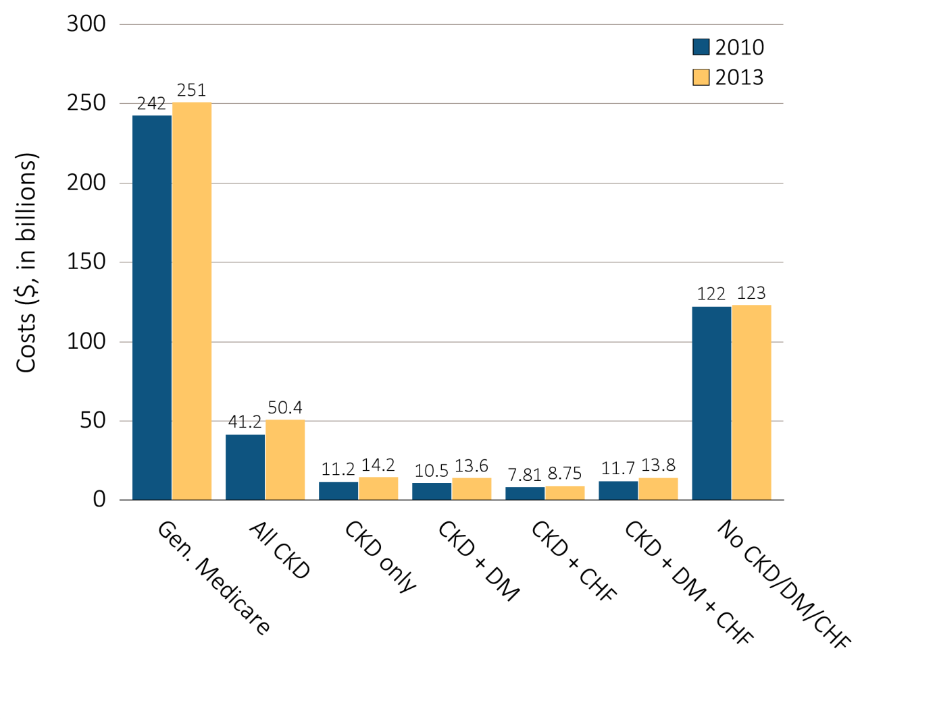
Figure 6.1 Overall Medicare Parts A, B, and D costs for fee-for-service patients
aged 65 and older, by CKD, DM, CHF, and year, 2010 & 2013
Data Source: Medicare 5 percent sample. Abbreviations: CKD, chronic kidney disease; CHF, congestive heart failure, DM, diabetes mellitus.

Slide 4
Table 6.2 Overall per person per year costs for Medicare Parts A, B, and D services for
CKD patients, by CKD stage, age, sex, race, and year, 2010 & 2013
 | 2010 |  |  |  |  | 2013
 | Any CKD | Stages 1-2 | Stage 3 | Stages 4-5 | Unk/ Unspc | Any CKD | Stages 1-2 | Stage 3 | Stages 4-5 | Unk/ Unspc
Patient years at risk | 1,836,715 | 161,650 | 660,612 | 202,278 | 812,175 | 2,300,310 | 227,260 | 1,023,273 | 229,857 | 819,920
All patients | $22,440 | $19,086 | $21,392 | $28,793 | $22,377 | $21,909 | $19,859 | $21,253 | $27,405 | $21,756
Age
65-69 | $20,433 | $17,054 | $20,117 | $29,474 | $19,716 | $20,964 | $16,943 | $20,819 | $30,890 | $20,281
70-74 | $20,670 | $16,688 | $19,642 | $28,231 | $20,763 | $20,274 | $17,503 | $19,475 | $26,615 | $20,607
75-79 | $21,921 | $18,782 | $20,615 | $29,599 | $21,823 | $21,441 | $19,930 | $20,817 | $26,369 | $21,354
80-84 | $23,422 | $20,967 | $22,218 | $28,209 | $23,596 | $22,375 | $21,218 | $21,468 | $27,384 | $22,367
85+ | $24,714 | $22,255 | $23,798 | $28,732 | $24,623 | $23,737 | $23,650 | $23,076 | $27,165 | $23,409
Sex
Male | $21,841 | $18,540 | $21,078 | $28,438 | $21,586 | $21,545 | $19,753 | $21,223 | $26,807 | $21,063
Female | $22,977 | $19,604 | $21,687 | $29,083 | $23,071 | $22,233 | $19,957 | $21,280 | $27,884 | $22,372
Race
White | $21,798 | $18,248 | $20,946 | $27,690 | $21,758 | $21,550 | $19,629 | $20,926 | $26,551 | $21,496
Black/African American | $26,075 | $22,567 | $24,024 | $33,206 | $26,372 | $24,281 | $20,729 | $23,235 | $32,322 | $23,784
Other | $25,054 | $22,153 | $23,325 | $33,833 | $24,720 | $22,694 | $20,901 | $22,487 | $27,658 | $22,100
Data Source: Medicare 5 percent sample. Abbreviations: CKD, chronic kidney disease; Unk/unspc, CKD stage unknown or unspecified.

Slide 5
Table 6.3 Per person per year costs for Parts A, B, and D services for Medicare
CKD patients with DM, by CKD stage, age, sex, race, and year, 2010 & 2013
 | 2010 |  |  |  |  | 2013
 | Any CKD | Stages 1-2 | Stage 3 | Stages 4-5 | Unk/ Unspc | Any CKD | Stages 1-2 | Stage 3 | Stages 4-5 | Unk/ Unspc
Patient years at risk | 870,939 | 78,316 | 322,900 | 105,972 | 363,752 | 1,100,774 | 110,909 | 499,897 | 120,675 | 369,293
All patients | $25,510 | $22,117 | $24,455 | $32,940 | $25,013 | $24,916 | $22,364 | $24,453 | $31,383 | $24,195
Age
65-69 | $23,726 | $20,296 | $23,689 | $32,805 | $22,369 | $24,561 | $19,721 | $24,561 | $35,068 | $23,317
70-74 | $23,731 | $19,499 | $23,058 | $31,020 | $23,381 | $23,086 | $20,435 | $22,703 | $29,438 | $22,593
75-79 | $25,251 | $22,248 | $23,774 | $33,883 | $24,735 | $24,407 | $22,238 | $23,877 | $30,046 | $23,991
80-84 | $26,767 | $23,625 | $25,412 | $32,635 | $26,773 | $25,445 | $25,351 | $24,631 | $31,640 | $24,415
85+ | $28,441 | $27,272 | $27,127 | $34,251 | $27,763 | $27,446 | $25,803 | $27,016 | $31,741 | $26,787
Sex
Male | $24,252 | $21,432 | $23,568 | $31,835 | $23,411 | $23,991 | $21,786 | $23,870 | $30,042 | $23,036
Female | $26,702 | $22,820 | $25,348 | $33,877 | $26,471 | $25,807 | $22,950 | $25,031 | $32,468 | $25,316
Race
White | $24,732 | $20,831 | $23,872 | $31,583 | $24,378 | $24,561 | $22,005 | $24,117 | $30,658 | $23,995
Black/African American | $28,904 | $26,164 | $27,066 | $37,642 | $28,153 | $26,927 | $23,254 | $26,221 | $35,389 | $25,637
Other | $27,767 | $25,507 | $26,488 | $36,765 | $26,553 | $25,089 | $23,869 | $25,051 | $30,165 | $23,873
Data Source: Medicare 5 percent sample. Abbreviations: CKD, chronic kidney disease; DM, diabetes mellitus; Unk/unspc, CKD stage unknown or unspecified.

Slide 6
Table 6.4 Per person per year costs for Parts A, B, and D services for Medicare
CKD patients with CHF, by CKD stage, age, sex, race, and year, 2010 & 2013
 | 2010 |  |  |  |  | 2013
 | Any CKD | Stages 1-2 | Stage 3 | Stages 4-5 | Unk/ Unspc | Any CKD | Stages 1-2 | Stage 3 | Stages 4-5 | Unk/ Unspc
Patient years at risk | 562,712 | 41,614 | 194,915 | 78,541 | 247,642 | 650,146 | 55,549 | 289,311 | 85,666 | 219,619
All patients | $34,766 | $33,276 | $34,044 | $40,563 | $33,747 | $34,715 | $34,113 | $34,538 | $38,846 | $33,489
Age
65-69 | $38,358 | $35,804 | $36,982 | $48,801 | $36,829 | $39,428 | $35,086 | $39,209 | $49,990 | $37,486
70-74 | $35,829 | $33,511 | $34,277 | $42,201 | $35,726 | $35,991 | $33,863 | $35,775 | $38,857 | $35,831
75-79 | $35,488 | $34,861 | $34,770 | $41,926 | $34,023 | $35,836 | $35,367 | $35,538 | $39,405 | $34,965
80-84 | $34,529 | $32,621 | $33,500 | $38,629 | $34,304 | $34,272 | $34,736 | $33,785 | $38,077 | $33,247
85+ | $32,757 | $31,195 | $32,686 | $37,841 | $31,510 | $32,144 | $32,517 | $32,234 | $35,904 | $30,458
Sex
Male | $33,906 | $33,686 | $33,122 | $39,935 | $32,686 | $33,603 | $33,431 | $34,001 | $38,291 | $31,364
Female | $35,535 | $32,912 | $34,959 | $41,098 | $34,634 | $35,714 | $34,745 | $35,049 | $39,284 | $35,337
Race
White | $33,569 | $31,617 | $33,051 | $38,595 | $32,772 | $34,036 | $33,122 | $33,993 | $37,641 | $32,969
Black/African American | $40,868 | $38,856 | $39,480 | $48,402 | $39,330 | $38,433 | $37,541 | $37,469 | $45,290 | $36,567
Other | $40,817 | $40,894 | $39,173 | $48,838 | $38,873 | $37,206 | $40,194 | $36,955 | $39,873 | $35,497
Data Source: Medicare 5 percent sample. Abbreviations: CHF, congestive heart failure; CKD, chronic kidney disease; Unk/unspc, CKD stage unknown.

Slide 7
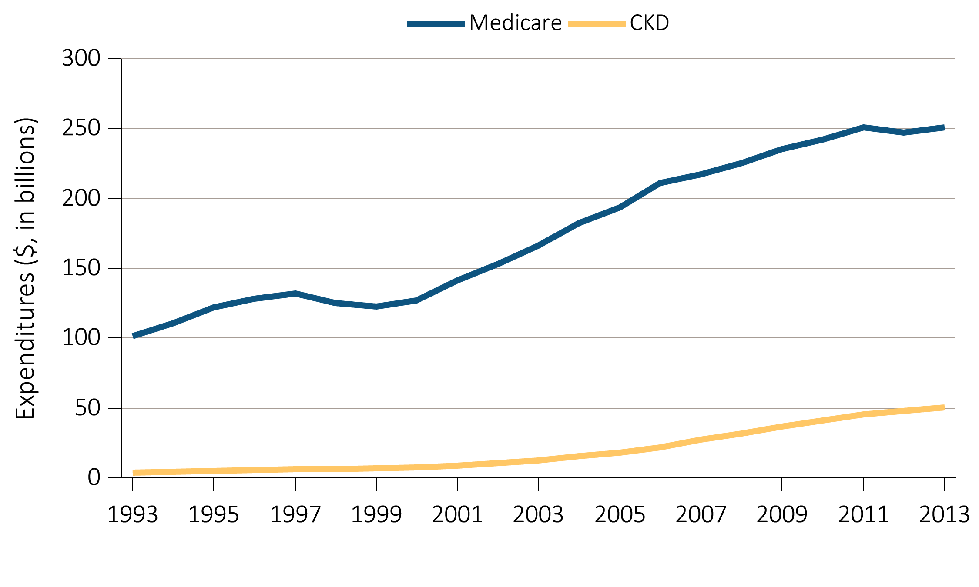
Figure 6.2 Overall expenditures on Parts A, B, and D services for the Medicare population aged 65+ and for those with CKD, by year, 1993-2013
Data Source: Medicare 5 percent sample. Abbreviations: CKD, chronic kidney disease.

Slide 8
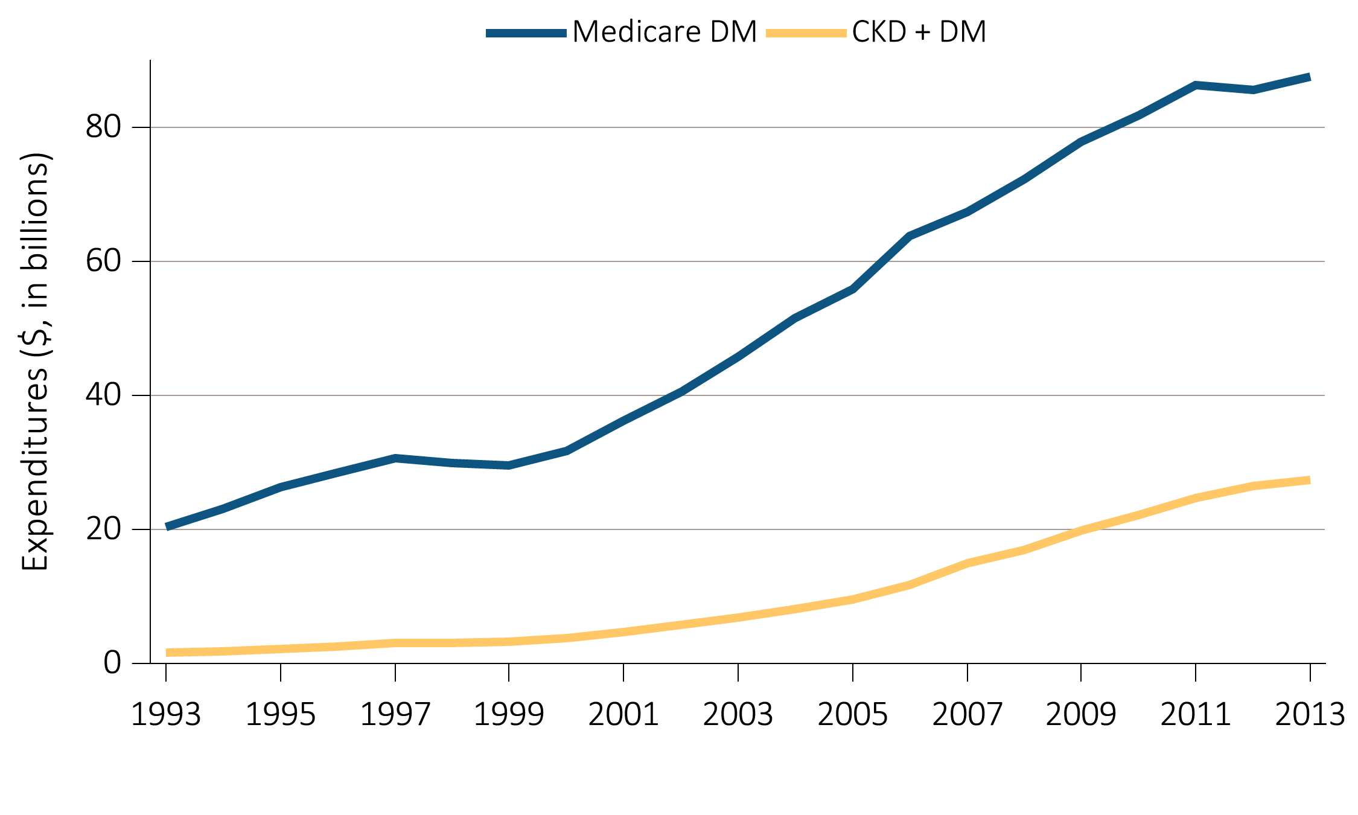
Figure 6.3 Overall expenditures on Parts A, B, and D services for the Medicare
DM population aged 65+ and for those with CKD and DM, by year, 1993-2013
Data Source: Medicare 5 percent sample. Abbreviations: CKD, chronic kidney disease; DM, diabetes mellitus.

Slide 9
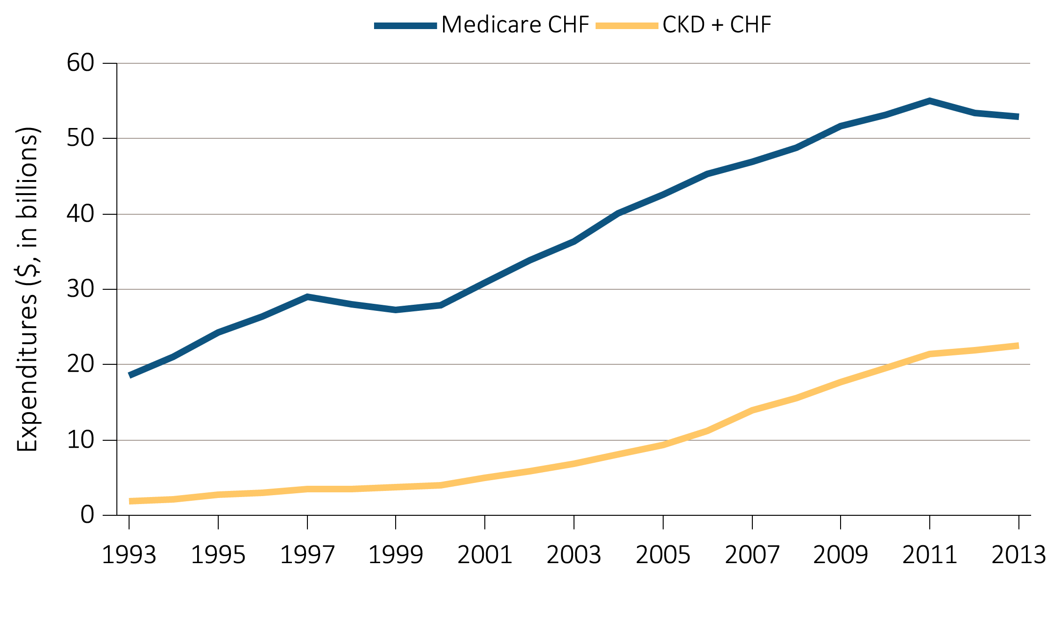
Figure 6.4 Overall expenditures on Parts A, B, and D services for the Medicare
CHF population aged 65+ and for those with CKD and CHF, by year, 1993-2013
Data Source: Medicare 5 percent sample. Abbreviations: CKD, chronic kidney disease; CHF, congestive heart failure.

Slide 10
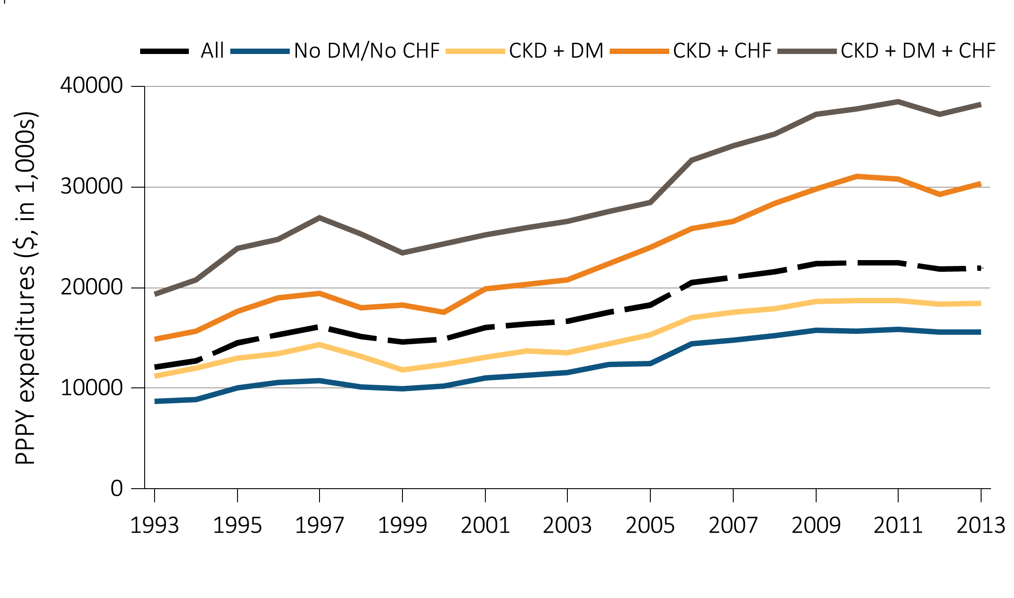
Figure 6.5 Per person per year expenditures on Parts A, B, and D services for
the CKD Medicare population aged 65+, by DM, CHF, and year, 1993-2013
Data Source: Medicare 5 percent sample. Abbreviations: CKD, chronic kidney disease; CHF, congestive heart failure, DM, diabetes mellitus; PPPY, per person per year.

