Slide 2
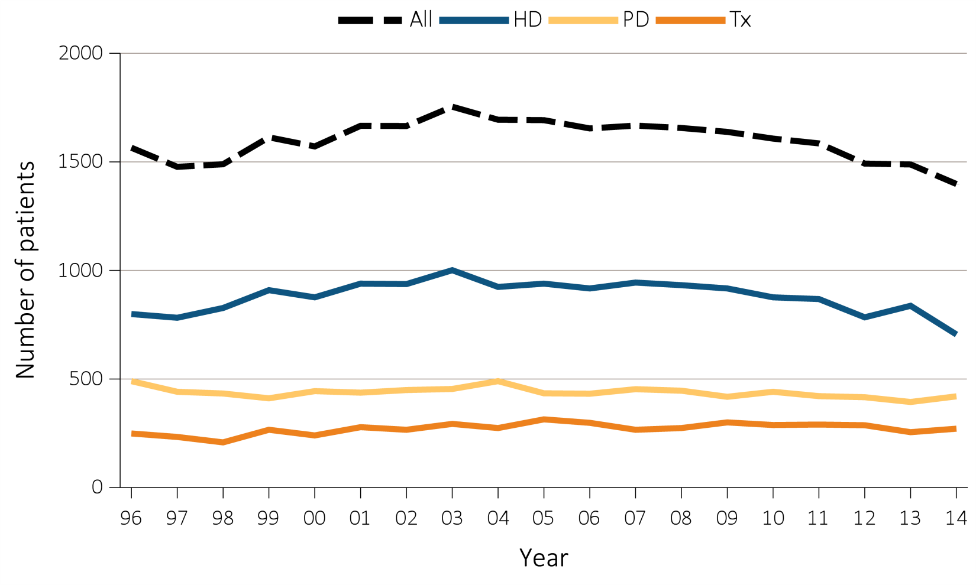
Figure 8.1 Number of (a) incident ESRD pediatric patients (aged 0–21 years),
^{by modality, 1996-2014}
Data Source: Special analyses, USRDS ESRD Database. Peritoneal dialysis consists of continuous ambulatory peritoneal dialysis and continuous cycling peritoneal dialysis. All consists of hemodialysis, peritoneal dialysis, uncertain dialysis, and transplant. Abbreviations: ESRD, end-stage renal disease; HD, hemodialysis; PD, peritoneal dialysis; Tx, transplant.

Slide 3
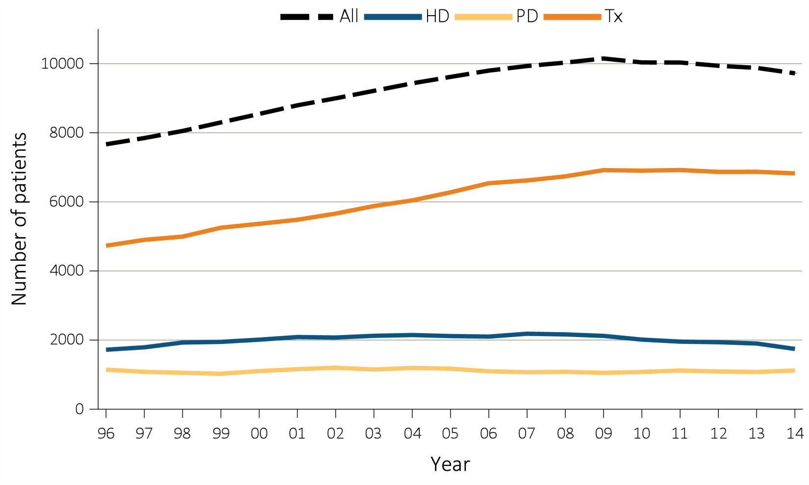
Figure 8.1 Number of (b) December 31 point prevalent ESRD pediatric patients
(aged 0–21 years), by modality, 1996-2014
Data Source: Special analyses, USRDS ESRD Database. Peritoneal dialysis consists of continuous ambulatory peritoneal dialysis and continuous cycling peritoneal dialysis. All consists of hemodialysis, peritoneal dialysis, uncertain dialysis, and transplant. Abbreviations: ESRD, end-stage renal disease; HD, hemodialysis; PD, peritoneal dialysis; Tx, transplant.

Slide 4
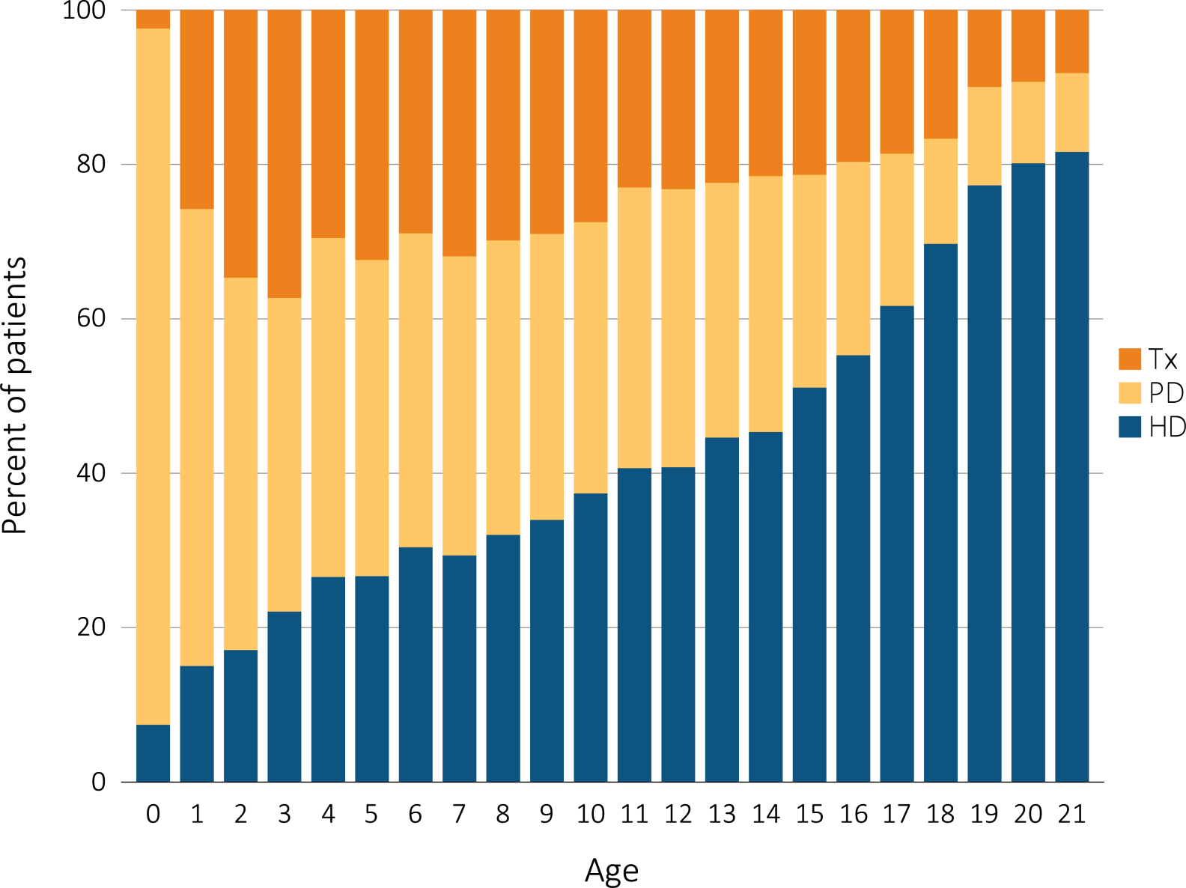
Figure 8.2 Cross-sectional trends in pediatric ESRD modality at initiation, by patient
^{(a) age, 1996-2014}
Data Source: Special analyses, USRDS ESRD Database. Includes incident ESRD patients in the years 1996-2014. Abbreviations: ESRD, end-stage renal disease; HD, hemodialysis; PD, peritoneal dialysis; Tx, transplant.

Slide 5
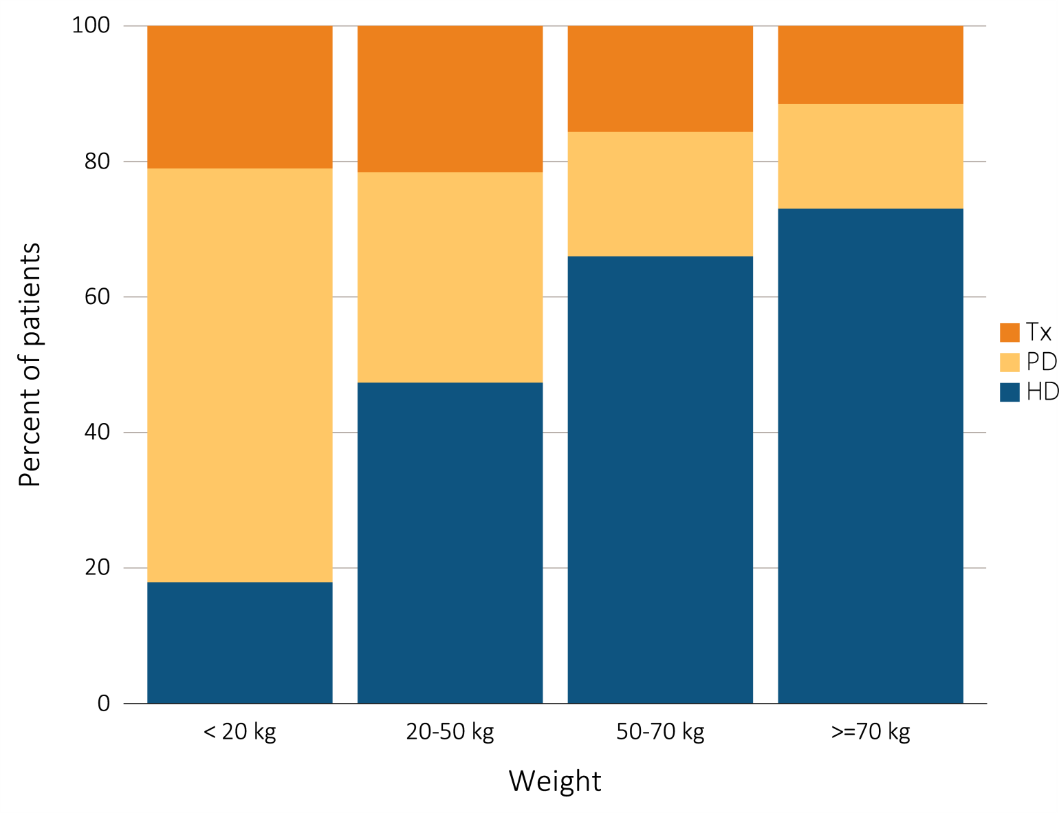
Figure 8.2 Trends in pediatric ESRD modality at initiation, by patient
^{(b) weight, 1996-2014}
Data Source: Special analyses, USRDS ESRD Database. Includes incident ESRD patients in the years 1996-2014. Abbreviations: ESRD, end-stage renal disease; HD, hemodialysis; PD, peritoneal dialysis; Tx, transplant.

Slide 6
Table 8.1 Distribution of reported incident pediatric ESRD patients by primary cause of ESRD (aged 0-21 years), and by demographic characteristics, 2005-2009 (period A) and 2010-2014 (period B)
 | Total patients |  | % Incident |  | Median age |  | % Males |  | % White |  | % Black/ African American |  | % Other race |  | % Transplant first year |  | % Died first year
Primary disease groups | A | B | A | B | A | B | A | B | A | B | A | B | A | B | A | B | A | B
All ESRD, (reference) | 8307 | 7570 | 100 | 100 | 16 | 16 | 56.6 | 56.4 | 65.4 | 66.0 | 25.3 | 24.1 | 9.3 | 9.9 | 37.4 | 36.0 | 3.6 | 2.7
Diabetes | 103 | 93 | 1.4 | 1.4 | 20 | 20 | 43.7 | 40.9 | 52.4 | 40.9 | 42.7 | 54.8 | 4.9 | 4.3 | 14.6 | 10.8 | 8.7 | 5.4
Diabetes with renal manifestations Type 2 | 45 | 45 | 0.6 | 0.7 | 20 | 20 | 40 | 42.2 | 53.3 | 42.2 | 40 | 53.3 | 6.7 | 4.4 | 11.1 | 8.9 | 8.9 | 6.7
Diabetes with renal manifestations Type 1 | 58 | 48 | 0.8 | 0.7 | 20 | 20 | 46.6 | 39.6 | 51.7 | 39.6 | 44.8 | 56.3 | 3.4 | 4.2 | 17.2 | 12.5 | 8.6 | 4.2
Primary glomerular disease | 1977 | 1702 | 26.4 | 25.3 | 18 | 18 | 55.5 | 55 | 61.3 | 64.3 | 32.1 | 28 | 6.6 | 7.7 | 32.2 | 30 | 1.6 | 1.6
Glomerulonephritis (GN) (histologically not examined) | 398 | 303 | 5.3 | 4.5 | 19 | 19 | 63.3 | 59.7 | 67.8 | 69.3 | 24.4 | 20.1 | 7.8 | 10.6 | 23.4 | 20.5 | 2.5 | 1.3
Focal glomerulosclerosis, focal sclerosing GN | 1018 | 901 | 13.6 | 13.4 | 17 | 17 | 55 | 55.8 | 52.2 | 58.8 | 42.9 | 35.7 | 4.9 | 5.4 | 35.4 | 29.1 | 1.7 | 1.8
Membranous nephropathy | 50 | 36 | 0.7 | 0.5 | 18 | 19 | 50 | 69.4 | 54 | 52.8 | 40 | 41.7 | 6 | 5.6 | 28 | 44.4 | 0 | 0
Membranoproliferative GN type 1, diffuse MPGN | 92 | 86 | 1.2 | 1.3 | 17 | 17 | 44.6 | 45.3 | 75 | 67.4 | 16.3 | 22.1 | 8.7 | 10.5 | 45.7 | 43 | 0 | 2.3
Dense deposit disease, MPGN type 2 | 31 | 28 | 0.4 | 0.4 | 16 | 15 | 51.6 | 50 | 100 | 75 | 0 | 10.7 | 0 | 14.3 | 32.3 | 7.1 | 3.2 | 0
IgA nephropathy, Berger’s disease (proven by immunofluorescence) | 212 | 204 | 2.8 | 3 | 19 | 19 | 63.7 | 59.8 | 72.2 | 77 | 17.5 | 10.3 | 10.4 | 12.7 | 35.8 | 40.7 | 0 | 2
IgM nephropathy (proven by immunofluorescence) | 15 | 16 | 0.2 | 0.2 | 19 | 19 | 53.3 | 62.5 | 66.7 | 68.8 | 26.7 | 25 | 6.7 | 6.3 | 26.7 | 18.8 | 0 | 0
With lesion of rapidly progressive GN | 61 | 54 | 0.8 | 0.8 | 16 | 16 | 37.7 | 20.4 | 72.1 | 74.1 | 13.1 | 20.4 | 14.8 | 5.6 | 11.5 | 27.8 | 1.6 | 1.9
Other proliferative GN | 100 | 74 | 1.3 | 1.1 | 16 | 17 | 38 | 41.9 | 76 | 66.2 | 17 | 27 | 7 | 6.8 | 30 | 41.9 | 2 | 1.4
CAKUT | 1694 | 1620 | 22.6 | 24.1 | 12 | 11 | 69.3 | 69.6 | 77.6 | 74.4 | 16.4 | 19.1 | 6 | 6.4 | 49.8 | 49.6 | 2.6 | 1.8
Congenital obstruction of ureteropelvic junction | 54 | 50 | 0.7 | 0.7 | 13 | 15 | 79.6 | 74 | 72.2 | 72 | 22.2 | 22 | 5.6 | 6 | 44.4 | 46 | 1.9 | 2
Congenital obstruction of uretrovesical junction | 56 | 50 | 0.7 | 0.7 | 14 | 14 | 85.7 | 82 | 76.8 | 72 | 21.4 | 18 | 1.8 | 10 | 50 | 44 | 0 | 2
Other Congenital obstructive uropathy | 515 | 541 | 6.9 | 8 | 12 | 11 | 82.1 | 82.1 | 73.8 | 71 | 20.8 | 23.1 | 5.4 | 5.9 | 44.1 | 49.5 | 2.7 | 0.7
Renal hypoplasia, dysplasia, oligonephronia | 753 | 728 | 10 | 10.8 | 10 | 10 | 62.7 | 61 | 77.6 | 75.3 | 15.8 | 18 | 6.6 | 6.7 | 51.4 | 50.1 | 3.1 | 2.3
Prune belly syndrome | 92 | 77 | 1.2 | 1.1 | 8 | 5 | 97.8 | 98.7 | 80.4 | 63.6 | 17.4 | 29.9 | 2.2 | 6.5 | 57.6 | 46.8 | 2.2 | 1.3
Chronic pyelonephritis, reflux nephropathy | 224 | 174 | 3 | 2.6 | 16 | 17 | 43.8 | 48.9 | 87.1 | 87.9 | 5.4 | 6.3 | 7.6 | 5.7 | 55.4 | 51.1 | 1.8 | 2.9
Secondary glomerular disease/Vasculitis | 1081 | 834 | 14.4 | 12.4 | 18 | 18 | 31.9 | 27.6 | 51.2 | 54.3 | 40.9 | 39.1 | 7.9 | 6.6 | 12.8 | 13.8 | 6.9 | 3
Lupus erythematosus, (SLE nephritis) | 649 | 489 | 8.7 | 7.3 | 19 | 19 | 20.5 | 19 | 38.8 | 38.2 | 50.8 | 54 | 10.3 | 7.8 | 6.5 | 4.9 | 8.3 | 2.9
Henoch-Schonlein syndrome | 30 | 30 | 0.4 | 0.4 | 17 | 14 | 56.7 | 53.3 | 93.3 | 83.3 | 3.3 | 10 | 3.3 | 6.7 | 43.3 | 40 | 0 | 3.3
Hemolytic uremic syndrome | 154 | 109 | 2.1 | 1.6 | 8 | 11 | 46.8 | 34.9 | 79.2 | 80.7 | 16.9 | 12.8 | 3.9 | 6.4 | 29.9 | 40.4 | 4.5 | 0.9
Polyarteritis and other vasculitis | 41 | 44 | 0.5 | 0.7 | 15 | 15 | 48.8 | 25 | 63.4 | 86.4 | 24.4 | 9.1 | 12.2 | 4.5 | 12.2 | 22.7 | 0 | 2.3
Wegeners granulomatosis | 59 | 59 | 0.8 | 0.9 | 16 | 17 | 44.1 | 47.5 | 84.7 | 76.3 | 11.9 | 16.9 | 3.4 | 6.8 | 28.8 | 16.9 | 0 | 1.7
Goodpasture syndrome | 50 | 53 | 0.7 | 0.8 | 20 | 19 | 46 | 39.6 | 88 | 98.1 | 8 | 0 | 4 | 1.9 | 12 | 17 | 2 | 3.8
Secondary GN, other | 26 | 18 | 0.3 | 0.3 | 18 | 19 | 65.4 | 27.8 | 76.9 | 77.8 | 19.2 | 16.7 | 3.8 | 5.6 | 26.9 | 33.3 | 7.7 | 0
AIDS nephropathy | 63 | 26 | 0.8 | 0.4 | 19 | 20 | 54 | 57.7 | 11.1 | 3.8 | 87.3 | 96.2 | 1.6 | 0 | 1.6 | 0 | 15.9 | 15.4
(Table 8.1 continued on next slide)

Slide 7
Table 8.1 Distribution of reported incident pediatric ESRD patients by primary cause of ESRD (aged 0-21 years), and by demographic characteristics, 2005-2009 (period A) and 2010-2014 (period B) (continued)
 | Total patients |  | % Incident |  | Median age |  | % Males |  | % White |  | % Black/ African American |  | % Other race |  | % Transplant first year |  | % Died first year
Primary disease groups | A | B | A | B | A | B | A | B | A | B | A | B | A | B | A | B | A | B
Interstitial nephritis/Pyelonephritis | 338 | 281 | 4.5 | 4.2 | 17 | 16 | 54.7 | 55.2 | 76.9 | 76.9 | 18.3 | 14.2 | 4.7 | 8.9 | 29.3 | 31 | 6.8 | 8.2
Nephropathy caused by other agents | 47 | 39 | 0.6 | 0.6 | 17 | 15 | 53.2 | 56.4 | 87.2 | 82.1 | 12.8 | 7.7 | 0 | 10.3 | 40.4 | 30.8 | 17 | 5.1
Nephrolithiasis | 21 | 16 | 0.3 | 0.2 | 18 | 14 | 42.9 | 25 | 85.7 | 81.3 | 9.5 | 12.5 | 4.8 | 6.3 | 57.1 | 68.8 | 0 | 12.5
Chronic interstitial nephritis | 80 | 73 | 1.1 | 1.1 | 17 | 17 | 60 | 53.4 | 76.3 | 76.7 | 20 | 13.7 | 3.8 | 9.6 | 50 | 45.2 | 2.5 | 4.1
Tubular necrosis (no recovery) | 167 | 138 | 2.2 | 2.1 | 15 | 14 | 55.1 | 57.2 | 75.4 | 75.4 | 18.6 | 15.9 | 6 | 8.7 | 15.6 | 18.1 | 7.2 | 10.9
Hypertensive/Large vessel disease | 16 | 15 | 0.2 | 0.2 | 14 | 14 | 56.3 | 53.3 | 81.3 | 86.7 | 6.3 | 13.3 | 12.5 | 0 | 43.8 | 26.7 | 6.3 | 0
Cystic/Hereditary/Congenital diseases | 910 | 959 | 12.1 | 14.3 | 14 | 13 | 58.8 | 59.2 | 78.2 | 76.9 | 16.9 | 15.8 | 4.8 | 7.3 | 54.4 | 47 | 4 | 3.3
Polycystic kidneys, adult type (dominant) | 49 | 48 | 0.7 | 0.7 | 19 | 18 | 44.9 | 45.8 | 77.6 | 79.2 | 20.4 | 18.8 | 2 | 2.1 | 44.9 | 43.8 | 2 | 2.1
Polycystic, infantile (recessive) | 141 | 152 | 1.9 | 2.3 | 7 | 1 | 52.5 | 46.1 | 80.1 | 75.7 | 16.3 | 17.1 | 3.5 | 7.2 | 48.9 | 40.1 | 12.1 | 6.6
Medullary cystic disease, including nephronophthisis | 102 | 115 | 1.4 | 1.7 | 13 | 12 | 38.2 | 46.1 | 87.3 | 80.9 | 5.9 | 11.3 | 6.9 | 7.8 | 71.6 | 67.8 | 0 | 1.7
Hereditary nephritis, Alport syndrome | 185 | 165 | 2.5 | 2.5 | 17 | 17 | 86.5 | 85.5 | 69.7 | 78.2 | 23.8 | 15.2 | 6.5 | 6.7 | 50.3 | 48.5 | 0 | 0
Cystinosis | 68 | 43 | 0.9 | 0.6 | 13 | 12 | 47.1 | 60.5 | 95.6 | 83.7 | 4.4 | 11.6 | 0 | 4.7 | 79.4 | 67.4 | 0 | 0
Primary oxalosis | 19 | 16 | 0.3 | 0.2 | 6 | 7 | 52.6 | 81.3 | 78.9 | 75 | 10.5 | 0 | 10.5 | 25 | 63.2 | 56.3 | 5.3 | 6.3
Congenital nephrotic syndrome | 123 | 138 | 1.6 | 2.1 | 2 | 3 | 56.9 | 52.2 | 80.5 | 81.2 | 14.6 | 12.3 | 4.9 | 6.5 | 58.5 | 39.1 | 5.7 | 3.6
Drash syndrome, mesangial sclerosis | 18 | 31 | 0.2 | 0.5 | 1 | 1 | 61.1 | 48.4 | 77.8 | 80.6 | 16.7 | 16.1 | 5.6 | 3.2 | 44.4 | 25.8 | 5.6 | 3.2
Other (congenital malformation syndromes) | 168 | 222 | 2.2 | 3.3 | 15 | 13 | 56 | 62.2 | 84.5 | 77.9 | 10.1 | 12.2 | 5.4 | 9.9 | 52.4 | 46.8 | 2.4 | 4.5
Sickle cell disease/anemia | 26 | 19 | 0.3 | 0.3 | 19 | 20 | 69.2 | 68.4 | 7.7 | 0 | 88.5 | 100 | 3.8 | 0 | 11.5 | 15.8 | 19.2 | 10.5
Neoplasms/Tumors | 50 | 51 | 0.7 | 0.8 | 8 | 10 | 46 | 45.1 | 70 | 76.5 | 18 | 13.7 | 12 | 9.8 | 16 | 21.6 | 28 | 9.8
Renal tumor | 37 | 41 | 0.5 | 0.6 | 5 | 5 | 45.9 | 41.5 | 67.6 | 73.2 | 21.6 | 17.1 | 10.8 | 9.8 | 16.2 | 22 | 21.6 | 9.8
Transplant complications | 148 | 84 | 2 | 1.2 | 16 | 17 | 55.4 | 56 | 77 | 69 | 14.9 | 21.4 | 8.1 | 9.5 | 46.6 | 26.2 | 14.2 | 14.3
Other transplant complication | 94 | 73 | 1.3 | 1.1 | 15 | 16 | 56.4 | 56.2 | 76.6 | 68.5 | 16 | 23.3 | 7.4 | 8.2 | 37.2 | 23.3 | 20.2 | 15.1
Kidney transplant complication | 48 | * | 0.6 | 0.1 | 16 | 19 | 56.3 | 50 | 77.1 | 83.3 | 14.6 | 0 | 8.3 | 16.7 | 62.5 | 50 | 0 | 0
Miscellaneous conditions | 812 | 849 | 10.8 | 12.6 | 19 | 19 | 62.4 | 60.1 | 60.5 | 60.4 | 33.7 | 32.2 | 5.8 | 7.4 | 30.4 | 24.3 | 3.4 | 2.7
Acquired obstructive uropathy | 54 | 42 | 0.7 | 0.6 | 17 | 16 | 77.8 | 69 | 75.9 | 78.6 | 18.5 | 14.3 | 5.6 | 7.1 | 40.7 | 35.7 | 0 | 0
Unspecified with renal failure | 495 | 517 | 6.6 | 7.7 | 20 | 20 | 62.4 | 63.1 | 50.1 | 50.1 | 45.1 | 44.9 | 4.8 | 5 | 17.8 | 11.8 | 2 | 2.9
Traumatic or surgical loss of kidney(s) | 15 | 11 | 0.2 | 0.2 | 9 | 12 | 66.7 | 54.5 | 80 | 54.5 | 13.3 | 18.2 | 6.7 | 27.3 | 53.3 | 9.1 | 13.3 | 18.2
Other renal disorders | 244 | 272 | 3.3 | 4 | 15 | 14 | 59.4 | 52.9 | 76.6 | 77.9 | 15.6 | 11.8 | 7.8 | 10.3 | 52.9 | 46 | 5.3 | 2.2
Etiology uncertain | 942 | 714 | 12.6 | 10.6 | 16 | 16 | 58 | 55.5 | 68.9 | 69 | 18 | 17.1 | 13.1 | 13.9 | 34.7 | 33.1 | 1.6 | 1.4
Missing | 236 | 368 | 3.1 | 5.5 | 14 | 15 | 64.8 | 62 | 9.7 | 36.7 | 4.7 | 12.5 | 85.6 | 50.8 | 94.9 | 73.1 | 0.8 | 2.4
Data Source: Special analyses, USRDS ESRD Database. Abbreviations: AIDS, acquired-immune deficiency syndrome; CAKUT, congenital anomalies of the kidney and urinary tract; congenital obstructive uropathy, combination of congenital ureteropelvic junction obstruction, congenital uretrovesical junction obstruction, and other congenital anomalies; ESRD, end-stage renal disease; GN glomerulonephritis; IgA immunoglobulin A; IgM, immunoglobulin M; incl., including; MPGN, membranoproliferative glomerulonephritis; SBE, sub-acute bacterial endocarditis. Diagnoses with 10 or fewer total patients for year categories are suppressed.

Slide 8
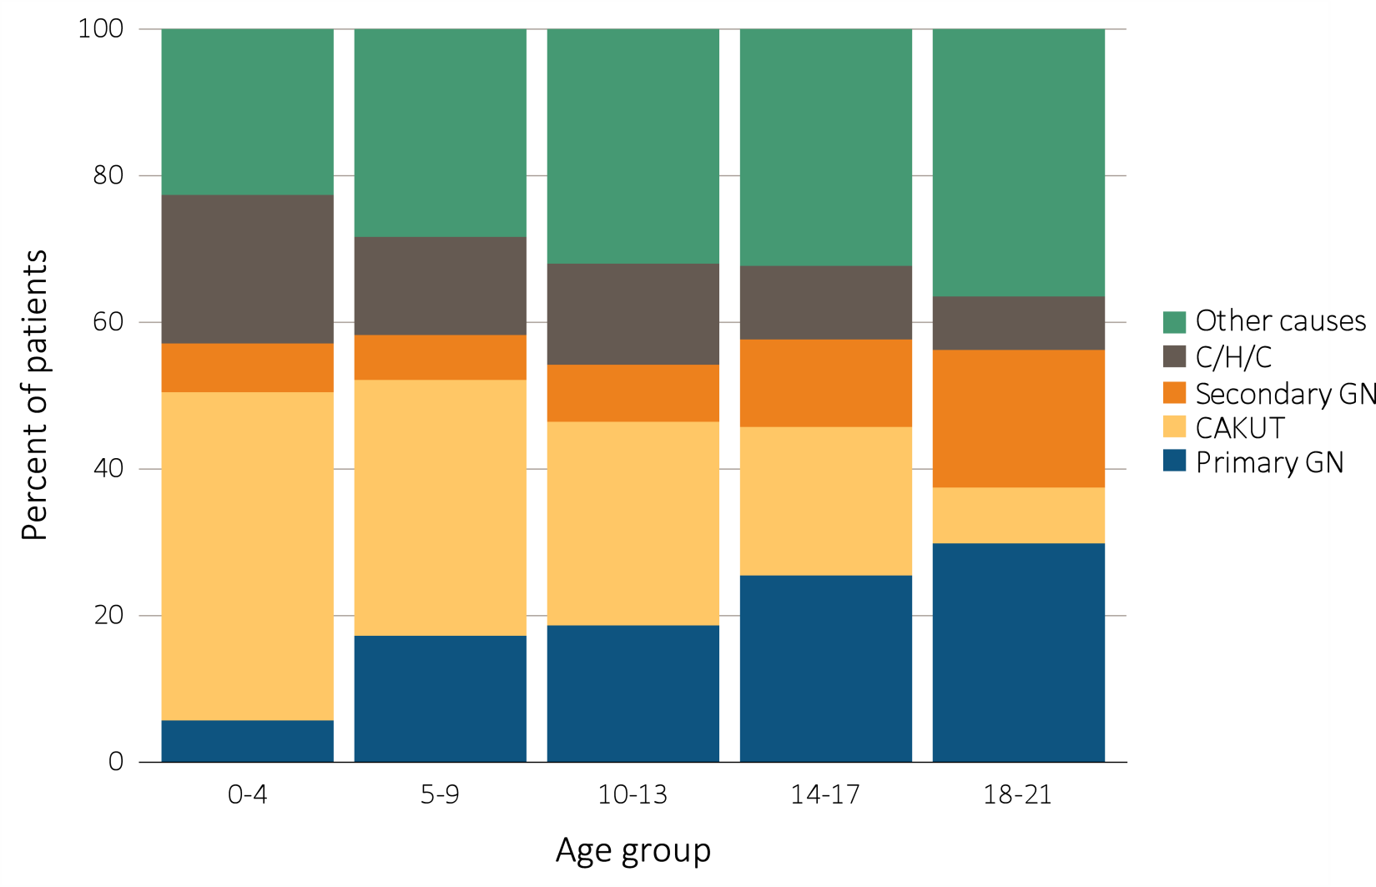
Figure 8.3 Distribution of reported incident pediatric ESRD patients by primary cause of ESRD, by age (a) 2005-2009 (period A)
Data Source: Special analyses, USRDS ESRD Database. Abbreviations: CAKUT, congenital anomalies of the kidney and urinary tract; C/H/C, cystic/hereditary/congenital diseases; GN, glomerulonephritis.

Slide 9
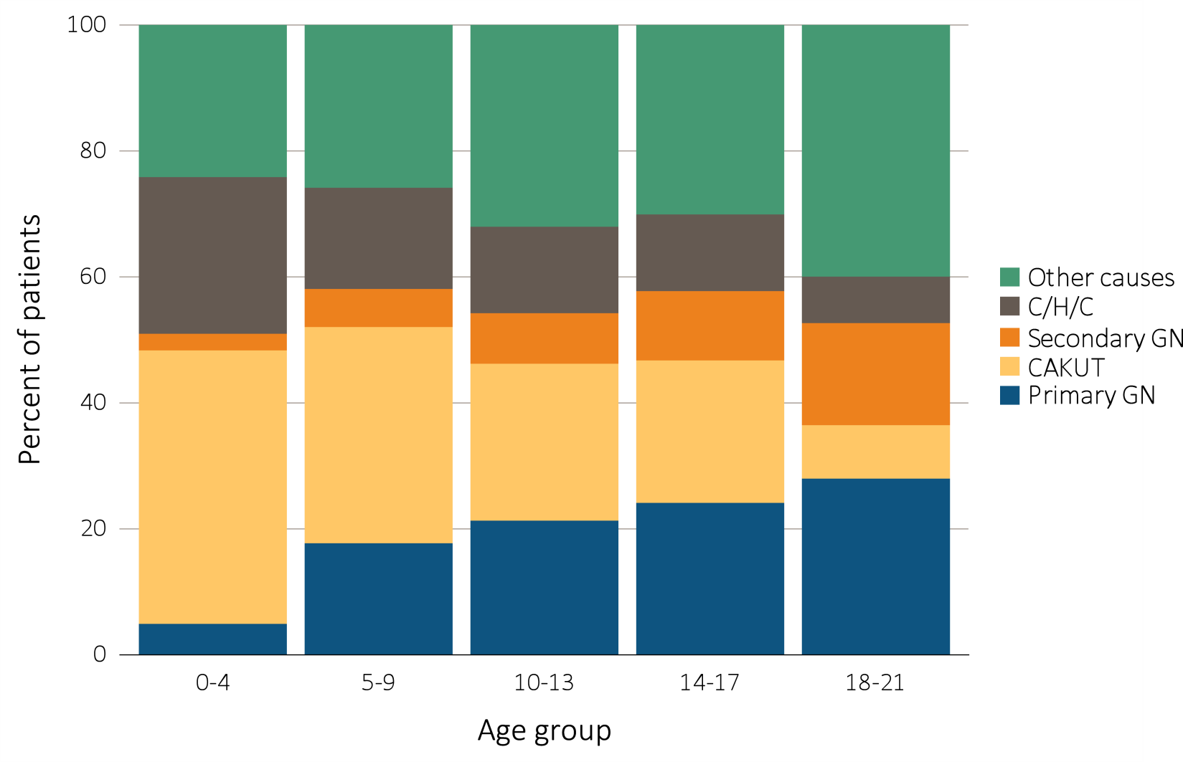
Figure 8.3 Distribution of reported incident pediatric ESRD patients by primary cause of ESRD, by age, (b) 2010-2014 (period B)
Data Source: Special analyses, USRDS ESRD Database. Abbreviations: CAKUT, congenital anomalies of the kidney and urinary tract; C/H/C, cystic/hereditary/congenital diseases; GN, glomerulonephritis.

Slide 10
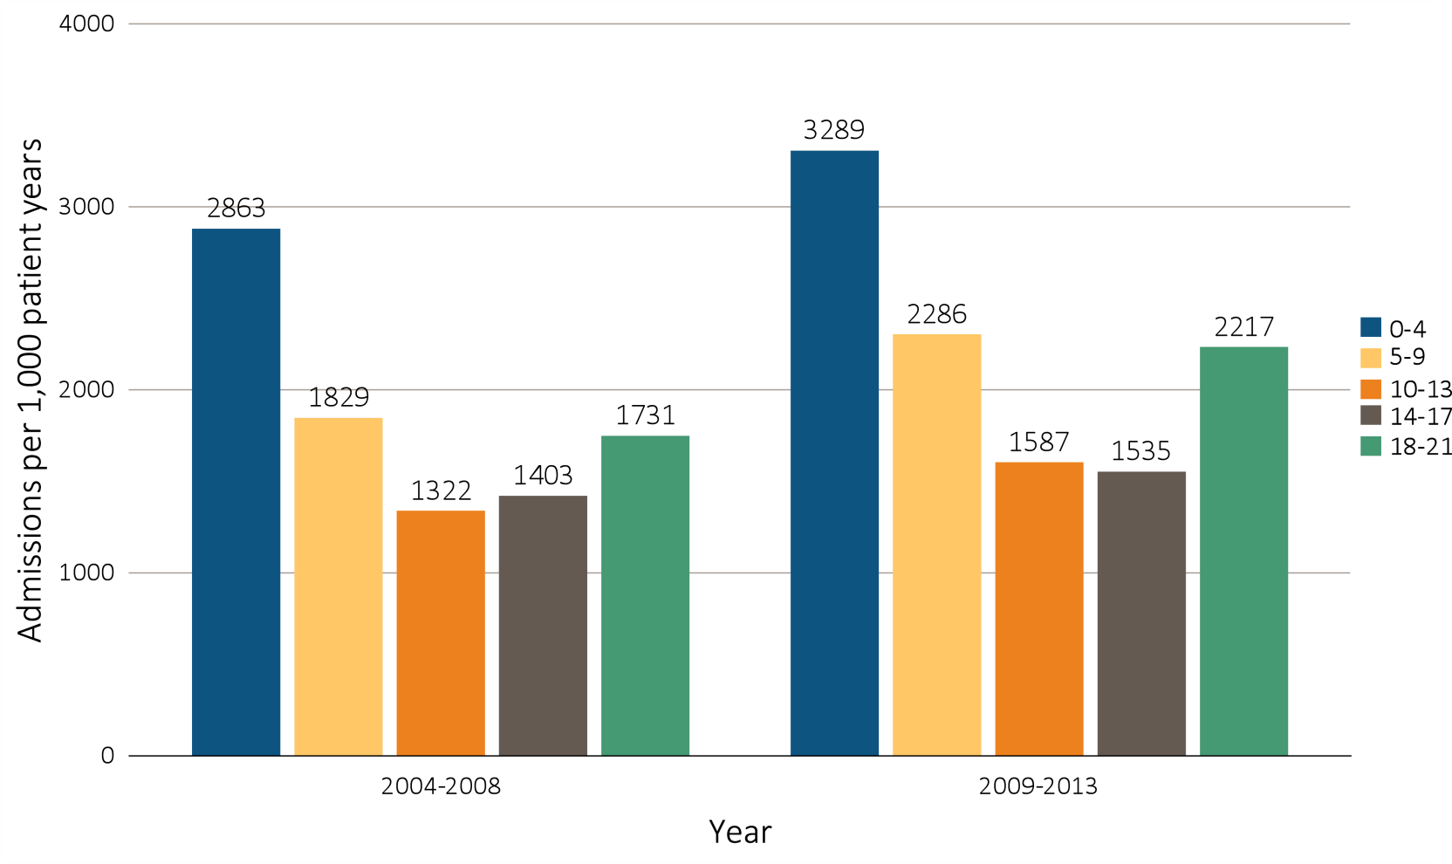
Figure 8.4 One-year adjusted all-cause hospitalization rates in incident pediatric patients (aged 0-21 years), by (a) age, 2004-2008 and 2009-2013
Data Source: Special analyses, USRDS ESRD Database. Includes incident pediatric ESRD patients in the years 2004-2013, surviving the first 90 days after ESRD initiation and followed from day 90. Adjusted for sex, race, primary cause of ESRD, and Hispanic ethnicity. Ref: incident ESRD patients aged 0-21, 2010-2011. Abbreviations: HD, hemodialysis; PD, peritoneal dialysis; Tx, transplant.

Slide 11
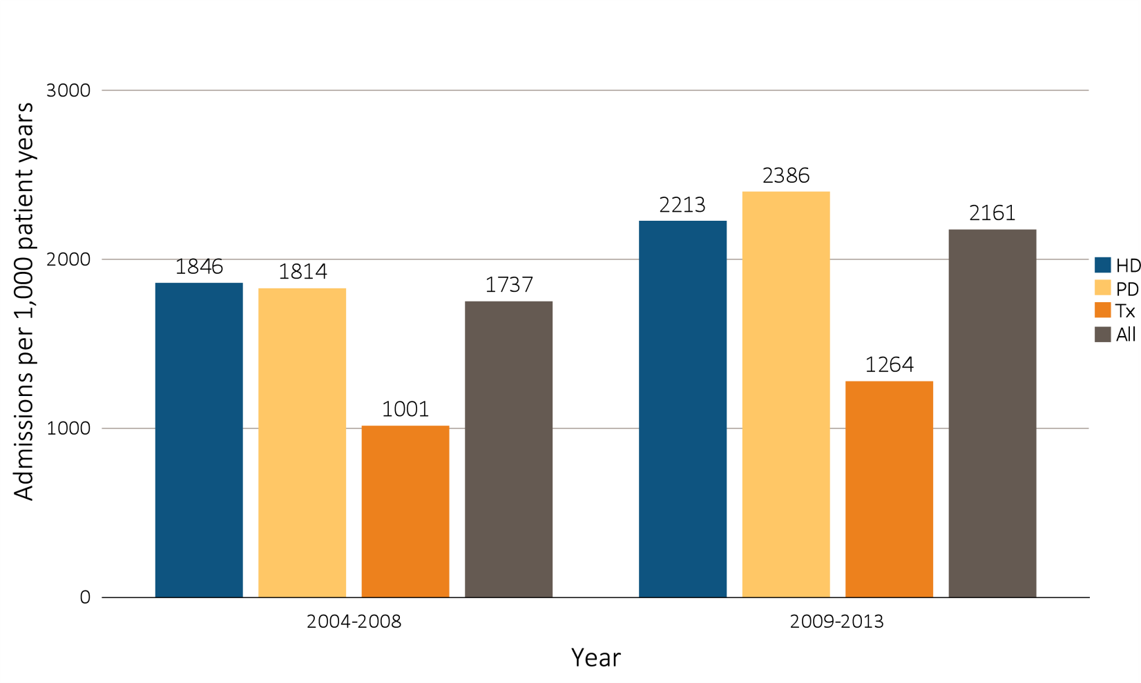
Figure 8.4 One-year adjusted all-cause hospitalization rates in incident pediatric patients (aged 0-21 years), by (b) modality, 2004-2008 and 2009-2013
Data Source: Special analyses, USRDS ESRD Database. Includes incident pediatric ESRD patients in the years 2004-2013, surviving the first 90 days after ESRD initiation and followed from day 90. Adjusted for sex, race, primary cause of ESRD, and Hispanic ethnicity. Ref: incident ESRD patients aged 0-21, 2010-2011. Abbreviations: HD, hemodialysis; PD, peritoneal dialysis; Tx, transplant.

Slide 12
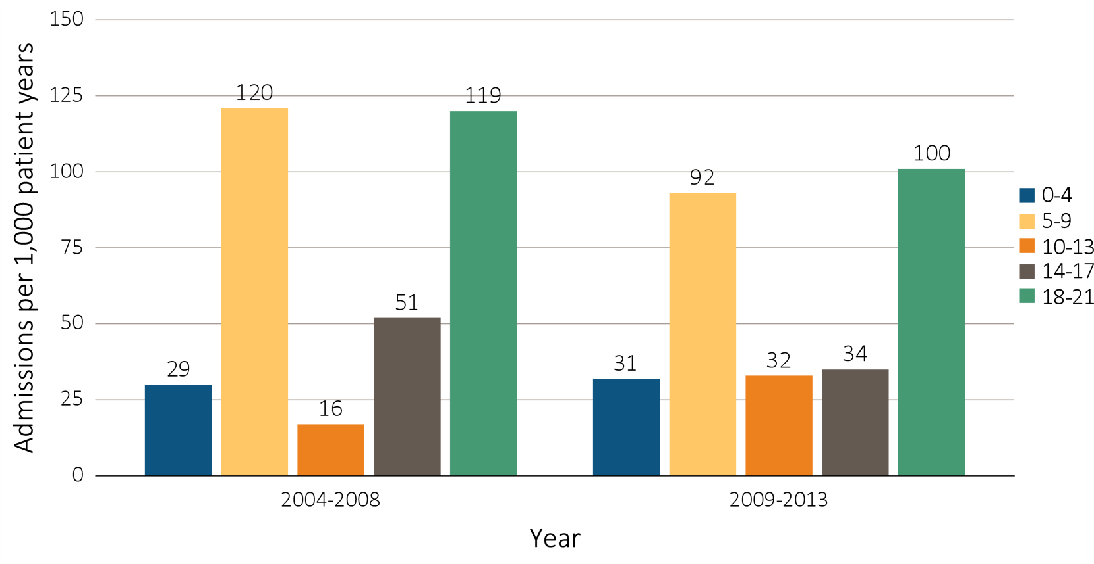
Figure 8.5 One-year cardiovascular hospitalization rates in incident pediatric patients (aged 0-21 years), by (a) age, 2004-2008 and 2009-2013
Data Source: Special analyses, USRDS ESRD Database. Includes incident pediatric ESRD patients in the years 2004-2013, surviving the first 90 days after ESRD initiation and followed from day 90. Reference population: incident ESRD patients aged 0-21, 2010-2011. (a) Adjusted for sex, race, primary cause of ESRD, and Hispanic ethnicity. (b) Unadjusted. Abbreviations: ESRD, end-stage renal disease; HD, hemodialysis; PD, peritoneal dialysis; Tx, transplant.

Slide 13
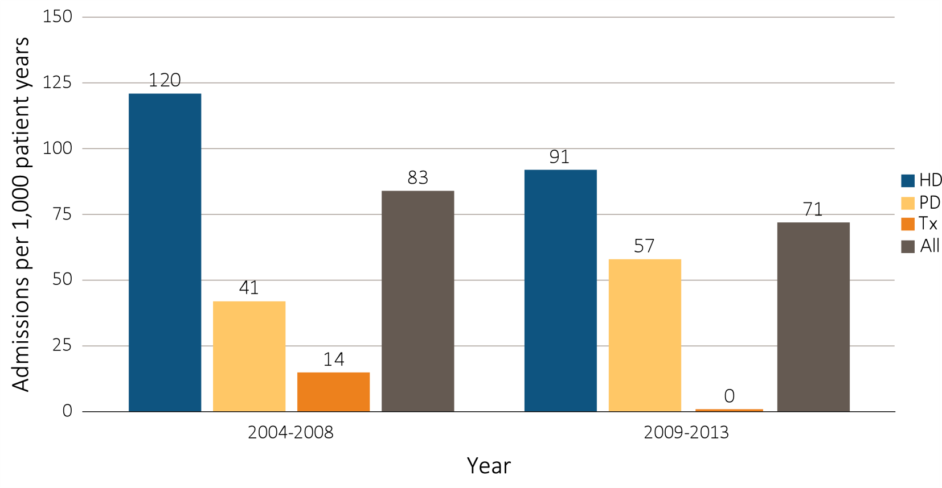
Figure 8.5 One-year cardiovascular hospitalization rates in incident pediatric patients (aged 0-21 years), by (b) modality, 2004-2008 and 2009-2013
Data Source: Special analyses, USRDS ESRD Database. Includes incident pediatric ESRD patients in the years 2004-2013, surviving the first 90 days after ESRD initiation and followed from day 90. Reference population: incident ESRD patients aged 0-21, 2010-2011. (a) Adjusted for sex, race, primary cause of ESRD, and Hispanic ethnicity. (b) Unadjusted. Abbreviations: ESRD, end-stage renal disease; HD, hemodialysis; PD, peritoneal dialysis; Tx, transplant.

Slide 14
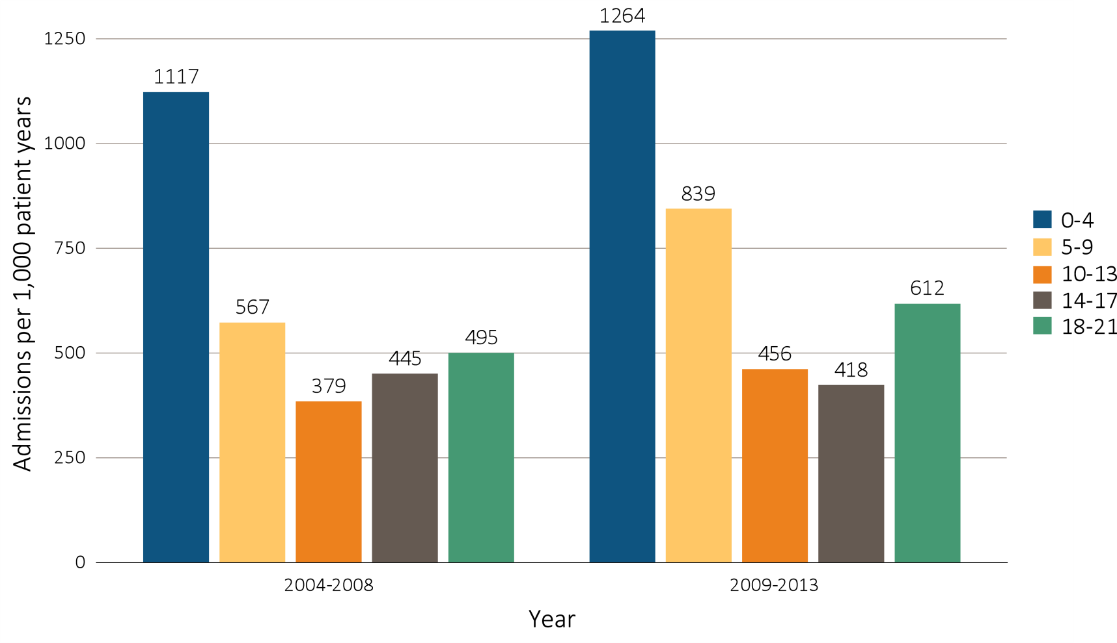
Figure 8.6 One-year adjusted hospitalization rates for infection in incident pediatric patients (aged 0-21 years), by (a) age, 2004-2008 and 2009-2013
Data Source: Special analyses, USRDS ESRD Database. Includes incident pediatric ESRD patients in the years 2004-2013, surviving the first 90 days after ESRD initiation and followed from day 90. Adjusted for sex, race, primary cause of ESRD, and Hispanic ethnicity. Ref: incident ESRD patients aged 0-21, 2010-2011. Abbreviations: HD, hemodialysis; PD, peritoneal dialysis; Tx, transplant.

Slide 15
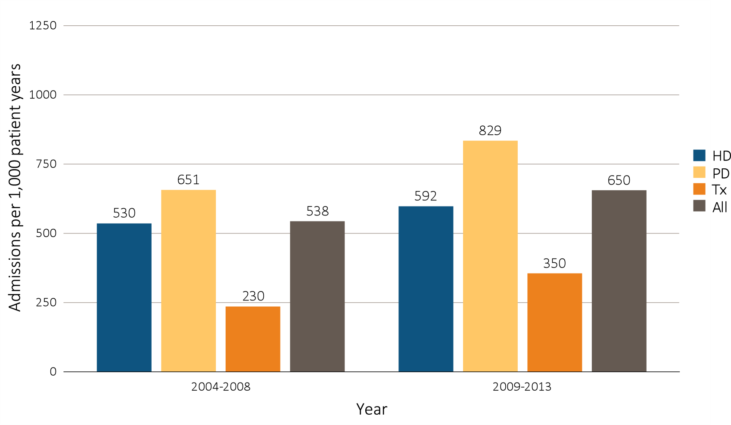
Figure 8.6 One-year adjusted hospitalization rates for infection in incident pediatric patients (aged 0-21 years), by (b) modality, 2004-2008 and 2009-2013
Data Source: Special analyses, USRDS ESRD Database. Includes incident pediatric ESRD patients in the years 2004-2013, surviving the first 90 days after ESRD initiation and followed from day 90. Adjusted for sex, race, primary cause of ESRD, and Hispanic ethnicity. Ref: incident ESRD patients aged 0-21, 2010-2011. Abbreviations: HD, hemodialysis; PD, peritoneal dialysis; Tx, transplant.

Slide 16
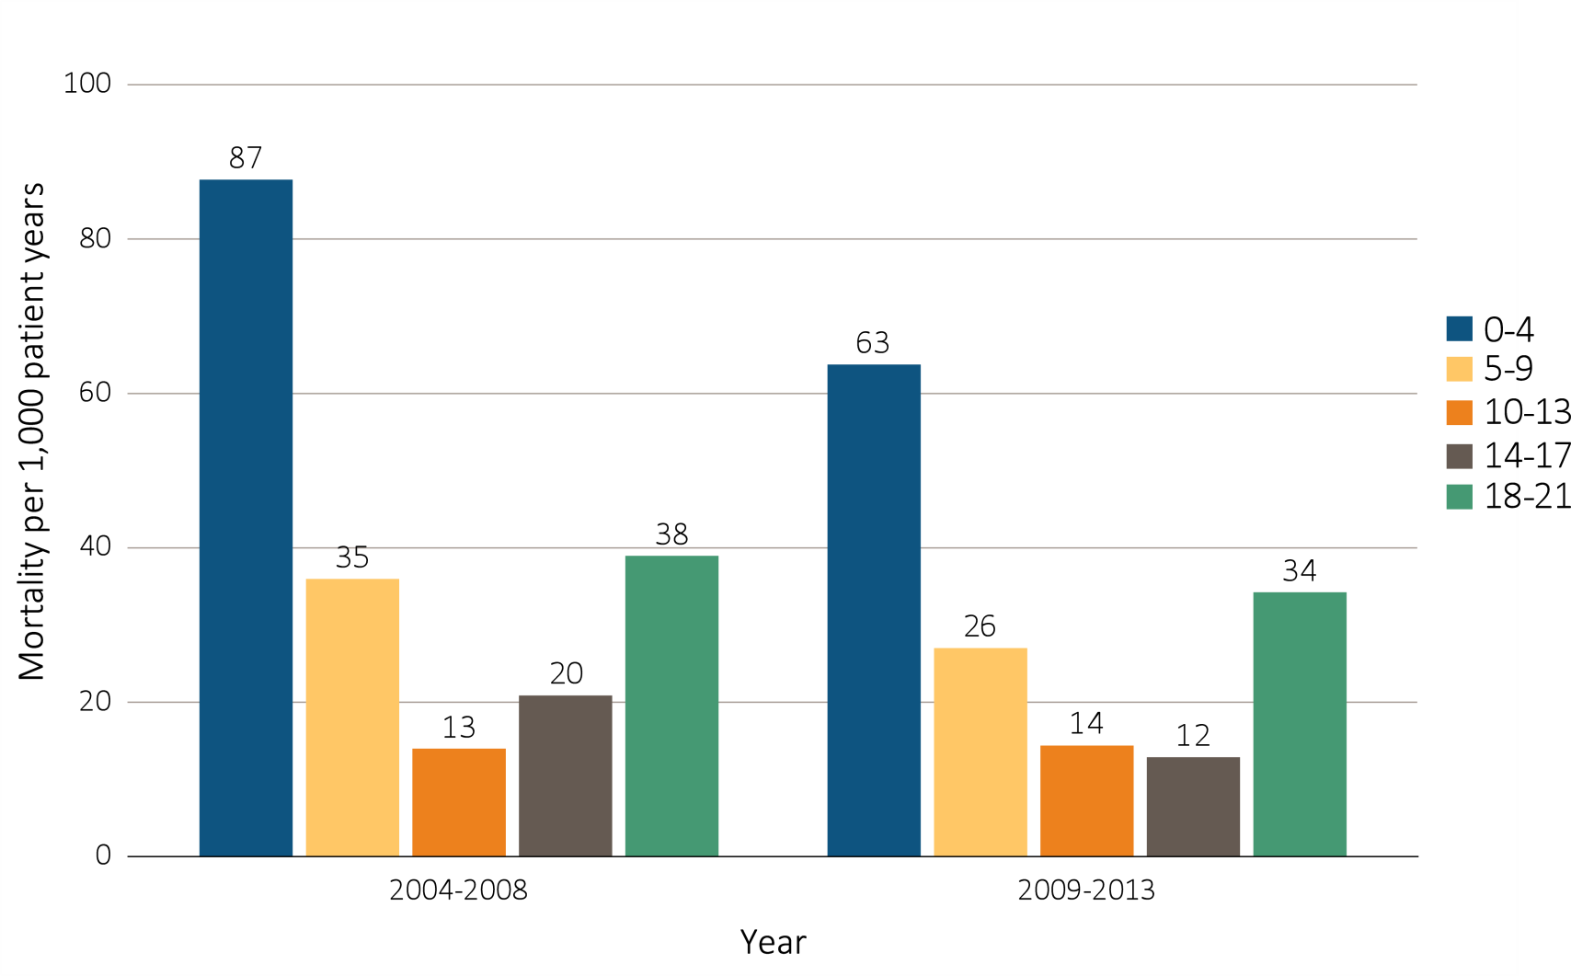
Figure 8.7 One-year adjusted all-cause mortality rates in incident pediatric patients with ESRD (aged 0-21 years), by (a) age, 2004-2008 and 2009-2013
Data Source: Special analyses, USRDS ESRD Database. Incident dialysis and transplant patients defined at the onset of dialysis or the day of transplant without the 60-day rule; followed to December 31, 2014. Adjusted for age, sex, race, Hispanic ethnicity, and primary cause of ESRD. Ref: incident ESRD patients aged 0-21, 2010-2011. Abbreviations: HD, hemodialysis; PD, peritoneal dialysis; Tx, transplant.

Slide 17
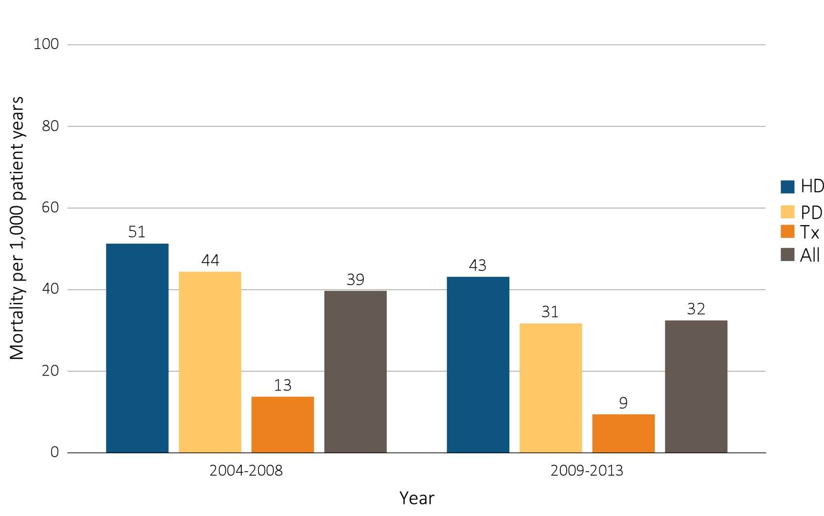
Figure 8.7 One-year adjusted all-cause mortality rates in incident pediatric patients with ESRD (aged 0-21 years), by (b) modality, 2004-2008 and 2009-2013
Data Source: Special analyses, USRDS ESRD Database. Incident dialysis and transplant patients defined at the onset of dialysis or the day of transplant without the 60-day rule; followed to December 31, 2014. Adjusted for age, sex, race, Hispanic ethnicity, and primary cause of ESRD. Ref: incident ESRD patients aged 0-21, 2010-2011. Abbreviations: HD, hemodialysis; PD, peritoneal dialysis; Tx, transplant.

Slide 18
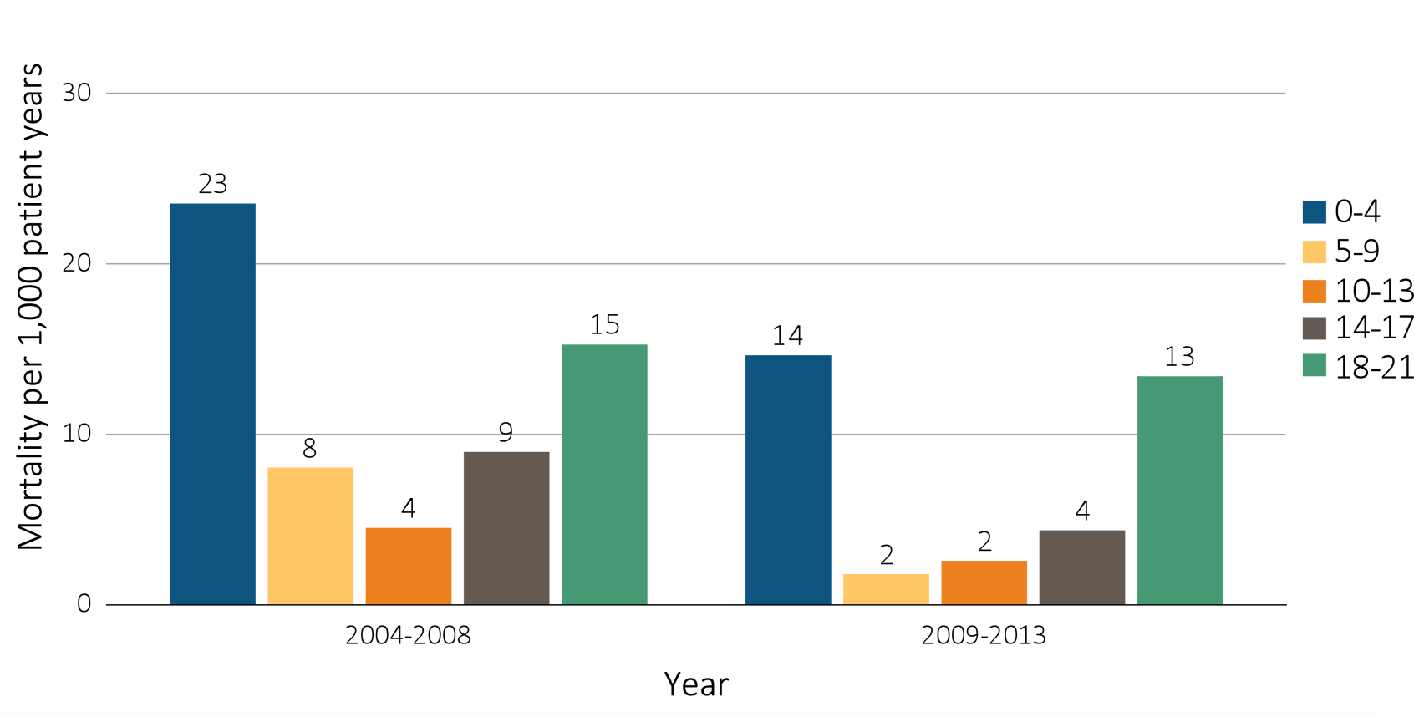
Figure 8.8 One-year adjusted cardiovascular mortality rates in incident pediatric patients with ESRD (aged 0-21 years), by (a) age, 2004-2008 and 2009-2013
Data Source: Special analyses, USRDS ESRD Database. Incident dialysis and transplant patients defined at the onset of dialysis or the day of transplant without the 60-day rule; followed to December 31, 2014. Adjusted for age, sex, race, Hispanic ethnicity, and primary cause of ESRD. Ref: incident ESRD patients aged 0-21, 2010-2011. Abbreviations: HD, hemodialysis; PD, peritoneal dialysis; Tx, transplant.

Slide 19
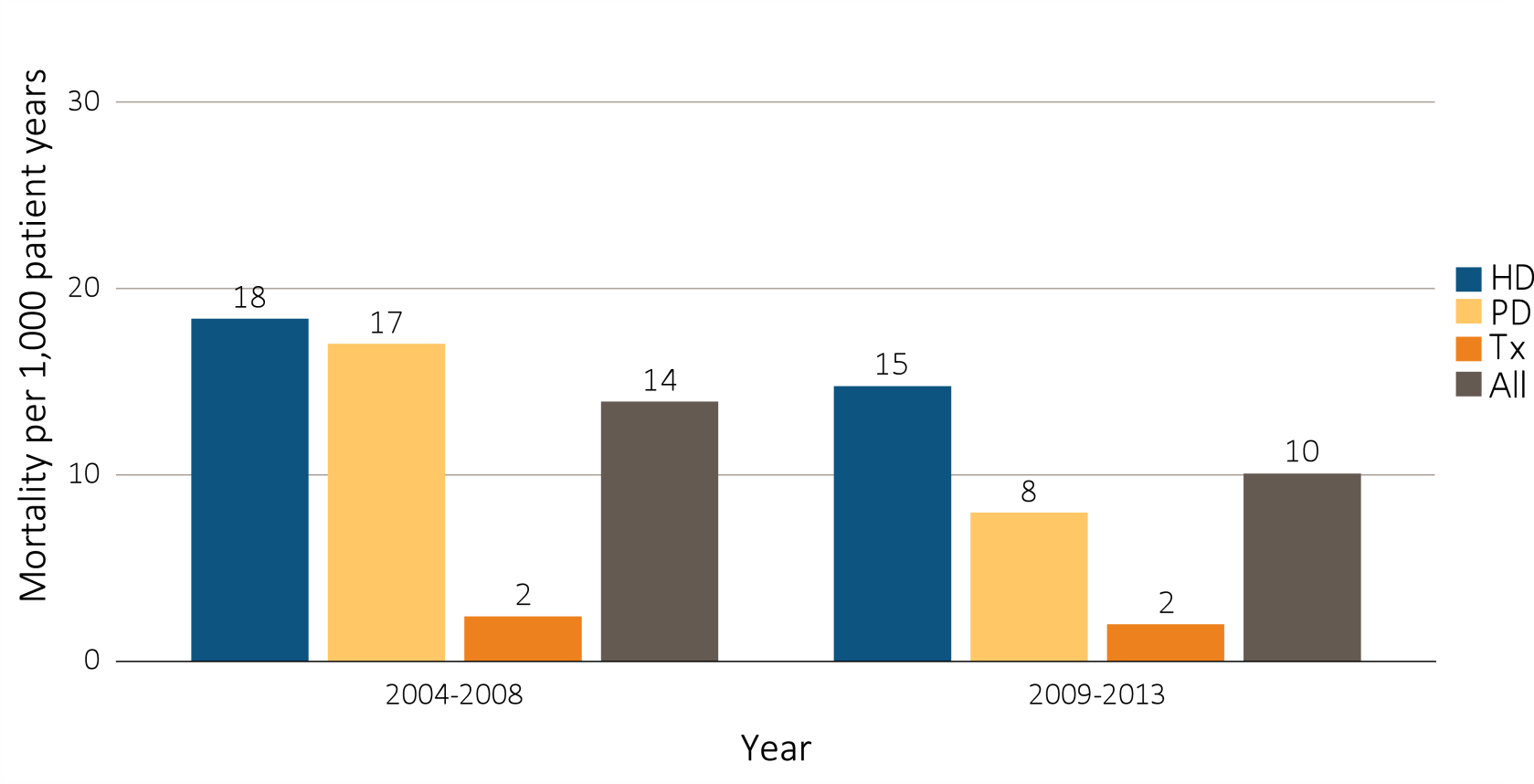
Figure 8.8 One-year adjusted cardiovascular mortality rates in incident pediatric patients with ESRD (aged 0-21 years), by (b) modality, 2004-2008 and 2009-2013
Data Source: Special analyses, USRDS ESRD Database. Incident dialysis and transplant patients defined at the onset of dialysis or the day of transplant without the 60-day rule; followed to December 31, 2014. Adjusted for age, sex, race, Hispanic ethnicity, and primary cause of ESRD. Ref: incident ESRD patients aged 0-21, 2010-2011. Abbreviations: HD, hemodialysis; PD, peritoneal dialysis; Tx, transplant.

Slide 20
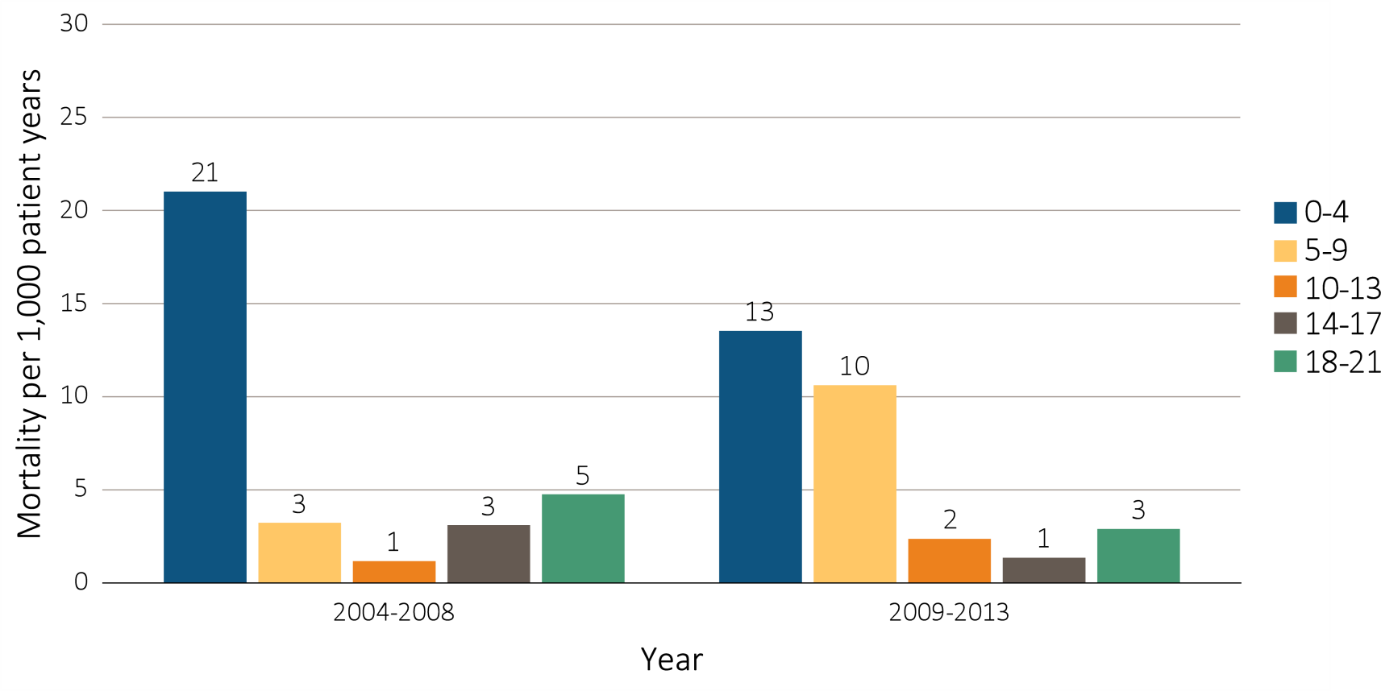
Figure 8.9 One-year adjusted rates of mortality due to infection in incident pediatric patients with ESRD (aged 0-21 years), by (a) age, 2004-2008 and 2009-2013
Data Source: Special analyses, USRDS ESRD Database. Incident dialysis and transplant patients defined at the onset of dialysis or the day of transplant without the 60-day rule; followed to December 31, 2014. Adjusted for age, sex, race, Hispanic ethnicity, and primary cause of ESRD. Ref: incident ESRD patients aged 0-21, 2010-2011. Abbreviations: HD, hemodialysis; PD, peritoneal dialysis; Tx, transplant.

Slide 21
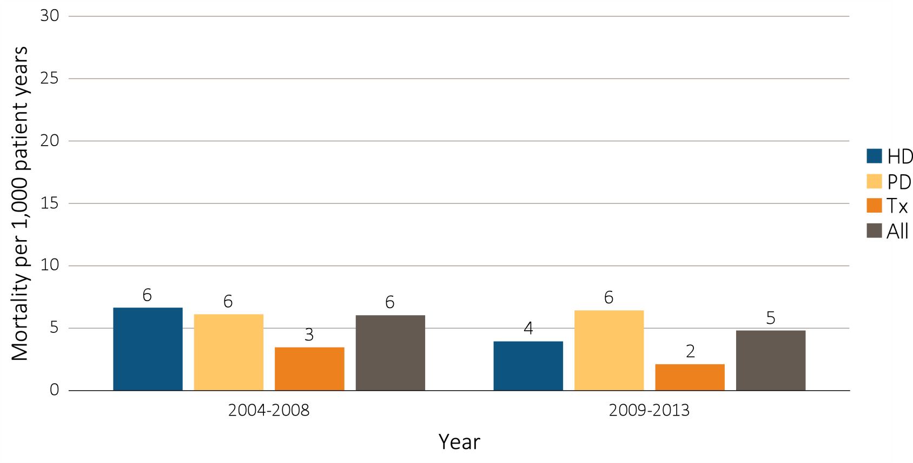
Figure 8.9 One-year adjusted rates of mortality due to infection in incident pediatric patients with ESRD (aged 0-21 years), by (b) modality, 2004-2008 and 2009-2013
Data Source: Special analyses, USRDS ESRD Database. Incident dialysis and transplant patients defined at the onset of dialysis or the day of transplant without the 60-day rule; followed to December 31, 2014. Adjusted for age, sex, race, Hispanic ethnicity, and primary cause of ESRD. Ref: incident ESRD patients aged 0-21, 2010-2011. Abbreviations: HD, hemodialysis; PD, peritoneal dialysis; Tx, transplant.

Slide 22
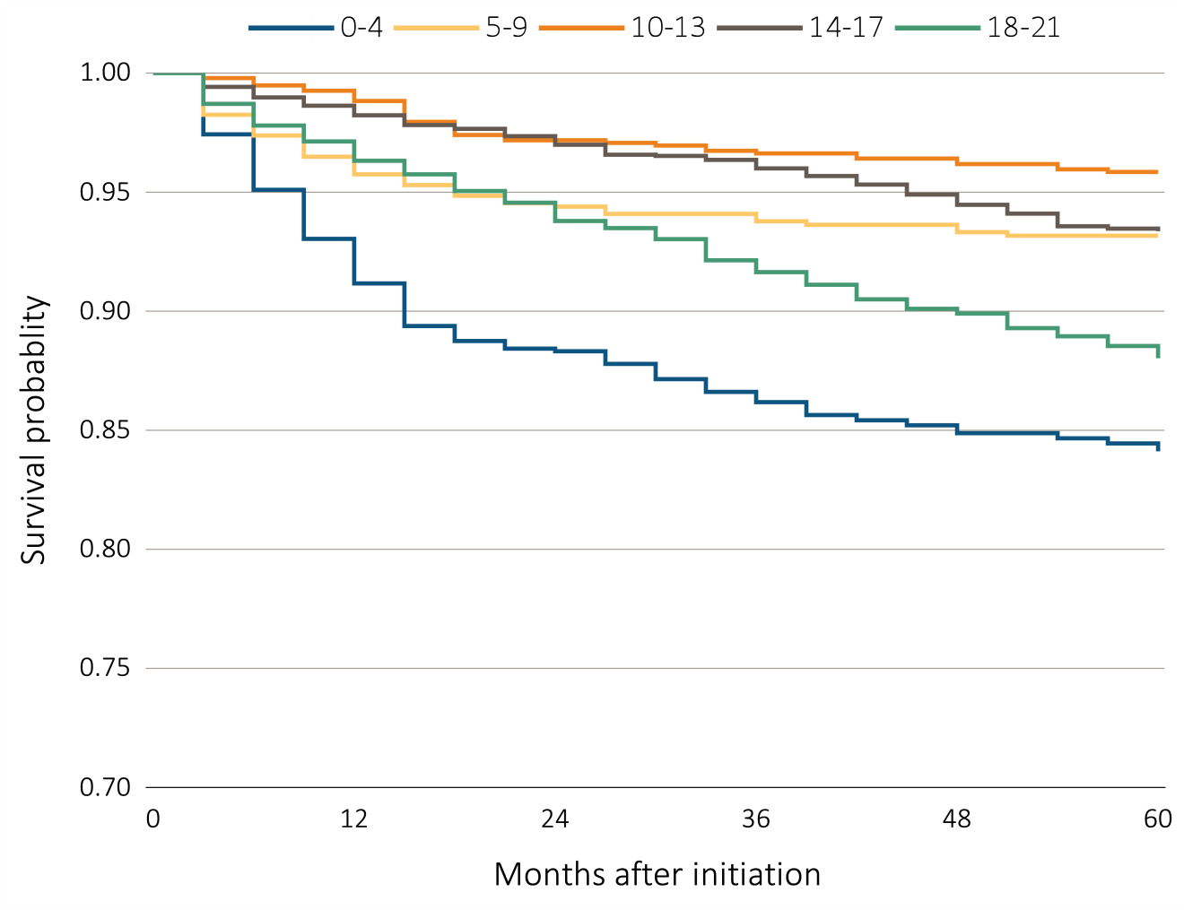
Figure 8.10 Adjusted five-year survival in incident pediatric patients (aged 0-21 years) from day 1, by (a) age, 2005-2009
Data Source: Special analyses, USRDS ESRD Database. Incident dialysis and transplant patients defined at the onset of dialysis or the day of transplant without the 60-day rule; followed to December 31, 2014. Adjusted for age, sex, race, Hispanic ethnicity, and primary cause of ESRD. Ref: incident ESRD patients aged 0-21, 2010-2011. Abbreviations: HD, hemodialysis; PD, peritoneal dialysis; Tx, transplant.

Slide 23
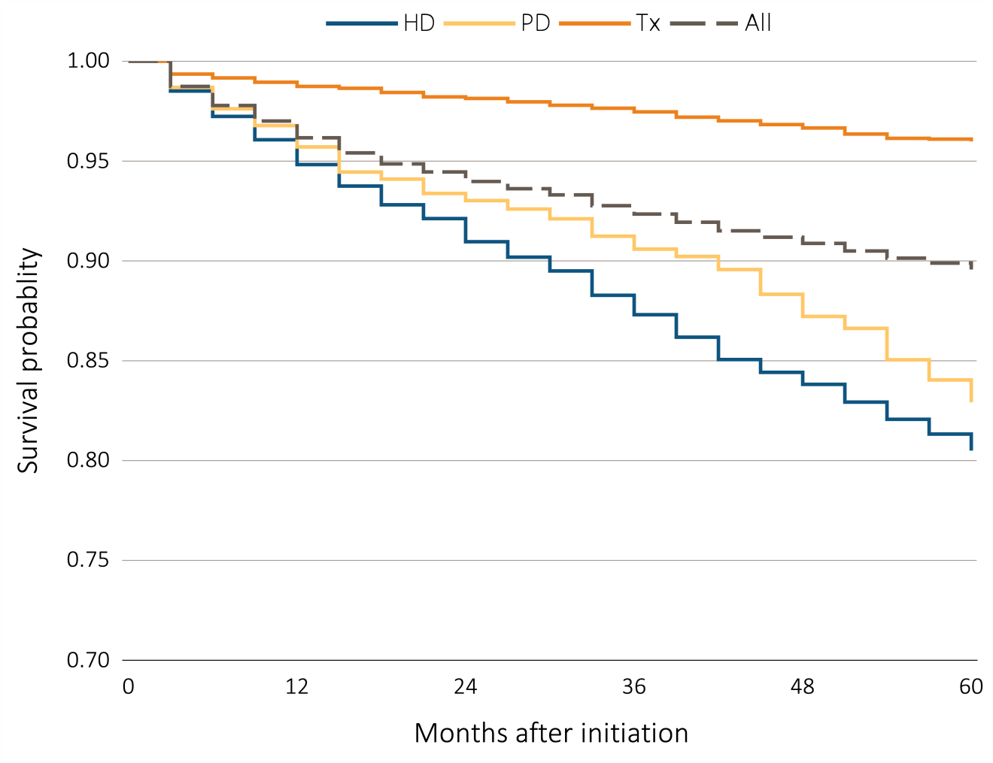
Figure 8.10 Adjusted five-year survival in incident pediatric patients (aged 0-21 years) from day 1, by (b) modality, 2005-2009
Data Source: Special analyses, USRDS ESRD Database. Incident dialysis and transplant patients defined at the onset of dialysis or the day of transplant without the 60-day rule; followed to December 31, 2014. Adjusted for age, sex, race, Hispanic ethnicity, and primary cause of ESRD. Ref: incident ESRD patients aged 0-21, 2010-2011. Abbreviations: HD, hemodialysis; PD, peritoneal dialysis; Tx, transplant.

Slide 24
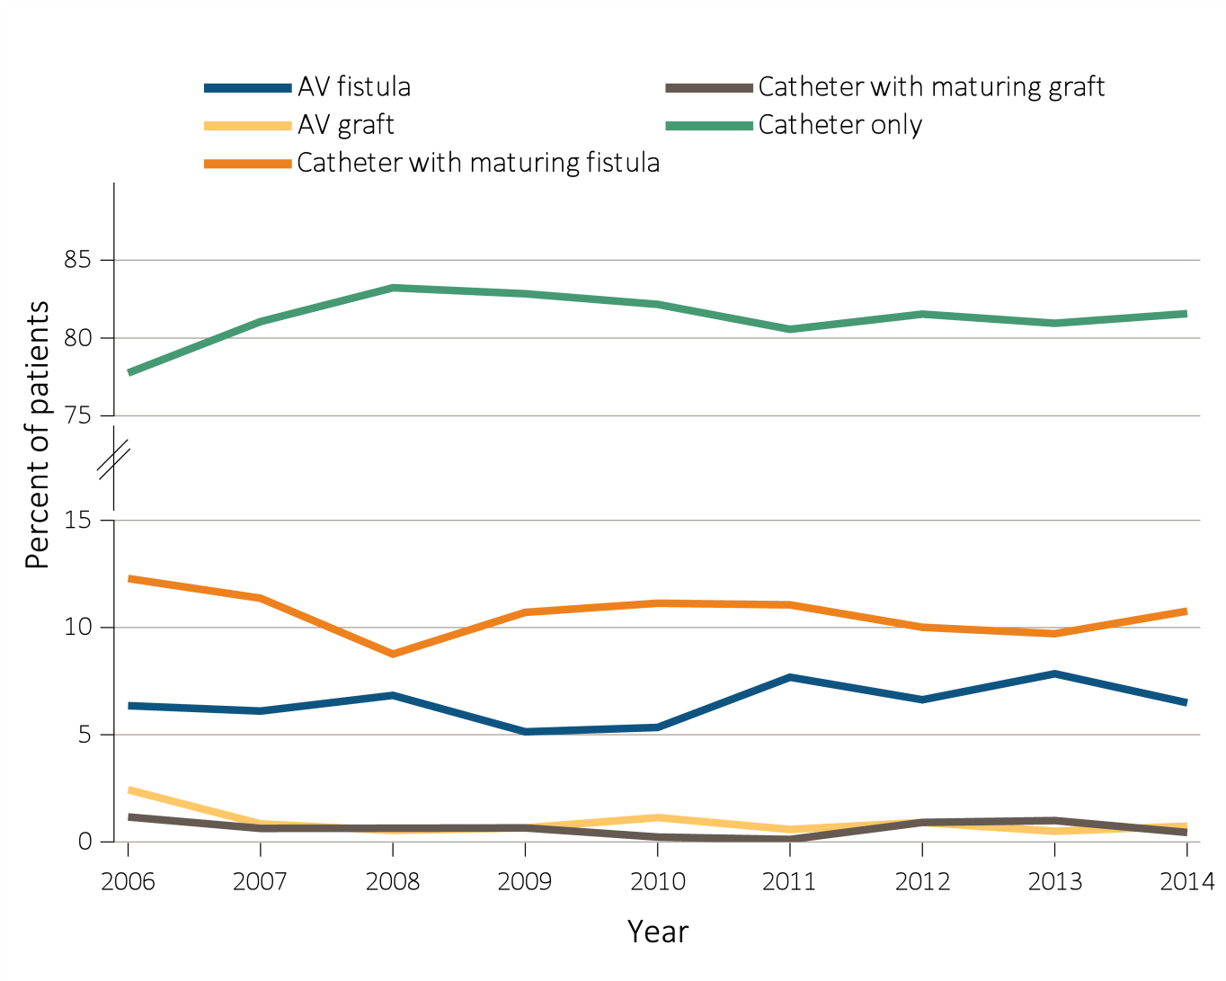
Figure 8.11 Vascular access type at initiation of incident pediatric hemodialysis patients (aged 0-21 years) by (a) year, 2006-2014
Data Source: Special analyses, USRDS ESRD Database. ESRD patients initiating hemodialysis in 2006-2014. Abbreviations: AV, arteriovenous.

Slide 25
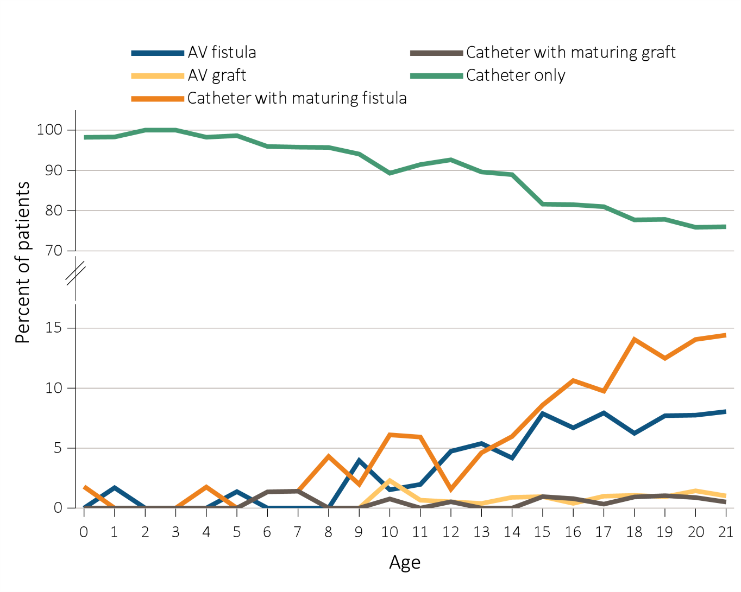
Figure 8.11 Vascular access type at initiation of incident pediatric hemodialysis patients (aged 0-21 years) by (b) age, 2006-2014
Data Source: Special analyses, USRDS ESRD Database. ESRD patients initiating hemodialysis in 2006-2014. Abbreviations: AV, arteriovenous.

Slide 26
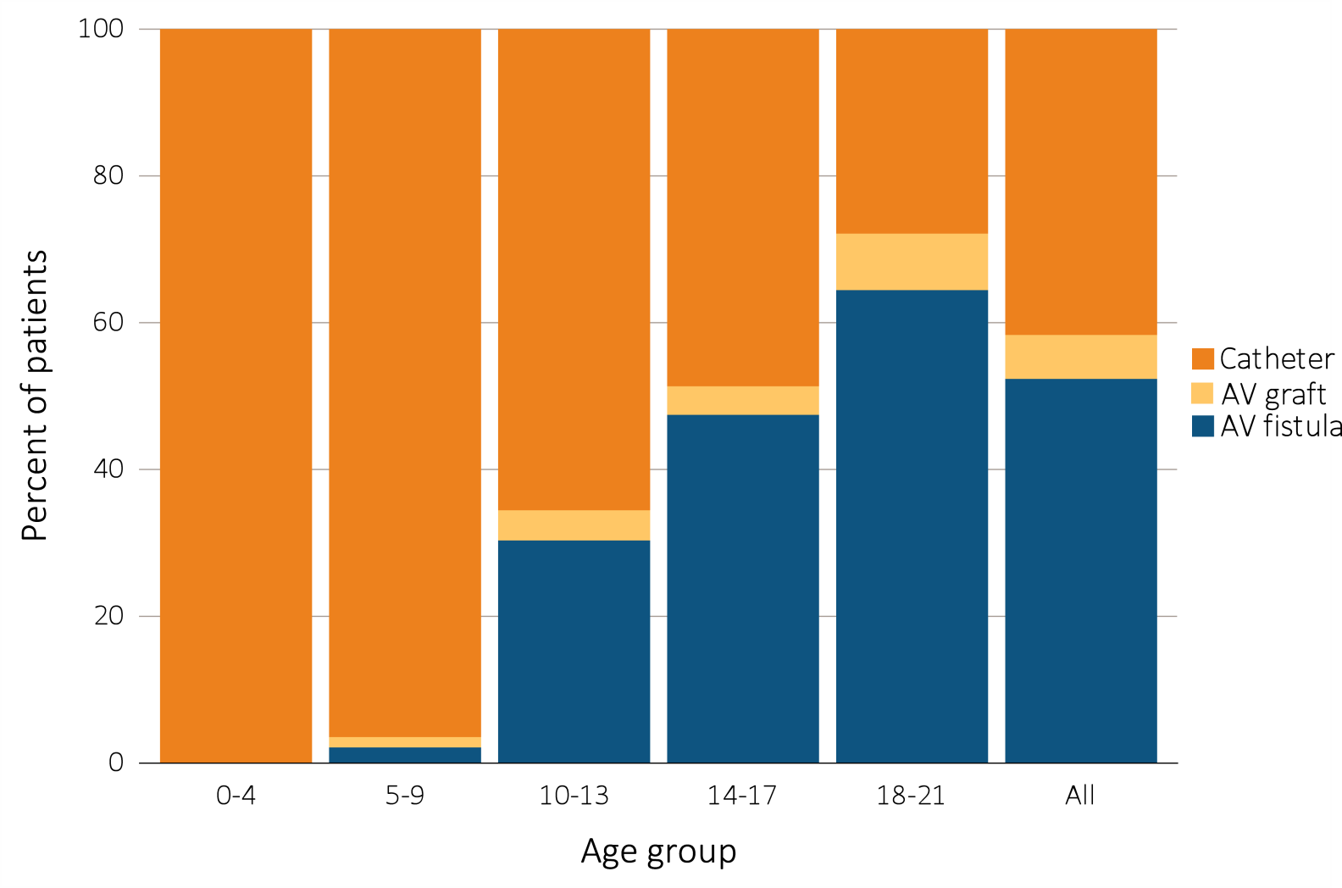
Figure 8.12 Distribution of vascular access type in prevalent pediatric hemodialysis patients (aged 0-21 years* as of December 31, 2015), 2015
Data Source: Special analyses, USRDS ESRD Database. Hemodialysis patients initiating treatment for ESRD at least 90 days prior to December 1, 2015, *who were <22 years old as December 1, 2015, and who were alive through December 31, 2015; Catheter = any catheter use; fistula and graft use shown are without the use of a catheter. Abbreviations: AV, arteriovenous; ESRD, end-stage renal disease.

Slide 27
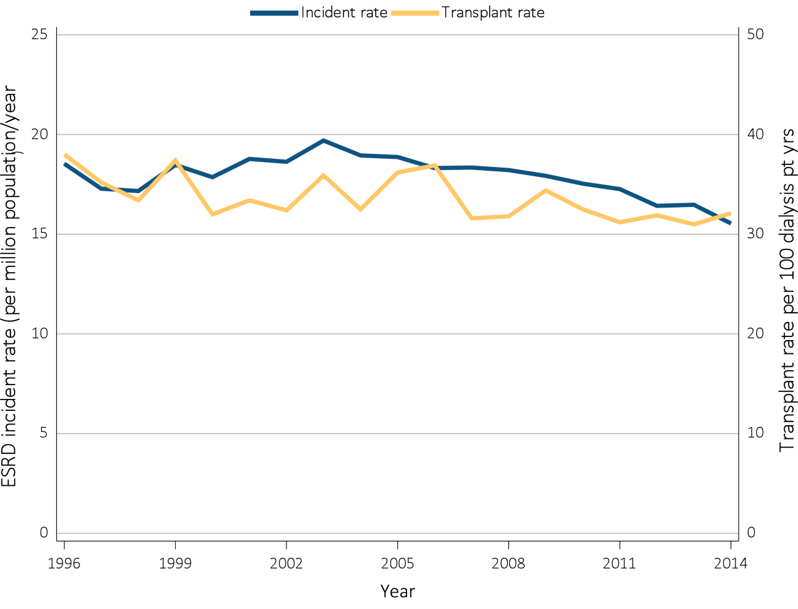
Figure 8.13 Trends in pediatric transplantation (aged 0-21 years), by (a) ESRD incident and kidney transplant rates, patients 18-21 years, 1996-2014
Data Source: Data Source: (a) Reference Tables A1, E9, and M1. The rate of ESRD per million among the U.S. population aged 0-21 years and the rate of transplantation in dialysis patients aged 0-21 years at the time of transplant, 1996–2014. (b) Special analyses, USRDS ESRD Database. The waiting list count provides the number of pediatric candidates aged 0-21 years on the Organ Procurement and Transplantation Network kidney transplant waiting list on December 31 of each year for first and subsequent kidney alone or kidney plus pancreas transplantation. Candidates listed at more than one center on December 31 are counted only once. There are no data available for median waiting list time for patients with prior transplants listed after 2012. (c)(d)(e) Reference Tables E8, E8(2), E8(3) . This figure represents kidney alone and kidney plus pancreas transplant counts for all pediatric candidates. Abbreviations: ESRD, end-stage renal disease; pt, patient; Tx, transplant; yrs, years.

Slide 28
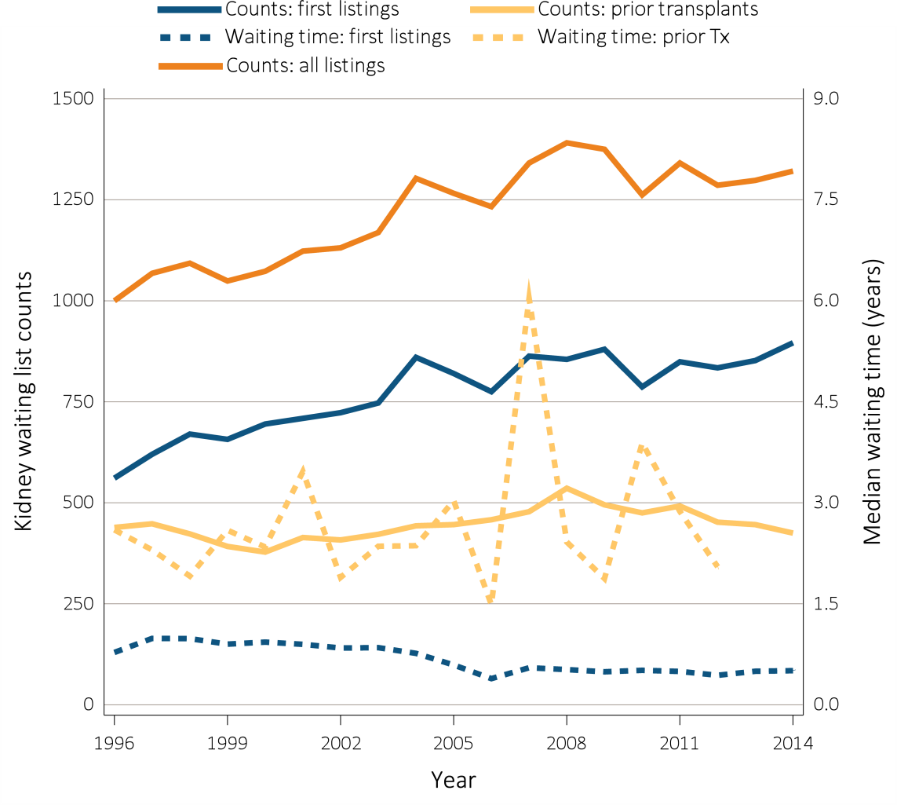
Figure 8.13 Trends in pediatric transplantation (aged 0-21 years), by (b) pediatric patient transplant counts and kidney transplant waiting list times, patients 18-21 years, 1996-2014
Data Source: Data Source: (a) Reference Tables A1, E9, and M1. The rate of ESRD per million among the U.S. population aged 0-21 years and the rate of transplantation in dialysis patients aged 0-21 years at the time of transplant, 1996–2014. (b) Special analyses, USRDS ESRD Database. The waiting list count provides the number of pediatric candidates aged 0-21 years on the Organ Procurement and Transplantation Network kidney transplant waiting list on December 31 of each year for first and subsequent kidney alone or kidney plus pancreas transplantation. Candidates listed at more than one center on December 31 are counted only once. There are no data available for median waiting list time for patients with prior transplants listed after 2012. (c)(d)(e) Reference Tables E8, E8(2), E8(3) . This figure represents kidney alone and kidney plus pancreas transplant counts for all pediatric candidates. Abbreviations: ESRD, end-stage renal disease; pt, patient; Tx, transplant; yrs, years.

Slide 29
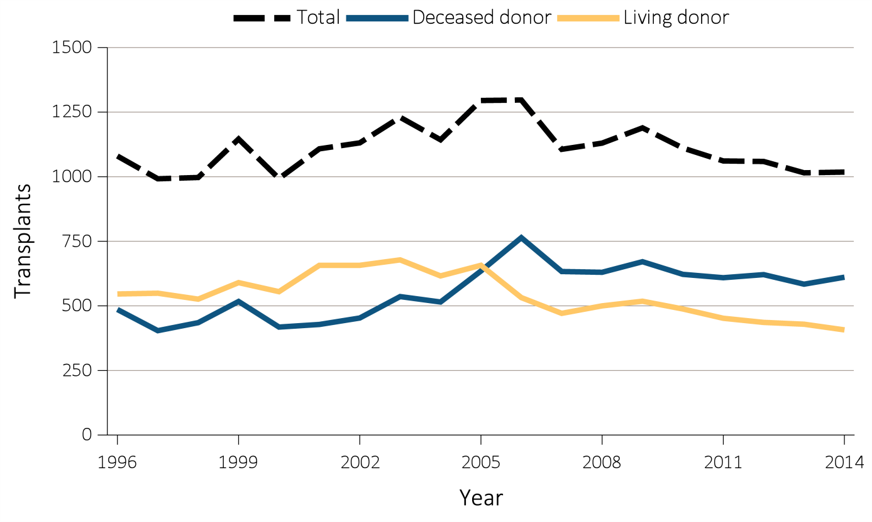
Figure 8.13 Trends in pediatric transplantation (aged 0-21 years), by (c) kidney transplant counts, patients 18-21 years, 1996-2014
Data Source: Data Source: (a) Reference Tables A1, E9, and M1. The rate of ESRD per million among the U.S. population aged 0-21 years and the rate of transplantation in dialysis patients aged 0-21 years at the time of transplant, 1996–2014. (b) Special analyses, USRDS ESRD Database. The waiting list count provides the number of pediatric candidates aged 0-21 years on the Organ Procurement and Transplantation Network kidney transplant waiting list on December 31 of each year for first and subsequent kidney alone or kidney plus pancreas transplantation. Candidates listed at more than one center on December 31 are counted only once. There are no data available for median waiting list time for patients with prior transplants listed after 2012. (c)(d)(e) Reference Tables E8, E8(2), E8(3) . This figure represents kidney alone and kidney plus pancreas transplant counts for all pediatric candidates. Abbreviations: ESRD, end-stage renal disease; pt, patient; Tx, transplant; yrs, years.

Slide 30
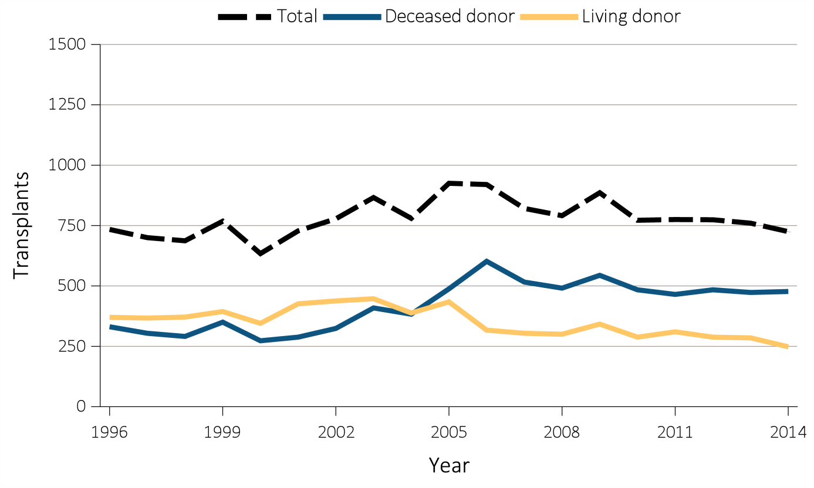
Figure 8.13 Trends in pediatric transplantation (aged 0-21 years), by (d) Kidney transplant counts, patients 0-17 years, patients 18-21 years, 1996-2014
Data Source: Data Source: (a) Reference Tables A1, E9, and M1. The rate of ESRD per million among the U.S. population aged 0-21 years and the rate of transplantation in dialysis patients aged 0-21 years at the time of transplant, 1996–2014. (b) Special analyses, USRDS ESRD Database. The waiting list count provides the number of pediatric candidates aged 0-21 years on the Organ Procurement and Transplantation Network kidney transplant waiting list on December 31 of each year for first and subsequent kidney alone or kidney plus pancreas transplantation. Candidates listed at more than one center on December 31 are counted only once. There are no data available for median waiting list time for patients with prior transplants listed after 2012. (c)(d)(e) Reference Tables E8, E8(2), E8(3) . This figure represents kidney alone and kidney plus pancreas transplant counts for all pediatric candidates. Abbreviations: ESRD, end-stage renal disease; pt, patient; Tx, transplant; yrs, years.

Slide 31
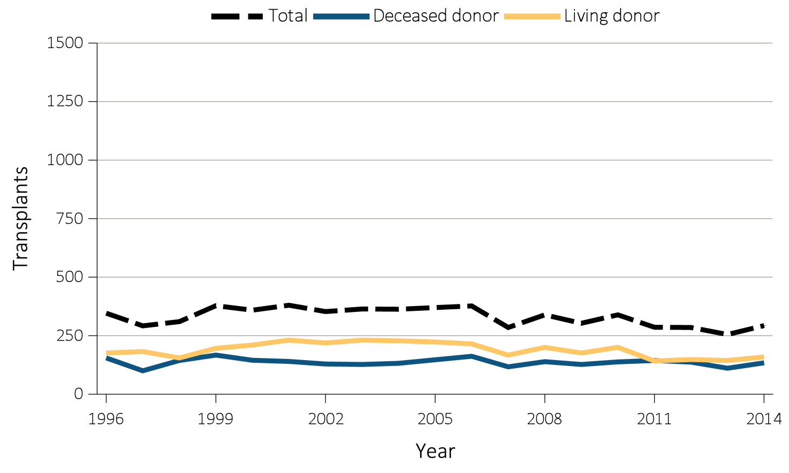
Figure 8.13 Trends in pediatric transplantation (aged 0-21 years), by (e) Kidney transplant counts, patients 18-21 years, 1996-2014
Data Source: Data Source: (a) Reference Tables A1, E9, and M1. The rate of ESRD per million among the U.S. population aged 0-21 years and the rate of transplantation in dialysis patients aged 0-21 years at the time of transplant, 1996–2014. (b) Special analyses, USRDS ESRD Database. The waiting list count provides the number of pediatric candidates aged 0-21 years on the Organ Procurement and Transplantation Network kidney transplant waiting list on December 31 of each year for first and subsequent kidney alone or kidney plus pancreas transplantation. Candidates listed at more than one center on December 31 are counted only once. There are no data available for median waiting list time for patients with prior transplants listed after 2013. (c)(d)(e) Reference Tables E8, E8(2), E8(3) . This figure represents kidney alone and kidney plus pancreas transplant counts for all pediatric candidates. Abbreviations: ESRD, end-stage renal disease; pt, patient; Tx, transplant; yrs, years.

Slide 32
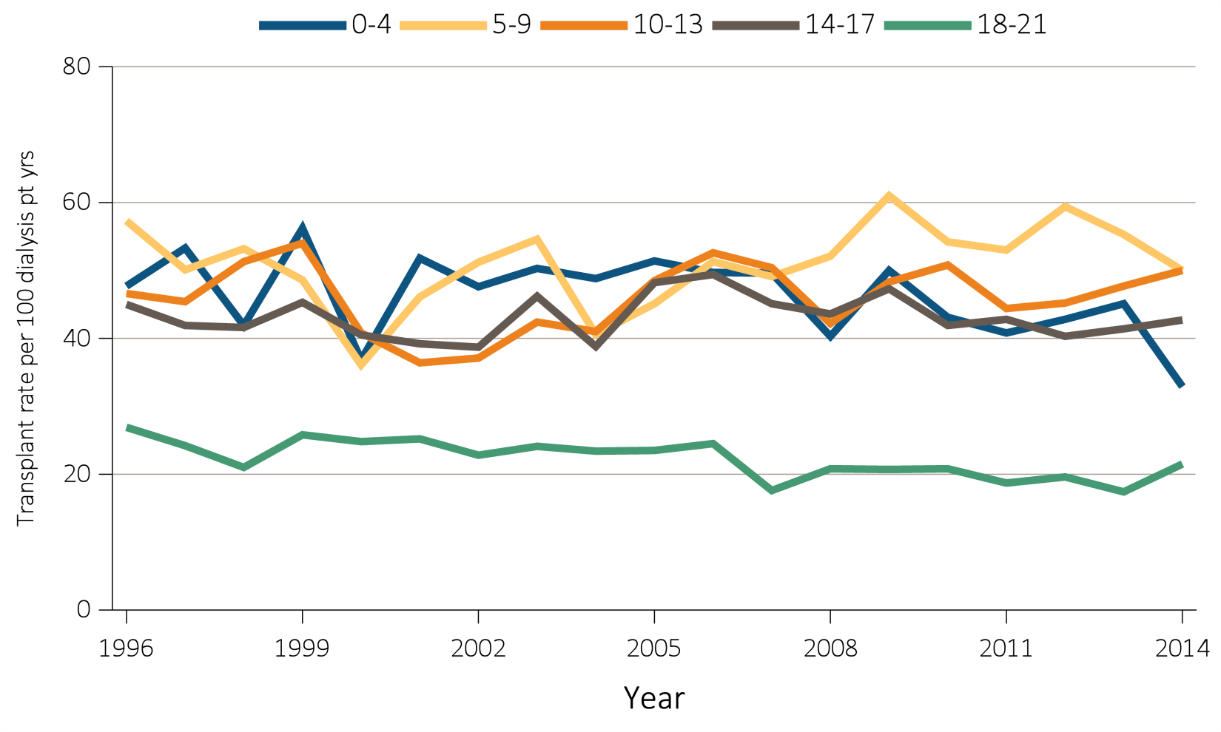
Figure 8.14 Annual rates of live and deceased donor transplants in pediatric dialysis patients (aged 0-21 years), by (a) age and (b) race, 1996-2014
^{(a) Age}
Data Source: Special analyses, USRDS ESRD Database. Includes transplant year between 1996–2014. Abbreviations: pt, patient; yrs, years.

Slide 33
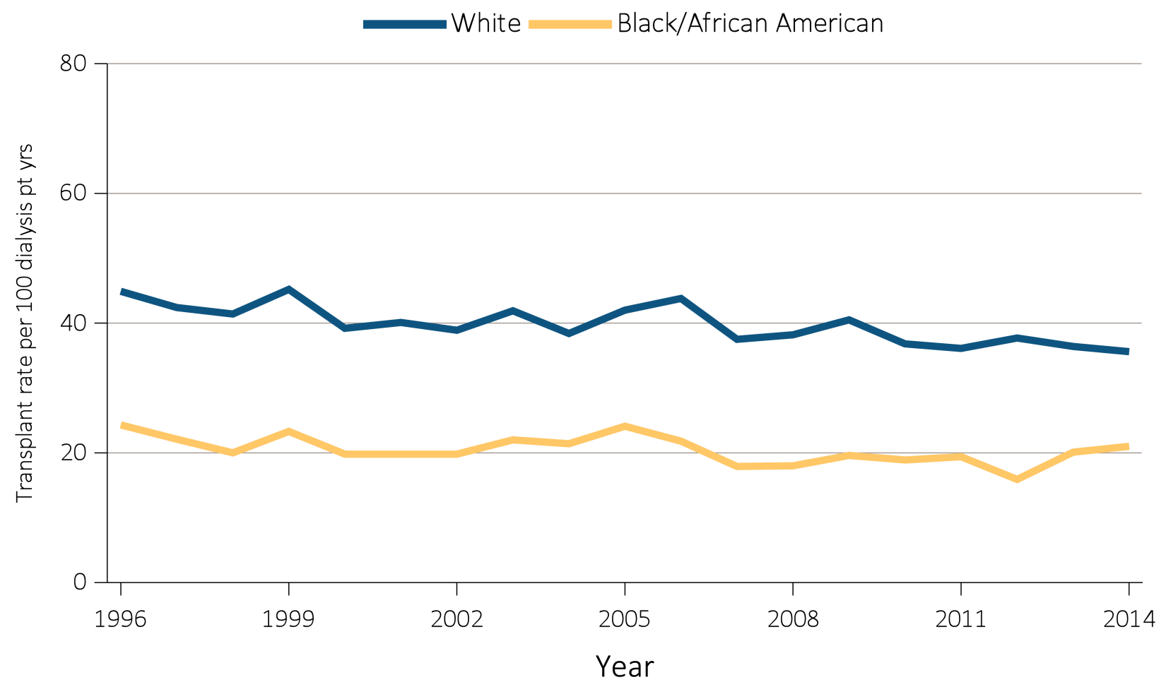
Figure 8.14 Annual rates of live and deceased donor transplants in pediatric dialysis patients (aged 0-21 years), by (a) age and (b) race, 1996-2014
^{(b) Race}
Data Source: Special analyses, USRDS ESRD Database. Includes transplant year between 1996–2014. Abbreviations: pt, patient; yrs, years.

Slide 34
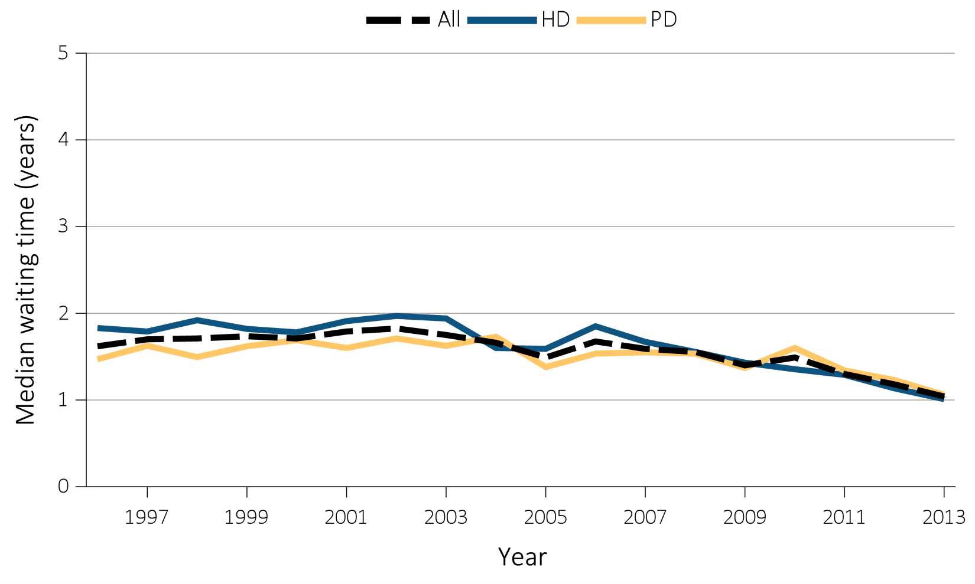
Figure 8.15 Median waiting time from incident hemodialysis (HD) or peritoneal dialysis (PD) to first transplant, by (a) modality, 1996-2013
Data Source: Data Source: Special analyses, USRDS ESRD Database. Incident dialysis and transplant patients defined at the onset of dialysis or the day of transplant with the 60-day rule. Includes pediatric patients (aged 0-21 years) starting initiation of HD or PD in 1996-2013 and having the first transplant before 12/31/2015. Abbreviations: HD, hemodialysis; PD, peritoneal dialysis; CAKUT, congenital anomalies of the kidney and urinary tract.

Slide 35
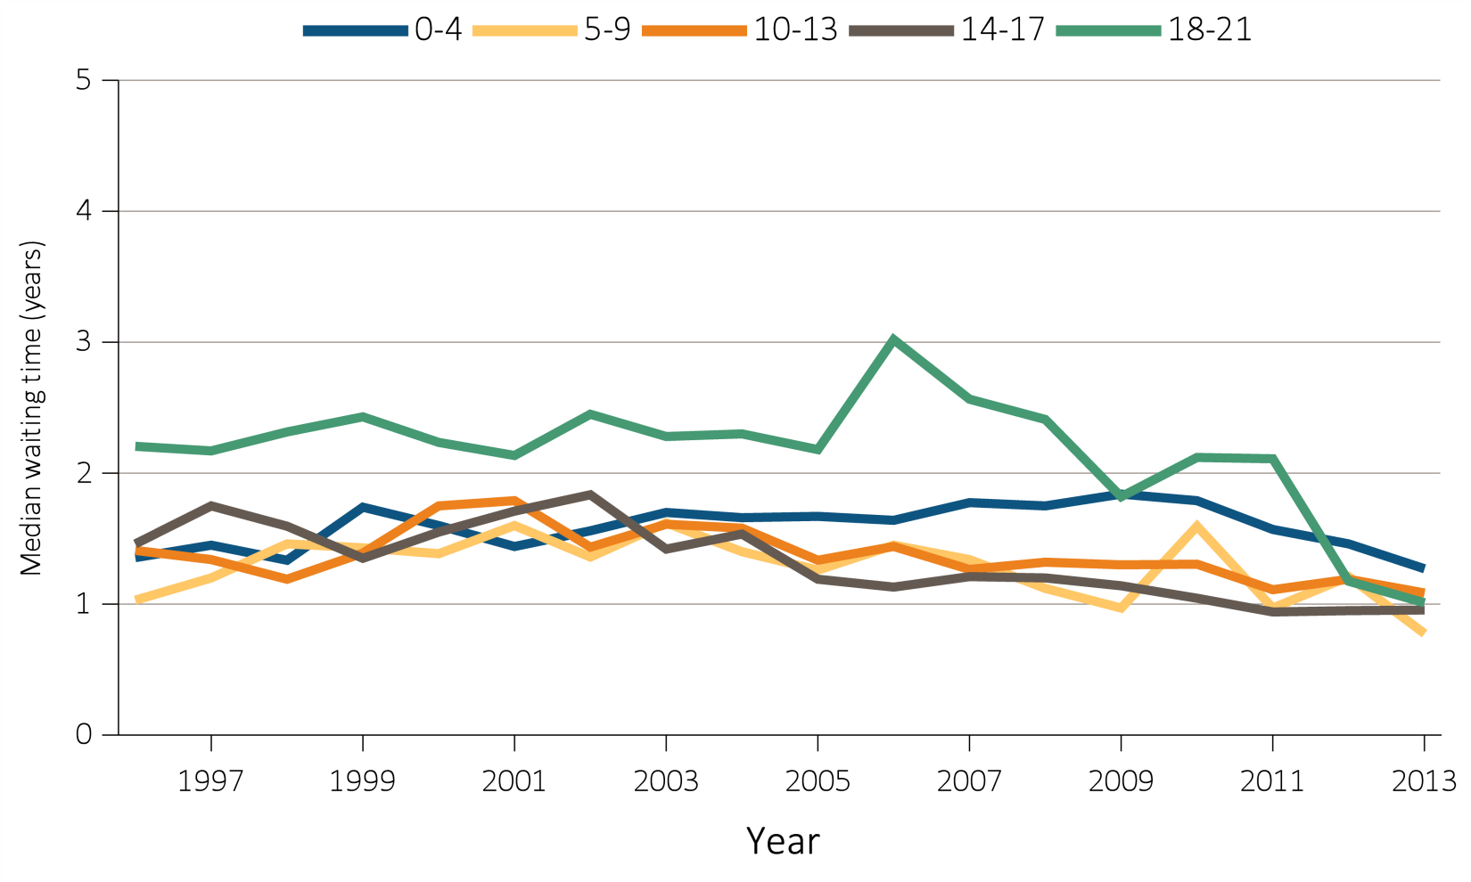
Figure 8.15 Median waiting time from incident hemodialysis (HD) or peritoneal dialysis (PD) to first transplant, by (b) age, 1996-2013
Data Source: Data Source: Special analyses, USRDS ESRD Database. Incident dialysis and transplant patients defined at the onset of dialysis or the day of transplant with the 60-day rule. Includes pediatric patients (aged 0-21 years) starting initiation of HD or PD in 1996-2013 and having the first transplant before 12/31/2015. Abbreviations: HD, hemodialysis; PD, peritoneal dialysis; CAKUT, congenital anomalies of the kidney and urinary tract.

Slide 36
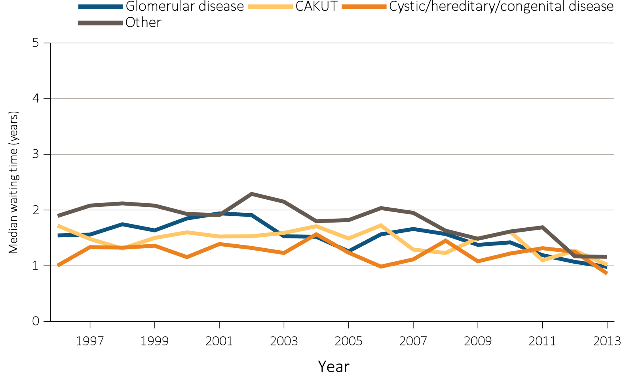
Figure 8.15 Median waiting time from incident hemodialysis (HD) or peritoneal dialysis (PD) to first transplant, by (c) primary cause of ESRD, 1996-2013
Data Source: Data Source: Special analyses, USRDS ESRD Database. Incident dialysis and transplant patients defined at the onset of dialysis or the day of transplant with the 60-day rule. Includes pediatric patients (aged 0-21 years) starting initiation of HD or PD in 1996-2013 and having the first transplant before 12/31/2015. Abbreviations: HD, hemodialysis; PD, peritoneal dialysis; CAKUT, congenital anomalies of the kidney and urinary tract.

Slide 37
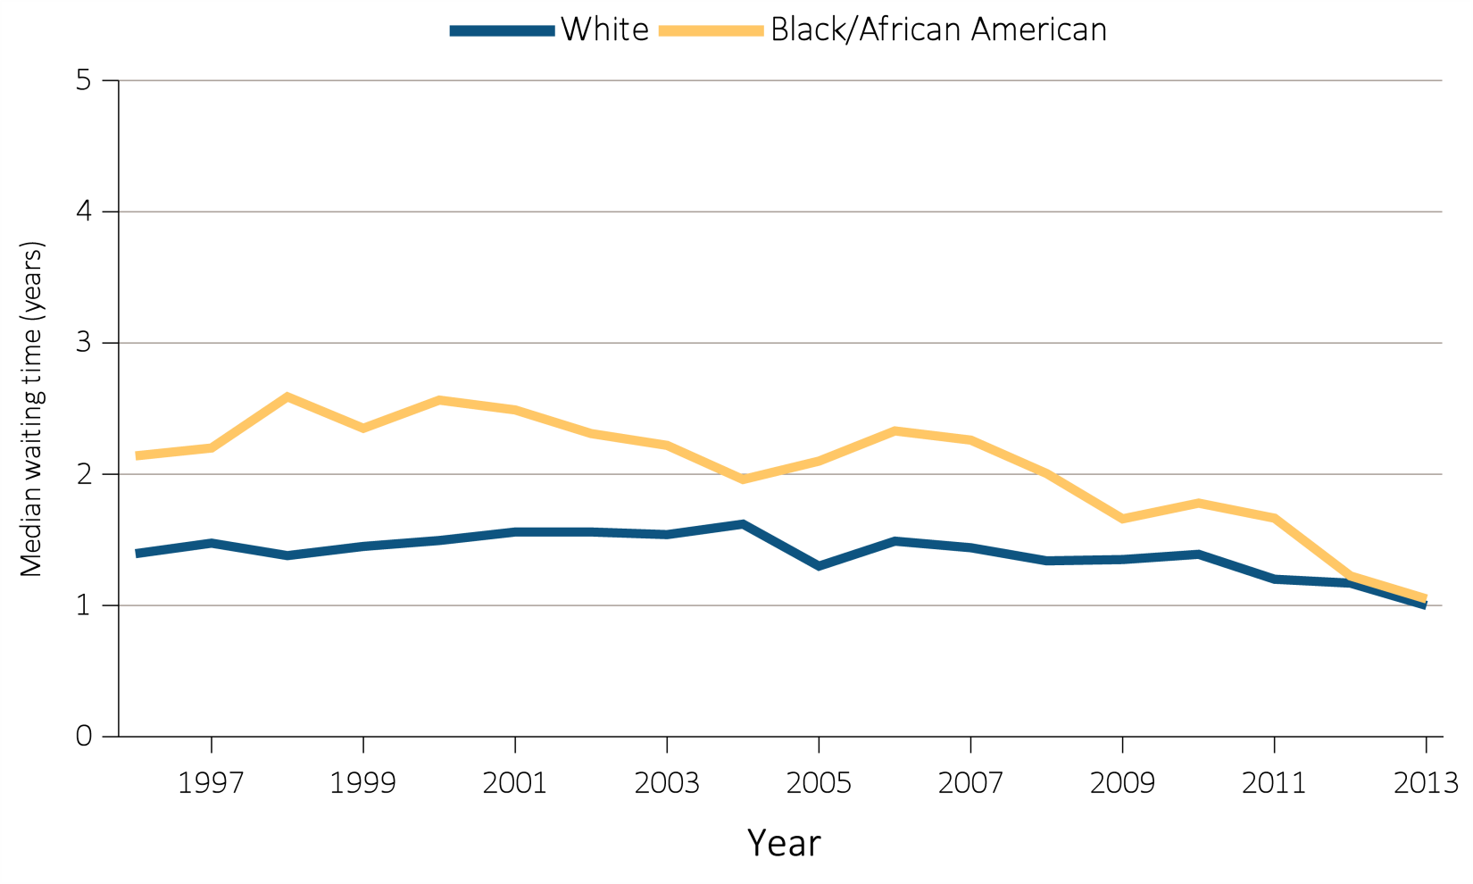
Figure 8.15 Median waiting time from incident hemodialysis (HD) or peritoneal dialysis (PD) to first transplant, by (d) race, 1996-2013
Data Source: Data Source: Special analyses, USRDS ESRD Database. Incident dialysis and transplant patients defined at the onset of dialysis or the day of transplant with the 60-day rule. Includes pediatric patients (aged 0-21 years) starting initiation of HD or PD in 1996-2013 and having the first transplant before 12/31/2015. Abbreviations: HD, hemodialysis; PD, peritoneal dialysis; CAKUT, congenital anomalies of the kidney and urinary tract.

Slide 38
Table 8.2 Adjusted ten-year outcomes for kidney transplants in pediatric patients (aged 0-21 years), by donor type and year, 1996-2004
Data Source: Data Source: Deceased: Reference Tables F6, F18, I30. Live: Reference Tables F12, F24, I36. Probabilities for all-cause graft failure and return to dialysis or repeat transplant are adjusted for age, sex, race, primary cause of ESRD, and first versus subsequent transplant. All-cause graft failure includes repeat transplant, return to dialysis, and death. The death outcome is not censored at graft failure, and includes deaths that occur after repeat transplant or return to dialysis. Probabilities of death are adjusted for age, sex, race, Hispanic ethnicity, and primary cause of ESRD. The reference population for all-cause graft failure and return to dialysis or repeat transplantation is all pediatric patients receiving a kidney alone transplant in 2011. The reference population for death is incident pediatric ESRD patients in 2011.

Slide 39
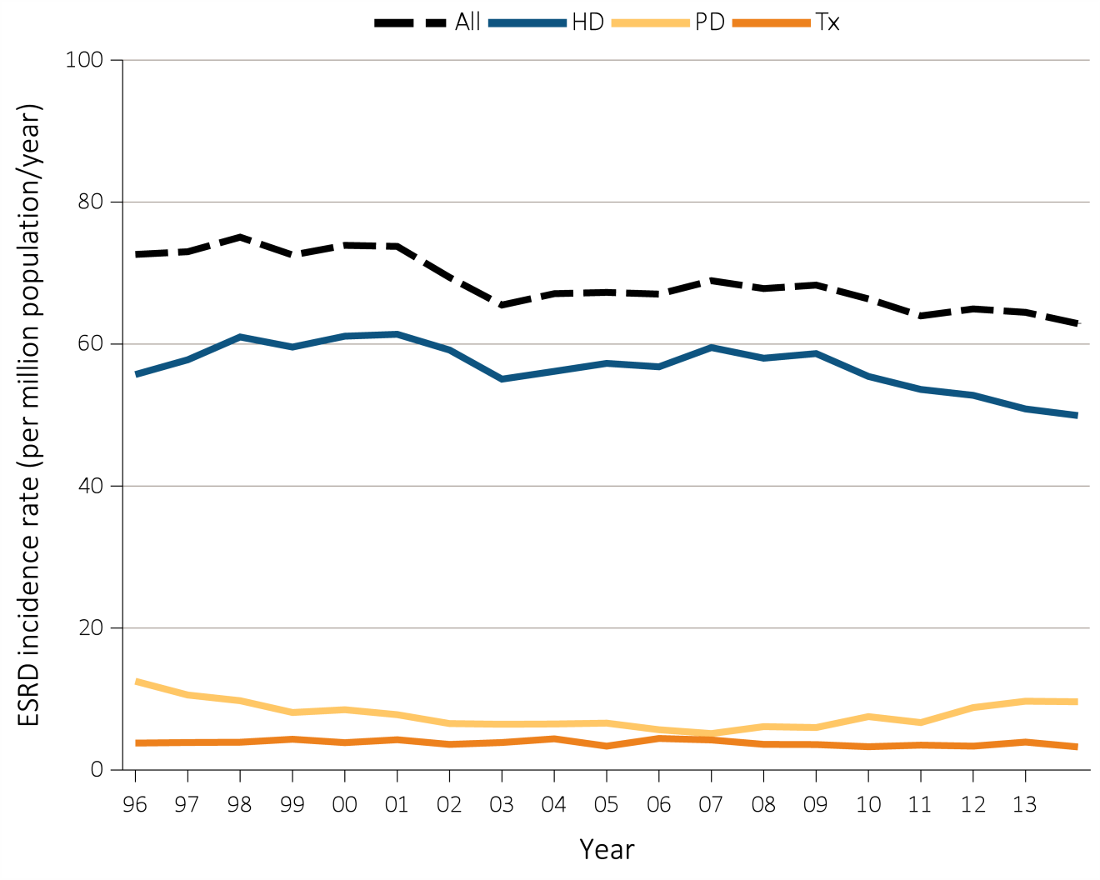
Figure 8.16 Trends in incident rates of ESRD in young adults (aged 22-29 years), by modality, 1996-2014
Data Source: Special analyses, USRDS ESRD Database. Peritoneal dialysis consists of continuous ambulatory peritoneal dialysis and continuous cycling peritoneal dialysis. Abbreviations: ESRD, end-stage renal disease; HD, hemodialysis; PD, peritoneal dialysis; Tx, transplant.

Slide 40
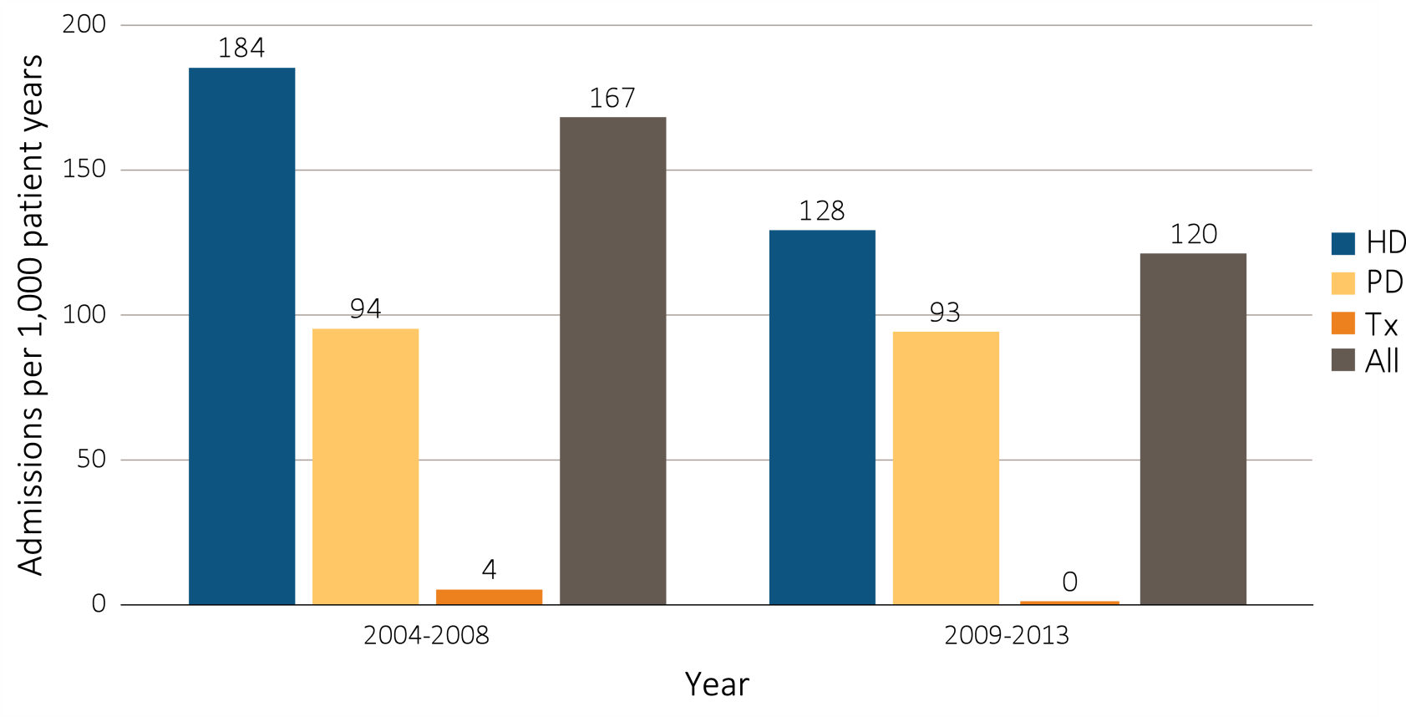
Figure 8.17 One-year unadjusted cardiovascular hospitalization rates in young adults with incident ESRD (aged 22-29 years), by modality, 2004-2008 and 2009-2013
^{Data Source:} Special analyses, USRDS ESRD Database. Includes incident pediatric ESRD patients in the years 2004-2013, surviving the first 90 days after ESRD initiation and followed from day 90. Abbreviations: HD, hemodialysis; PD, peritoneal dialysis; Tx, transplant.

Slide 41
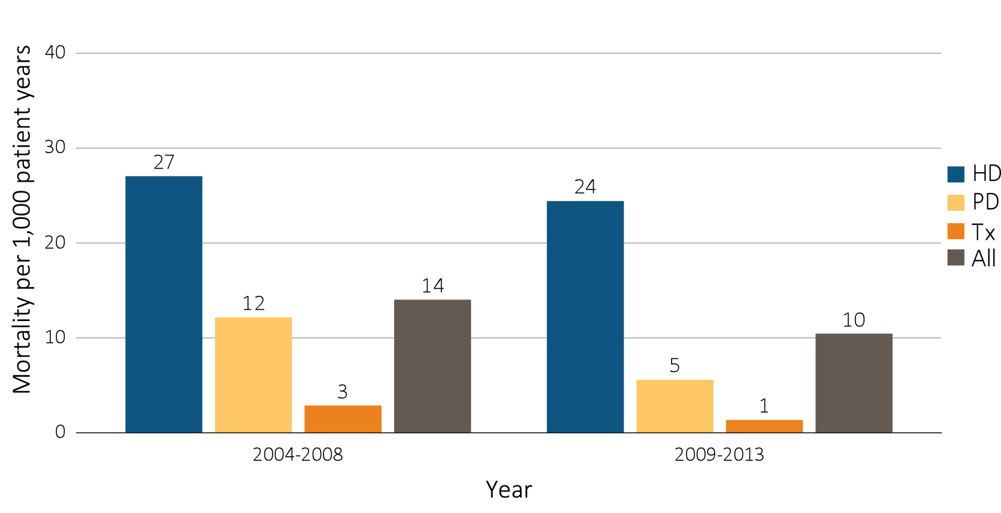
Figure 8.18 One-year adjusted cardiovascular mortality rates in young adults with incident ESRD (aged 22-29 years), by modality, 2004-2008 and 2009-2013
Data Source: Special analyses, USRDS ESRD Database. Incident dialysis and transplant patients defined at the onset of dialysis or the day of transplant without the 60-day rule; followed to December 31, 2014. Adjusted for age, sex, race, Hispanic ethnicity, and primary cause of ESRD. Ref: incident ESRD patients aged 22-29, 2010-2011. Abbreviations: HD, hemodialysis; PD, peritoneal dialysis; Tx, transplant.

Slide 42
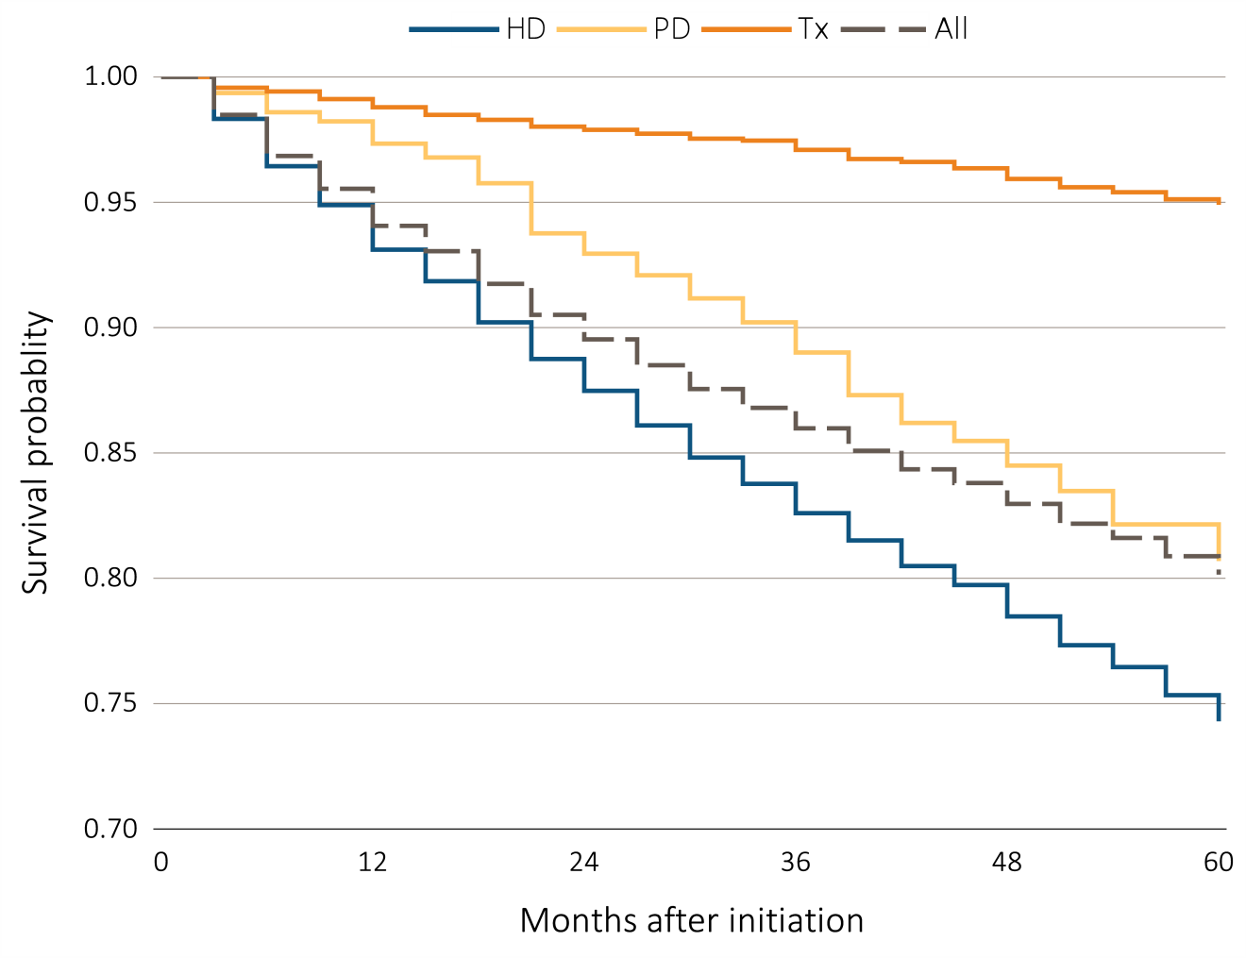
Figure 8.19 Adjusted five-year survival probability of young adults with incident ESRD (aged 22-29 years), by modality and months after initiation, 2005–2009
Data Source: Special analyses, USRDS ESRD Database. Incident dialysis and transplant patients defined at the onset of dialysis or the day of transplant without the 60-day rule; followed to December 31, 2014. Adjusted for age, sex, race, Hispanic ethnicity, and primary cause of ESRD. Ref: incident ESRD patients aged 22-29, 2010-2011. Abbreviations: HD, hemodialysis; PD, peritoneal dialysis; Tx, transplant.

