Slide 2
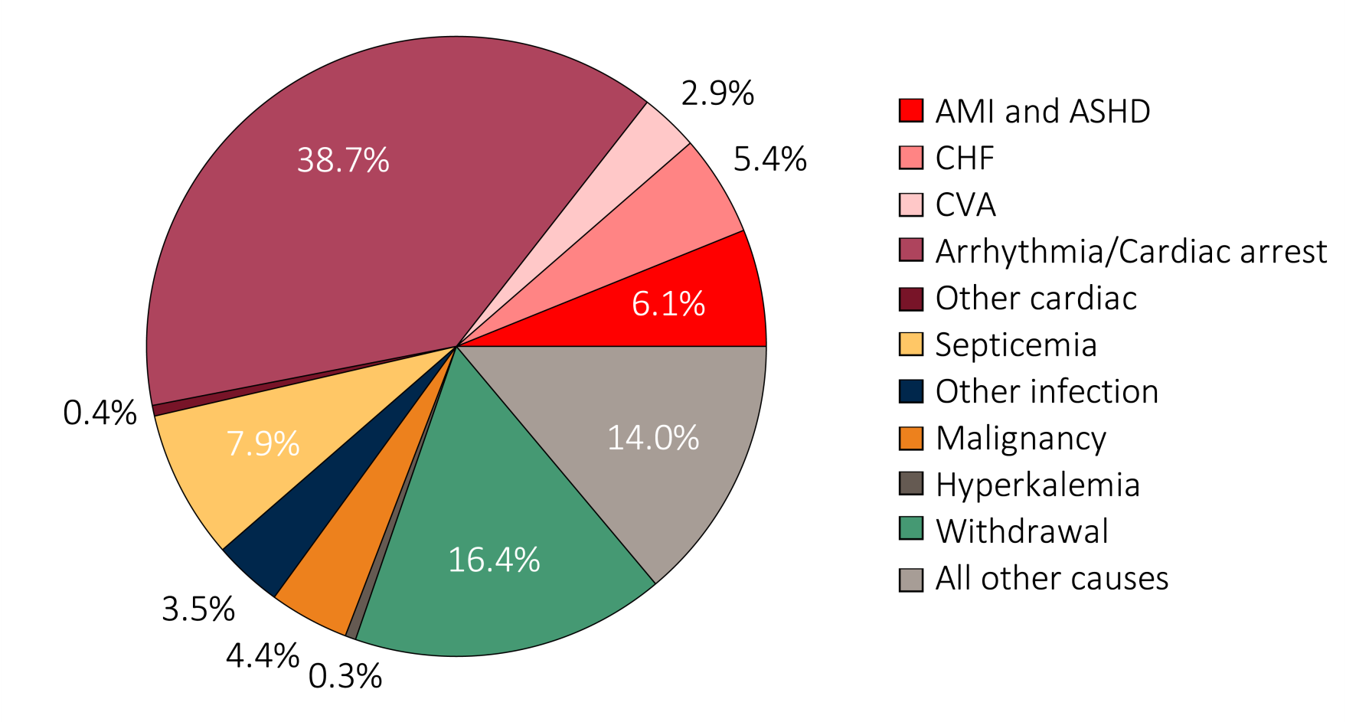
Figure 9.1 Causes of death in ESRD patients, 2012-2014
(a) Denominator excludes missing/unknown causes of death
Data Source: Special analysis using Reference Table H12. Denominator includes other causes of death and excludes missing/unknown causes of death (24.7% of patients have unknown or missing causes of death). Abbreviations: ASHD, atherosclerotic heart disease; AMI, acute myocardial infarction; CHF, congestive heart failure; CVA, cerebrovascular accident.

Slide 3
Figure 9.1 Causes of death in ESRD patients, 2012-2014
(b) Denominator includes missing/unknown causes of death
Data Source: Special analysis using Reference Table H12. Denominator includes other known causes, unknown causes of death, and records that are missing the cause of death. Unknown causes include records from the CMS 2746 ESRD death notification form that specifically designate an unknown cause of death. Missing includes records in the ESRD database that are missing the CMS 2746, or have the form but are missing or have recording errors in the primary cause of death field. Abbreviations: ASHD, atherosclerotic heart disease; AMI, acute myocardial infarction; CHF, congestive heart failure; CVA, cerebrovascular accident.

Slide 4
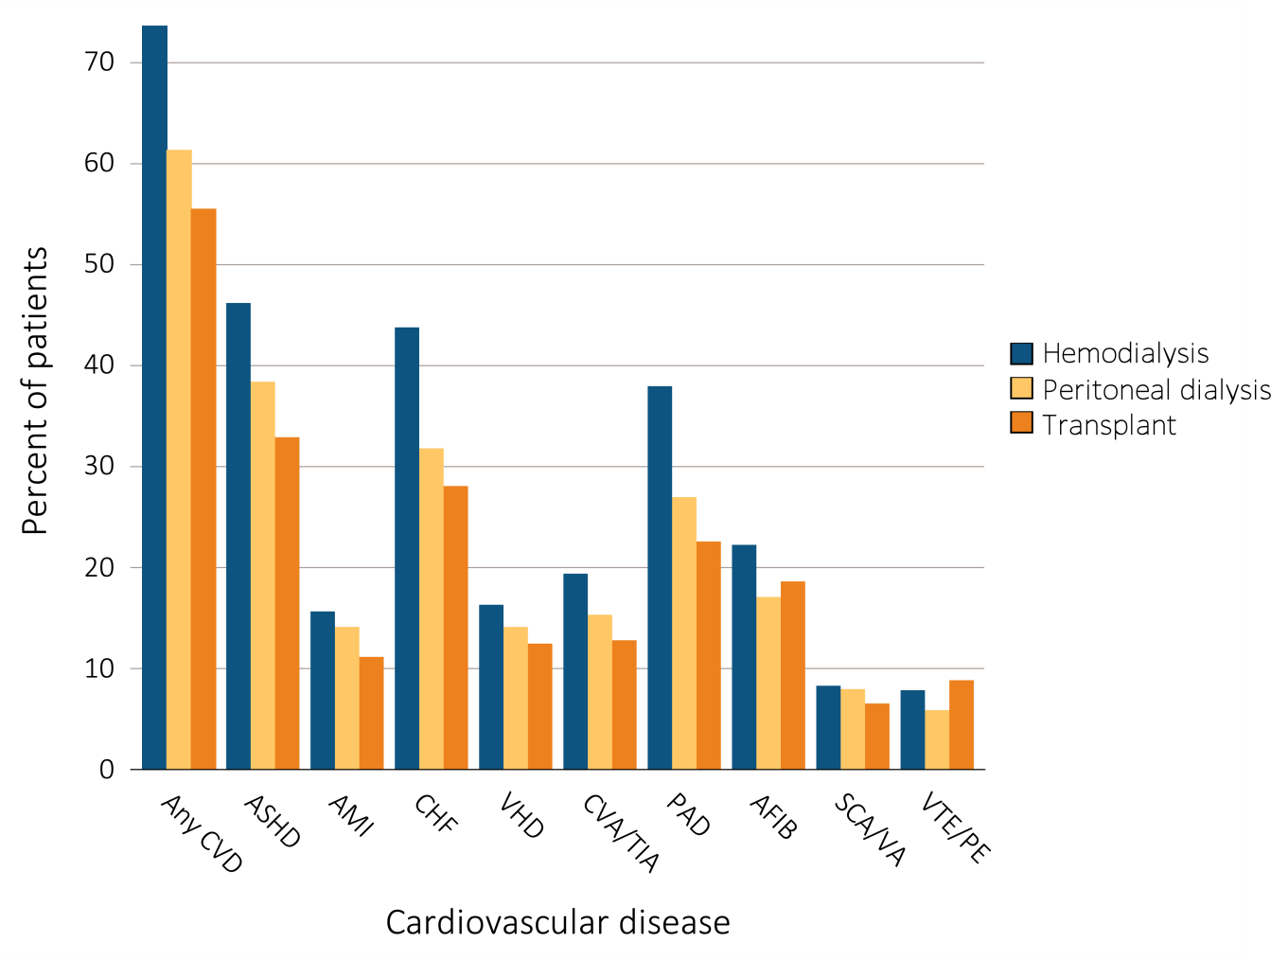
Figure 9.2 Prevalence of cardiovascular diseases in adult ESRD patients, by treatment modality, 2014
Data Source: Special analyses, USRDS ESRD Database. Point prevalent hemodialysis, peritoneal dialysis, and transplant patients aged 22 and older, with Medicare as primary payer on January 1, 2014, who are continuously enrolled in Medicare Parts A and B from January, 1, 2013 to December 31, 2013,and ESRD service date is at least 90 days prior to January 1, 2014. Abbreviations: AFIB, atrial fibrillation; AMI, acute myocardial infarction; ASHD, atherosclerotic heart disease; CHF, congestive heart failure; CVA/TIA, cerebrovascular accident/transient ischemic attack; CVD, cardiovascular disease; PAD, peripheral arterial disease; SCA/VA, sudden cardiac arrest and ventricular arrhythmias; VHD, valvular heart disease; VTE/PE, venous thromboembolism and pulmonary embolism.

Slide 5
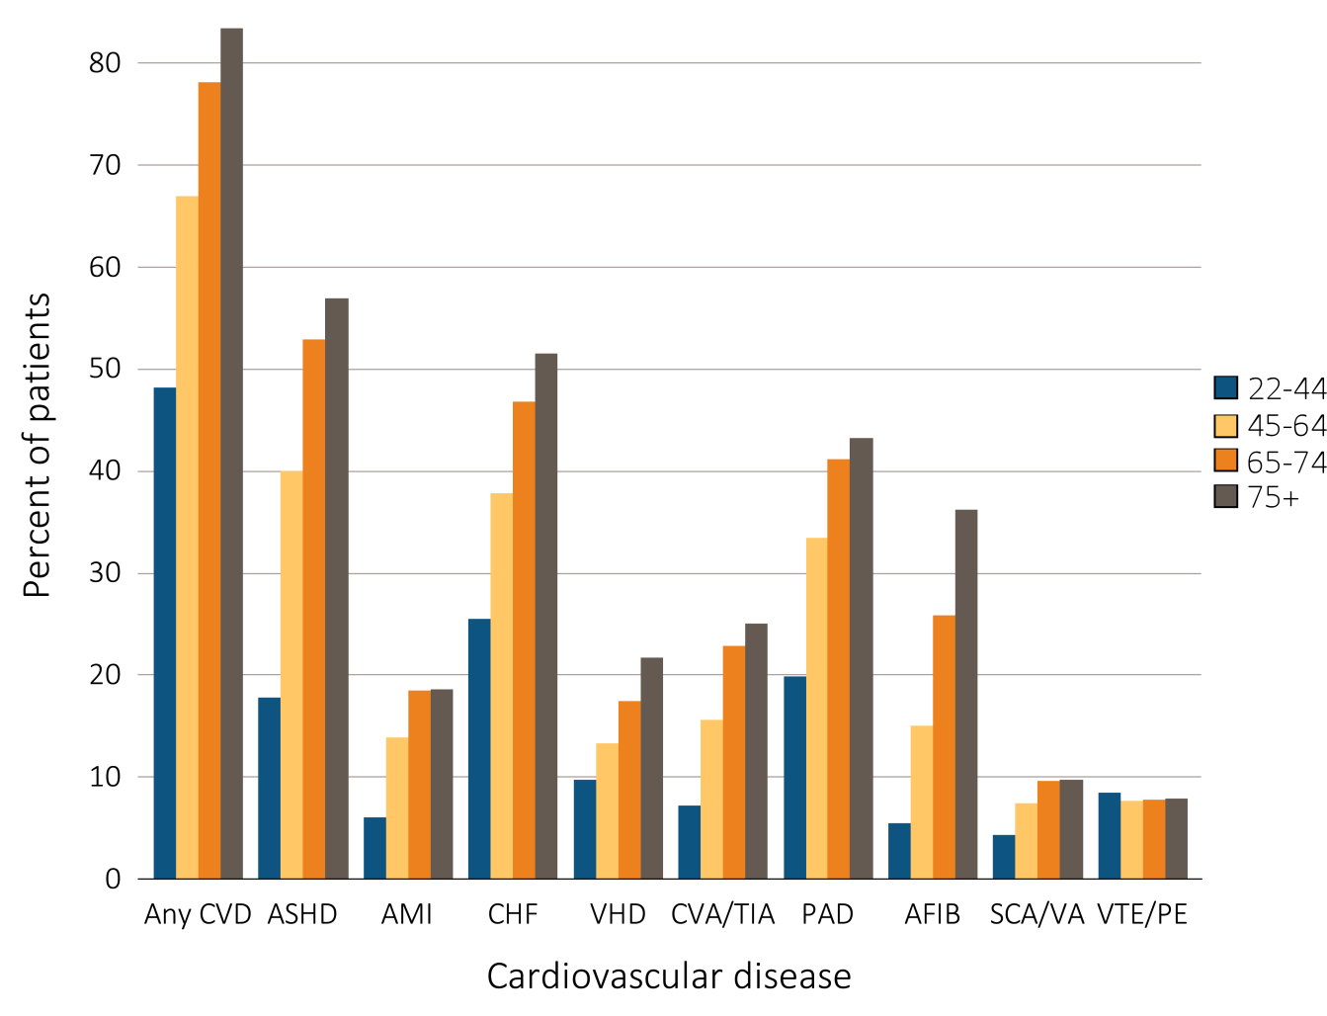
Figure 9.3 Prevalence of cardiovascular diseases in adult ESRD patients, by age, 2014
Data Source: Special analyses, USRDS ESRD Database. Point prevalent hemodialysis, peritoneal dialysis, and transplant patients aged 22 and older, with Medicare as primary payer on January 1, 2014, who are continuously enrolled in Medicare Parts A and B from January, 1, 2013 to December 31, 2013,and ESRD service date is at least 90 days prior to January 1, 2014. Abbreviations: AFIB, atrial fibrillation; AMI, acute myocardial infarction; ASHD, atherosclerotic heart disease; CHF, congestive heart failure; CVA/TIA, cerebrovascular accident/transient ischemic attack; CVD, cardiovascular disease; PAD, peripheral arterial disease; SCA/VA, sudden cardiac arrest and ventricular arrhythmias; VHD, valvular heart disease; VTE/PE, venous thromboembolism and pulmonary embolism.

Slide 6
Table 9.1 Prevalence of (a) cardiovascular comorbidities & (b) cardiovascular procedures in adult ESRD patients, (%) by treatment modality, age, race, & sex, 2014
Cardiovascular Comorbidities
 | # Patients | % Patients
 |  | Overall | 22-44 | 45-64 | 65-74 | 75+ | White | Blk/Af Am | Other | Male | Female
Atherosclerotic heart disease (ASHD)
Hemodialysis | 191,559 | 46.2 | 18.9 | 41.4 | 54.1 | 57.4 | 50.8 | 40.3 | 44.0 | 46.8 | 45.4
Peritoneal dialysis | 15,225 | 38.3 | 16.1 | 34.9 | 49.4 | 53.8 | 41.8 | 31.6 | 32.3 | 43.4 | 32.8
Transplant | 14,918 | 32.9 | 8.9 | 28.1 | 42.6 | 49.4 | 35.8 | 26.0 | 30.3 | 35.5 | 28.9
Acute myocardial infarction (AMI)
Hemodialysis | 191,559 | 15.6 | 6.4 | 14.2 | 18.8 | 18.7 | 17.4 | 13.5 | 14.7 | 16.0 | 15.2
Peritoneal dialysis | 15,225 | 14.1 | 5.4 | 13.4 | 18.2 | 18.8 | 15.8 | 11.2 | 9.2 | 15.9 | 12.2
Transplant | 14,918 | 11.1 | 3.3 | 9.9 | 14.6 | 15.0 | 12.2 | 8.6 | 10.2 | 11.7 | 10.2
Congestive heart failure (CHF)
Hemodialysis | 191,559 | 43.8 | 27.8 | 39.7 | 48.4 | 52.4 | 45.1 | 42.8 | 38.5 | 42.0 | 45.9
Peritoneal dialysis | 15,225 | 31.7 | 19.6 | 29.5 | 38.0 | 40.7 | 32.1 | 32.4 | 25.5 | 33.4 | 29.9
Transplant | 14,918 | 28.1 | 10.3 | 22.1 | 36.3 | 44.9 | 29.3 | 25.9 | 24.0 | 28.2 | 27.9
Valvular heart disease (VHD)
Hemodialysis | 191,559 | 16.3 | 10.4 | 13.7 | 17.6 | 21.6 | 17.6 | 14.9 | 14.2 | 15.4 | 17.4
Peritoneal dialysis | 15,225 | 14.1 | 8.7 | 12.3 | 16.1 | 21.2 | 14.9 | 12.9 | 11.3 | 14.3 | 14.0
Transplant | 14,918 | 12.5 | 4.7 | 8.7 | 16.4 | 22.4 | 13.5 | 10.4 | 9.9 | 11.9 | 13.3
Cerebrovascular accident/transient ischemic attack (CVA/TIA)
Hemodialysis | 191,559 | 19.4 | 7.6 | 16.2 | 23.5 | 25.2 | 19.6 | 19.5 | 15.9 | 17.7 | 21.4
Peritoneal dialysis | 15,225 | 15.3 | 6.7 | 12.7 | 21.0 | 22.1 | 16.5 | 13.5 | 10.5 | 15.2 | 15.4
Transplant | 14,918 | 12.8 | 3.2 | 10.2 | 16.5 | 21.8 | 13.6 | 11.1 | 10.9 | 12.2 | 13.8
(Continued on the next slide)

Slide 7
Table 9.1 Prevalence of (a) cardiovascular comorbidities & (b) cardiovascular procedures in adult ESRD patients, (%) by treatment modality, age, race, & sex, 2014 (continued)
Cardiovascular Comorbidities
 | # Patients | % Patients
 |  | Overall | 22-44 | 45-64 | 65-74 | 75+ | White | Blk/Af Am |  | Other | Male | Female
Peripheral artery disease (PAD)
Hemodialysis | 191,559 | 37.9 | 21.7 | 35.3 | 42.9 | 44.1 | 39.9 | 36.3 |  | 31.5 | 37.9 | 38.0
Peritoneal dialysis | 15,225 | 26.9 | 13.2 | 24.9 | 33.8 | 35.8 | 29.8 | 22.0 |  | 18.7 | 28.9 | 24.8
Transplant | 14,918 | 22.6 | 9.4 | 19.3 | 28.6 | 32.1 | 23.9 | 20.5 |  | 16.9 | 23.7 | 20.8
Atrial fibrillation (AFIB)
Hemodialysis | 191,559 | 22.2 | 5.9 | 15.6 | 25.9 | 36.1 | 26.5 | 17.0 |  | 19.5 | 22.8 | 21.5
Peritoneal dialysis | 15,225 | 17.0 | 3.9 | 11.1 | 23.6 | 35.6 | 20.0 | 10.4 |  | 14.4 | 20.3 | 13.4
Transplant | 14,918 | 18.6 | 2.3 | 11.6 | 26.3 | 38.0 | 21.2 | 12.5 |  | 15.7 | 19.7 | 16.8
Cardiac arrest and ventricular arrhythmias (SCA/VA)
Hemodialysis | 191,559 | 8.3 | 4.5 | 7.6 | 9.6 | 9.6 | 8.4 | 8.3 |  | 7.2 | 8.9 | 7.5
Peritoneal dialysis | 15,225 | 7.9 | 4.0 | 7.0 | 10.1 | 11.1 | 8.4 | 7.6 |  | 4.8 | 9.2 | 6.6
Transplant | 14,918 | 6.5 | 2.9 | 4.7 | 8.9 | 9.9 | 6.9 | 5.9 |  | 4.2 | 7.2 | 5.4
Venous thromboembolism and pulmonary embolism (VTE/PE)
Hemodialysis | 191,559 | 7.8 | 8.8 | 7.7 | 7.7 | 7.7 | 7.1 | 9.2 |  | 5.3 | 7.2 | 8.7
Peritoneal dialysis | 15,225 | 5.8 | 7.2 | 5.4 | 5.7 | 5.6 | 5.5 | 7.2 |  | 2.8 | 5.3 | 6.4
Transplant | 14,918 | 8.8 | 6.3 | 7.6 | 10.2 | 11.9 | 9.0 | 9.2 |  | 5.6 | 8.4 | 9.5
(Continued on the next slide)

Slide 8
Table 9.1 Prevalence of (a) cardiovascular comorbidities & (b) cardiovascular procedures in adult ESRD patients, (%) by treatment modality, age, race, & sex, 2014 (continued)
(b) Cardiovascular Procedures
 | # Patients | % Patients
 |  | Overall | 22-44 | 45-64 | 65-74 | 75+ | White | Blk/Af Am | Other | Male | Female
Revascularization – percutaneous coronary interventions (PCI)
Hemodialysis | 88,440 | 4.9 | 4.0 | 5.7 | 5.4 | 3.6 | 5.1 | 4.5 | 5.5 | 5.0 | 4.8
Peritoneal dialysis | 5,836 | 6.9 | 7.6 | 7.6 | 6.6 | 5.8 | 7.1 | 6.2 | 5.9 | 7.2 | 6.4
Transplant | 4,905 | 4.2 | 4.8 | 5.0 | 3.9 | 3.5 | 4.2 | 3.6 | 6.3 | 4.3 | 4.1
Revascularization – coronary artery bypass graft (CABG)
Hemodialysis | 88,440 | 1.6 | 1.8 | 2.3 | 1.7 | 0.7 | 1.7 | 1.4 | 2.4 | 1.9 | 1.2
Peritoneal dialysis | 5,836 | 3.4 | 3.5 | 4.1 | 3.6 | 1.9 | 3.4 | 3.3 | 3.4 | 3.6 | 3.1
Transplant | 4,905 | 1.5 | 1.1 | 2.0 | 1.2 | 1.2 | 1.6 | 0.7 | 3.1 | 1.7 | 1.0
(Continued on the next slide)

Slide 9
Table 9.1 Prevalence of (a) cardiovascular comorbidities & (b) cardiovascular procedures in adult ESRD patients, (%) by treatment modality, age, race, & sex, 2014 (continued)
(b) Cardiovascular Procedures
 | # Patients | % Patients
 |  | Overall | 22-44 | 45-64 | 65-74 | 75+ | White | Blk/Af Am | Other | Male | Female
Implantable cardioverter defibrillators & cardiac resynchronization therapy with defibrillator devices (ICD/CRT-D)
Hemodialysis | 83,841 | 0.7 | 0.7 | 0.7 | 0.8 | 0.5 | 0.7 | 0.7 | 0.7 | 0.9 | 0.5
Peritoneal dialysis | 4,828 | 0.8 | 0.6 | 0.8 | 0.9 | 0.9 | 1.1 | 0.4 | 0.0 | 0.9 | 0.7
Transplant | 4,187 | 0.7 | 0.5 | 1.0 | 0.5 | 0.6 | 0.6 | 0.9 | 0.9 | 0.9 | 0.5
Carotid artery stenting and carotid artery endarterectomy (CAS/CEA)
Hemodialysis | 120,105 | 0.4 | 0.1 | 0.3 | 0.5 | 0.4 | 0.5 | 0.2 | 0.2 | 0.3 | 0.4
Peritoneal dialysis | 7,759 | 0.7 | 0.0 | 0.3 | 1.1 | 1.0 | 0.8 | 0.3 | 0.2 | 0.7 | 0.7
Transplant | 6,603 | 0.4 | 0.3 | 0.2 | 0.4 | 0.7 | 0.5 | 0.1 | 0.0 | 0.3 | 0.6
Data Source: Special analyses, USRDS ESRD Database. Point prevalent hemodialysis, peritoneal dialysis, and transplant patients aged 22 and older, with Medicare as primary payer on January 1, 2014, who are continuously enrolled in Medicare Parts A and B from January, 1, 2013 to December 31, 2013, and ESRD service date is at least 90 days prior to January 1, 2014. (a) The denominators for all cardiovascular comorbidities are patients described above by modality.(b) The denominators for PCI and CABG are patients with ASHD by modality. The denominator for ICD/CRT-D is patients with CHF by modality. The denominator for CAS/CEA is patients with ASHD, CVA/TIA, or PAD by modality. Abbreviations: AFIB, atrial fibrillation; AMI, acute myocardial infarction; ASHD, atherosclerotic heart disease; Af Am, African American; Blk, black; CABG, coronary artery bypass grafting; CAS/CEA, carotid artery stenting and carotid artery endarterectomy; CHF, congestive heart failure; CVA/TIA, cerebrovascular accident/transient ischemic attack; CVD, cardiovascular disease; ICD/CRT-D, implantable cardioverter defibrillators/cardiac resynchronization therapy with defibrillator devices; PAD, peripheral arterial disease; PCI, percutaneous coronary interventions; SCA/VA, sudden cardiac arrest and ventricular arrhythmias; VHD, valvular heart disease; VTE/PE, venous thromboembolism and pulmonary embolism.

Slide 10
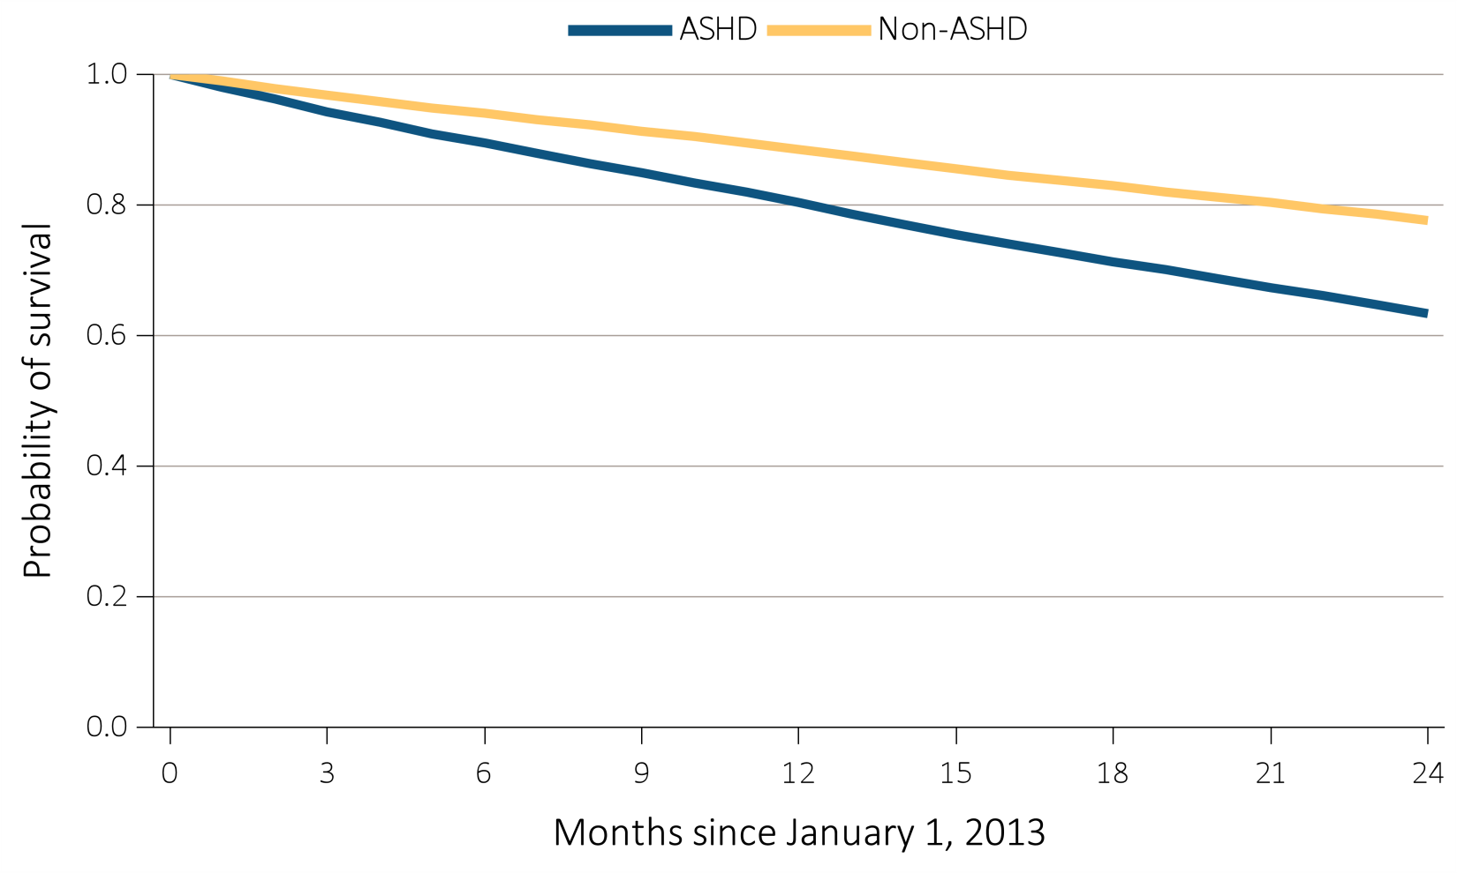
Figure 9.4 Probability of survival of adult ESRD patients with or without a cardiovascular disease or undergoing a cardiovascular procedure, adjusted for age and sex, 2013-2014
^{(a) ASHD}
Data Source: Special analyses, USRDS ESRD Database. Point prevalent hemodialysis, peritoneal dialysis, and transplant patients aged 22 and older, with Medicare as primary payer on January 1, 2012, who are continuously enrolled in Medicare Parts A and B from January, 1, 2011 to December 31, 2011, and whose first ESRD service date is at least 90 days prior to January 1, 2012, and survived past 2012. Abbreviations: ASHD, atherosclerotic heart disease.

Slide 11
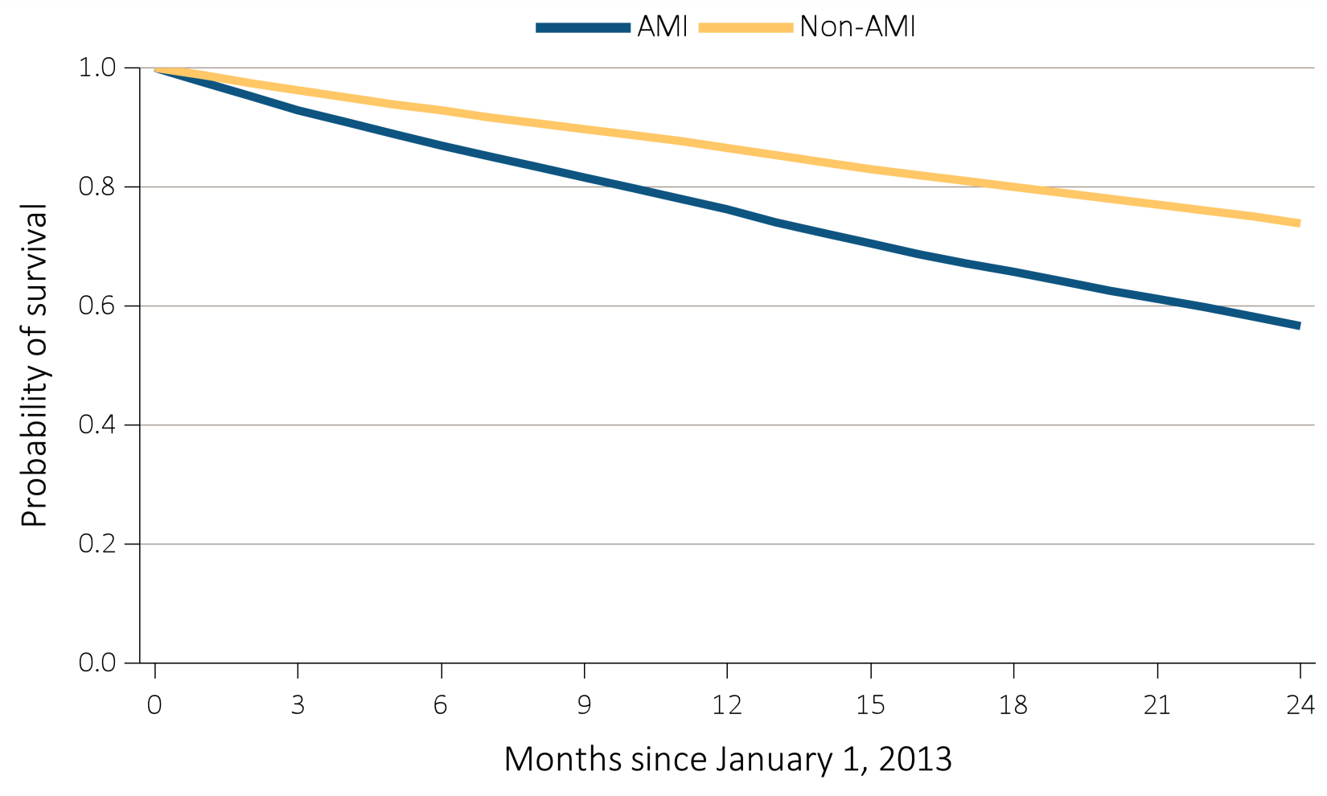
Figure 9.4 Probability of survival of adult ESRD patients with or without a cardiovascular disease or undergoing a cardiovascular procedure, adjusted for age and sex, 2013-2014
^{(b) AMI}
Data Source: Special analyses, USRDS ESRD Database. Point prevalent hemodialysis, peritoneal dialysis, and transplant patients aged 22 and older, with Medicare as primary payer on January 1, 2012, who are continuously enrolled in Medicare Parts A and B from January, 1, 2011 to December 31, 2011, and whose first ESRD service date is at least 90 days prior to January 1, 2012, and survived past 2012. Abbreviations: AMI, acute myocardial infarction.

Slide 12
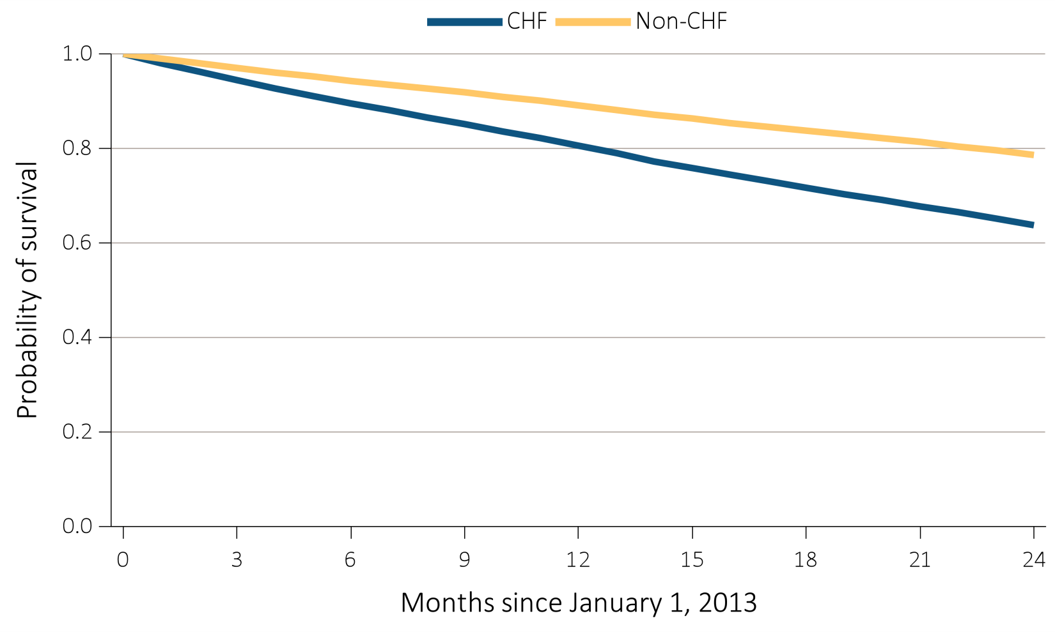
Figure 9.4 Probability of survival of adult ESRD patients with or without a cardiovascular disease or undergoing a cardiovascular procedure, adjusted for age and sex, 2013-2014
^{(c) CHF}
Data Source: Special analyses, USRDS ESRD Database. Point prevalent hemodialysis, peritoneal dialysis, and transplant patients aged 22 and older, with Medicare as primary payer on January 1, 2012, who are continuously enrolled in Medicare Parts A and B from January, 1, 2011 to December 31, 2011, and whose first ESRD service date is at least 90 days prior to January 1, 2012, and survived past 2012. Abbreviations: CHF, congestive heart failure.

Slide 13
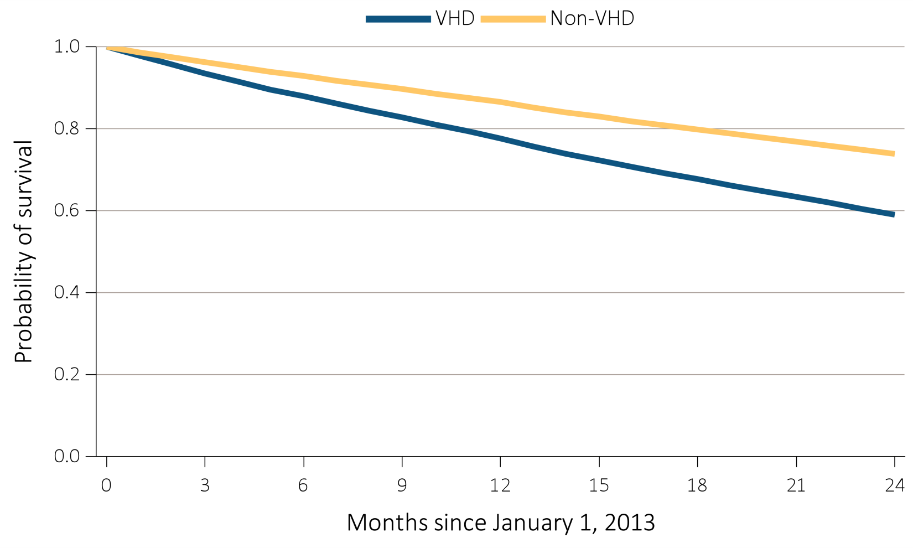
Figure 9.4 Probability of survival of adult ESRD patients with or without a cardiovascular disease or undergoing a cardiovascular procedure, adjusted for age and sex, 2013-2014
^{(d) VHD}
Data Source: Special analyses, USRDS ESRD Database. Point prevalent hemodialysis, peritoneal dialysis, and transplant patients aged 22 and older, with Medicare as primary payer on January 1, 2012, who are continuously enrolled in Medicare Parts A and B from January, 1, 2011 to December 31, 2011, and whose first ESRD service date is at least 90 days prior to January 1, 2012, and survived past 2012. Abbreviations: VHD, valvular heart disease.

Slide 14
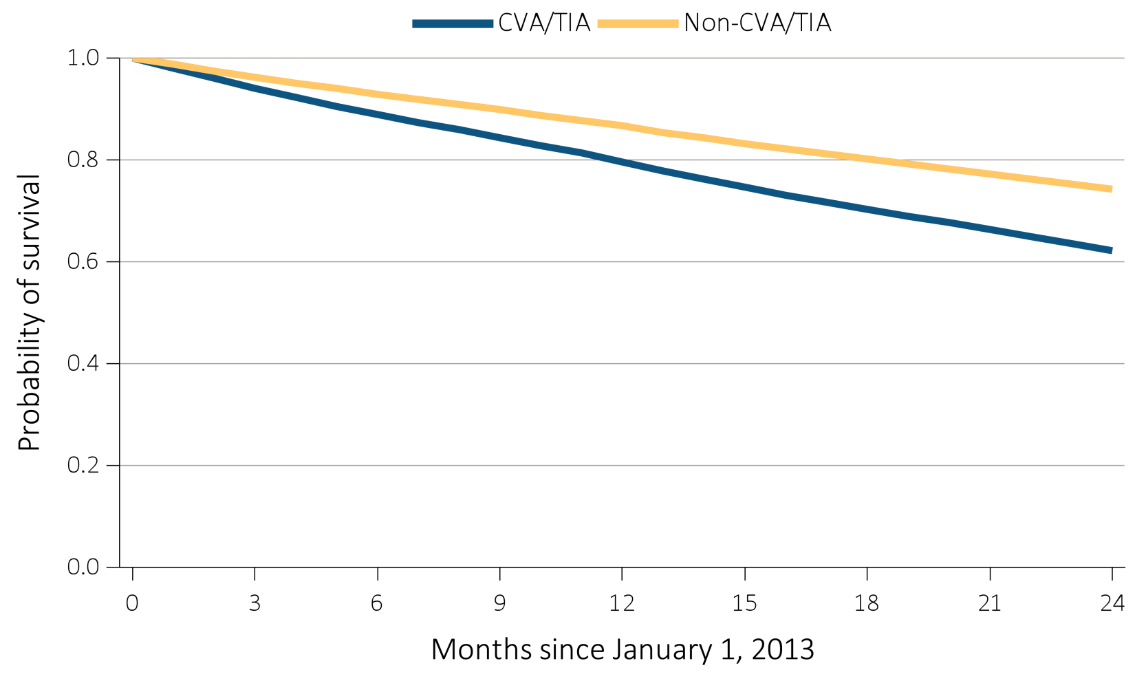
Figure 9.4 Probability of survival of adult ESRD patients with or without a cardiovascular disease or undergoing a cardiovascular procedure, adjusted for age and sex, 2013-2014
^{(e) CVA/TIA}
Data Source: Special analyses, USRDS ESRD Database. Point prevalent hemodialysis, peritoneal dialysis, and transplant patients aged 22 and older, with Medicare as primary payer on January 1, 2012, who are continuously enrolled in Medicare Parts A and B from January, 1, 2011 to December 31, 2011, and whose first ESRD service date is at least 90 days prior to January 1, 2012, and survived past 2012. Abbreviations: CVA/TIA, cerebrovascular accident/transient ischemic attack.

Slide 15
Figure 9.4 Probability of survival of adult ESRD patients with or without a cardiovascular disease or undergoing a cardiovascular procedure, adjusted for age and sex, 2013-2014
^{(f) PAD}
Data Source: Special analyses, USRDS ESRD Database. Point prevalent hemodialysis, peritoneal dialysis, and transplant patients aged 22 and older, with Medicare as primary payer on January 1, 2012, who are continuously enrolled in Medicare Parts A and B from January, 1, 2011 to December 31, 2011, and whose first ESRD service date is at least 90 days prior to January 1, 2012, and survived past 2012. Abbreviations: PAD, peripheral arterial disease.

Slide 16
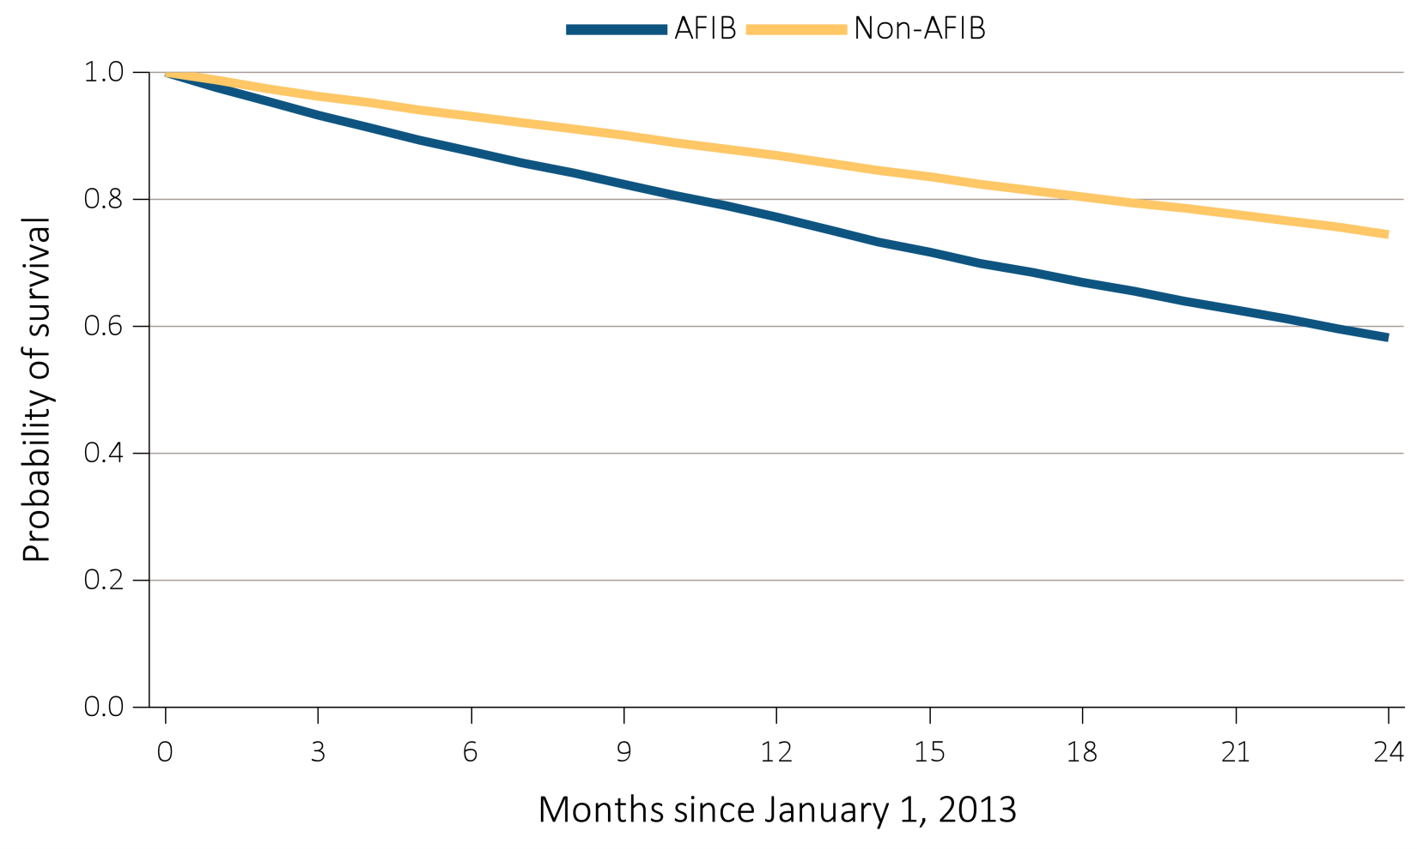
Figure 9.4 Probability of survival of adult ESRD patients with or without a cardiovascular disease or undergoing a cardiovascular procedure, adjusted for age and sex, 2013-2014
^{(g) AFIB}
Data Source: Special analyses, USRDS ESRD Database. Point prevalent hemodialysis, peritoneal dialysis, and transplant patients aged 22 and older, with Medicare as primary payer on January 1, 2012, who are continuously enrolled in Medicare Parts A and B from January, 1, 2011 to December 31, 2011, and whose first ESRD service date is at least 90 days prior to January 1, 2012, and survived past 2012. Abbreviations: AFIB, atrial fibrillation.

Slide 17
Figure 9.4 Probability of survival of adult ESRD patients with or without a cardiovascular disease or undergoing a cardiovascular procedure, adjusted for age and sex, 2013-2014
^{(h) SCA/VA}
Data Source: Special analyses, USRDS ESRD Database. Point prevalent hemodialysis, peritoneal dialysis, and transplant patients aged 22 and older, with Medicare as primary payer on January 1, 2012, who are continuously enrolled in Medicare Parts A and B from January, 1, 2011 to December 31, 2011, and whose first ESRD service date is at least 90 days prior to January 1, 2012, and survived past 2012. Abbreviations: SCA/VA, sudden cardiac arrest and ventricular arrhythmias.

Slide 18
Figure 9.4 Probability of survival of adult ESRD patients with or without a cardiovascular disease or undergoing a cardiovascular procedure, adjusted for age and sex, 2013-2014
^{(i) VTE/PE}
Data Source: Special analyses, USRDS ESRD Database. Point prevalent hemodialysis, peritoneal dialysis, and transplant patients aged 22 and older, with Medicare as primary payer on January 1, 2012, who are continuously enrolled in Medicare Parts A and B from January, 1, 2011 to December 31, 2011, and whose first ESRD service date is at least 90 days prior to January 1, 2012, and survived past 2012. Abbreviations: VTE/PE, venous thromboembolism and pulmonary embolism.

Slide 19
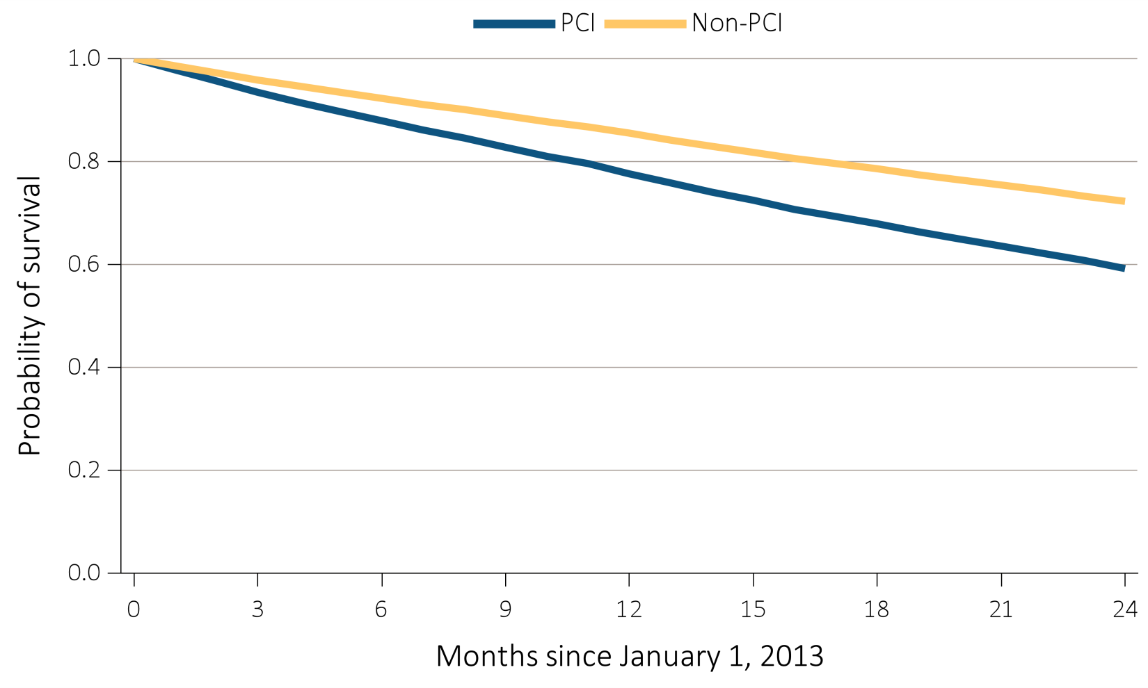
Figure 9.4 Probability of survival of adult ESRD patients with or without a cardiovascular disease or undergoing a cardiovascular procedure, adjusted for age and sex, 2013-2014
^{(j) PCI}
Data Source: Special analyses, USRDS ESRD Database. Point prevalent hemodialysis, peritoneal dialysis, and transplant patients aged 22 and older, with Medicare as primary payer on January 1, 2012, who are continuously enrolled in Medicare Parts A and B from January, 1, 2011 to December 31, 2011, and whose first ESRD service date is at least 90 days prior to January 1, 2012, and survived past 2012. Abbreviations: PCI, percutaneous coronary interventions.

Slide 20
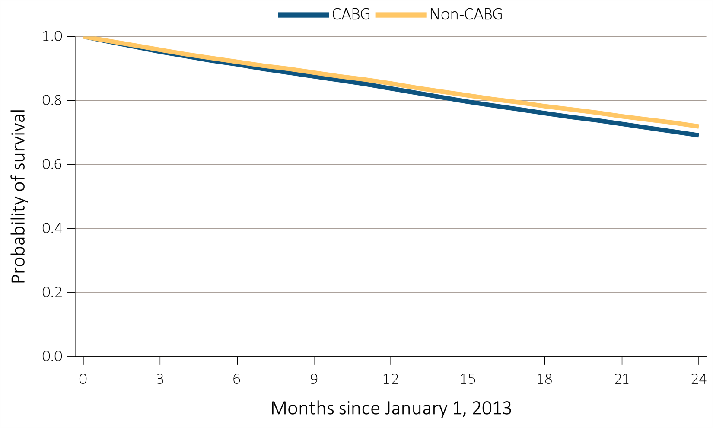
Figure 9.4 Probability of survival of adult ESRD patients with or without a cardiovascular disease or undergoing a cardiovascular procedure, adjusted for age and sex, 2013-2014
^{(k) CABG}
Data Source: Special analyses, USRDS ESRD Database. Point prevalent hemodialysis, peritoneal dialysis, and transplant patients aged 22 and older, with Medicare as primary payer on January 1, 2012, who are continuously enrolled in Medicare Parts A and B from January, 1, 2011 to December 31, 2011, and whose first ESRD service date is at least 90 days prior to January 1, 2012, and survived past 2012. Abbreviations: CABG, coronary artery bypass grafting.

Slide 21
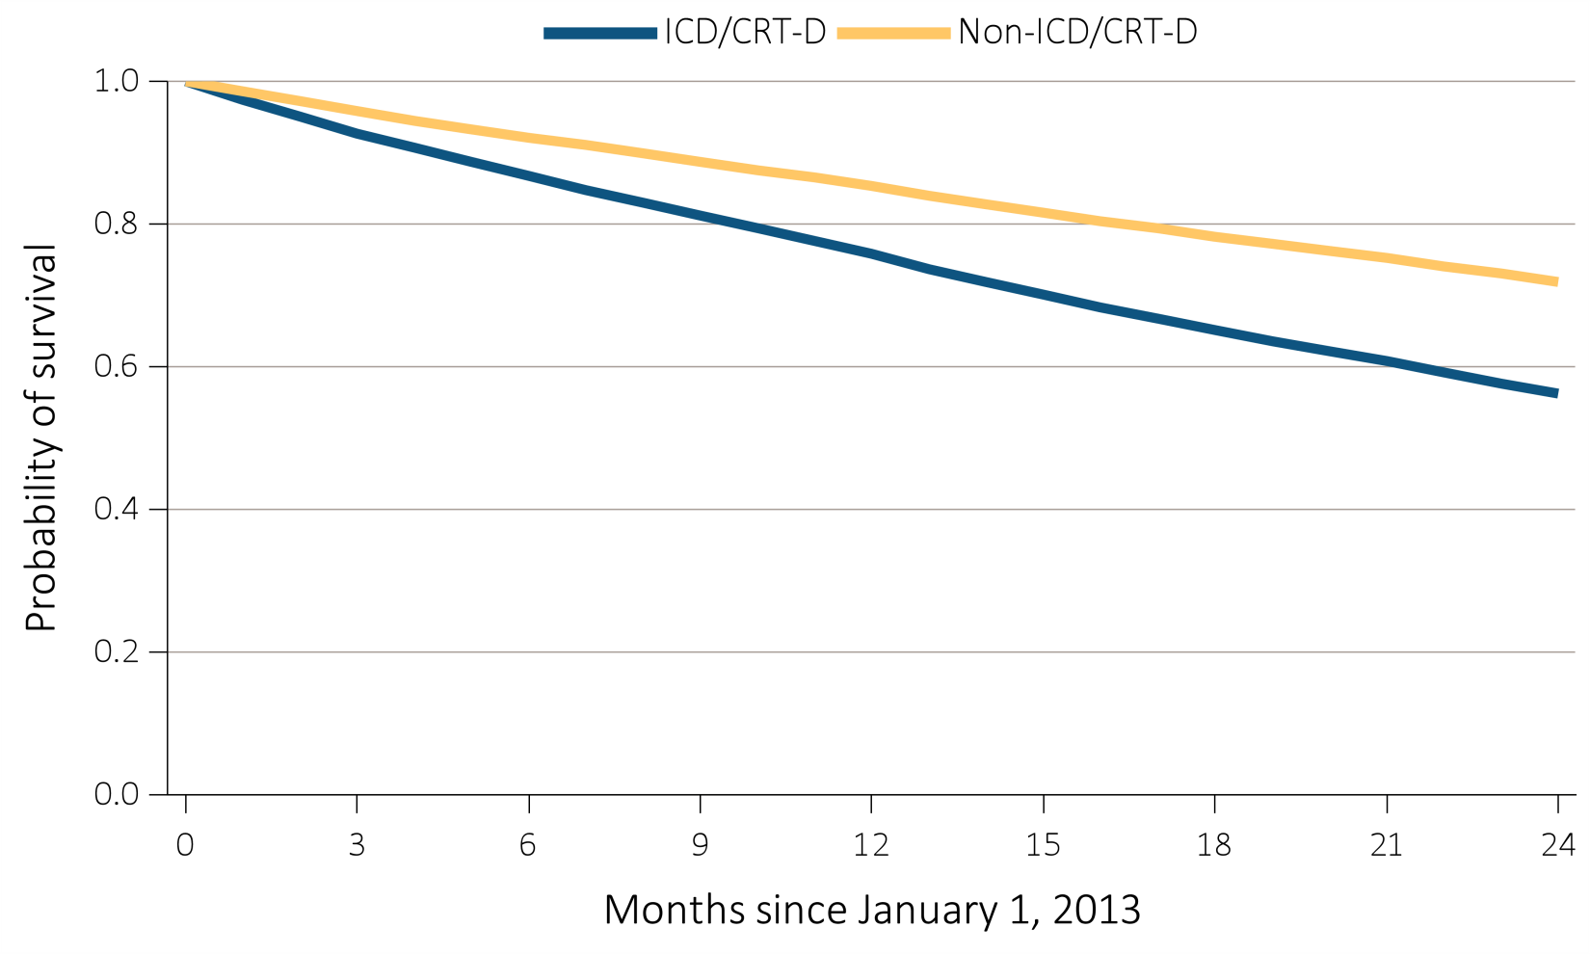
Figure 9.4 Probability of survival of adult ESRD patients with or without a cardiovascular disease or undergoing a cardiovascular procedure, adjusted for age and sex, 2013-2014
^{(l) ICD/CRT-D}
Data Source: Special analyses, USRDS ESRD Database. Point prevalent hemodialysis, peritoneal dialysis, and transplant patients aged 22 and older, with Medicare as primary payer on January 1, 2012, who are continuously enrolled in Medicare Parts A and B from January, 1, 2011 to December 31, 2011, and whose first ESRD service date is at least 90 days prior to January 1, 2012, and survived past 2012. Abbreviations: ICD/CRT-D, implantable cardioverter defibrillators/cardiac resynchronization therapy with defibrillator devices.

Slide 22
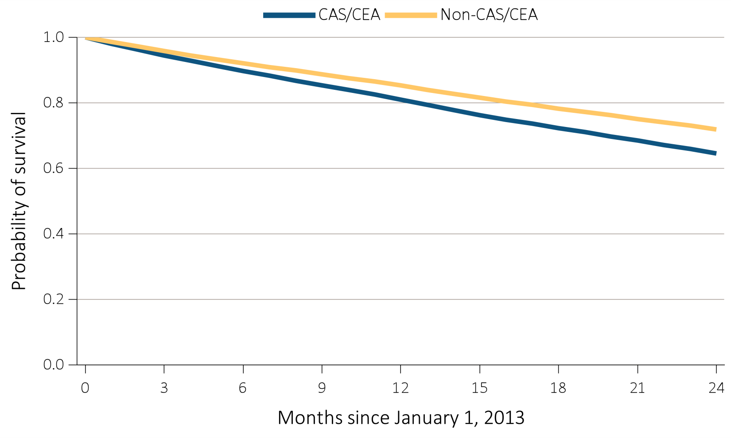
Figure 9.4 Probability of survival of adult ESRD patients with or without a cardiovascular disease or undergoing a cardiovascular procedure, adjusted for age and sex, 2013-2014
^{(m) CAS/CEA}
Data Source: Special analyses, USRDS ESRD Database. Point prevalent hemodialysis, peritoneal dialysis, and transplant patients aged 22 and older, with Medicare as primary payer on January 1, 2012, who are continuously enrolled in Medicare Parts A and B from January, 1, 2011 to December 31, 2011, and whose first ESRD service date is at least 90 days prior to January 1, 2012, and survived past 2012. Abbreviations: CAS/CEA, carotid artery stunting and carotid artery endarterectomy.

Slide 23
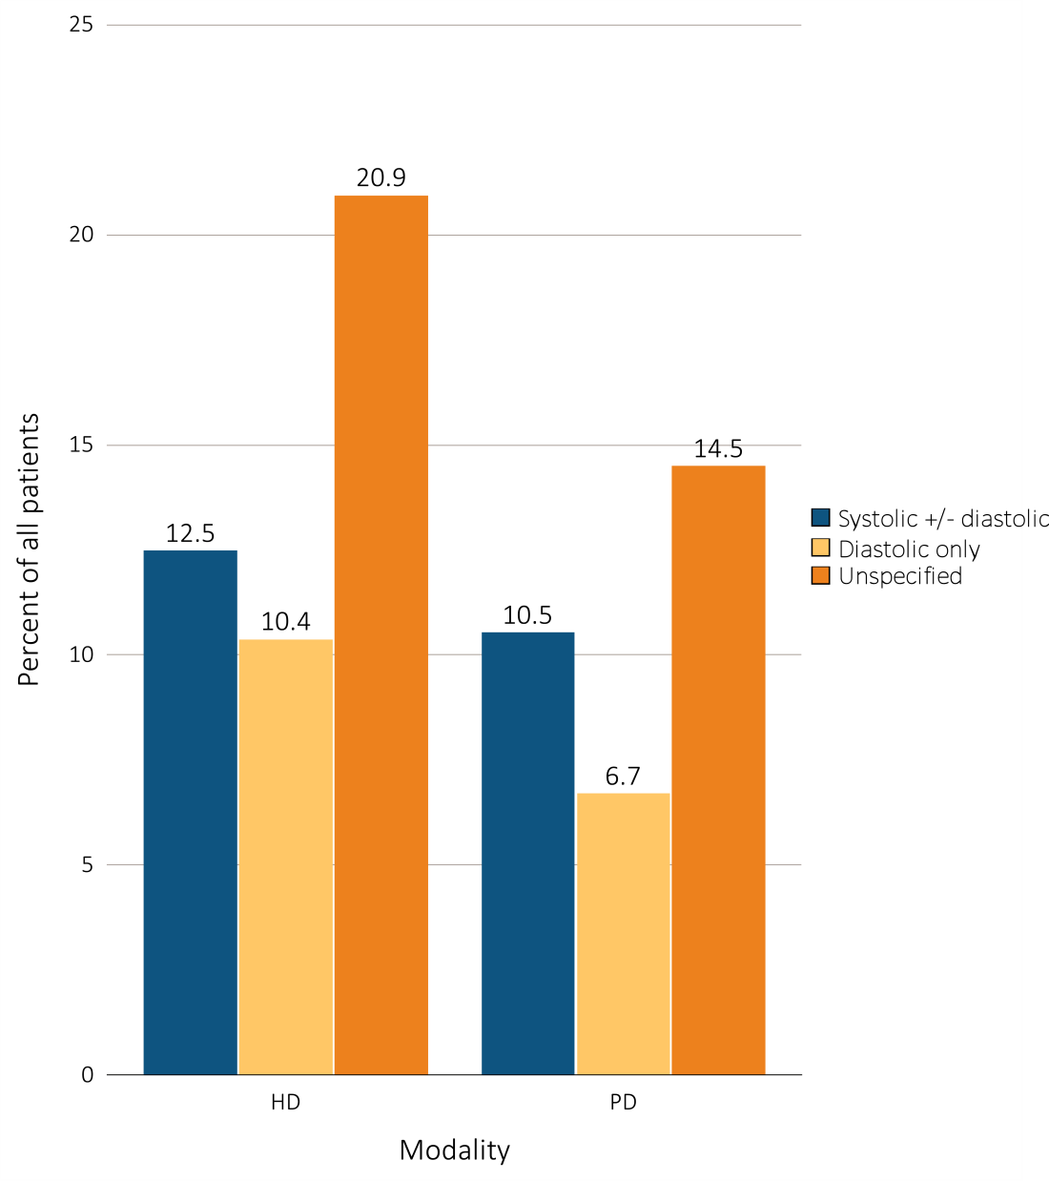
Figure 9.5 Heart failure in adult ESRD patients by modality, 2014
Data Source: Special analyses, USRDS ESRD Database. Point prevalent hemodialysis and peritoneal dialysis patients aged 22 and older, with Medicare as primary payer on January 1, 2014, who are continuously enrolled in Medicare Parts A and B from January, 1, 2013 to December 31, 2013,and ESRD service date is at least 90 days prior to January 1, 2014. Abbreviations: HD, hemodialysis; PD, peritoneal dialysis.

