Slide 2
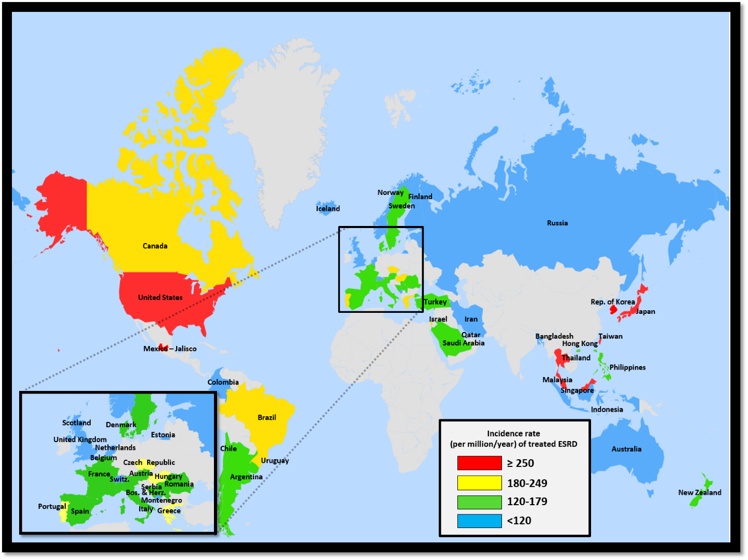
Figure 13.1 Geographic variations in the incidence rate of treated ESRD (per million population/year), by country, 2014
Data Source: Special analyses, USRDS ESRD Database. Data presented only for countries from which relevant information was available. All rates are unadjusted. ^United Kingdom: England, Wales, Northern Ireland (Scotland data reported separately). Data for Italy include 6 regions. Data for Indonesia represent the West Java region. Data for France include 22 regions. Data for Spain include 18 of 19 regions. Data for Canada excludes Quebec. Japan includes dialysis patients only. Abbreviations: ESRD, end-stage renal disease .

Slide 3
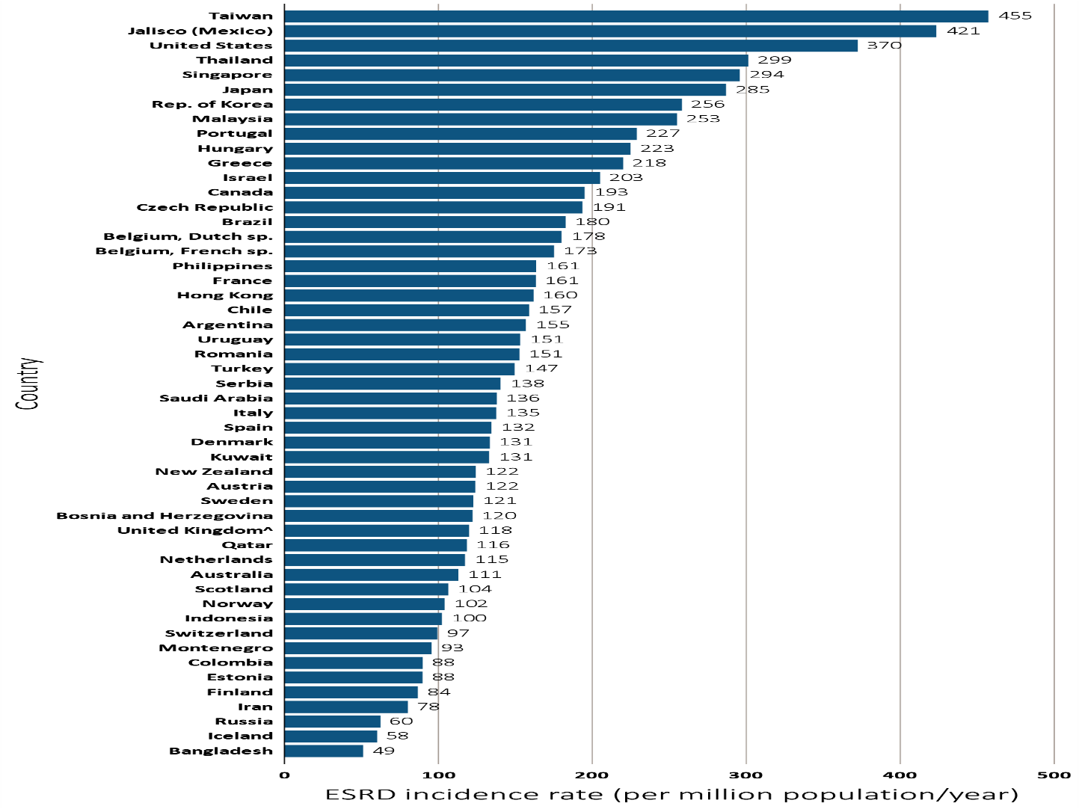
^{Figure 13.2 Incidence} rate of treated ESRD (per million population/year), by country, 2014
^{Data Source:} Special analyses, USRDS ESRD Database. Data presented only for countries from which relevant information was available. All rates are unadjusted. ^United Kingdom: England, Wales, Northern Ireland (Scotland data reported separately). Data for Italy include 6 regions. Data for Indonesia represent the West Java region. Data for France include 22 regions. Data for Spain include 18 of 19 regions. Data for Canada excludes Quebec. Japan includes dialysis patients only. Abbreviations: ESRD, end-stage renal disease; sp., speaking.

Slide 4
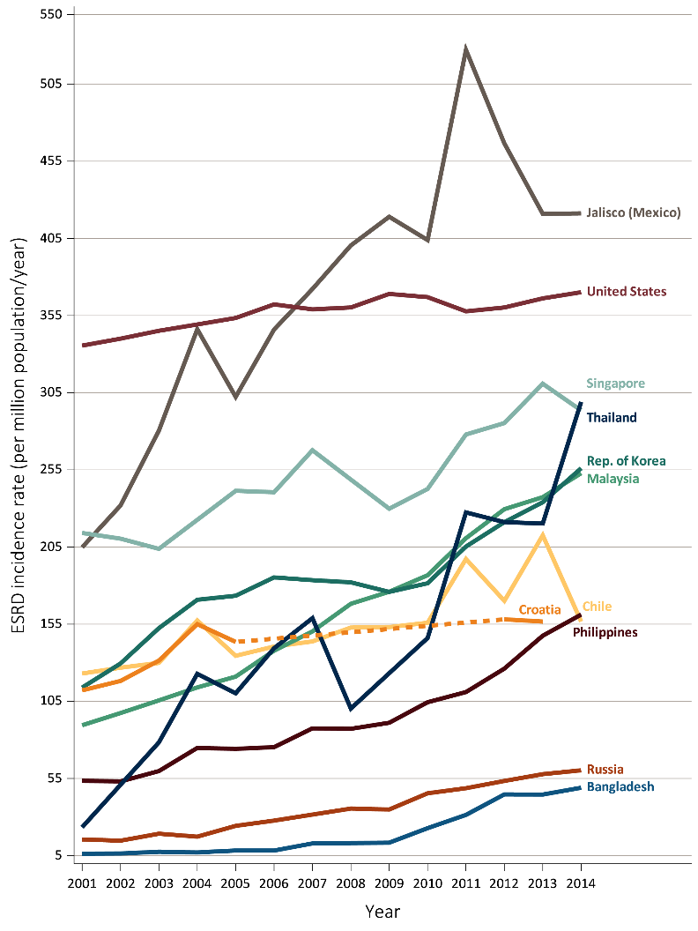
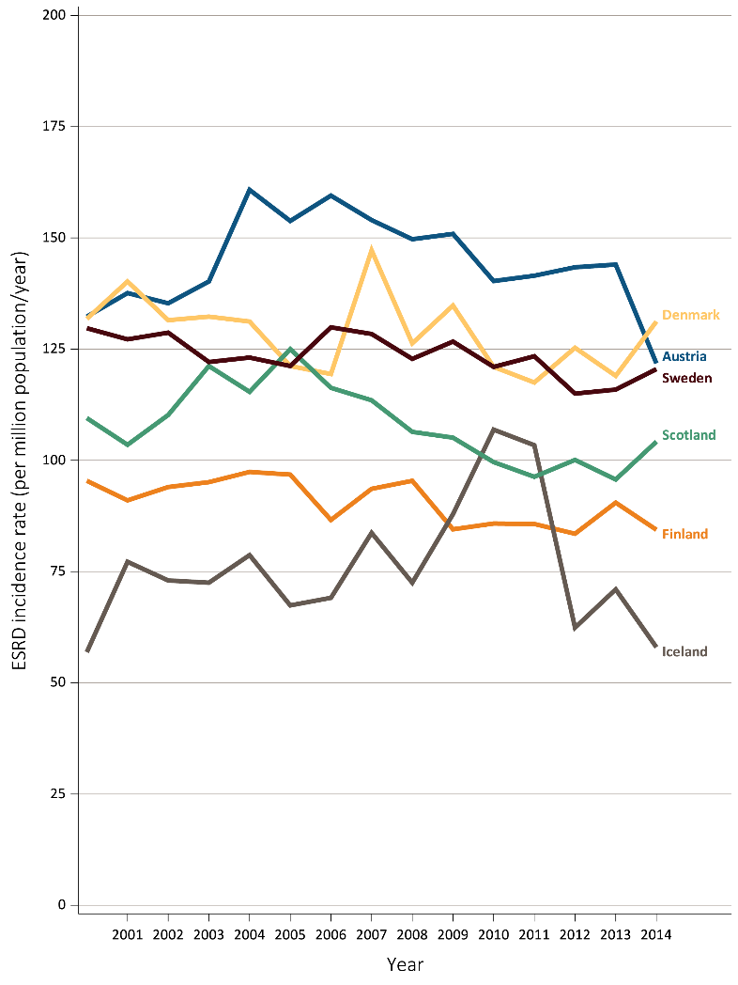
Figure 13.3 Trends in the incidence rate of treated ESRD (per million population/year), by country, 2001-2014
Ten countries having the highest % rise in ESRD incidence rate in 2001/02 versus that in 2013/14, plus the U.S.
Six countries having the largest % decline in ESRD incidence rate: 2013/14 versus that in 2001/02
Data Source: Special analyses, USRDS ESRD Database. All rates are unadjusted. Data for Croatia are missing from 2006-2011, 2014, indicated by the dashed line. Data for U.S. are shown for comparison purposes. Only six countries had a decrease in incidence from 2001/02-2013/14. Abbreviations: ESRD, end-stage renal disease.

Slide 5
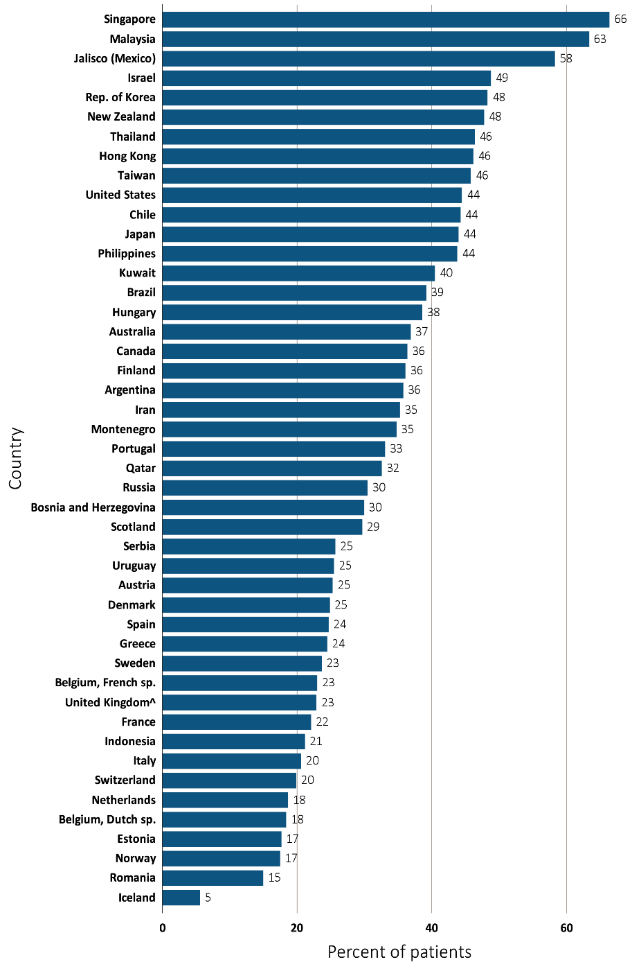
Figure 13.4 Percentage of incident ESRD patients with diabetes as the primary cause of ESRD, by country, 2014
^{Data Source:} Special analyses, USRDS ESRD Database. Data presented only for countries from which relevant information was available. ^United Kingdom: England, Wales, Northern Ireland (Scotland data reported separately). Data for Spain include 18 of 19 regions. Data for France include 22 regions. Data for Indonesia represent the West Java region. Data for Italy includes 6 regions. Data for Canada excludes Quebec. Abbreviations: ESRD, end-stage renal disease; sp., speaking

Slide 6
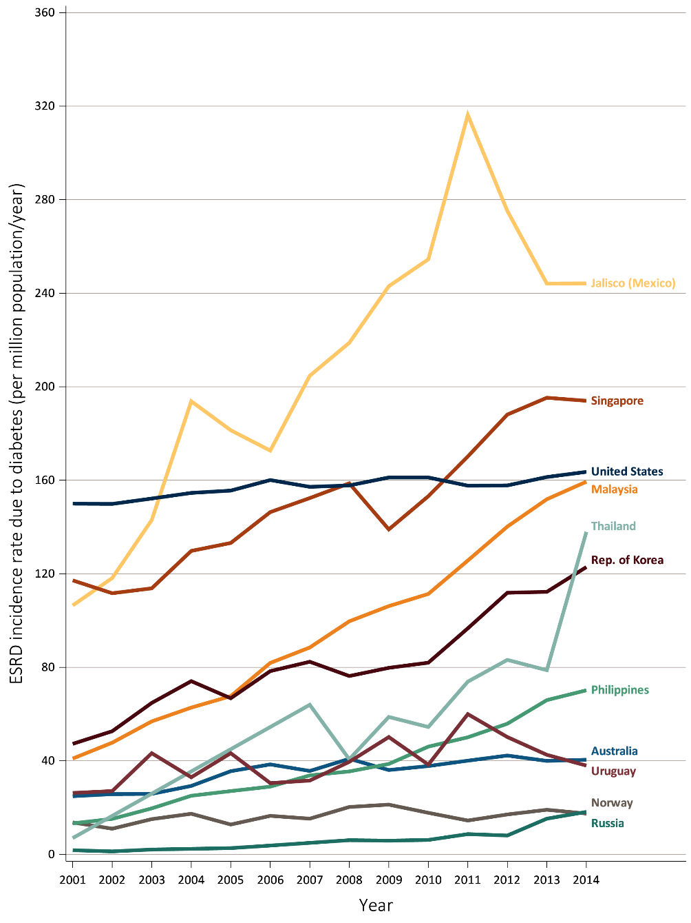
Figure 13.5 Trends in the incidence rate of treated ESRD due to diabetes (per million population/year), by country, 2001-2014
Ten countries having the highest % rise in 2001/02 versus that in 2013/14, plus the U.S.
^{Data Source:} Special analyses, USRDS ESRD Database. Data presented only for countries from which relevant information was available. Abbreviations: ESRD, end-stage renal disease.

Slide 7
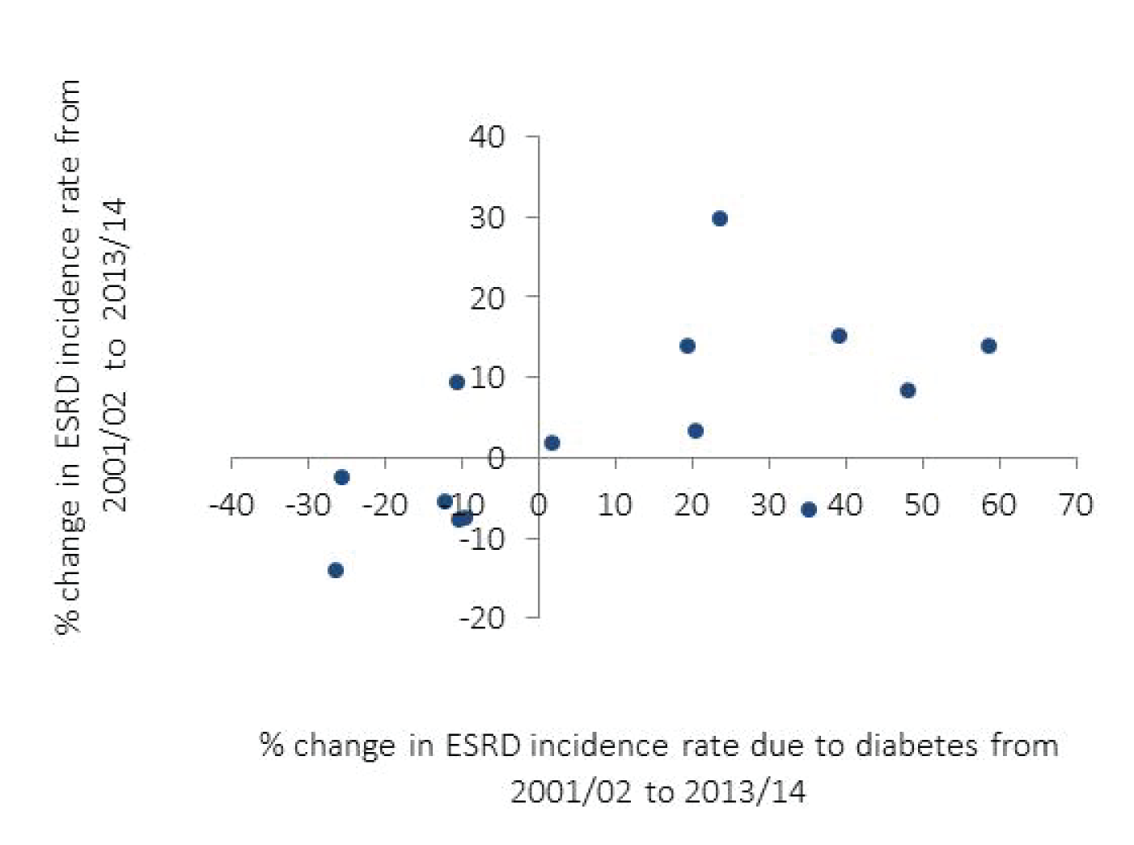
Figure 13.6 Country correlation of the percent change in ESRD incidence with the percent change in ESRD due to diabetes, by region, 2001-2014
^{(a) Europe, Australia,} ^{New Zealand, and Israel}
^{Data Source:} Special analyses, USRDS ESRD Database. Data presented only for countries from which relevant information was available. United Kingdom: England, Wales, Northern Ireland (Scotland data reported separately). Countries listed in order of lowest to highest % change in ESRD incidence due to diabetes in each panel (a) Europe and Israel: (< 3%) Iceland, Austria, Finland, Belgium (Dutch-speaking), Denmark, Sweden, Belgium (French-speaking), (> 20%) the Netherlands, New Zealand, Greece, Scotland, Israel, Norway, Australia; (b) North and Latin America: United States, Canada, Uruguay, Jalisco (Mexico); (c) Asia and Russia: (27%-135%) Hong Kong, Japan, Taiwan, Singapore, Rep. of Korea, (>251%) Malaysia, Philippines, Russia, and Thailand. Abbreviations: ESRD, end-stage renal disease.

Slide 8
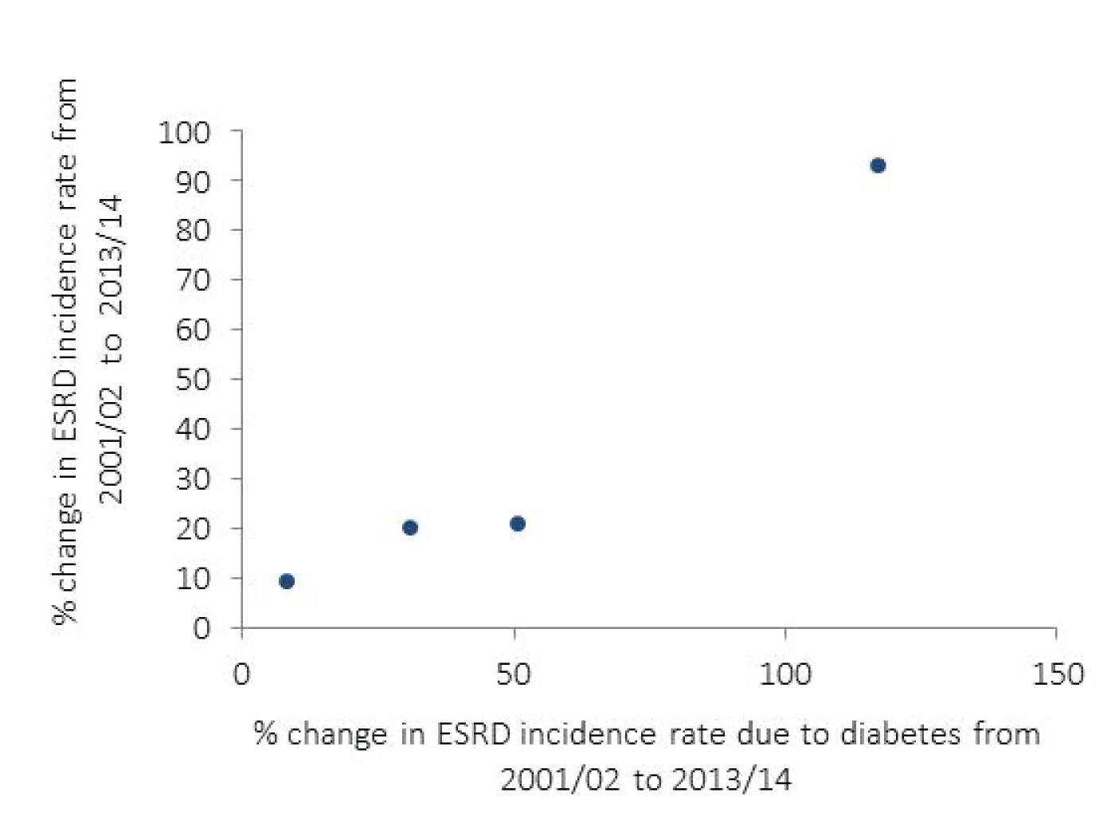
Figure 13.6 Country correlation of the percent change in ESRD incidence with the percent change in ESRD due to diabetes, by region, 2001-2014
^{(b) North and Latin America}
^{Data Source:} Special analyses, USRDS ESRD Database. Data presented only for countries from which relevant information was available. United Kingdom: England, Wales, Northern Ireland (Scotland data reported separately). Countries listed in order of lowest to highest % change in ESRD incidence due to diabetes in each panel (a) Europe and Israel: (< 3%) Iceland, Austria, Finland, Belgium (Dutch-speaking), Denmark, Sweden, Belgium (French-speaking), (> 20%) the Netherlands, New Zealand, Greece, Scotland, Israel, Norway, Australia; (b) North and Latin America: United States, Canada, Uruguay, Jalisco (Mexico); (c) Asia and Russia: (27%-135%) Hong Kong, Japan, Taiwan, Singapore, Rep. of Korea, (>251%) Malaysia, Philippines, Russia, and Thailand. Abbreviations: ESRD, end-stage renal disease.

Slide 9
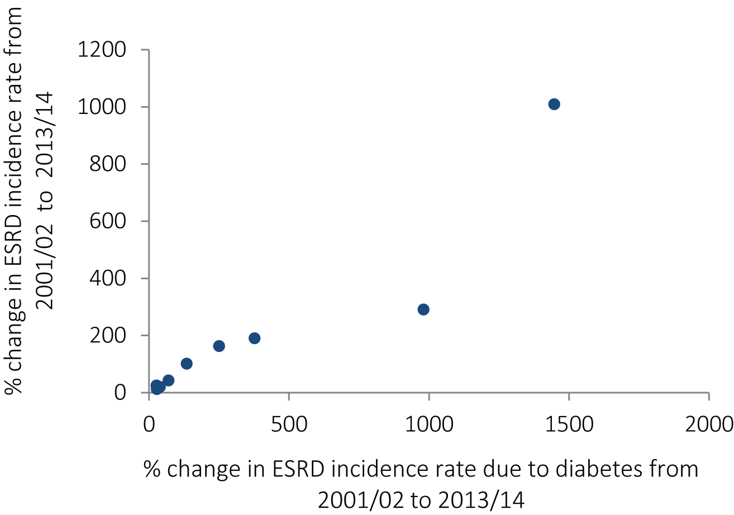
Figure 13.6 Country correlation of the percent change in ESRD incidence with the percent change in ESRD due to diabetes, by region, 2001-2014
^{(c) Asia and Russia}
^{Data Source:} Special analyses, USRDS ESRD Database. Data presented only for countries from which relevant information was available. United Kingdom: England, Wales, Northern Ireland (Scotland data reported separately). Countries listed in order of lowest to highest % change in ESRD incidence due to diabetes in each panel (a) Europe and Israel: (< 3%) Iceland, Austria, Finland, Belgium (Dutch-speaking), Denmark, Sweden, Belgium (French-speaking), (> 20%) the Netherlands, New Zealand, Greece, Scotland, Israel, Norway, Australia; (b) North and Latin America: United States, Canada, Uruguay, Jalisco (Mexico); (c) Asia and Russia: (27%-135%) Hong Kong, Japan, Taiwan, Singapore, Rep. of Korea, (>251%) Malaysia, Philippines, Russia, and Thailand. Abbreviations: ESRD, end-stage renal disease.

Slide 10
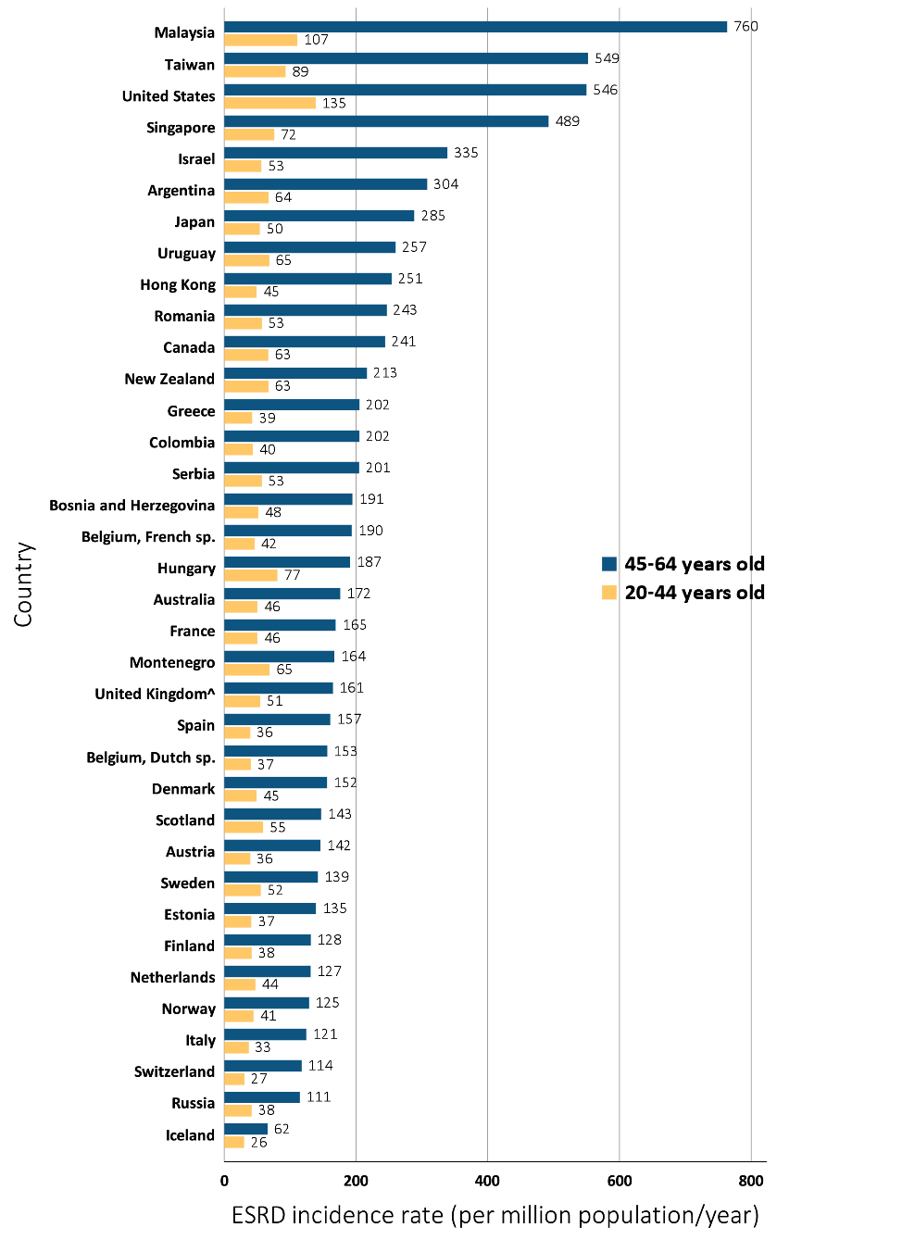
Figure 13.7 Incidence rate of treated ESRD (per million population/year), by age group and country, 2014
^{(a) 20-44 and 45-64 years old}
Data Source: Special analyses, USRDS ESRD Database. Data presented only for countries from which relevant information was available. ^United Kingdom: England, Wales, Northern Ireland (Scotland data reported separately). Data for Spain include 18 of 19 regions. Data for Italy include 6 regions. Data for France include 22 regions. Data for Canada excludes Quebec. Japan includes dialysis patients only. For graph (a), data for Spain include patients 15-64 years old, and data for the United States include patients 22-64 years old. Abbreviations: ESRD, end-stage renal disease; sp., speaking.

Slide 11
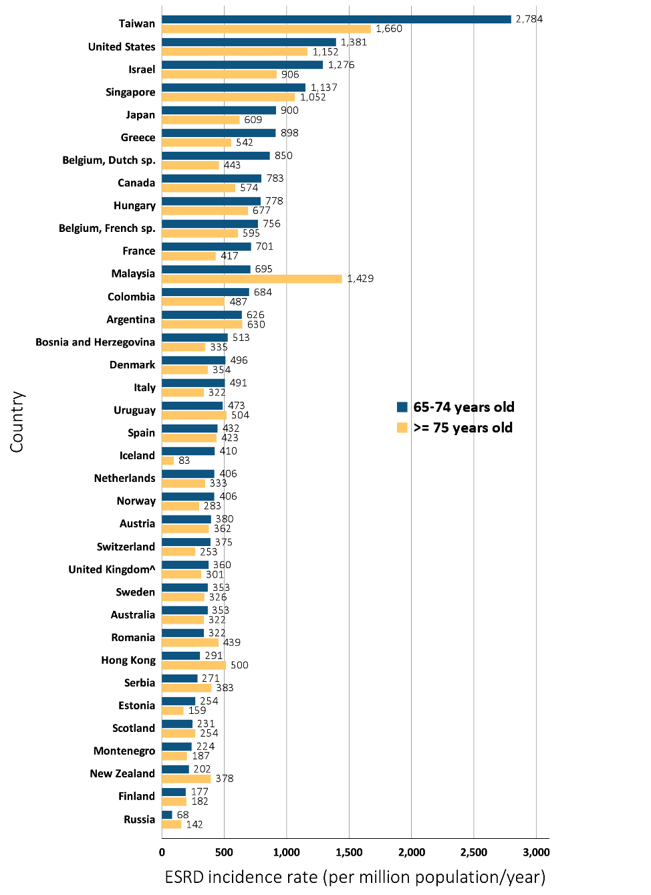
Figure 13.7 Incidence rate of treated ESRD (per million population/year), by age group and country, 2014
^{(b) 65-74} ^{and ≥ 75 years old}
Data Source: Special analyses, USRDS ESRD Database. Data presented only for countries from which relevant information was available. ^United Kingdom: England, Wales, Northern Ireland (Scotland data reported separately). Data for Spain include 18 of 19 regions. Data for Italy include 6 regions. Data for France include 22 regions. Data for Canada excludes Quebec. Japan includes dialysis patients only. For graph (a), data for Spain include patients 15-64 years old, and data for the United States include patients 22-64 years old. Abbreviations: ESRD, end-stage renal disease; sp., speaking.

Slide 12
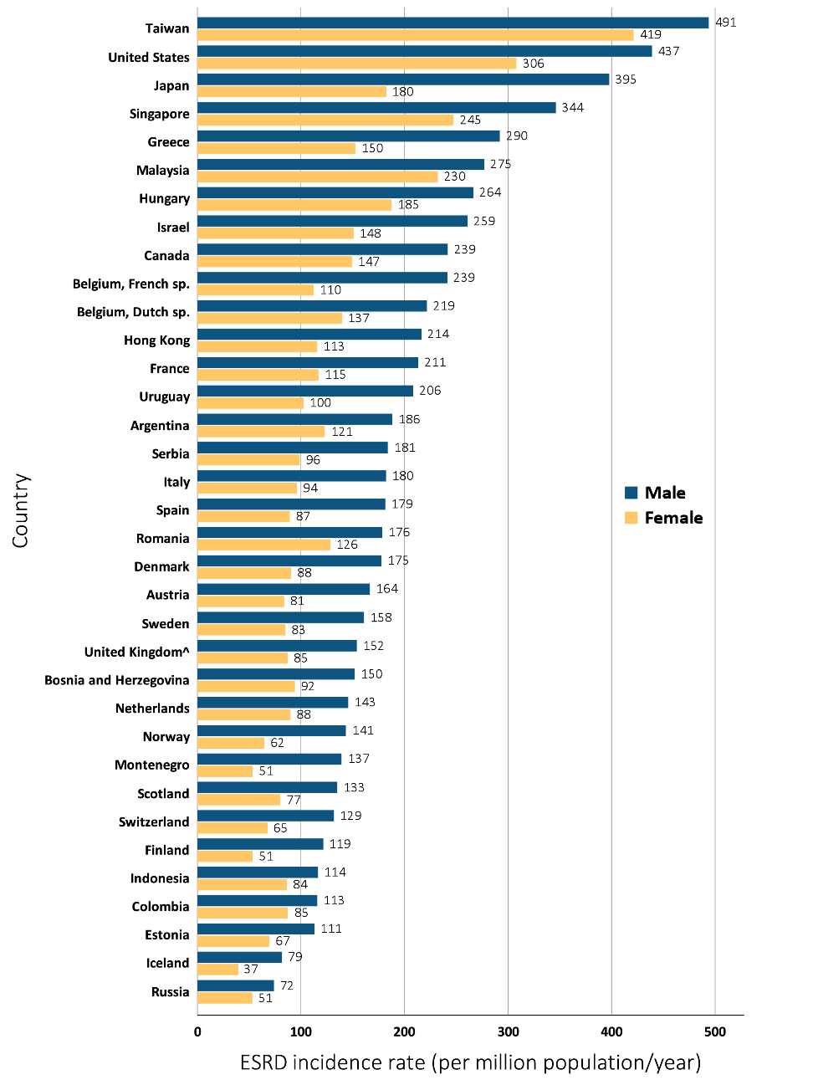
Figure 13.8 Incidence rate of treated ESRD (per million population/year), by sex and country, 2014
Data Source: Special analyses, USRDS ESRD Database. Data presented only for countries from which relevant information was available. ^United Kingdom: England, Wales, Northern Ireland (Scotland data reported separately). Data for Spain include 18 of 19 regions. Data for France include 22 regions. Data for Indonesia represent the West Java region. Data for Italy represent 6 regions. Data for Canada excludes Quebec. Japan includes dialysis patients only. Abbreviations: ESRD, end-stage renal disease; sp., speaking.

Slide 13
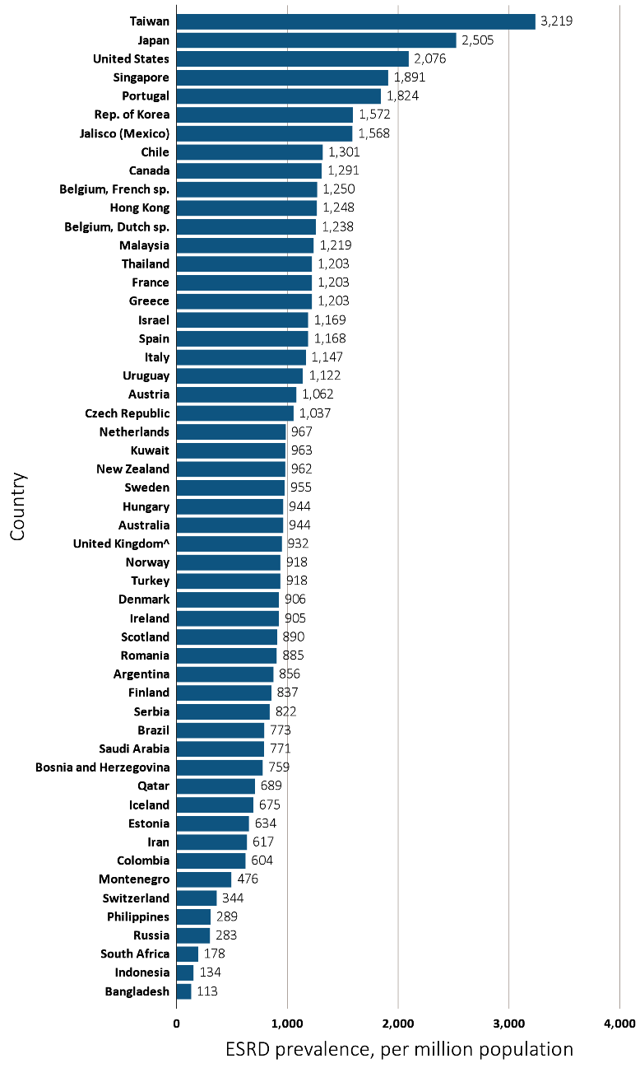
Figure 13.9 Prevalence of treated ESRD per million population, by country, 2014
Data Source: Special analyses, USRDS ESRD Database. Data presented only for countries from which relevant information was available. ^United Kingdom: England, Wales, Northern Ireland (Scotland data reported separately). The prevalence is unadjusted and reflects prevalence at the end of 2014. Switzerland includes dialysis patients only. Data for Indonesia represent the West Java region. Data for Spain include 18 of 19 regions. Data for France include 22 regions. Data for Italy includes 6 regions. Data for Canada excludes Quebec. Abbreviations: ESRD, end-stage renal disease; sp., speaking.

Slide 14
^{Figure 13.10 Prevalence} of treated ESRD per million population, by sex and country, 2014
Data Source: Special analyses, USRDS ESRD Database. Data presented only for countries from which relevant information was available. ^United Kingdom: England, Wales, Northern Ireland (Scotland data reported separately). Switzerland includes dialysis patients only. Data for Spain include 18 of 19 regions. Data for France include 22 regions. Data for Italy include 6 regions. Data for Canada excludes Quebec. Abbreviations: ESRD, end-stage renal disease; sp., speaking.

Slide 15
Figure 13.11 Trends in the prevalence of treated ESRD per million population, by country, 2001-2014
Ten countries having the highest % rise in ESRD prevalence from 2001/02 versus that in 2013/14, plus the U.S.
^{Data Source:} Special analyses, USRDS ESRD Database. ESRD prevalence is unadjusted. Israel includes dialysis patients only from 2001-2002. U.S. is shown for comparison purposes. Abbreviations: ESRD, end-stage renal disease.

Slide 16
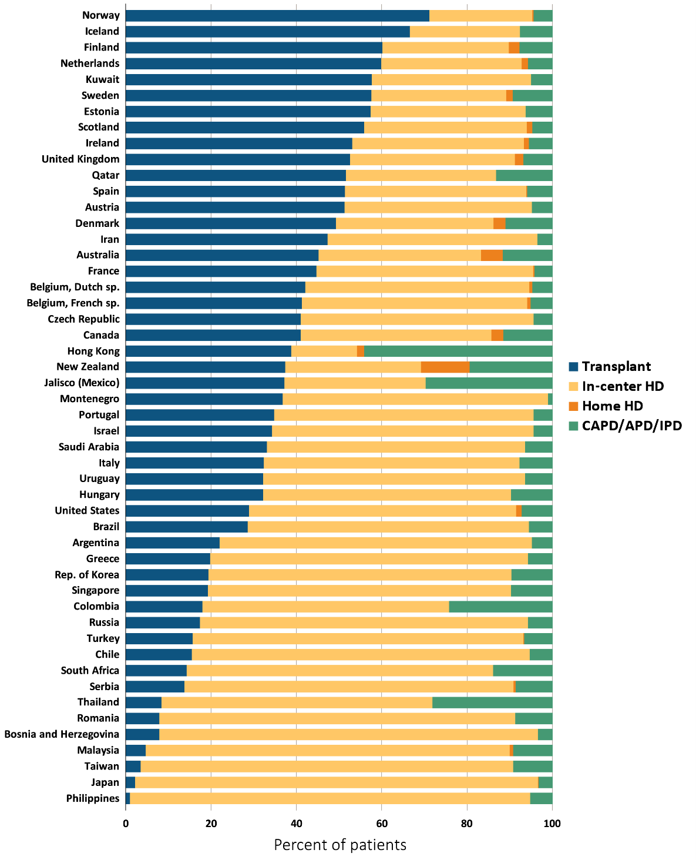
Figure 13.12 Percent distribution of type of renal replacement therapy modality used by ESRD patients, by country, 2014
^{Data Source:} Special analyses, USRDS ESRD Database. Denominator is calculated as the sum of patients receiving HD, PD, Home HD, or treated with a functioning transplant; does not include patients with other/unknown modality. Data for Spain include 18 of 19 regions. Data for France include 22 regions. Data for Italy include 6 regions. Data for Canada excludes Quebec. Abbreviations: CAPD, continuous ambulatory peritoneal dialysis; APD, automated peritoneal dialysis; IPD, intermittent peritoneal dialysis; ESRD, end-stage renal disease; HD, hemodialysis; PD, peritoneal dialysis; sp., speaking

Slide 17
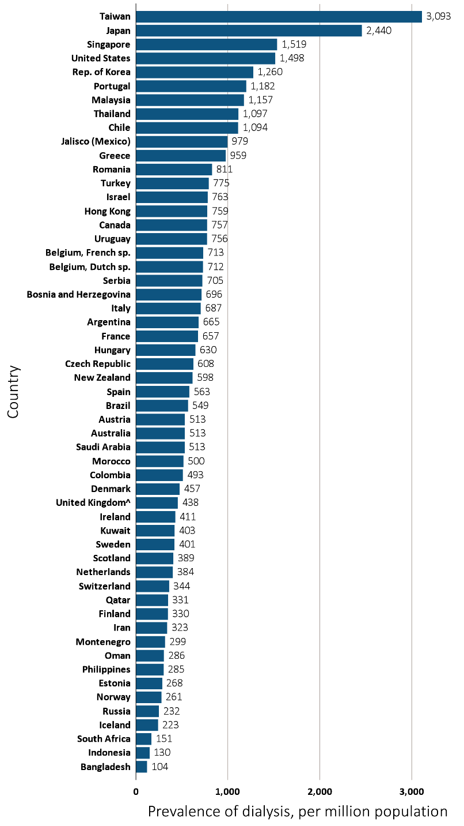
Figure 13.13 Prevalence of dialysis per million population, by country, 2014
Data Source: Special analyses, USRDS ESRD Database. ESRD prevalence is unadjusted and reflects prevalence at the end of 2014. United Kingdom: England, Wales, Northern Ireland (Scotland data reported separately). Data for Indonesia represent the West Java region. Data for Spain include 18 of 19 regions. Data for France include 22 regions. Data for Italy include 6 regions. Data for Canada excludes Quebec. Abbreviations: sp., speaking.

Slide 18
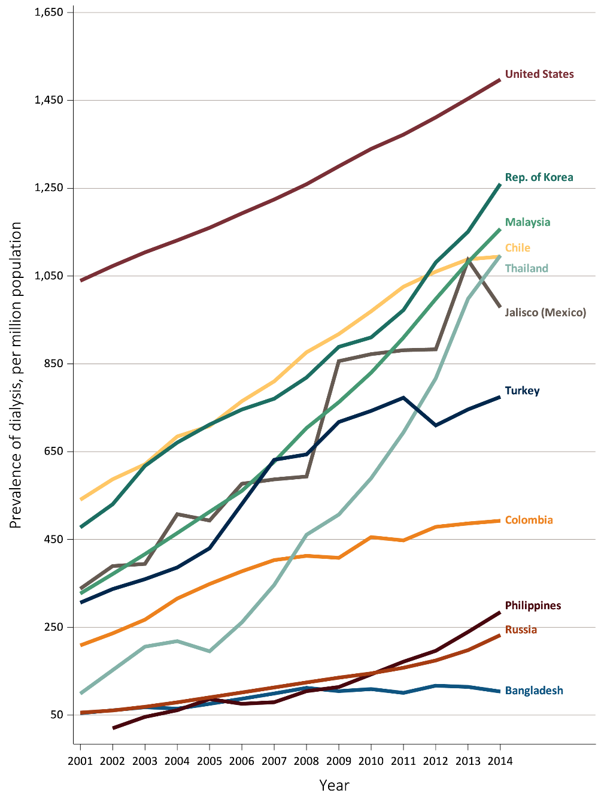
Figure 13.14 Trends in the prevalence of dialysis per million population, by country, 2001-2014
Ten countries having the highest % rise in dialysis prevalence from 2001/02 versus that in 2013/14, plus the U.S.
^{Data Source:} Special analyses, USRDS ESRD Database. The prevalence is unadjusted and reflects prevalence of dialysis at the end of each year. Abbreviations: ESRD, end-stage renal disease.

Slide 19
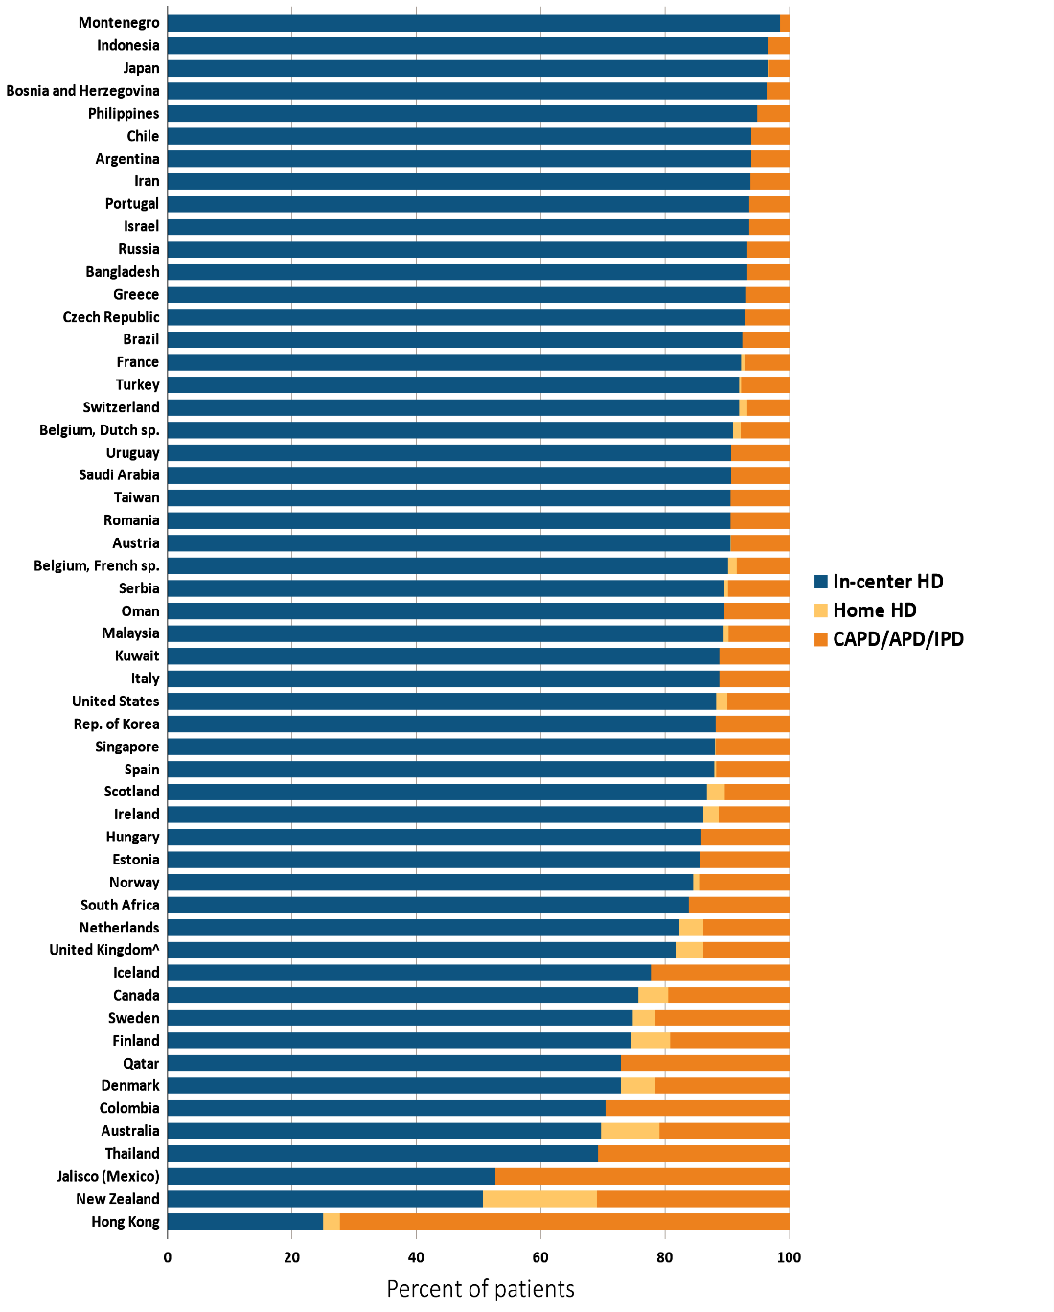
Figure 13.15 Distribution of the percentage of prevalent dialysis patients using in-center HD, home HD, or peritoneal dialysis (CAPD/APD/IPD), 2014
^{Data Source:} Special analyses, USRDS ESRD Database. Denominator is calculated as the sum of patients receiving HD, PD, Home HD; does not include patients with other/unknown modality. ^United Kingdom: England, Wales, & Northern Ireland (Scotland data reported separately). Data for Spain include 18 of 19 regions. Data for France include 22 regions. Data for Italy include 6 regions. Data for Canada excludes Quebec. Abbreviations: CAPD, continuous ambulatory peritoneal dialysis; APD, automated peritoneal dialysis; IPD, intermittent peritoneal dialysis.

Slide 20
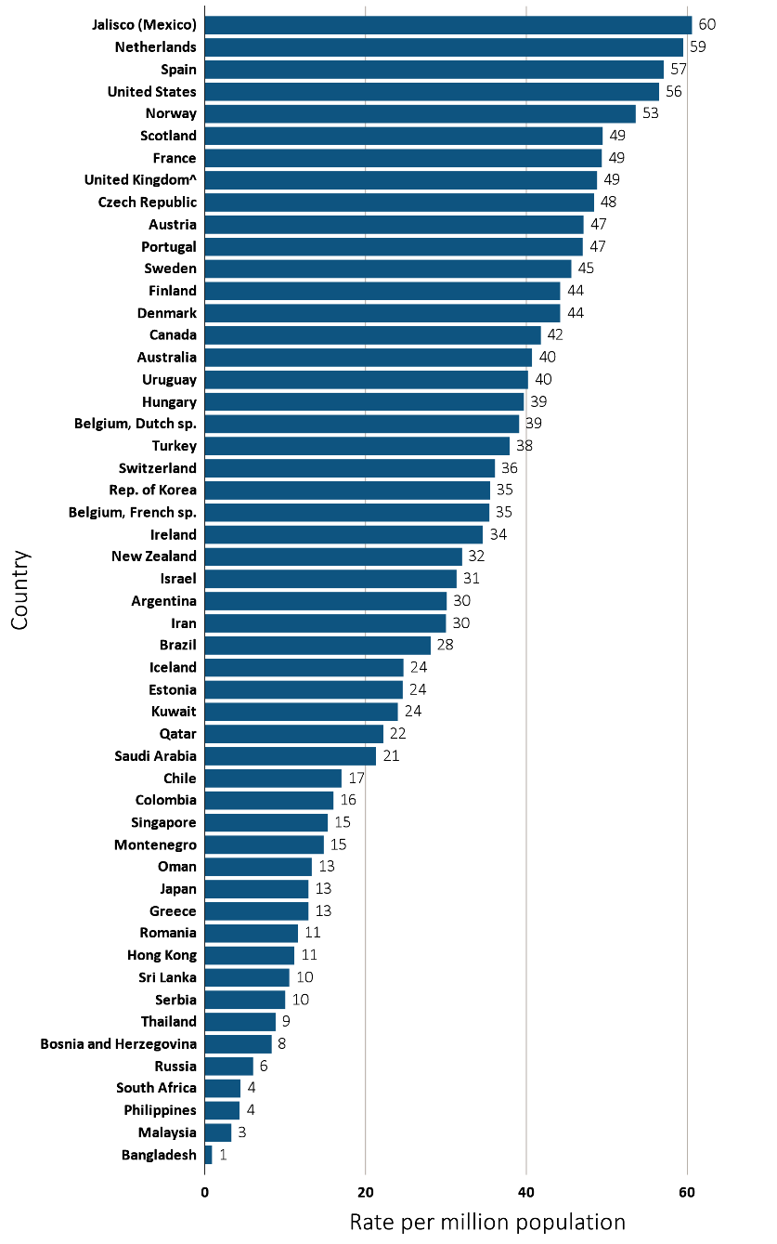
Figure 13.16 Kidney transplantation rate, by country, 2014
^{(a) Per million population}
Data Source: Special analyses, USRDS ESRD Database. Data presented only for countries from which relevant information was available. All rates are unadjusted. ^United Kingdom: England, Wales, & Northern Ireland (Scotland data reported separately). Data for France include 22 regions. Data for Sri Lanka is from 7 government hospitals. Data for Spain include all regions. Data for Canada excludes Quebec. Abbreviations: sp., speaking.

Slide 21
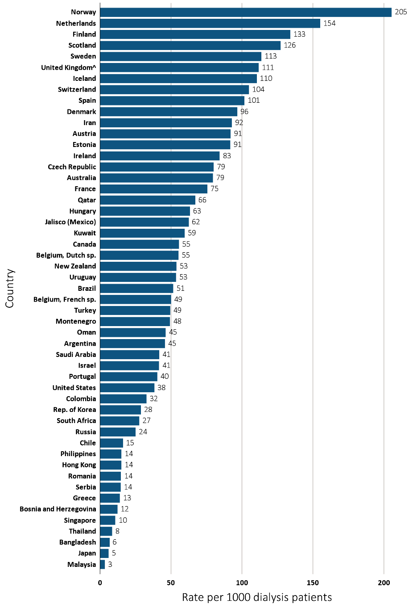
Figure 13.16 Kidney transplantation rate, by country, 2014
^{(a) Per 1000 dialysis patients}
Data Source: Special analyses, USRDS ESRD Database. Data presented only for countries from which relevant information was available. All rates are unadjusted. ^United Kingdom: England, Wales, & Northern Ireland (Scotland data reported separately). Data for France include 22 regions. Data for Sri Lanka is from 7 government hospitals. Data for Spain include all regions. Data for Canada excludes Quebec. Abbreviations: sp., speaking.

Slide 22
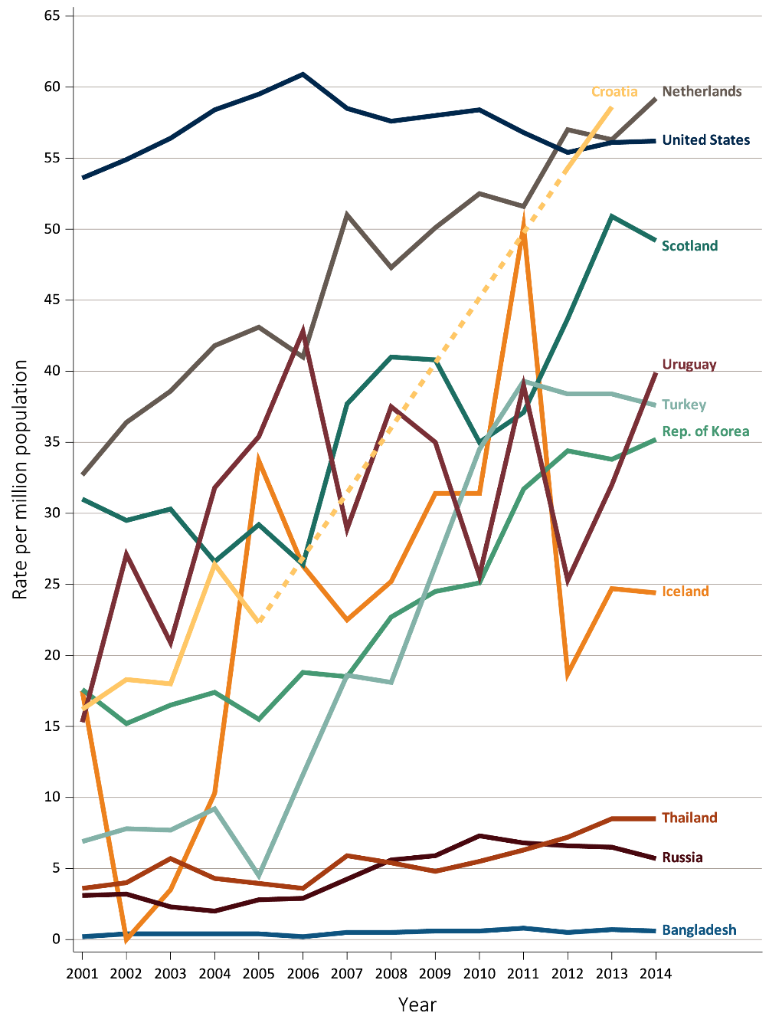
Figure 13.17 Trends in transplantation rates per million population, by country
Ten countries having the highest % rise in kidney transplantation rate from 2001/02 versus that in 2013/14, plus the U.S.
^{Data Source:} Special analyses, USRDS ESRD Database. All rates are unadjusted. Data for Croatia are missing from 2006-2011, 2014. Abbreviations: ESRD, end-stage renal disease.

Slide 23
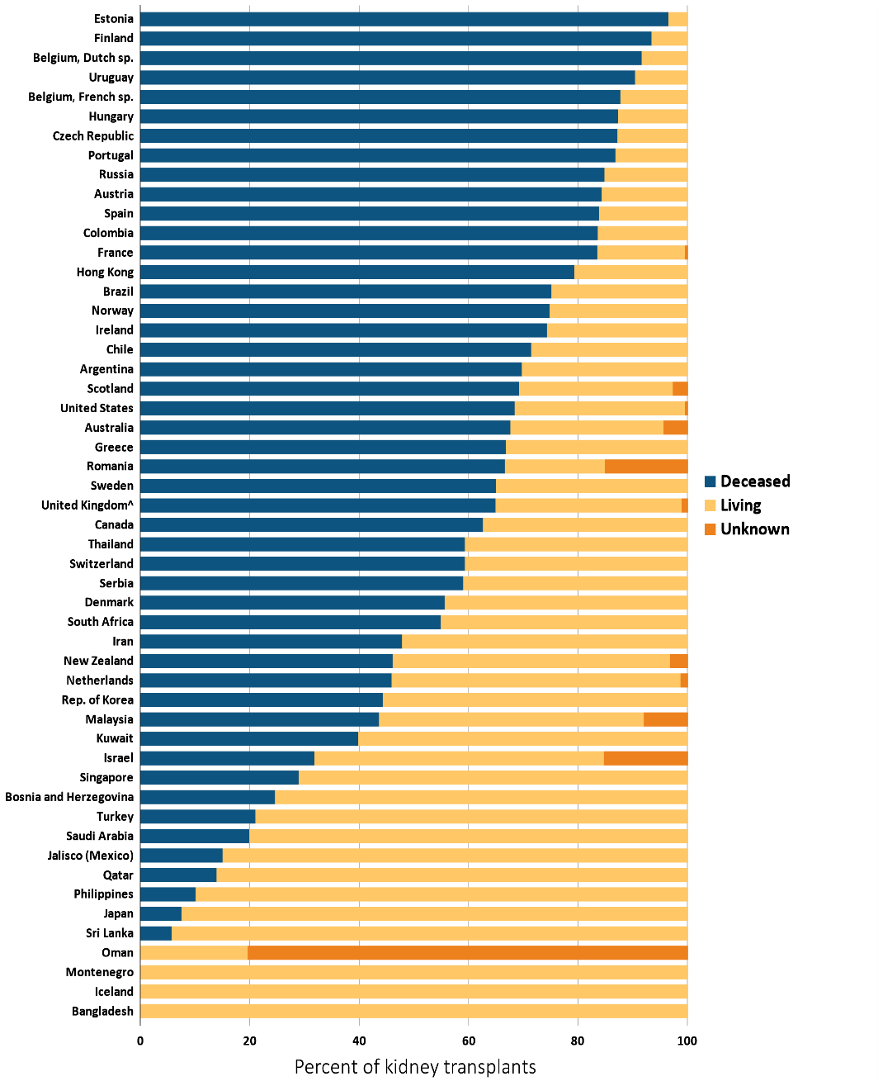
Figure 13.18 Distribution of the percentage of kidney transplantations by kidney donor type and country, 2014
^{Data Source:} Special analyses, USRDS ESRD Database. Denominator is calculated as the sum of deceased, living donor, and unknown transplants. ^United Kingdom: England, Wales, & Northern Ireland (Scotland data reported separately). Data for France include 22 regions. Data for Sri Lanka is from 7 government hospitals. Data from Canada excludes Quebec. Abbreviations: ESRD, end-stage renal disease.

Slide 24
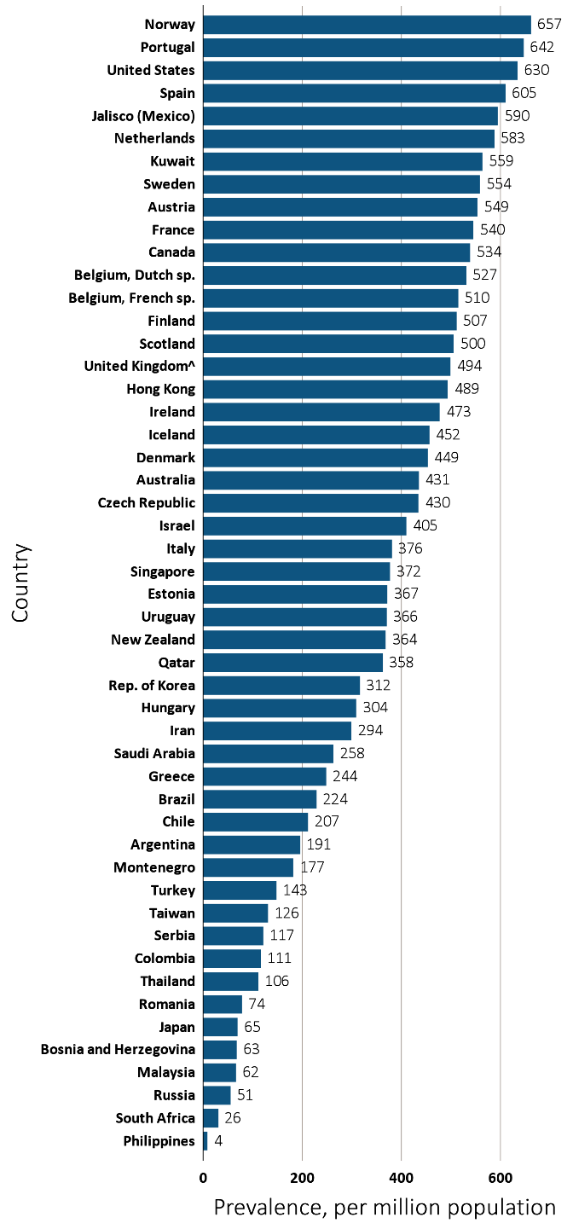
Figure 13.19 Prevalence of treated ESRD patients with a functioning kidney transplant, per million population, by country, 2014
^{Data Source:} Special analyses, USRDS ESRD Database. Data presented only for countries from which relevant information was available. The prevalence is unadjusted. ^United Kingdom: England, Wales, & Northern Ireland (Scotland data reported separately). Data for Spain include 18 of 19 regions. Data for France include 22 regions. Data for Italy includes 6 regions. Data for Canada excludes Quebec. Abbreviations: ESRD, end-stage renal disease; sp., speaking.

