Slide 1
2017 Annual Data Report
Volume 1: Chronic Kidney Disease
Chapter 6: Health Expenditures for Persons with CKD

Slide 2
vol 1 Table 6.1 Prevalent Medicare fee-for-service patient counts and spending for beneficiaries aged 65 and older, by diabetes, heart failure, and/or CKD, 2015
 | U.S. Medicare Population | Total Spending (millions, U.S. $) | PPPY (U.S. $) | Population (%) | Spending (%)
All | 24,449,480 | $262,261 | $11,127 | 100.00 | 100.00
With HF or CKD or DM | 8,106,280 | $133,562 | $17,506 | 33.16 | 50.93
CKD only (- DM & HF) | 1,070,980 | $16,124 | $15,930 | 4.38 | 6.15
DM only (- HF & CKD) | 4,003,460 | $48,143 | $12,432 | 16.37 | 18.36
HF only (- DM & CKD) | 872,680 | $17,290 | $21,707 | 3.57 | 6.59
CKD and DM only (- HF) | 886,240 | $15,993 | $19,109 | 3.63 | 6.10
CKD and HF only (- DM) | 347,500 | $9,255 | $31,401 | 1.42 | 3.53
DM and HF only (- CKD) | 495,060 | $12,343 | $27,397 | 2.03 | 4.71
CKD and HF and DM | 430,360 | $14,413 | $39,395 | 1.76 | 5.50
No CKD or DM or HF | 16,343,200 | $128,699 | $8,074 | 66.85 | 49.07
All CKD (+/- DM & HF) | 2,735,080 | $55,785 | $22,228 | 11.19 | 21.27
All DM (+/- CKD & HF) | 5,815,120 | $90,892 | $16,448 | 23.78 | 34.66
All HF (+/- DM & CKD) | 2,145,600 | $53,302 | $27,941 | 8.78 | 20.32
CKD and DM (+/- HF) | 1,316,600 | $30,406 | $25,280 | 5.39 | 11.59
CKD and HF (+/- DM) | 777,860 | $23,668 | $35,828 | 3.18 | 9.03
DM and HF (+/- CKD) | 925,420 | $26,756 | $32,774 | 3.79 | 10.20
Data Source: Medicare 5% sample. Abbreviations: CKD, chronic kidney disease; HF, heart failure; DM, diabetes mellitus; PPPY, per patient per year spending.

Slide 3
vol 1 Table 6.2 Prevalent Medicare Advantage and managed care spending for beneficiaries aged 65 and older, by diabetes, heart failure, and/or CKD, 2015
 | Medicare Advantage |  |  |  | Managed care
 | PPPY (U.S. $) | Population (%) | Spending (%) |  | PPPY (U.S. $) | Population (%) | Spending (%)
All | $11,191 | 100.00 | 100.00 |  | $11,146 | 100.00 | 100.00
With HF or CKD or DM | $17,253 | 29.81 | 45.29 |  | $17,100 | 24.19 | 36.80
CKD only (- DM & HF) | $15,630 | 4.14 | 5.71 |  | $17,615 | 2.75 | 4.37
DM only (- HF & CKD) | $13,612 | 15.54 | 18.88 |  | $13,675 | 14.76 | 17.99
HF only (- DM & CKD) | $20,916 | 2.69 | 4.84 |  | $21,260 | 2.16 | 4.07
CKD and DM only (- HF) | $19,226 | 3.73 | 6.32 |  | $21,008 | 2.32 | 4.32
CKD and HF only (- DM) | $27,505 | 1.02 | 2.34 |  | $30,363 | 0.55 | 1.44
DM and HF only (- CKD) | $27,223 | 1.47 | 3.41 |  | $27,612 | 1.00 | 2.43
CKD and HF and DM | $37,105 | 1.23 | 3.78 |  | $38,928 | 0.65 | 2.18
No CKD or DM or HF | $8,670 | 70.19 | 54.71 |  | $9,267 | 75.81 | 63.20
All CKD (+/- DM & HF) | $20,603 | 10.12 | 18.16 |  | $22,092 | 6.27 | 12.32
All DM (+/- CKD & HF) | $16,673 | 21.96 | 32.39 |  | $16,167 | 18.73 | 26.92
All HF (+/- DM & CKD) | $26,435 | 6.41 | 14.38 |  | $26,431 | 4.37 | 10.12
CKD and DM (+/- HF) | $23,459 | 4.96 | 10.10 |  | $24,841 | 2.97 | 6.50
CKD and HF (+/- DM) | $32,736 | 2.26 | 6.13 |  | $35,002 | 1.20 | 3.62
DM and HF (+/- CKD) | $31,658 | 2.70 | 7.19 |  | $32,012 | 1.65 | 4.61
Data Source: Optum Clinformatics™. Abbreviations: CKD, chronic kidney disease; HF, heart failure; DM, diabetes mellitus; PPPY, per patient per year costs. Numbers of ‘All’ patients included in this table are 2,167,627 and 223,395 for Medicare Advantage and Commercial managed care respectively

Slide 4
vol 1 Table 6.3 Prevalent Medicare fee-for-service patient counts and spending for beneficiaries younger than age 65, by diabetes, heart failure, and/or CKD, 2015
 | U.S. Medicare Population | Total Costs (millions, U.S. $) | PPPY spending (U.S. $) | Population (%) | Spending (%)
All | 4,967,060 | $62,093 | $13,025 | 100.00 | 100.00
With HF or CKD or DM | 1,278,300 | $26,984 | $22,311 | 25.74 | 43.46
CKD only (- DM & HF) | 99,680 | $2,236 | $23,803 | 2.01 | 3.60
DM only (- HF & CKD) | 808,920 | $13,605 | $17,551 | 16.29 | 21.91
HF only (- DM & CKD) | 99,140 | $2,295 | $24,701 | 2.00 | 3.70
CKD and DM only (- HF) | 113,500 | $3,078 | $29,119 | 2.29 | 4.96
CKD and HF only (- DM) | 21,600 | $775 | $40,786 | 0.44 | 1.25
DM and HF only (- CKD) | 83,280 | $2,673 | $34,484 | 1.68 | 4.30
CKD and HF and DM | 52,180 | $2,322 | $51,377 | 1.05 | 3.74
No CKD or DM or HF | 3,688,760 | $35,109 | $9,868 | 74.26 | 56.54
All CKD (+/- DM & HF) | 286,960 | $8,411 | $31,879 | 5.78 | 13.55
All DM (+/- CKD & HF) | 1,057,880 | $21,677 | $21,600 | 21.30 | 34.91
All HF (+/- DM & CKD) | 256,200 | $8,065 | $34,373 | 5.16 | 12.99
CKD and DM (+/- HF) | 165,680 | $5,399 | $35,785 | 3.34 | 8.70
CKD and HF (+/- DM) | 73,780 | $3,097 | $48,241 | 1.49 | 4.99
DM and HF (+/- CKD) | 135,460 | $4,995 | $40,705 | 2.73 | 8.04
Data Source: Medicare 5% sample. Abbreviations: CKD, chronic kidney disease; HF, heart failure; DM, diabetes mellitus; PPPY, per patient per year costs.

Slide 5
vol 1 Table 6.4 Prevalent Medicare Advantage and managed care fee-for-service spending for beneficiaries younger than age 65, by diabetes, heart failure, and/or CKD, 2015
 | Medicare Advantage |  |  |  | Managed care
 | PPPY (U.S. $) | Population (%) | Spending (%) |  | PPPY (U.S. $) | Population (%) | Spending (%)
All | $18,503 | 100.00 | 100.00 |  | $5,279 | 100.00 | 100.00
With HF or CKD or DM | $27,572 | 29.77 | 43.92 |  | $13,208 | 6.37 | 15.62
CKD only (- DM & HF) | $29,476 | 2.04 | 3.23 |  | $16,206 | 0.55 | 1.66
DM only (- HF & CKD) | $22,035 | 19.20 | 22.77 |  | $11,029 | 5.02 | 10.30
HF only (- DM & CKD) | $32,499 | 2.09 | 3.59 |  | $20,752 | 0.30 | 1.14
CKD and DM only (- HF) | $34,673 | 2.99 | 5.54 |  | $22,361 | 0.32 | 1.33
CKD and HF only (- DM) | $53,785 | 0.44 | 1.23 |  | $40,815 | 0.03 | 0.21
DM and HF only (- CKD) | $39,620 | 1.91 | 3.97 |  | $28,588 | 0.11 | 0.56
CKD and HF and DM | $63,266 | 1.12 | 3.59 |  | $59,704 | 0.04 | 0.41
No CKD or DM or HF | $14,713 | 70.23 | 56.08 |  | $4,751 | 93.63 | 84.38
All CKD (+/- DM & HF) | $38,954 | 6.58 | 13.60 |  | $20,782 | 0.94 | 3.62
All DM (+/- CKD & HF) | $26,570 | 25.21 | 35.88 |  | $12,359 | 5.49 | 12.60
All HF (+/- DM & CKD) | $42,663 | 5.55 | 12.38 |  | $26,831 | 0.48 | 2.33
CKD and DM (+/- HF) | $42,169 | 4.10 | 9.14 |  | $26,253 | 0.36 | 1.75
CKD and HF (+/- DM) | $60,539 | 1.56 | 4.83 |  | $51,605 | 0.07 | 0.63
DM and HF (+/- CKD) | $48,183 | 3.02 | 7.56 |  | $36,721 | 0.15 | 0.97
Data Source: Optum Clinformatics™. Abbreviations: CKD, chronic kidney disease; HF, heart failure; DM, diabetes mellitus; PPPY, per patient per year spending. Number of ‘All’ patients included in this table are 277,724 and 4,868,546 for Medicare Advantage and Managed care respectively.

Slide 6
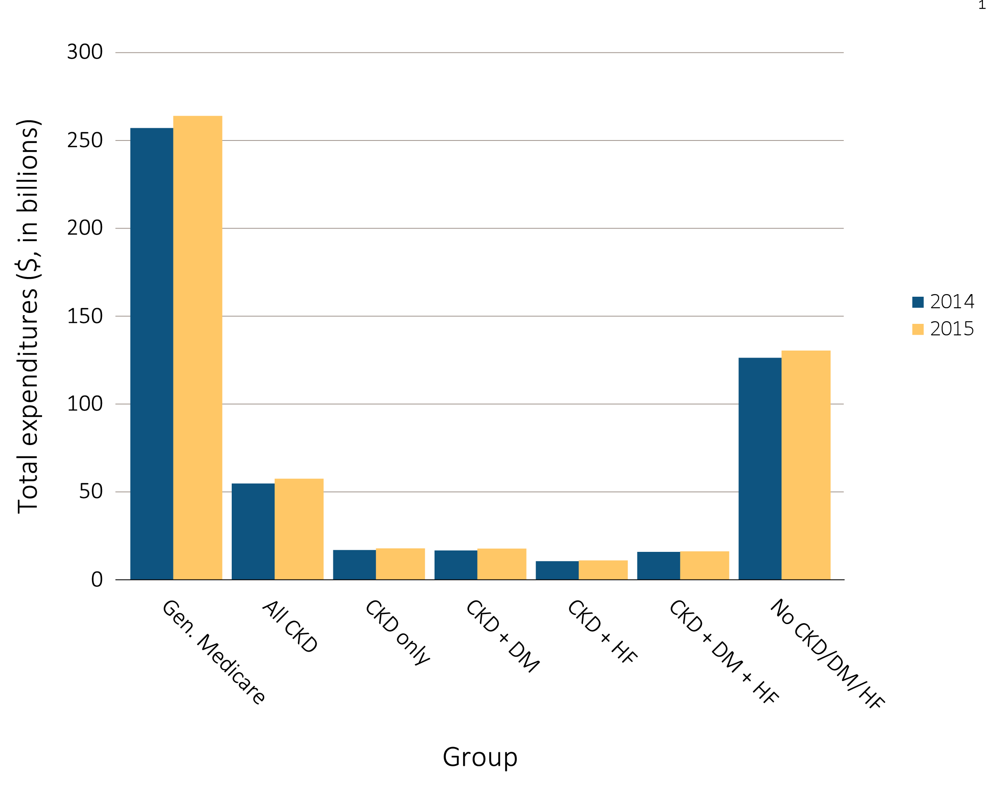
vol 1 Figure 6.1 Overall Medicare Parts A, B, and D fee-for-service spending for beneficiaries aged 65 and older, by CKD, diabetes, and heart failure, 2014 & 2015
Data source: Medicare 5% sample. Abbreviations: CKD, chronic kidney disease; HF, heart failure, DM, diabetes mellitus.

Slide 7
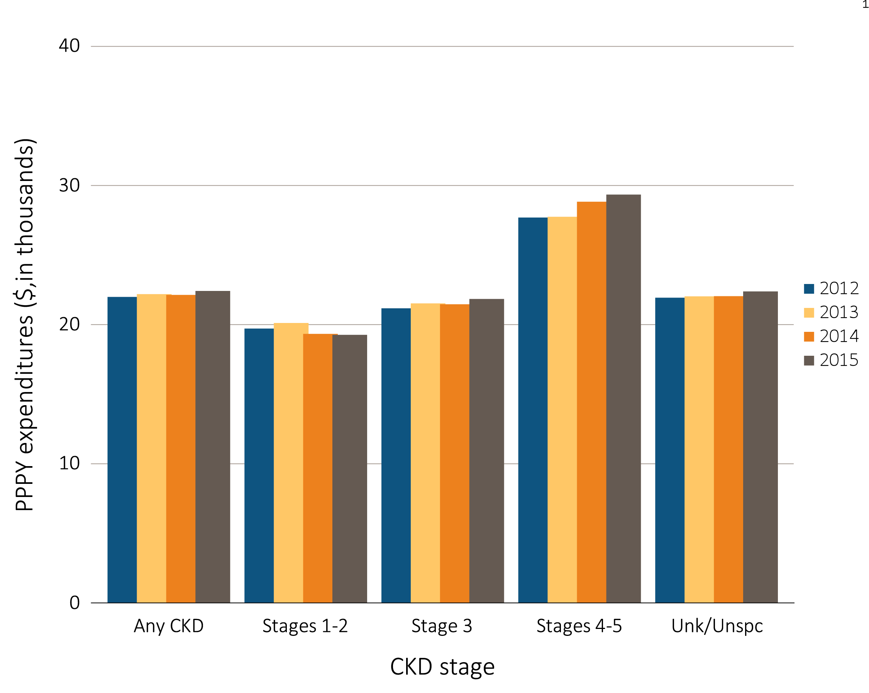
vol 1 Figure 6.2 Overall per person per year spending for beneficiaries aged 65 and older, by CKD stage, and year, 2012-2015
(a) Medicare fee-for service
Data Source: Medicare 5% sample and Optum Clinformatics™. Abbreviations: CKD, chronic kidney disease; PPPY, per patient per year.

Slide 8
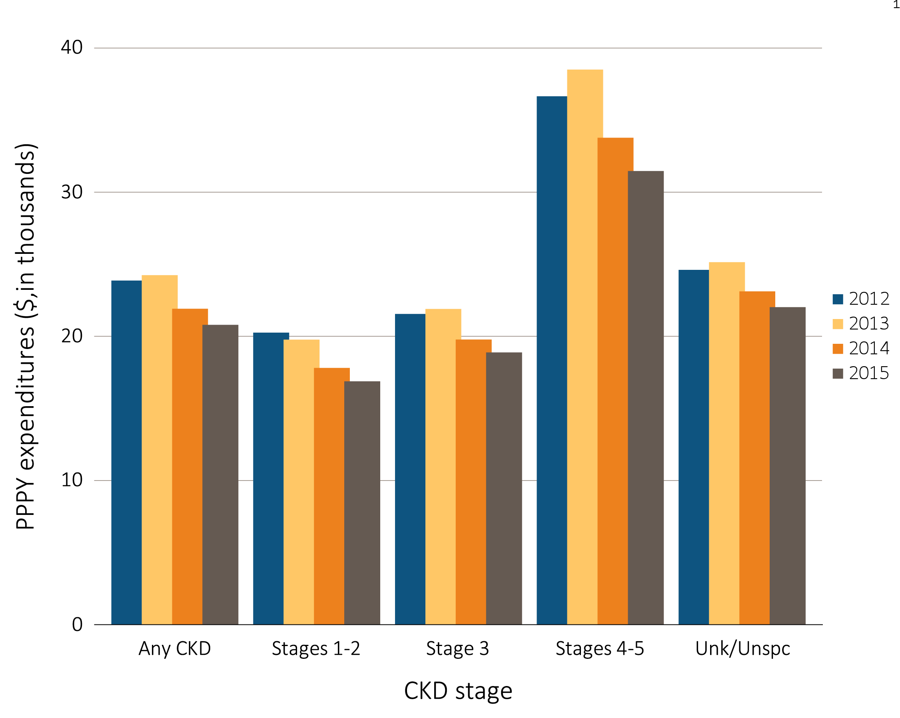
vol 1 Figure 6.2 Overall per person per year spending for beneficiaries aged 65 and older, by CKD stage, and year, 2012-2015
(b) Medicare Advantage
Data Source: Medicare 5% sample and Optum Clinformatics™. Abbreviations: CKD, chronic kidney disease; PPPY, per patient per year.

Slide 9
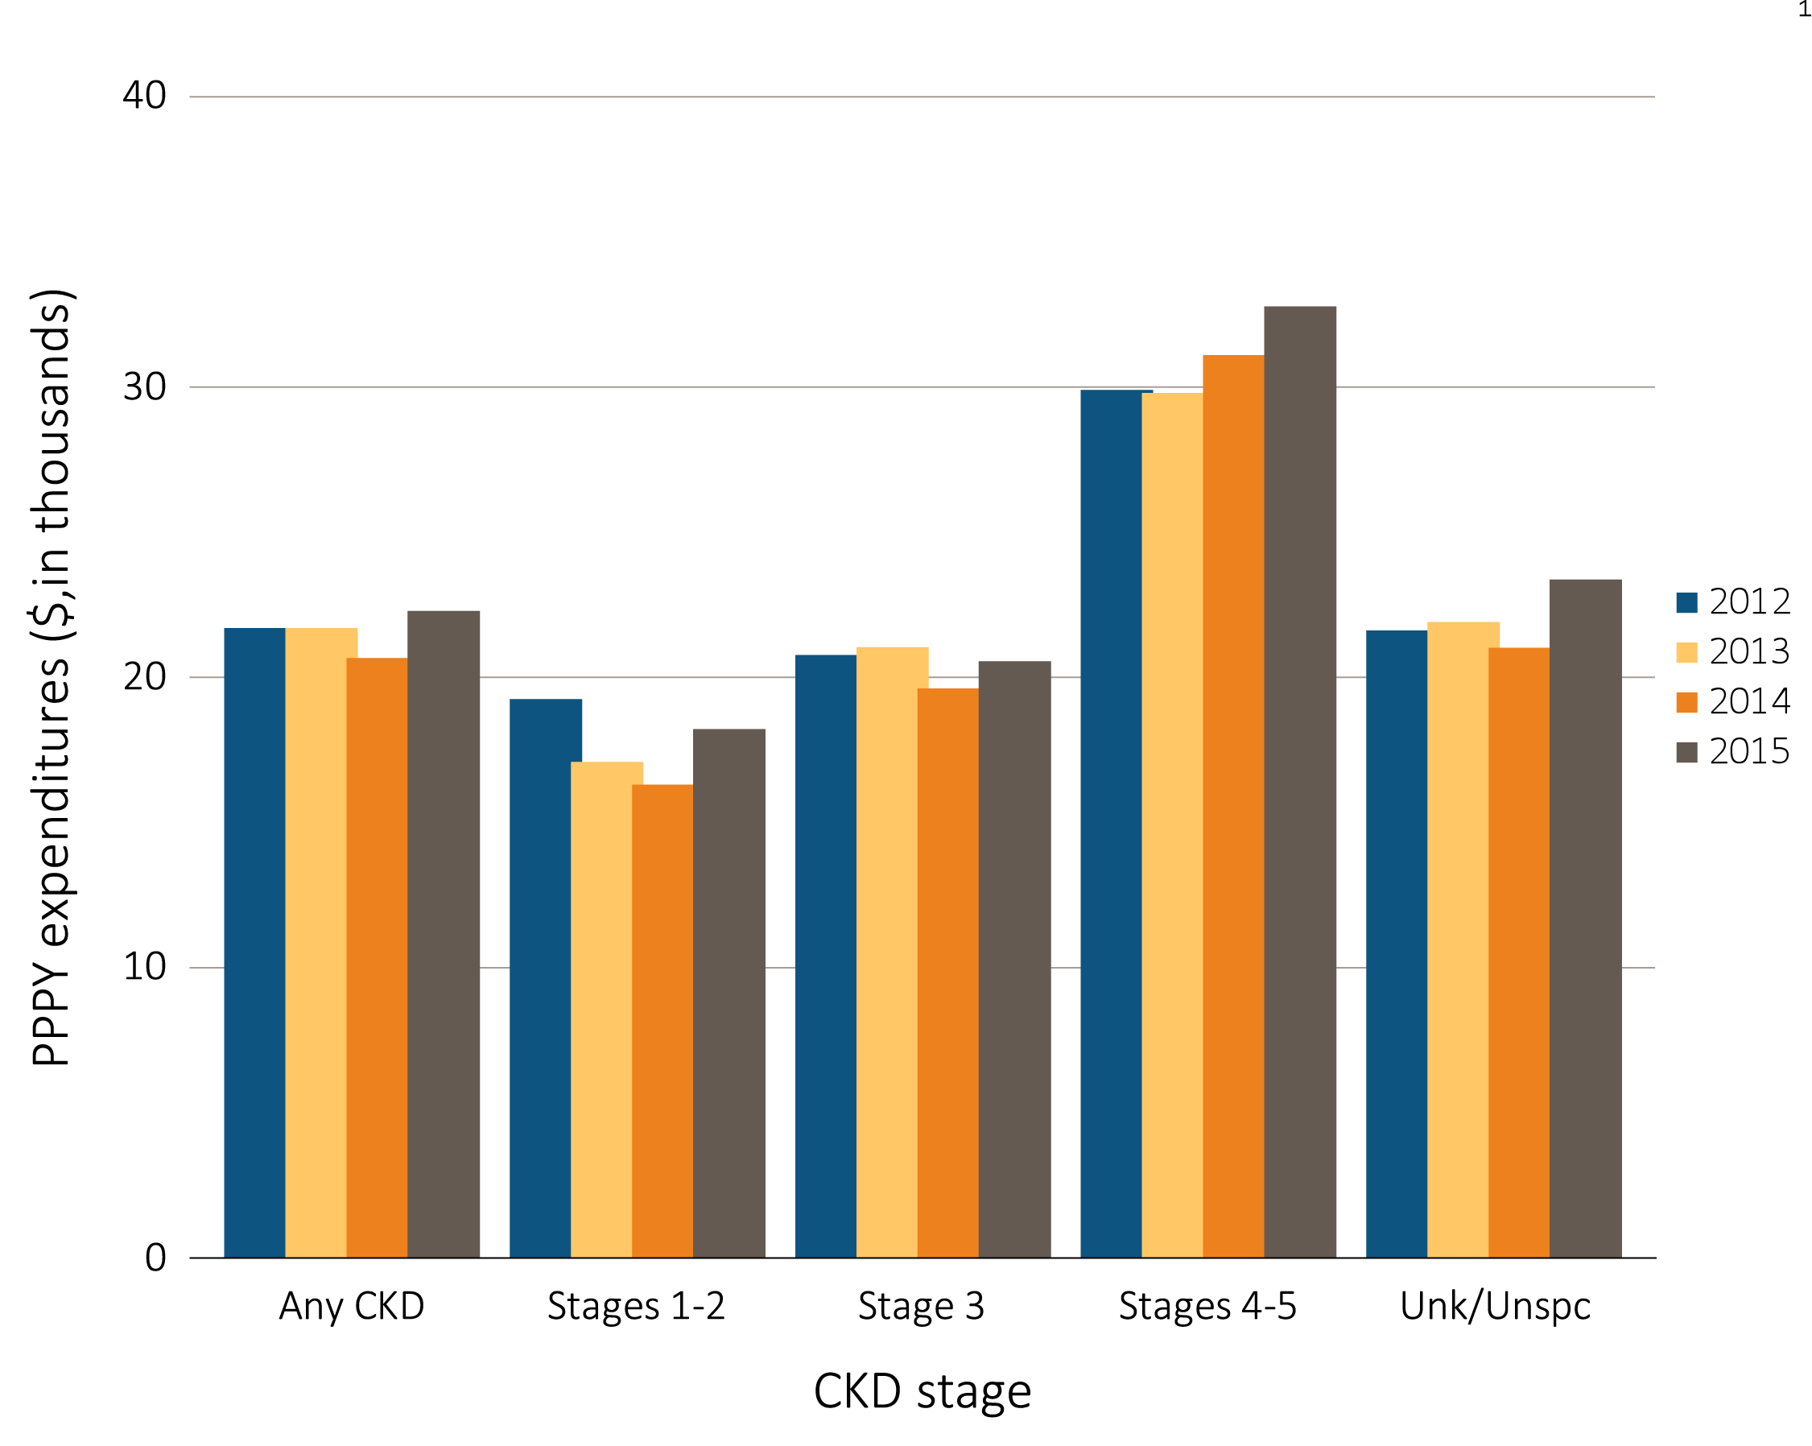
vol 1 Figure 6.2 Overall per person per year spending for beneficiaries aged 65 and older, by CKD stage, and year, 2012-2015
(c) Managed care
Data Source: Medicare 5% sample and Optum Clinformatics™. Abbreviations: CKD, chronic kidney disease; PPPY, per patient per year.

Slide 10
Table A. ICD-9-CM and ICD-10-CM codes for Chronic Kidney Disease (CKD) stages
ICD-9-CM codeª | ICD-10-CM codeª | Stage
585.1 | N18.1 | CKD, Stage 1
585.2 | N18.2 | CKD, Stage 2 (mild)
585.3 | N18.3 | CKD, Stage 3 (moderate)
585.4 | N18.4 | CKD, Stage 4 (severe)
585.5 | N18.5 | CKD, Stage 5 (excludes 585.6: Stage 5, requiring chronic dialysis^{b})
CKD Stage-unspecified | CKD Stage-unspecified | For these analyses, identified by multiple codes including 585.9, 250.4x, 403.9x & others for ICD-9-CM and A18.xx, E08.xx, E11.xx and other for ICD-10-CM.
ª For analyses in this chapter, CKD stage estimates require at least one occurrence of a stage-specific code, and the last available CKD stage in a given year is used. ^{b} In USRDS analyses, patients with ICD-9-CM code 585.6 or ICD-10-CM code N18.6 & with no ESRD 2728 form or other indication of end-stage renal disease (ESRD) are considered to have code 585.5 or N18.5

Slide 11
vol 1 Table 6.5 Per person per year Medicare Parts A, B, and D fee-for-service spending for all CKD beneficiaries aged 65 and older, by CKD stage, age, sex, and race, 2014 & 2015
 | 2014 |  |  |  |  |  | 2015
 | Any CKD | Stages 1-2 | Stage 3 | Stages 4-5 | Unk/ Unspc |  | Any CKD | Stages 1-2 | Stage 3 | Stages 4-5 | Unk/ Unspc
Patient years at risk | 2,416,562 | 248,272 | 1,125,995 | 227,538 | 814,757 |  | 2,509,731 | 266,837 | 1,231,392 | 228,778 | 782,724
All patients | $21,942 | $19,139 | $21,271 | $28,637 | $21,854 |  | $22,228 | $19,074 | $21,649 | $29,151 | $22,190
Age
65-69 | $20,751 | $17,380 | $20,541 | $30,039 | $20,137 |  | $21,115 | $17,869 | $20,801 | $31,518 | $20,431
70-74 | $20,437 | $17,460 | $20,036 | $28,398 | $20,247 |  | $20,363 | $16,778 | $19,940 | $28,408 | $20,459
75-79 | $21,512 | $17,472 | $20,924 | $28,916 | $21,740 |  | $21,516 | $18,711 | $20,820 | $28,681 | $21,746
80-84 | $22,217 | $20,511 | $21,253 | $27,794 | $22,417 |  | $22,737 | $19,779 | $22,190 | $28,657 | $22,776
85+ | $23,957 | $23,214 | $22,907 | $28,587 | $23,967 |  | $24,600 | $22,760 | $23,673 | $29,170 | $24,882
Sex
Male | $21,542 | $18,916 | $21,099 | $28,166 | $21,221 |  | $21,928 | $18,499 | $21,589 | $29,200 | $21,661
Female | $22,303 | $19,348 | $21,429 | $29,022 | $22,424 |  | $22,501 | $19,631 | $21,704 | $29,111 | $22,677
Race
White | $21,551 | $18,921 | $20,939 | $27,871 | $21,476 |  | $21,990 | $18,809 | $21,563 | $28,272 | $21,962
Black/African American | $24,746 | $21,099 | $23,787 | $32,269 | $24,566 |  | $23,983 | $19,880 | $22,439 | $33,943 | $24,139
Other | $22,457 | $18,470 | $21,625 | $30,737 | $22,811 |  | $22,492 | $20,878 | $21,520 | $30,138 | $22,185
Data source: Medicare 5% sample. Abbreviations: CKD, chronic kidney disease; Unk/unspc, CKD stage unknown or unspecified.

Slide 12
vol 1 Table 6.6 Per person per year Medicare Advantage and managed care spending for all CKD beneficiaries aged 65 and older, by CKD stage, age, sex, and race, 2015
 | Medicare Advantage |  |  |  |  |  | Managed care
 | Any CKD | Stages 1-2 | Stage 3 | Stages 4-5 | Unk/ Unspc |  | Any CKD | Stages 1-2 | Stage 3 | Stages 4-5 | Unk/ Unspc
Patient years at risk | 219,259 | 20,495 | 95,087 | 14,940 | 88,737 |  | 14,011 | 1,362 | 5,689 | 885 | 6,075
All patients | $20,603 | $16,691 | $18,693 | $31,277 | $21,829 |  | $22,092 | $18,026 | $20,361 | $32,585 | $23,181
Age
65-69 | $23,527 | $17,190 | $21,886 | $44,084 | $24,137 |  | $24,336 | $17,469 | $22,059 | $46,513 | $25,893
70-74 | $21,985 | $17,372 | $19,741 | $39,711 | $23,206 |  | $22,982 | $17,434 | $21,171 | $36,387 | $24,639
75-79 | $21,877 | $16,864 | $20,030 | $36,906 | $22,773 |  | $21,245 | $18,328 | $19,516 | $32,263 | $21,899
80-84 | $19,893 | $16,195 | $18,033 | $28,614 | $21,269 |  | $21,046 | $22,427 | $19,681 | $28,361 | $21,024
85+ | $16,823 | $15,424 | $15,522 | $19,491 | $18,104 |  | $17,723 | $15,833 | $17,728 | $20,386 | $17,265
Sex
Male | $21,368 | $16,838 | $19,439 | $33,226 | $22,607 |  | $22,401 | $18,668 | $20,884 | $33,259 | $23,275
Female | $19,958 | $16,563 | $18,082 | $29,777 | $21,143 |  | $21,520 | $17,010 | $19,634 | $30,595 | $22,941
Race
White | $20,675 | $17,205 | $18,746 | $28,785 | $22,259 |  | $22,051 | $18,662 | $20,563 | $31,447 | $22,840
Black/African American | $15,316 | $9,883 | $13,756 | $30,632 | $15,671 |  | $14,326 | $9,709 | $13,809 | $16,624 | $15,869
Other | $21,058 | $16,534 | $19,134 | $36,471 | $21,648 |  | $22,955 | $17,167 | $20,220 | $37,534 | $25,162
Data Source: Optum Clinformatics™. Abbreviations: CKD, chronic kidney disease; Unk/unspc, CKD stage unknown or unspecified.

Slide 13
vol 1 Table 6.7 Per person per year Medicare Parts A, B, and D fee-for-service spending for CKD patients with, aged 65 and older, by CKD stage, age, sex, and race, 2014 & 2015
 | 2014 |  |  |  |  |  | 2015
 | Any CKD | Stages 1-2 | Stage 3 | Stages 4-5 | Unk/ Unspc |  | Any CKD | Stages 1-2 | Stage 3 | Stages 4-5 | Unk/ Unspc
Patient years at risk | 1,162,063 | 120,091 | 549,920 | 119,516 | 372,537 |  | 1,202,782 | 128,814 | 594,220 | 121,161 | 358,588
All patients | $24,967 | $21,570 | $24,500 | $32,440 | $24,354 |  | $25,280 | $21,797 | $24,884 | $32,981 | $24,585
Age
65-69 | $24,083 | $19,437 | $24,709 | $32,609 | $22,750 |  | $24,540 | $20,290 | $24,791 | $35,626 | $22,878
70-74 | $23,657 | $20,235 | $23,321 | $32,854 | $22,836 |  | $23,494 | $19,302 | $23,080 | $32,525 | $23,234
75-79 | $24,488 | $19,732 | $24,237 | $31,863 | $24,205 |  | $24,861 | $22,062 | $24,094 | $32,501 | $24,692
80-84 | $25,378 | $24,944 | $24,261 | $31,261 | $25,138 |  | $26,032 | $22,450 | $25,815 | $32,439 | $25,194
85+ | $27,438 | $26,046 | $26,286 | $33,507 | $27,039 |  | $27,854 | $27,396 | $27,078 | $32,502 | $27,318
Sex
Male | $24,023 | $21,210 | $23,884 | $31,141 | $23,101 |  | $24,469 | $20,952 | $24,242 | $33,138 | $23,506
Female | $25,892 | $21,945 | $25,119 | $33,493 | $25,586 |  | $26,091 | $22,709 | $25,536 | $32,850 | $25,676
Race
White | $24,447 | $21,301 | $23,990 | $31,348 | $23,983 |  | $25,033 | $21,259 | $24,937 | $31,991 | $24,264
Black/African American | $28,184 | $23,038 | $27,392 | $37,347 | $27,386 |  | $27,016 | $23,370 | $25,170 | $37,048 | $27,042
Other | $24,914 | $21,601 | $25,129 | $32,986 | $23,376 |  | $24,927 | $24,014 | $23,732 | $34,155 | $24,011
Data source: Medicare 5% sample. Abbreviations: CKD, chronic kidney disease; Unk/unspc, CKD stage unknown or unspecified.

Slide 14
vol 1 Table 6.8 Per person per year Medicare Advantage and managed care spending for CKD patients with diabetes, aged 65 and older, by CKD stage, age, sex, and race, 2015
 | Medicare Advantage |  |  |  |  |  | Managed care
 | Any CKD | Stages 1-2 | Stage 3 | Stages 4-5 | Unk/ Unspc |  | Any CKD | Stages 1-2 | Stage 3 | Stages 4-5 | Unk/ Unspc
Patient years at risk | 107,428 | 9,995 | 43,494 | 7,767 | 46,172 |  | 6,635 | 639 | 2,654 | 463 | 2,879
All patients | $23,459 | $19,036 | $22,041 | $37,182 | $23,520 |  | $24,841 | $20,492 | $22,766 | $40,557 | $25,317
Age
65-69 | $26,544 | $19,241 | $25,468 | $47,871 | $26,425 |  | $26,569 | $20,232 | $24,953 | $57,489 | $25,754
70-74 | $24,704 | $20,200 | $23,189 | $46,334 | $24,195 |  | $26,149 | $20,599 | $23,648 | $34,882 | $28,886
75-79 | $24,210 | $19,675 | $23,096 | $40,660 | $23,647 |  | $25,107 | $21,032 | $21,791 | $43,039 | $26,212
80-84 | $21,876 | $17,292 | $20,196 | $31,204 | $22,715 |  | $21,687 | $20,809 | $19,994 | $32,716 | $21,318
85+ | $19,103 | $17,144 | $18,085 | $22,900 | $19,679 |  | $18,985 | $20,578 | $19,382 | $18,487 | $18,494
Sex
Male | $23,726 | $18,819 | $22,148 | $39,575 | $23,959 |  | $24,446 | $20,642 | $23,026 | $37,771 | $24,757
Female | $23,213 | $19,248 | $21,942 | $35,321 | $23,111 |  | $25,342 | $20,305 | $22,399 | $42,098 | $26,236
Race
White | $23,863 | $20,115 | $22,348 | $34,321 | $24,408 |  | $25,208 | $21,737 | $23,826 | $37,791 | $25,244
Black/African American | $16,837 | $10,561 | $16,427 | $34,072 | $15,804 |  | $15,377 | $9,056 | $13,847 | $29,197 | $16,665
Other | $23,558 | $18,545 | $22,138 | $42,299 | $22,931 |  | $24,750 | $18,664 | $20,564 | $48,899 | $26,600
Data Source: Optum Clinformatics™. Abbreviations: CKD, chronic kidney disease; Unk/unspc, CKD stage unknown or unspecified.

Slide 15
vol 1 Table 6.9 Per person per year Medicare Parts A, B, and D fee-for-service spending for CKD patients with heart failure, aged 65 and older, by CKD stage, age, sex, race, and year, 2014 & 2015
 | 2014 |  |  |  |  |  | 2015
 | Any CKD | Stages 1-2 | Stage 3 | Stages 4-5 | Unk/ Unspc |  | Any CKD | Stages 1-2 | Stage 3 | Stages 4-5 | Unk/ Unspc
Patient years at risk | 654,204 | 55,380 | 307,873 | 83,501 | 207,451 |  | 660,606 | 57,097 | 330,479 | 83,409 | 189,622
All patients | $35,089 | $32,559 | $34,707 | $41,078 | $33,920 |  | $35,828 | $33,808 | $35,519 | $41,364 | $34,540
Age
65-69 | $38,964 | $35,468 | $38,564 | $48,415 | $37,139 |  | $39,623 | $36,226 | $39,094 | $50,216 | $37,389
70-74 | $35,963 | $29,170 | $35,946 | $43,186 | $35,479 |  | $36,739 | $31,040 | $36,867 | $42,396 | $36,129
75-79 | $36,424 | $31,296 | $36,130 | $43,382 | $35,605 |  | $36,501 | $35,705 | $35,884 | $42,059 | $35,505
80-84 | $34,257 | $34,638 | $33,533 | $39,513 | $33,075 |  | $35,416 | $33,497 | $35,522 | $39,841 | $33,786
85+ | $33,136 | $32,880 | $32,752 | $37,922 | $31,686 |  | $33,936 | $33,324 | $33,469 | $38,722 | $32,654
Sex
Male | $34,250 | $32,001 | $34,025 | $40,137 | $32,947 |  | $34,930 | $32,710 | $34,640 | $41,134 | $33,565
Female | $35,846 | $33,096 | $35,360 | $41,834 | $34,747 |  | $36,682 | $34,895 | $36,387 | $41,556 | $35,451
Race
White | $34,139 | $31,708 | $33,906 | $39,922 | $32,868 |  | $35,188 | $32,972 | $35,058 | $39,893 | $34,087
Black/African American | $40,636 | $36,146 | $40,085 | $46,446 | $39,937 |  | $39,417 | $34,856 | $38,612 | $48,199 | $37,335
Other | $38,247 | $36,062 | $36,300 | $44,948 | $39,040 |  | $38,654 | $43,218 | $36,990 | $45,342 | $36,434
Data source: Medicare 5% sample. Abbreviations: CKD, chronic kidney disease; Unk/unspc, CKD stage unknown or unspecified.

Slide 16
vol 1 Table 6.10 Per person per year Medicare Advantage and managed care spending for CKD patients with heart failure, aged 65 and older, by CKD stage, age, sex, and race, 2015
 | Medicare Advantage |  |  |  |  |  | Managed care
 | Any CKD | Stages 1-2 | Stage 3 | Stages 4-5 | Unk/ Unspc |  | Any CKD | Stages 1-2 | Stage 3 | Stages 4-5 | Unk/ Unspc
Patient years at risk | 48,871 | 3,174 | 19,734 | 4,511 | 21,452 |  | 2,690 | 163 | 1,136 | 258 | 1,133
All patients | $32,736 | $29,232 | $30,743 | $43,293 | $32,942 |  | $35,002 | $38,649 | $31,856 | $44,486 | $35,500
Age
65-69 | $44,743 | $37,331 | $42,551 | $63,593 | $44,291 |  | $49,769 | $44,473 | $49,095 | $88,857 | $45,340
70-74 | $39,263 | $34,410 | $36,482 | $53,006 | $40,104 |  | $39,502 | $35,685 | $33,810 | $45,028 | $45,420
75-79 | $36,693 | $30,348 | $34,727 | $55,871 | $35,681 |  | $34,234 | $56,697 | $27,289 | $48,370 | $34,927
80-84 | $31,036 | $26,279 | $29,781 | $42,645 | $30,439 |  | $30,377 | $35,981 | $27,208 | $37,293 | $30,957
85+ | $22,865 | $21,992 | $21,782 | $25,391 | $23,468 |  | $21,646 | $21,051 | $22,002 | $21,908 | $21,248
Sex
Male | $33,430 | $29,907 | $31,443 | $44,242 | $33,698 |  | $34,497 | $41,971 | $31,942 | $48,441 | $33,205
Female | $32,103 | $28,621 | $30,082 | $42,488 | $32,264 |  | $35,950 | $32,429 | $31,858 | $39,303 | $39,650
Race
White | $31,967 | $29,231 | $29,922 | $39,984 | $32,672 |  | $33,237 | $36,180 | $29,610 | $41,622 | $34,534
Black/African American | $25,266 | $13,455 | $26,010 | n/a | $23,104 |  | $24,231 | $31,264 | $29,097 | n/a | $19,525
Other | $35,124 | $30,102 | $33,213 | $51,387 | $34,282 |  | $42,126 | $46,988 | $40,216 | $55,446 | $40,197
Data Source: Optum Clinformatics™. n/a: data not shown due to limited number of patients. Abbreviations: CKD, chronic kidney disease; Unk/unspc, CKD stage unknown or unspecified.

Slide 17
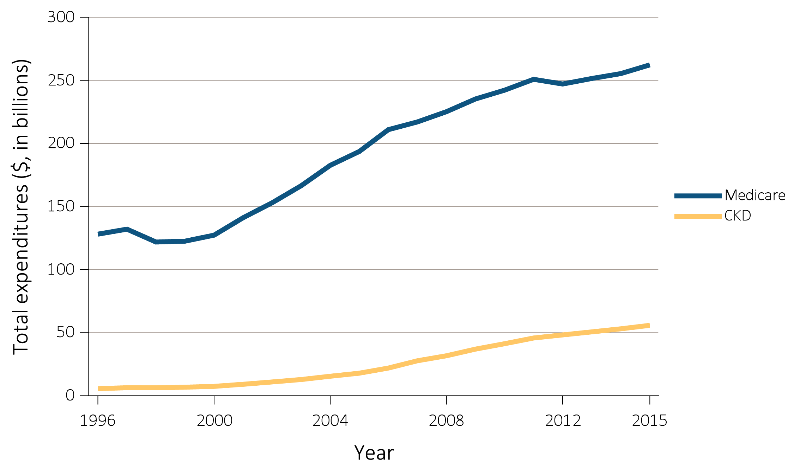
vol 1 Figure 6.3 Overall Medicare Parts A, B, and D fee-for-service spending for general Medicare population aged 65 and older and for those with CKD, 1996-2015
(a) All Patients
Data Source: Medicare 5% sample. Abbreviation: CKD, chronic kidney disease.

Slide 18
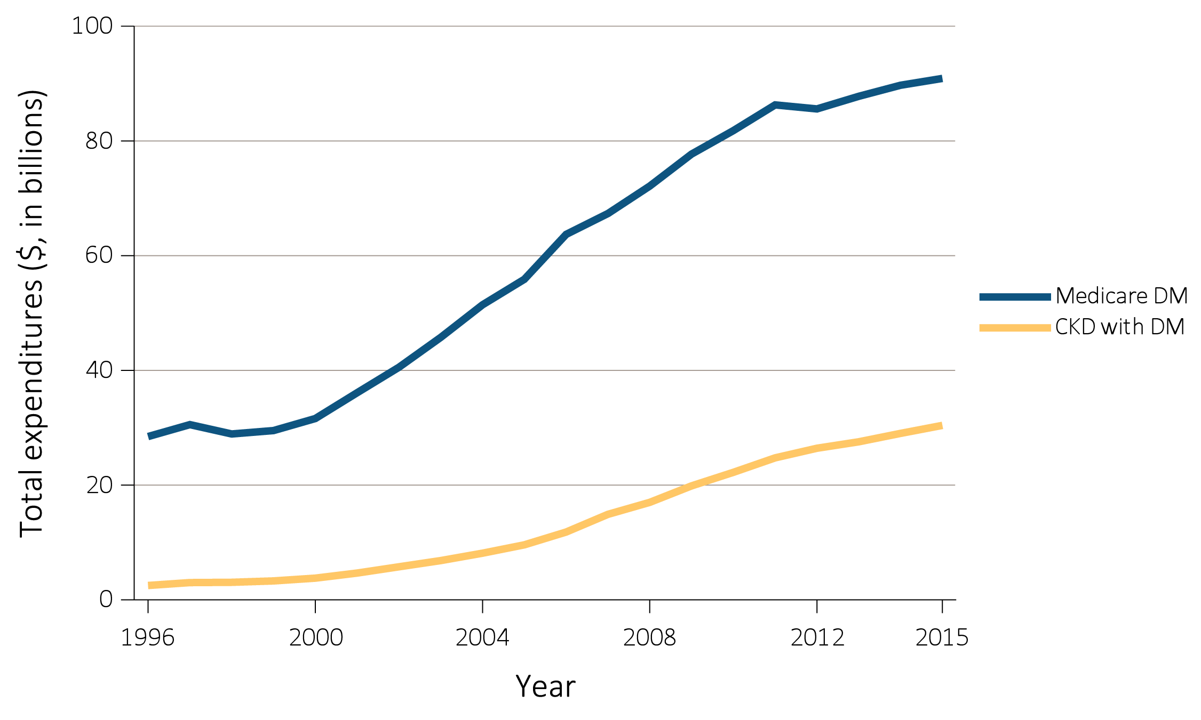
vol 1 Figure 6.3 Overall Medicare Parts A, B, and D fee-for-service spending for general Medicare population aged 65 and older and for those with CKD, 1996-2015
(b) Patients with diabetes
Data Source: Medicare 5% sample. Abbreviation: CKD, chronic kidney disease.

Slide 19
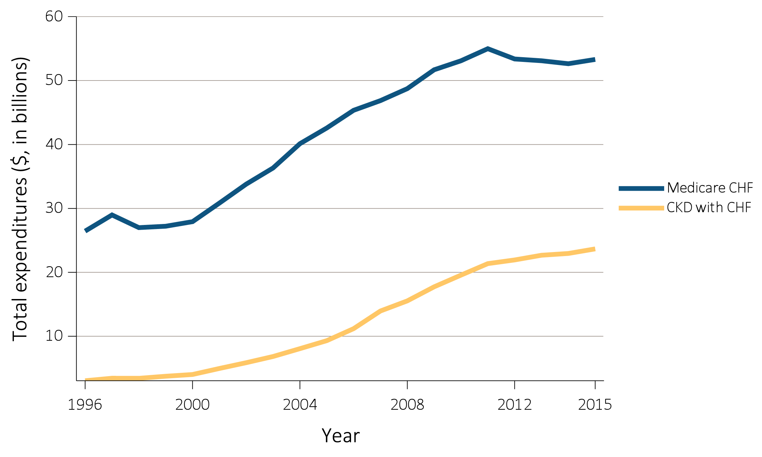
vol 1 Figure 6.3 Overall Medicare Parts A, B, and D fee-for-service spending for general Medicare population aged 65 and older and for those with CKD, 1996-2015
(c) Patients with heart failure
Data Source: Medicare 5% sample. Abbreviation: CKD, chronic kidney disease.

Slide 20
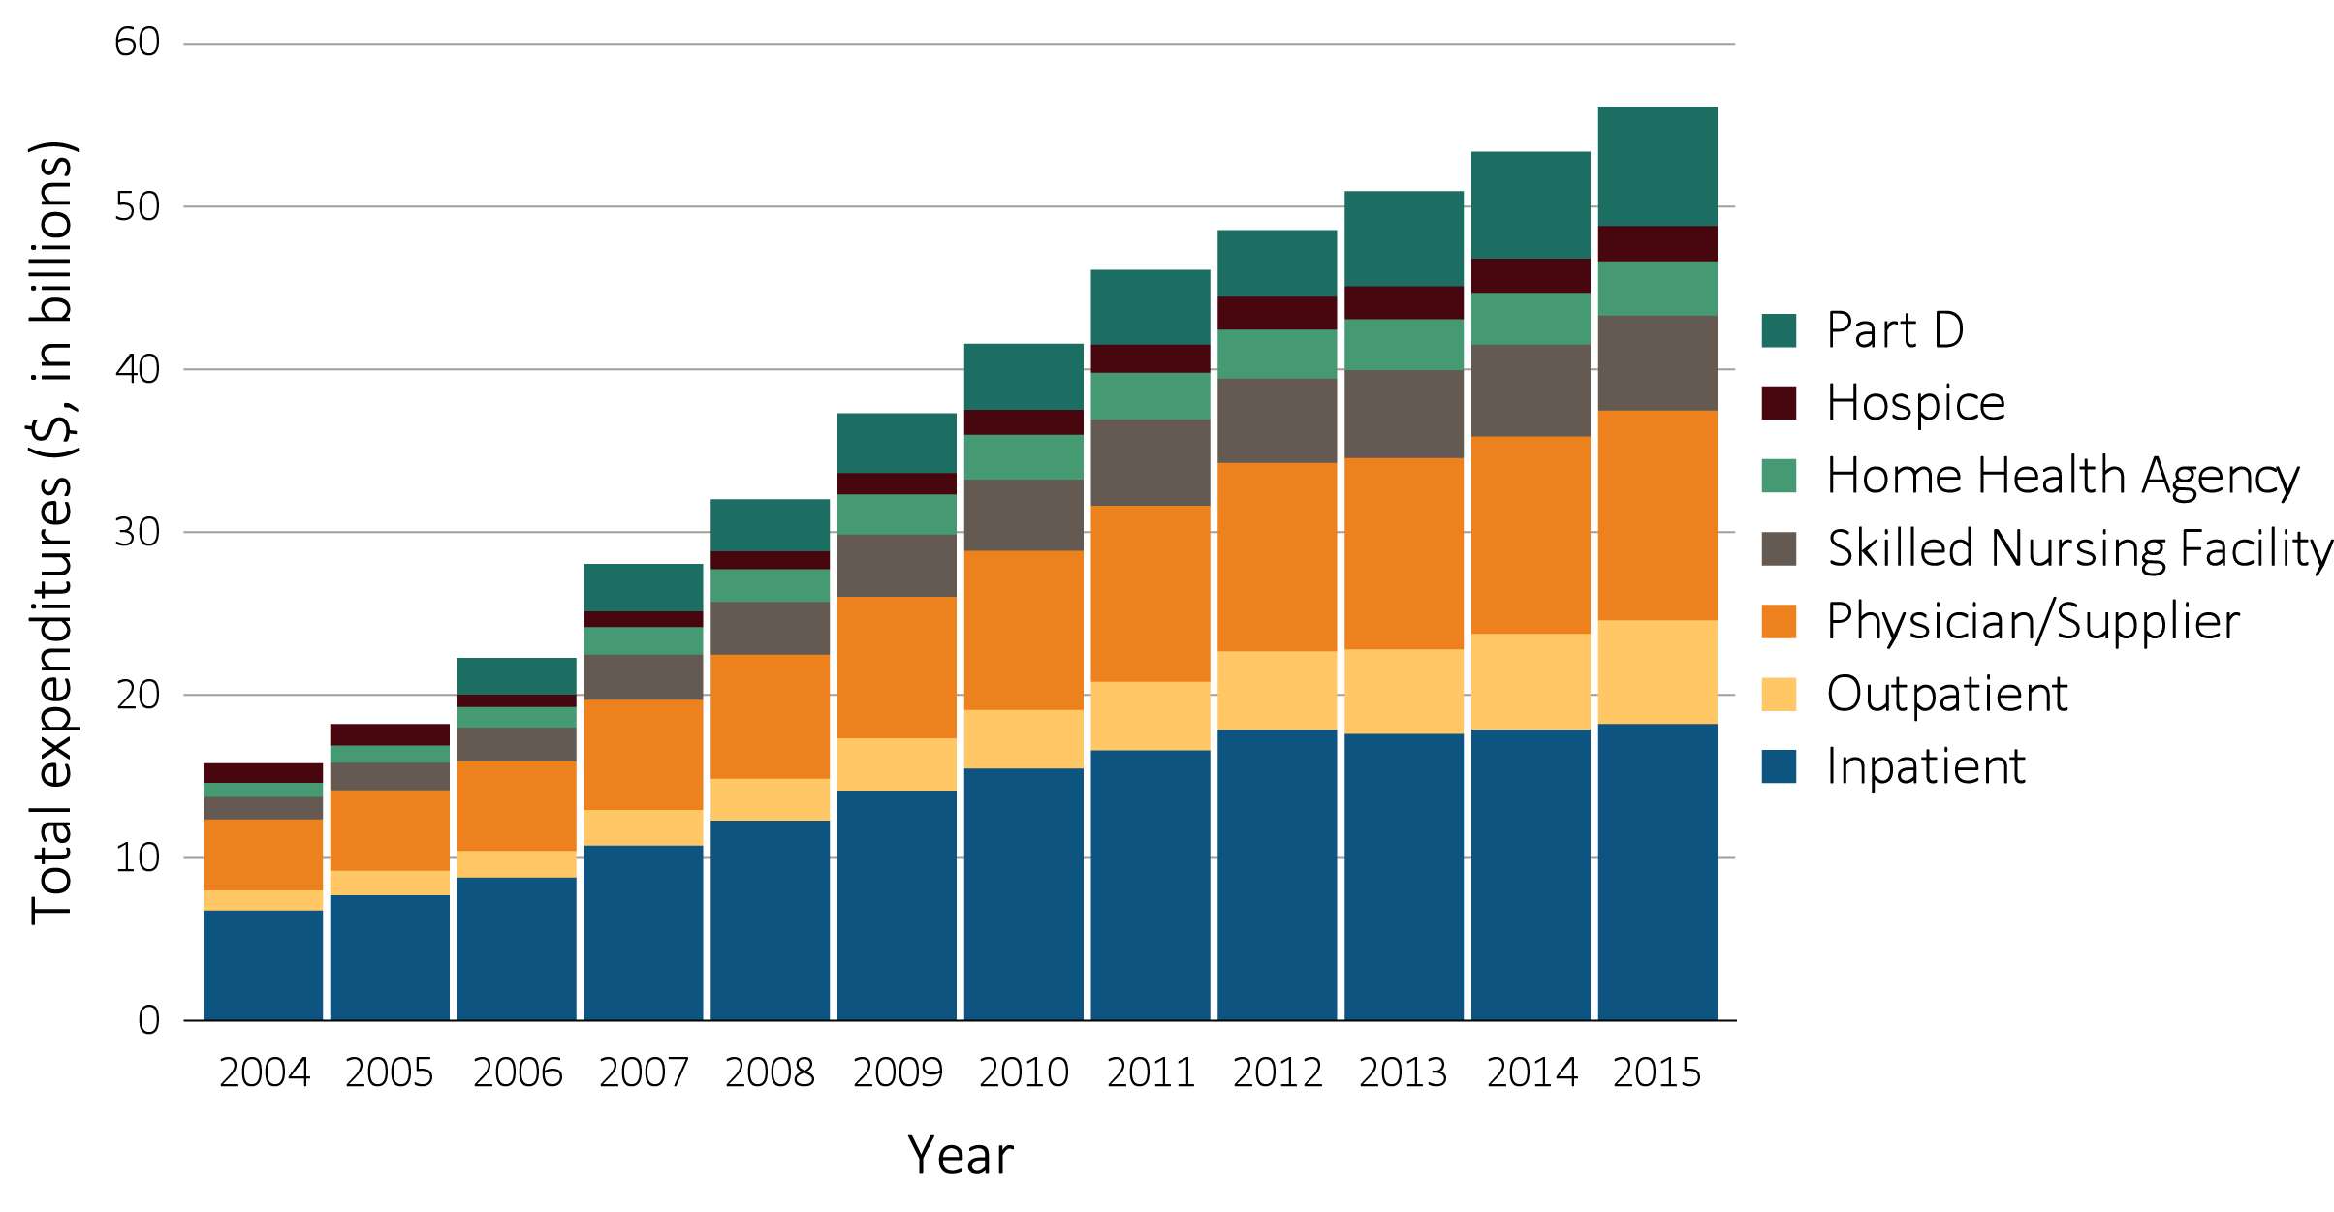
vol 1 Figure 6.4 Trends in total Medicare Parts A, B, and D fee-for-service spending for CKD patients aged 65 and older, by claim type, 2004-2015
Data source: Medicare 5% sample. Part D data occurring since 2006.

Slide 21
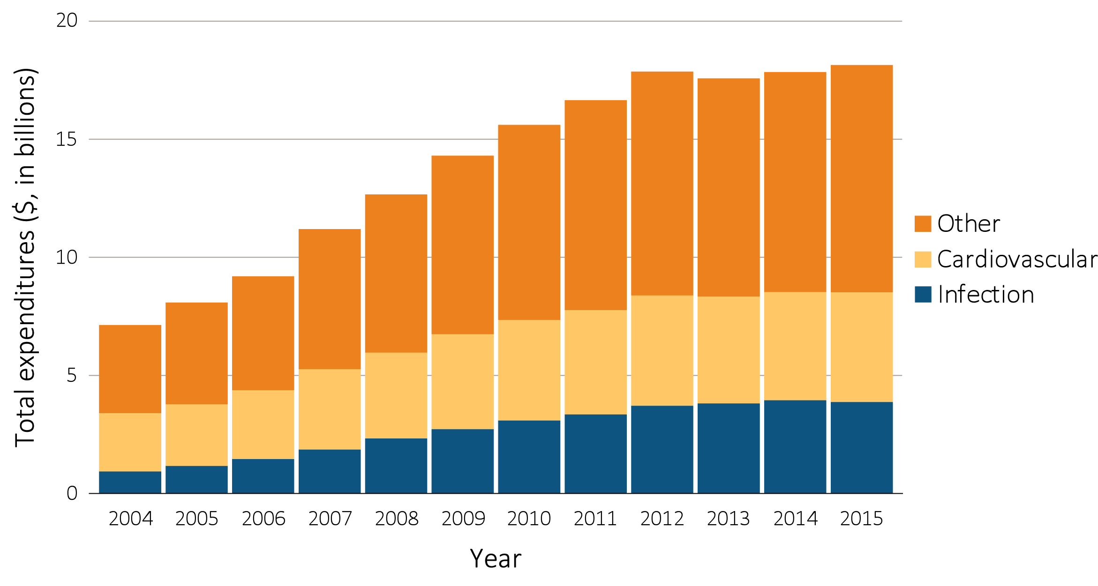
vol 1 Figure 6.5 Total Medicare fee-for-service inpatient spending for CKD patients aged 65 and older, by cause of hospitalization, 2004-2015
Data source: Medicare 5% sample. Part D data occurring since 2006.

Slide 22
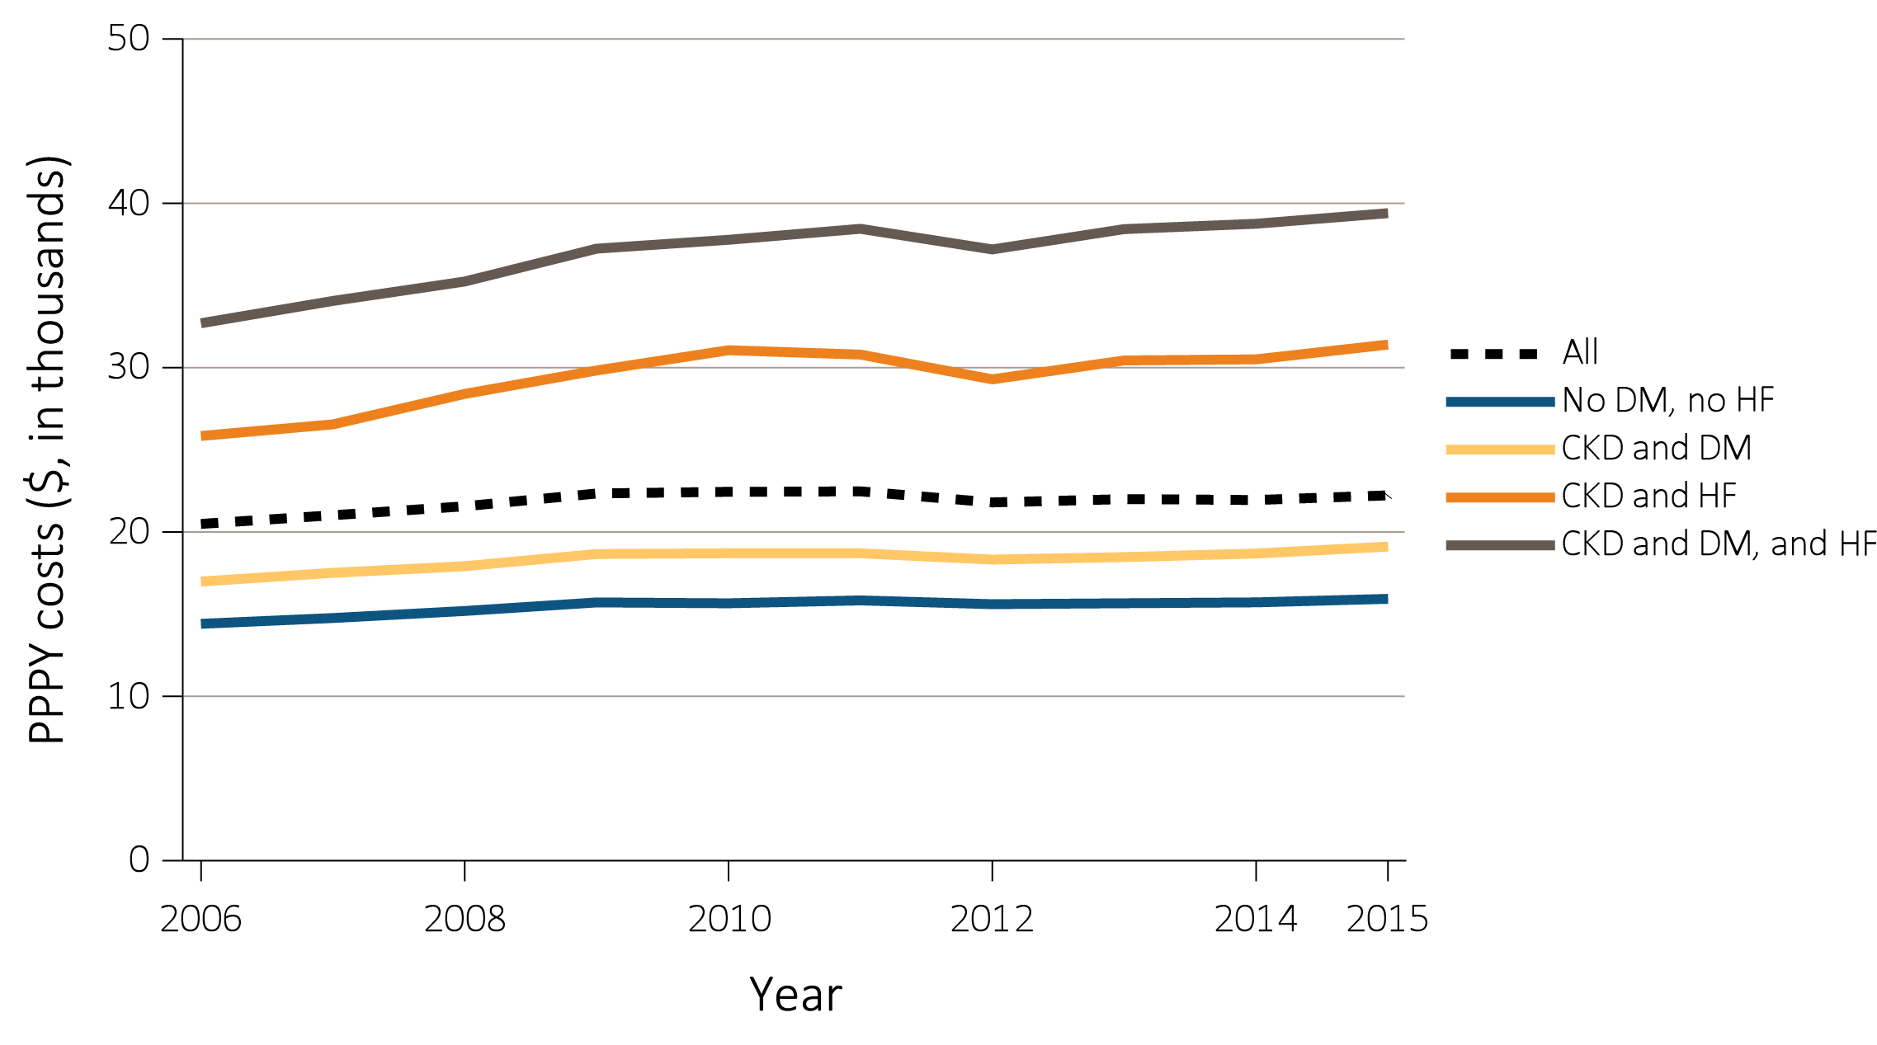
vol 1 Figure 6.6 Per person per year Medicare, Medicare advantage, and managed care spending for the CKD patients aged 65 and older, by diabetes and heart failure, 2006-2015
(a) Medicare fee-for-service
Data Source: Medicare 5% sample and Optum Clinformatics™. Abbreviations: CKD, chronic kidney disease; DM, diabetes mellitus; HF, heart failure; PPPY, per person per year. Due to the inconsistent data, PPPY costs for Medicare Advantage in 2006 are suppressed.

Slide 23
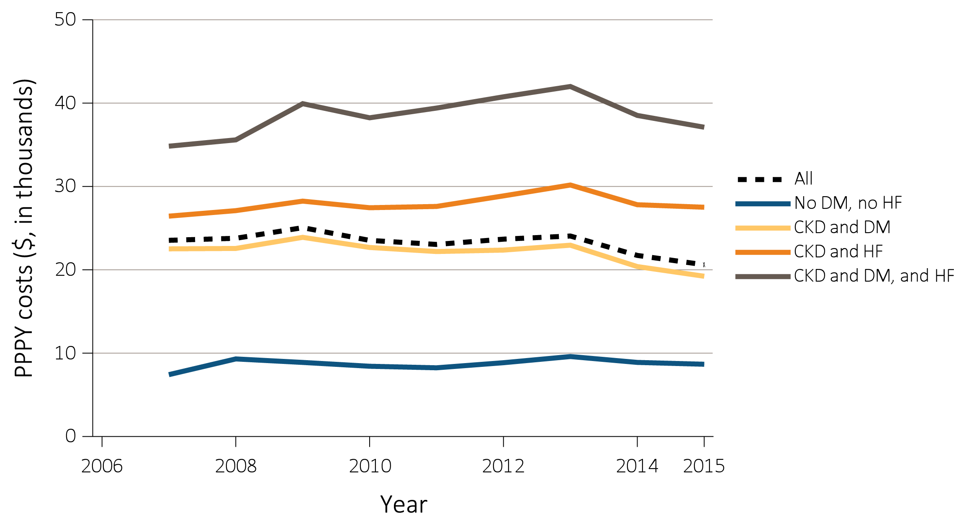
vol 1 Figure 6.6 Per person per year Medicare, Medicare advantage, and managed care spending for the CKD patients aged 65 and older, by diabetes and heart failure, 2006-2015
(b) Medicare Advantage
Data Source: Medicare 5% sample and Optum Clinformatics™. Abbreviations: CKD, chronic kidney disease; DM, diabetes mellitus; HF, heart failure; PPPY, per person per year. Due to the inconsistent data, PPPY costs for Medicare Advantage in 2006 are suppressed.

Slide 24
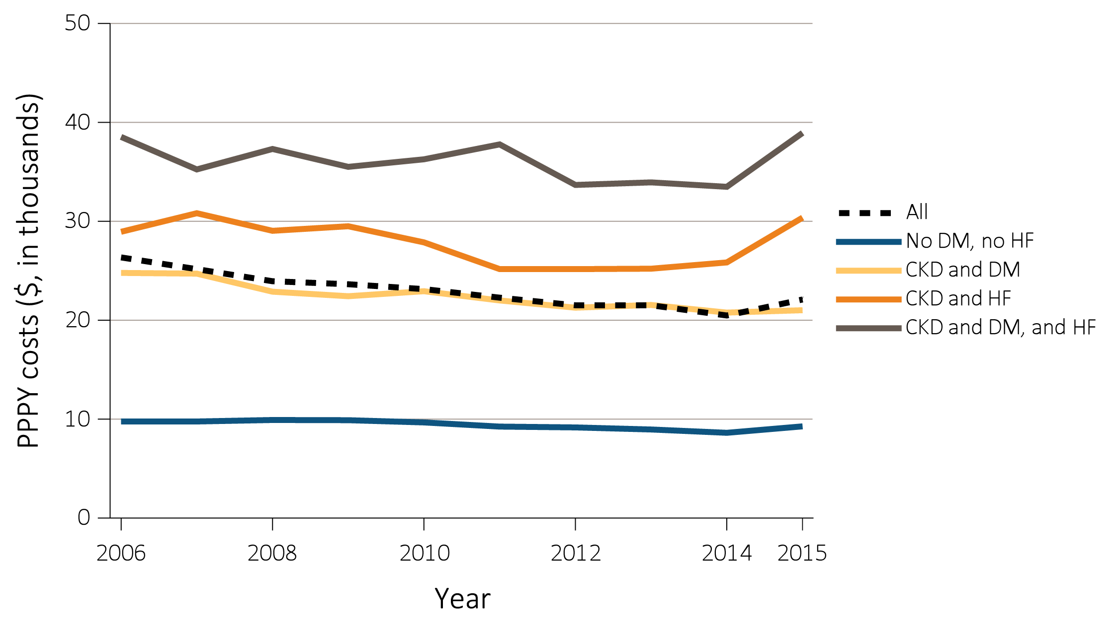
vol 1 Figure 6.6 Per person per year Medicare, Medicare advantage, and managed care spending for the CKD patients aged 65 and older, by diabetes and heart failure, 2006-2015
(c) Managed care
Data Source: Medicare 5% sample and Optum Clinformatics™. Abbreviations: CKD, chronic kidney disease; DM, diabetes mellitus; HF, heart failure; PPPY, per person per year. Due to the inconsistent data, PPPY costs for Medicare Advantage in 2006 are suppressed.

