Slide 1
2017 Annual Data Report
Volume 2: End-Stage Renal Disease
Chapter 10:
Prescription Drug Coverage in
Patients with ESRD

Slide 2
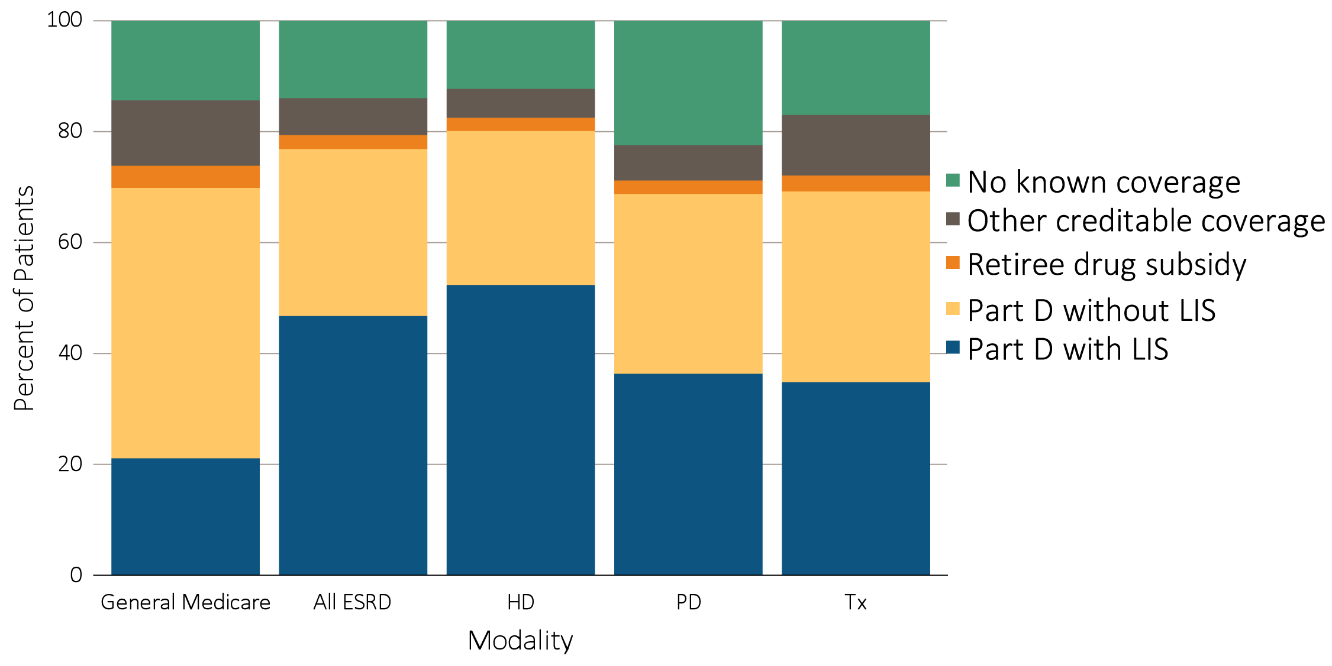
vol 2 Figure 10.1 Sources of prescription drug coverage in Medicare ESRD enrollees, by population, 2015
Data source: 2015 Medicare Data, point prevalent Medicare enrollees alive on January 1, 2015. Abbreviations: ESRD, end-stage renal disease; HD, hemodialysis; LIS, Low-income Subsidy; Part D, Medicare Part D prescription drug coverage; PD, peritoneal dialysis; Tx, kidney transplant.

Slide 3
vol 2 Table 10.1 Percentage of general Medicare & ESRD patients enrolled in Part D
 | General Medicare (%) | All ESRD (%) | Hemodialysis (%) | Peritoneal dialysis (%) | Transplant (%)
2011 | 60.1 | 69.4 | 73.3 | 61.2 | 59.0
2012 | 61.8 | 71.3 | 75.2 | 63.5 | 61.4
2013 | 67.2 | 75.2 | 78.9 | 67.2 | 66.0
2014 | 69.1 | 76.5 | 79.9 | 68.7 | 68.2
2015 | 70.4 | 77.4 | 80.7 | 69.3 | 69.7
Data source: 2011-2015 Medicare data, point prevalent Medicare enrollees alive on January 1. Medicare data: general Medicare, 5% Medicare sample (ESRD, hemodialysis, peritoneal dialysis, and transplant, 100% ESRD population). Abbreviations: ESRD, end-stage renal disease; Part D, Medicare Part D prescription drug coverage.

Slide 4
vol 2 Table 10.2 Medicare Part D parameters for defined standard benefit, 2010 & 2015
 | 2010 | 2015
Deductible | $310 | $320
After the deductible is met, the beneficiary pays 25% of total prescription costs up to the initial coverage limit.
Initial coverage limit | $2,830 | $2,960
The coverage gap (“donut hole”) begins at this point.
The beneficiary pays 100% of their prescription costs up to the out-of-pocket threshold
Out-of-pocket threshold | $4,550 | $4,700
The total out-of-pocket costs including the “donut hole”
Total covered Part D prescription out-of-pocket spending | $6,440.00 | $6,680.00
Catastrophic coverage begins after this point (including the coverage gap).
Catastrophic coverage benefit | $2.50 | *$2.65
Generic/preferred multi-source drug | $6.30 | *$6.60
Other drugs |  | plus a 55% brand-name medication discount
2015 Example:
$320 (deductible) | $310.00 | $320
+(($2960-$320)*25%) (initial coverage) | $630.00 | $660.00
+(($6680-$2960)*100%) (coverage gap) | $3,610.00 | $3,720.00
Total | $4,550.00 | $4,700.00
(maximum out-of-pocket costs prior to catastrophic coverage, excluding plan premium)
*The catastrophic coverage amount is the greater of 5% of medication cost or the values shown in the chart above. In 2015, beneficiaries were charged $2.65 for those generic or preferred multisource drugs with a retail price less than $53 and 5% for those with a retail price over $53. For brand name drugs, beneficiaries paid $6.6 for those drugs with a retail price less than $132 and 5% for those with a retail price over $132. Table adapted from http://www.q1medicare.com/PartD-The-2015-Medicare-Part-D-Outlook.php.

Slide 5
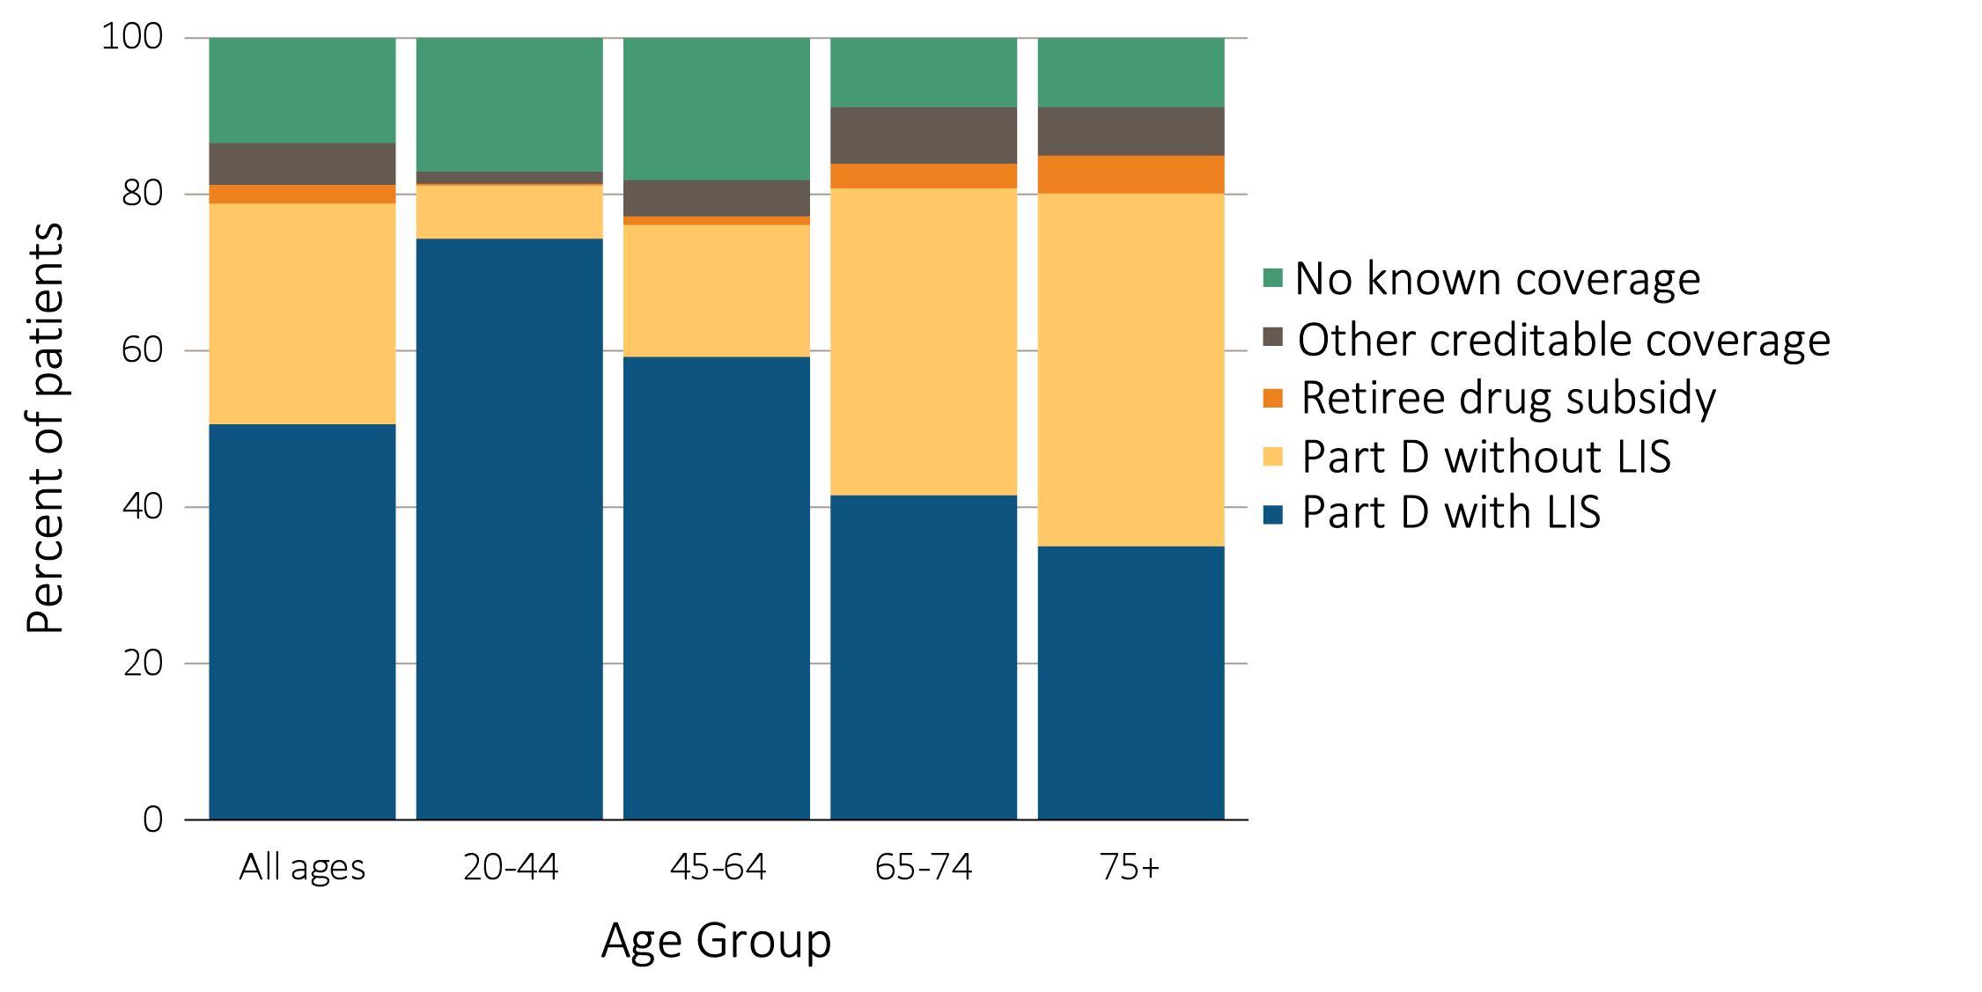
vol 2 Figure 10.2 Sources of prescription drug coverage in Medicare ESRD enrollees, by age & modality, 2015
(a) Dialysis patients
Data source: 2015 Medicare Data, point prevalent Medicare enrollees alive on January 1, 2015. Abbreviations: ESRD, end-stage renal disease; LIS, Low-income Subsidy; Part D, Medicare Part D prescription drug coverage. ESRD patients aged under 20 were not presented.

Slide 6
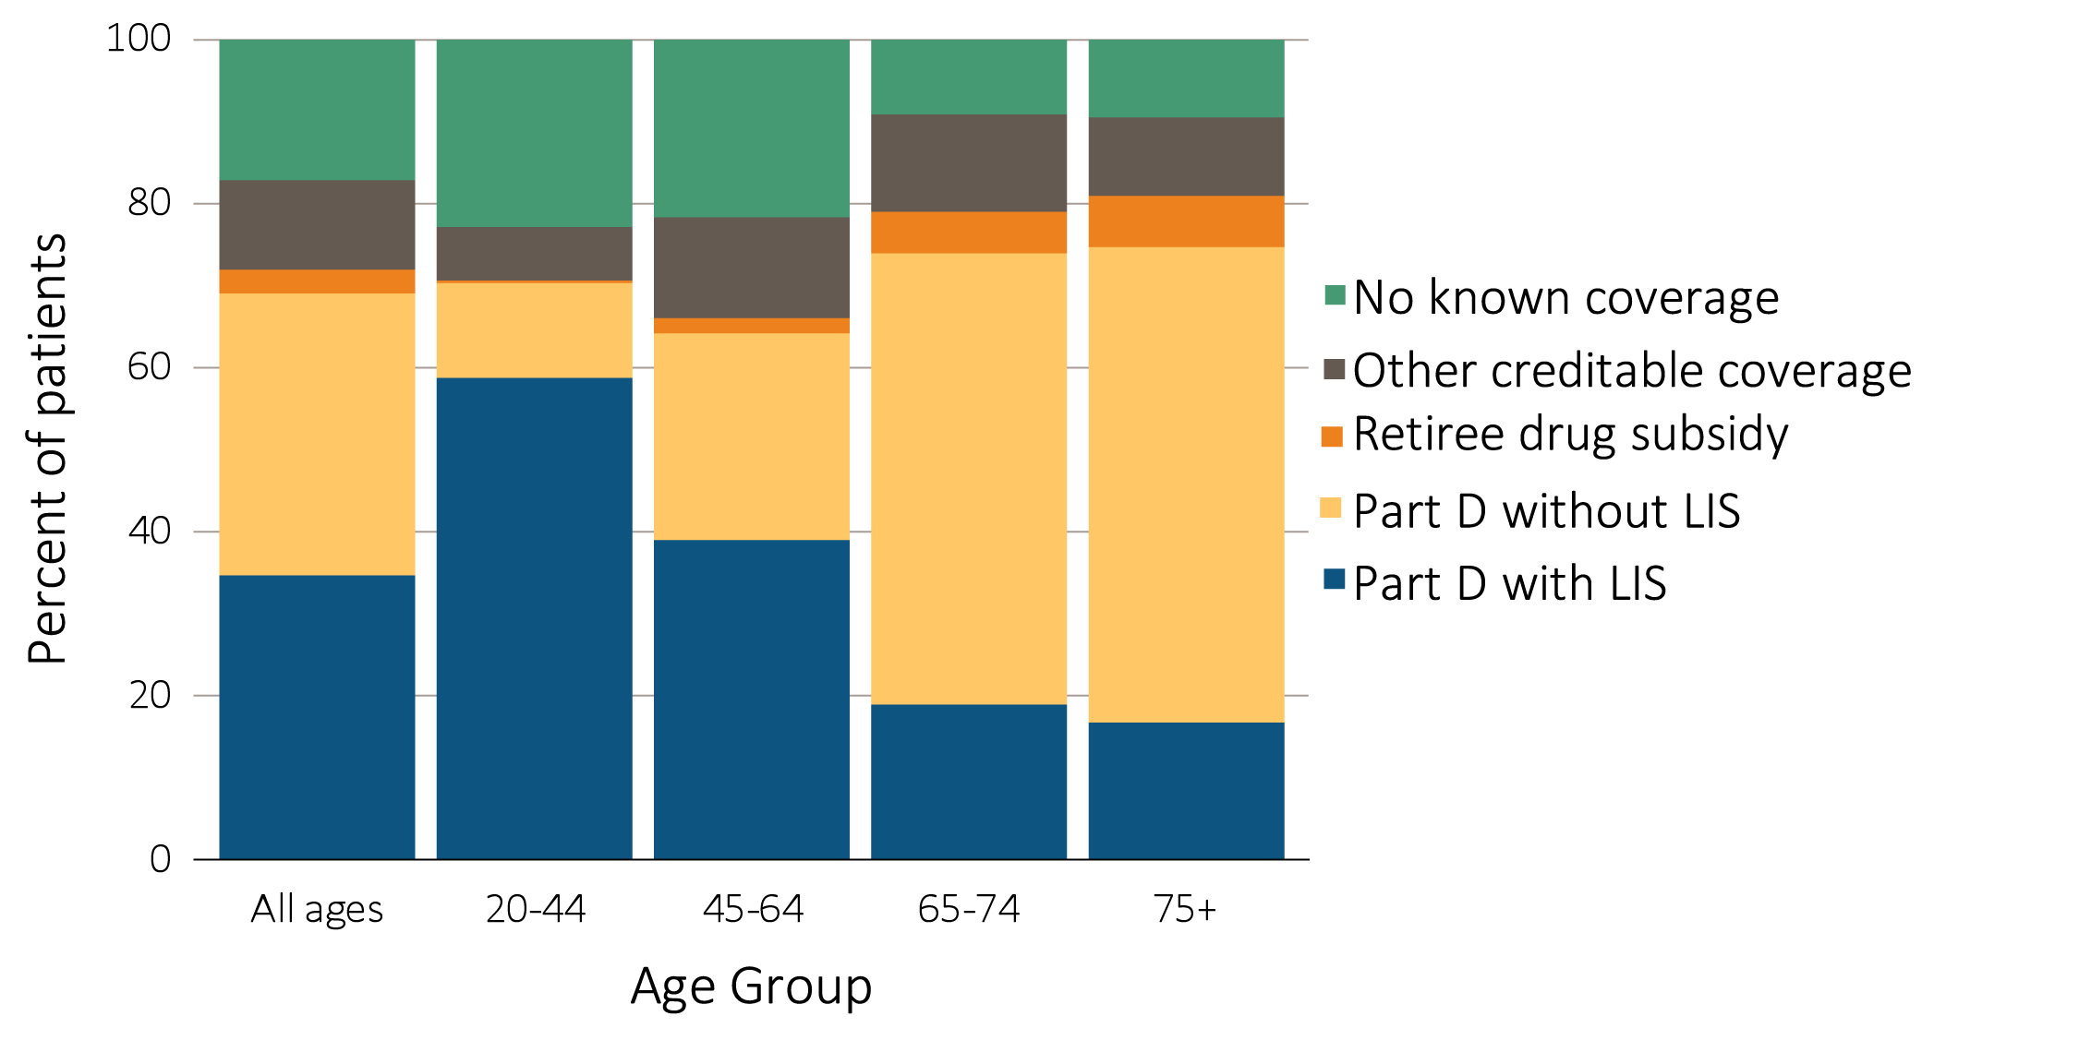
vol 2 Figure 10.2 Sources of prescription drug coverage in Medicare ESRD enrollees, by age & modality, 2015
(b) Transplant patients
Data source: 2015 Medicare Data, point prevalent Medicare enrollees alive on January 1, 2015. Abbreviations: ESRD, end-stage renal disease; LIS, Low-income Subsidy; Part D, Medicare Part D prescription drug coverage. ESRD patients aged under 20 were not presented.

Slide 7
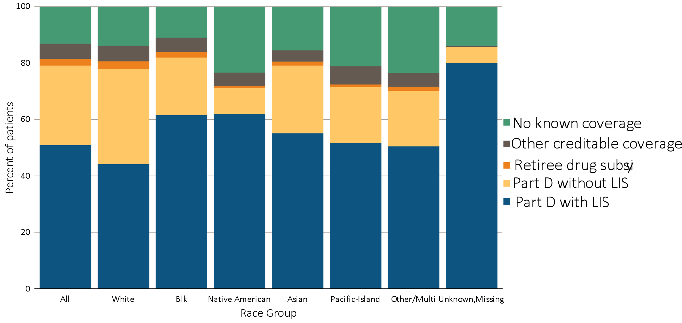
vol 2 Figure 10.3 Sources of prescription drug coverage in Medicare ESRD enrollees, by race/ethnicity & modality, 2015
(a) Dialysis patients
Data source: 2015 Medicare Data, point prevalent Medicare enrollees alive on January 1, 2015. Abbreviations: Blk/Af Am, Black or African American; ESRD, end-stage renal disease; LIS, Low-income Subsidy; Part D, Medicare Part D prescription drug coverage.

Slide 8
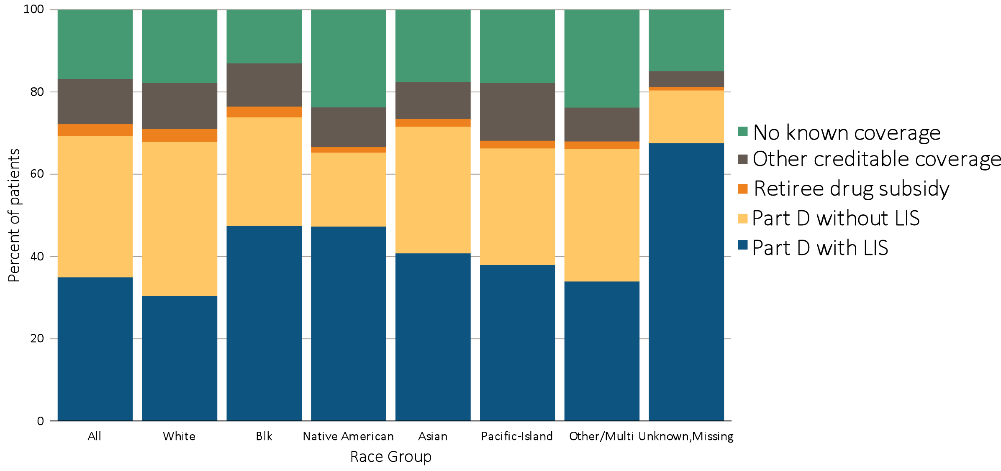
vol 2 Figure 10.3 Sources of prescription drug coverage in Medicare ESRD enrollees, by race/ethnicity & modality, 2015
(b) Transplant patients
Data source: 2015 Medicare Data, point prevalent Medicare enrollees alive on January 1, 2015. Abbreviations: Blk/Af Am, Black or African American; ESRD, end-stage renal disease; LIS, Low-income Subsidy; Part D, Medicare Part D prescription drug coverage.

Slide 9
vol 2 Table 10.3 Percentage of Medicare Part D enrollees with the Low-income Subsidy, by age & race, 2015
 | General Medicare (%) | All ESRD (%) | Hemodialysis (%) | Peritoneal dialysis (%) | Transplant (%)
White
All ages | 24.2 | 53.6 | 58.2 | 46.8 | 45.1
20-44 | 88.2 | 87.5 | 90.7 | 87.5 | 81.9
45-64 | 52.0 | 70.1 | 75.9 | 63.6 | 57.1
65-74 | 14.5 | 39.1 | 48.0 | 24.3 | 20.9
75+ | 18.4 | 33.5 | 37.1 | 17.5 | 18.0
Black/African American
All ages | 57.2 | 73.6 | 75.6 | 69.0 | 64.4
20-44 | 92.8 | 92.2 | 93.8 | 89.3 | 87.5
45-64 | 74.8 | 80.3 | 82.7 | 73.3 | 69.8
65-74 | 41.6 | 58.5 | 62.8 | 40.2 | 39.2
75+ | 48.5 | 58.6 | 60.5 | 35.1 | 38.9
Native American/Alaska Native
All ages | 68.0 | 84.4 | 87.7 | 80.5 | 72.6
20-44 | 92.7 | 93.1 | 94.7 | 92.4 | 85.0
45-64 | 82.2 | 88.2 | 90.5 | 80.8 | 81.6
65-74 | 55.4 | 75.8 | 81.6 | 63.8 | 55.5
75+ | 56.7 | 75.1 | 80.3 | 54.5 | 54.7
Asian
All ages | 62.9 | 66.8 | 72.0 | 54.3 | 57.2
20-44 | 90.5 | 86.4 | 89.4 | 83.6 | 83.1
45-64 | 65.0 | 71.8 | 77.3 | 55.5 | 65.4
65-74 | 53.7 | 56.9 | 64.7 | 40.1 | 43.7
75+ | 70.7 | 65.8 | 70.0 | 50.4 | 41.5
Hawaiian Native/Pacific Islander
All ages | n/a | 70.2 | 73.6 | 60.1 | 57.5
20-44 | n/a | 88.4 | 89.3 | 87.5 | 85.1
45-64 | n/a | 76.8 | 80.5 | 61.7 | 64.4
65-74 | n/a | 57.3 | 62.0 | 40.2 | 44.4
75+ | n/a | 62.1 | 65.3 | 56.3 | 29.4
Other/multiple race
All ages | 30.5 | 61.2 | 72.4 | 69.7 | 51.6
20-44 | 85.5 | 81.4 | 88.7 | 83.3 | 75.0
45-64 | 45.1 | 67.4 | 82.4 | 88.9 | 53.8
65-74 | 21.1 | 47.5 | 59.5 | 33.3 | 39.9
75+ | 33.8 | 45.7 | 56.3 | 25.0 | 32.8
Unknown/missing
All ages | 28.8 | 87.4 | 93.8 | 88.0 | 84.1
20-44 | 90.5 | 93.8 | 97.6 | 91.7 | 98.4
45-64 | 26.6 | 88.3 | 94.6 | 100.0 | 78.5
65-74 | 18.9 | 74.8 | 86.8 | 60.0 | 70.8
75+ | 79.8 | 85.0 | 83.3 | . | 90.0
Data source: 2015 Medicare data, point prevalent Medicare enrollees alive on January 1, 2015. Abbreviations: ESRD, end-stage renal disease; LIS, Low-income Subsidy; Part D, Medicare Part D prescription drug coverage. ESRD patients aged under 20 were not presented

Slide 10
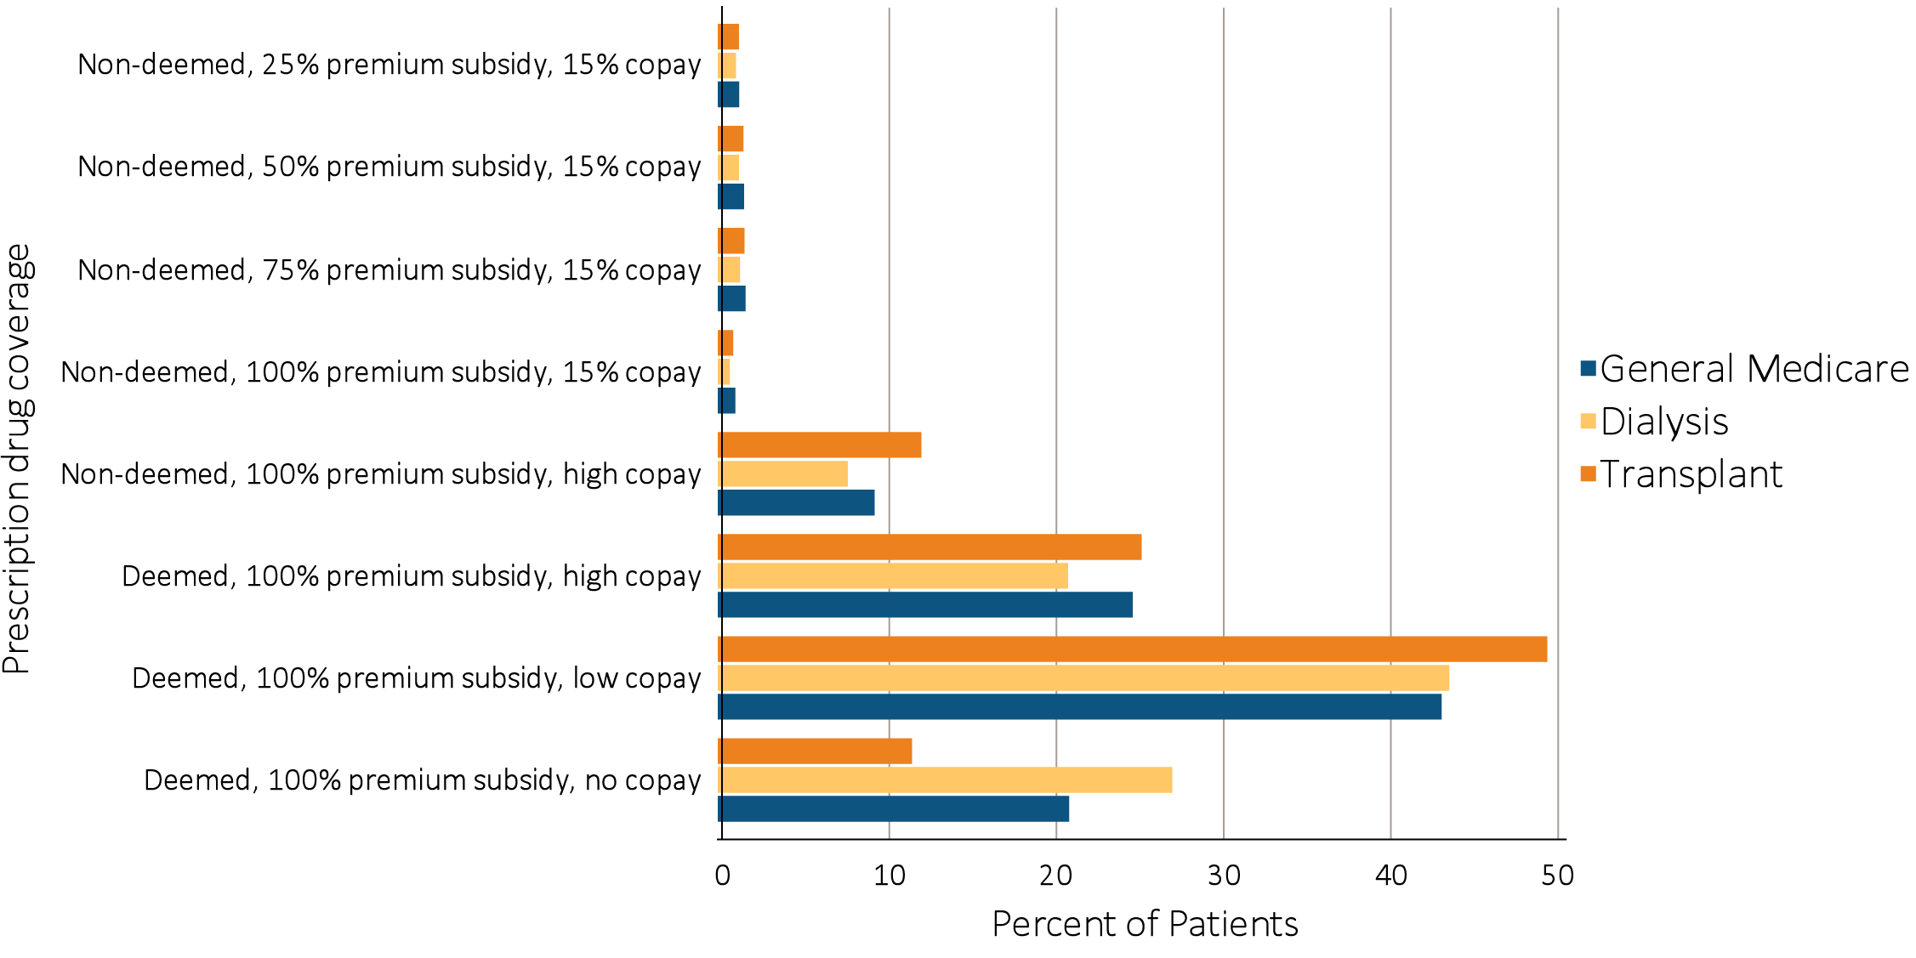
vol 2 Figure 10.4 Distribution of Low-income Subsidy categories in Part D general Medicare & ESRD patients, 2015
Data source: 2015 Medicare data, point prevalent Medicare enrollees alive on January 1, 2015. Abbreviations: ESRD, end-stage renal disease; Part D, Medicare Part D prescription drug coverage.

Slide 11
vol 2 Table 10.4 Total estimated Medicare Part D spending for enrollees, in billions, 2011-2015
 | General Medicare ($) | All ESRD ($) | Hemodialysis ($) | Peritoneal Dialysis ($) | Transplant ($)
2011 | 46.0 | 1.8 | 1.4 | 0.1 | 0.2
2012 | 40.1 | 2.0 | 1.6 | 0.1 | 0.3
2013 | 52.1 | 2.3 | 1.8 | 0.1 | 0.3
2014 | 58.1 | 2.7 | 2.1 | 0.2 | 0.4
2015 | 63.4 | 3.2 | 2.5 | 0.2 | 0.5
Data source: 2011-2015 Medicare data, period prevalent Medicare enrollees alive on January 1, excluding those in Medicare Advantage Part D plans and Medicare secondary payer, using as-treated actuarial model (see ESRD Methods chapter for analytical methods). Part D spending represents the sum of the Medicare covered amount and the Low-income Subsidy amount.

Slide 12
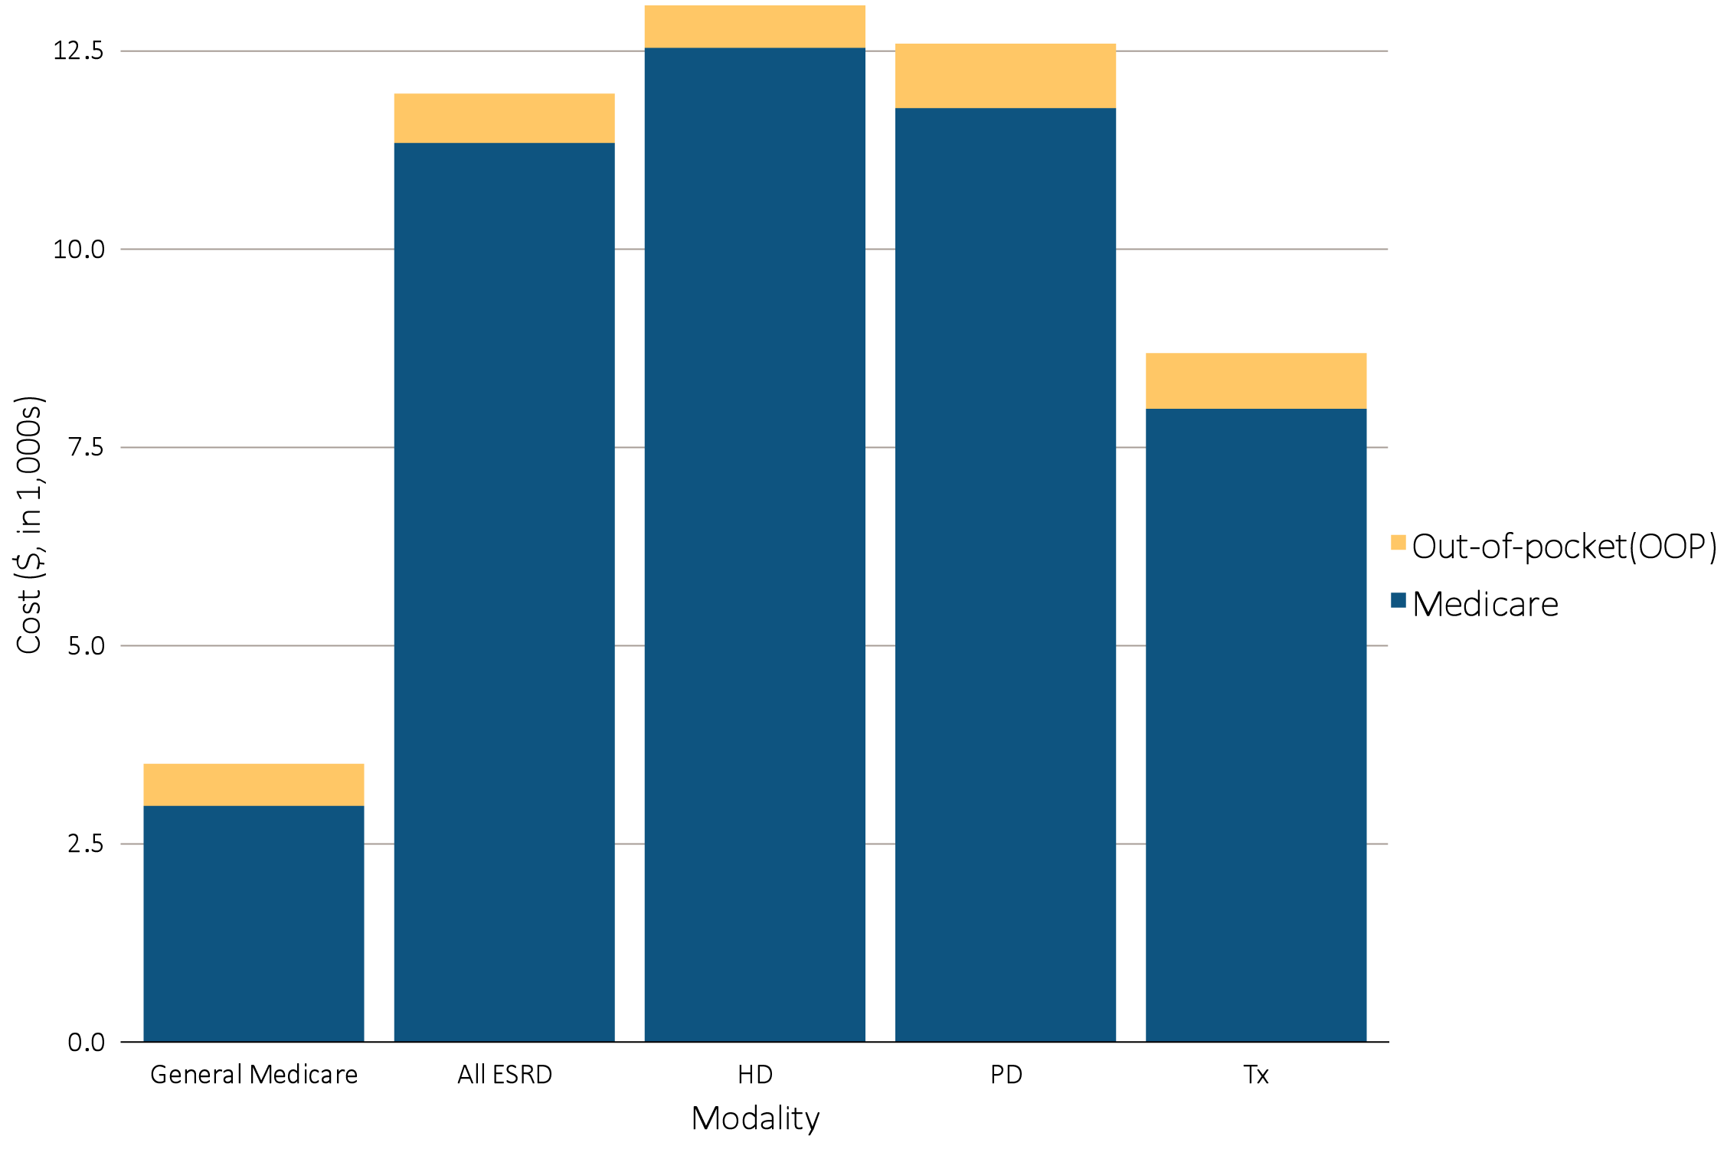
vol 2 Figure 10.5 Per person per year insurance & out-of-pocket costs for enrollees, 2015
(a) Medicare
Data source: Medicare Part D claims and Optum Clinformatics™ claims. Medicare totals include Part D claims for Part D enrollees with traditional Medicare (Parts A & B)., Costs are per person per year for calendar year 2015, using as-treated actuarial model (see ESRD Methods chapter for analytical methods). Part D spending represents the sum of the Medicare covered amount and the Low-income Subsidy amount.

Slide 13
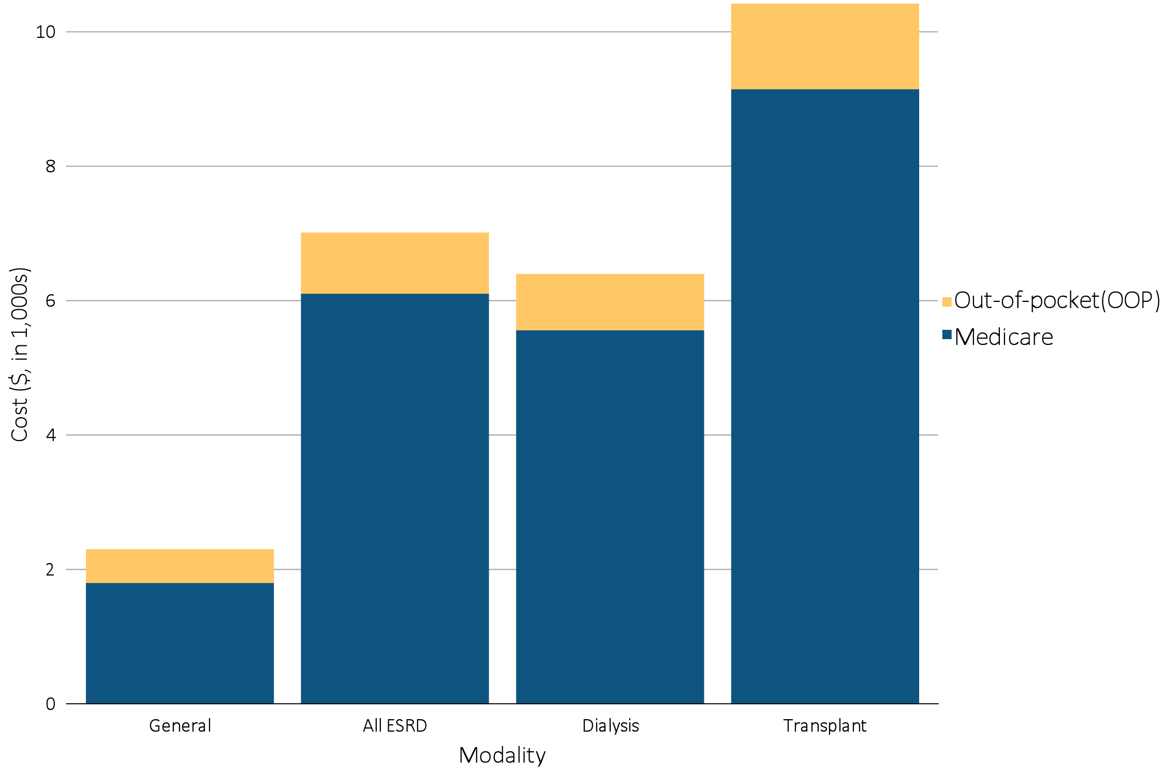
vol 2 Figure 10.5 Per person per year insurance & out-of-pocket costs for enrollees, 2015
(b) Medicare Advantage
Data source: Medicare Part D claims and Optum Clinformatics™ claims. Medicare totals include Part D claims for Part D enrollees with traditional Medicare (Parts A & B)., Costs are per person per year for calendar year 2015, using as-treated actuarial model (see ESRD Methods chapter for analytical methods). Part D spending represents the sum of the Medicare covered amount and the Low-income Subsidy amount.

Slide 14
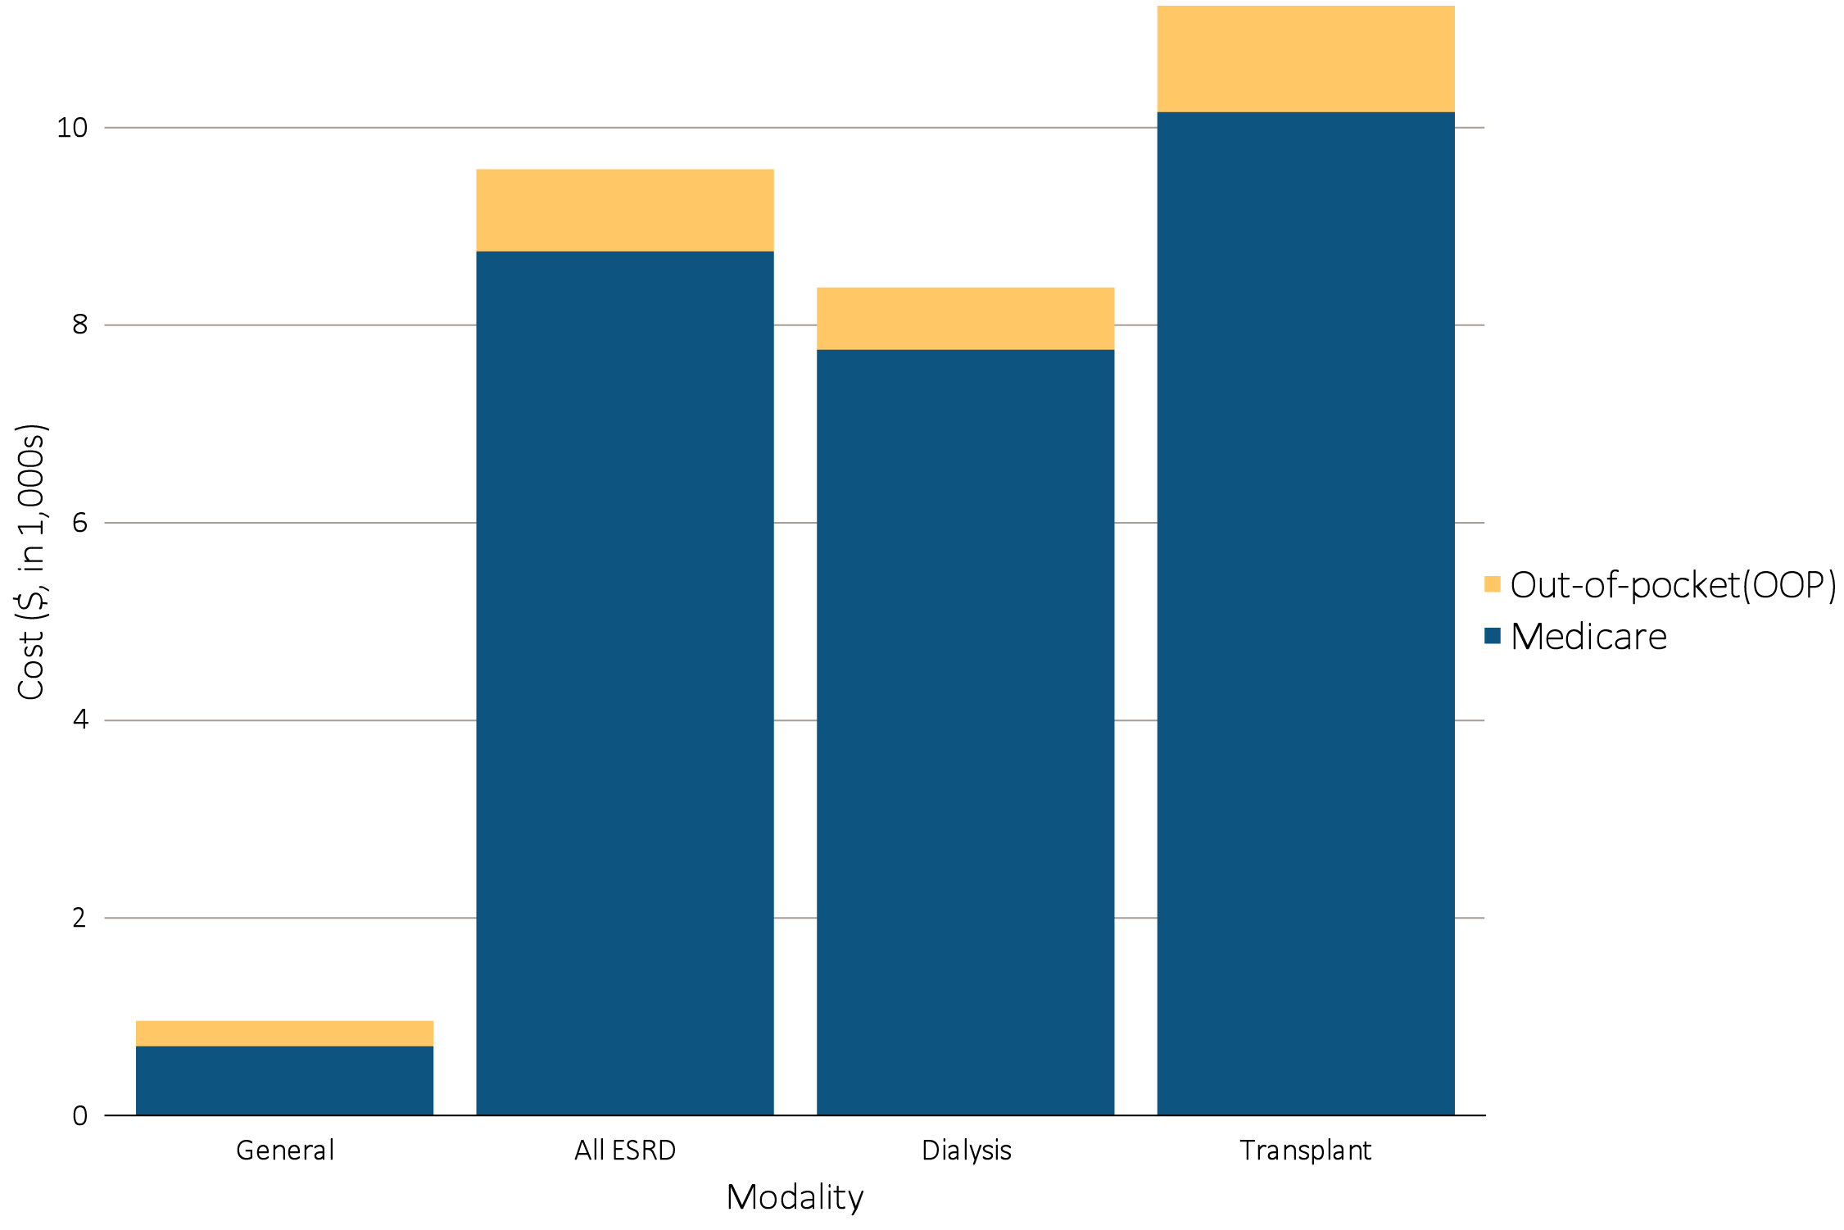
vol 2 Figure 10.5 Per person per year insurance & out-of-pocket costs for enrollees, 2015
(c) Managed Care
Data source: Medicare Part D claims and Optum Clinformatics™ claims. Medicare totals include Part D claims for Part D enrollees with traditional Medicare (Parts A & B)., Costs are per person per year for calendar year 2015, using as-treated actuarial model (see ESRD Methods chapter for analytical methods). Part D spending represents the sum of the Medicare covered amount and the Low-income Subsidy amount.

Slide 15
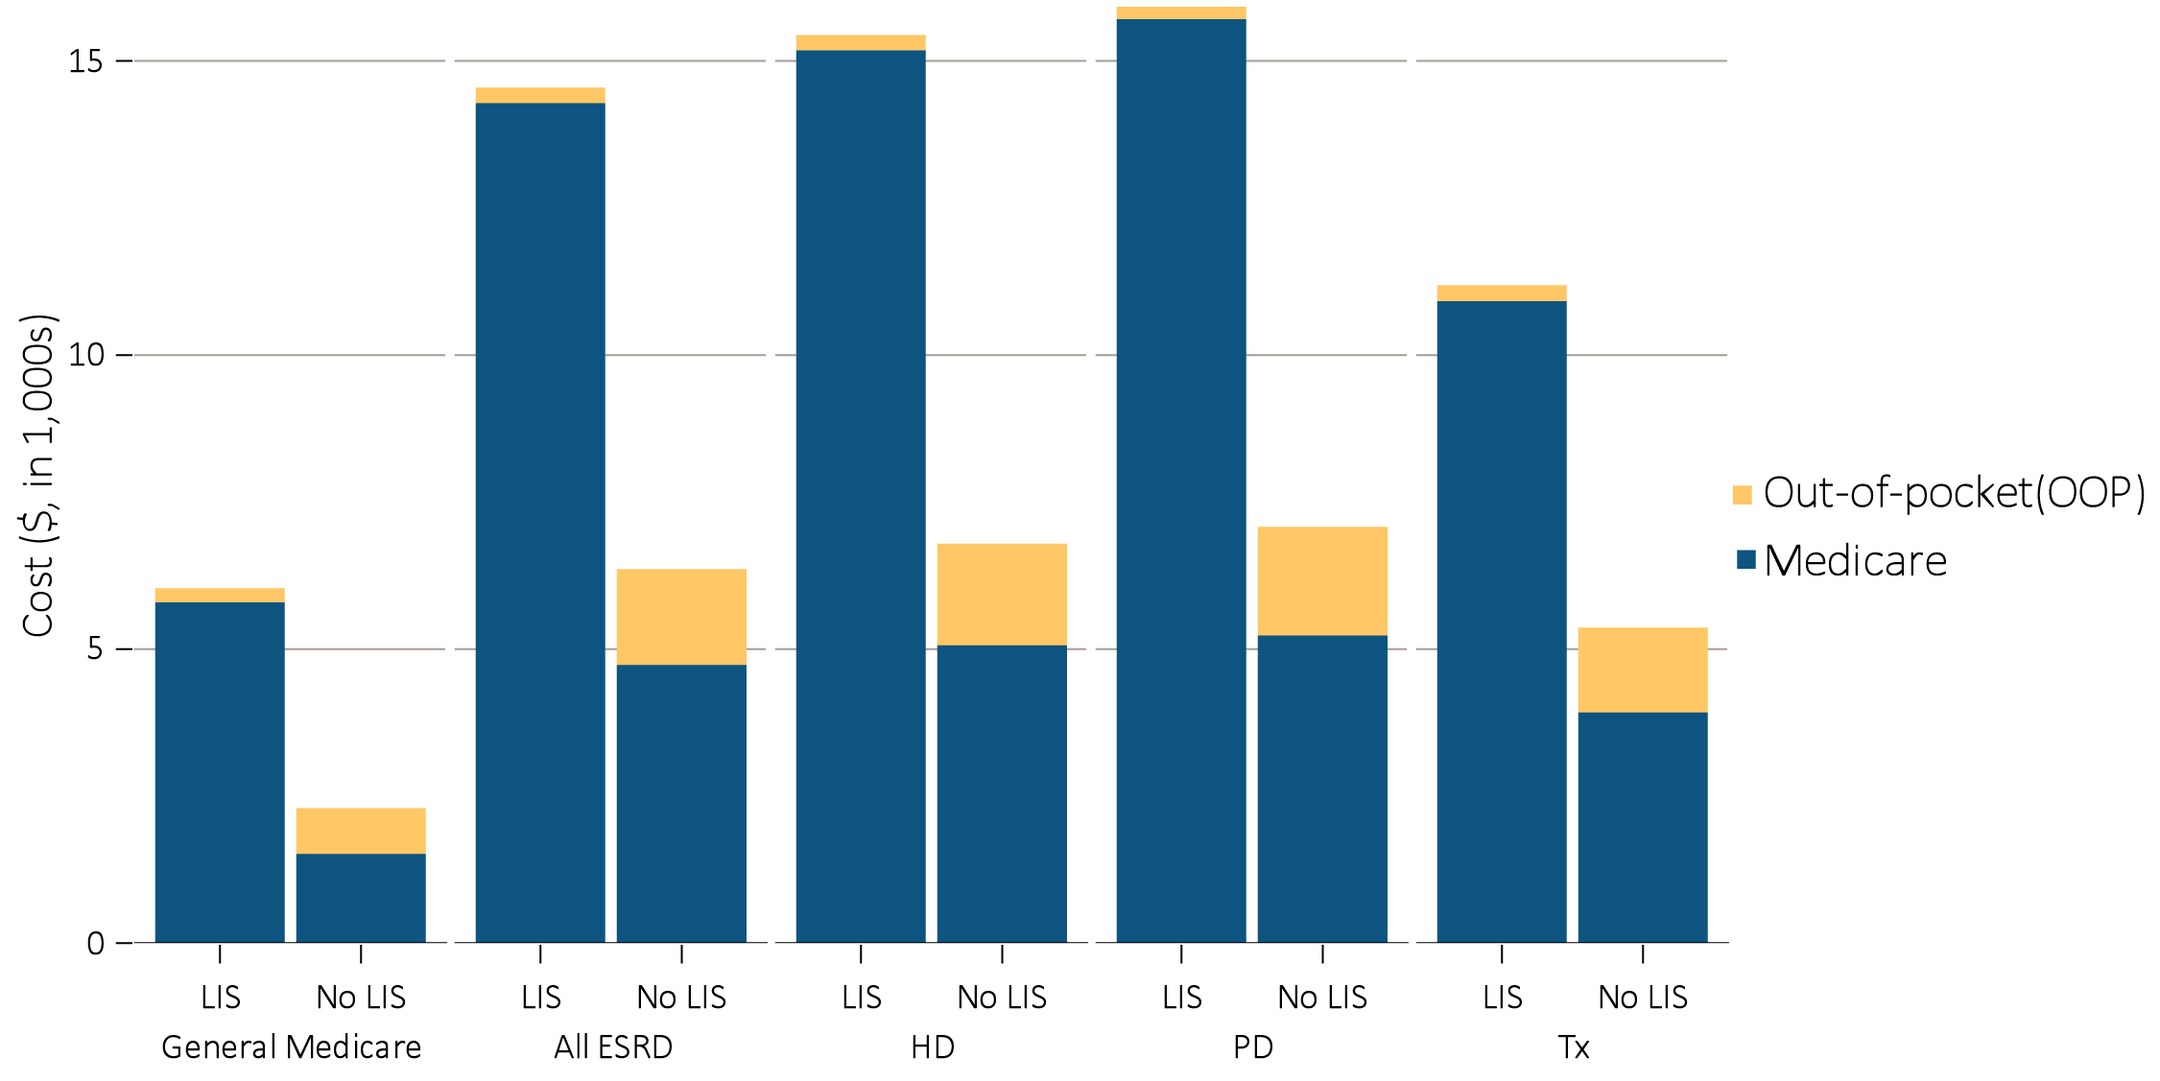
vol 2 Figure 10.5 Per person per year insurance & out-of-pocket costs for enrollees, 2015
(d) Medicare by Low-income Subsidy status
Data source: Medicare Part D claims and Optum Clinformatics™ claims. Medicare totals include Part D claims for Part D enrollees with traditional Medicare (Parts A & B)., Costs are per person per year for calendar year 2015, using as-treated actuarial model (see ESRD Methods chapter for analytical methods). Part D spending represents the sum of the Medicare covered amount and the Low-income Subsidy amount.

Slide 16
vol 2 Table 10.5 Per person per year insurance spending for enrollees, 2015 (continued)
(a) Medicare
 | General ($) |  |  | All ESRD ($) |  |  | Hemodialysis ($) |  |  | Peritoneal dialysis ($) |  |  | Transplant ($)
 | Part D with LIS | Part D without LIS |  | Part D with LIS | Part D without LIS |  | Part D with LIS | Part D without LIS |  | Part D with LIS | Part D without LIS |  | Part D with LIS | Part D without LIS
Age
All | 5,877 | 1,600 |  | 14,364 | 4,812 |  | 15,263 | 5,146 |  | 15,791 | 5,311 |  | 10,995 | 4,006
20-44 | 5,839 | 2,510 |  | 14,574 | 4,670 |  | 16,584 | 5,994 |  | 16,000 | 5,091 |  | 9,433 | 3,027
45-64 | 7,909 | 2,934 |  | 15,623 | 5,675 |  | 16,549 | 5,944 |  | 16,321 | 5,720 |  | 12,027 | 4,856
65-74 | 4,965 | 1,514 |  | 12,993 | 4,947 |  | 13,605 | 5,472 |  | 13,572 | 5,640 |  | 10,645 | 3,928
75+ | 4,208 | 1,461 |  | 10,601 | 3,819 |  | 11,179 | 4,077 |  | 10,647 | 4,277 |  | 7,435 | 2,882
Sex
Male | 6,028 | 1,756 |  | 14,689 | 4,955 |  | 15,551 | 5,138 |  | 16,636 | 5,317 |  | 11,615 | 4,411
Female | 5,771 | 1,484 |  | 13,997 | 4,596 |  | 14,945 | 5,159 |  | 15,030 | 5,302 |  | 10,172 | 3,384
Race
White | 6,029 | 1,586 |  | 13,941 | 4,732 |  | 15,107 | 5,167 |  | 16,183 | 5,343 |  | 10,351 | 3,813
Black/African American | 6,090 | 1,873 |  | 15,068 | 5,061 |  | 15,612 | 5,082 |  | 15,053 | 5,119 |  | 12,463 | 4,931
Native American/Alaska Native | 4,774 | 2,605 |  | 9,218 | 4,533 |  | 9,204 | 5,185 |  | 11,767 | 4,355 |  | 8,438 | 3,607
Asian | 4,637 | 1,268 |  | 14,511 | 5,031 |  | 15,575 | 5,622 |  | 16,953 | 5,640 |  | 10,895 | 4,144
Native Hawaiian/Pacific-Islander | NA | NA |  | 14,898 | 4,085 |  | 15,685 | 3,929 |  | 17,203 | 4,875 |  | 9,126 | 4,053
Other race | 4,973 | 1,599 |  | 12,478 | 4,856 |  | 14,175 | 6,161 |  | 12,446 | 4,726 |  | 10,868 | 4,397
Unknown/missing | 4,723 | 1,534 |  | 13,829 | 3,347 |  | 15,155 | 3,870 |  | 20,957 | 33,966 |  | 10,907 | 4,149
Data source: Medicare Part D claims and Optum Clinformatics™ claims. Costs are per person per year for calendar year 2015, using as-treated actuarial model (see ESRD Methods chapter for analytical methods). Part D spending represents the sum of the Medicare covered amount and the Low-income Subsidy amount.

Slide 17
vol 2 Table 10.5 Per person per year insurance spending for enrollees, 2015 (continued)
(b) Medicare Advantage
 | General ($) | All ESRD ($) | All Dialysis ($) | Transplant ($)
Age
All | 1,836 | 6,139 | 5,596 | 9,181
20-44 | 4,849 | 14,168 | 10,725 | 20,641
45-64 | 4,928 | 10,035 | 9,228 | 12,295
65-74 | 1,563 | 5,893 | 5,619 | 7,093
75+ | 1,421 | 4,125 | 4,050 | 5,387
Sex
Male | 1,836 | 5,932 | 5,186 | 9,915
Female | 1,836 | 6,376 | 6,057 | 8,265
Race
White | 1,855 | 5,738 | 5,249 | 8,305
Black/African American | 2,678 | 7,477 | 6,701 | 13,897
Asian | 1,842 | 7,805 | 7,176 | 11,468
Unknown | 1,689 | 5,590 | 5,321 | 6,756
Data source: Medicare Part D claims and Optum Clinformatics™ claims. Costs are per person per year for calendar year 2015, using as-treated actuarial model (see ESRD Methods chapter for analytical methods). Part D spending represents the sum of the Medicare covered amount and the Low-income Subsidy amount.

Slide 18
vol 2 Table 10.5 Per person per year insurance spending for enrollees, 2015
(c) Managed care
 | General ($) | All ESRD ($) | All Dialysis ($) | Transplant ($)
Age
All | 744 | 8,790 | 7,794 | 10,199
20-44 | 504 | 7,434 | 6,665 | 8,135
45-64 | 1,233 | 9,173 | 8,384 | 10,310
65-74 | 2,018 | 8,686 | 7,892 | 10,609
75+ | 2,711 | 5,792 | 5,466 | 8,616
Sex
Male | 738 | 9,147 | 8,206 | 10,540
Female | 749 | 8,260 | 7,148 | 9,718
Race
White | 773 | 9,093 | 8,191 | 10,178
Black/African American | 693 | 7,871 | 6,890 | 11,141
Asian | 413 | 8,009 | 7,701 | 8,395
Unknown | 764 | 8,909 | 7,051 | 10,592
Data source: Medicare Part D claims and Optum Clinformatics™ claims. Costs are per person per year for calendar year 2015, using as-treated actuarial model (see ESRD Methods chapter for analytical methods). Part D spending represents the sum of the Medicare covered amount and the Low-income Subsidy amount.

Slide 19
vol 2 Table 10.6 Top 15 drug classes received by ESRD cohorts in different health plans, by modality, 2015 (continued)
 | Hemodialysis |  | Peritoneal Dialysis |  | Transplant
Rank | Drug class | % | Drug class | % | Drug class | %
1 | Ion-removing agents | 71.2 | Ion-removing agents | 61.7 | Antibacterials | 74.3
2 | β-adrenergic blocking agents | 63.7 | β-adrenergic blocking agents | 60.3 | β-Adrenergic blocking agents | 63.0
3 | Antibacterials | 58.7 | Antibacterials | 58.6 | Antiulcer agents and acid suppressants | 59.6
4 | Analgesics and antipyretics | 58.4 | Analgesics and antipyretics | 47.5 | Lipid-lowering agents | 56.6
5 | Lipid-lowering agents | 49.6 | Lipid-lowering agents | 47.3 | Calcium-channel blocking agents | 50.3
6 | Calcium-channel blocking agents | 47.7 | Calcium-channel blocking agents | 46.3 | Analgesics and antipyretics | 49.2
7 | Antiulcer agents and acid suppressants | 46.9 | Renin-angiotensin-aldosterone system inhibitors | 42.8 | Adrenals | 47.0
8 | Renin-angiotensin-aldosterone system inhibitors | 38.5 | Antiulcer agents and acid suppressants | 39.7 | Antidiabetic agents | 39.1
9 | Antidiabetic agents | 37.1 | Antidiabetic agents | 33.5 | Renin-angiotensin-aldosterone system inhibitors | 36.3
10 | Hypotensive agents | 32.5 | Anti-infectives | 33.5 | Diuretics | 33.5
11 | Psychotherapeutic agents | 31.7 | Diuretics | 32.7 | Psychotherapeutic agents | 25.3
12 | Anticonvulsants | 31.4 | Hypotensive agents | 27.2 | Antivirals | 24.8
13 | Cinacalcet | 30.9 | Psychotherapeutic agents | 27.2 | Diabetic consumables | 24.6
14 | Antithrombotic agents | 30.2 | Cinacalcet | 25.6 | Anticonvulsants | 22.3
15 | Anxiolytics, sedatives, and hypnotics | 26.8 | Replacement preparations | 25.1 | Anti-infectives | 20.4
(a) Medicare
Data source: Medicare Part D claims and Optum Clinformatics™ claims. Ion-removing agents include phosphate-binding agents, potassium-binding agents, etc. Hypotension agents include alpha-2-agonist and vasodilators. Diabetic consumables refer to blood glucose test strips, blood glucose meters/sensors, lancets, needles, pen needles, etc.

Slide 20
vol 2 Table 10.6 Top 15 drug classes received by ESRD cohorts in different health plans, by modality, 2015 (continued)
(b) Medicare Advantage
 | Dialysis |  | Transplant
Rank | Drug class | % | Drug class | %
1 | β-adrenergic blocking agents | 44.8 | Immunosuppressive agents | 48.0
2 | Lipid-lowering agents | 41.0 | Antibacterials | 40.9
3 | Analgesics and antipyretics | 40.4 | Adrenals | 38.8
4 | Antibacterials | 40.2 | β-adrenergic blocking agents | 35.5
5 | Ion-removing agents | 37.2 | Lipid-lowering agents | 34.8
6 | Calcium-channel Blocking agents | 35.2 | Antiulcer agents and acid suppressants | 29.4
7 | Antiulcer agents and acid suppressants | 31.5 | Calcium-channel Blocking agents | 28.0
8 | Antidiabetic agents | 29.1 | Analgesics and antipyretics | 27.8
9 | Diuretics | 26.8 | Renin-angiotensin-aldosterone system inhibitors | 25.1
10 | Renin-angiotensin-aldosterone system inhibitors | 26.7 | Antidiabetic agents | 24.4
11 | Diabetic consumables | 24.8 | Diabetic consumables | 23.3
12 | Antithrombotic agents | 22.5 | Diuretics | 20.2
13 | Hypotensive agents | 22.0 | Psychotherapeutic agents | 15.6
14 | Psychotherapeutic agents | 21.9 | Antithrombotic agents | 14.5
15 | Anticonvulsants | 20.1 | Anticonvulsants | 13.9
Data source: Medicare Part D claims and Optum Clinformatics™ claims. Ion-removing agents include phosphate-binding agents, potassium-binding agents, etc. Hypotension agents include alpha-2-agonist and vasodilators. Diabetic consumables refer to blood glucose test strips, blood glucose meters/sensors, lancets, needles, pen needles, etc.

Slide 21
vol 2 Table 10.6 Top 15 drug classes received by ESRD cohorts in different health plans, by modality, 2015
(c) Managed Care
 | Dialysis |  | Transplant
Rank | Drug class | % | Drug class | %
1 | Ion-removing agents | 44.0 | Immunosuppressive agents | 52.8
2 | β-adrenergic blocking agents | 42.6 | Antibacterials | 43.8
3 | Analgesics and antipyretics | 37.8 | Adrenals | 39.3
4 | Antibacterials | 36.6 | β-adrenergic blocking agents | 32.0
5 | Calcium-channel Blocking agents | 35.7 | Lipid-lowering agents | 30.2
6 | Lipid-lowering agents | 31.3 | Calcium-channel Blocking agents | 26.0
7 | Renin-angiotensin-aldosterone system inhibitors | 28.5 | Renin-angiotensin-aldosterone system inhibitors | 25.8
8 | Antidiabetic agents | 24.3 | Analgesics and antipyretics | 25.6
9 | Diuretics | 24.0 | Antiulcer agents and acid suppressants | 20.6
10 | Hypotensive agents | 22.9 | Antidiabetic agents | 15.3
11 | Vitamin D | 20.0 | Diuretics | 14.3
12 | Antiulcer agents and acid suppressants | 19.7 | Vitamin D | 13.1
13 | Diabetic consumables | 18.9 | Diabetic consumables | 13.0
14 | Antithrombotic agents | 14.9 | Anxiolytics, sedatives, and hypnotics | 11.9
15 | Anxiolytics, sedatives, and hypnotics | 14.5 | Psychotherapeutic agents | 11.7
Data source: Medicare Part D claims and Optum Clinformatics™ claims. Ion-removing agents include phosphate-binding agents, potassium-binding agents, etc. Hypotension agents include alpha-2-agonist and vasodilators. Diabetic consumables refer to blood glucose test strips, blood glucose meters/sensors, lancets, needles, pen needles, etc.

Slide 22
vol 2 Table 10.7 Top 15 drug classes received by different ESRD cohorts, by modality and insurance spending, 2015 (continued)
(a) Medicare
 | Hemodialysis |  |  | Peritoneal Dialysis |  |  | Transplant
Rank | Drug class | Costs | % | Drug class | Costs | % | Drug class | Costs | %
1 | Ion-removing agents | $1,005.1 | 40.7 | Ion-removing agents | $83.3 | 41.7 | Antivirals | $152.0 | 33.4
2 | Cinacalcet | $546.0 | 22.1 | Cinacalcet | $41.8 | 20.9 | Antidiabetic agents | $76.2 | 16.8
3 | Antidiabetic agents | $192.0 | 7.8 | Antidiabetic agents | $20.2 | 10.1 | Cinacalcet | $40.3 | 8.9
4 | Antivirals | $135.3 | 5.5 | Antivirals | $11.1 | 5.5 | Immunosuppressive agents | $21.8 | 4.8
5 | Antineoplastic agents | $57.8 | 2.3 | Antineoplastic agents | $4.4 | 2.2 | Antiulcer agents and acid suppressants | $11.9 | 2.6
6 | Antiulcer agents and acid suppressants | $35.1 | 1.4 | Lipid-lowering agents | $3.0 | 1.5 | Lipid-lowering agents | $11.8 | 2.6
7 | Analgesics and antipyretics | $32.2 | 1.3 | Antiulcer agents and acid suppressants | $2.4 | 1.2 | Adrenocortical Insufficiency | $8.5 | 1.9
8 | Lipid-lowering agents | $31.9 | 1.3 | Antibacterials | $2.1 | 1.1 | Antibacterials | $7.7 | 1.7
9 | Psychotherapeutic agents | $26.6 | 1.1 | Analgesics and antipyretics | $1.6 | 0.8 | Hematopoietic agents | $7.4 | 1.6
10 | Vasodilating agents | $26.4 | 1.1 | Serums | $1.5 | 0.8 | Antineoplastic agents | $7.0 | 1.5
11 | Antibacterials | $26.3 | 1.1 | Pituitary | $1.5 | 0.8 | Psychotherapeutic agents | $7.0 | 1.5
12 | Anticonvulsants | $25.2 | 1.0 | Vasodilating agents | $1.4 | 0.7 | Serums | $6.4 | 1.4
13 | Caloric agents | $23.7 | 1.0 | Anticonvulsants | $1.4 | 0.7 | Anticonvulsants | $6.2 | 1.4
14 | Anti-inflammatory agents | $20.5 | 0.8 | Psychotherapeutic agents | $1.3 | 0.6 | Analgesics and antipyretics | $5.8 | 1.3
15 | Antithrombotic agents | $15.2 | 0.6 | β-adrenergic blocking agents | $1.1 | 0.6 | Antithrombotic agents | $4.7 | 1.0
Data source: Medicare Part D claims and Optum Clinformatics™ claims. Part D spending represents the sum of the Medicare covered amount and the Low-income Subsidy amount. Ion-removing agents include phosphate-binding agents, potassium-binding agents, etc. Hypotension agents include alpha-2-agonists and vasodilators. Diabetic consumables refer to blood glucose test strips, blood glucose meters/sensors, lancets, needles, pen needles, etc.

Slide 23
vol 2 Table 10.7 Top 15 drug classes received by different ESRD cohorts, by modality and insurance spending, 2015 (continued)
(b) Medicare Advantage
 | Dialysis |  |  | Transplant
Rank | Drug class | Costs | % | Drug class | Costs | %
1 | Ion-removing agents | $13.9 | 27.4 | Immunosuppressive agents | $5.2 | 34.8
2 | Cinacalcet | $7.3 | 14.3 | Antivirals | $2.8 | 19.0
3 | Antidiabetic agents | $5.2 | 10.3 | Antidiabetic agents | $1.3 | 8.8
4 | Antineoplastic agents | $2.2 | 4.3 | Cinacalcet | $1.3 | 8.4
5 | Diabetic consumables | $1.9 | 3.7 | Diabetic consumables | $0.5 | 3.5
6 | Antivirals | $1.7 | 3.4 | Ion-removing agents | $0.4 | 2.8
7 | Lipid-lowering agents | $1.6 | 3.2 | Lipid-lowering agents | $0.3 | 2.2
8 | Vasodilating agents | $1.2 | 2.3 | Antithrombotic agents | $0.2 | 1.3
9 | Analgesics and antipyretics | $1.0 | 1.9 | Antiulcer agents and acid suppressants | $0.2 | 1.3
10 | Antiulcer agents and acid suppressants | $0.8 | 1.6 | Antibacterials | $0.2 | 1.3
11 | Calcium-channel Blocking agents | $0.7 | 1.5 | Psychotherapeutic agents | $0.2 | 1.1
12 | Psychotherapeutic agents | $0.7 | 1.5 | Analgesics and antipyretics | $0.2 | 1.0
13 | Anti-inflammatory agents | $0.7 | 1.4 | Calcium-channel Blocking agents | $0.1 | 0.9
14 | Antibacterials | $0.7 | 1.4 | Serums | $0.1 | 0.9
15 | Hypotensive agents | $0.7 | 1.4 | β-adrenergic blocking agents | $0.1 | 0.8
Data source: Medicare Part D claims and Optum Clinformatics™ claims. Part D spending represents the sum of the Medicare covered amount and the Low-income Subsidy amount. Ion-removing agents include phosphate-binding agents, potassium-binding agents, etc. Hypotension agents include alpha-2-agonists and vasodilators. Diabetic consumables refer to blood glucose test strips, blood glucose meters/sensors, lancets, needles, pen needles, etc.

Slide 24
vol 2 Table 10.7 Top 15 drug classes received by different ESRD cohorts, by modality and insurance spending, 2015
(c) Managed Care
 | Dialysis |  |  | Transplant | Costs
Rank | Drug class | Costs | % | Drug class |  | %
1 | Ion-removing agents | $8.4 | 35.6 | Immunosuppressive agents | $9.4 | 43.2
2 | Cinacalcet | $3.2 | 13.7 | Antivirals | $3.4 | 15.9
3 | Antidiabetic agents | $2.4 | 10.3 | Cinacalcet | $1.5 | 6.7
4 | Antineoplastic agents | $1.2 | 5.0 | Antidiabetic agents | $1.4 | 6.4
5 | Antivirals | $1.1 | 4.8 | Ion-removing agents | $1.0 | 4.4
6 | Immunosuppressive agents | $0.7 | 3.0 | Lipid-lowering agents | $0.4 | 2.1
7 | Diabetic consumables | $0.5 | 2.2 | Hematopoietic agents | $0.4 | 1.8
8 | Lipid-lowering agents | $0.5 | 2.2 | Antibacterials | $0.4 | 1.6
9 | Antibacterials | $0.3 | 1.3 | Diabetic consumables | $0.3 | 1.6
10 | Vasodilating agents | $0.3 | 1.3 | Antithrombotic agents | $0.2 | 1.0
11 | Calcium-channel Blocking agents | $0.3 | 1.3 | Pituitary | $0.2 | 1.0
12 | Hypotensive agents | $0.3 | 1.2 | β-adrenergic blocking agents | $0.2 | 0.8
13 | Hematopoietic agents | $0.3 | 1.1 | Calcium-channel Blocking agents | $0.2 | 0.7
14 | Analgesics and antipyretics | $0.3 | 1.1 | Antifungals | $0.2 | 0.7
15 | β-adrenergic blocking agents | $0.3 | 1.1 | Psychotherapeutic agents | $0.2 | 0.7
Data source: Medicare Part D claims and Optum Clinformatics™ claims. Part D spending represents the sum of the Medicare covered amount and the Low-income Subsidy amount. Ion-removing agents include phosphate-binding agents, potassium-binding agents, etc. Hypotension agents include alpha-2-agonists and vasodilators. Diabetic consumables refer to blood glucose test strips, blood glucose meters/sensors, lancets, needles, pen needles, etc.

Slide 25
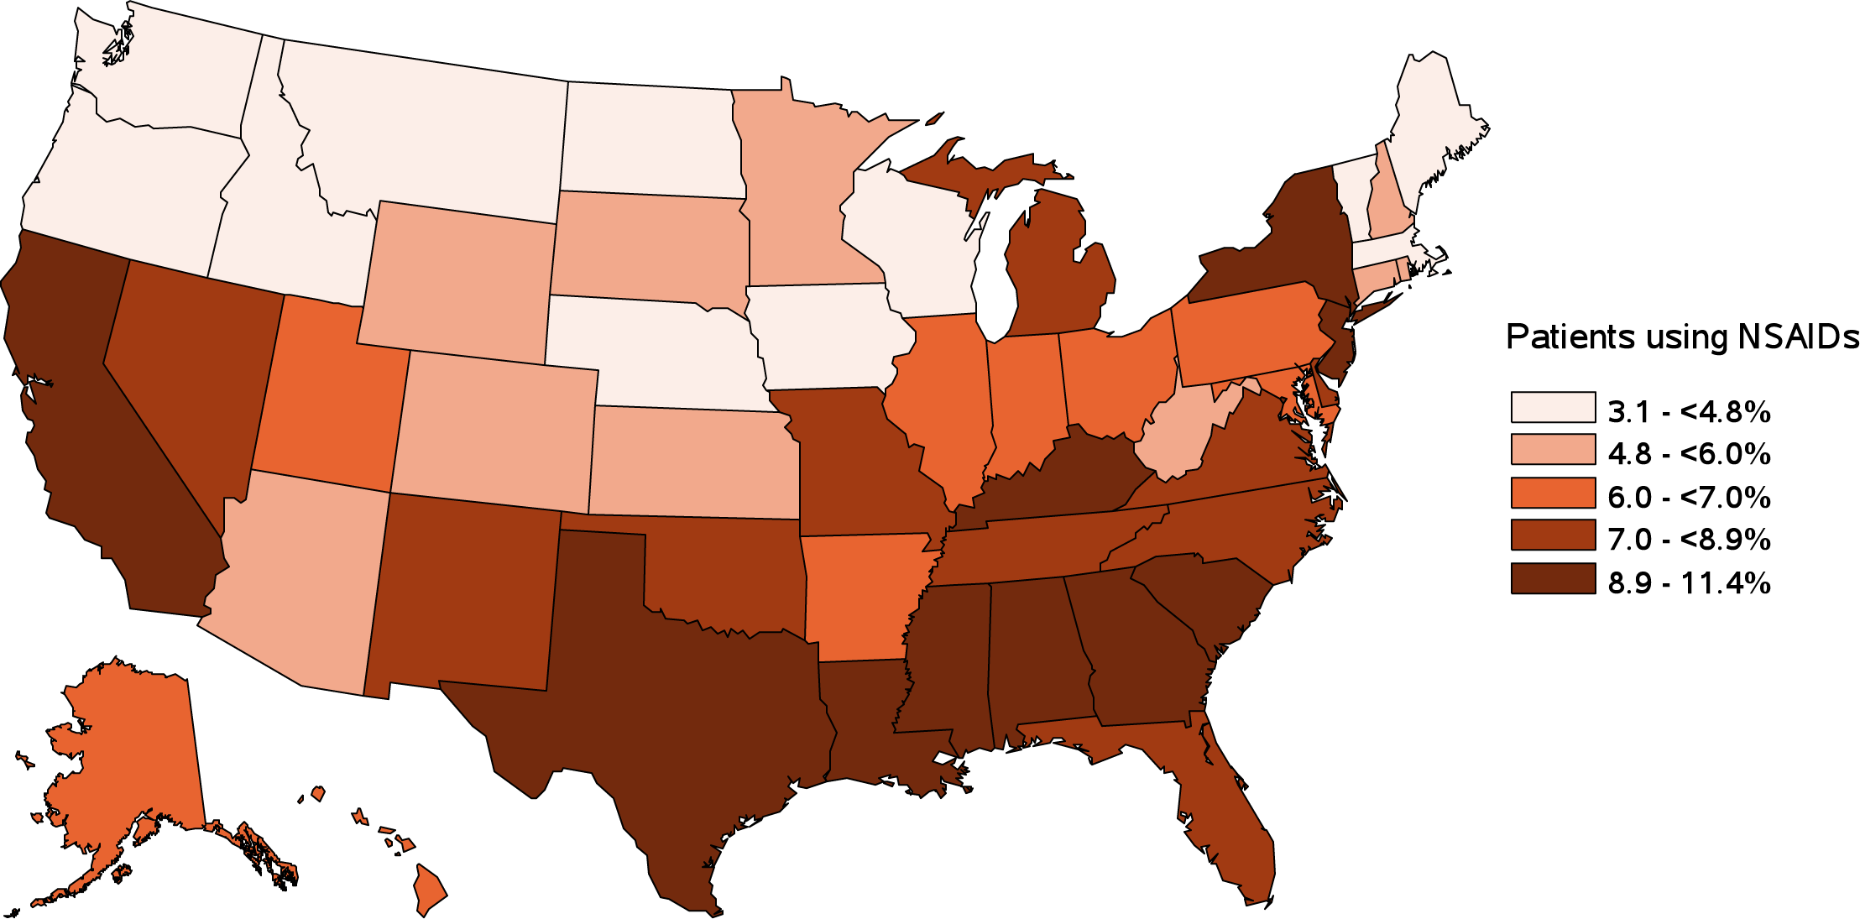
vol 2 Figure 10.6 Estimated utilization rate of prescription NSAIDs by state, Medicare ESRD Patients, 2015
Data source: Medicare Part D claims. ESRD patients with Medicare Part D stand-alone prescription drug plans. Abbreviations: NSAIDs, nonsteroidal anti-inflammatory agents. NSAID filled under Medicare Part D represent a fraction of actual NSAID use. .

Slide 26
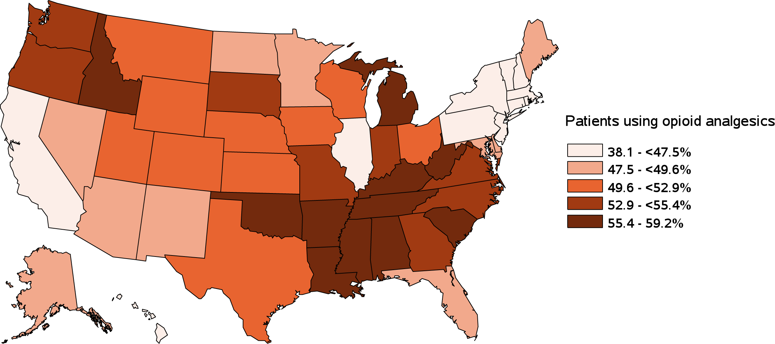
vol 2 Figure 10.7 Estimated utilization rate of opioid analgesics by state, Medicare ESRD Patients, 2015
Data source: Medicare Part D claims. ESRD patients with Medicare Part D stand-alone prescription drug plans.

