Slide 1
2017 Annual Data Report
Volume 2: End-Stage Renal Disease
Chapter 11:
International Comparisons

Slide 2
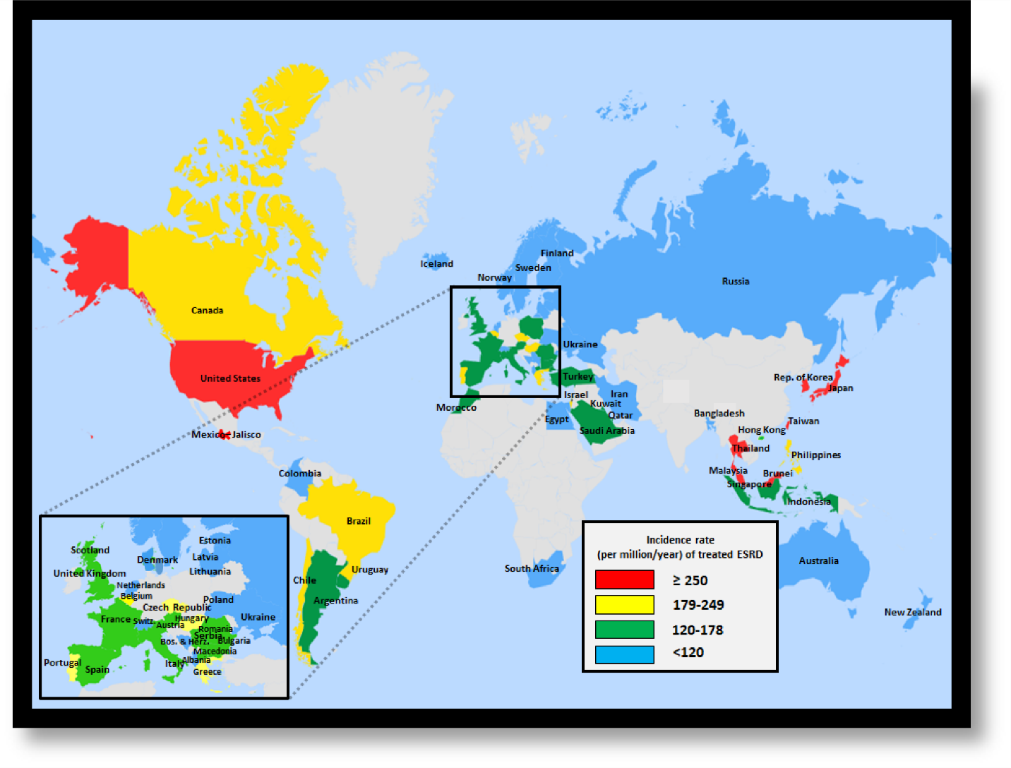
vol 2 Figure 11.1 Geographic variations in the incidence rate of treated ESRD (per million population/year), by country, 2015
Data source: Special analyses, USRDS ESRD Database. Data presented only for countries from which relevant information was available. All rates are unadjusted. United Kingdom: England, Wales, Northern Ireland (Scotland data reported separately). Data for Italy include five regions. Data for Indonesia represent the West Java region. Data for France exclude Martinique. Data for Canada excludes Quebec. Japan includes dialysis patients only. Abbreviation: ESRD, end-stage renal disease. NOTE: Data collection methods vary across countries, suggesting caution in making direct comparisons.

Slide 3
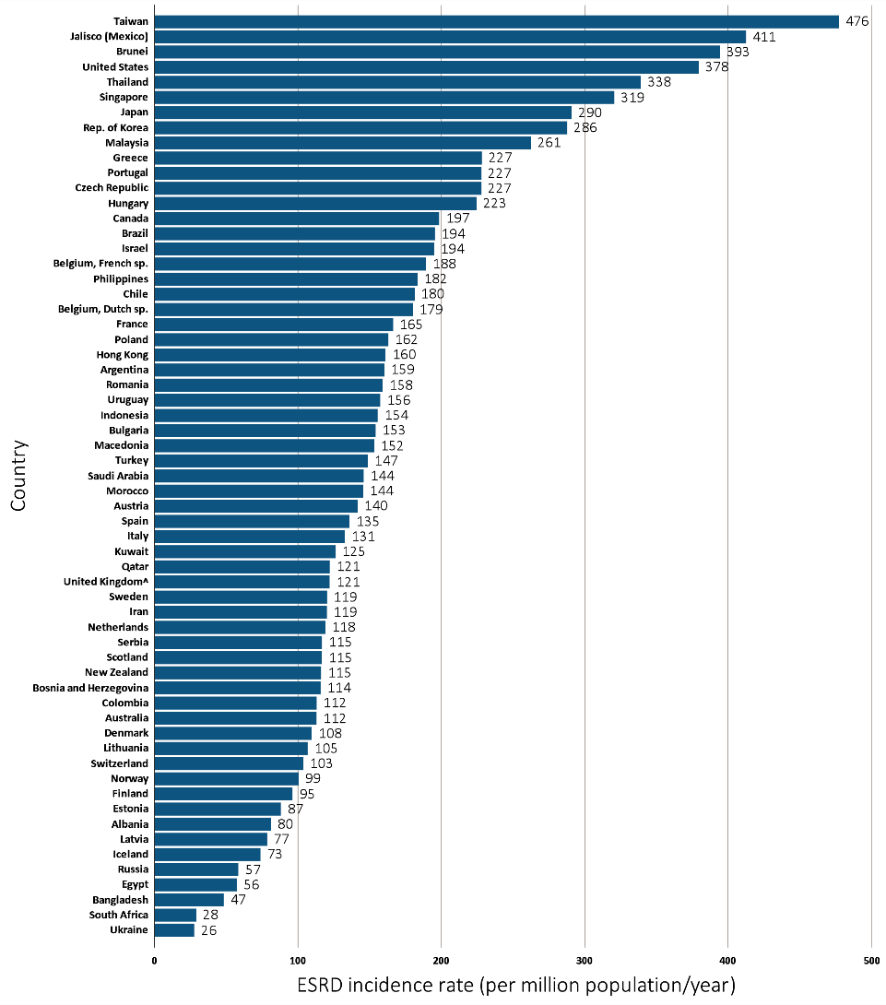
vol 2 Figure 11.2 Incidence rate of treated ESRD (per million population/year), by country, 2015
Data source: Special analyses, USRDS ESRD Database. Data presented only for countries from which relevant information was available. All rates are unadjusted. ^United Kingdom: England, Wales, Northern Ireland (Scotland data reported separately). Data for Italy include five regions. Data for Indonesia represent the West Java region. Data for France exclude Martinique. Data for Canada excludes Quebec. Japan includes dialysis patients only. Data for Latvia represents 80% of the country’s population. Abbreviations: ESRD, end-stage renal disease; sp., speaking. NOTE: Data collection methods vary across countries, suggesting caution in making direct comparisons.

Slide 4
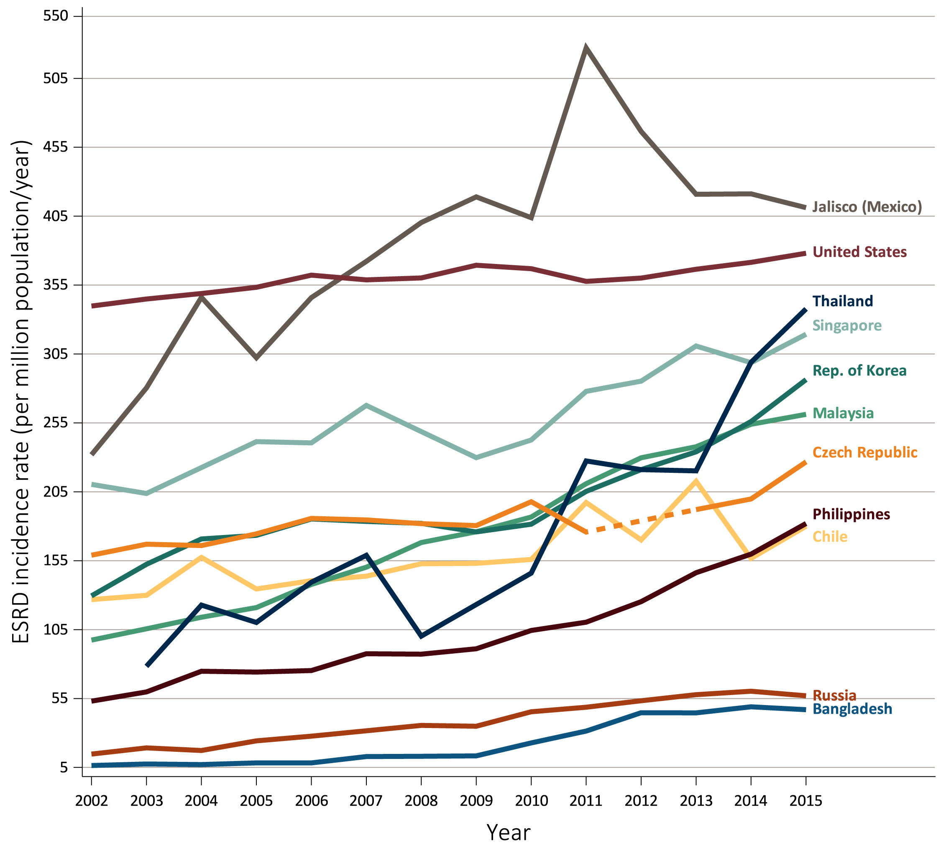
vol 2 Figure 11.3 Trends in the incidence rate of treated ESRD (per million population/year), by country, 2002-2015
(a) Ten countries having the highest percentage rise in ESRD incidence rate in 2002/03 versus that in 2014/15, plus the U.S.
Data source: Special analyses, USRDS ESRD Database. All rates are unadjusted. Data for the Czech Republic are missing from 2012 indicated by the dashed line. Data for U.S. are shown for comparison purposes. Abbreviation: ESRD, end-stage renal disease. NOTE: Data collection methods vary across countries, suggesting caution in making direct comparisons.

Slide 5
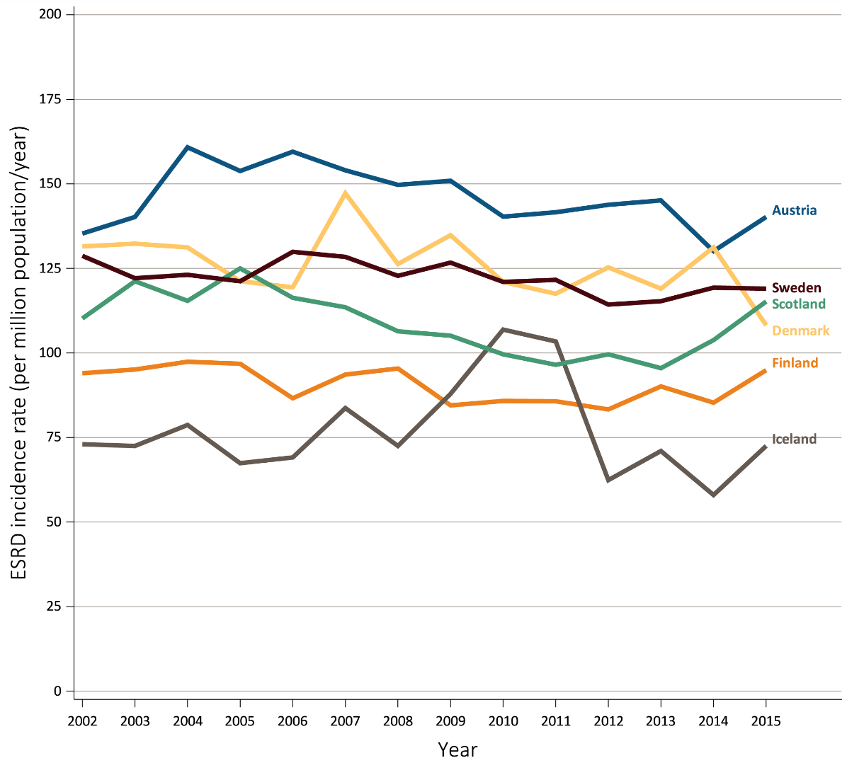
vol 2 Figure 11.3 Trends in the incidence rate of treated ESRD (per million population/year), by country, 2002-2015
(b) Six countries having the largest percentage decline in ESRD incidence rate: 2002/03 versus that in 2014/15
Data source: Special analyses, USRDS ESRD Database. All rates are unadjusted. Only six countries had a decrease in incidence from 2002/03-2014/15. Abbreviation: ESRD, end-stage renal disease. NOTE: Data collection methods vary across countries, suggesting caution in making direct comparisons.

Slide 6
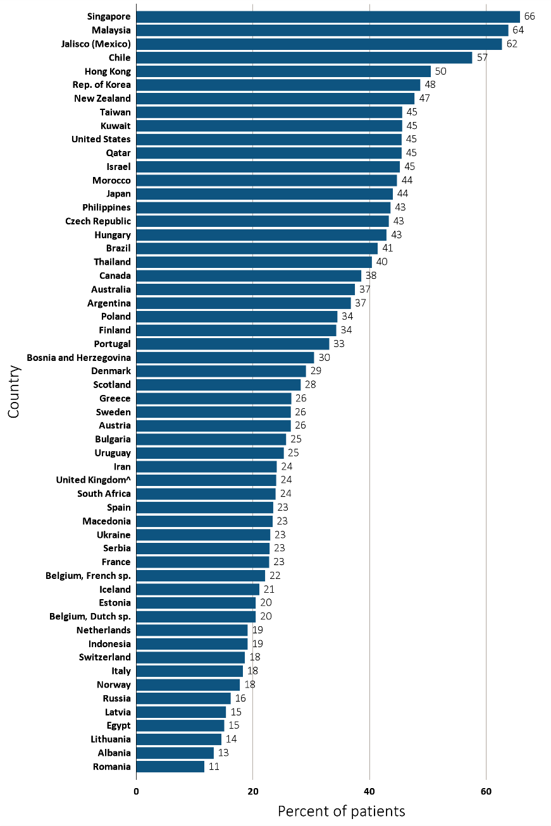
vol 2 Figure 11.4 Percentage of incident ESRD patients with diabetes as the primary cause of ESRD, by country, 2015
Data source: Special analyses, USRDS ESRD Database. Data presented only for countries from which relevant information were available. ^United Kingdom: England, Wales, Northern Ireland (Scotland data reported separately). Data for France exclude Martinique. Data for Indonesia represent the West Java region. Data for Italy includes five regions. Data for Canada excludes Quebec. Data for Latvia represents 80% of the country’s population. Abbreviations: ESRD, end-stage renal disease; sp., speaking. NOTE: Data collection methods vary across countries, suggesting caution in making direct comparisons.

Slide 7
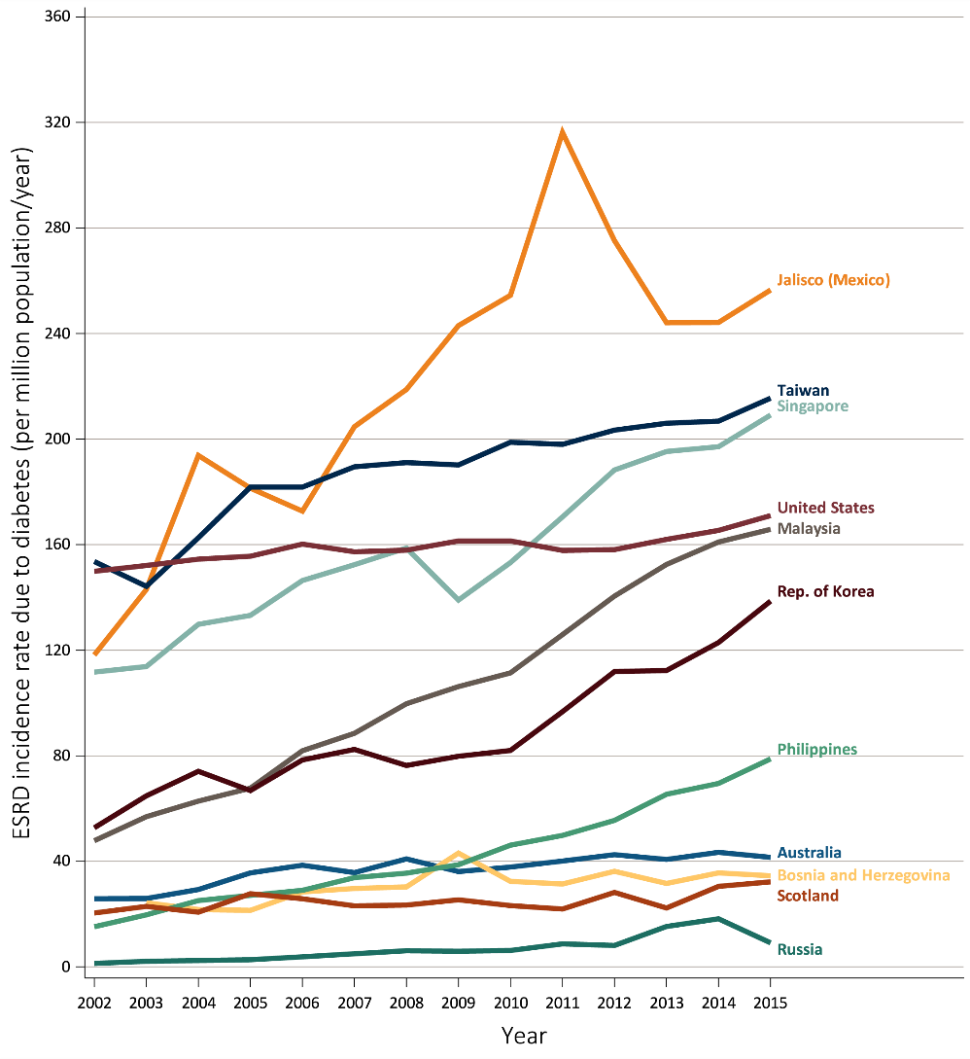
vol 2 Figure 11.5 Trends in the incidence rate of treated ESRD due to diabetes (per million population/year), by country, 2002-2015
Data source: Special analyses, USRDS ESRD Database. Ten countries having the highest percentage rise in 2014/15 versus that in 2002/03, plus the U.S. Data presented only for countries from which relevant information were available. Abbreviation: ESRD, end-stage renal disease. NOTE: Data collection methods vary across countries, suggesting caution in making direct comparisons.

Slide 8
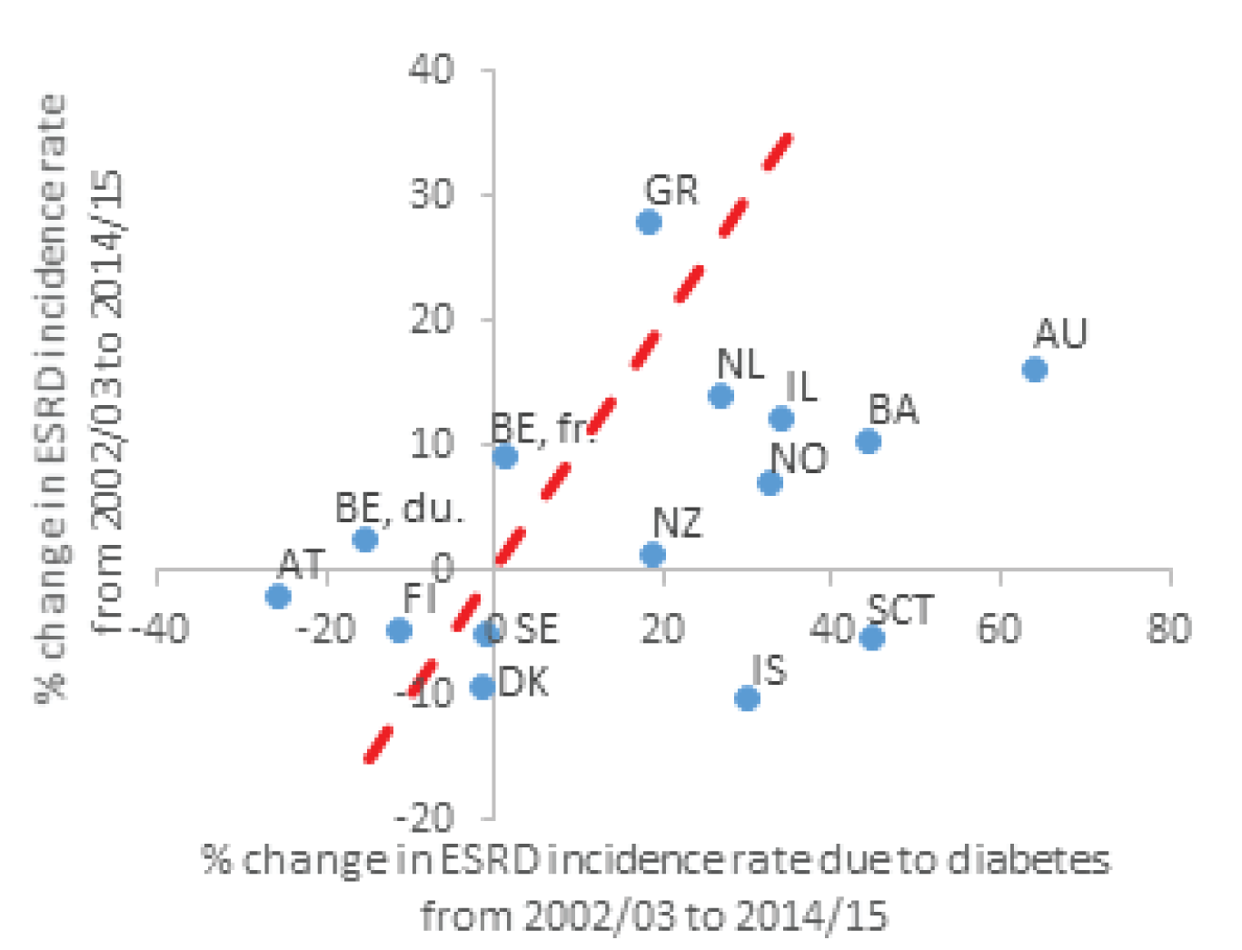
vol 2 Figure 11.6 Correlation, by country, of the percentage change in ESRD incidence with the percentage change in ESRD incidence due to diabetes, from 2002-2015, with countries displayed by region
(a) Europe, Australia, New Zealand and Israel
Data source: Special analyses, USRDS ESRD Database. Data presented only for countries from which relevant information was available. Reference line (in red) represents 1:1 ratio of percentage change in ESRD incidence rate due to diabetes and percentage change in ESRD incidence rate from 2002/03-2014/15. Countries listed in order of lowest to highest percentage change in ESRD incidence due to diabetes in each panel (a) Europe, Australia, New Zealand, and Israel: (1%-64%) Sweden (SE), Belgium (BE, French speaking), Denmark (DK), Finland (FI), Belgium (BE, Dutch Speaking) Greece (GR), New Zealand (NZ), Austria (AT), the Netherlands (NL), Iceland (IL), Norway (NO), Israel (IS), Bosnia and Herzegovina (BA), Scotland (SCT), Australia (AU).; (b) North and Latin America: (9%-92%) Uruguay (UY), United States (U.S.), Canada (CA), Jalisco (Mexico, MX-JAL); (c) Asia and Russia: (22%-703%) Japan (JP), Hong Kong (HK), Taiwan (TW), Singapore (SG), Rep. of Korea (KR), Malaysia (MY), Philippines (PH), Russia (RU). Abbreviation: ESRD, end-stage renal disease. NOTE: Data collection methods vary across countries, suggesting caution in making direct comparisons.

Slide 9
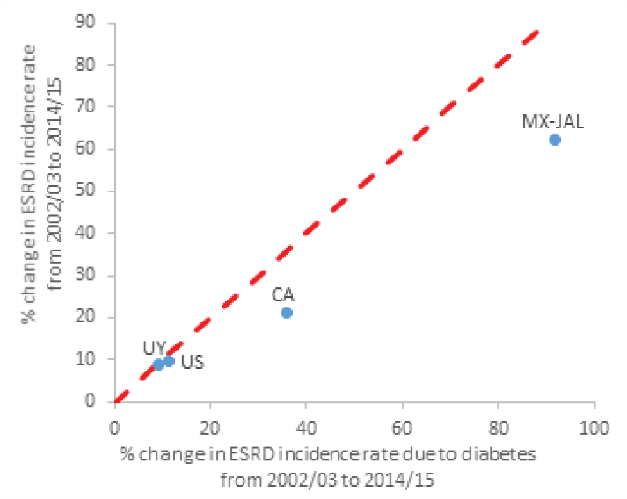
vol 2 Figure 11.6 Correlation, by country, of the percentage change in ESRD incidence with the percentage change in ESRD incidence due to diabetes, from 2002-2015, with countries displayed by region
(b) North and Latin America
Data source: Special analyses, USRDS ESRD Database. Data presented only for countries from which relevant information was available. Reference line (in red) represents 1:1 ratio of percentage change in ESRD incidence rate due to diabetes and percentage change in ESRD incidence rate from 2002/03-2014/15. Countries listed in order of lowest to highest percentage change in ESRD incidence due to diabetes in each panel (a) Europe, Australia, New Zealand, and Israel: (1%-64%) Sweden (SE), Belgium (BE, French speaking), Denmark (DK), Finland (FI), Belgium (BE, Dutch Speaking) Greece (GR), New Zealand (NZ), Austria (AT), the Netherlands (NL), Iceland (IL), Norway (NO), Israel (IS), Bosnia and Herzegovina (BA), Scotland (SCT), Australia (AU).; (b) North and Latin America: (9%-92%) Uruguay (UY), United States (U.S.), Canada (CA), Jalisco (Mexico, MX-JAL); (c) Asia and Russia: (22%-703%) Japan (JP), Hong Kong (HK), Taiwan (TW), Singapore (SG), Rep. of Korea (KR), Malaysia (MY), Philippines (PH), Russia (RU). Abbreviation: ESRD, end-stage renal disease. NOTE: Data collection methods vary across countries, suggesting caution in making direct comparisons.

Slide 10
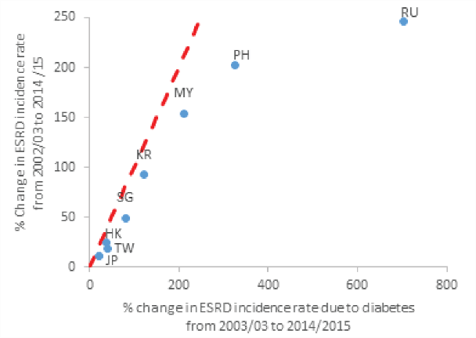
vol 2 Figure 11.6 Correlation, by country, of the percentage change in ESRD incidence with the percentage change in ESRD incidence due to diabetes, from 2002-2015, with countries displayed by region
(c) Asia and Russia
Data source: Special analyses, USRDS ESRD Database. Data presented only for countries from which relevant information was available. Reference line (in red) represents 1:1 ratio of percentage change in ESRD incidence rate due to diabetes and percentage change in ESRD incidence rate from 2002/03-2014/15. Countries listed in order of lowest to highest percentage change in ESRD incidence due to diabetes in each panel (a) Europe, Australia, New Zealand, and Israel: (1%-64%) Sweden (SE), Belgium (BE, French speaking), Denmark (DK), Finland (FI), Belgium (BE, Dutch Speaking) Greece (GR), New Zealand (NZ), Austria (AT), the Netherlands (NL), Iceland (IL), Norway (NO), Israel (IS), Bosnia and Herzegovina (BA), Scotland (SCT), Australia (AU).; (b) North and Latin America: (9%-92%) Uruguay (UY), United States (U.S.), Canada (CA), Jalisco (Mexico, MX-JAL); (c) Asia and Russia: (22%-703%) Japan (JP), Hong Kong (HK), Taiwan (TW), Singapore (SG), Rep. of Korea (KR), Malaysia (MY), Philippines (PH), Russia (RU). Abbreviation: ESRD, end-stage renal disease. NOTE: Data collection methods vary across countries, suggesting caution in making direct comparisons.

Slide 11
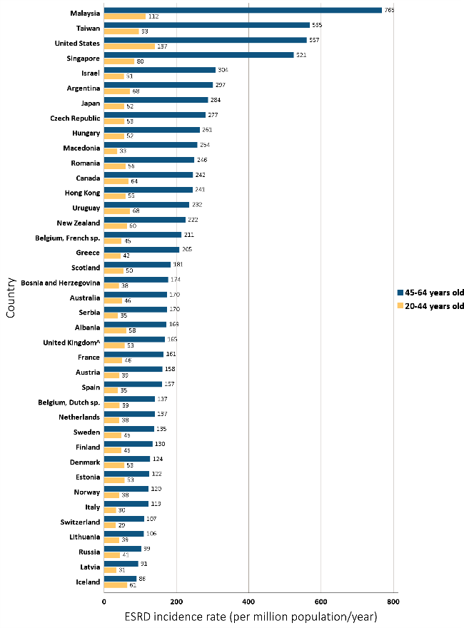
vol 2 Figure 11.7 Incidence rate of treated ESRD (per million population/year), by age group and country, 2015
(a) 20-44 and 45-64 years old
Data source: Special analyses, USRDS ESRD Database. Data presented only for countries from which relevant information was available. ^United Kingdom: England, Wales, Northern Ireland (Scotland data reported separately). Data for Italy include five regions. Data for France exclude Martinique. Data for Canada excludes Quebec. Japan includes dialysis patients only. Data for Latvia represents 80% of country’s population. For graph (a), data for Spain include patients 15-64 years old, and data for the United States include patients 22-64 years old.(b) data for Morocco include patients 65 years old and older Abbreviations: ESRD, end-stage renal disease; sp., speaking. NOTE: Data collection methods vary across countries, suggesting caution in making direct comparisons.

Slide 12
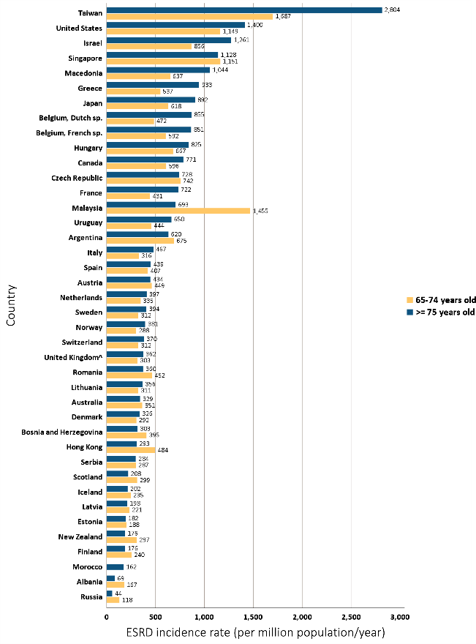
vol 2 Figure 11.7 Incidence rate of treated ESRD (per million population/year), by age group and country, 2015
(b) 65-74 and ≥75 years old
Data source: Special analyses, USRDS ESRD Database. Data presented only for countries from which relevant information was available. ^United Kingdom: England, Wales, Northern Ireland (Scotland data reported separately). Data for Italy include five regions. Data for France exclude Martinique. Data for Canada excludes Quebec. Japan includes dialysis patients only. Data for Latvia represents 80% of country’s population. For graph (a), data for Spain include patients 15-64 years old, and data for the United States include patients 22-64 years old.(b) data for Morocco include patients 65 years old and older Abbreviations: ESRD, end-stage renal disease; sp., speaking. NOTE: Data collection methods vary across countries, suggesting caution in making direct comparisons.

Slide 13
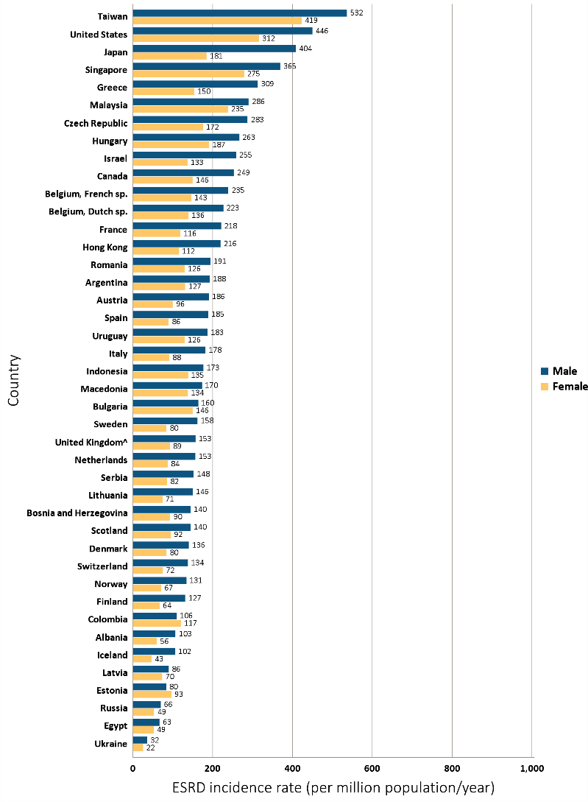
vol 2 Figure 11.8 Incidence rate of treated ESRD (per million population/year), by sex and country, 2015
Data source: Special analyses, USRDS ESRD Database. Data presented only for countries from which relevant information was available. ^United Kingdom: England, Wales, Northern Ireland (Scotland data reported separately). Data for France exclude Martinique. Data for Indonesia represent the West Java region. Data for Italy represent five regions. Data for Canada excludes Quebec. Japan includes dialysis patients only. Data for Latvia represents 80% of country’s population. Abbreviations: ESRD, end-stage renal disease; sp., speaking. NOTE: Data collection methods vary across countries, suggesting caution in making direct comparisons.

Slide 14
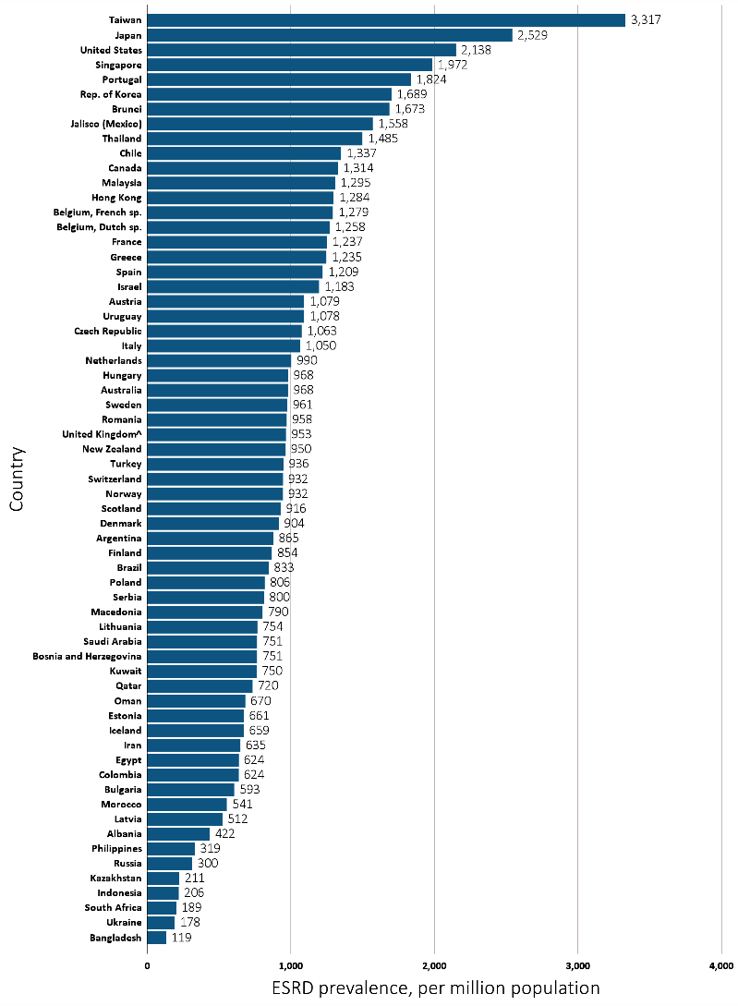
vol 2 Figure 11.9 Prevalence of treated ESRD per million population, by country, 2015
Data source: Special analyses, USRDS ESRD Database. Data presented only for countries from which relevant information was available. ^United Kingdom: England, Wales, Northern Ireland (Scotland data reported separately). The prevalence is unadjusted and reflects prevalence at the end of 2015. Switzerland includes dialysis patients only. Data for Indonesia represent the West Java region. Data for France exclude Martinique. Data for Italy includes five regions. Data for Canada excludes Quebec. Data for Latvia represents 80% of country’s population. Abbreviations: ESRD, end-stage renal disease; sp., speaking. NOTE: Data collection methods vary across countries, suggesting caution in making direct comparisons.

Slide 15
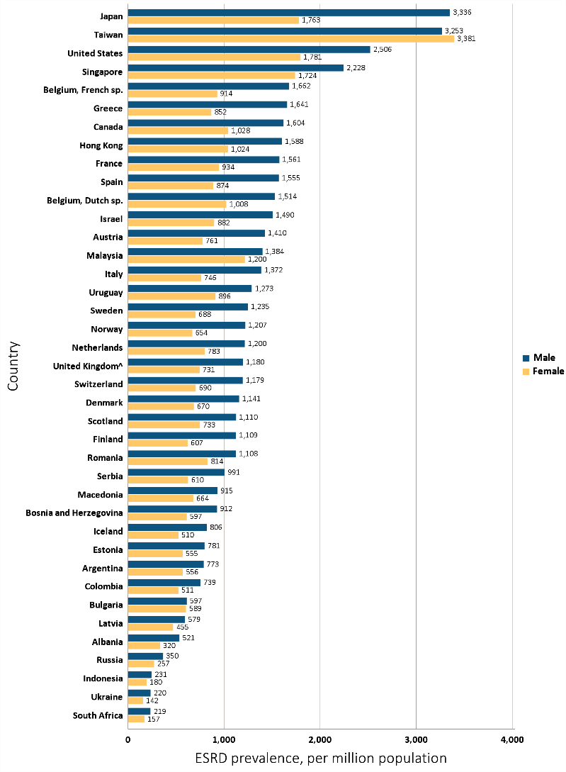
vol 2 Figure 11.10 Prevalence of treated ESRD per million population, by sex and country, 2015
Data source: Special analyses, USRDS ESRD Database. Data presented only for countries from which relevant information was available. ^United Kingdom: England, Wales, Northern Ireland (Scotland data reported separately). Switzerland includes dialysis patients only. Data for France exclude Martinique. Data for Italy include five regions. Data for Canada excludes Quebec. Data for Latvia represents 80% of country’s population. Abbreviations: ESRD, end-stage renal disease; sp., speaking. NOTE: Data collection methods vary across countries, suggesting caution in making direct comparisons.

Slide 16
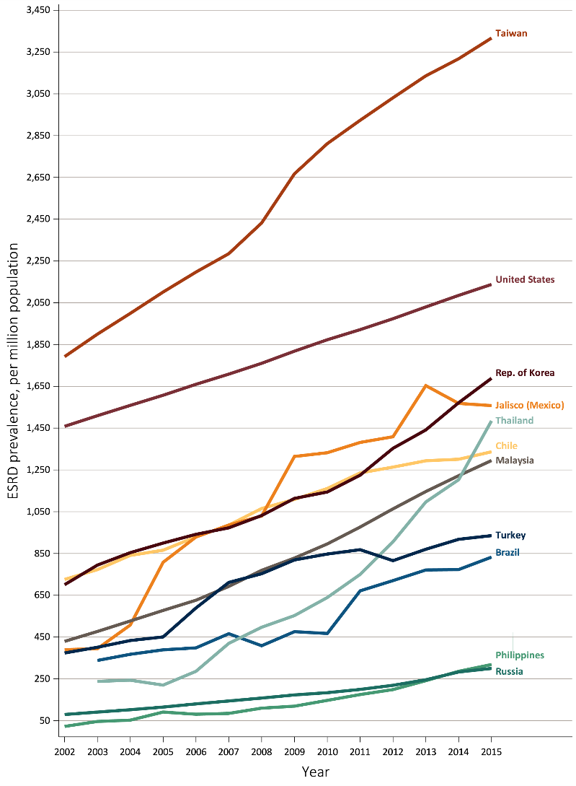
vol 2 Figure 11.11 Trends in the prevalence of treated ESRD per million population, by country, 2002-2015
Data source: Special analyses, USRDS ESRD Database. Denominator is calculated as the sum of patients receiving HD, PD, Home HD, or treated with a functioning transplant; does not include patients with other/unknown modality. Data for France exclude Martinique. Data for Italy include five regions. Data for Canada excludes Quebec. Data for Latvia represents 80% of country’s population; transplant data for Latvia is nationally representative. Abbreviations: CAPD, continuous ambulatory peritoneal dialysis; APD, automated peritoneal dialysis; IPD, intermittent peritoneal dialysis; ESRD, end-stage renal disease; HD, hemodialysis; PD, peritoneal dialysis; sp., speaking. NOTE: Data collection methods vary across countries, suggesting caution in making direct comparisons.

Slide 17
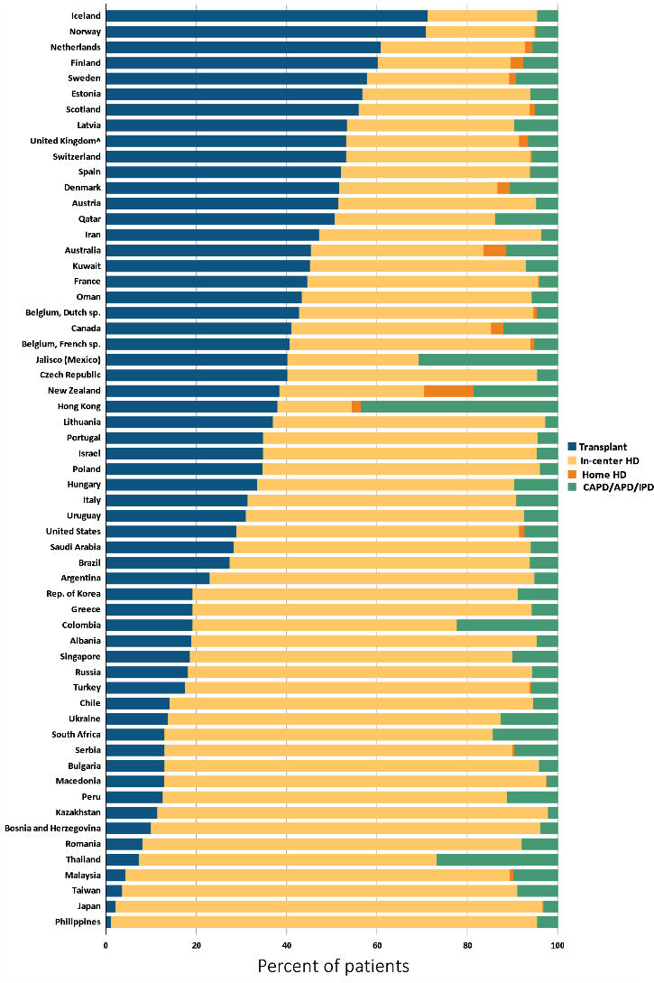
vol 2 Figure 11.12 Percentage distribution of type of renal replacement therapy modality used by ESRD patients, by country, in 2015
Data source: Special analyses, USRDS ESRD Database. Denominator is calculated as the sum of patients receiving HD, PD, Home HD, or treated with a functioning transplant; does not include patients with other/unknown modality. Data for France exclude Martinique. Data for Italy include five regions. Data for Canada excludes Quebec. Data for Latvia represents 80% of country’s population; transplant data for Latvia is nationally representative. Abbreviations: CAPD, continuous ambulatory peritoneal dialysis; APD, automated peritoneal dialysis; IPD, intermittent peritoneal dialysis; ESRD, end-stage renal disease; HD, hemodialysis; PD, peritoneal dialysis; sp., speaking. NOTE: Data collection methods vary across countries, suggesting caution in making direct comparisons.

Slide 18
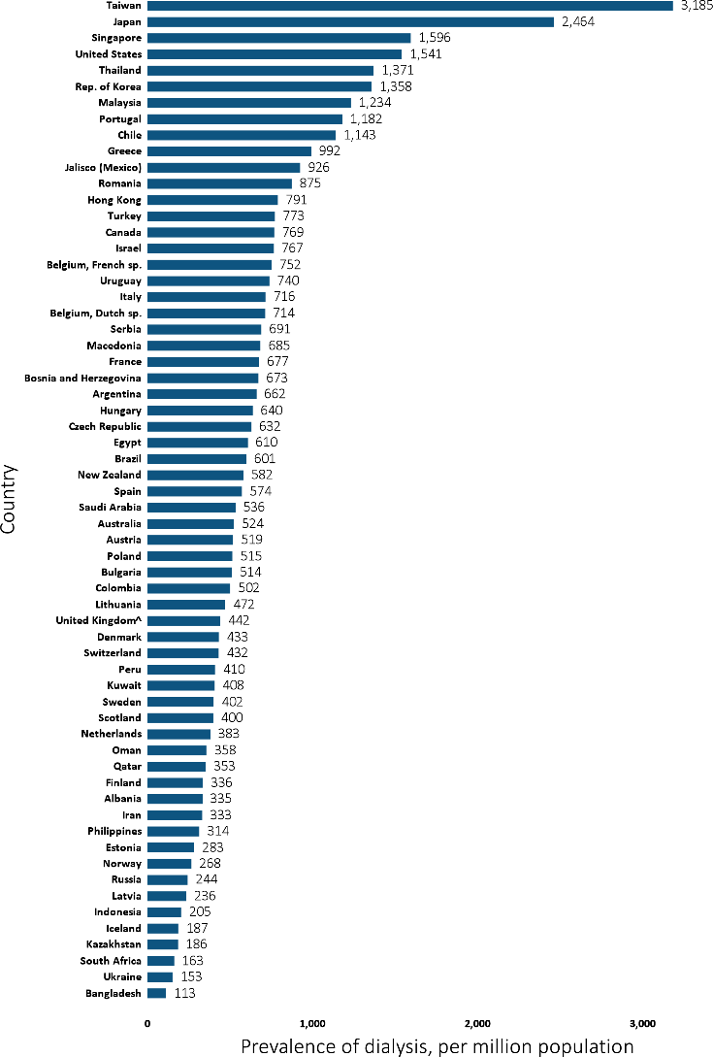
vol 2 Figure 11.13 Prevalence of dialysis per million population, by country, 2015
Data source: Special analyses, USRDS ESRD Database. ESRD prevalence is unadjusted and reflects prevalence at the end of 2015. United Kingdom: England, Wales, Northern Ireland (Scotland data reported separately). Data for Indonesia represent the West Java region. Data for France exclude Martinique. Data for Italy include five regions. Data for Canada excludes Quebec. Data for Latvia represents 80% of country’s population. Abbreviation: sp., speaking. NOTE: Data collection methods vary across countries, suggesting caution in making direct comparisons.

Slide 19
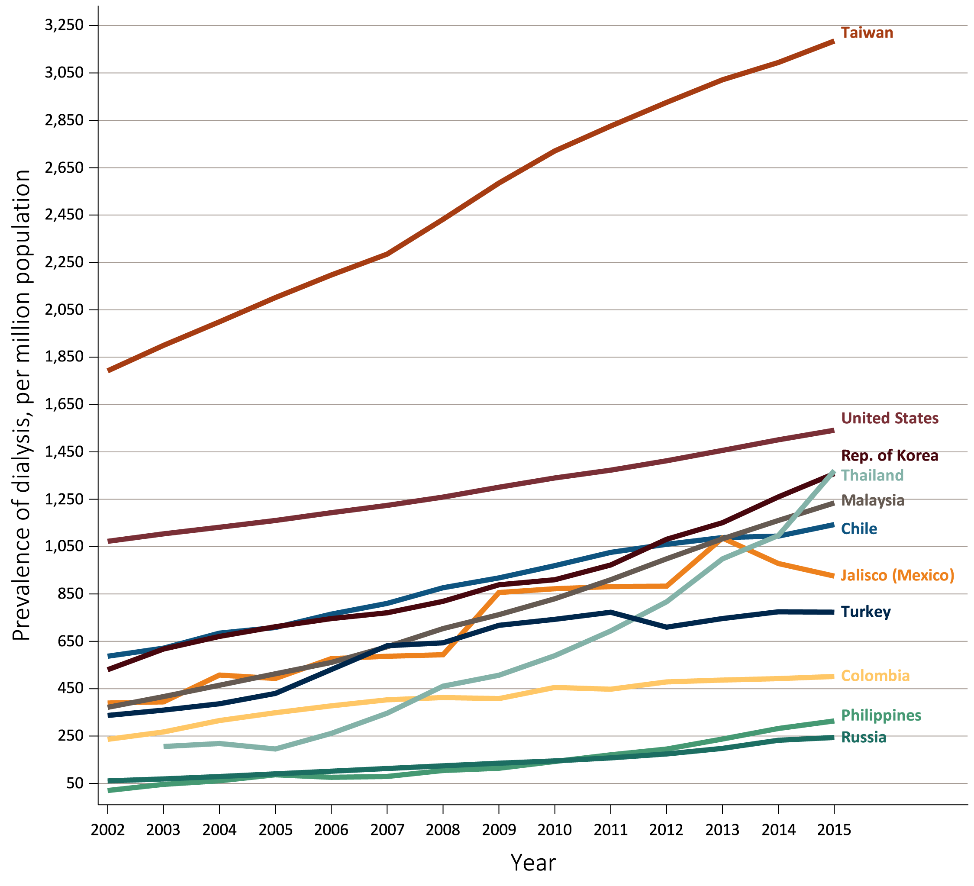
vol 2 Figure 11.14 Trends in the prevalence of dialysis per million population, by country, 2002 -2015
Data source: Special analyses, USRDS ESRD Database. Ten countries having the highest percentage rise in dialysis prevalence: 2014/15 versus that in 2002/03, plus the U.S. The prevalence is unadjusted and reflects prevalence of dialysis at the end of each year. Abbreviation: ESRD, end-stage renal disease. NOTE: Data collection methods vary across countries, suggesting caution in making direct comparisons.

Slide 20
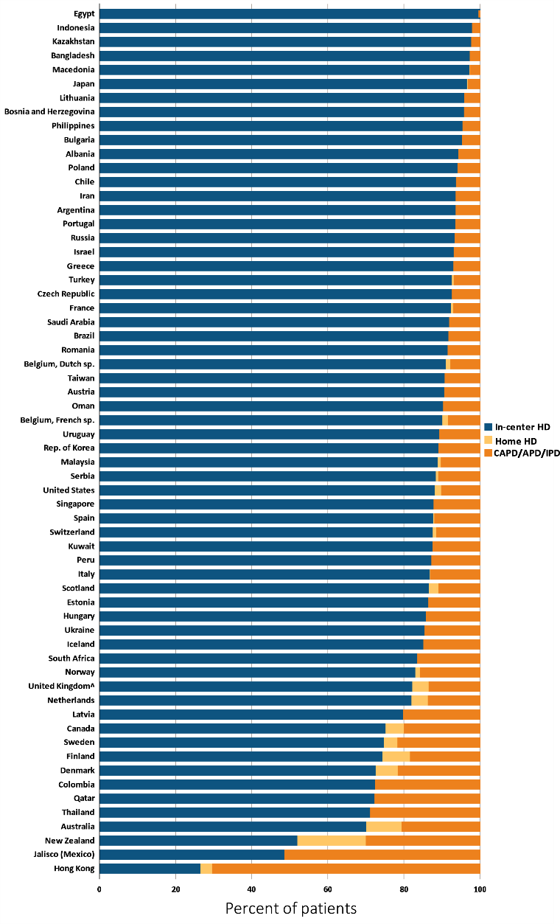
vol 2 Figure 11.15 Distribution of the percentage of prevalent dialysis patients using in-center HD, home HD, or peritoneal dialysis (CAPD/APD/IPD), 2015
Data source: Special analyses, USRDS ESRD Database. Denominator was calculated as the sum of patients receiving HD, PD, Home HD; does not include patients with other/unknown modality. ^United Kingdom: England, Wales, & Northern Ireland (Scotland data reported separately). Data for France exclude Martinique. Data for Italy include five regions. Data for Canada excludes Quebec. Data for Latvia represents 80% of country’s population. Abbreviations: CAPD, continuous ambulatory peritoneal dialysis; APD, automated peritoneal dialysis; IPD, intermittent peritoneal dialysis. NOTE: Data collection methods vary across countries, suggesting caution in making direct comparisons.

Slide 21
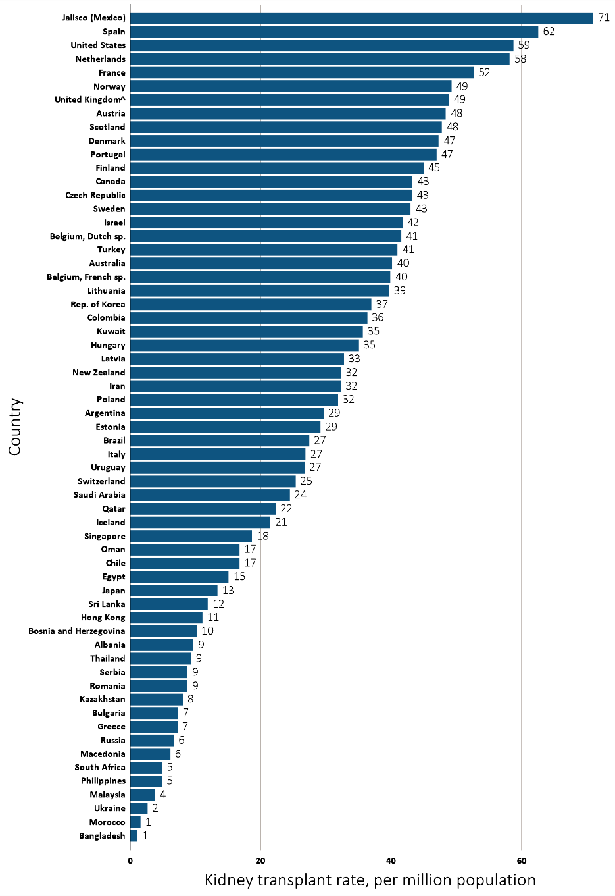
vol 2 Figure 11.16 Kidney transplantation rate, by country, 2015
(a) Per Million Population
Data source: Special analyses, USRDS ESRD Database. Data presented only for countries from which relevant information was available. All rates are unadjusted. ^United Kingdom: England, Wales, & Northern Ireland (Scotland data reported separately). Data for France exclude Martinique. Data from Italy represent five regions. Data for Sri Lanka is from seven government hospitals. Data for Canada excludes Quebec. Abbreviation: sp., speaking. NOTE: Data collection methods vary across countries, suggesting caution in making direct comparisons.

Slide 22
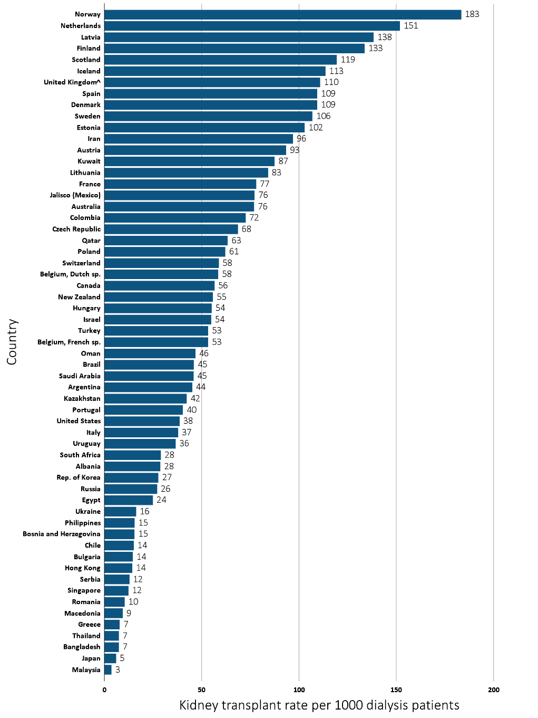
vol 2 Figure 11.16 Kidney transplantation rate, by country, 2015
(b) Per 1,000 Dialysis Patients
Data source: Special analyses, USRDS ESRD Database. Data presented only for countries from which relevant information was available. All rates are unadjusted. ^United Kingdom: England, Wales, & Northern Ireland (Scotland data reported separately). Data for France exclude Martinique. Data from Italy represent five regions. Data for Sri Lanka is from seven government hospitals. Data for Canada excludes Quebec. Abbreviation: sp., speaking. NOTE: Data collection methods vary across countries, suggesting caution in making direct comparisons.

Slide 23
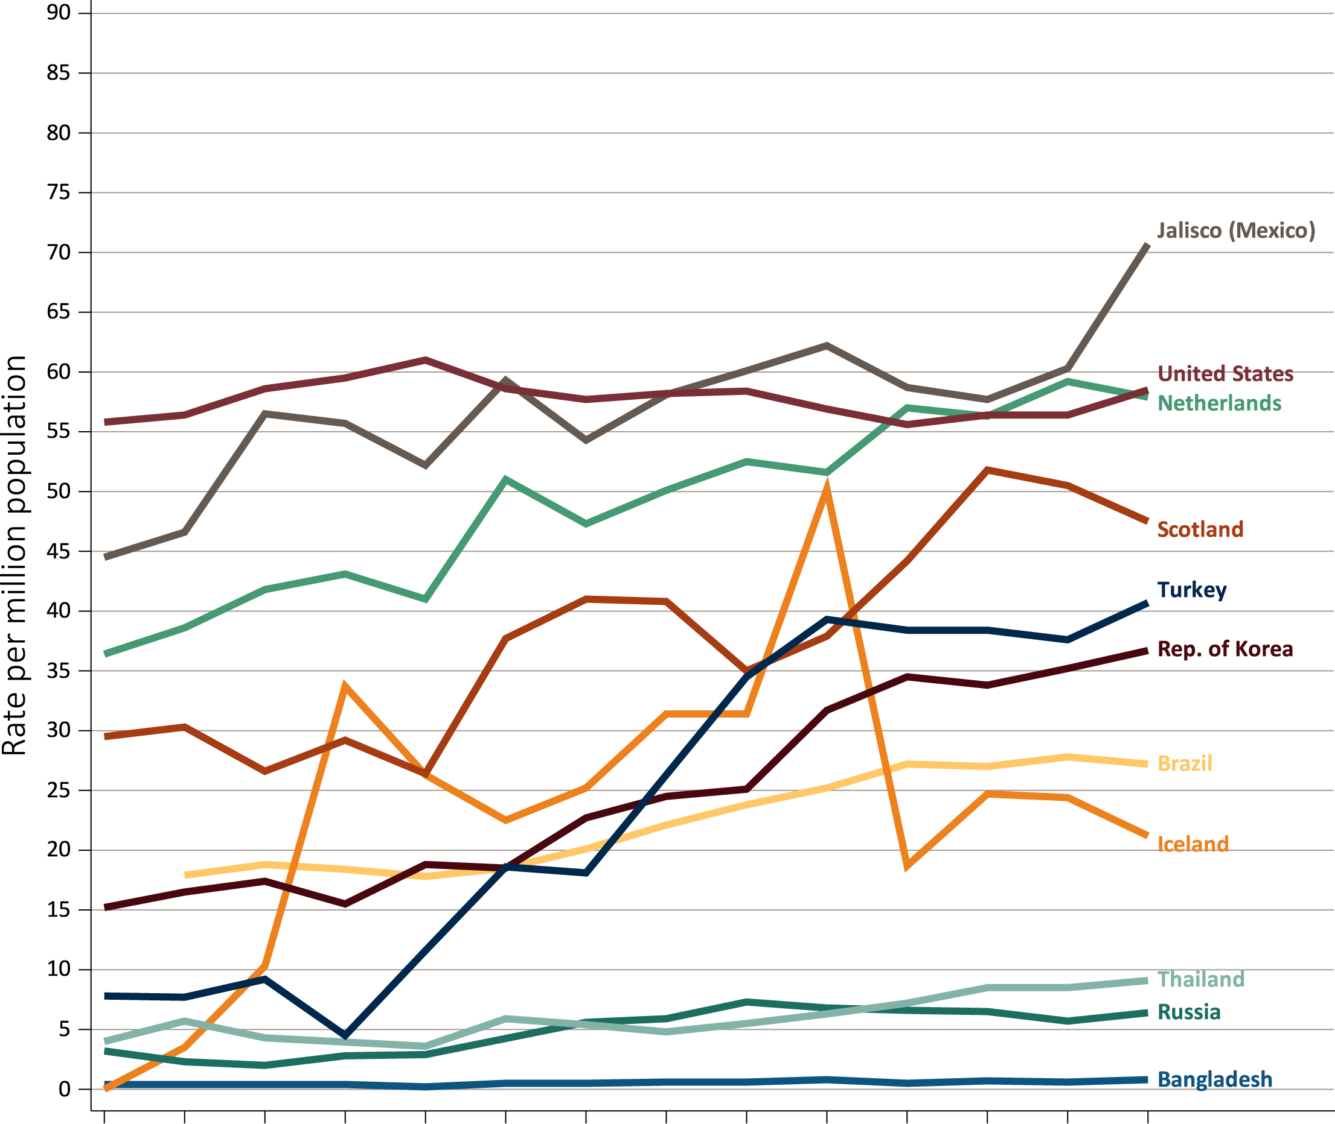
vol 2 Figure 11.17 Trends in kidney transplantation rates per million population, by country 2015
Data source: Special analyses, USRDS ESRD Database. Ten countries having the highest percentage rise in kidney transplantation rate: 2014/15 versus that in 2002/03, plus the U.S. All rates are unadjusted. Abbreviations: ESRD, end-stage renal disease. NOTE: Data collection methods vary across countries, suggesting caution in making direct comparisons.

Slide 24
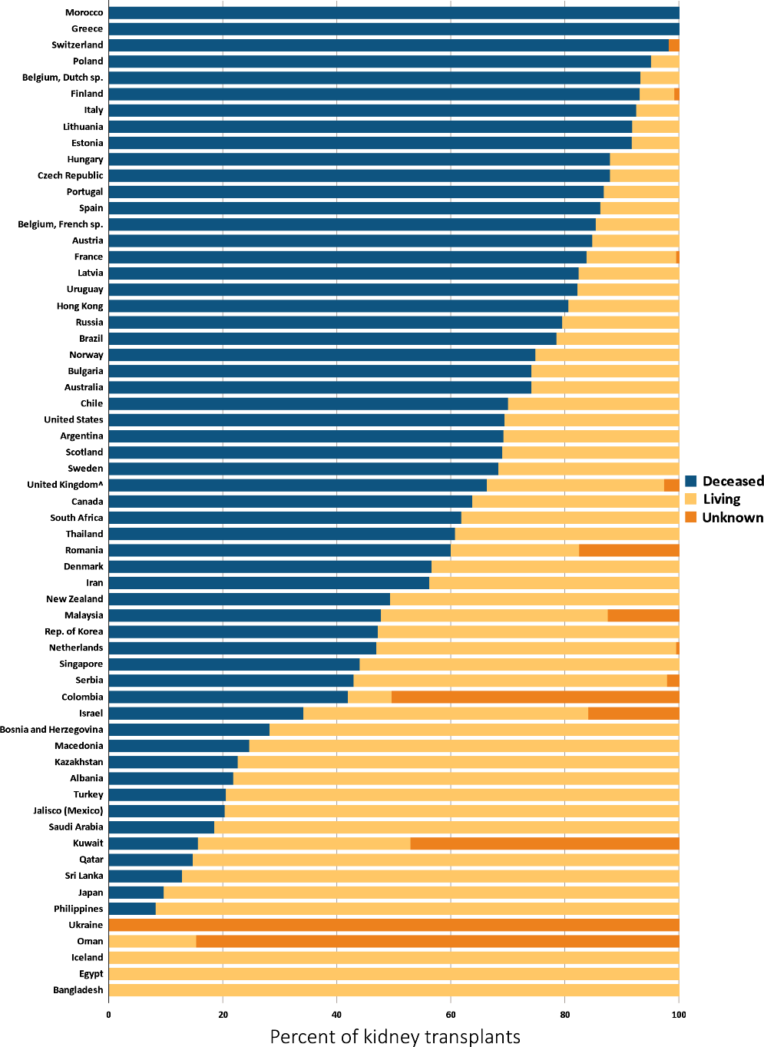
vol 2 Figure 11.18 Distribution of the percentage of kidney transplantations by kidney donor type and country, 2015
Data source: Special analyses, USRDS ESRD Database. Denominator is calculated as the sum of deceased, living donor, and unknown transplants. ^United Kingdom: England, Wales, & Northern Ireland (Scotland data reported separately). Data for France exclude Martinique. Data from Canada excludes Quebec. Data from Italy represent five regions. Data from Sri Lanka is from seven government hospitals. Abbreviation: ESRD, end-stage renal disease. NOTE: Data collection methods vary across countries, suggesting caution in making direct comparisons.

Slide 25
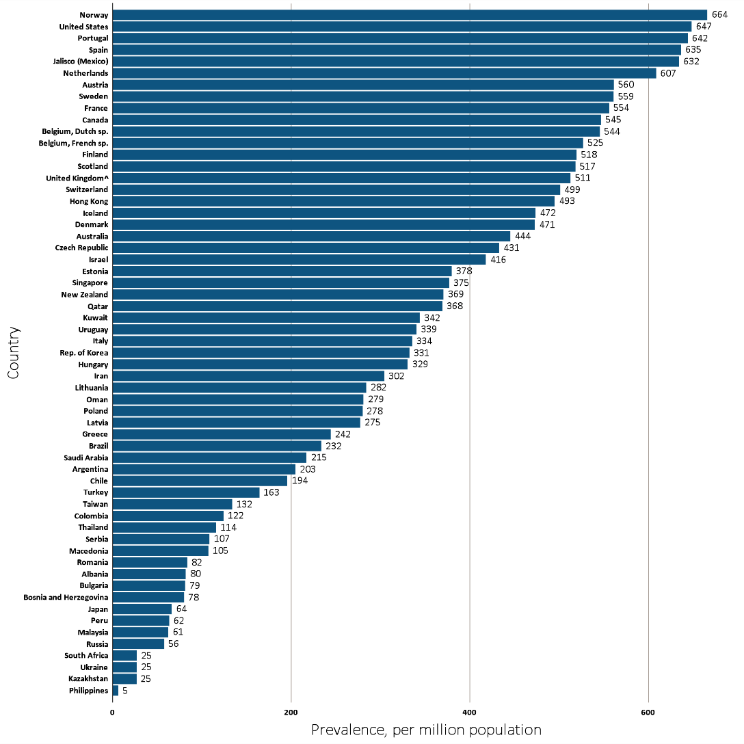
vol 2 Figure 11.19 Prevalence of treated ESRD patients with a functioning kidney transplant, per million population, by country, 2015
Data source: Special analyses, USRDS ESRD Database. Data presented only for countries from which relevant information was available. The prevalence is unadjusted. ^United Kingdom: England, Wales, & Northern Ireland (Scotland data reported separately). Data for France exclude Martinique. Data for Italy includes five regions. Data for Canada excludes Quebec. Abbreviations: ESRD, end-stage renal disease; sp., speaking. NOTE: Data collection methods vary across countries, suggesting caution in making direct comparisons.

