Slide 1
2018 Annual Data Report
Volume 1: Chronic Kidney Disease
Chapter 7: Healthcare Expenditures for Persons with CKD
2018 Annual Data Report Volume 1 CKD, Chapter 7

Slide 2
vol 1 Table 7.1 Prevalent Medicare fee-for-service patient counts and spending for beneficiaries aged 65 and older, by diabetes, heart failure, and/or CKD, 2016
 | U.S. Medicare Population | Total Spending (millions, U.S. $) | PPPY (U.S. $) | Population (%) | Spending (%)
All | 24,247,520 | $271,334 | $11,534 | 100.00 | 100.00
With HF or CKD or DM | 8,246,040 | $139,538 | $17,809 | 34.01 | 51.43
CKD only (- DM & HF) | 1,176,200 | $18,139 | $16,176 | 4.85 | 6.69
DM only (- HF & CKD) | 3,730,480 | $44,533 | $12,229 | 15.39 | 16.41
HF only (- DM & CKD) | 860,780 | $17,372 | $21,808 | 3.55 | 6.40
CKD and DM only (- HF) | 1,183,580 | $21,738 | $19,243 | 4.88 | 8.01
CKD and HF only (- DM) | 367,500 | $10,124 | $31,887 | 1.52 | 3.73
DM and HF only (- CKD) | 424,260 | $10,445 | $26,544 | 1.75 | 3.85
CKD and HF and DM | 503,240 | $17,187 | $39,506 | 2.08 | 6.33
No CKD or DM or HF | 16,001,480 | $131,796 | $8,400 | 65.99 | 48.57
All CKD (+/- DM & HF) | 3,230,520 | $67,188 | $22,369 | 13.32 | 24.76
All DM (+/- CKD & HF) | 5,841,560 | $93,904 | $16,769 | 24.09 | 34.61
All HF (+/- DM & CKD) | 2,155,780 | $55,128 | $28,378 | 8.89 | 20.32
CKD and DM (+/- HF) | 1,686,820 | $38,925 | $24,877 | 6.96 | 14.35
CKD and HF (+/- DM) | 870,740 | $27,311 | $36,291 | 3.59 | 10.07
DM and HF (+/- CKD) | 927,500 | $27,633 | $33,350 | 3.83 | 10.18
Data Source: Medicare 5% sample. Abbreviations: CKD, chronic kidney disease; ESRD, end-stage renal disease; HF, heart failure; DM, diabetes mellitus; PPPY, per-person per-year.

Slide 3
vol 1 Table 7.2 Prevalent Medicare Advantage and managed care spending for beneficiaries aged 65 and older, by diabetes, heart failure, and/or CKD, 2016
 | Medicare Advantage |  |  |  | Managed care
 | PPPY (U.S. $) | Population (%) | Spending (%) |  | PPPY (U.S. $) | Population (%) | Spending (%)
All | $10,356 | 100 | 100 |  | $12,176 | 100 | 100
With HF or CKD or DM | $15,362 | 34.15 | 49.97 |  | $20,562 | 24.15 | 40.53
CKD only (- DM & HF) | $13,418 | 5.96 | 7.63 |  | $22,124 | 3.33 | 6.04
DM only (- HF & CKD) | $11,942 | 15.48 | 17.92 |  | $15,627 | 13.74 | 17.63
HF only (- DM & CKD) | $18,291 | 2.74 | 4.67 |  | $24,352 | 1.98 | 3.93
CKD and DM only (- HF) | $16,051 | 5.31 | 8.15 |  | $25,132 | 2.68 | 5.51
CKD and HF only (- DM) | $24,601 | 1.53 | 3.36 |  | $37,903 | 0.77 | 2.25
DM and HF only (- CKD) | $23,949 | 1.38 | 3.08 |  | $32,561 | 0.87 | 2.28
CKD and HF and DM | $33,143 | 1.75 | 5.17 |  | $48,110 | 0.78 | 2.90
No CKD or DM or HF | $7,813 | 65.85 | 50.03 |  | $9,527 | 75.85 | 59.47
All CKD (+/- DM & HF) | $17,757 | 14.54 | 24.30 |  | $27,289 | 7.56 | 16.70
All DM (+/- CKD & HF) | $14,968 | 23.92 | 34.32 |  | $19,164 | 18.07 | 28.31
All HF (+/- DM & CKD) | $24,063 | 7.40 | 16.28 |  | $32,359 | 4.40 | 11.35
CKD and DM (+/- HF) | $20,066 | 7.06 | 13.32 |  | $30,085 | 3.46 | 8.41
CKD and HF (+/- DM) | $29,158 | 3.28 | 8.52 |  | $43,047 | 1.55 | 5.15
DM and HF (+/- CKD) | $28,988 | 3.13 | 8.25 |  | $39,754 | 1.65 | 5.18
Data Source: Optum Clinformatics™. Abbreviations: CKD, chronic kidney disease; ESRD, end-stage renal disease; HF, heart failure; DM, diabetes mellitus; PPPY, per-person per-year. Numbers of ‘All’ patients included in this table are 2,536,831 and 236,268 for Medicare Advantage and Commercial managed care respectively.

Slide 4
vol 1 Table 7.3 Prevalent Medicare fee-for-service patient counts and spending for beneficiaries younger than age 65, by diabetes, heart failure, and/or CKD, 2016
 | U.S. Medicare Population | Total Costs (millions, U.S. $) | PPPY spending (U.S. $) | Population (%) | Spending (%)
All | 4,709,780 | $66,276 | $14,558 | 100.00 | 100.00
With HF or CKD or DM | 1,269,900 | $28,917 | $23,851 | 26.96 | 43.63
CKD only (- DM & HF) | 111,820 | $2,691 | $25,394 | 2.37 | 4.06
DM only (- HF & CKD) | 714,800 | $12,248 | $17,705 | 15.18 | 18.48
HF only (- DM & CKD) | 96,120 | $2,401 | $26,462 | 2.04 | 3.62
CKD and DM only (- HF) | 190,680 | $5,429 | $30,002 | 4.05 | 8.19
CKD and HF only (- DM) | 23,400 | $992 | $46,599 | 0.50 | 1.50
DM and HF only (- CKD) | 67,100 | $2,078 | $33,051 | 1.43 | 3.14
CKD and HF and DM | 65,980 | $3,079 | $52,335 | 1.40 | 4.65
No CKD or DM or HF | 3,439,880 | $37,359 | $11,185 | 73.04 | 56.37
All CKD (+/- DM & HF) | 391,880 | $12,190 | $33,214 | 8.32 | 18.39
All DM (+/- CKD & HF) | 1,038,560 | $22,834 | $22,961 | 22.05 | 34.45
All HF (+/- DM & CKD) | 252,600 | $8,549 | $36,580 | 5.36 | 12.90
CKD and DM (+/- HF) | 256,660 | $8,508 | $35,482 | 5.45 | 12.84
CKD and HF (+/- DM) | 89,380 | $4,071 | $50,812 | 1.90 | 6.14
DM and HF (+/- CKD) | 133,080 | $5,157 | $42,374 | 2.83 | 7.78
Data Source: Medicare 5% sample. Abbreviations: CKD, chronic kidney disease; DM, diabetes mellitus; ESRD, end-stage renal disease; HF, heart failure; PPPY, per-person per-year.

Slide 5
vol 1 Table 7.4 Prevalent Medicare Advantage and managed care fee-for-service spending for beneficiaries younger than age 65, by diabetes, heart failure, and/or CKD, 2016
 | Medicare Advantage |  |  |  | Managed care
 | PPPY (U.S. $) | Population (%) | Spending (%) |  | PPPY (U.S. $) | Population (%) | Spending (%)
All | $16,358 | 100.00 | 100.00 |  | $5,317 | 100.00 | 100.00
With HF or CKD or DM | $24,317 | 33.34 | 49.24 |  | $15,313 | 6.43 | 18.54
CKD only (- DM & HF) | $25,398 | 3.24 | 5.00 |  | $18,996 | 0.77 | 2.74
DM only (- HF & CKD) | $18,863 | 19.32 | 22.30 |  | $12,161 | 4.77 | 10.96
HF only (- DM & CKD) | $27,505 | 2.06 | 3.41 |  | $23,139 | 0.29 | 1.25
CKD and DM only (- HF) | $28,616 | 4.62 | 8.03 |  | $25,423 | 0.40 | 1.91
CKD and HF only (- DM) | $45,866 | 0.67 | 1.78 |  | $52,704 | 0.05 | 0.42
DM and HF only (- CKD) | $33,680 | 1.83 | 3.70 |  | $32,309 | 0.10 | 0.59
CKD and HF and DM | $54,296 | 1.60 | 5.01 |  | $71,480 | 0.05 | 0.66
No CKD or DM or HF | $12,416 | 66.66 | 50.76 |  | $4,629 | 93.57 | 81.46
All CKD (+/- DM & HF) | $32,571 | 10.13 | 19.83 |  | $24,214 | 1.27 | 5.73
All DM (+/- CKD & HF) | $23,449 | 27.37 | 39.04 |  | $14,066 | 5.32 | 14.13
All HF (+/- DM & CKD) | $38,093 | 6.15 | 13.91 |  | $32,647 | 0.49 | 2.92
CKD and DM (+/- HF) | $34,971 | 6.22 | 13.05 |  | $30,457 | 0.45 | 2.57
CKD and HF (+/- DM) | $51,798 | 2.26 | 6.80 |  | $62,768 | 0.10 | 1.08
DM and HF (+/- CKD) | $43,101 | 3.42 | 8.71 |  | $45,383 | 0.15 | 1.25
Data Source: Optum Clinformatics™. Abbreviations: CKD, chronic kidney disease; HF, heart failure; DM, diabetes mellitus; ESRD, end-stage renal disease; PPPY, per-person per-year. Number of ‘All’ patients included in this table are 279,972 and 5,011,031 for Medicare Advantage and Managed care respectively.

Slide 6
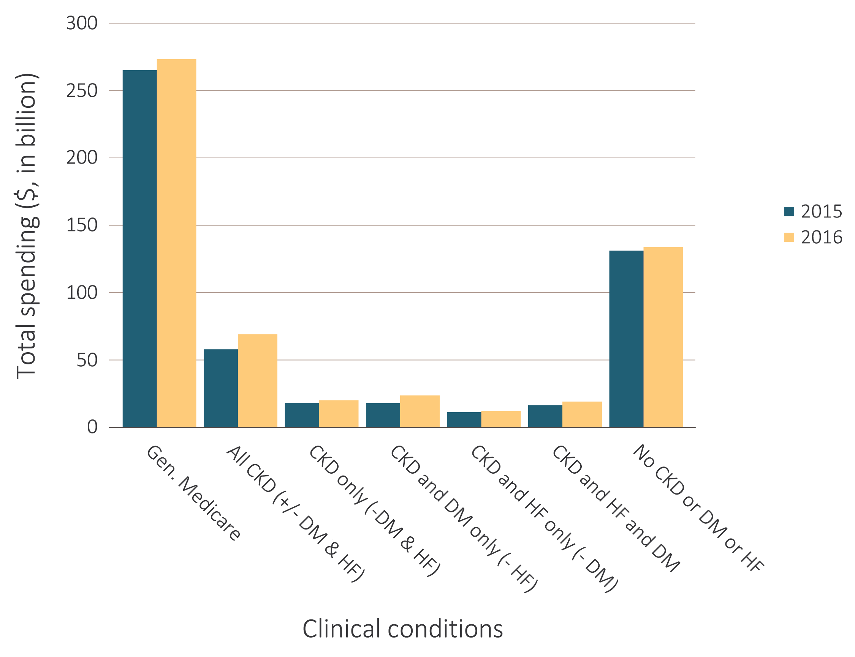
vol 1 Figure 7.1 Overall Medicare Parts A, B, and D fee-for-service spending for beneficiaries aged 65 and older, by CKD, diabetes, and heart failure, 2015 & 2016
Data source: Medicare 5% sample. Abbreviations: CKD, chronic kidney disease; DM, diabetes mellitus; ESRD, end-stage renal disease; HF, heart failure.

Slide 7
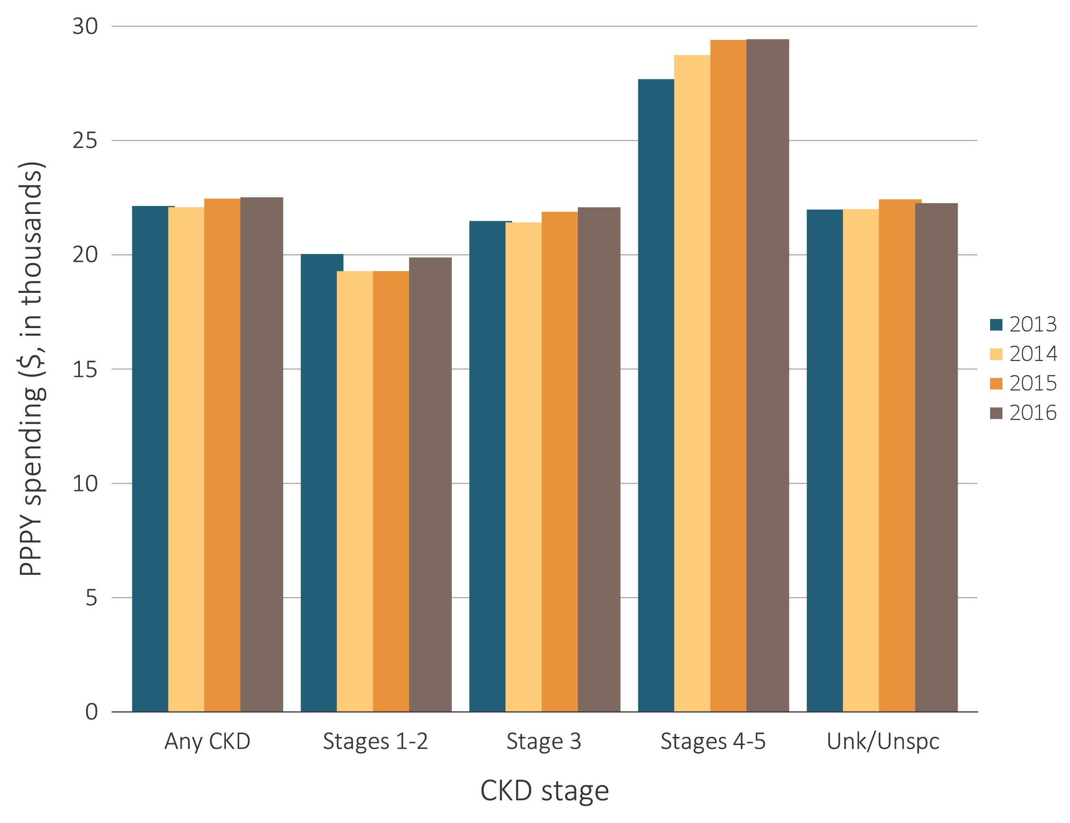
vol 1 Figure 7.2 Overall per person per year spending for beneficiaries aged 65 and older, by CKD stage, and year, 2013-2016
Data Source: Medicare 5% sample and Optum Clinformatics™. Abbreviations: CKD, chronic kidney disease; ESRD, end-stage renal disease; PPPY, per-person per-year; Unk/unspc, CKD stage unknown or unspecified.

Slide 8
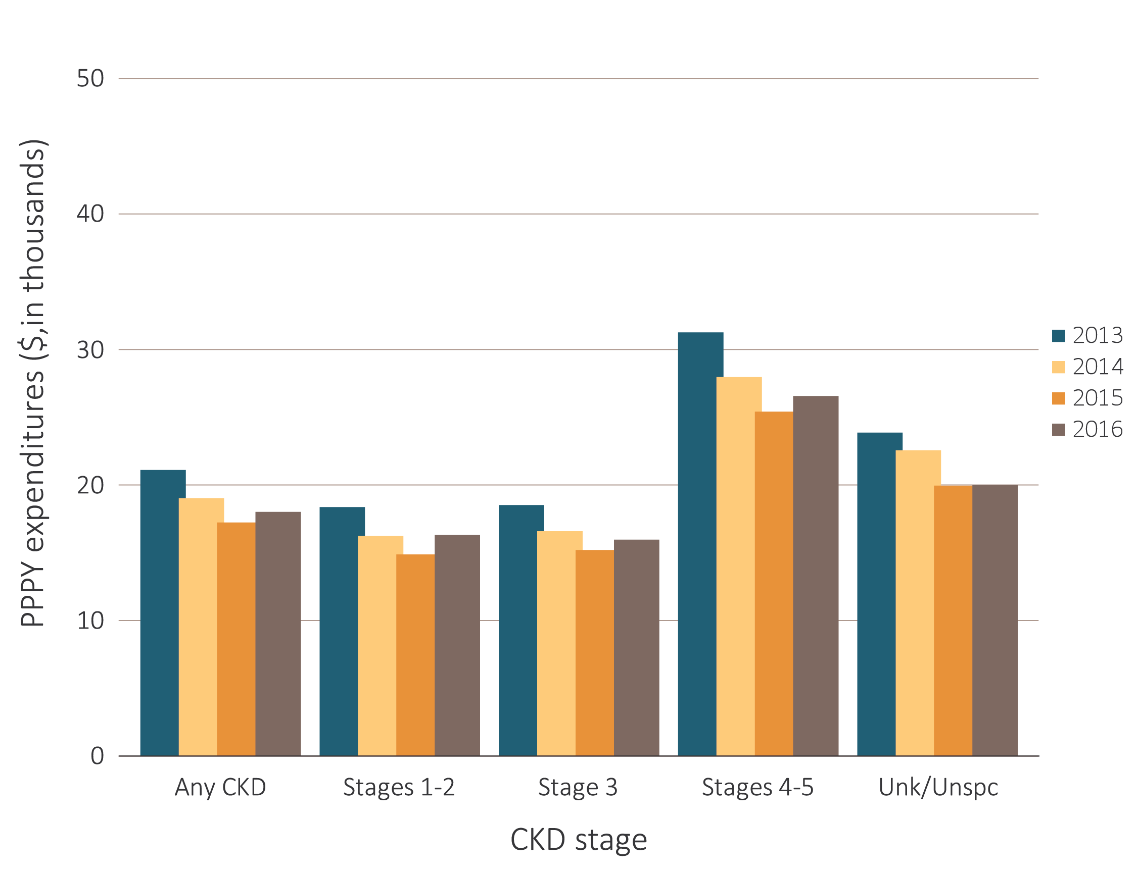
vol 1 Figure 7.2 Overall per person per year spending for beneficiaries aged 65 and older, by CKD stage, and year, 2013-2016
Data Source: Medicare 5% sample and Optum Clinformatics™. Abbreviations: CKD, chronic kidney disease; ESRD, end-stage renal disease; PPPY, per-person per-year; Unk/Unspc, CKD stage unknown or unspecified.

Slide 9
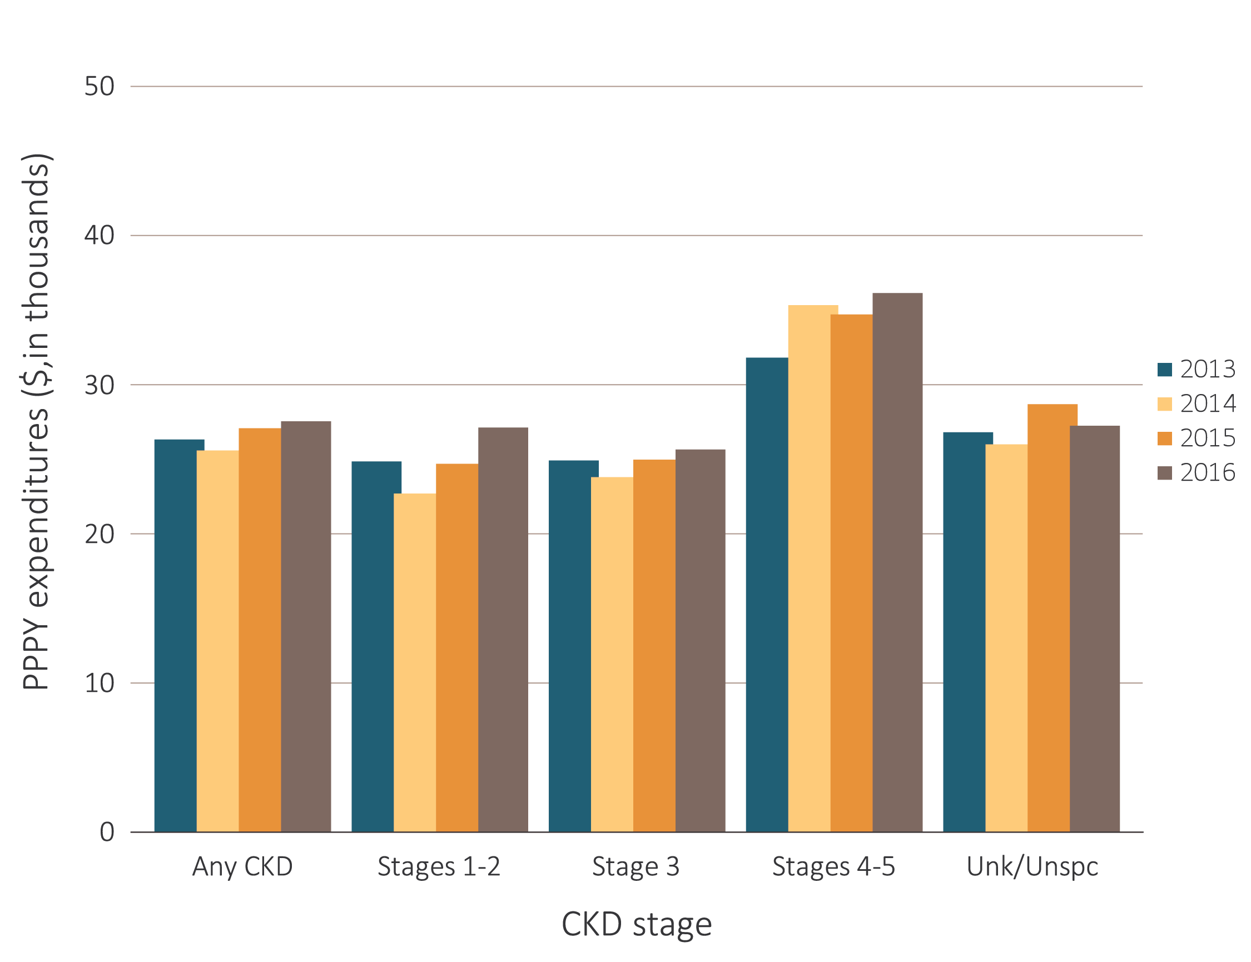
vol 1 Figure 7.2 Overall per person per year spending for beneficiaries aged 65 and older, by CKD stage, and year, 2013-2016
Data Source: Medicare 5% sample and Optum Clinformatics™. Abbreviations: CKD, chronic kidney disease; ESRD, end-stage renal disease; PPPY, per-person per-year; Unk/Unspc, CKD stage unknown or unspecified.

Slide 10
Table A. ICD-9-CM and ICD-10-CM codes for Chronic Kidney Disease (CKD) stages
ICD-9-CM codeª | ICD-10-CM codeª | Stage
585.1 | N18.1 | CKD, Stage 1
585.2 | N18.2 | CKD, Stage 2 (mild)
585.3 | N18.3 | CKD, Stage 3 (moderate)
585.4 | N18.4 | CKD, Stage 4 (severe)
585.5 | N18.5 | CKD, Stage 5 (excludes 585.6: Stage 5, requiring chronic dialysis^{b})
CKD Stage-unspecified | CKD Stage-unspecified | For these analyses, identified by multiple codes including 585.9, 250.4x, 403.9x & others for ICD-9-CM and A18.xx, E08.xx, E11.xx and others for ICD-10-CM.
a For analyses in this chapter, CKD stage estimates require at least one occurrence of a stage-specific code, and the last available CKD stage in a given year is used. b In USRDS analyses, patients with ICD-9-CM code 585.6 or ICD-10-CM code N18.6 & with no ESRD 2728 form or other indication of end-stage renal disease (ESRD) are considered to have code 585.5 or N18.5

Slide 11
vol 1 Table 7.5 Per person per year Medicare Parts A, B, and D fee-for-service spending for all CKD beneficiaries aged 65 and older, by CKD stage, age, sex, and race, 2015 & 2016
 | 2015 |  |  |  |  |  | 2016
 | Any CKD | Stages 1-2 | Stage 3 | Stages 4-5 | Unk/ Unspc |  | Any CKD | Stages 1-2 | Stage 3 | Stages 4-5 | Unk/ Unspc
Patient years at risk | 2,509,508 | 266,835 | 1,231,417 | 228,519 | 782,737 |  | 3,003,561 | 307,714 | 1,411,160 | 244,364 | 1,040,323
All patients | $22,314 | $19,137 | $21,734 | $29,256 | $22,282 |  | $22,369 | $19,737 | $21,932 | $29,285 | $22,117
Age
65-69 | $21,234 | $17,945 | $20,897 | $31,636 | $20,597 |  | $21,266 | $18,456 | $21,820 | $31,291 | $20,150
70-74 | $20,461 | $16,844 | $20,053 | $28,638 | $20,518 |  | $21,237 | $17,800 | $21,018 | $28,904 | $21,184
75-79 | $21,587 | $18,772 | $20,921 | $28,608 | $21,818 |  | $22,082 | $19,493 | $21,517 | $29,940 | $21,951
80-84 | $22,818 | $19,844 | $22,266 | $28,770 | $22,862 |  | $22,683 | $20,711 | $21,724 | $29,032 | $23,051
85+ | $24,674 | $22,812 | $23,725 | $29,305 | $24,972 |  | $24,178 | $22,713 | $23,180 | $28,460 | $24,776
Sex
Male | $22,031 | $18,577 | $21,685 | $29,345 | $21,770 |  | $22,134 | $19,636 | $21,974 | $29,488 | $21,485
Female | $22,573 | $19,681 | $21,780 | $29,184 | $22,754 |  | $22,585 | $19,835 | $21,894 | $29,118 | $22,699
Race
White | $22,074 | $18,880 | $21,643 | $28,387 | $22,051 |  | $22,189 | $19,695 | $21,809 | $28,440 | $22,013
Black/African American | $24,086 | $19,907 | $22,549 | $34,080 | $24,264 |  | $24,086 | $20,229 | $23,104 | $34,126 | $23,600
Other | $22,577 | $20,928 | $21,654 | $30,097 | $22,261 |  | $21,970 | $19,373 | $21,727 | $29,794 | $21,312
Data source: Medicare 5% sample. Abbreviations: CKD, chronic kidney disease; ESRD, end-stage renal disease; Unk/unspc, CKD stage unknown or unspecified.

Slide 12
vol 1 Table 7.6 Per person per year Medicare Advantage and managed care spending for all CKD beneficiaries aged 65 and older, by CKD stage, age, sex, and race, 2016
 | Medicare Advantage |  |  |  |  |  |  | Managed care
 | Any CKD |  | Stages 1-2 | Stage 3 | Stages 4-5 | Unk/ Unspc |  | Any CKD | Stages 1-2 | Stage 3 | Stages 4-5 | Unk/ Unspc
Patient years at risk |  | 350,359 | 70,836 | 169,180 | 37,853 | 72,490 |  | 16,032 | 2,945 | 6,534 | 1,752 | 4,802
All patients |  | $17,757 | $16,051 | $15,708 | $26,314 | $19,737 |  | $27,289 | $26,869 | $25,394 | $35,886 | $26,989
Age
65-69 |  | $20,238 | $16,993 | $18,456 | $33,200 | $21,153 |  | $27,172 | $27,963 | $45,841 | $29,063 | $27,172
70-74 |  | $18,399 | $14,977 | $16,476 | $31,252 | $20,080 |  | $28,435 | $27,221 | $41,549 | $28,127 | $28,435
75-79 |  | $18,411 | $16,221 | $16,645 | $27,323 | $20,342 |  | $23,993 | $24,890 | $33,114 | $26,535 | $23,993
80-84 |  | $17,602 | $16,536 | $15,505 | $26,061 | $19,339 |  | $29,480 | $23,935 | $29,858 | $24,574 | $29,480
85+ |  | $15,161 | $15,931 | $13,307 | $19,254 | $17,391 |  | $24,092 | $20,803 | $23,593 | $19,529 | $24,092
Sex
Male |  | $18,745 | $17,096 | $16,836 | $27,768 | $19,949 |  | $27,717 | $26,428 | $38,560 | $27,726 | $27,717
Female |  | $16,936 | $15,071 | $14,841 | $25,094 | $19,550 |  | $25,316 | $23,820 | $31,944 | $25,683 | $25,316
Race
White |  | $18,655 | $18,145 | $16,437 | $25,779 | $20,591 |  | $27,390 | $27,099 | $25,287 | $35,284 | $27,487
Black/African American |  | $13,489 | $10,069 | $12,821 | $21,514 | $14,478 |  | $19,682 | $13,956 | $17,829 | $24,685 | $26,569
Other |  | $16,545 | $13,617 | $14,579 | $27,751 | $18,631 |  | $27,686 | $27,816 | $26,475 | $38,685 | $25,260
Data Source: Optum Clinformatics™. Abbreviations: CKD, chronic kidney disease; ESRD, end-stage renal disease; Unk/unspc, CKD stage unknown or unspecified.

Slide 13
vol 1 Table 7.7 Per person per year Medicare Parts A, B, and D fee-for-service spending for CKD patients with, aged 65 and older, by CKD stage, age, sex, and race, 2015 & 2016
 | 2015 |  |  |  |  |  | 2016
 | Any CKD | Stages 1-2 | Stage 3 | Stages 4-5 | Unk/ Unspc |  | Any CKD | Stages 1-2 | Stage 3 | Stages 4-5 | Unk/ Unspc
Patient years at risk | 1,202,549 | 128,812 | 594,206 | 120,943 | 358,589 |  | 1,564,729 | 153,255 | 682,630 | 129,606 | 599,238
All patients | $25,386 | $21,872 | $24,986 | $33,107 | $24,708 |  | $24,877 | $22,575 | $25,140 | $32,671 | $23,480
Age
65-69 | $24,704 | $20,387 | $24,908 | $35,736 | $23,152 |  | $23,643 | $21,975 | $25,439 | $34,027 | $21,248
70-74 | $23,604 | $19,389 | $23,191 | $32,814 | $23,305 |  | $23,728 | $20,446 | $24,415 | $31,653 | $22,549
75-79 | $24,944 | $22,135 | $24,224 | $32,342 | $24,790 |  | $24,873 | $21,861 | $24,822 | $33,501 | $23,834
80-84 | $26,131 | $22,499 | $25,907 | $32,660 | $25,275 |  | $25,641 | $24,027 | $25,134 | $31,797 | $25,020
85+ | $27,935 | $27,447 | $27,135 | $32,671 | $27,413 |  | $27,029 | $26,592 | $26,089 | $32,614 | $26,632
Sex
Male | $24,598 | $21,033 | $24,355 | $33,343 | $23,660 |  | $24,178 | $22,149 | $24,529 | $32,248 | $22,652
Female | $26,174 | $22,778 | $25,627 | $32,910 | $25,766 |  | $25,556 | $23,036 | $25,761 | $33,031 | $24,244
Race
White | $25,145 | $21,348 | $25,039 | $32,129 | $24,396 |  | $24,788 | $22,586 | $25,118 | $31,979 | $23,478
Black/African American | $27,126 | $23,396 | $25,293 | $37,237 | $27,145 |  | $26,168 | $22,530 | $25,623 | $36,148 | $24,927
Other | $24,968 | $24,044 | $23,808 | $34,054 | $24,066 |  | $23,769 | $22,539 | $24,583 | $32,358 | $21,599
Data source: Medicare 5% sample. Abbreviations: CKD, chronic kidney disease; ESRD, end-stage renal disease; Unk/unspc, CKD stage unknown or unspecified.

Slide 14
vol 1 Table 7.8 Per person per year Medicare Advantage and managed care spending for CKD patients with diabetes, aged 65 and older, by CKD stage, age, sex, and race, 2016
 | Medicare Advantage |  |  |  |  |  | Managed care
 | Any CKD | Stages 1-2 | Stage 3 | Stages 4-5 | Unk/ Unspc |  | Any CKD | Stages 1-2 | Stage 3 | Stages 4-5 | Unk/ Unspc
Patient years at risk | 169,933 | 36,448 | 78,671 | 19,927 | 34,887 |  | 7,323 | 1,436 | 3,026 | 899 | 1,963
All patients | $20,066 | $18,014 | $18,305 | $30,438 | $20,256 |  | $30,085 | $29,580 | $28,857 | $40,934 | $27,382
Age
65-69 | $22,819 | $18,630 | $21,982 | $37,769 | $22,060 |  | $32,165 | $29,730 | $32,715 | $51,024 | $27,152
70-74 | $20,443 | $17,046 | $18,762 | $34,665 | $20,469 |  | $30,947 | $28,247 | $29,552 | $42,224 | $30,225
75-79 | $20,287 | $18,195 | $18,954 | $30,031 | $20,082 |  | $30,153 | $29,062 | $28,802 | $37,813 | $28,707
80-84 | $19,474 | $18,477 | $17,322 | $29,088 | $19,658 |  | $27,405 | $35,741 | $23,699 | $32,824 | $25,213
85+ | $17,150 | $18,149 | $15,238 | $22,104 | $17,973 |  | $23,650 | $26,235 | $22,955 | $25,248 | $22,205
Sex
Male | $20,438 | $18,826 | $18,805 | $30,954 | $19,950 |  | $30,792 | $31,236 | $29,317 | $45,524 | $25,997
Female | $19,725 | $17,185 | $17,867 | $29,985 | $20,544 |  | $28,729 | $26,324 | $28,036 | $33,388 | $29,361
Race
White | $21,777 | $21,466 | $19,700 | $30,212 | $21,888 |  | $30,043 | $30,565 | $28,207 | $39,625 | $27,941
Black/African American | $14,619 | $10,894 | $14,592 | $24,679 | $13,445 |  | $20,035 | $17,429 | $18,962 | $24,341 | $22,318
Other | $18,148 | $14,814 | $16,533 | $31,354 | $18,496 |  | $31,290 | $28,702 | $31,656 | $46,461 | $26,432
Data Source: Optum Clinformatics™. Abbreviations: CKD, chronic kidney disease; ESRD, end-stage renal disease; Unk/unspc, CKD stage unknown or unspecified.

Slide 15
vol 1 Table 7.9 Per person per year Medicare Parts A, B, and D fee-for-service spending for CKD patients with heart failure, aged 65 and older, by CKD stage, age, sex, race, and year, 2015 & 2016
2015
2016
 | Any CKD | Stages 1-2 | Stage 3 | Stages 4-5 | Unk/ Unspc |  | Any CKD | Stages 1-2 | Stage 3 | Stages 4-5 | Unk/ Unspc
Patient years at risk | 660,426 | 57,097 | 330,474 | 83,233 | 189,622 |  | 752,556 | 64,737 | 379,373 | 88,744 | 219,701
All patients | $35,986 | $33,929 | $35,666 | $41,519 | $34,735 |  | $36,291 | $34,604 | $35,526 | $41,496 | $36,008
Age
65-69 | $39,993 | $36,445 | $39,285 | $50,581 | $38,097 |  | $40,114 | $38,820 | $40,323 | $47,286 | $38,072
70-74 | $37,006 | $31,130 | $37,176 | $42,916 | $36,281 |  | $39,302 | $34,516 | $39,155 | $42,003 | $40,068
75-79 | $36,622 | $35,836 | $36,073 | $41,927 | $35,632 |  | $37,129 | $35,314 | $36,343 | $44,253 | $36,424
80-84 | $35,532 | $33,653 | $35,623 | $39,917 | $33,932 |  | $35,066 | $32,929 | $33,951 | $42,310 | $34,702
85+ | $34,014 | $33,384 | $33,527 | $38,856 | $32,748 |  | $33,571 | $33,400 | $32,648 | $37,845 | $33,267
Sex
Male | $35,131 | $32,898 | $34,802 | $41,353 | $33,834 |  | $35,546 | $33,684 | $34,895 | $41,333 | $35,060
Female | $36,800 | $34,948 | $36,518 | $41,658 | $35,576 |  | $37,000 | $35,574 | $36,153 | $41,633 | $36,856
Race
White | $35,352 | $33,103 | $35,207 | $40,043 | $34,293 |  | $35,690 | $34,129 | $34,948 | $40,120 | $35,732
Black/African American | $39,567 | $34,923 | $38,751 | $48,514 | $37,464 |  | $39,825 | $35,848 | $39,255 | $46,995 | $38,235
Other | $38,735 | $43,312 | $37,110 | $45,230 | $36,570 |  | $38,715 | $39,151 | $37,912 | $47,167 | $36,165
Data source: Medicare 5% sample. Abbreviations: CKD, chronic kidney disease; ESRD, end-stage renal disease; Unk/unspc, CKD stage unknown or unspecified.

Slide 16
vol 1 Table 7.10 Per person per year Medicare Advantage and managed care spending for CKD patients with heart failure, aged 65 and older, by CKD stage, age, sex, and race, 2016
 |  | Medicare Advantage |  |  |  |  |  | Managed care
 | Any CKD |  | Stages 1-2 | Stage 3 | Stages 4-5 | Unk/ Unspc |  | Any CKD | Stages 1-2 | Stage 3 | Stages 4-5 | Unk/ Unspc
Patient years at risk | 74,824 |  | 14,160 | 35,035 | 10,933 | 14,697 |  | 3,132 | 616 | 1,307 | 426 | 783
All patients | $29,158 |  | $30,079 | $26,155 | $37,063 | $29,550 |  | $43,047 | $45,986 | $43,565 | $47,448 | $37,476
Age
65-69 | $39,570 |  | $39,471 | $37,984 | $48,091 | $37,586 |  | $60,018 | $64,900 | $68,670 | $63,410 | $46,224
70-74 | $34,879 |  | $33,139 | $31,908 | $48,930 | $33,058 |  | $51,973 | $49,037 | $52,791 | $61,756 | $47,758
75-79 | $32,857 |  | $33,107 | $30,207 | $42,309 | $32,079 |  | $37,381 | $32,973 | $40,399 | $42,768 | $32,597
80-84 | $27,510 |  | $28,022 | $24,745 | $36,553 | $27,075 |  | $38,351 | $45,237 | $39,906 | $35,767 | $31,106
85+ | $21,381 |  | $23,538 | $19,169 | $25,115 | $22,496 |  | $26,505 | $29,758 | $25,309 | $33,010 | $22,180
Sex
Male | $29,982 |  | $30,449 | $27,358 | $37,716 | $29,941 |  | $43,976 | $43,990 | $45,970 | $51,554 | $36,552
Female | $28,406 |  | $29,670 | $25,105 | $36,485 | $29,212 |  | $41,479 | $49,337 | $39,623 | $41,231 | $38,960
Race
White | $29,348 |  | $31,528 | $26,268 | $35,957 | $29,994 |  | $41,251 | $42,145 | $41,520 | $48,100 | $36,261
Black/African American | $24,994 |  | $20,677 | $25,183 | $32,092 | $22,611 |  | $33,798 | $38,872 | $15,882 | $13,468 | $55,978
Other | $29,041 |  | $28,039 | $25,968 | $39,652 | $29,064 |  | $50,436 | $59,821 | $53,558 | $45,521 | $40,594
Data Source: Optum Clinformatics™. n/a: data not shown due to limited number of patients. Abbreviations: CKD, chronic kidney disease; ESRD, end-stage renal disease; Unk/unspc, CKD stage unknown or unspecified.

Slide 17
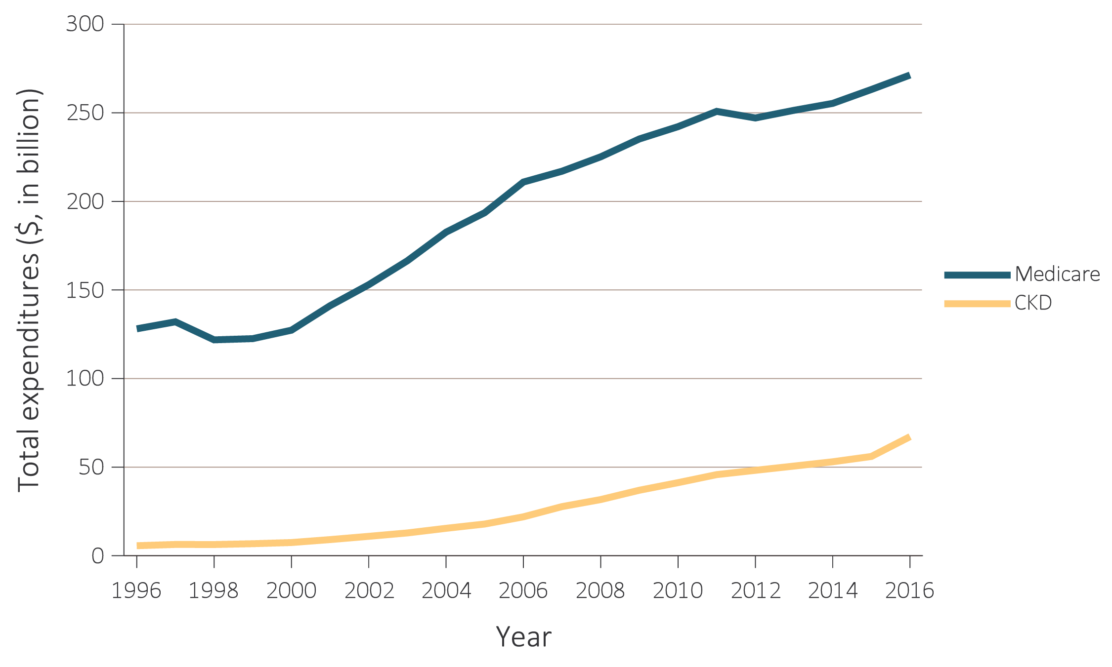
vol 1 Figure 7.3 Overall Medicare Parts A, B, and D fee-for-service spending for general Medicare population aged 65 and older and for those with CKD, 1996-2016
Data Source: Medicare 5% sample. Abbreviations: CKD, chronic kidney disease; DM, diabetes mellitus; ESRD, end-stage renal disease; HF, heart failure.

Slide 18
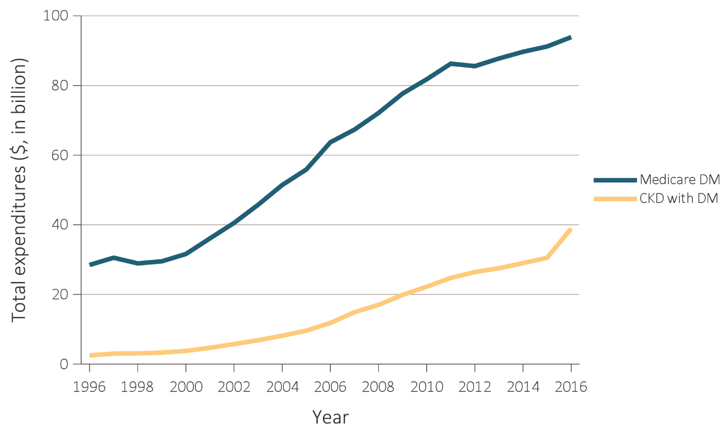
vol 1 Figure 7.3 Overall Medicare Parts A, B, and D fee-for-service spending for general Medicare population aged 65 and older and for those with CKD, 1996-2016
(b) Patients with diabetes
Data Source: Medicare 5% sample. Abbreviations: CKD, chronic kidney disease; DM, diabetes mellitus; ESRD, end-stage renal disease; HF, heart failure.

Slide 19
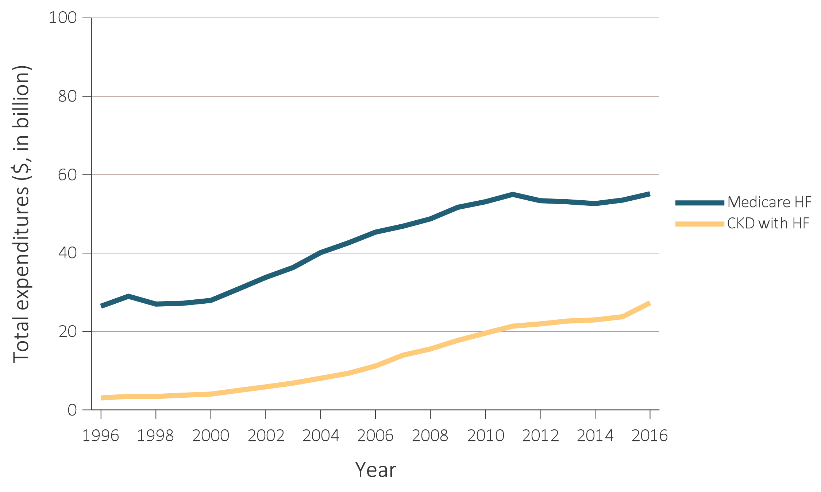
vol 1 Figure 7.3 Overall Medicare Parts A, B, and D fee-for-service spending for general Medicare population aged 65 and older and for those with CKD, 1996-2016
Data Source: Medicare 5% sample. Abbreviations: CKD, chronic kidney disease; DM, diabetes mellitus; ESRD, end-stage renal disease; HF, heart failure.

Slide 20
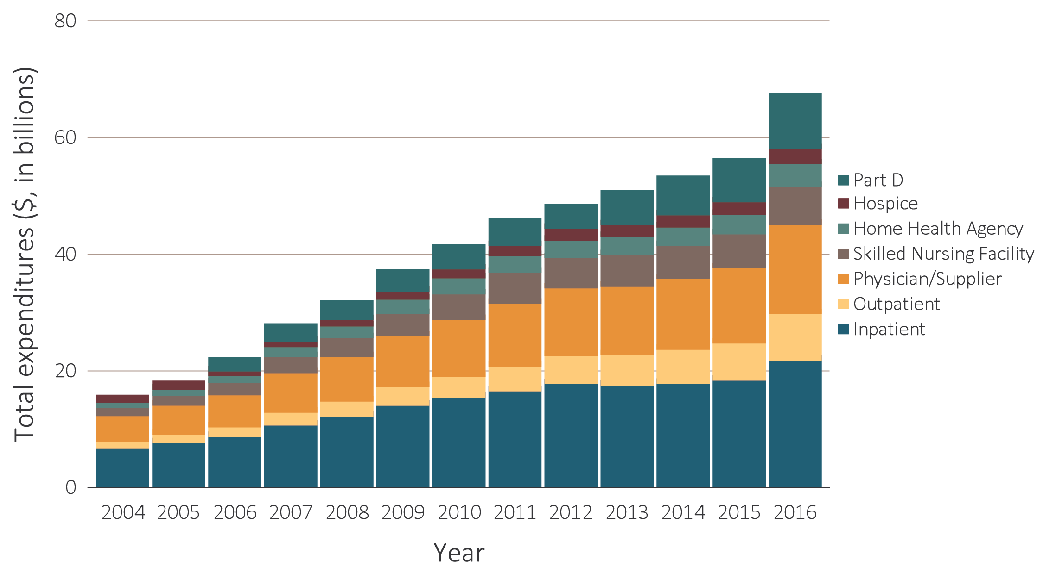
vol 1 Figure 7.4 Trends in total Medicare Parts A, B, and D fee-for-service spending for CKD patients aged 65 and older, by claim type, 2004-2016
Data source: Medicare 5% sample. Part D data occurring since 2006. Abbreviations: CKD, chronic kidney disease; ESRD, end-stage renal disease.

Slide 21
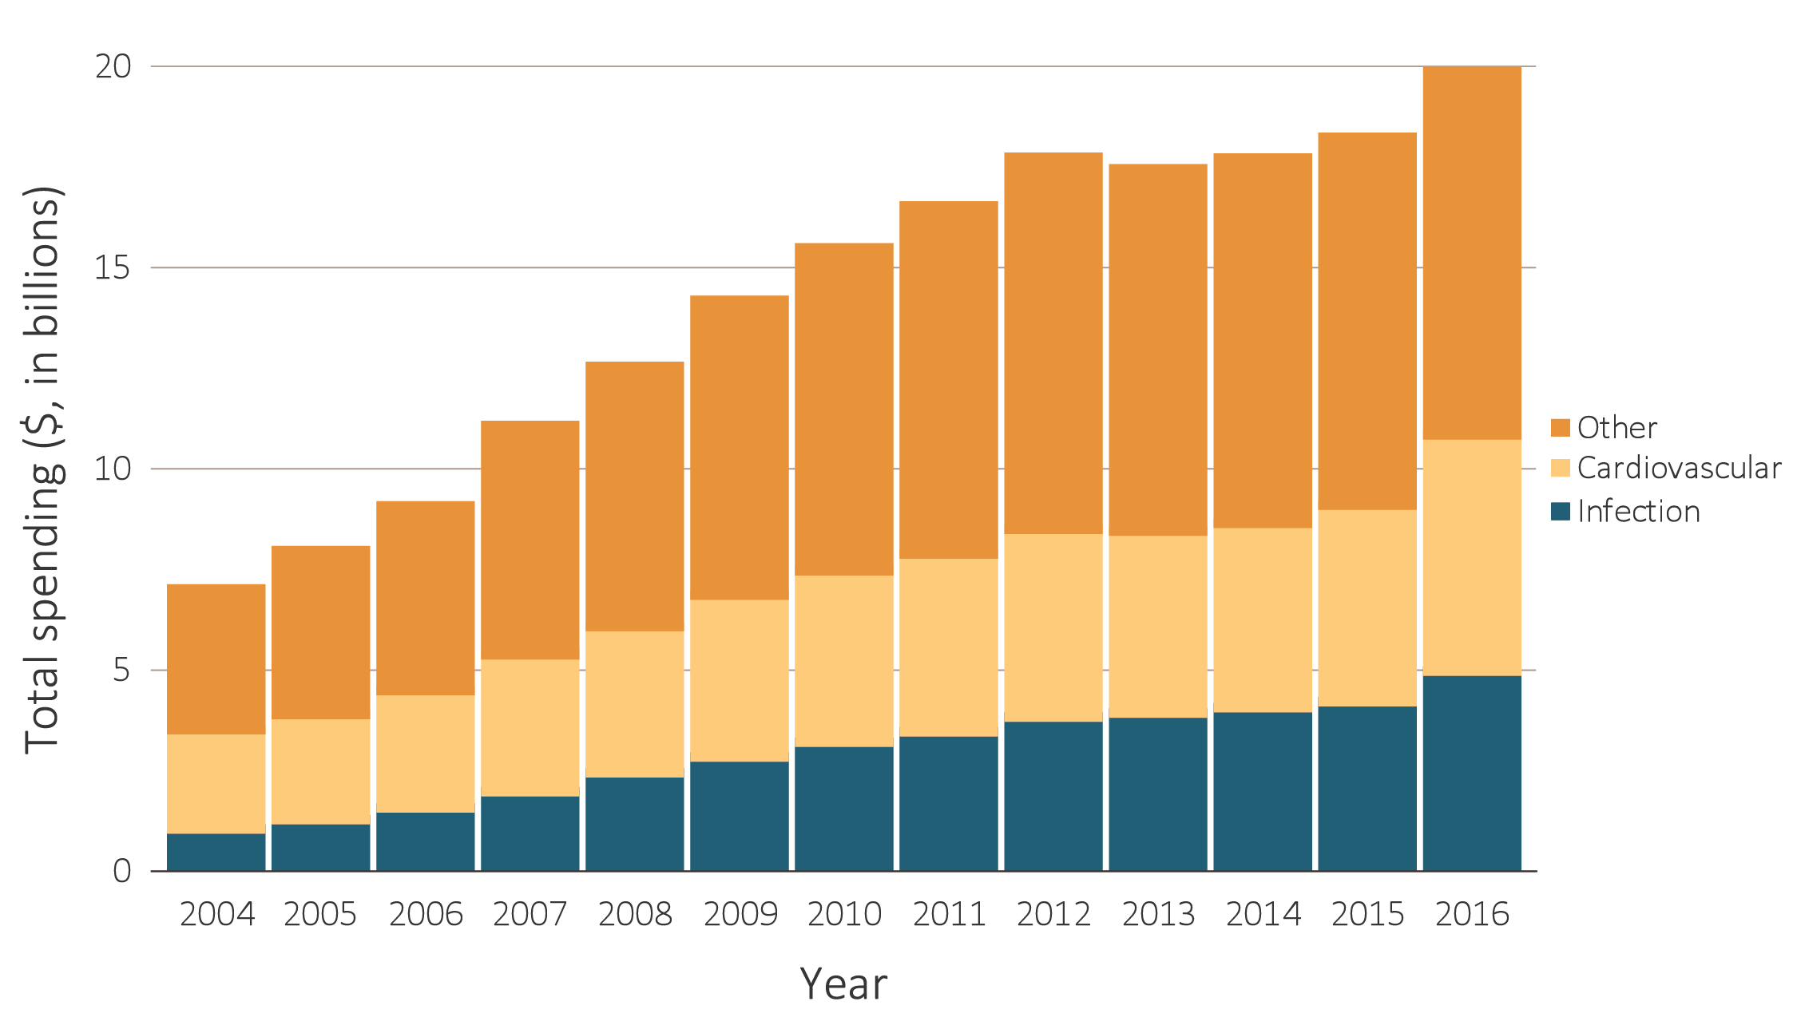
vol 1 Figure 7.5 Total Medicare fee-for-service inpatient spending for CKD patients aged 65 and older, by cause of hospitalization, 2004-2016
Data source: Medicare 5% sample. Part D data occurring since 2006. Abbreviations: CKD, chronic kidney disease; ESRD, end-stage renal disease.

Slide 22
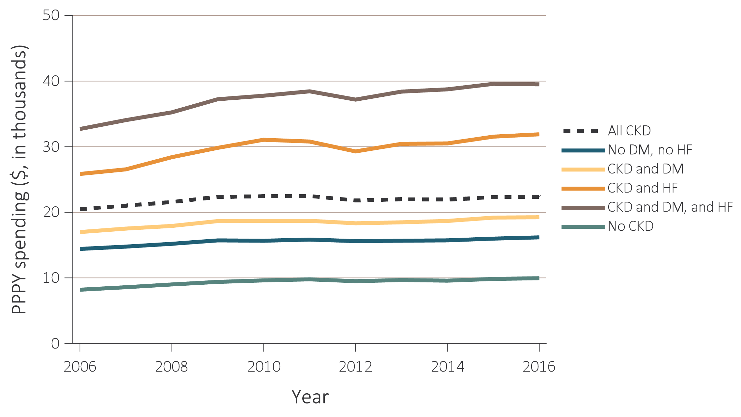
vol 1 Figure 7.6 Per person per year Medicare, Medicare advantage, and managed care spending for the CKD patients aged 65 and older, by diabetes and heart failure, 2006-2016
Data Source: Medicare 5% sample and Optum Clinformatics™. Abbreviations: CKD, chronic kidney disease; DM, diabetes mellitus; ESRD, end-stage renal disease; HF, heart failure; PPPY, per person per year.

Slide 23
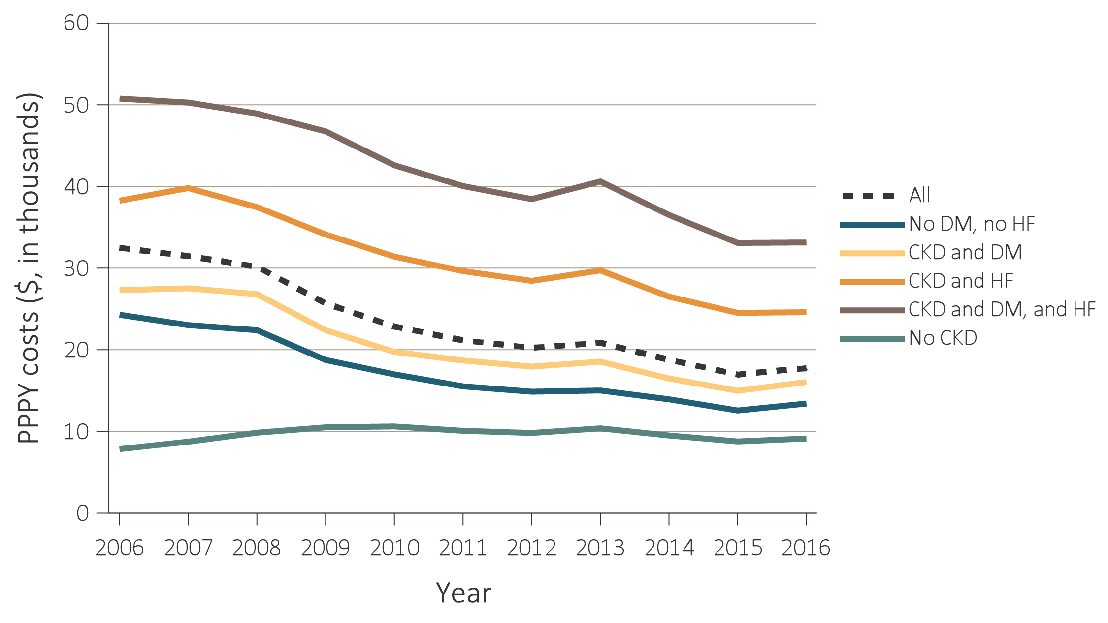
vol 1 Figure 7.6 Per person per year Medicare, Medicare advantage, and managed care spending for the CKD patients aged 65 and older, by diabetes and heart failure, 2006-2016
Data Source: Medicare 5% sample and Optum Clinformatics™. Abbreviations: CKD, chronic kidney disease; DM, diabetes mellitus; ESRD, end-stage renal disease; HF, heart failure; PPPY, per person per year.

Slide 24
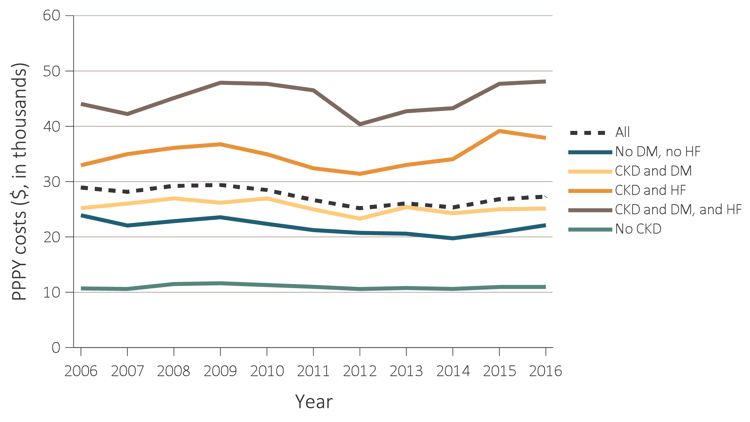
vol 1 Figure 7.6 Per person per year Medicare, Medicare advantage, and managed care spending for the CKD patients aged 65 and older, by diabetes and heart failure, 2006-2016
Data Source: Medicare 5% sample and Optum Clinformatics™. Abbreviations: CKD, chronic kidney disease; DM, diabetes mellitus; ESRD, end-stage renal disease; HF, heart failure; PPPY, per person per year.

Slide 25
Vol 1 Table 7.11 Overall CKD percentage for Medicare, Medicare advantage, and managed care beneficiaries aged 65 and older, by CKD stage, and year, ESRD excluded, 2006-2016
Year | Insurance Plan | CKD Stages 1 & 2 (%) | CKD Stage 3 (%) |  | CKD Stages 4 & 5 (%) | CKD Stage Unknown (%)
2006 | Medicare FFS | 0.0 | 0.0 |  | 0.0 | 100.0
 | Managed care | 0.0 | 0.0 |  | 0.0 | 100.0
 | Medicare Advantage | 0.0 | 0.0 |  | 0.0 | 100.0
2007 | Medicare FFS | 8.6 | 22.2 |  | 12.5 | 56.7
 | Managed care | 17.4 | 23.7 |  | 13.3 | 45.5
 | Medicare Advantage | 19.1 | 23.8 |  | 12.6 | 44.5
2008 | Medicare FFS | 8.5 | 27.7 |  | 12.6 | 51.2
 | Managed care | 18.0 | 28.3 |  | 15.5 | 38.2
 | Medicare Advantage | 19.8 | 28.1 |  | 14.8 | 37.2
2009 | Medicare FFS | 8.3 | 31.5 |  | 12.3 | 47.9
 | Managed care | 17.4 | 31.1 |  | 14.0 | 37.5
 | Medicare Advantage | 18.7 | 34.9 |  | 13.3 | 33.1
2010 | Medicare FFS | 8.5 | 35.4 |  | 11.9 | 44.2
 | Managed care | 16.9 | 34.6 |  | 13.2 | 35.4
 | Medicare Advantage | 18.9 | 41.0 |  | 11.9 | 28.1
2011 | Medicare FFS | 8.7 | 38.6 |  | 11.4 | 41.3
 | Managed care | 17.1 | 36.6 |  | 12.7 | 33.6
 | Medicare Advantage | 18.2 | 44.8 |  | 11.4 | 25.6
2012 | Medicare FFS | 9.3 | 41.8 |  | 11.0 | 37.9
 | Managed care | 17.0 | 38.0 |  | 12.5 | 32.4
 | Medicare Advantage | 18.4 | 46.4 |  | 11.2 | 23.9
2013 | Medicare FFS | 9.7 | 44.0 |  | 10.8 | 35.6
 | Managed care | 17.1 | 38.9 |  | 12.1 | 31.9
 | Medicare Advantage | 19.4 | 45.9 |  | 11.0 | 23.7
2014 | Medicare FFS | 10.0 | 46.1 |  | 10.2 | 33.7
 | Managed care | 17.0 | 40.3 |  | 11.4 | 31.2
 | Medicare Advantage | 19.7 | 47.2 |  | 10.9 | 22.2
2015 | Medicare FFS | 10.4 | 48.5 |  | 9.9 | 31.2
 | Managed care | 17.0 | 42.1 |  | 11.3 | 29.6
 | Medicare Advantage | 18.7 | 48.7 |  | 10.7 | 21.9
2016 | Medicare FFS | 10.0 | 46.7 |  | 8.8 | 34.4
 | Managed care | 18.5 | 40.1 |  | 11.2 | 30.2
 | Medicare Advantage | 20.1 | 48.0 |  | 11.0 | 20.8
Data Source: Optum Clinformatics™. Abbreviations: CKD, chronic kidney disease; FFS, fee-for-service; ESRD, end-stage renal disease.

