Slide 1
2018 Annual Data Report
Volume 2: End-Stage Renal Disease
Chapter 9: Healthcare Expenditures for Persons with ESRD

Slide 2
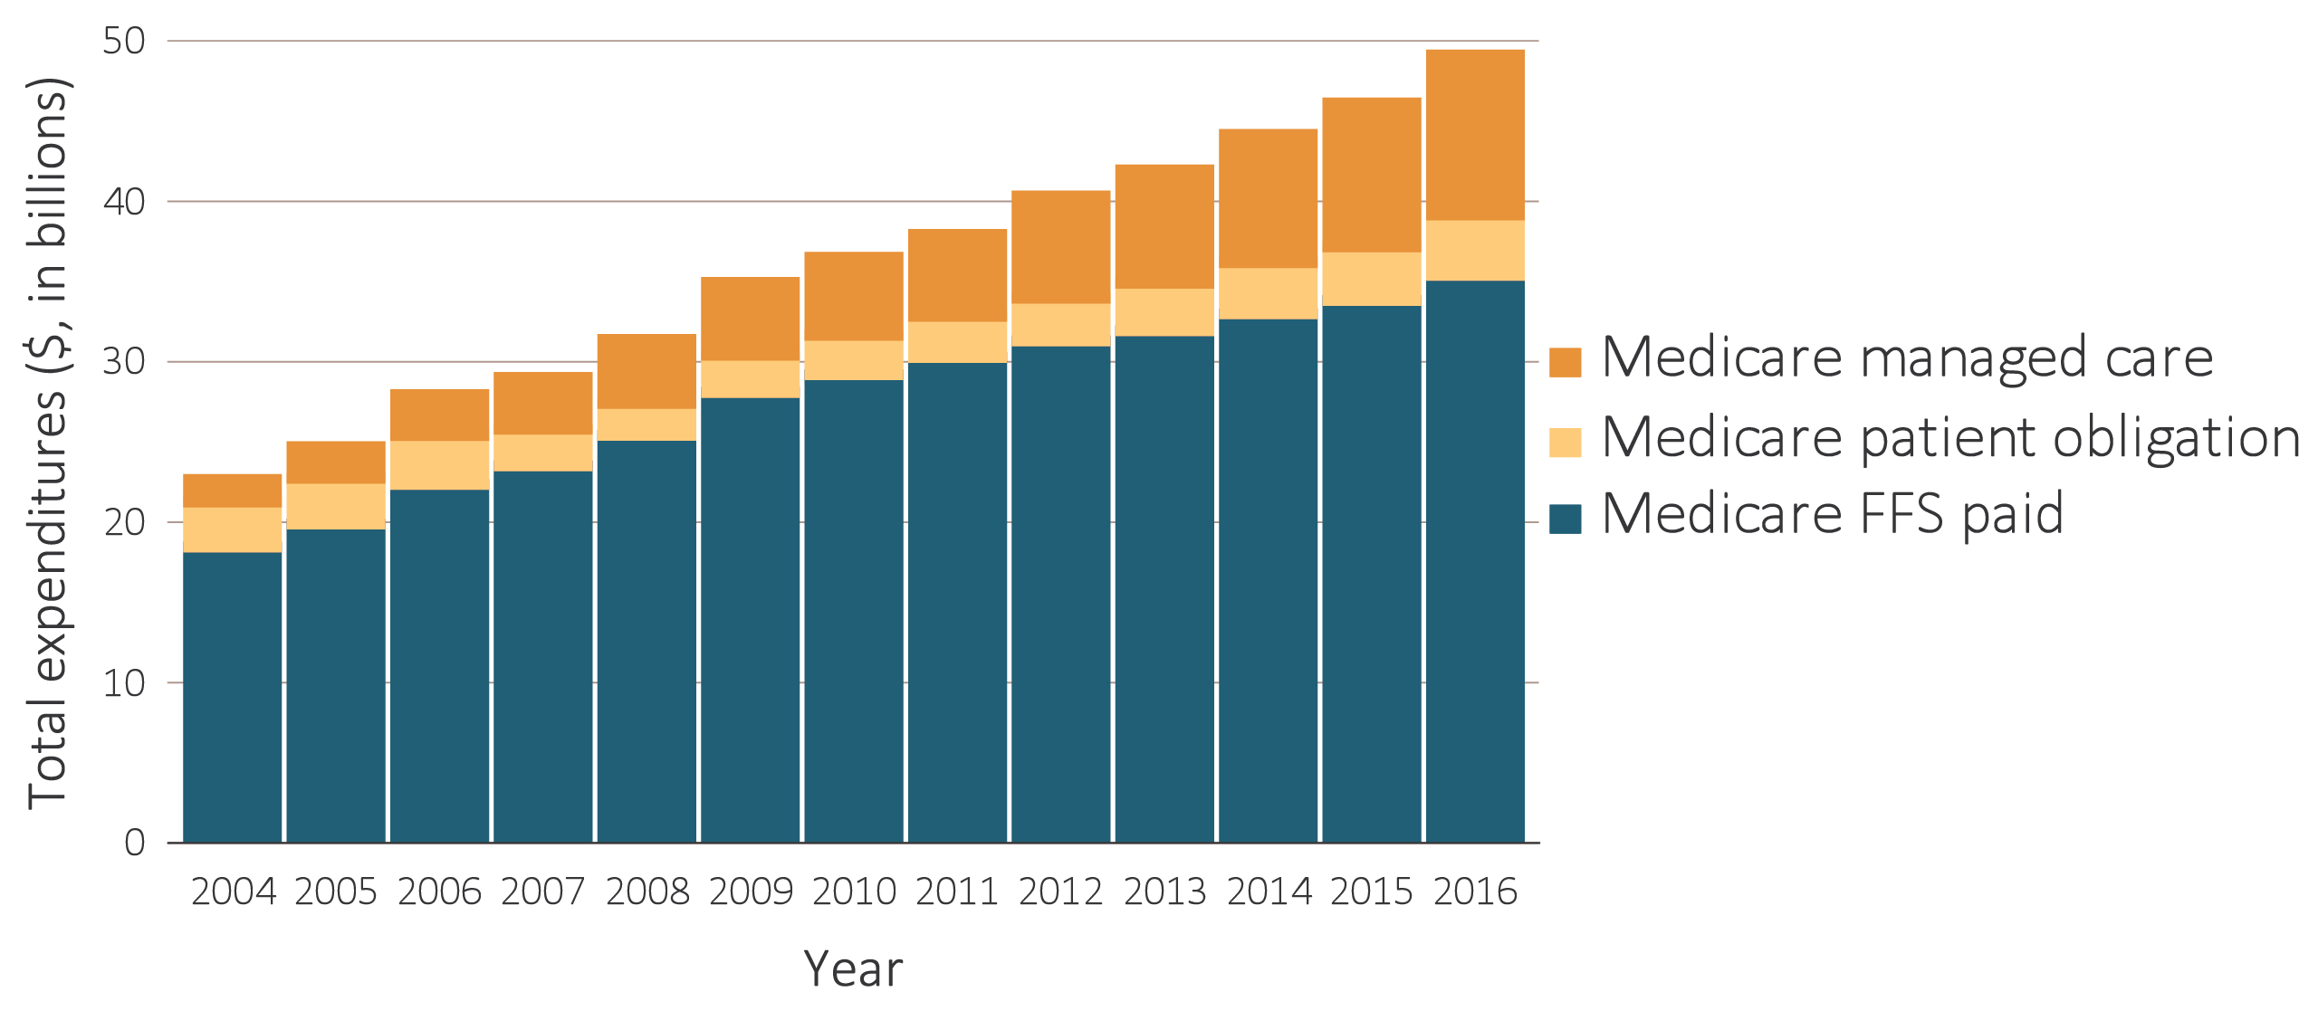
vol 2 Figure 9.1 Trends in ESRD expenditures, 2004-2016
Data Source: USRDS ESRD Database; Reference Table K.1. Abbreviations: ESRD, end-stage renal disease; FFS, fee-for-service.

Slide 3
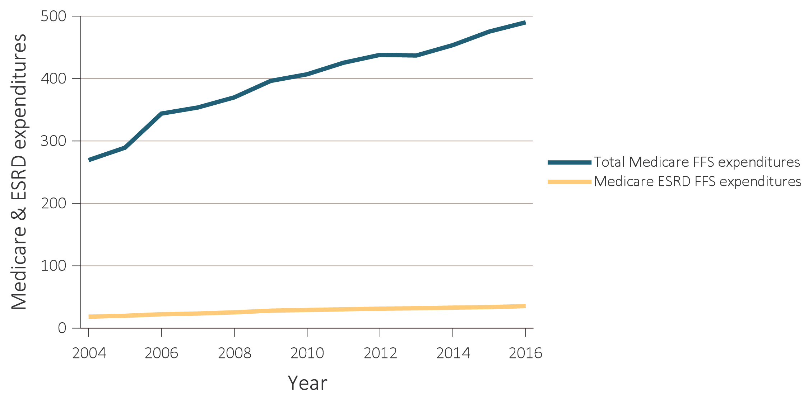
Vol 2 Figure 9.2 Trends in (a) total Medicare & ESRD fee-for-service spending ($, in billions), and (b) ESRD spending as percentage of Medicare fee-for-service spending, 2004-2016
(a) Total Medicare & ESRD FFS spending ($, in billions)
Data Source: Total ESRD spending obtained from USRDS ESRD Database; Reference Table K.1. Total Medicare expenditures obtained from Trustees Report, Table II.B1 https://www.cms.gov/Research-Statistics-Data-and-Systems/Statistics-Trends-and-Reports/ReportsTrustFunds/TrusteesReports.html. Abbreviations: ESRD, end-stage renal disease; FFS, fee-for-service.

Slide 4
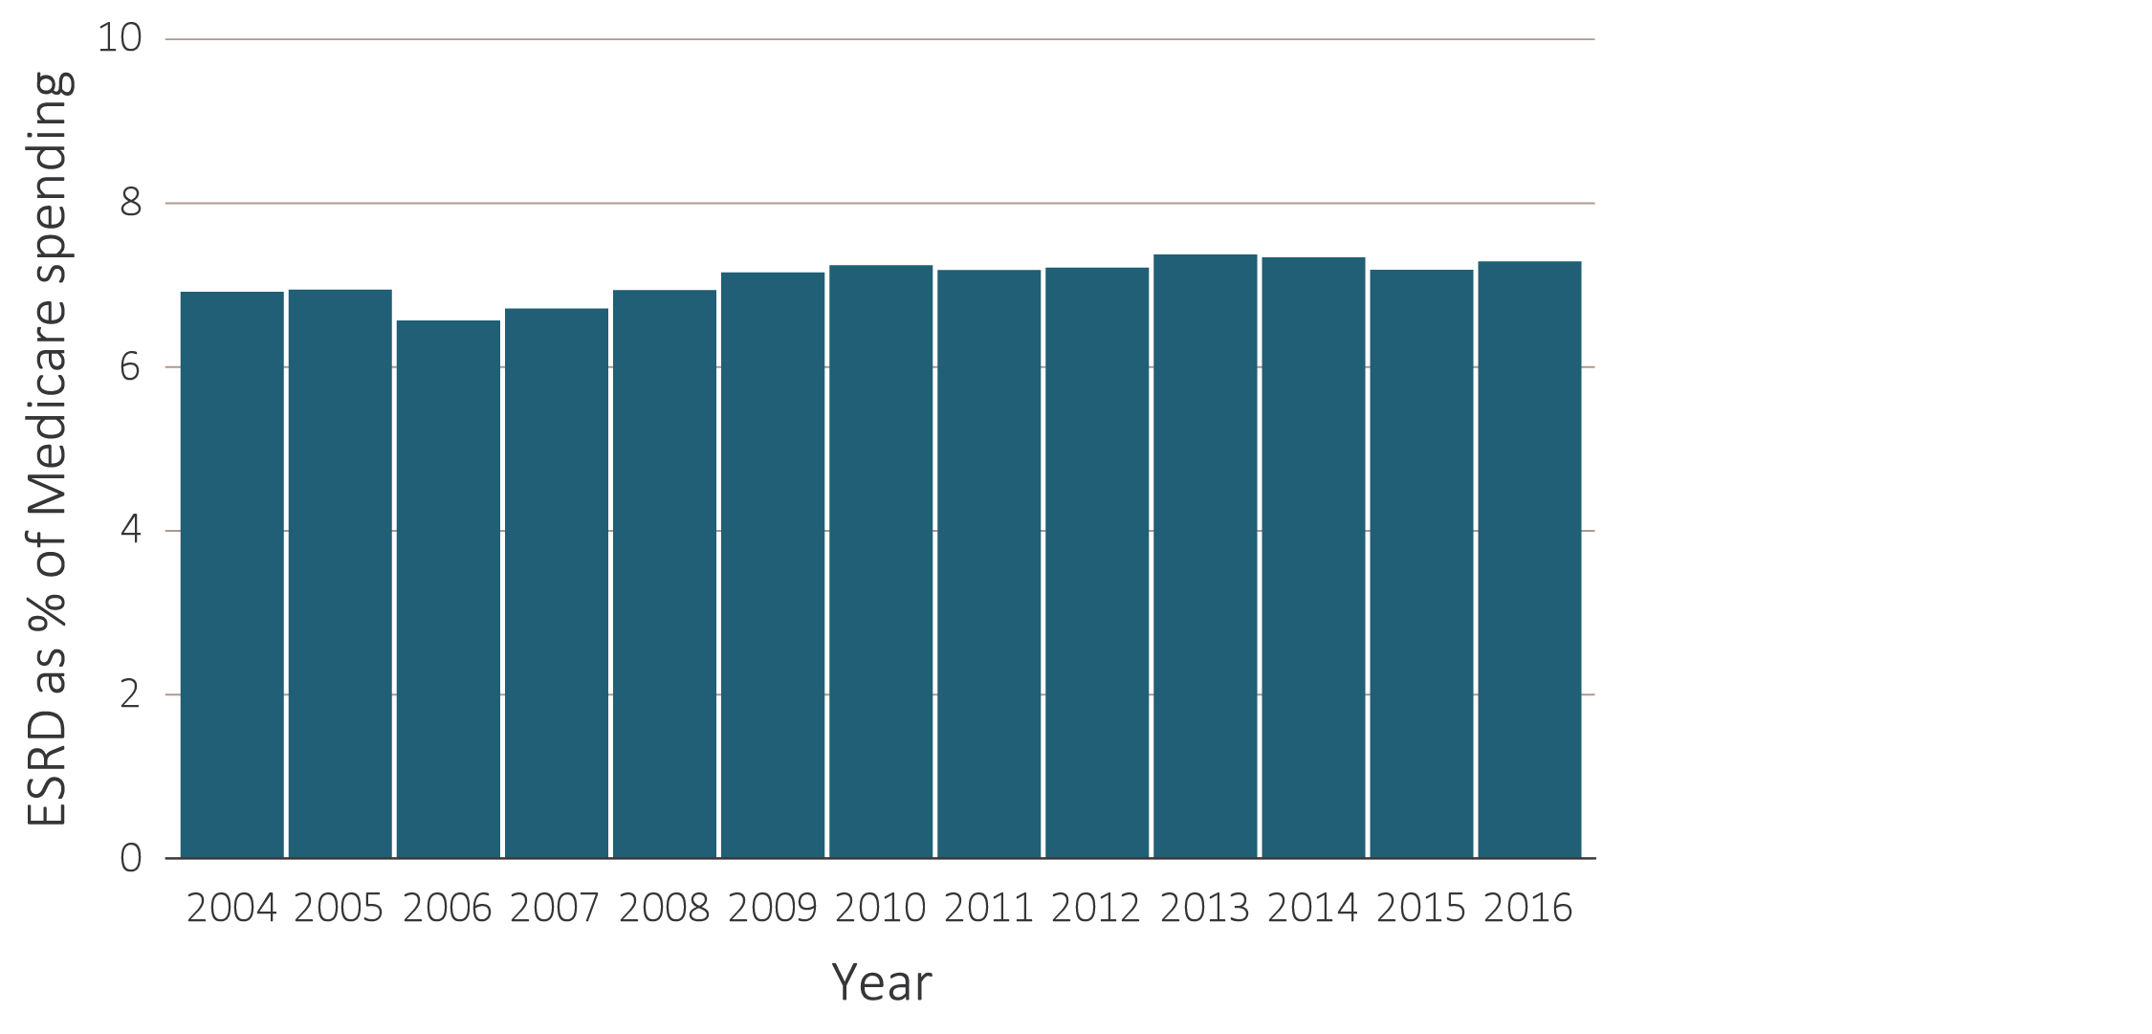
Vol 2 Figure 9.2 Trends in (a) total Medicare & ESRD fee-for-service spending ($, in billions), and (b) ESRD spending as percentage of Medicare fee-for-service spending, 2004-2016
(b) ESRD spending as percentage of total Medicare FFS spending
Data Source: Total ESRD spending obtained from USRDS ESRD Database; Reference Table K.1. Total Medicare expenditures obtained from Trustees Report, Table II.B1 https://www.cms.gov/Research-Statistics-Data-and-Systems/Statistics-Trends-and-Reports/ReportsTrustFunds/TrusteesReports.html. Abbreviations: ESRD, end-stage renal disease; FFS, fee-for-service.

Slide 5
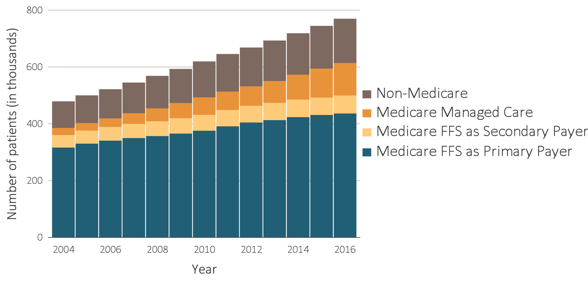
vol 2 Figure 9.3 Trends in numbers of point prevalent ESRD patients, 2004-2016
Data Source: USRDS ESRD Database. December 31 point prevalent ESRD patients. Abbreviations: ESRD, end-stage renal disease; FFS, fee-for-service.

Slide 6
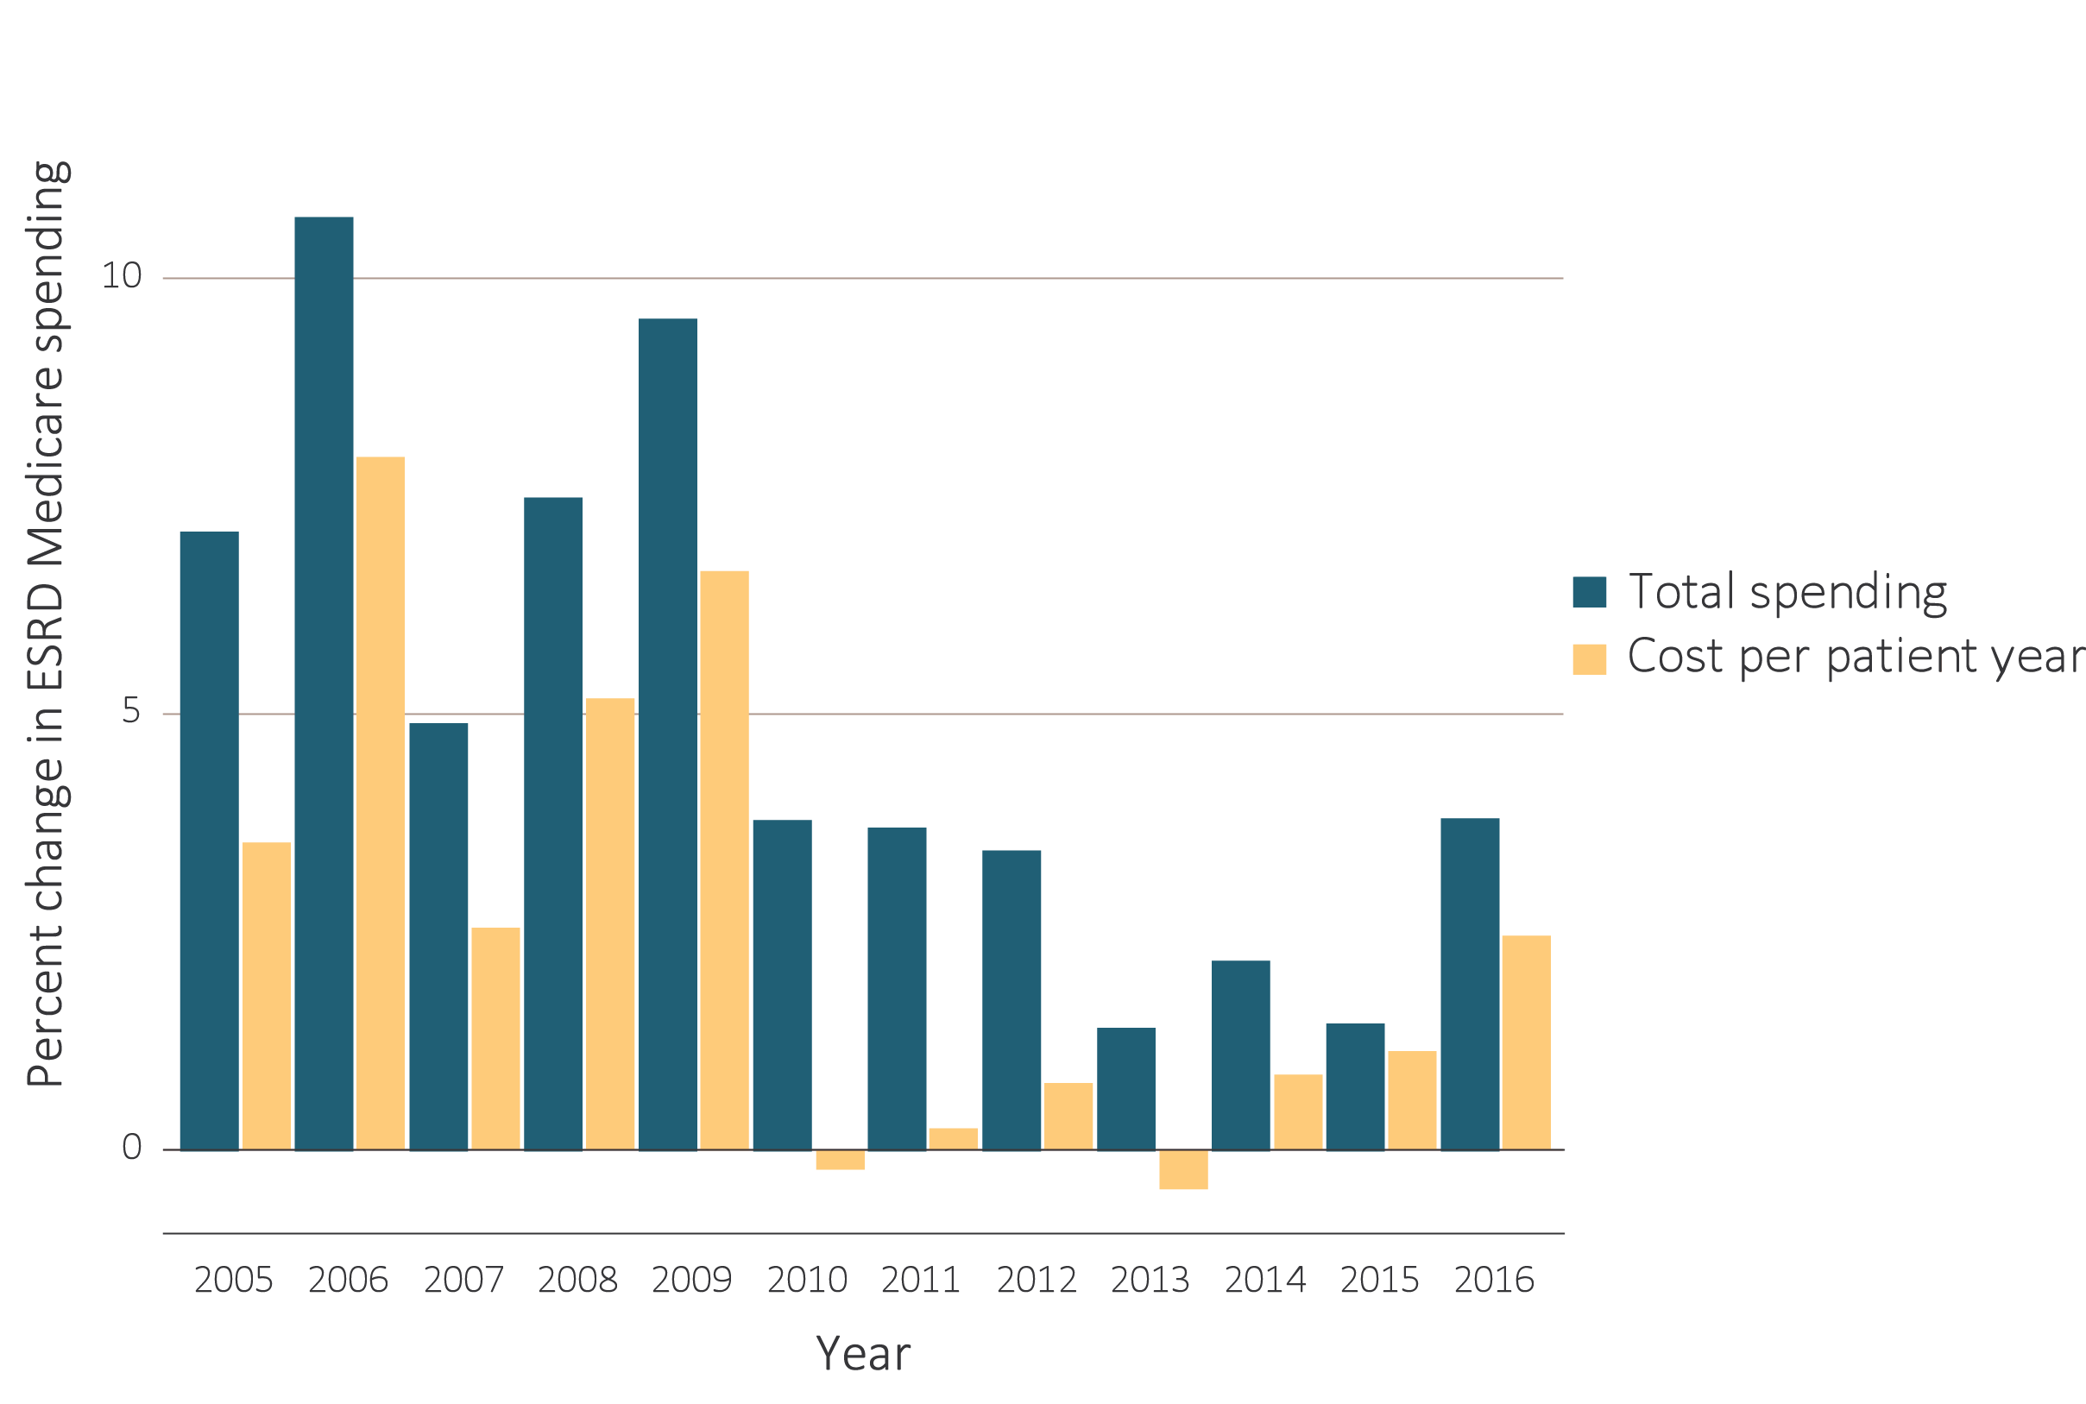
vol 2 Figure 9.4 Annual percent change in Medicare ESRD spending, 2004-2016
Data Source: USRDS ESRD Database; Reference Table K.4. Total Medicare ESRD costs from claims data; includes all claims with Medicare as primary payer only. Abbreviation: ESRD, end-stage renal disease.

Slide 7
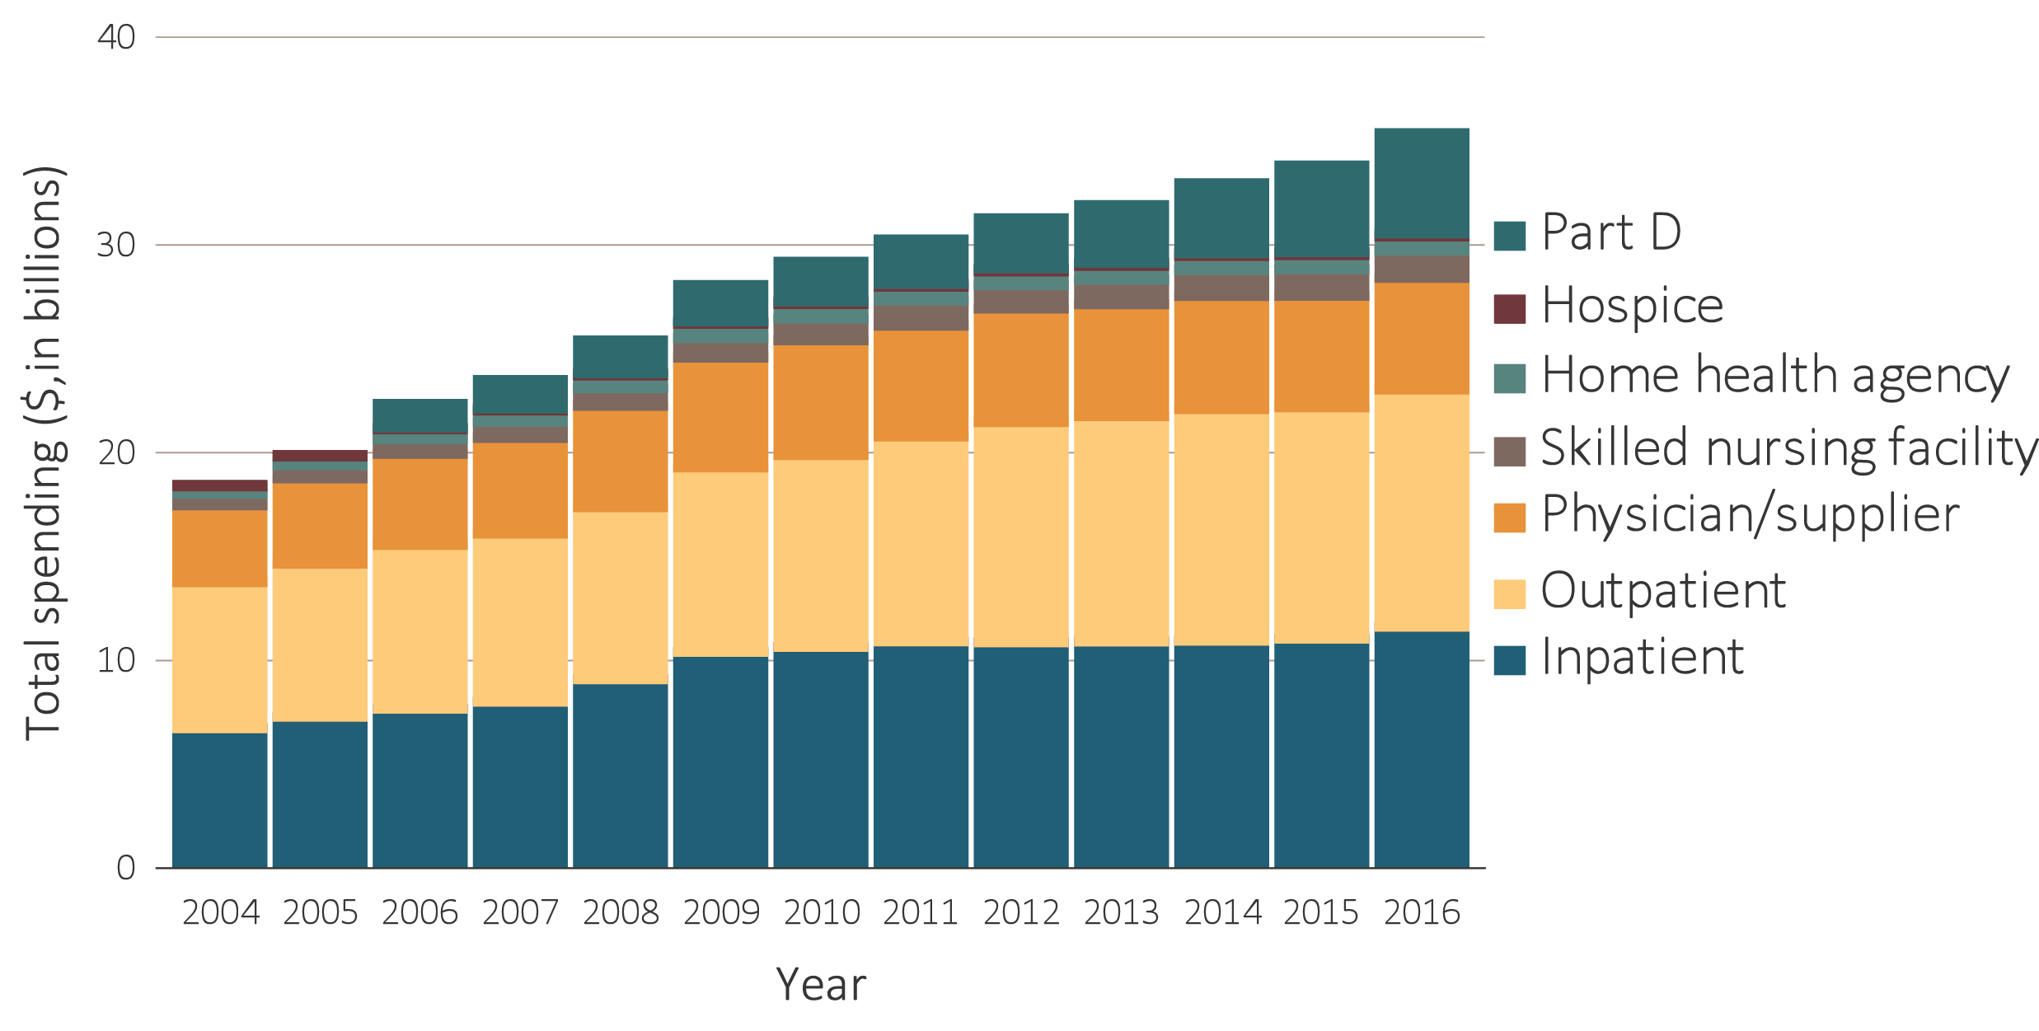
vol 2 Figure 9.5 Trends in total Medicare fee-for-service spending for ESRD, by type of service, 2004-2016
Data Source: USRDS ESRD Database; Reference Table K.1. Total Medicare costs from claims data. Abbreviation: ESRD, end-stage renal disease.

Slide 8
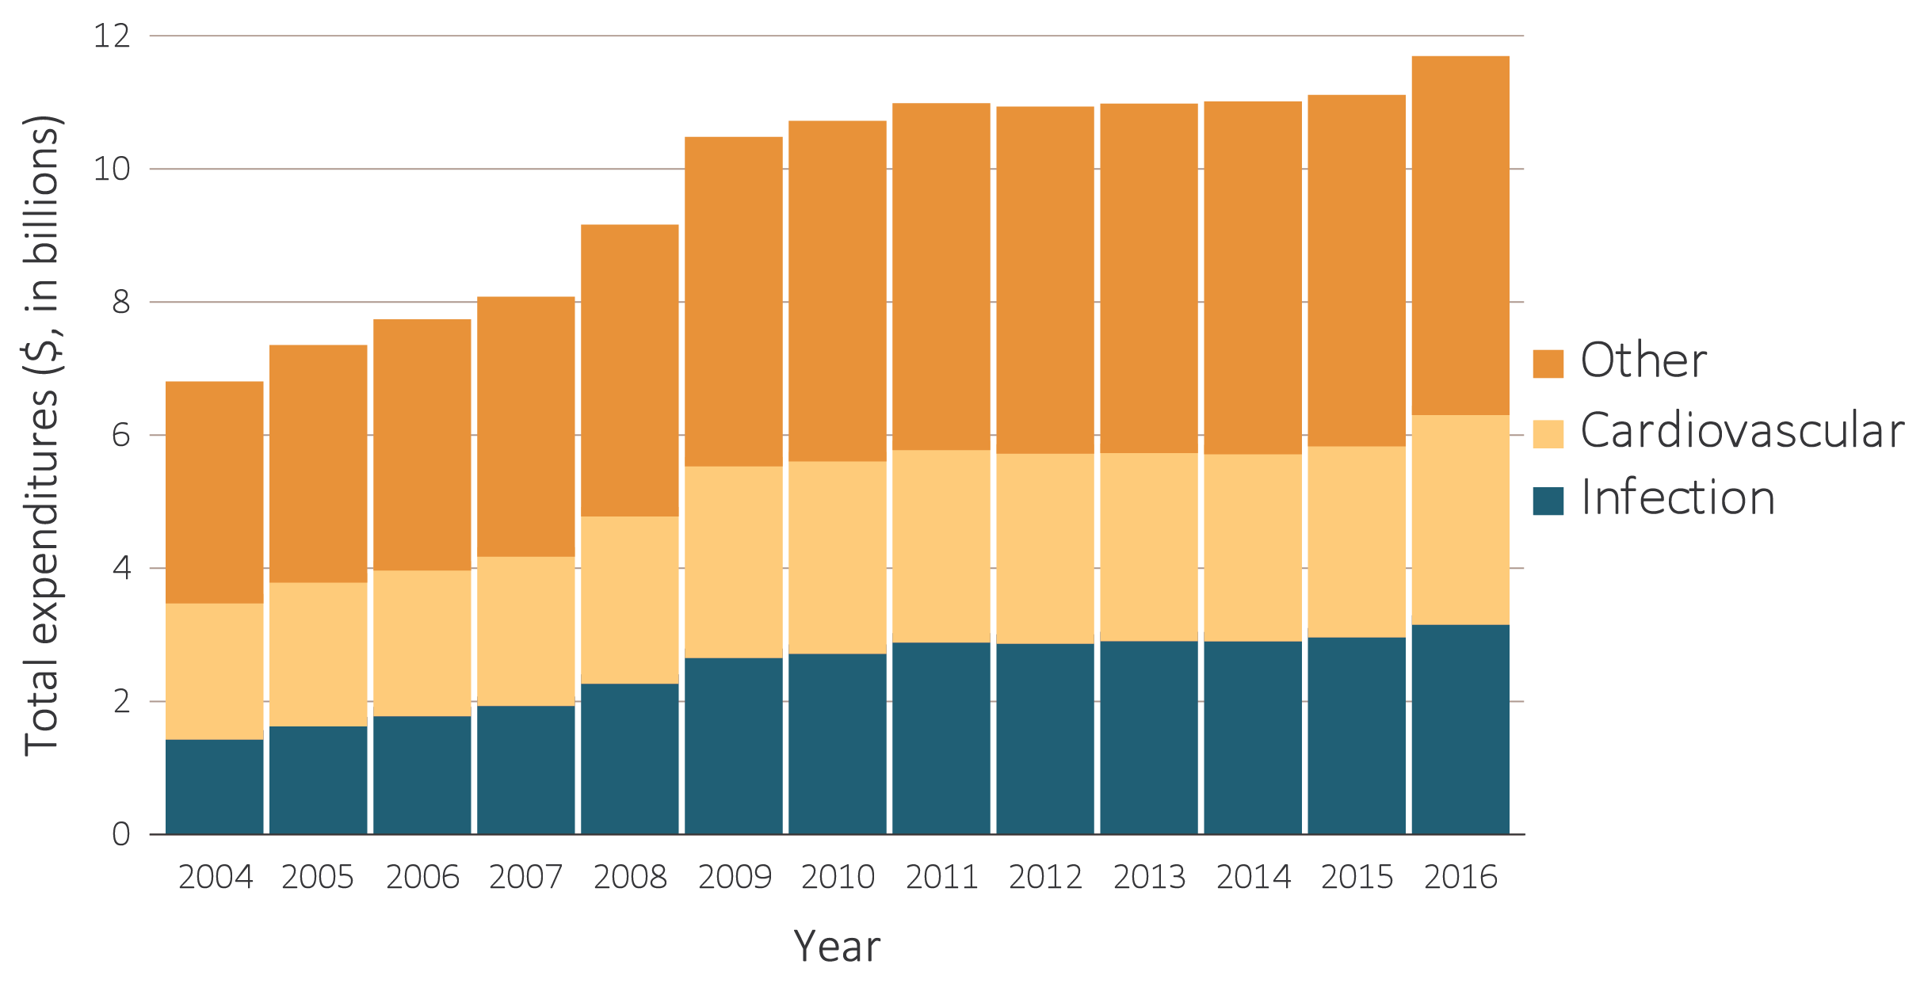
vol 2 Figure 9.6 Total Medicare fee-for-service inpatient spending by cause of hospitalization, 2004-2016
Data Source: USRDS ESRD Database. Total Medicare costs from claims data. Unknown hospitalization cost (<0.01%) was combined with ‘Other’. Abbreviation: ESRD, end-stage renal disease.

Slide 9
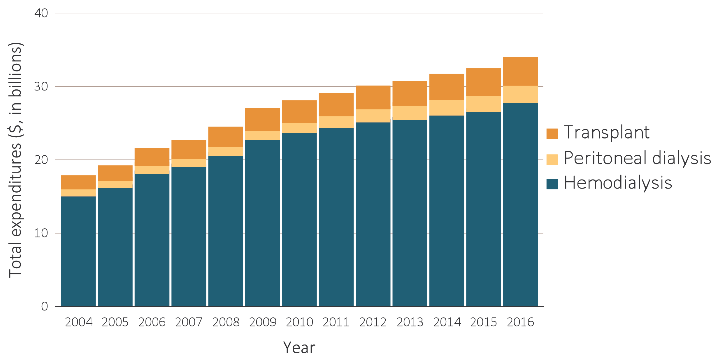
vol 2 Figure 9.7 Total Medicare ESRD expenditures, by modality, 2004-2016
Data Source: USRDS ESRD Database. Total Medicare costs from claims data for period prevalent ESRD patients. Abbreviation: ESRD, end-stage renal disease.

Slide 10
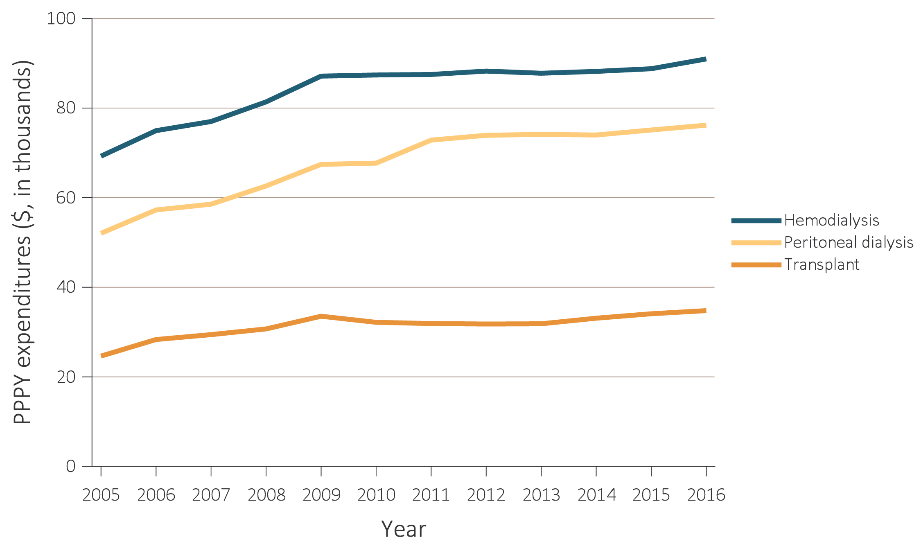
vol 2 Figure 9.8 Total Medicare ESRD expenditures per person per year, by modality, 2004-2016
Data Source: USRDS ESRD Database; Reference Tables K.7, K.8, & K.9. Period prevalent ESRD patients; includes all claims with Medicare as primary payer only. Abbreviations: ESRD, end-stage renal disease; PPPY, per person per year.

